Slide 1
Pulsar Timing Arrays
Current and Future Instrumentation
Joseph Lazio
Jet Propulsion Laboratory, California Institute of Technology
© 2012 California Institute of Technology. Government sponsorship acknowledged.

Slide 2
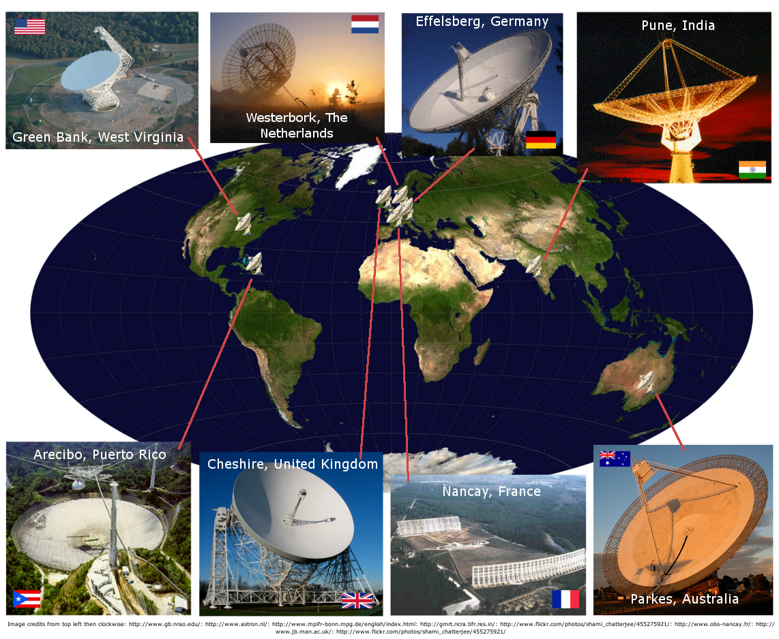



Pulsar Timing Arrays
Current and Future Instrumentation
What are the requirements?
  Timing precision and instrumental performance
What exists?
  Telescopes
  Feeds, receivers, and backends
  IT infrastructure
What is on the horizon?

Slide 3
Pulsar Timing Arrays
Current Results
J1713+0747
30 ns RMS
J1012+5307
280 ns RMS
J1643-1224
1500 ns RMS
Demorest et al. 2012, submitted

Slide 4
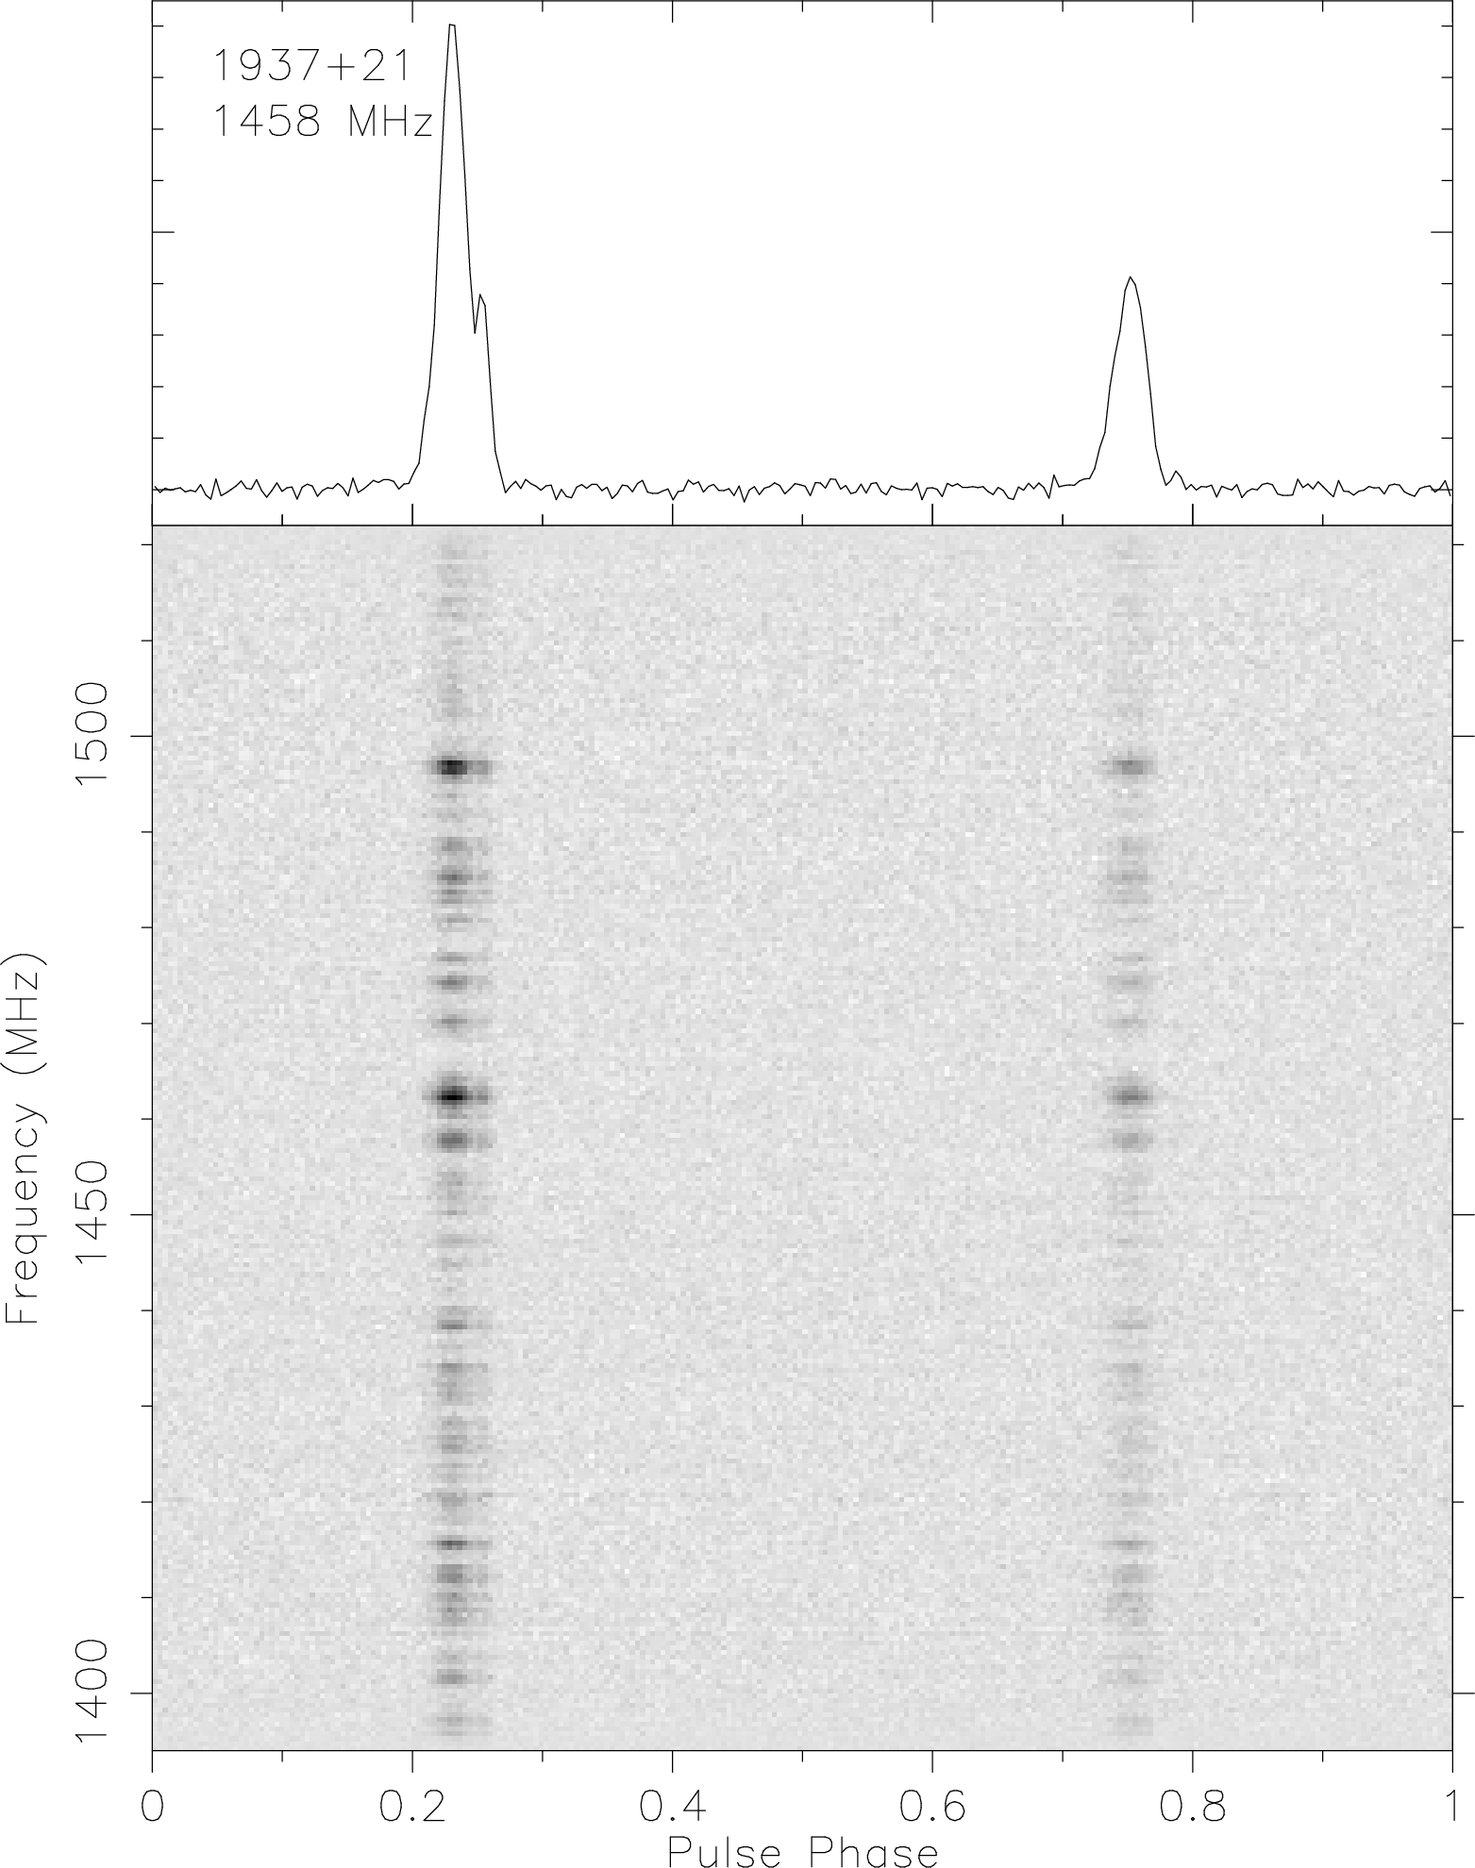
Timing Precision
Assume σ_{TOA} ≤ 100 ns
  May be necessary, but not sufficient condition
SNR
W
P
W ➔ pulse width
SNR ➔ signal-to-noise ratio
Assumes sufficient calibration of telescope system
  Other contributions can include pulse-phase jitter, uncorrected propagation effects

Slide 5
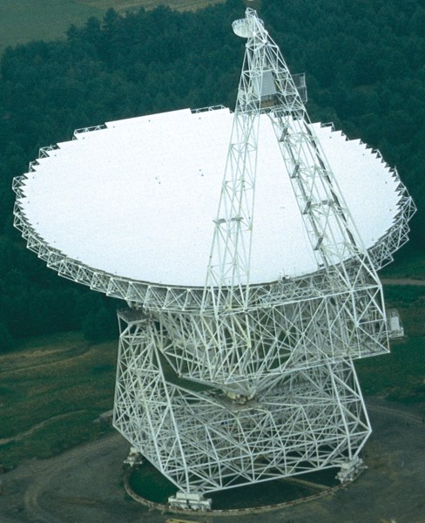
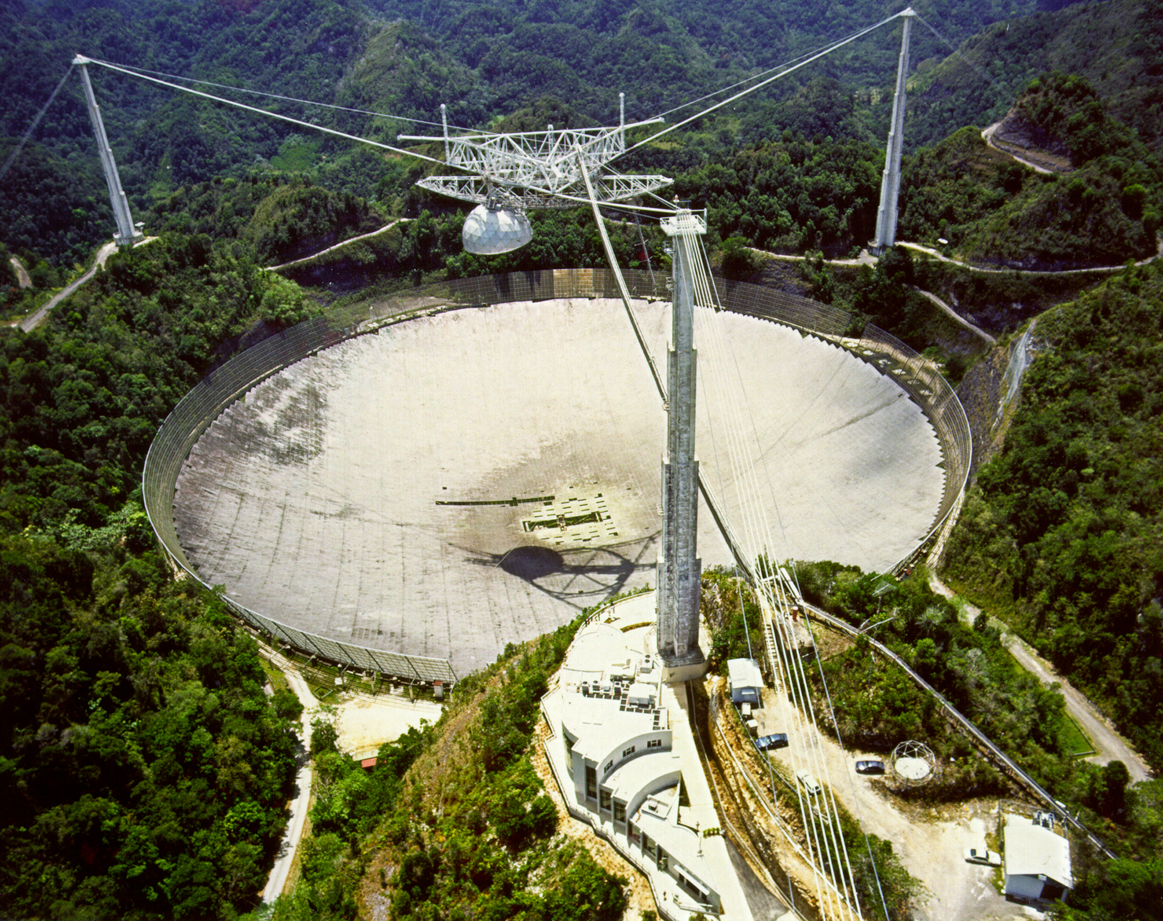
Radio Telescope

Slide 6
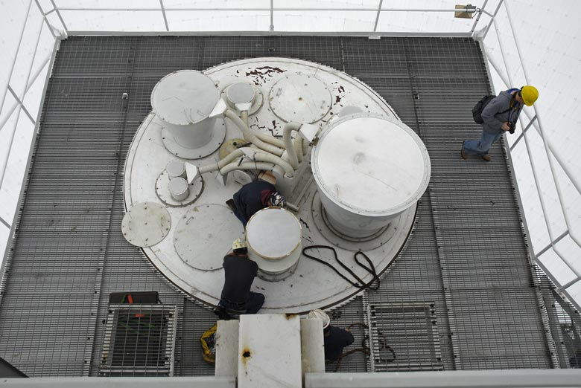
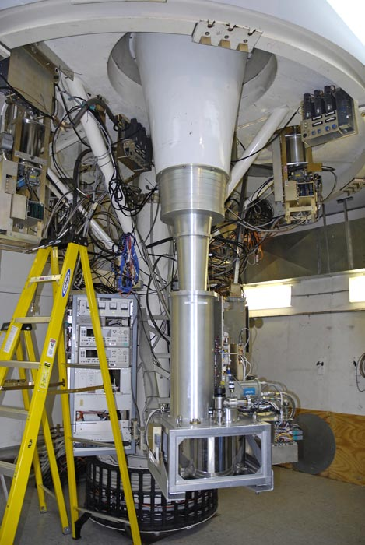
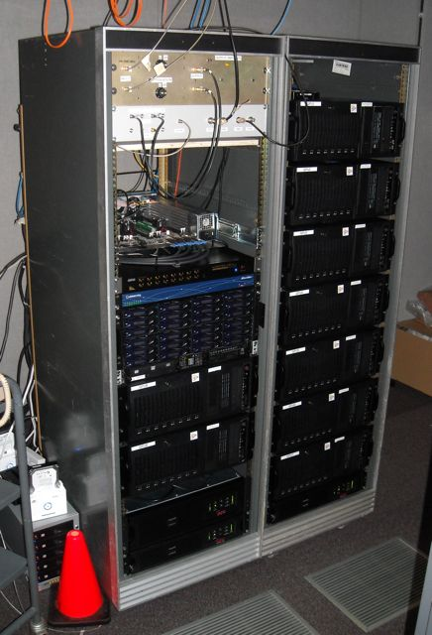
Radio Telescope
Data Acquisition System
Data Storage
Radio Frequency
Intermediate Frequency
Baseband
Local Oscillator
Local Oscillator

Slide 7
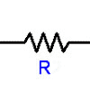
Radio Telescope
Noise Temperature
Replace entire telescope system by resistor in a heat bath
Output voltage equivalent
Not necessarily physical temperature
T_{sys} = T_{sky} + T_{spill} + T_{Rx} + …
P = k_{B}TΔν
T

Slide 8
Radiometer Equation
For T_{PSR} << T_{sys}
Where can improvements be made?
T_{sys} portion determined by telescope
  T_{sys} = T_{sky} + T_{spill} + T_{Rx} + …
Δν – processed bandwidth
A_{eff} – effective area of telescope
Δt – observation time
  within limits imposed by pulsar or ISM
Improvements benefit both timing and survey programs
S ➔ spectral flux density [W/m²/Hz]
1 Jy = 10⁻²⁶ W/m²/Hz

Slide 9
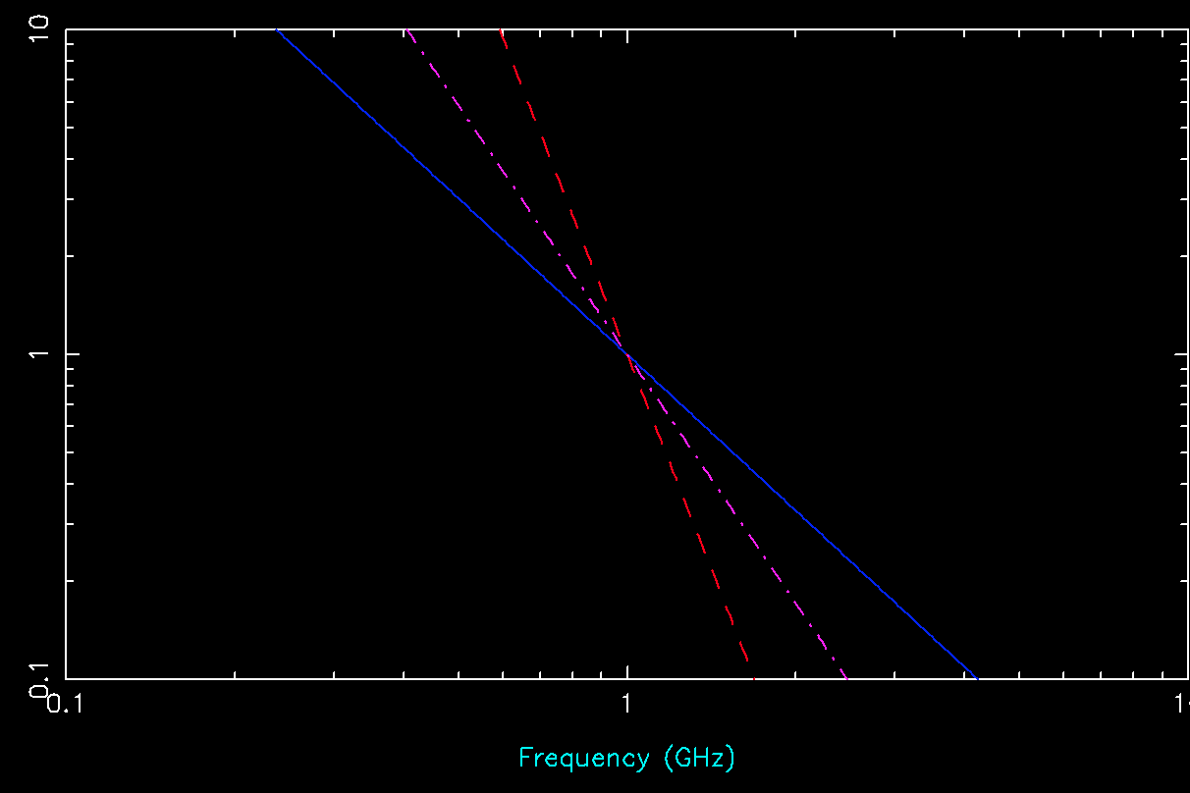
Pulsar Observations
Observational frequency determined by balancing
pulsar spectrum vs.
sky spectrum vs.
scattering
Typically about 1 GHz
scattering
Pulsar spectrum
sky spectrum

Slide 10
Pulsar Timing Arrays
Current Instrumentation

Slide 11
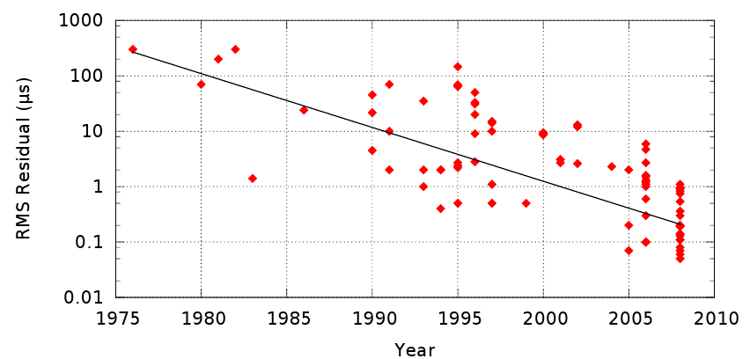
Pulsar Timing Arrays
Current Instrumentation
Discovery of millisecond pulsars (MSPs)
Robert C. Byrd Green Bank Telescope (GBT) dedicated

Slide 12
Pulsar Timing
Historical Context
1974: Hulse-Taylor binary pulsar
  Arecibo telescope @ 430 MHz
  ≤ 8 MHz bandwidth
  175 K system temperature
    T_{sky} = 25 K @ 430 MHz
1982: first millisecond pulsar (B1937+21)
  Arecibo telescope @ 1400 MHz
  16 MHz bandwidth
  40 K system temperature
    T_{sky} ~ 7 K @ 1400 MHz

Slide 13
Pulsar Timing Arrays
Current Instrumentation
Typical Parameters
Current Publications
A_{eff} ~ 100 m
Δν ~ 100 MHz
T_{sys} ~ 30 K
Δt ~ 15 min.
Yardley et al. 2011, “On detection of the stochastic gravitational-wave background using the Parkes pulsar timing array,” Mon. Not. R. Astron. Soc., 414, 1777
van Haasteren et al. 2011, “Placing limits on the stochastic gravitational-wave background using European Pulsar Timing Array data,” Mon. Not. R. Astron. Soc., 414, 3117
Demorest et al. 2012, “Limits on the Stochastic Gravitational Wave Background from the North American Nanohertz Observatory for Gravitational Waves,” ApJ, in press
Hobbs et al. 2010, “The International Pulsar Timing Array project: using pulsars as a gravitational wave detector,” Class. Quant. Grav., 27, 084013

Slide 14
Pulsar Timing Arrays
Near Future
Instrumentation
New Pulsars
Receiver performance reaching fundamental limits, e.g.,
T_{sys} ≈ 20 K
Δν ~ 1 GHz for observations near 1 GHz
Major radio pulsar surveys worldwide
  HTRU (Parkes)
  GBNCC (GBT)
  GBT drift scan (GBT)
  P-ALFA (Arecibo)
Multi-wavelength MSPs
  a.k.a. Fermi

Slide 15
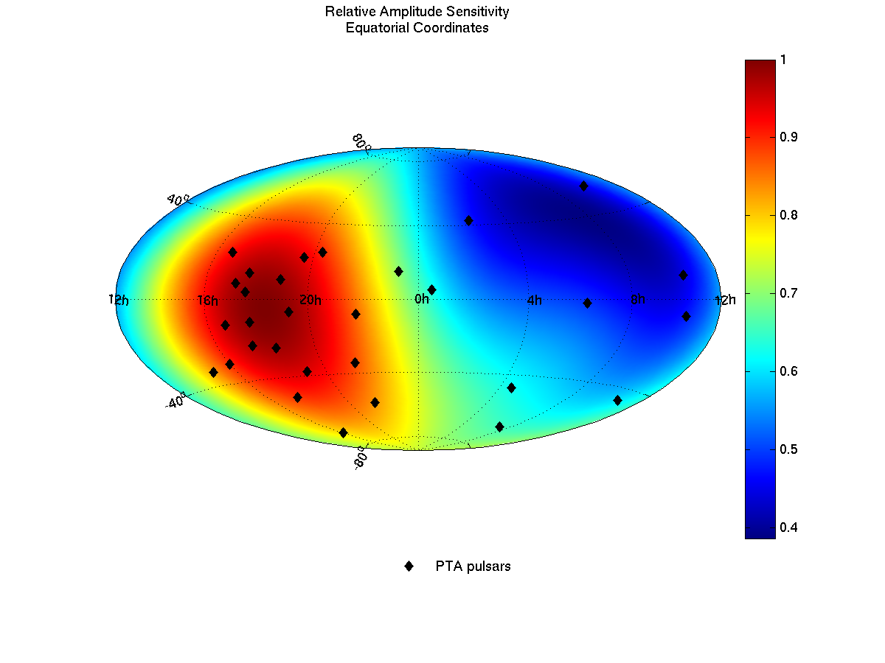
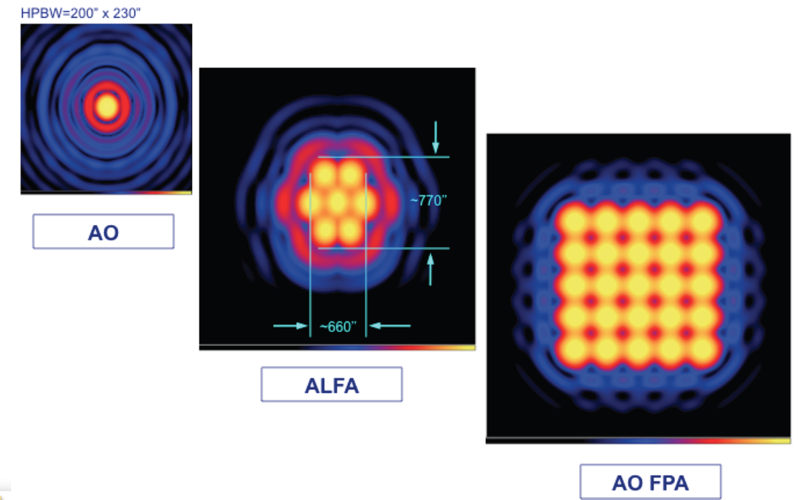
Pulsar Surveys
New pulsars
  Add more arms to PTA, increase sensitivity; or
  For fixed amount of observing time, improve quality of PTA
Survey algorithm
  Observe position on sky
  Search resulting time series for periodic signal at period P with dispersion DM, with orbital parameters
  Loop
a “position” on the sky

Slide 16
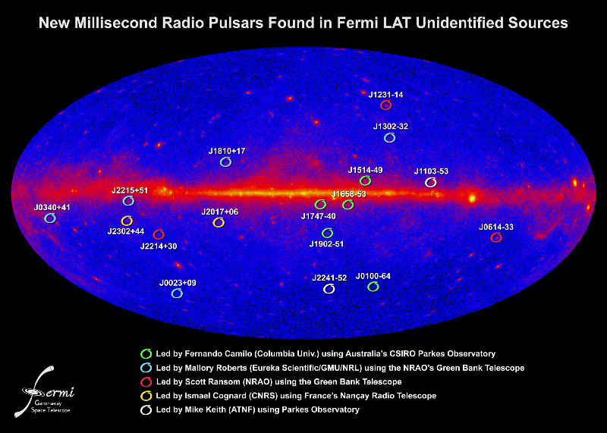
Pulsar Timing Arrays
Near Future

Slide 17
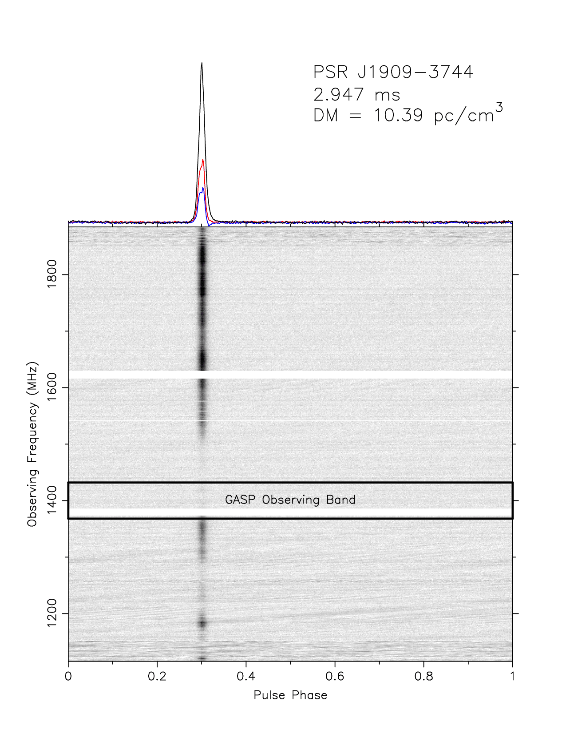
Pulsar Timing Arrays
Digital Backends
Green Bank Ultimate Pulsar Processing Instrument (GUPPI)
BEE2 feeds 8 gaming systems w/NVIDIA GPUs
100, 200, or 800 MHz bandwidth
Large improvement in timing precision
~1 TFLOP in real time
operational

Slide 18
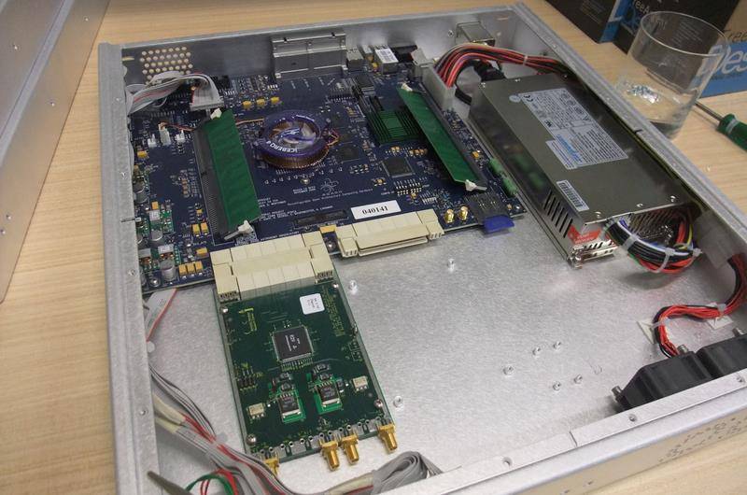
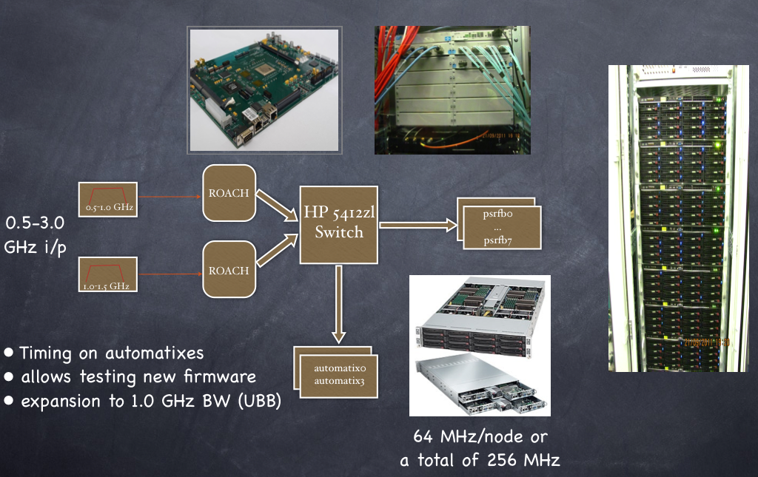
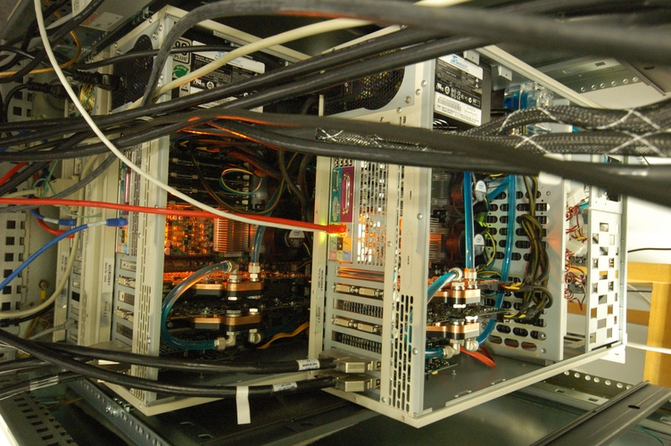
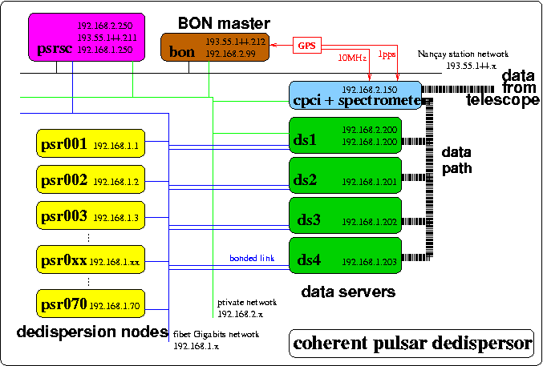
Pulsar Timing Arrays
Digital Backends
Wide-bandwidth (1+ GHz), real-time systems implementing RFI mitigation and folding
  (in construction)
Parkes HIPSR
Effelsberg ASTERIX and follow-on
Arecibo PUPPI
  Clone of GBT GUPPI
FPGA-based Reconfigurable Open Architecture Computing Hardware (ROACH), developed by Center for Astronomical Signal Processing and Electronics Research (CASPER, at UC Berkeley)

Slide 19
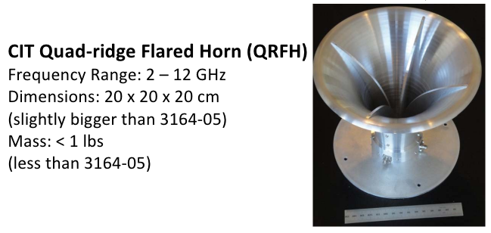
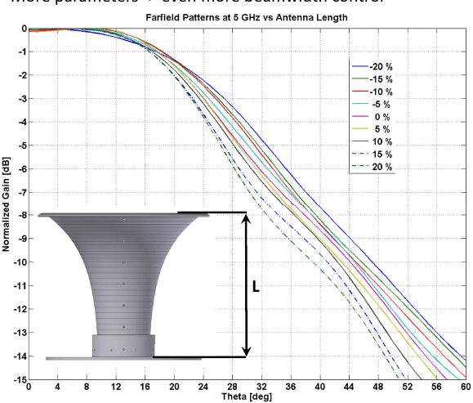
Pulsar Timing Arrays
New Feed & Rx Systems
GBT Wide-Band Pulsar System
Arecibo Wide-Band System
Effelsberg Ultra-broad Band
Arecibo AO40
Five-hundred metre Aperture Spherical Telescope (FAST) multi-feed system
  19 or 100 feed horns
T_{sys} ~ 29K (5K sky + 9K spill + 4K coax jct + 7K dewar jct + 3K LNA)

Slide 20
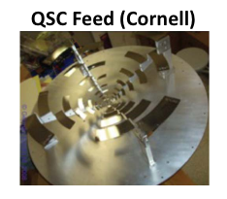
Pulsar Timing Arrays
New Feed & Rx Systems
GBT Wide-Band Pulsar System
Arecibo Wide-Band System
Effelsberg Ultra-broad Band
Arecibo AO40
Five-hundred metre Aperture Spherical Telescope (FAST) multi-feed system
  19 or 100 feed horns
Quasi Self-Complementary Feed
(developed under U.S. SKA auspices)

Slide 21
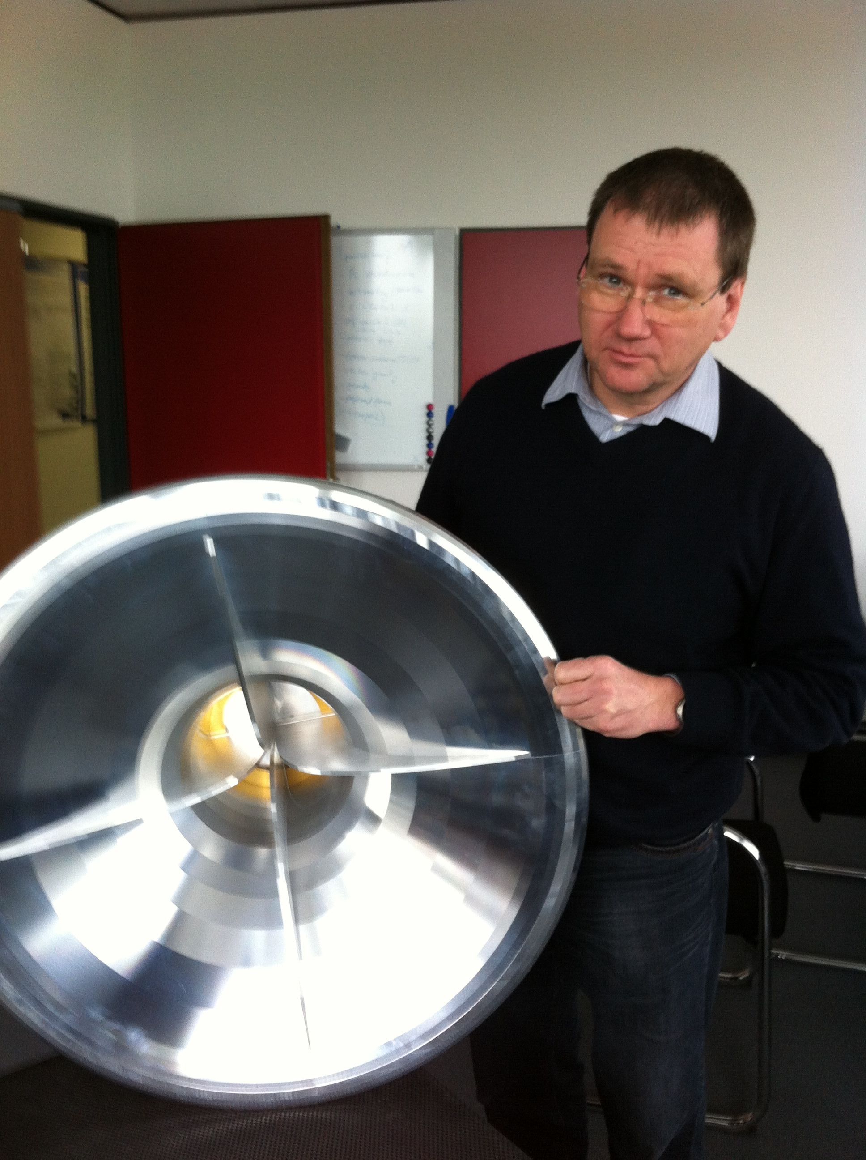
Pulsar Timing Arrays
New Feed & Rx Systems
GBT Wide-Band Pulsar System
Arecibo Wide-Band System
Effelsberg Ultra-broad Band
Arecibo AO40
Five-hundred metre Aperture Spherical Telescope (FAST) multi-feed system
  19 or 100 feed horns
continuous coverage from 600-3000 MHz
cryogenically cooled receiver
design by Weinreb (JPL/TDP) + MPIfR

Slide 22
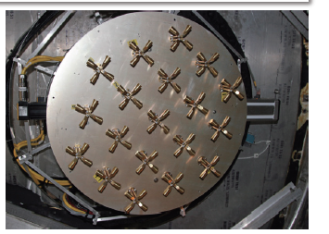
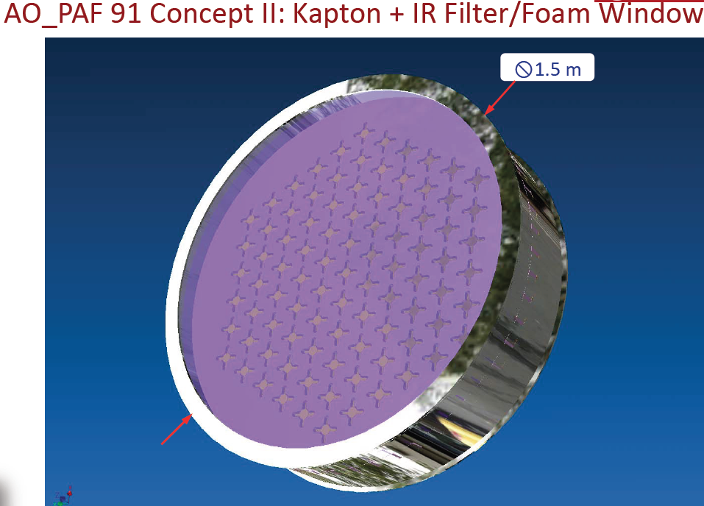
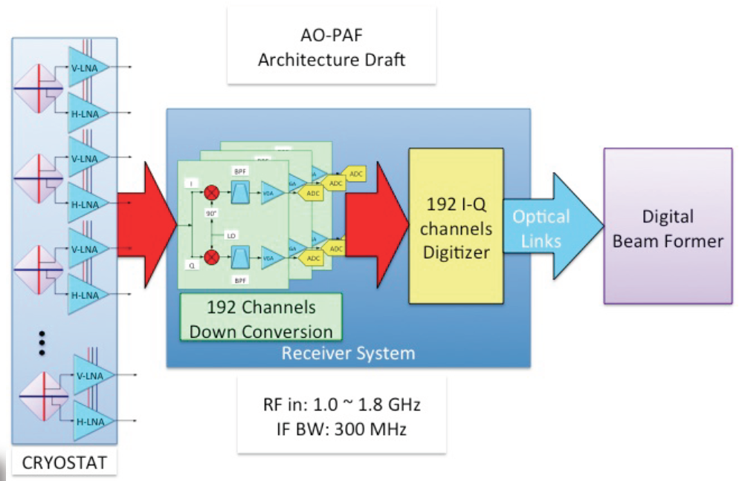
Pulsar Timing Arrays
New Feed & Rx Systems
GBT Wide-Band Pulsar System
Arecibo Wide-Band System
Effelsberg Ultra-broad Band
Arecibo AO40
Five-hundred metre Aperture Spherical Telescope (FAST) multi-feed system
  19 or 100 feed horns

Slide 23
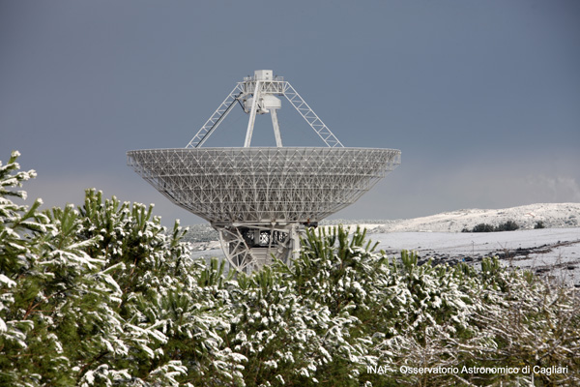
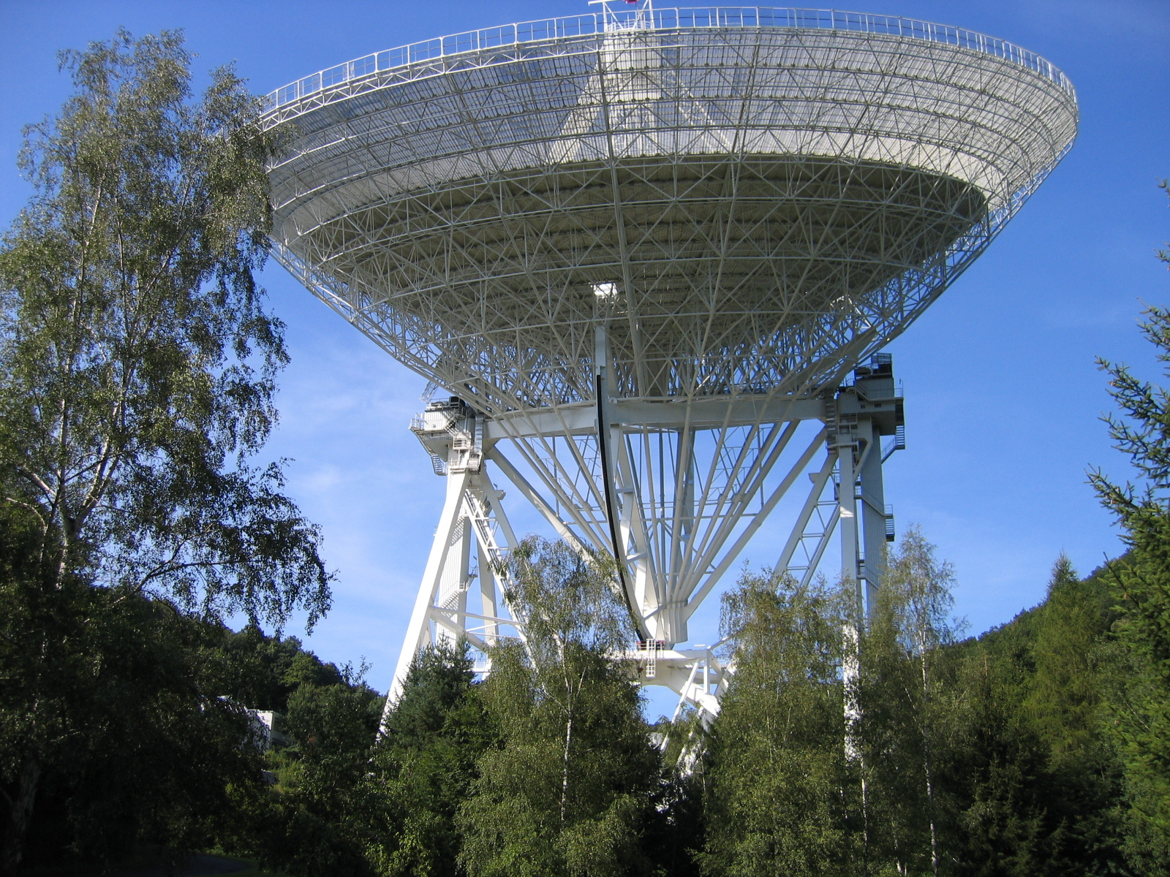
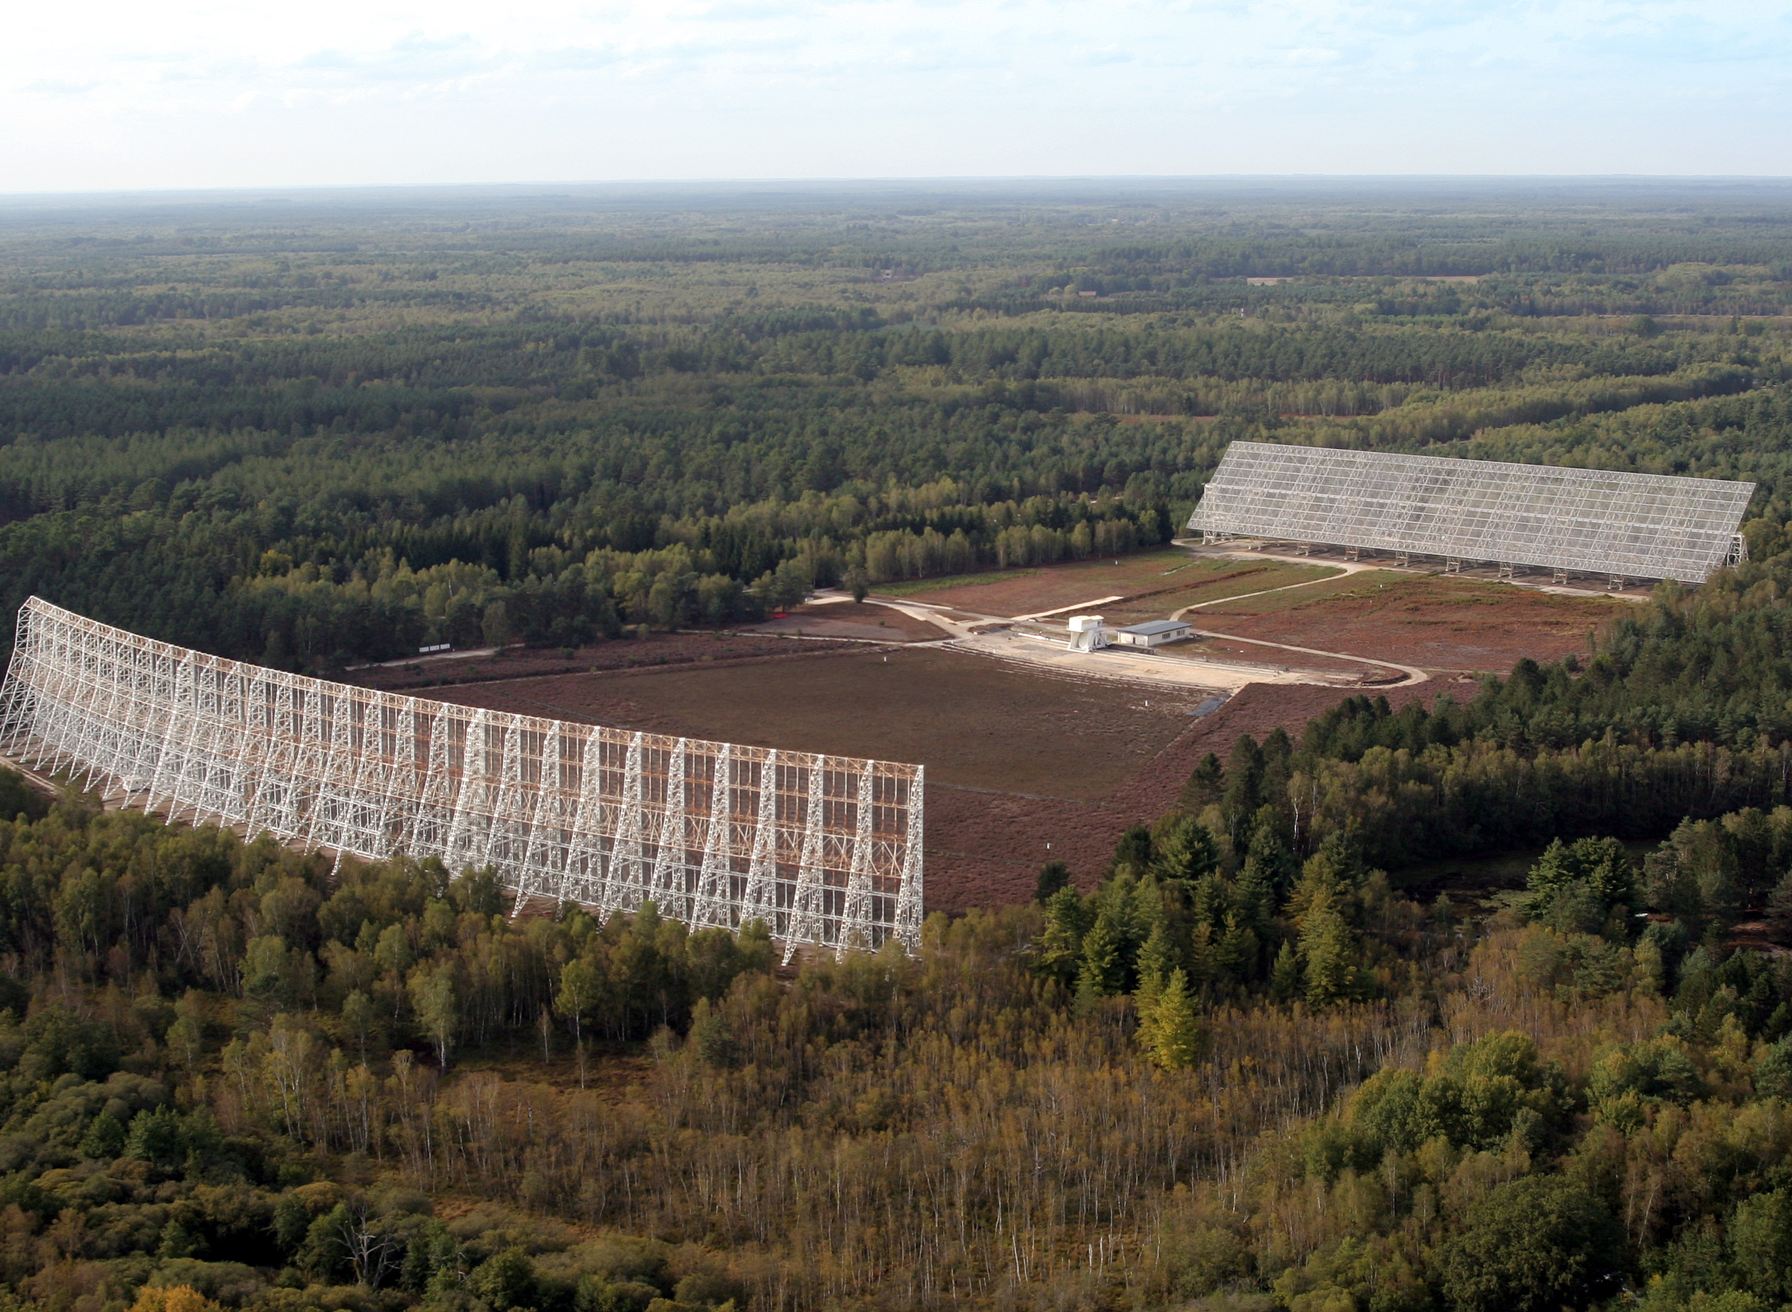
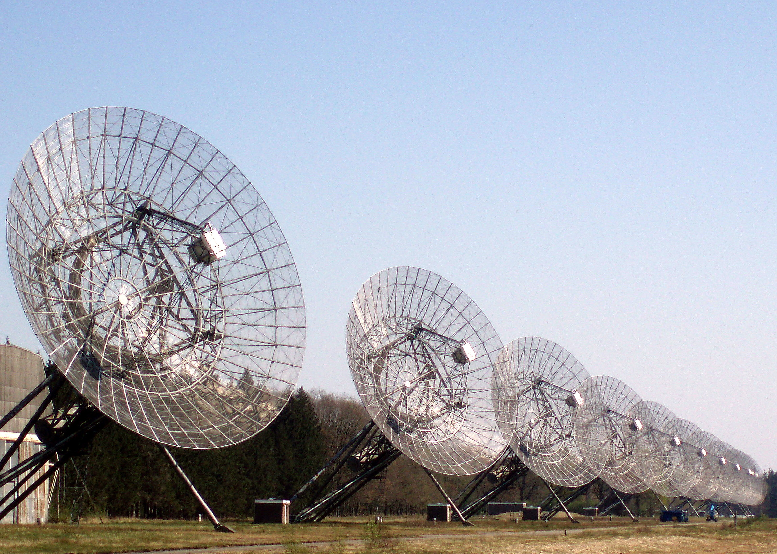
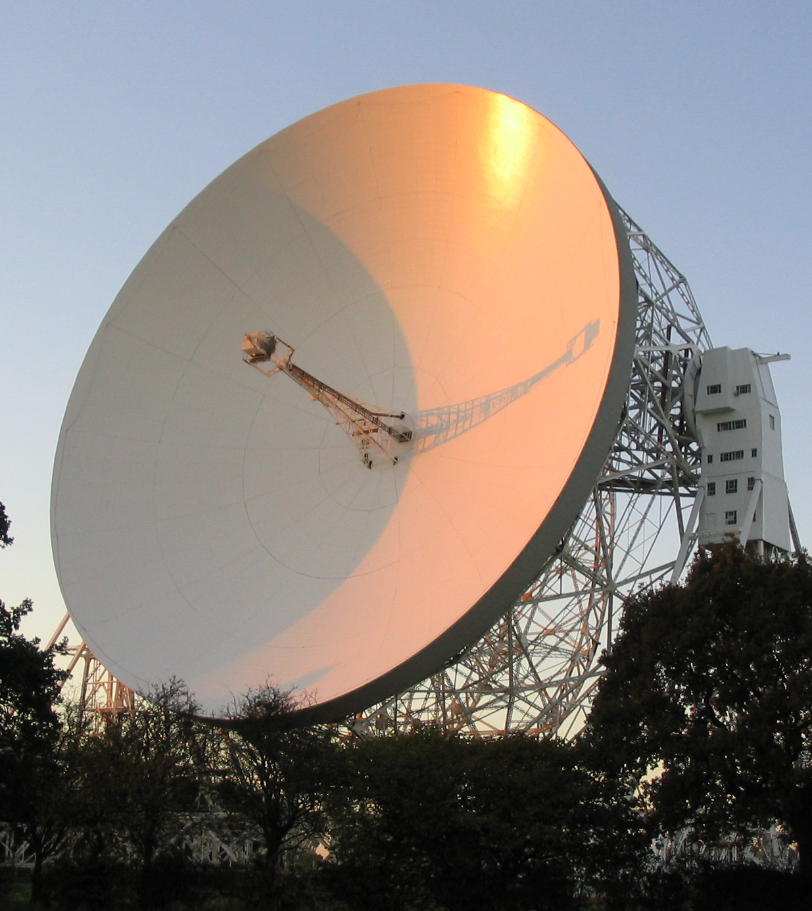
Pulsar Timing Arrays
New Approaches
SRT, Sardinia, Italy
The European Pulsar Timing Array (EPTA):
100-m class telescopes
Effelsberg 100-m, Germany
Lovell, Jodrell Bank,
UK
NRT, Nancay, France
WSRT, Westerbork, NL
Ultimately forming the Large European Array for Pulsars (LEAP)

Slide 24
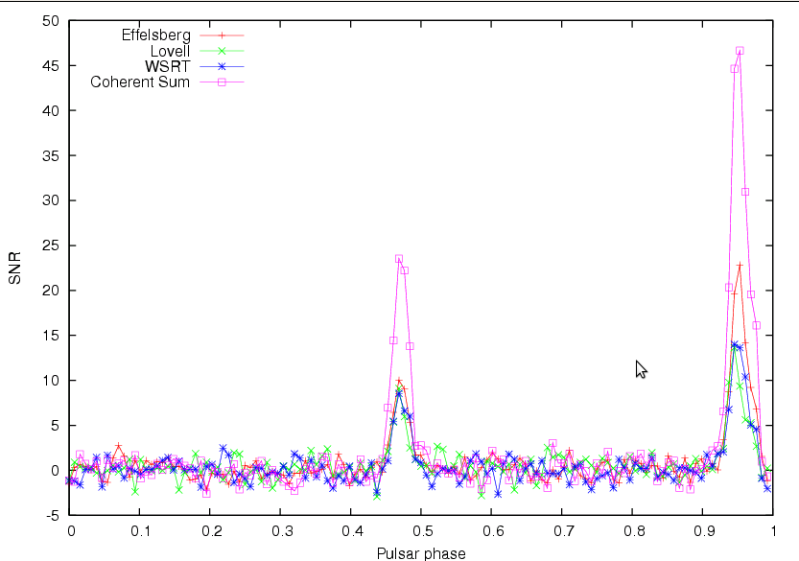
Pulsar Timing Arrays
New Approaches
Large European Array for Pulsars = LEAP!
Current status:
- Hardware to record >128 MHz BW, 8 bits, baseband data in
place at all telescopes:
ASTERIX-like systems at Effelsberg and Jodrell Bank
PUMA-II at Westerbork
BON at Nançay
DFB (in APSR-mode, to be tested) at Sardinia
- 24 hr observations at L-band, once per month (in addition
to regular EPTA observations – 30 TB/site/session)
- Data currently shipped by disk, internet tested
- Successful addition of EFF-JB-WSRT,
Nançay added within days/week, SRT in Q4/2012
Almost there: 160-m dish!
Only 10-sec of data:
Notes:
30 M, 0.1-d orbit, e=0.9

Slide 25
Pulsar Timing Arrays
New Approaches
For a set of N telescopes and M pulsars, what is the optimal scheduling that maximizes the probability of detecting gravitational waves?
Telescope Infrastructure
Pulsar Sample

Slide 26
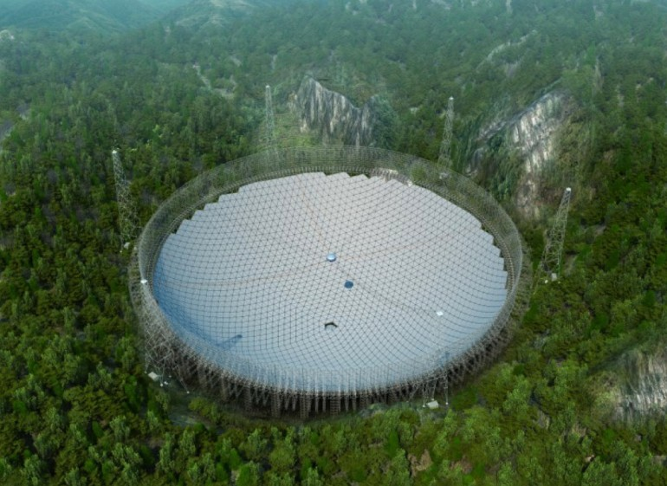
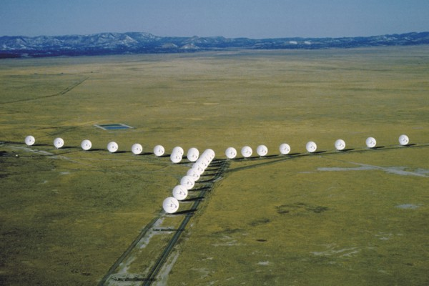


Pulsar Timing Arrays
Future Telescopes
Karl G. Jansky Very Large Array
Five-hundred metre Aperture Spherical Telescope (FAST)
A_{eff} ~ 130 m
YUPPI backend
  Clone of GUPPI, implemented in existing correlator
Primarily a timing instrument
D_{eff} ~ 300 m
19 or 100-beam system
~ 500 new MSPs discovered (projected)

Slide 27
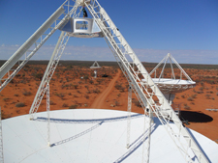
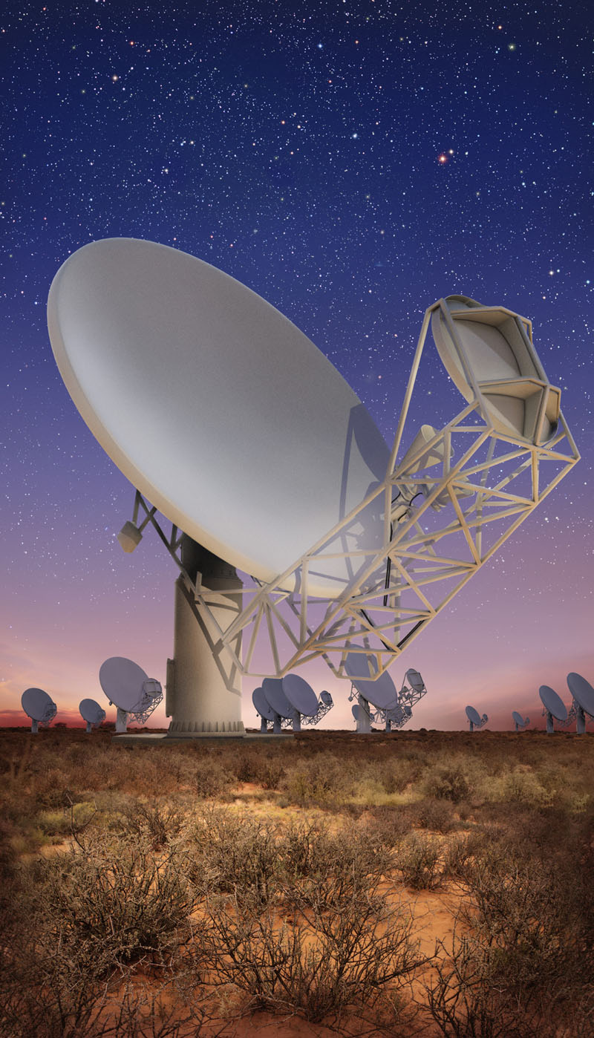


Pulsar Timing Arrays
Future Telescopes
Australian Square Kilometre Array Pathfinder (ASKAP)
Karoo Array Telescope (MeerKAT)
A_{eff} ~ 60 m
Phased array feed ~ 30 deg² field of view
Primarily a search instrument
A_{eff} ~ 100 m
Primarily a timing instrument

Slide 28
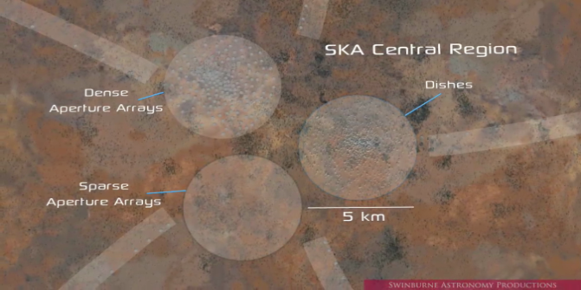
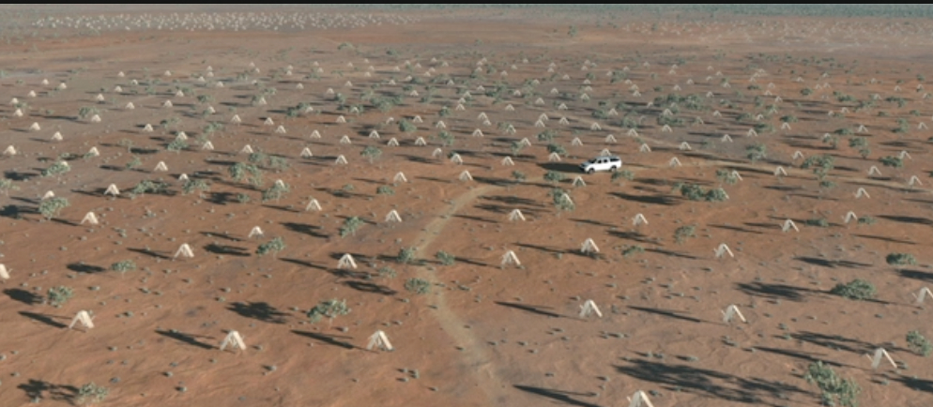
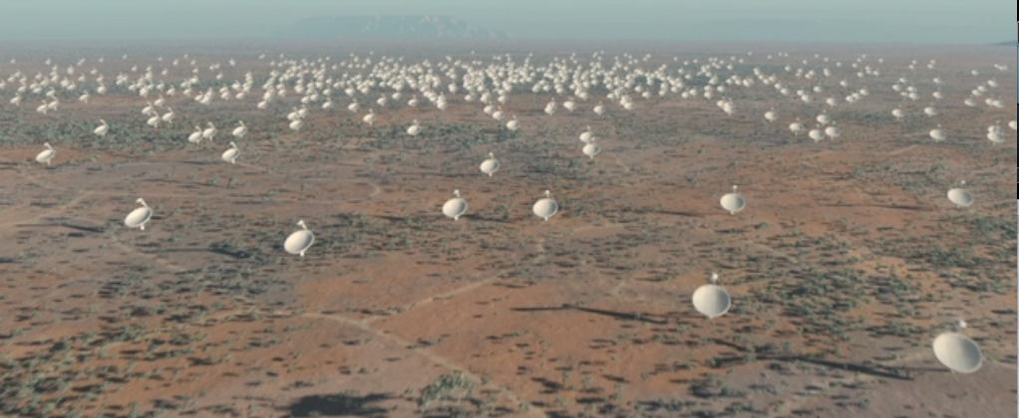
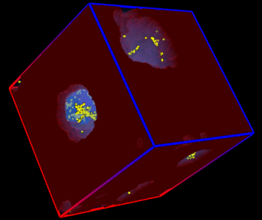
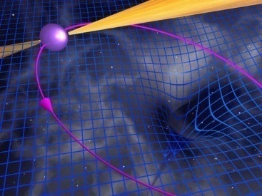
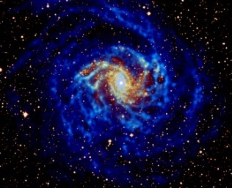
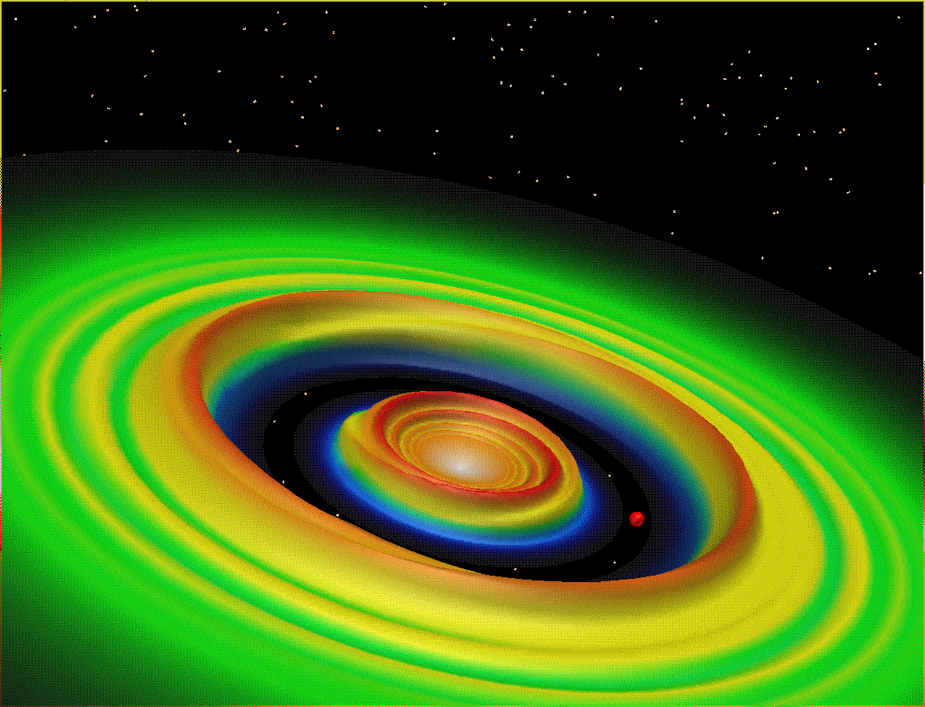
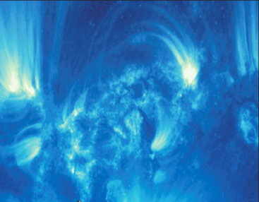
Square Kilometre Array
The Global Radio Wavelength Observatory
Originally: “Hydrogen telescope”
  Detect H I 21-cm emission from Milky Way-like galaxy at z ~ 1
SKA science much broader
  Multi-wavelength, multi-messenger
On-going technical development
International involvement

Slide 29
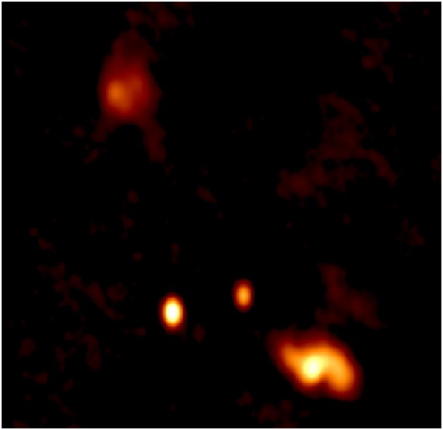
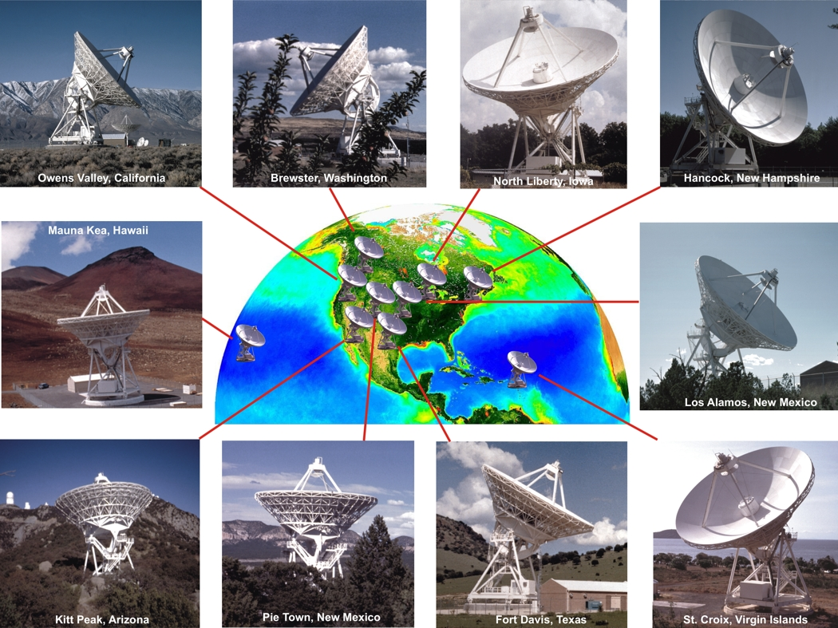
Radio Telescopes and Astrophysical Sources
Search for additional dual SMBHs, progenitors of GW-emitting binary SMBHs
With VLBA now, SKA in the future
Relevant for future space-based GW mission
7 pc
B0402+679
Very Long Baseline Array (VLBA)

Slide 30
Pulsar Timing Arrays
Current and Future Instrumentation
What are the requirements?
  Instrumental performance improving steadily
What exists?
  Powerful set of telescopes
What is on the horizon?
  Increasing capability with new telescopes

