Slide 1


QRPN Experiment
with
Suspended 20mg Mirrors
D. Friedrich
ICRR, The University of Tokyo
K. Agatsuma, S. Sakata, T. Mori, S. Kawamura

Slide 2
Objectives
Observation/Reduction of Quantum Radiation Pressure Noise
  Back-action correlates amplitude and phase fluctuations
  Ponderomotive squeezing
Laser light and
vacuum fluctuations
Laser light and
ponderomotively
squeezed vacuum
displacement

Slide 3
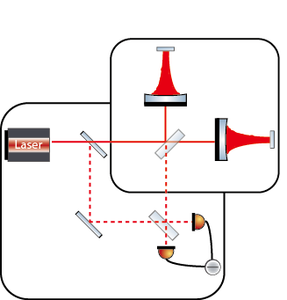
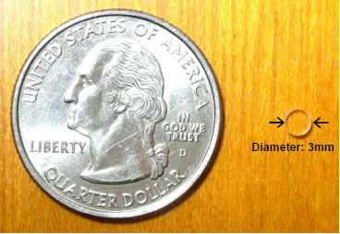
Approach
Topology
  Fabry-Perot Michelson interferometer
  Homodyne detection
Key elements
  High Finesse cavities (F=10000)
  Tiny suspended end mirrors (m=20mg)
Fabry-Perot Michelson ifo
Suspended
20mg mirror
@1064nm
≈500W
20mg
20mg
mirror
Homodyne detection

Slide 4
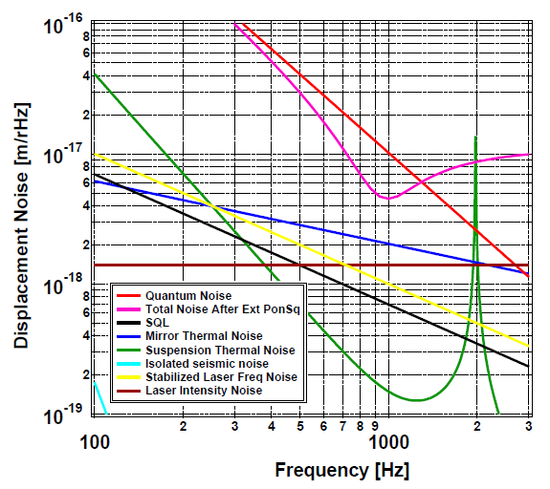
Design Sensitivity/Parameter
Observation of QRPN around 1kHz
Reduction @ 1kHz by 6db ponderomotive squeezing
Laser power | 200 mW
Injected laser power | 120 mW
Finesse | 10000
End mirror mass | 20 mg
Diameter of end mirror | 3 mm
Thickness of end mirror | 1.5 mm
Front mirror mass | 14 g
Reflectivity of end mirror | 99.999 %
Reflectivity of front mirror | 99.94 %
Optical loss | 50 ppm
Beam waist of end mirror | 340 μm
Mechanical loss of substrate | 10⁻⁵
Mechanical loss of coating | 4×10⁻⁴
Length of silica fiber | 1 cm
Diameter of silica fiber | 10 μm
S.Sakata et al. J.Phys.: Conf. Ser. 122, 012020 (2008)

Slide 5
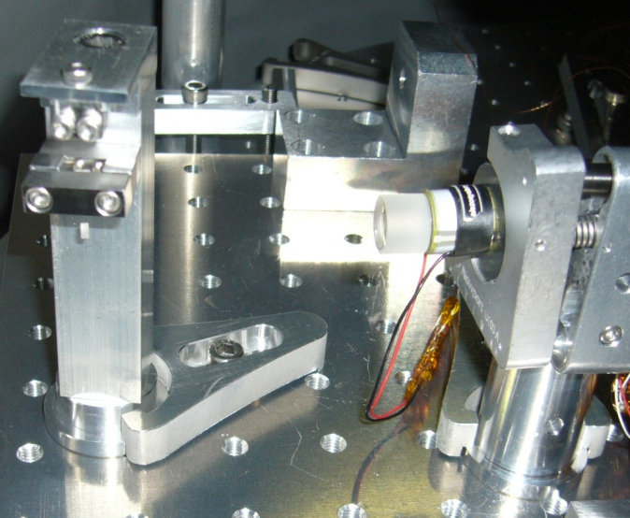
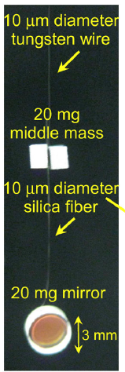
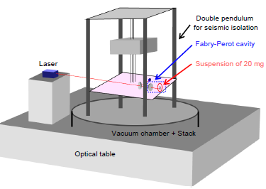
Initial Experimental Setup
Seismic isolation for core optics is provided by a double pendulum
Fabry-Perot-cavity under vacuum
Front mirror: fixed mirror mounted on a Piezo actuator
End mirror: 20mg mirror suspended by a 10μm diameter silica fiber
Front mirror
End mirror
S.Sakata, Ph.D. thesis, Ochanomizu University (2008)

Slide 6
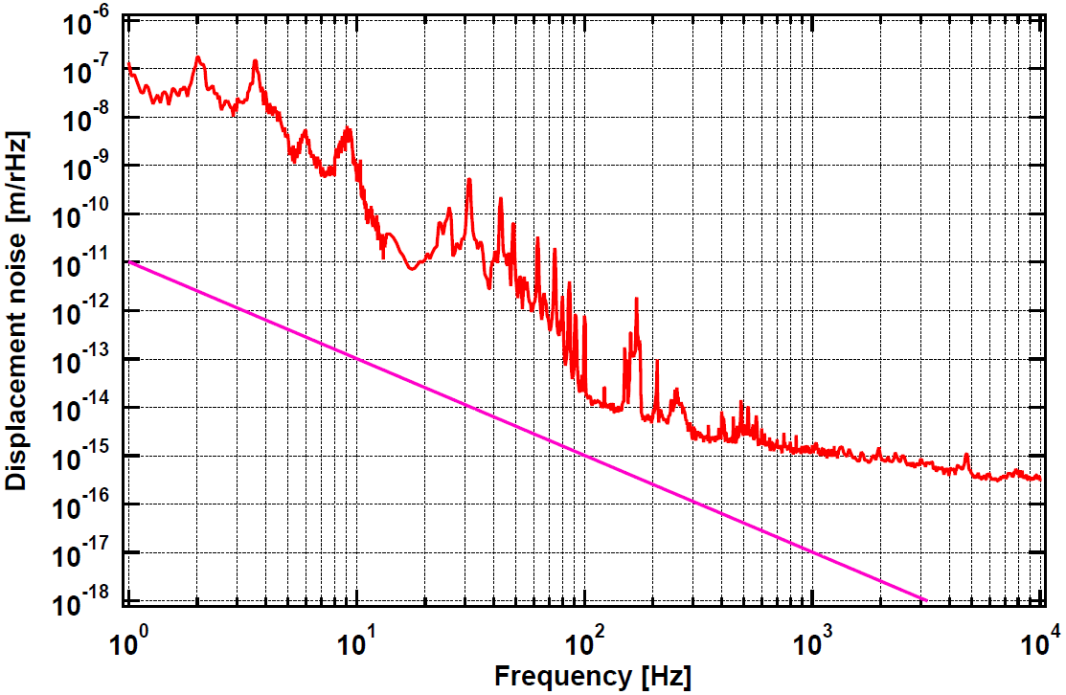
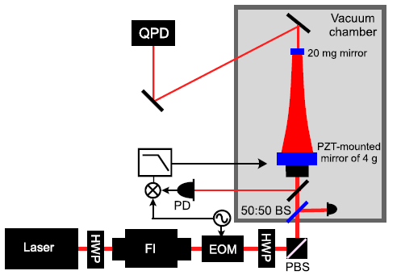
Achieved Sensitivity
Cavity parameter:
Finesse = 1400
L = 70mm
RoC1 = 2m
RoC2 = inf
Goal sensitivity
100x @1kHz
10x @100Hz
Stabilized via PDH-scheme
Sensitivity via calibrated feedback signal
S.Sakata, GWADW (2008)

Slide 7
Angular Anti-Spring in Suspended Cavities
Optical axis is shifted by mirror rotation (yaw/pitch)
  Torque by radiation pressure
  For high circulating power: optical torque > restoring force
  Cavity becomes instable (angular anti-spring effect)
Large front mirror (curved)
small end mirror (flat)
x
Center of curvature RoC1
Incident light
1) End mirror rotation
x
Center of curvature RoC1
Incident light
2) Radiation pressure torque
[see e.g. J.A.Sidles, D.Sigg, Phys. Lett. A 354, 167 (2006)]

Slide 8
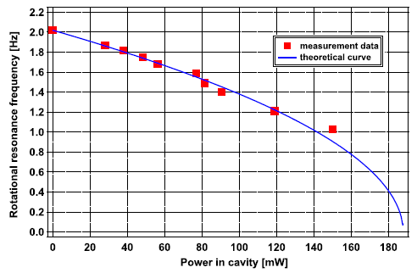

Measurement of Angular Anti-Spring (Yaw)
kopt: optical anti-spring constant
kΘ2: torsional spring constant
Cavity parameter:
Finesse = 1400
L = 70mm
R1 = 2m
R2 = inf
Optical anti-spring increases with laser power
Observed via a decrease in yaw eigenfrequency
Data was taken until near instability ( ≈190mW)
S.Sakata et al. Phys. Rev. D 81, 064023 (2010)

Slide 9
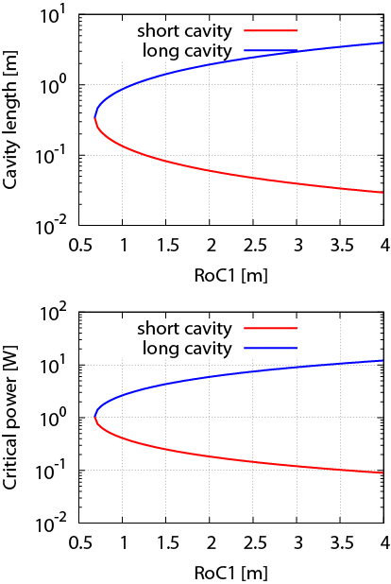
How to Cope the Angular Anti-Spring
Optimize the cavity geometry:
  Change cavity g-factors
  Change RoC of the front mirror
Restriction:
  Using a flat end mirror*
  Beam radius of 340μm (coating TN)
  Reasonable cavity length ≤ 0.3m
Result:
  Going to smaller RoC1
  Critical power still < 1W
  Circulating Power in final design ≈ 500W
  Angular control is required!
Change front Mirror
* A curved 20mg mirror is advantageous, but not available so far

Slide 10
Angular Control – Idea
Difficult to apply an external force to the small mirror directly
    Idea: Control the small end mirror via radiation pressure
  Error signal is derived via a quadrant diode (QPD)
Θ2
Positive feedback
QPD
Method:
Shift optical axis
by
angular control
of the
front mirror
x
Negative feedback
Xspot
x
Θ1

Slide 11
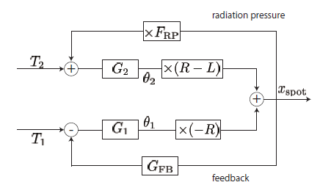
Angular Control - Model
Positive feedback
QPD
xspot
Θ2
Θ1
R1=1m
Negative feedback
Incident light
Ti: torque, Gi: pendulum transfer function
Model for angular control to suppress xspot (for final design):
  GFB: can provide sufficient gain at low frequencies (zero/pole @ 200/500Hz)
  Need to suppress electronic noise around 1kHz (yaw to longitudinal coupling)
S. Sakata, internal document (2008)
T.Mori, Ph.D. thesis, The University of Tokyo (2012)

Slide 12
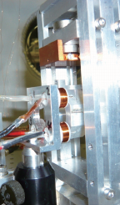
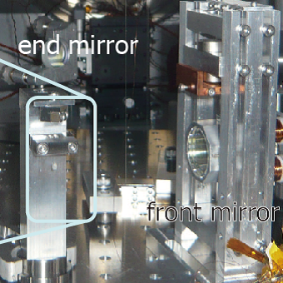
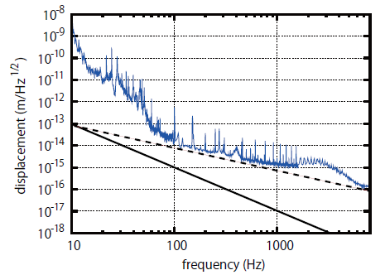
Results with a Fully Suspended Cavity
Suspended front mirror
coil-magnet actuators
increase the actuation range
stable longitudinal lock (low power)
sensitivity comparable to prev. setup
End mirror
Front mirror
Cavity parameter:
Finesse = 1300
L = 80mm
R1 = 1m, R2 = inf
measured
laser freq.noise (estimated)
Angular control via front mirror
  control circuit was installed
  stabilization of angular anti-spring
  via RP not demonstrated yet
Goal sensitivity
T.Mori, Ph.D. thesis, The University of Tokyo (2012)

Slide 13
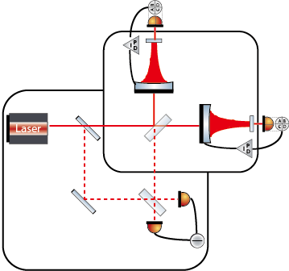
Summary
Goal: Observation and Reduction of QRPN
  Key element: 20mg mirror suspended by a 10μm silica fiber
Fully suspended cavity locked stable (at low power)
  Model/setup for angular control via radiation pressure
Demonstrate angular control (with preliminary setup)
  Investigate feasibility for the final design
Upgrade the vacuum system by an Ion-getter-pump
  More stable working conditions
Setting up the full interferometer
  Common noise rejection
Outlook

Slide 14
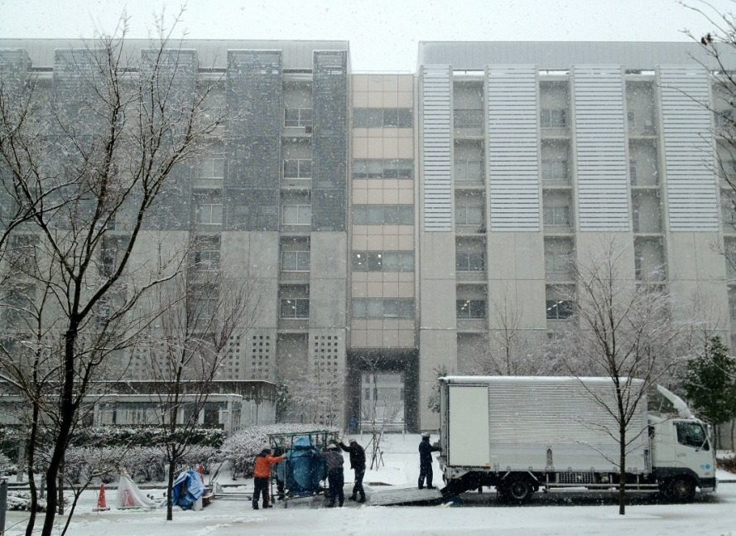
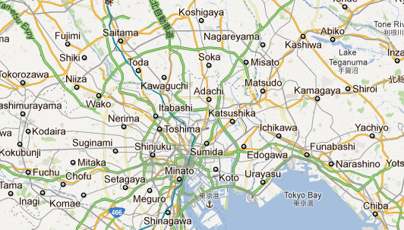
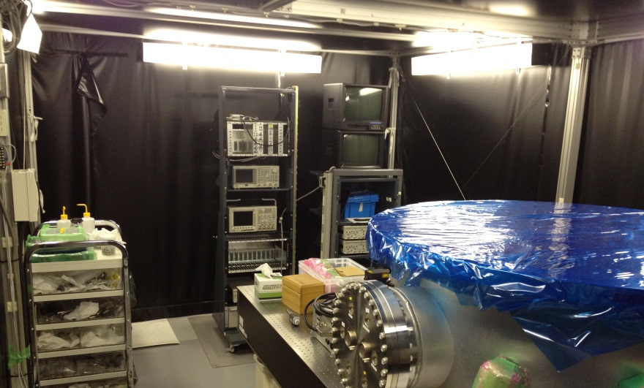

Thank you
The new lab
Arrival at ICRR, March 2012

