Slide 1
Enhanced LIGO with squeezing:
Lessons Learned for Advanced LIGO and beyond

Slide 2
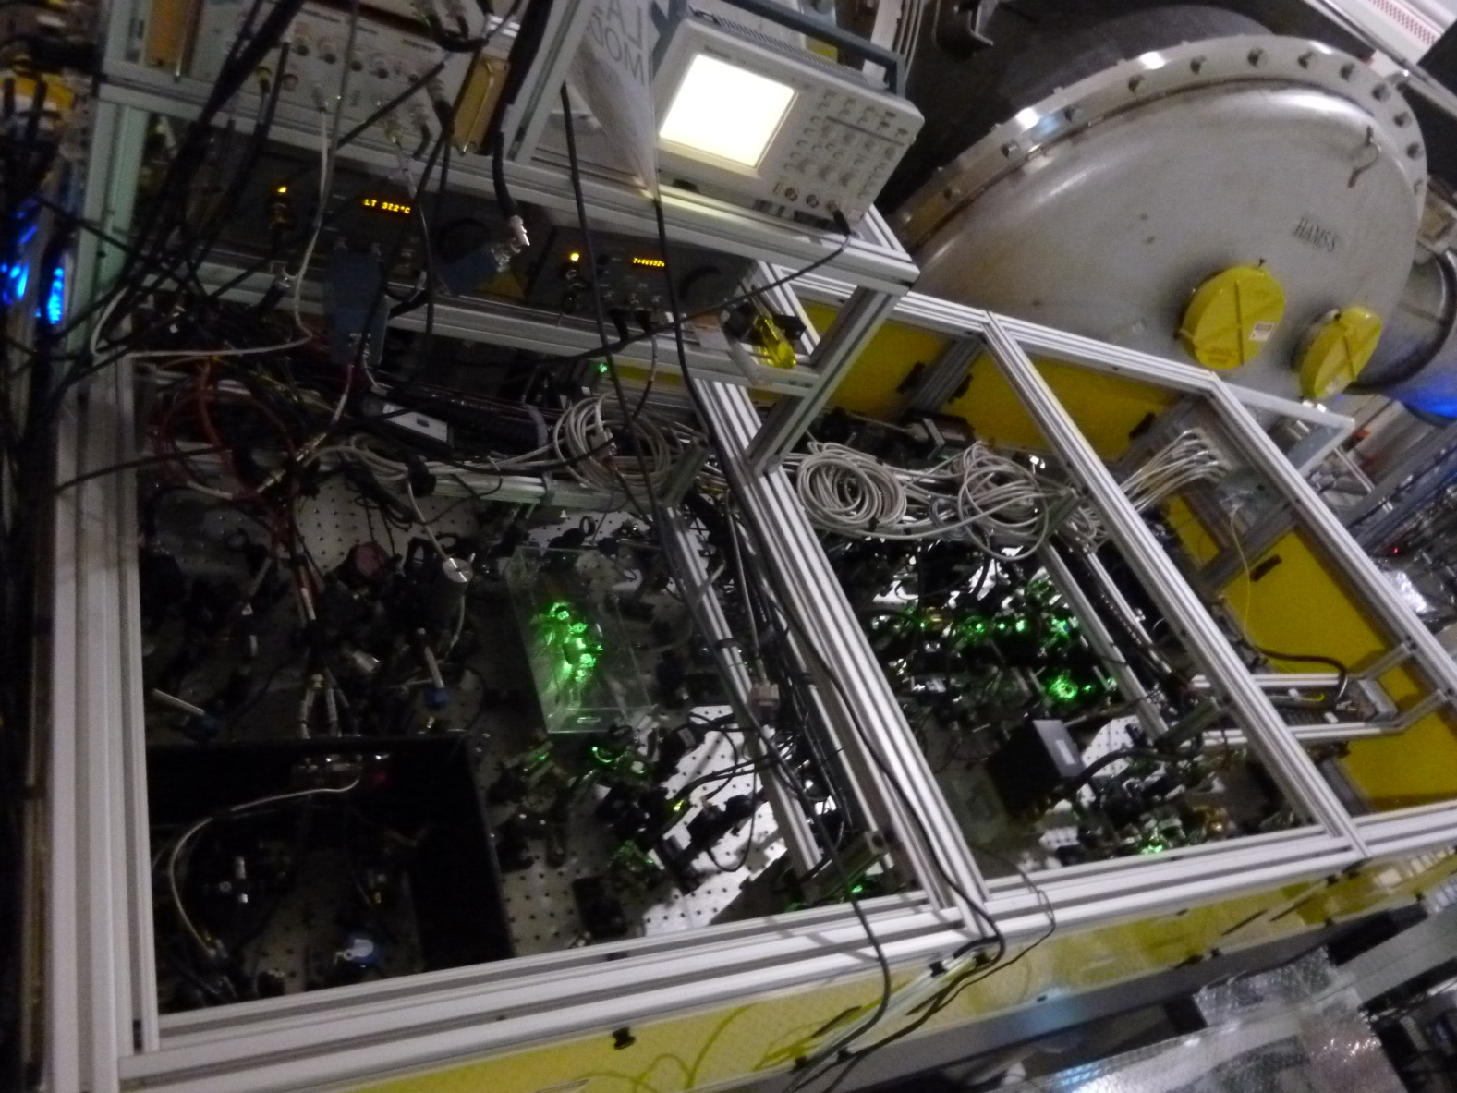
Enhanced LIGO
with squeezing
Advanced LIGO
with squeezing

Slide 3
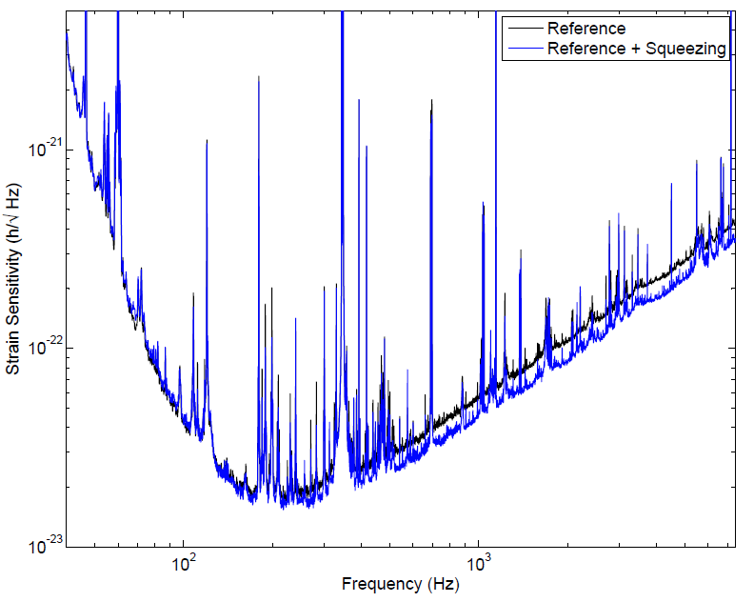
Enhanced LIGO with squeezing
2.1 dB

Slide 4
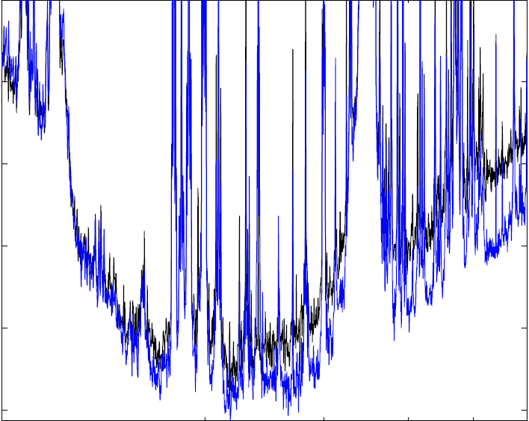
Enhanced LIGO with squeezing

Slide 5
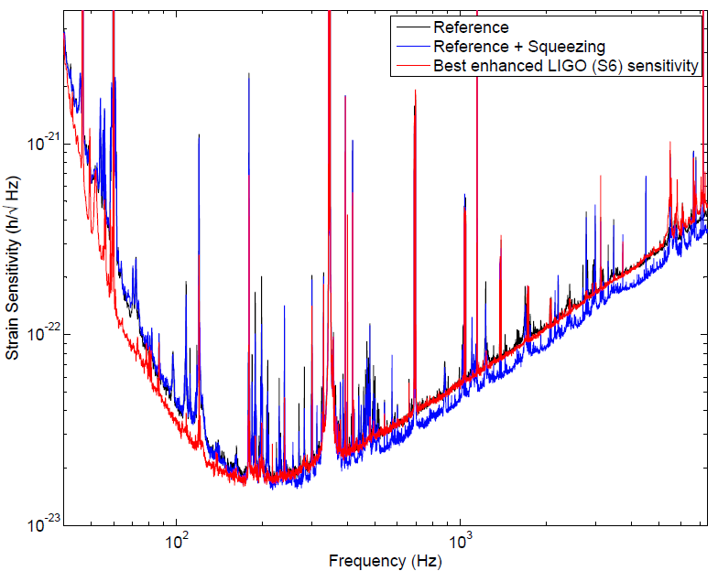
Best broadband sensitivity

Slide 6
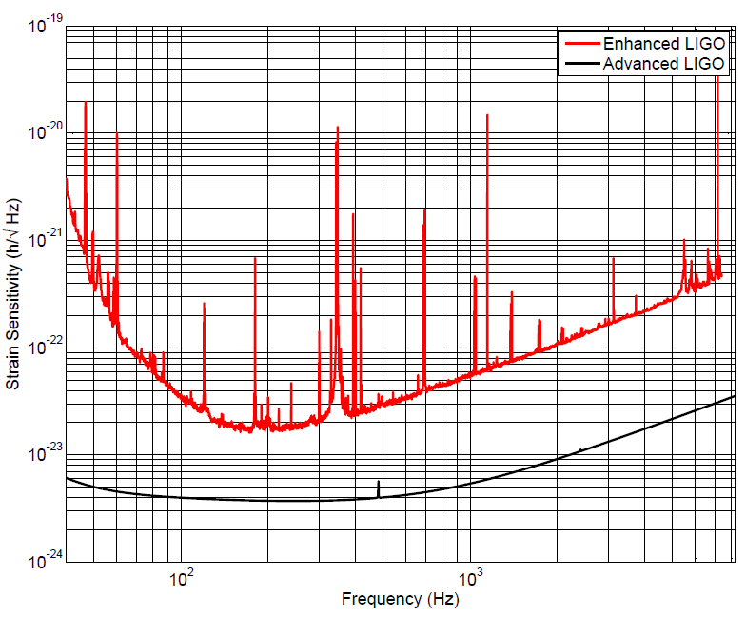
Requirements for Advanced LIGO + squeezing
Frequency dependent squeezing angle
(Jan Harms and Patrick Kwee talks)
More sensitive to acoustic noise added by squeezing
Higher level of squeezing desired

Slide 7
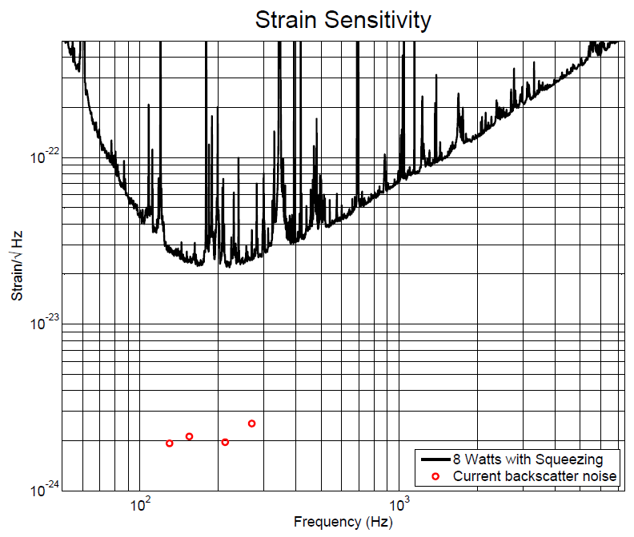
Acoustic Noise Coupling

Slide 8
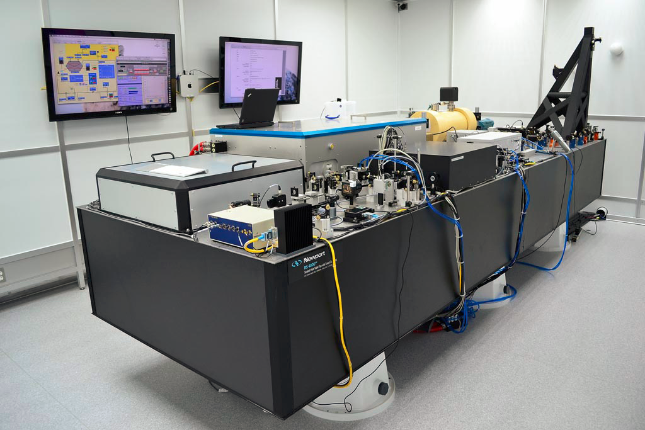
Mitigate Acoustic couplings
Reduce relative motion between squeezer and interferometer
Advanced LIGO Pre Stabilized Laser enclosure and table:
Factor of 10 reduction in motion demonstrated
Other options:
Improved isolation from Faradays (factor of 3)
Move OPO in vacuum onto seismic isolation table

Slide 9
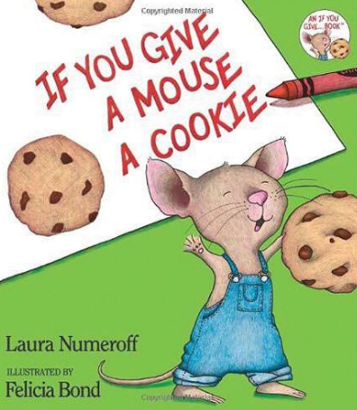
You want more than 2 dB of noise reduction!
Losses and phase noise will limit the performance of a squeezer for Advanced LIGO

Slide 10
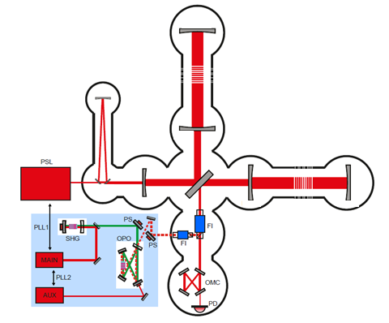
Losses destroy squeezing

Slide 11
Phase Noise
X₂
Phase noise of the squeezing angle mixes squeezed and antisqueezed quadrature
Total rms phase noise decreases the level of squeezing broadband
X₁

Slide 12
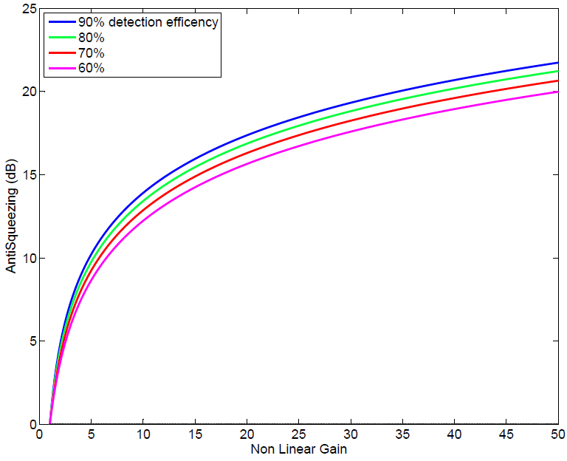
Total losses (1-η_{esc}η_{det})

Slide 13
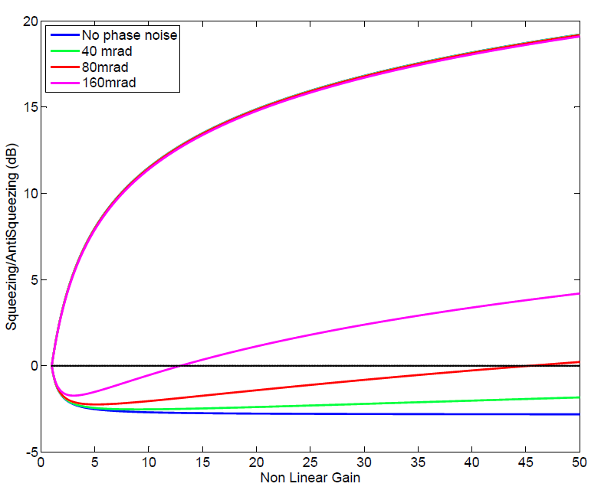
Total Phase Noise
Increasing the amount of anti squeezing allows us to measure total phase noise accurately.

Slide 14
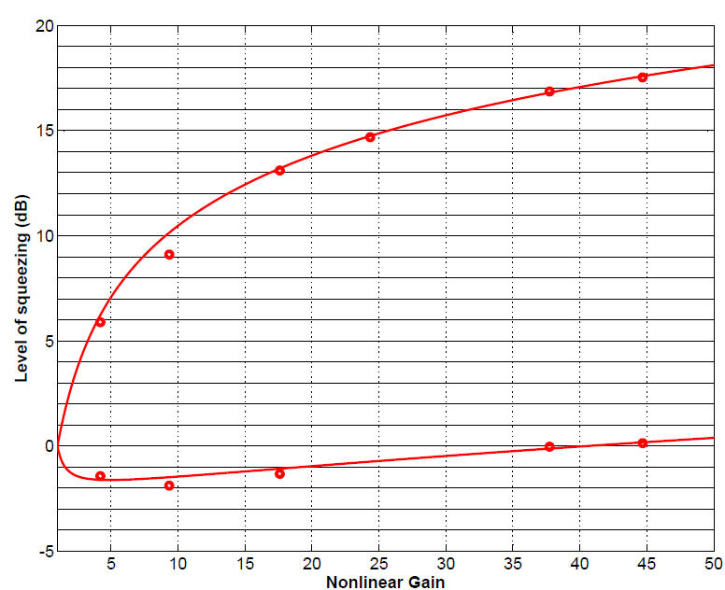
H1 as a squeezing detector
60% losses, 80 mrad phase noise in this example
55-60% total losses during H1 experiment
37 mrad rms phase noise at best

Slide 15
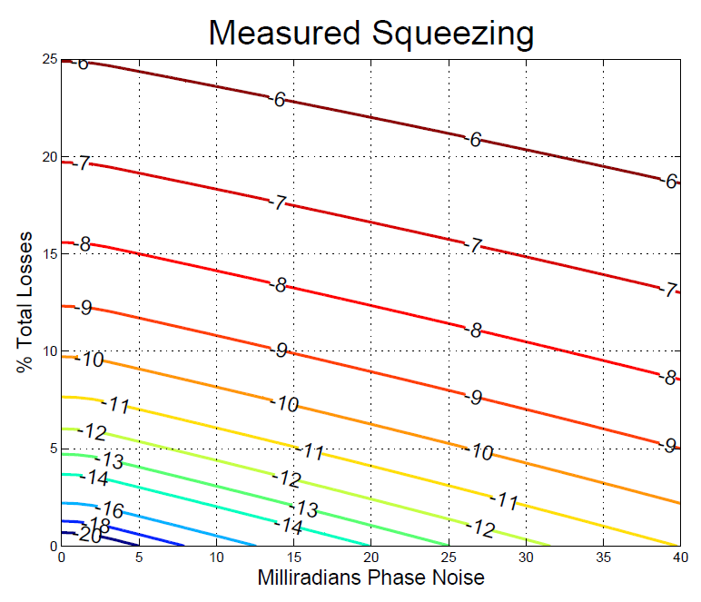
Paths to better squeezing
Non linear gain optimized for best high frequency squeezing, maximum pump power 80% of threshold

Slide 16
Loss goals
 | Past | Present | Future
3 faraday passes | 5% each | 3% each | Aim for all less than 0.2%
Signal recycling cavity@100 Hz |  | 2.5% (Tsrm=35%)
Squeezer mode matching to OMC | 30% | 4%
OMC transmission | 19% | 1%
Total losses | 55-60% | 20%
Detected Squeezing | 2+dB | 6dB | 10-15dB
Based on tally of 11 different loss sources

Slide 17
Phase Noise goals
 | Past | Present | Future
RF sidebands | 1.3 mrad | same | Reduce all to less than 1 mrad
Sources on squeezer table | ≤22
Beam jitter | 30 mrad
Total phase noise | 37mrad
Detected Squeezing | 2+dB | 6dB | 10-15dB
Our sensor for the squeezing angle is sensitive to alignment, couples beam jitter to phase noise

Slide 18
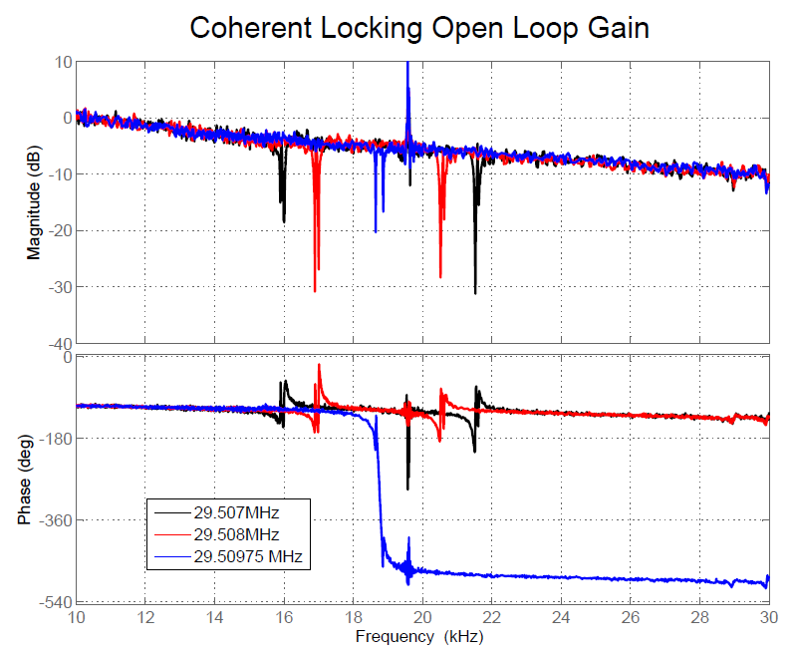
Phase noise control
Bandwidth is limited to 10kHz by arm cavities
Need to mitigate phase noise at the source
Changes to control scheme and in vacuum OPO may be necessary for 10-15 dB of squeezing

Slide 19
Enhanced LIGO
with squeezing
Advanced LIGO
with squeezing
Give us 6 months,
a million dollars
For risk mitigation/ faster science running
Auto alignment
Long term stability

Slide 20
Squeezing beyond Advanced LIGO
Filter Cavities
Reduce all interferometer losses
  remote or active mode matching
  development of low loss faradays
Reduce phase noise
  Rethinking control scheme
  OPO in vacuum

Slide 21
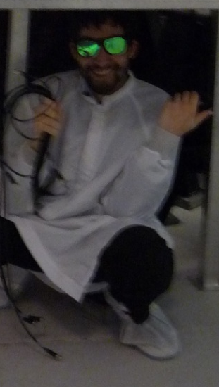
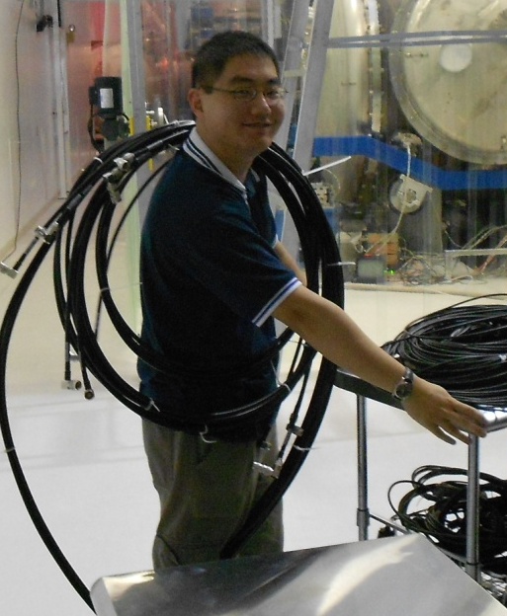
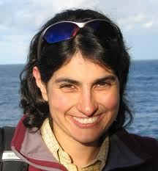

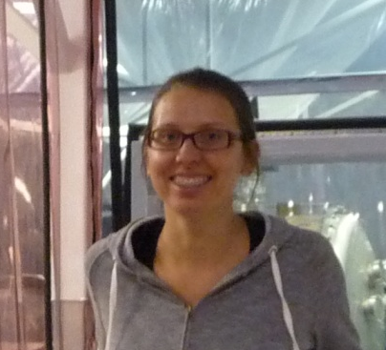
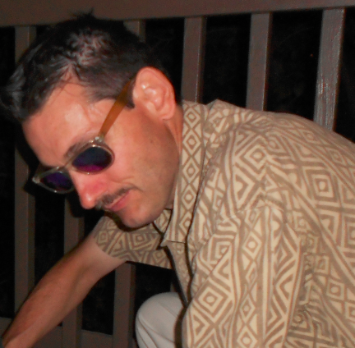
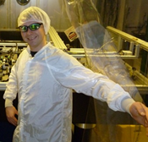
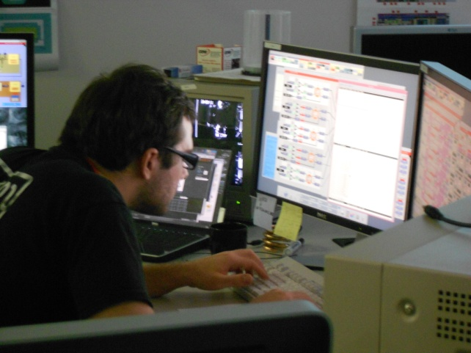
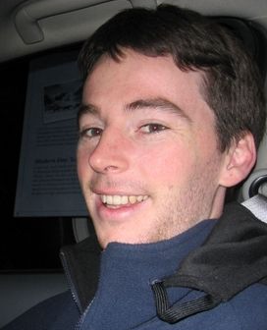


Thank you!
LHO: Daniel Sigg, Keita Kawabe, Robert Schofield, Cheryl Vorvick, Dick Gustafson, Max Factourovich, Grant Meadors, everyone else at LHO
MIT: Lisa Barsotti, Nergis Mavalvala, Nicolas Smith-Lefebvre, Matt Evans
ANU: Sheon Chua, Michael Stefszky, Conor Mow-Lowry, Ping Koy Lam, Ben Buchler, David McClelland
AEI:Alexander Khalaidovski, Roman Schnabel

Slide 22
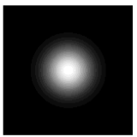
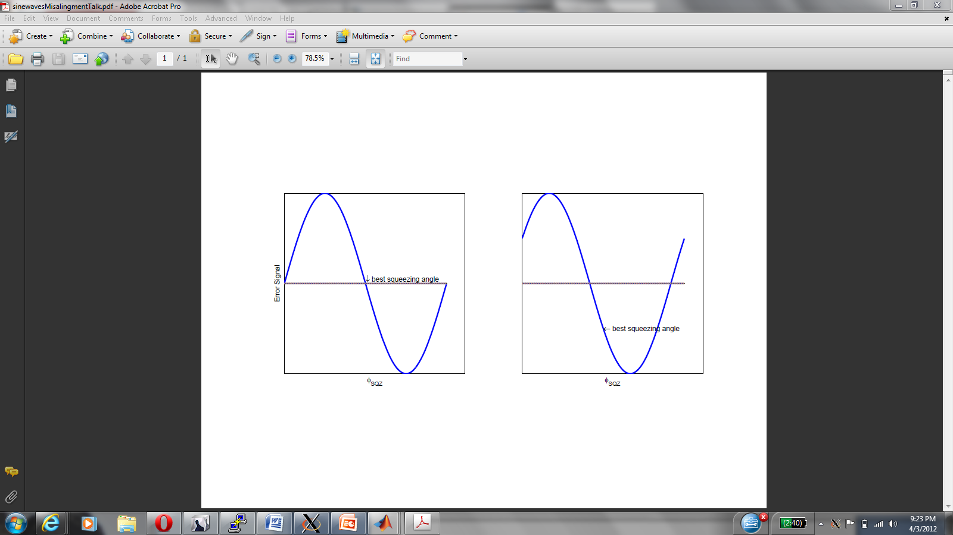
Coherent locking of squeezing angle inject frequency shifted sideband with coherent amplitude
IFO carrier
SQZ sideband
x

Slide 23

Squeezing angle error signal
IFO carrier
SQZ sideband
IFO carrier
SQZ sideband
x
x

Slide 24
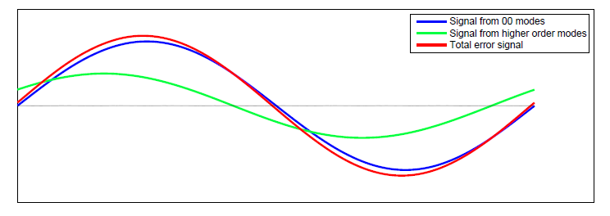
Squeezing angle error signal
IFO carrier
SQZ sideband
+
x
+

Slide 25
Squeezing angle error signal
IFO carrier
SQZ sideband
x
+
+
Static misalignments will cause a change in the demodulation phase needed to detect the maximum squeezing
Beam jitter will add phase noise, especially when beating against a static misalignment.

Slide 26
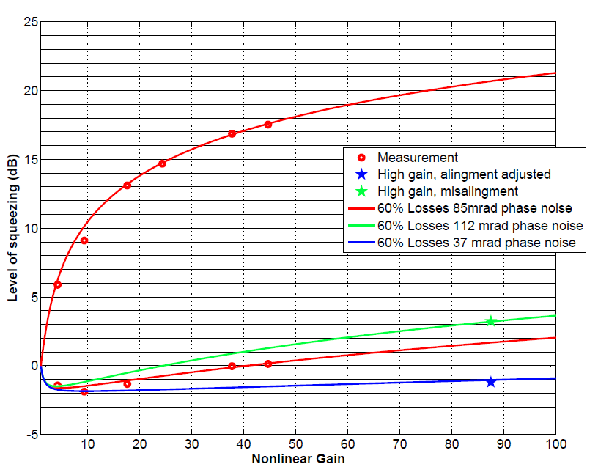
Phase noise reduced by changing IFO alignment
Auto alignment may reduce phase noise, keep it more stable

Slide 27
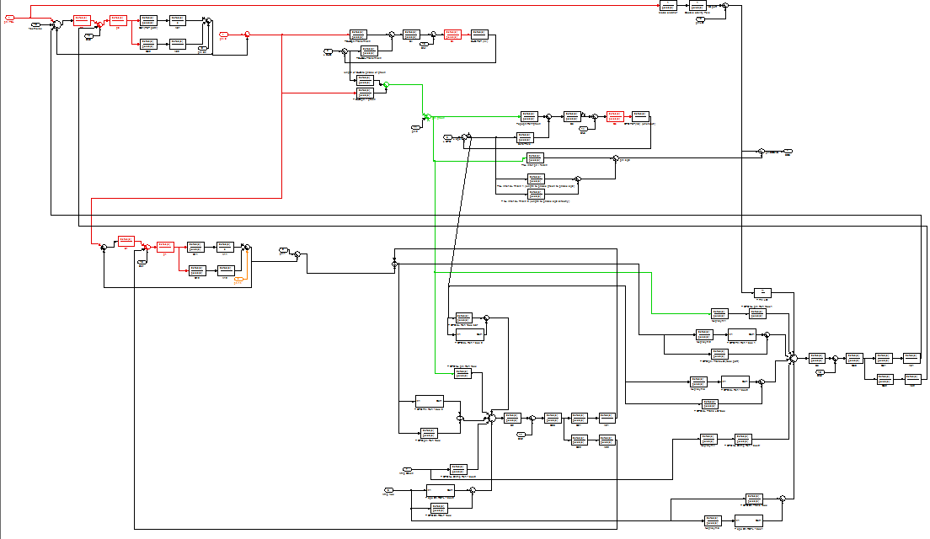
Control Scheme
Modeled before construction of the squeezer to understand phase noise propagation

Slide 28
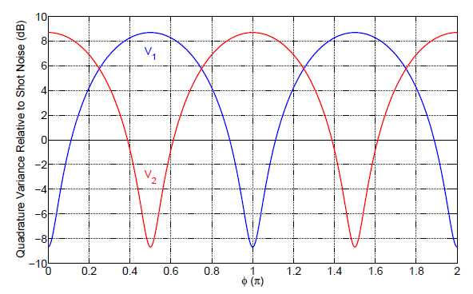
Phase Noise
Operating point is at a minimum, any fluctuation leads to an increase in noise
Goda
For higher levels of squeezing, the “dip” gets steeper so phase noise has a larger effect

Slide 29
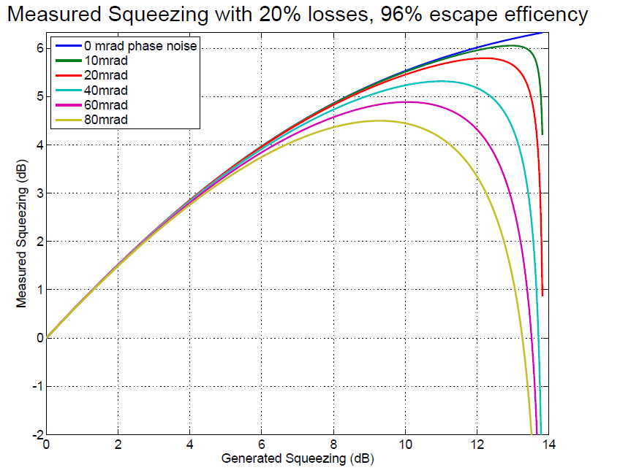
Phase Noise also limits squeezing

Slide 30
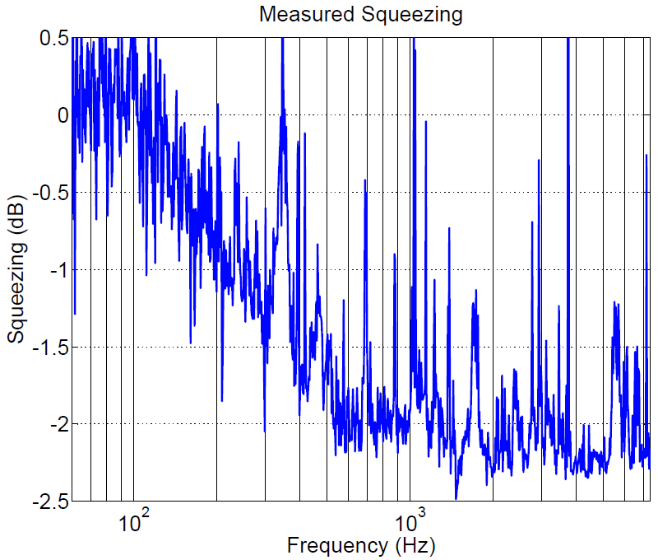
Squeezing Results
2.25 dB quantum enhancement
Some squeezing down to nearly 100 Hz
Technical noise from IFO causes peaks

Slide 31
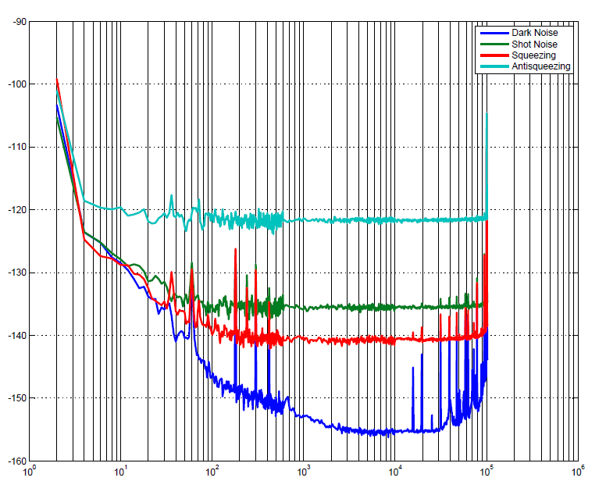

Slide 32
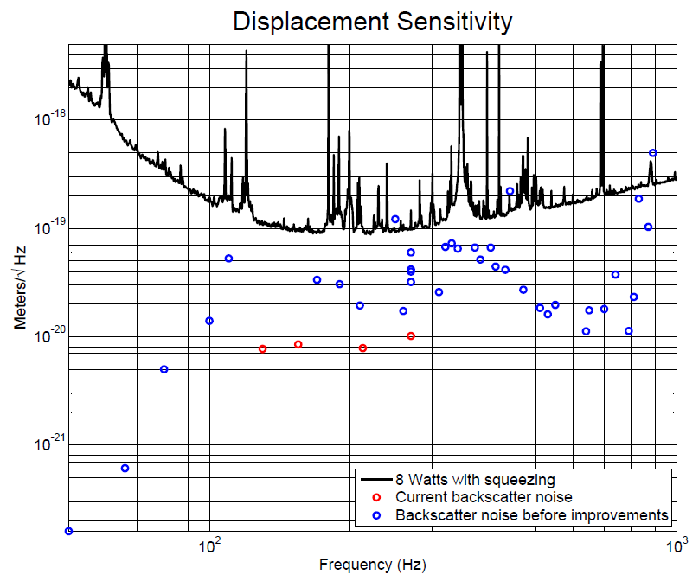

Slide 33
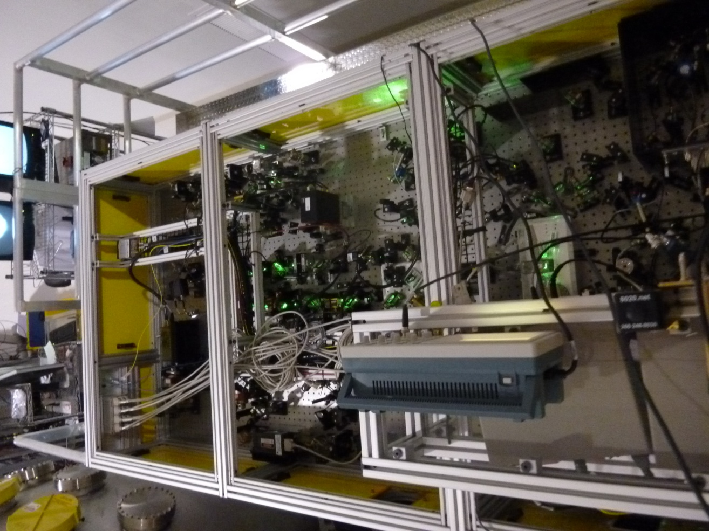
A squeezer table
Homodyne
Detector
Second Harmonic Generator
Optical Parametric Oscillator
Laser
Interferometer
Anti Symmetric Port

