Slide 1
Towards aLIGO Heirarchical Control Scheme
J. Kissel

Slide 2
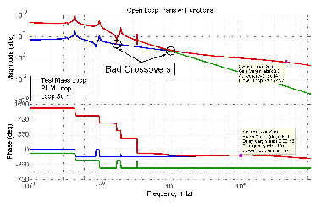
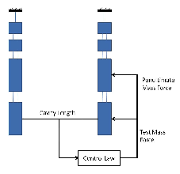
The History
Brett’s Doc T1000242
  Pros and cons of distributed vs. heirarchical control
  Points out how/why cross-overs are important
  Describes, in general, the right math
  Developed for/on the Noise-Prototype QUAD at LASTI

Slide 3
Why the aLIGO Scheme Will be Different than what Brett did
Different electronics (frequency response will be compensated, but gains are different)
Several cavity signals vs. just one
Control signals sent to several different types of suspensions
Better (?) sensing
More complete model(s) / new understanding

Slide 4
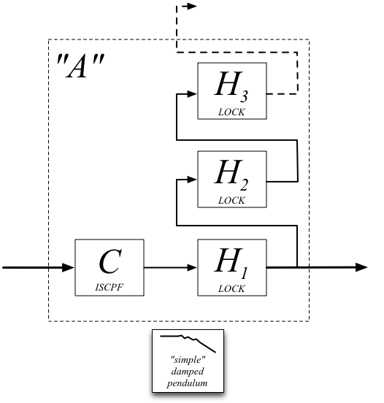
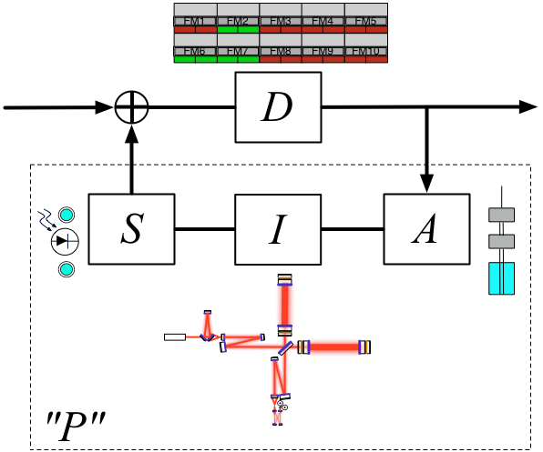
Why the aLIGO Scheme Will be Different than what Brett did
Artifically separate the global control “plant”
1 nm/ct @DC
Falls as f² at HF
0 deg phase at DC, -180 deg phase above resonances

Slide 5
The “For starters” aLIGO Scheme
Science mode configuration of aLIGO control scheme from the ISC FDR (and discussions with Peter & M. Evans)
  See T1000298 (ISC, LSC), T070247 (ISC, ) and T0900511 (ASC)
Diagram is covered with grains of salt, since it depends on what we get from SEI+SUS, what SNR we get from the various optical ports, power level, the balance between coupling and control strength, etc., etc.
The point of me showing it is merely to
  Give you a feel for what signals go where, to which suspensions
  Give you a feel for the bandwidth of each of the loops
  Point out that we won’t have to control “every optic”
  Point out that optics will often be receiving more than one cavity signal

Slide 6
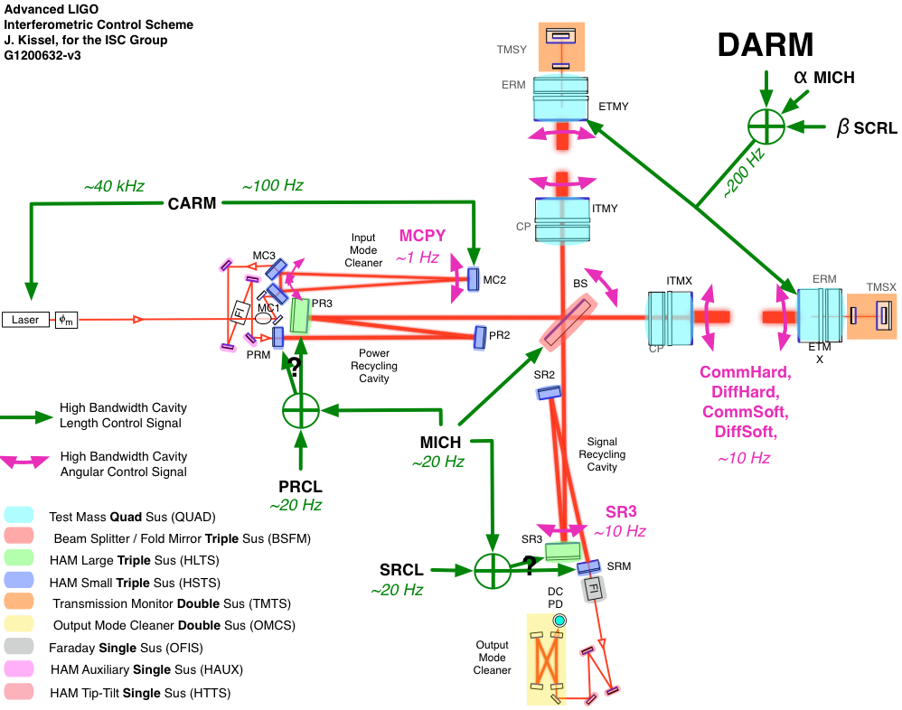

Slide 7
The puzzle
Need lots of complicated pieces:
A closed-loop SUS model one can trust to be accurate (since we can’t sense the plant before we get started); measurements, if possible
A model of the input motion (HPI + ISI), projected to SUS point
Complete understanding of control signal chain (hard be cause each SUS layer is different) and its possible states

Slide 8
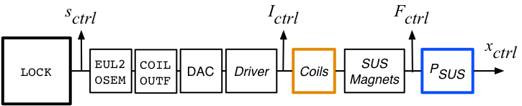
The output path
[(response) m]
[(drive) ct]
[(drive) A]
[(drive) N]
The Barton models of transfer functions come in terms of [m (response)] / [N (drive)]
The “plant” for the control system is (drive at the LOCK filters to the displacement of test mass) or [m (response) / ct (drive)]
Frequency response of analog electronics in drive chain is compensated, EUL2OSEM matrix preserves units, so we only need DC gains of all components
${SusSVN}/sus/trunk/Common/MatlabTools/make_OSEM_filter_model.m

Slide 9
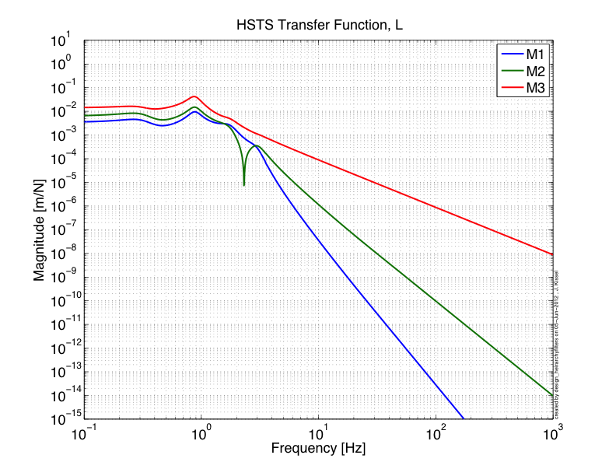
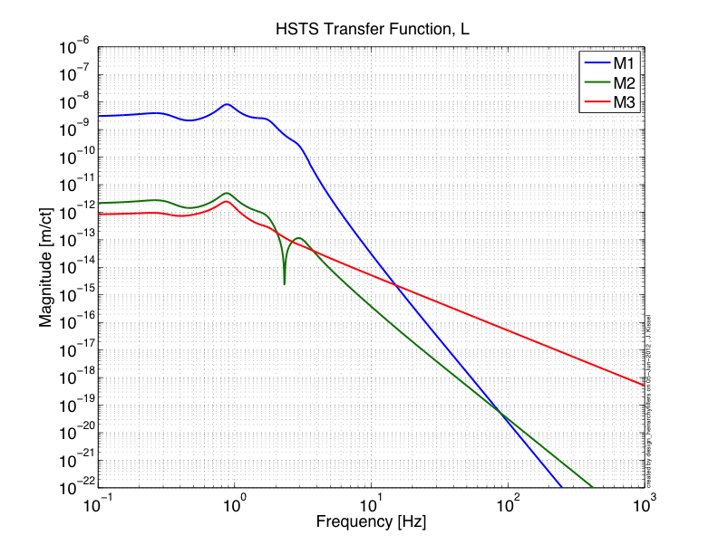
The output path

Slide 10
The remaining To-Do list
Complete assessment of output path for all suspensions
Get the latest input motion models
Design appropriate locking filters
Show stability / compatibility of design, show open loop gains and crossovers
Get infrastructure up and running to push these filters out in a reasonably automated fashion
Starting with HSTSs (for IMC control) because they’re more simple then moving on immediately to QUADs (for single arm control)

