Slide 1
Regression of environmental noise in gravitational-wave detectors.
Sergey Klimenko
University of Florida
In collaboration with
V.Tewari, V.Necula, G.Vedovato, M.Drago, G.Prodi,
G.Mitselmakher V.Re, I.Yakushin, V.Frolov
Notes:
How used in data analysis and mainly potential for reconstruction

Slide 2
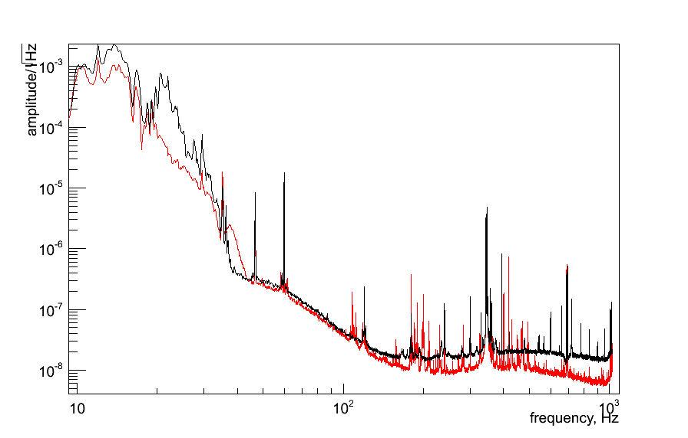
Environmental Noise
Snapshots of H1 data (15 min): black S5(820707090), red S6(942451300)
Both broad/narrow band
highly variable
mostly up-conversion
most artifacts are not well understood (particularly in S6)
Many (thousands) monitors are used to measure ENV disturbances
not calibrated data
H1:LSC-DARM_ERR

Slide 3
Basics: FIR Wiener-Kolmogorov Filter
target
witness
A(z)
residual
prediction
find A = {a[0],…,a[K]} by minimization of residual
target s[n] can be predicted if there is a linear association with
witness channel w[n].
N – filter training length, K – filter length
Notes:
2

Slide 4
Basics: Wiener-Hopf Equation
r is cross-correlation vector between s and w
R is Toeplitz matrix constructed from autocorrelation of w
Solved by using advantage of Levinson-Durbin algorithm
....
CQG, 25, 114029 (2008) - application of LPR in burst analysis by cWB & Ω
RSI, 83, 024501 (2012) – active noise cncellation in suspended interferometers
Notes:
2

Slide 5
Wavelet Regression
3 key components
Do analysis in wavelet domain (use WDM – next slide)
Calculate a bank of elementary Wiener filters instead of a BIG filter
pros: split complex problem into a set of simple problems
pros: reduce computational complexity (feasible in real time)
pros: greatly simplify use of regulators
Use/construct multiple witness channels
pros: enhance regression
pros: address up-conversion (non-linear coupling)
cons: add noise to prediction
Regulators-mitigate fitting problems
reduce excessive noise due to multiple witness channels
obtain stable/robust filter solutions
reduce artifacts
Notes:
2

Slide 6
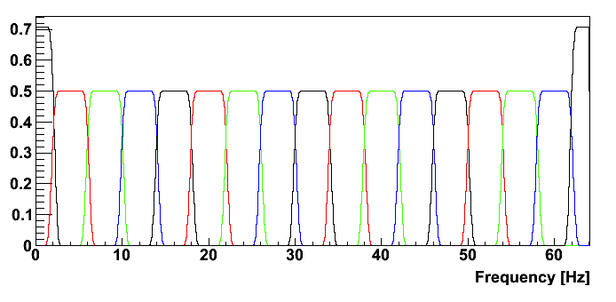
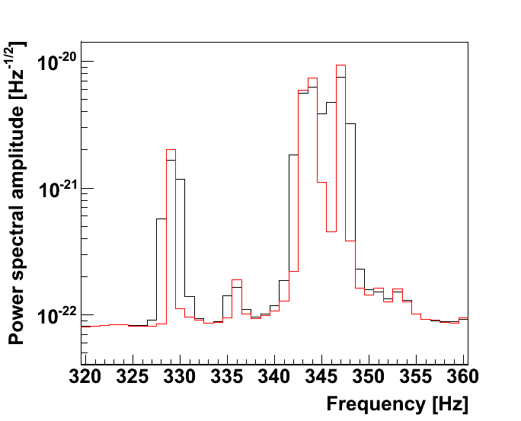
Regression in Wavelet Domain
Wilson-Daubechies-Meyer (& V.Necula) transformation [LIGO-P1100152]
orthonormal, invertible, critically sampled, exceptional control of spectral leakage
each wavelet (frequency ω_{n}) layer is a time series representing band-limited data.
Filters can be constructed for every target layer and arbitrary set of witness layers
Easily zoom into desired frequency sub-bands (layers) in the data
LIGO data (1Hz resolution):
black – Hann FFT
red - WDM
Wavelet (basis) functions in Fourier domain
Notes:
2

Slide 7
Multiple Witness Channels
Witness channels can be:
Layers (sub-bands) of multiple witness channels
Different layers of the same witness channel
Constructed from other WDM-conditioned witness channels
magnetometer x ITM/ETM coils – can remove bi-linear noise
In general, s[n], w[n],u[n],[v[n] and filters A are complex
Notes:
2

Slide 8
Regulators
-L<k<L
hard
soft
address rank deficiency of WH matrix
for each filter (in the set) typically only few λ are significant
reduce filter noise, suppress irrelevant channels
Notes:
2

Slide 9
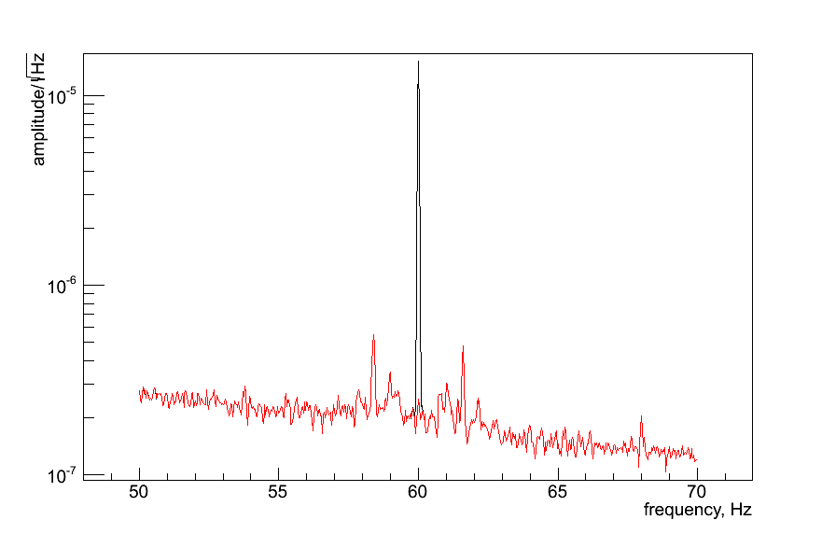
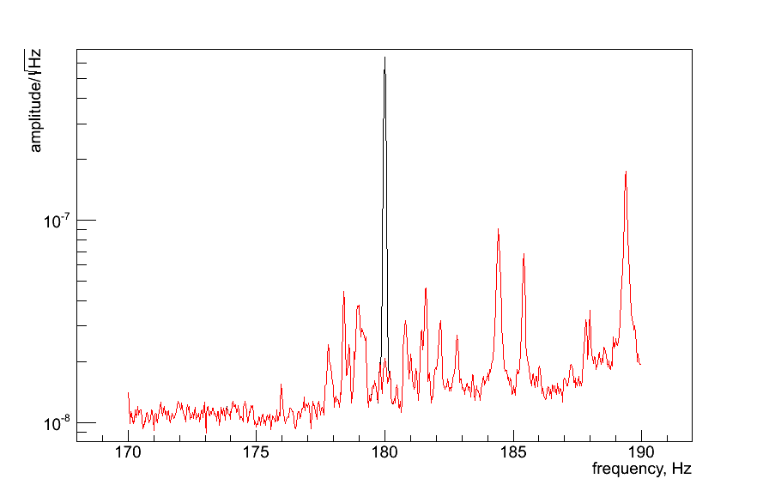
Power Lines
H1:DARM, 15min of S6 data
most obvious case – power lines – well removed by many methods, including wavelet regression using power monitors or magnetometers (H0:PEM-BSC10_MAGX)
Are there any other cases of linear coupling, particularly broad-band?
How to identify and remove non-linear coupling?
Notes:
2

Slide 10
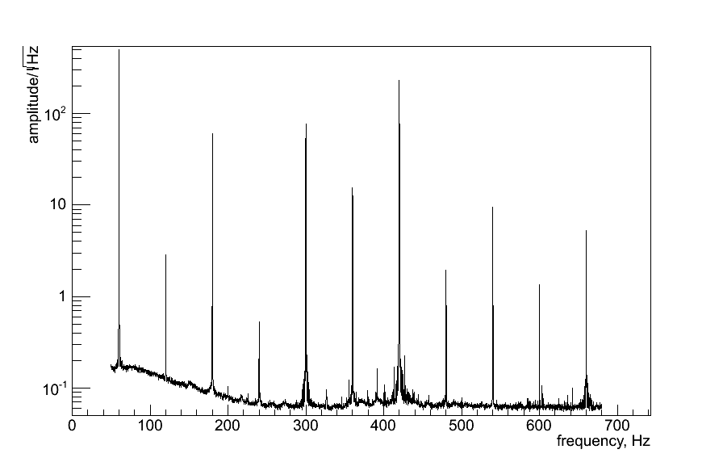
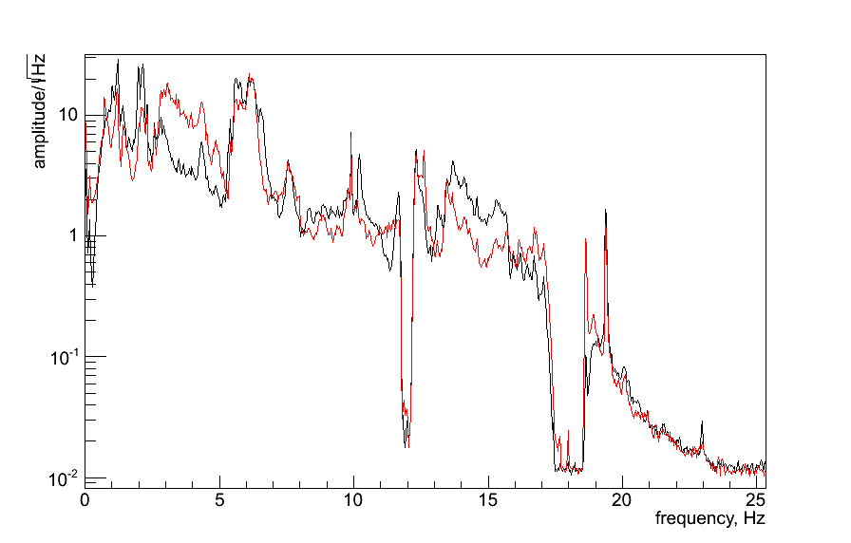
Bi-Linear coupling
H0:PEM_COIL_MAGX
H1:SUS-ITMX_COIL_UL
H1:SUS-ETMX_COIL_UL
Interaction of mirror’s magnets with ambient magnetic field from power mains and low frequency coil current.
Construct artificial witness channels
BICO_XX_YY(t) = H0:PEM_COIL_MAGX(t) X H1:SUS-XX_COIL_YY
ITMX, ETMX, RM, BS, MMT,…
Notes:
2

Slide 11
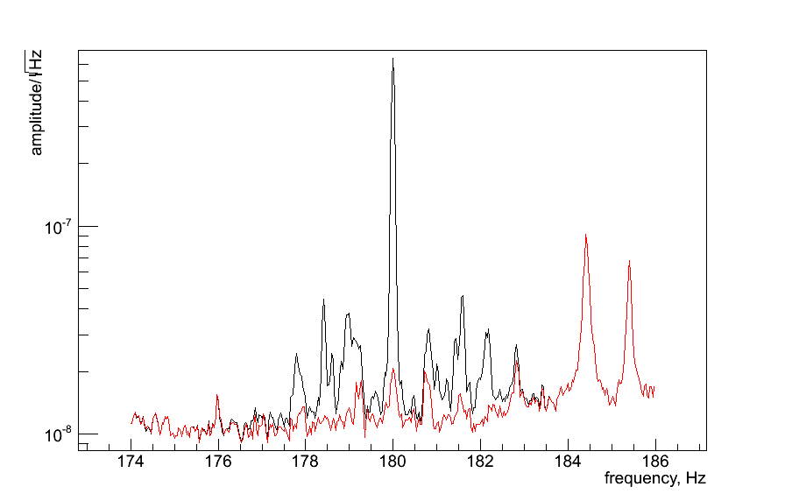
Regression of PL bi-coherence
H1:DARM
V.Tewari
LIGO-G1200288
not cleaned –
different coupling
mechanism
small residual can be
cleaned further by
adding more coil channels
first example of up-conversion removal from LIGO data.
Channels used:
H0:PEM-BSC10_MAGX magnetometer
8 BICO(t) witnesses constructed from ITMX and ETMX coil channels.
Notes:
2

Slide 12
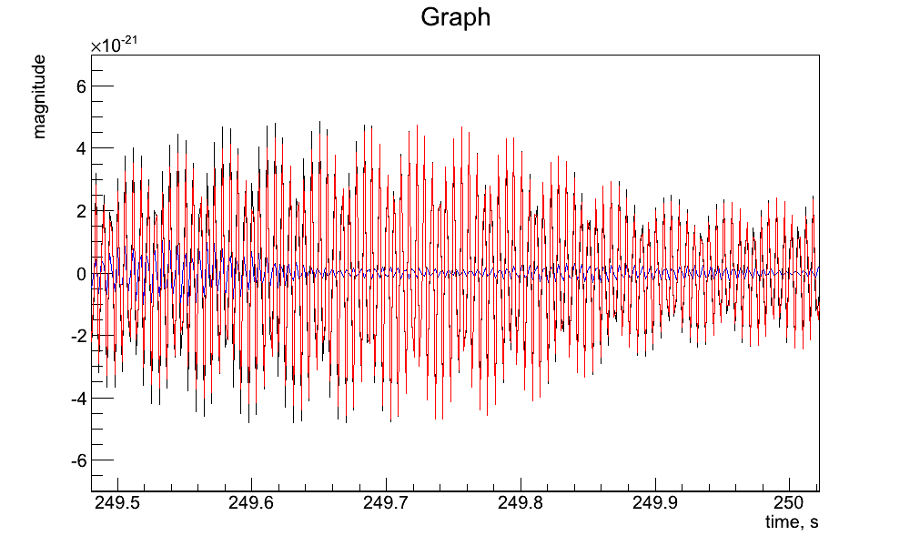
Monitoring environmental coupling
Significance/strength of environmental coupling can be estimated from the eigenvalue analysis and directly from the prediction (in units of the target channel RMS)
H1 bandlimited (177-183Hz) strain
black – h(t), red – prediction, blue - residual
Notes:
2

Slide 13
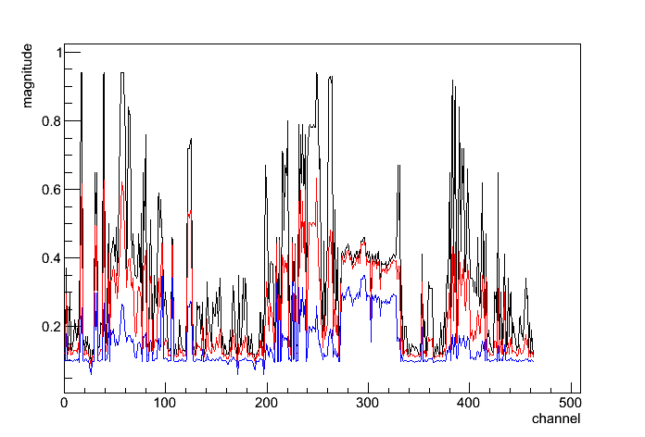
Linear coupling FOM
S5 coupling: 50-1024 Hz, 1Hz resolution
black – narrow band coupling (lines) blue – broadband coupling
15 min of
S5 H1 data
Witness channel coupling is characterized by RMS of whitened prediction to target channel.
target channel is whitened (RMS=1), power lines are removed
black/red/blue – average over 1/10/100 loudest (max RMS) bins
coupling is insignificant if RMS<0.5
similar FOMS can be produced for different frequency resolutions
Notes:
2

Slide 14
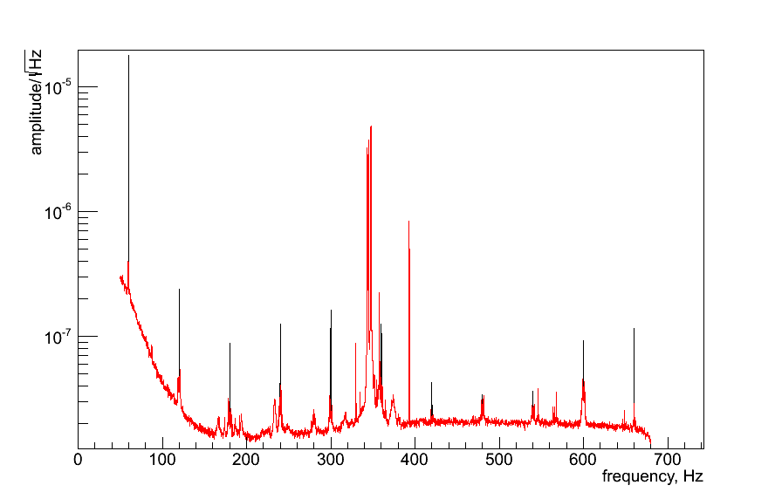
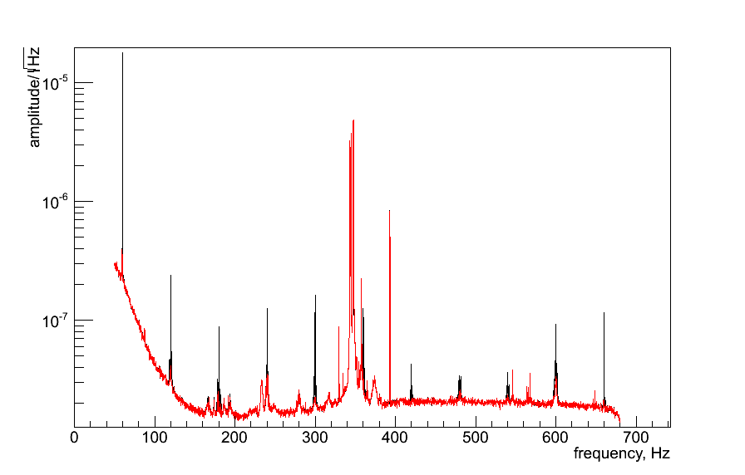
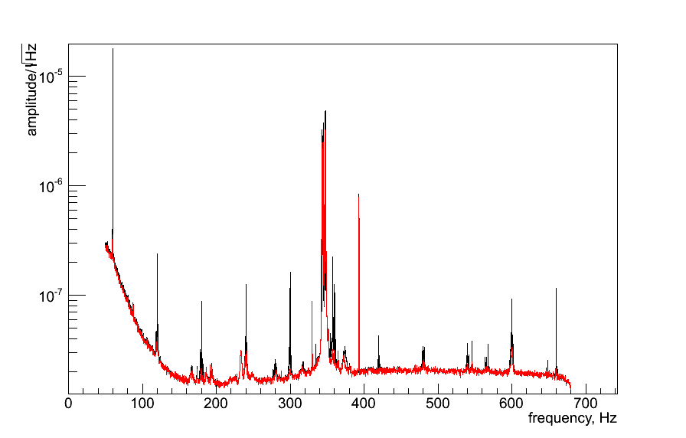
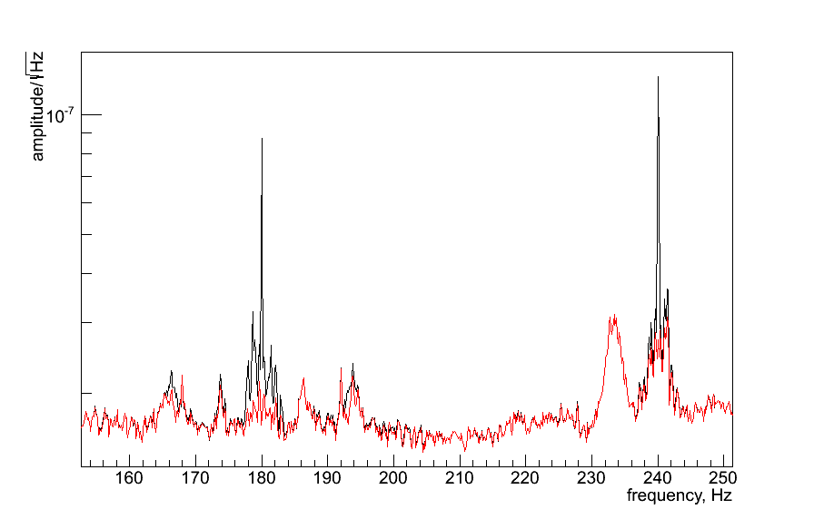
Regression of S5 data
construct 1024 filters for 0-1024Hz band
Good progress, but need more work to improve regression.
No obvious correlation of remaining artifacts with aux. channels
could be a result of a more complicated non-linear coupling
Notes:
2

Slide 15
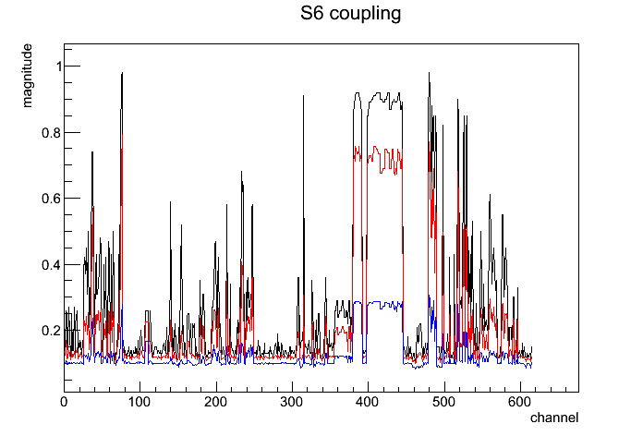
S6 H1 coupling: 50-1024 Hz
GPS 942450050-942450982
time
Can characterize coupling for the entire run as 3D (2D) plot
Despite a large number of environmental monitors, just few show measurable linear coupling with h(t)
Notes:
2

Slide 16
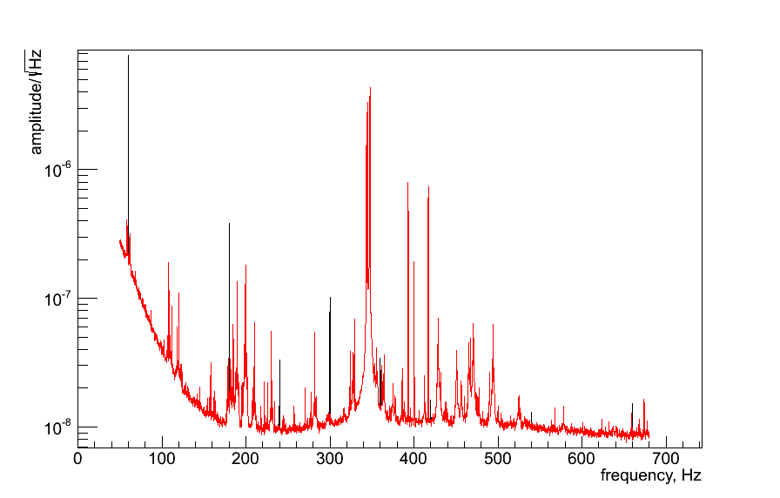
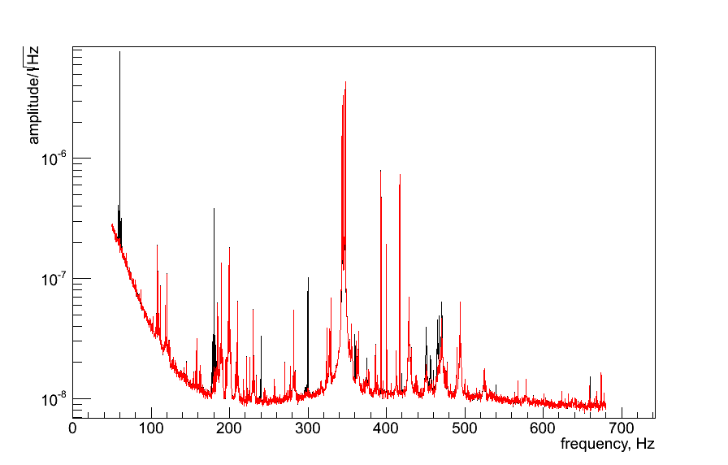
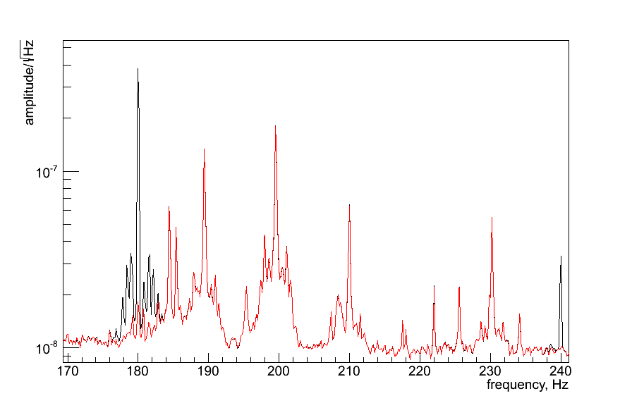
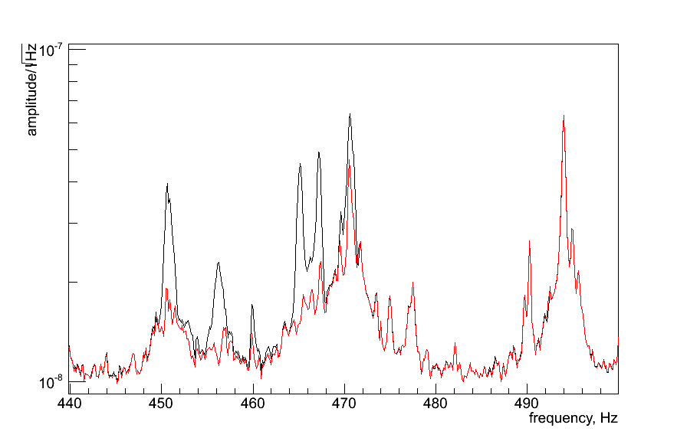
Regression of S6 data
S6 has more artifacts, with no obvious association with environment
PEM-HAM6_ACCX
PEM-HAM6_ACCY
PEM-HAM6_ACCZ
Environmental noise varies a lot depending on the detector and run configurations.
Notes:
2

Slide 17
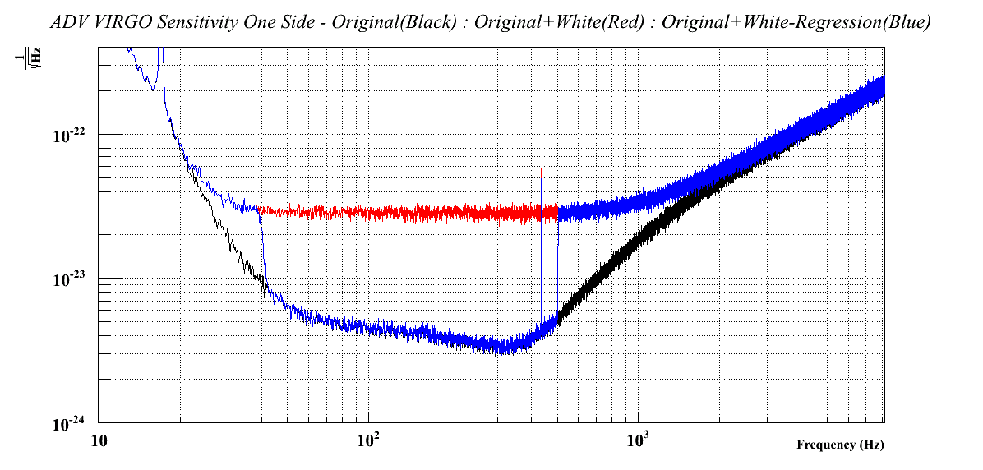
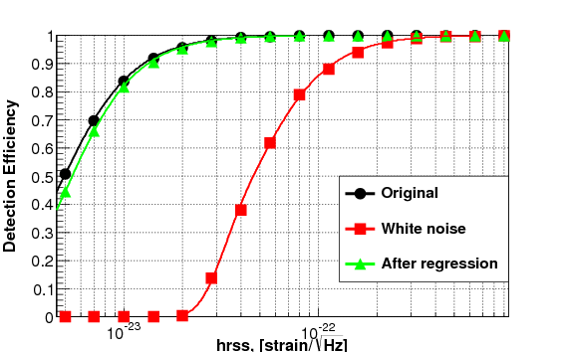
Simulation test (preliminary)
Network: L1H1V1
Target : aLIGO/aVIRGO noise + White Noise
Witness: White Noise @ 3x10 ⁻²³
Efficiency of simulated GW events (SG235HzQ9) is fully recovered
after regression
Target
aVIRGO
After Regression
45-512 Hz

Slide 18
Relevance to aLIGO/aVirgo
Dream (?): Remove almost any environmental disturbance from the IFO output.
We may never isolate instruments from the environment
Need to put an effort into the design and improvement of a set of auxiliary channels
What could we do with the wavelet regression tool?
Identify a list of regression problems (already have few)
Test runs with S5/S6 data
Help systematically design a system of auxiliary channels to address specific regression problems.
Monitor environmental couplings starting at early stages of the commissioning.
Notes:
2

Slide 19
Summary and Plans
The wavelet regression tool is working
Hope to address noise artifacts in 10-1000Hz
count on help from commissioners & DC experts
Run regression on the entire S5/S6
condition S5/S6 data for re-run of burst search
remove 60Hz up-conversion for Crab analysis
Work with commissioners on aLIGO applications
understand how to design useful auxiliary channels
monitoring of early aLIGO data
Notes:
2

