Slide 1

COATING RESEARCH & DEVELOPMENT
@ LMA
G. Cagnoli, A. Cajfinger, V. Dolique, G. Cochez, R. Flaminio, D. Forest,
J. Franc, M. Granata, C. Michel, N. Morgado, L. Pinard, E. Saracco
Laboratoire des Matériaux Avancés (LMA) - Lyon
in collaboration with:
  T. Epicier & B. Van de Moortèle Centre Lyonnais de Microscopie (CLYM)
E. Härkönen, M. Ritala & M. Leskelä University of Helsinki
GWADW – Waikoloa, May 14th 2012

Slide 2

Outline
Investigation of Multilayer-Coating Loss
Updates on Atomic Layer Deposition
GWADW – Waikoloa, May 14th 2012
2

Slide 3

Investigation of Multilayer-Coating Loss
in collaboration with T. Epicier & B. Van de Moortèle, CLYM
GWADW – Waikoloa, May 14th 2012
3

Slide 4
Thermal Noise of Coatings
Virgo technical note VIR–0128A–12
the sensitivity gravitational-wave interferometers of 2nd and 3rd generation will be limited by coating thermal noise around 10² Hz
Advanced Virgo
coatings are multilayer stacks realized through Ion Beam Sputtering (IBS)
last SiO₂ layer
Ti:Ta₂O₅ layer
Ti:TaO₂O₅: HIGH (H) refractive index
✕ N
SiO₂ layer
SiO₂: LOW (L) refractive index
1st Ti:Ta₂O₅ layer
SiO₂ substrate
GWADW – Waikoloa, May 14th 2012
4

Slide 5
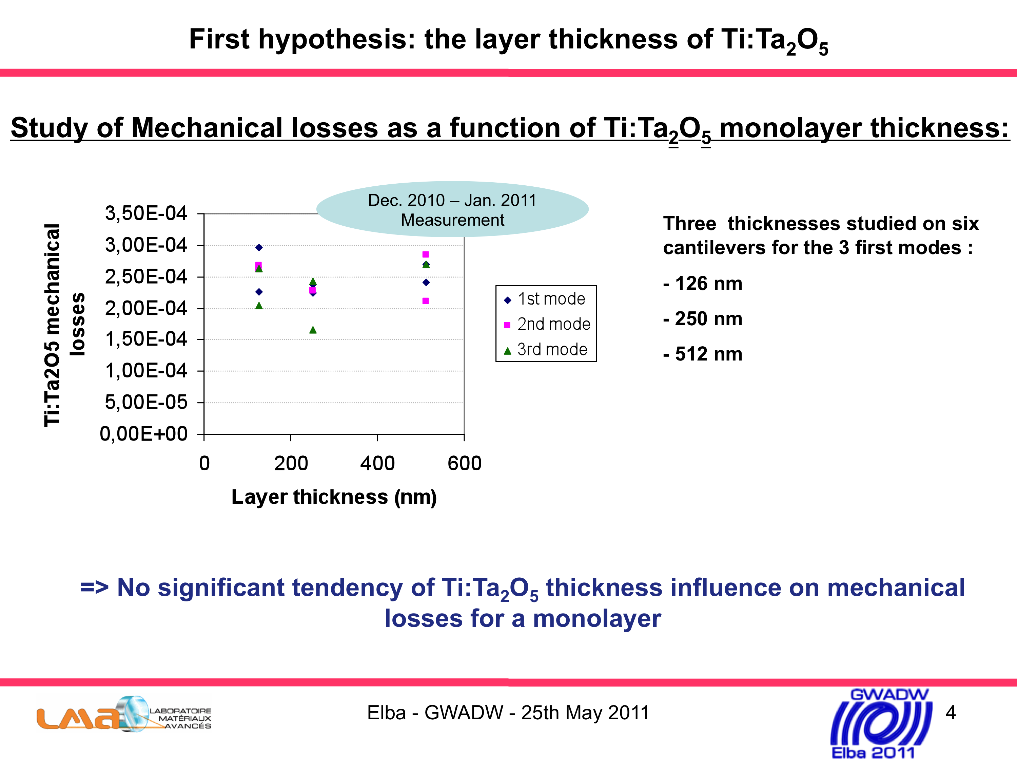
The Story So Far
multilayer coatings show more loss than expected
1st clue [J. Franc @ GWADW10]: « mechanical losses of different multilayer coatings
(…) have been measured and confirm larger losses than expected. »
new measures [A. Villar @ LVC – Krakow[*] / E. Saracco @ GWADW11]:
➔ the trend is confirmed
➔ thickness of Ti:Ta₂O₅ is NOT relevant…
credits: E. Saracco
…as the NUMBER OF INTERFACES matters.
characterization [R. Flaminio @ Amaldi 9]:
➔ linear dependence of loss wrt number of interfaces
credits: R. Flaminio
[*] LIGO technical note G1000937
GWADW – Waikoloa, May 14th 2012
5

Slide 6
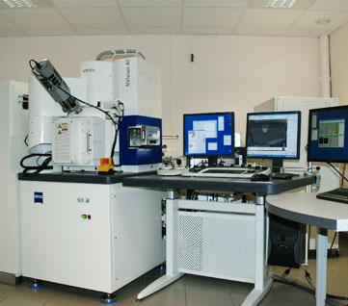
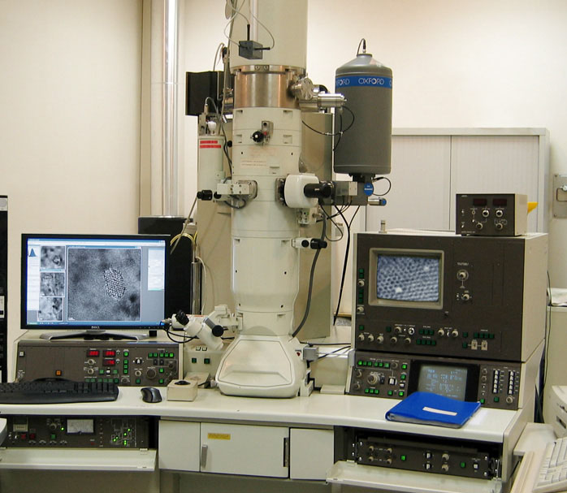
Later Developments
physico-chemical characterization of SiO₂/Ti:Ta₂O₅ interfaces:
  sample: ITM-HR coating, 1.031H(1.3927L 0.5854H)8 1.199L [18 layers]
  Scanning/Transmission Electron Microscopy (SEM/TEM) @ CLYM: study at atomic scale
Focused Ion Beam Microscope
Transmission Electron Microscope
  imagery
  density profiles
  energy-dispersive X-ray analysis (EDX) ➔ atomic contentration
hypothesis: interdiffusion of materials?
GWADW – Waikoloa, May 14th 2012
6

Slide 7
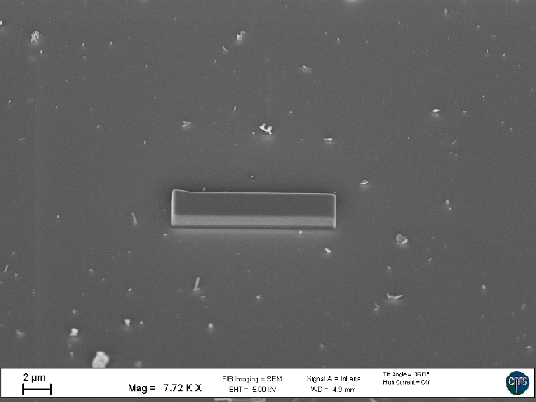
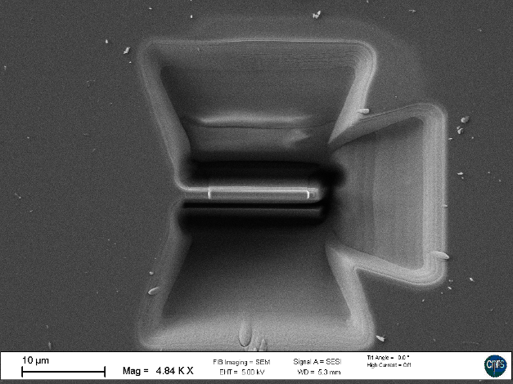
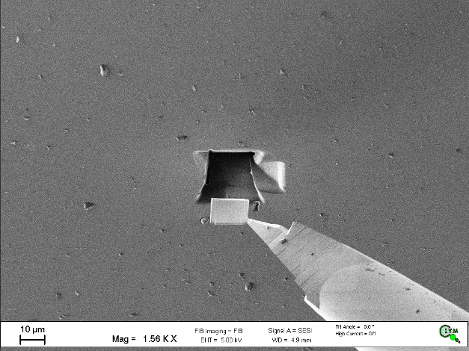
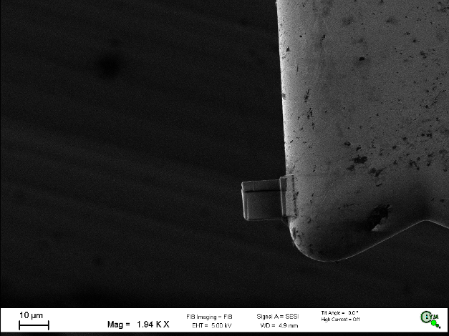
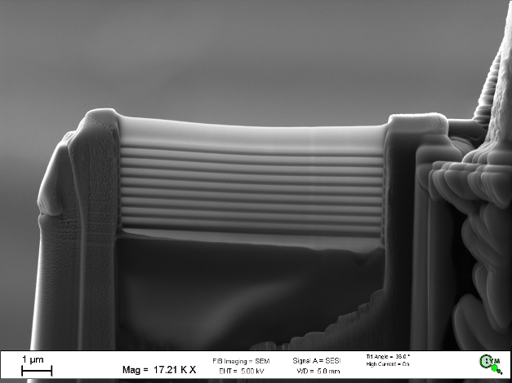
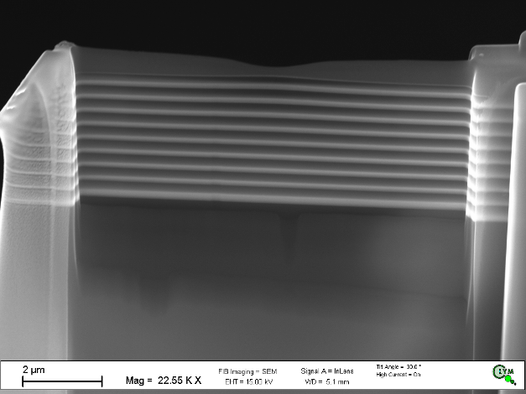
Preparation of the Sample
50 nm-thick blade
GWADW – Waikoloa, May 14th 2012
7

Slide 8
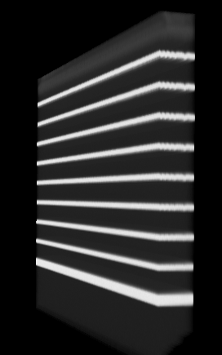
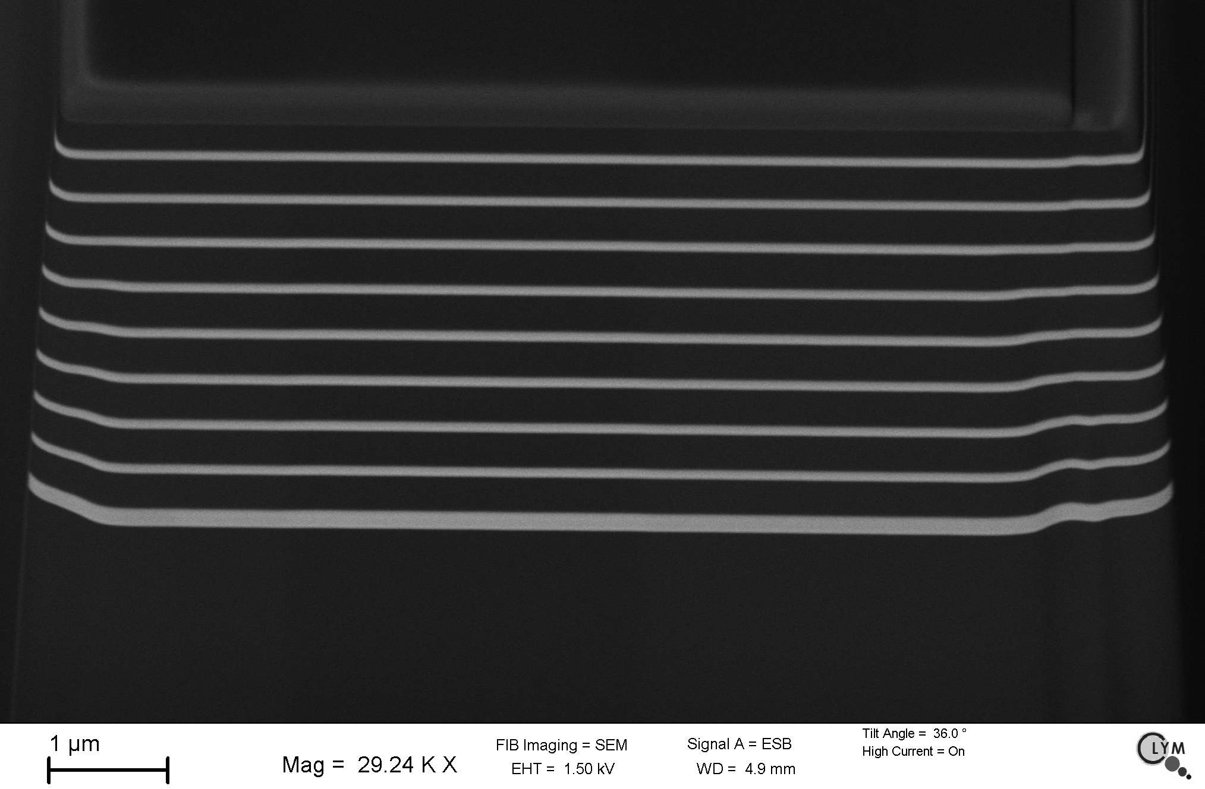
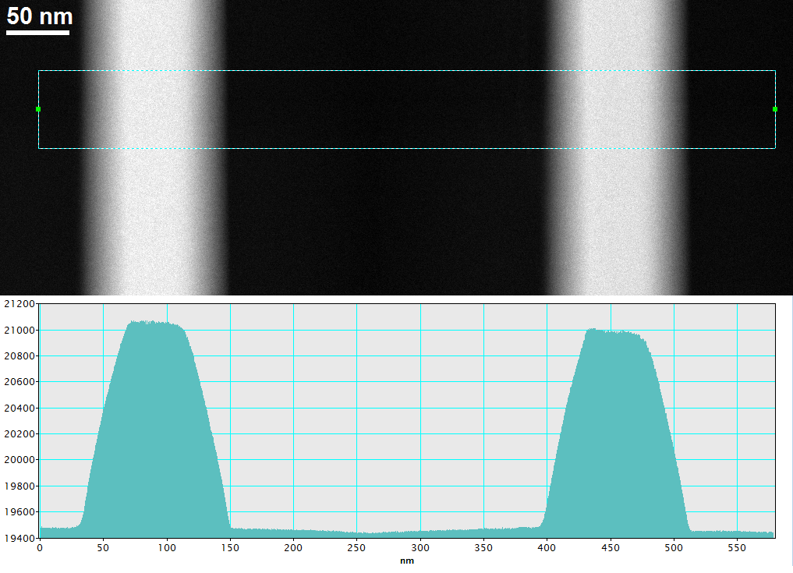
Tomography & Density Profiles
[SEM]
[SEM]
yz
[SEM]
density profiles
depth
SiO₂
Ti:Ta₂O₅
xy
Ti:Ta₂O₅
measures give expected coating thickness and show no defects
depth
3D tomography
smooth transition between layers
gradient of concentration at interface
  ➔ materials do mix
[TEM]
GWADW – Waikoloa, May 14th 2012
8

Slide 9
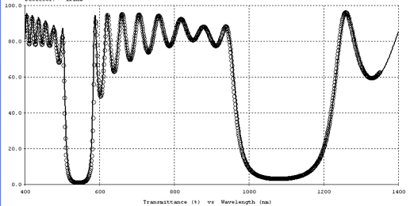
The Picture
no cristalline phase observed in layers
analyses reveal a mixing interface of 20 to 35 nm
simulated optical spectra of multilayer coatings with mixed materials at
  interfaces are compatible with measures on 1" substrate
optical simulations also show that gradients should be symmetric:
Ti:Ta₂O₅ and SiO₂ diffuse into each other
circles = DATA
analyses of atomic concentrations are not conclusive ➔ new measures in progress
line = SIMULATION
GWADW – Waikoloa, May 14th 2012
9

Slide 10
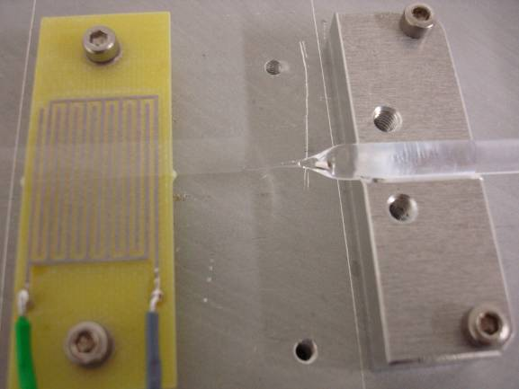
Mixed Materials
could mixed interfaces explain exceeding loss?
[TEM]
simple model of the interface: discrete gradient
  mixed material 1 = 65% SiO₂ + 35% Ti:Ta₂O₅
    mixed material 2 = 65% Ti:Ta₂O₅ + 35% SiO₂
50 nm
100% Ti:Ta₂O₅
coating of a SiO₂ blade with mixed material 1
measure of loss of mix1:
mix 2
Φ_{mix1} = (2.7 +/- 0.2) × 10⁻⁴
100% SiO₂
loss similar to Ti:Ta₂O₅
mix 1
to be done: deposit
and measure mix 2
setup for ringdown technique
GWADW – Waikoloa, May 14th 2012
10

Slide 11
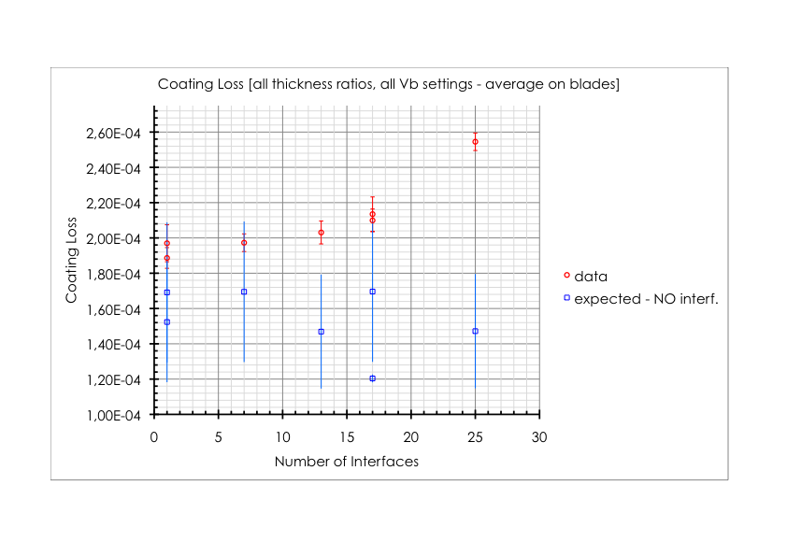
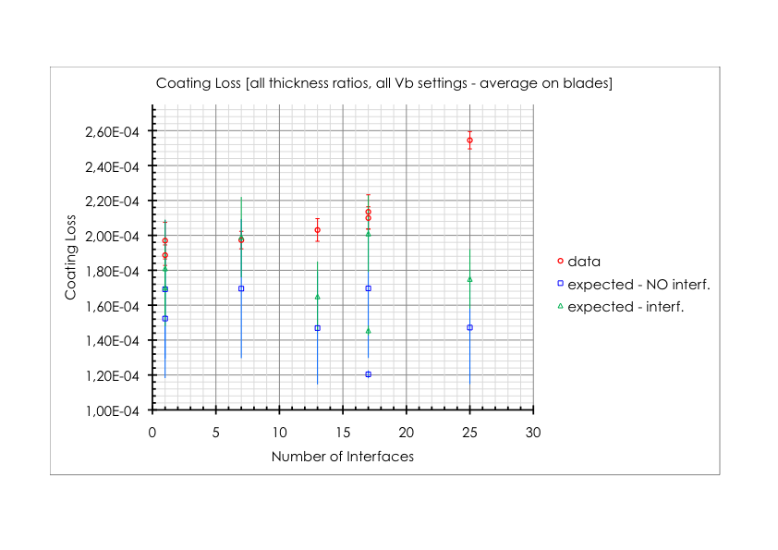
Interfaces – Results
interfaces only partly fill the gap
mix1 = 65% SiO₂ + 35% Ti:Ta₂O₅
mix2 = 65% Ti:Ta₂O₅ + 35% SiO₂
Φ_{Ti:Ta2O5} = (2.4 +/- 0.4) × 10⁻⁴
Φ_{SiO2} = (4.6 +/- 0.1) × 10⁻⁵
Φ_{mix1} = (2.7 +/- 0.2) × 10⁻⁴
Φ_{mix1} = Φ_{mix2} [assumption]
Y_{Ti:Ta2O5} = 140 Gpa
Y_{SiO2} = 73 Gpa
Y_{mix1} = 65% Y_{SiO2} + 35% Y_{Ti:Ta2O5}
Y_{mix2} = 65% Y_{Ti:Ta2O5} + 35% Y_{SiO2}
theory:
Φ_{k} : loss angle of the material
t_{k} : total thickness of the material
Y_{k} : Young’s modulus
GWADW – Waikoloa, May 14th 2012
11

Slide 12
Interfaces – Conclusions
  excess of mechanical loss is observed in multilayer coatings, depending on the number of interfaces between layers
  interfaces have been characterized
    ➔ analyses revealed a mixing zone with gradients of atomic concentration
  loss of a mixed material (65% SiO₂ + 35% Ti:Ta₂O₅) has been measured
    ➔ loss is similar to that of Ti:Ta₂O₅ …
  … but the presence of mixing interfaces only partially explains the exceeding loss [mixed material 2 has to be measured]
do we need a more complex model of the gradient?
GWADW – Waikoloa, May 14th 2012
12

Slide 13

Updates on Atomic Layer Deposition
in collaboration with E. Härkönen, M. Ritala & M. Leskelä University of Helsinki
GWADW – Waikoloa, May 14th 2012
13

Slide 14
Atomic Layer Deposition (ALD)
the idea:
investigation of new techniques to improve quality of coatings
➔ we want lower mechanical losses
test of ALD realized @ University of Helsinki
advantages:
self-limiting mechanism of film growth
excellent coating uniformity - even on large areas
homogeneous stoichiometry
high reproducibility
      ➔ coatings of good quality factors[*] and optical properties
major concern:
low deposition rate
[*] O Hahtela & al., J. Micromech. Microeng. 17, 2007
GWADW – Waikoloa, May 14th 2012
14

Slide 15
Reminder
method based on alternate saturative surface reactions
purge [N₂ – 5 s pulse]
precursor 1
[Ta(OCH₂CH₃)₅ – 0.3 s pulse]
purge [N₂ – 5 s pulse]
precursor 2 [H₂O – 0.3 s pulse]
purge[N₂ – 5 s pulse]
➔ back to step 2
substrate @ T = 250 °C
credits: J. Franc
GWADW – Waikoloa, May 14th 2012
15

Slide 16
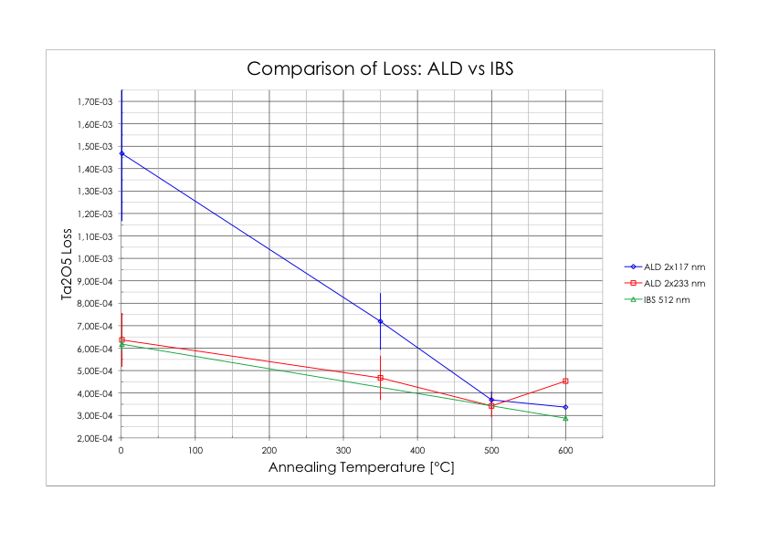
ALD – Results
monolayer coatings of undoped Ta₂O₅ on SiO₂ cantilever blades
previous measurements: J. Franc @ GWADW11 / R. Flaminio @ Amaldi 9
(Φ_{Ta2O5})_{ALD} > (Φ_{Ta2O5})_{IBS}
GWADW – Waikoloa, May 14th 2012
16

Slide 17
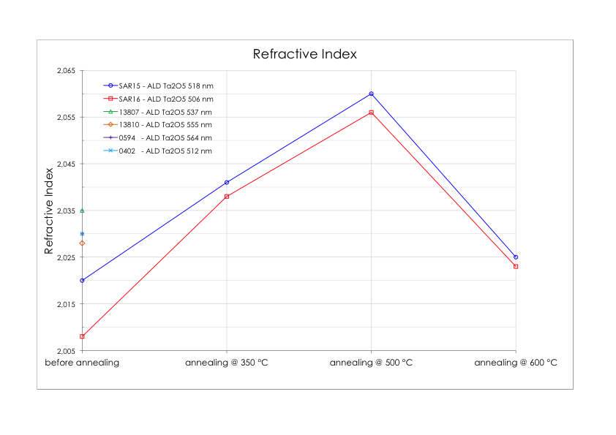
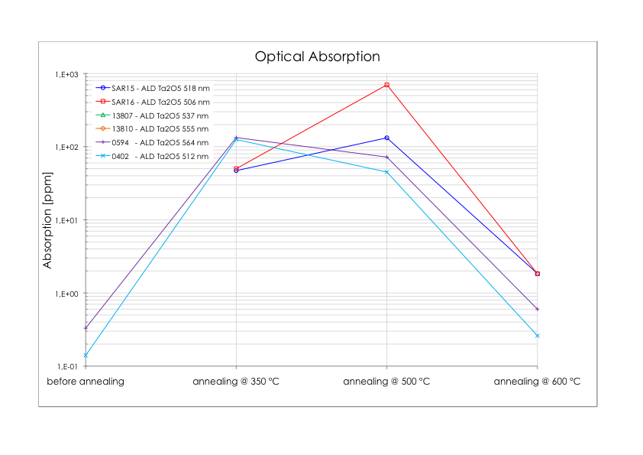
ALD – Results
monolayer coatings of undoped Ta₂O₅ on 6 SiO₂ substrates of 1"
previous measurements: J. Franc @ GWADW11 / R. Flaminio @ Amaldi 9
absorption is highly dependent on annealing temperature
➔ do the material structure change?
lowest absorption of ALD @ 600 °C: 0.26 ppm – IBS: 1.2 ppm
IBS: n = 2.035
GWADW – Waikoloa, May 14th 2012
17

Slide 18
ALD – Conclusions
  ALD is a well-estabilished technique to realize high-quality coatings
  deposition rate is low
  mechanical losses of ALD coatings are larger
  ➔ no specific advantage in using ALD instead of IBS
  ALD coatings show good optical absorption
  ➔ unusual behavior wrt annealing might be worth further investigation
GWADW – Waikoloa, May 14th 2012
18

Slide 19
Summary
  the structure of multilayer coatings has been characterized
  analyses revealed interfaces of mixed materials
  mixed interfaces can only partly explain the gap between predicted and measured losses
  ALD coating technique has been investigated
    losses are larger compared to IBS coatings
    optical absorption seems lower for T_{annealing} > 600 °C
  next step: further characterization of optical absorption wrt T_{annealing}
GWADW – Waikoloa, May 14th 2012
19

Slide 20
              Thank you for your attention.
GWADW – Waikoloa, May 14th 2012
20

