Slide 1
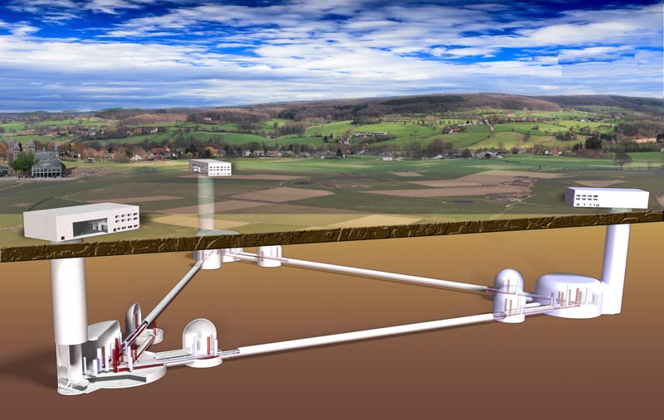
GW sources from a few Hz to a few kHz
Cole Miller, University of Maryland

Slide 2
Outline
The most massive white dwarfs
Long lead times for telescopes
Nonzero eccentricities?
Intermediate-mass black holes
High freq: NS masses, radii, and modes
High freq: SN bursts

Slide 3
Frequency of Waves
Object of average density ρ has maximum frequency ~(Gρ)^{1/2} for gravitationally bound object
True for orbit, rotation, or full-body pulsation
Neutron star: ~1200-2000 Hz
White dwarf: up to ~1 Hz (but see later)

Slide 4
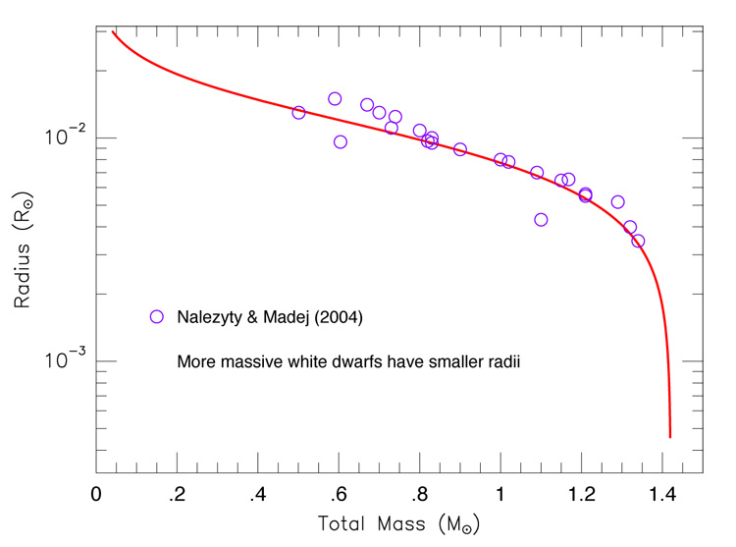
The Most Massive WD
~10⁸⁻⁹ WD binaries in Milky Way
Even small fraction with M~1.4 M_{sun} gives large number; new category of sources
f_{GW}=1 Hz
http://cococubed.asu.edu/images/coldwd/mass_radius_web.jpg

Slide 5
Who Cares About Massive WD?
Precise maximum mass depends on composition, other properties
Massive WD (in binaries with normal stars) possible Type Ia SNe progenitors
Mergers would be spectacular but short-lived EM events How much lead time do we have?

Slide 6
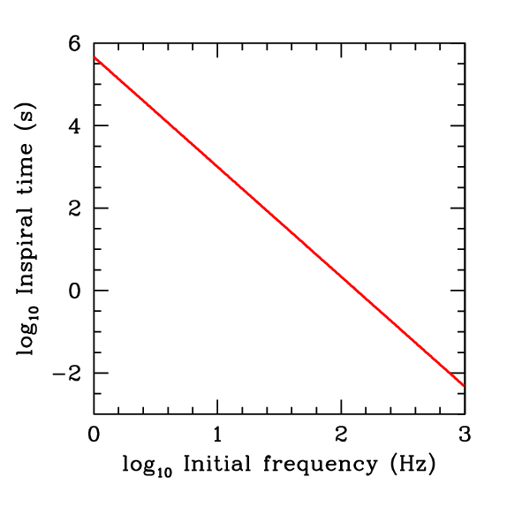
Advance Warning of Merger
EM counterparts to mergers: lots of info! Precise localization Nature of transients
Time to merger scales as f_{init}^{-8/3}
At 3 Hz, could be identified hours in advance
Key: how soon could GW be localized? Rotation of Earth?

Slide 7
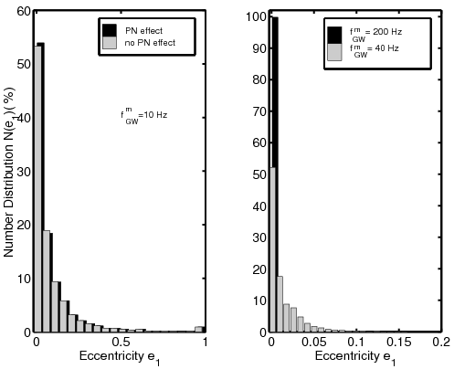
Nonzero Eccentricities?
Usually, think of binary GW as circular ~true for >10 Hz or field binaries
Dynamical interactions can change, e.g., Kozai in dense systems Eccentric Kozai
e~1/f for e<<1
Low freq important for inferring dynamic origin
L. Wen 2002
Following Miller & Hamilton 2002

Slide 8
Plunges into IMBHs
Haas et al. 2012
You can get some leakage to higher freq with plunge
WD disrupted but bulk moves along same trajectory
Evidence of IMBH? This, or IMBH-IMBH, could be first direct proof
10³ M_{sun} BH, 1 M_{sun} WD, penetration
factors of 6 and 8; assume 20 kpc for
distance of source

Slide 9
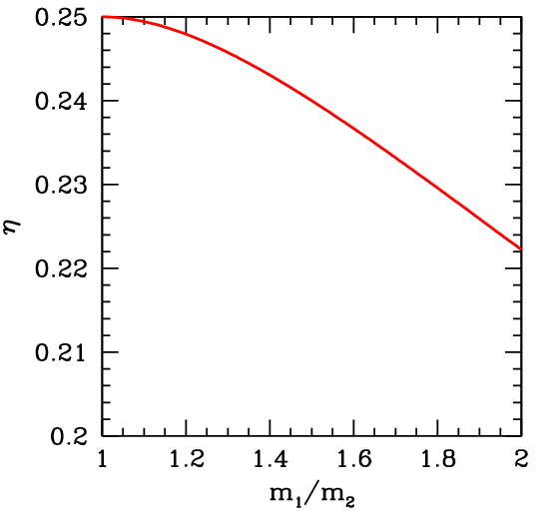
NS and BH masses
Chirp mass is easy: df/dt~ηM^{5/3}f^{11/3}
Getting both masses requires symmetric mass ratio η=m₁m₂/M²
Need higher-order, high freq effects in GW
aLIGO/Virgo at SNR=15: Δη~0.007
Bad for NS-NS; okay for NS-BH, but better high-freq sensitivity is a must!

Slide 10
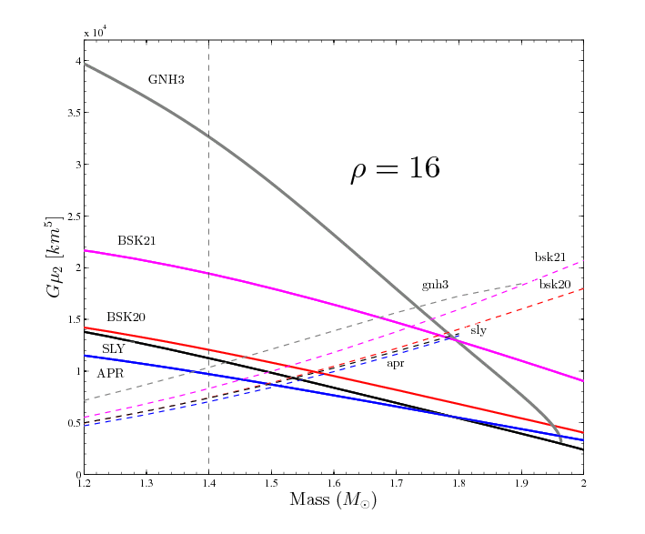
NS Radius: Phase Accumulation
Radius: key EOS unknown
Deviation from point mass: accumulated tidal effects
For aLIGO, can measure tidal param; SNR>30 can distinguish EOS, barely
Higher sensitivity at high frequencies would allow fairly precise measurement of tidal parameter, hence radius
Damour et al., arXiv:1203.4352

Slide 11
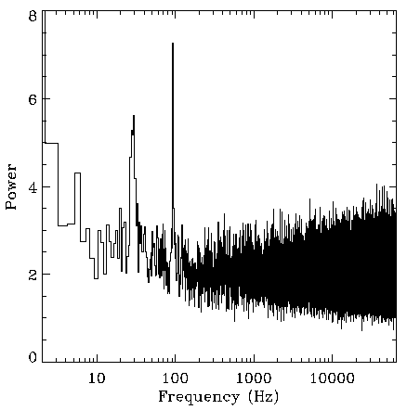
NS Modes
NS seismology could tell us a lot!
Indeed, QPOs have been seen
But...
Crust has ~1% of M, I; very weak GW
If detectable, need huge, transient perturbation at main body freq: ~2000 Hz
QPOs from SGR 1806-20 superburst
Strohmayer 2007

Slide 12
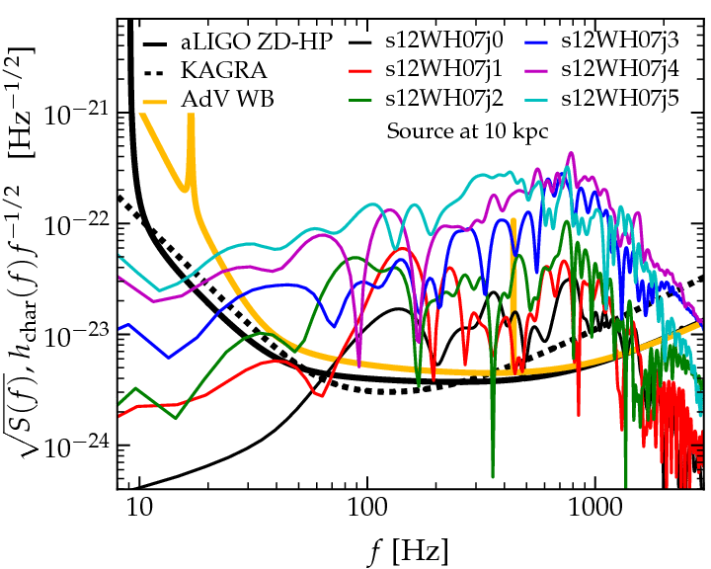
GW from Supernovae
>~10% chance for MW SN (~10 kpc) in decade
Much uncertainty about mechanism!
GW (+ν) will give invaluable info
High freq are key
Ott et al. 2012

Slide 13
Conclusions
The ~few Hz range contains qualitatively new sources: heavy WD and IMBH
Long lead time will allow pointing of large telescopes if the direction can be established to within a few degrees
The ~few kHz range gives us prospects of unique measurements of NS radius, many measurements of NS mass, and new insights about supernovae

Slide 14
Amplitude of Gravitational Waves
Binary of reduced mass μ, total mass M.
At luminosity distance d, frequency f_{GW},
dimensionless strain amplitude is
h=3x10⁻²³ (f_{GW}/1Hz)^{2/3(}M_{ch}/10 M_{sun})^{5/3}(100Mpc/d)
where M_{ch}^{5/3}=μM^{2/3} defines the “chirp mass”.

Slide 15
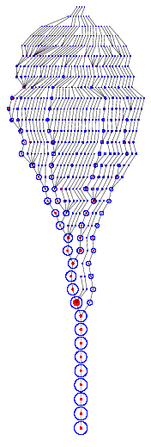
Context and Connections of IMBH
In z~5-30 universe, seeds for SMBH
In local universe, probes of star cluster dynamics
Potentially unique sources of gravitational waves (ground and space)
Wechsler et al. 2002

Slide 16
Why Are We Not Sure?
Stellar-mass (5-20 M_{sun}) and supermassive (10⁶-10¹⁰ M_{sun}) BH are established with certainty
Why not IMBH (10²-10⁴ M_{sun})?
Lack of dynamical evidence Too rare for easy binary observations Too light for easy radius of influence obs
Attempts being made, but settle for indirect observations in the meantime

Slide 17
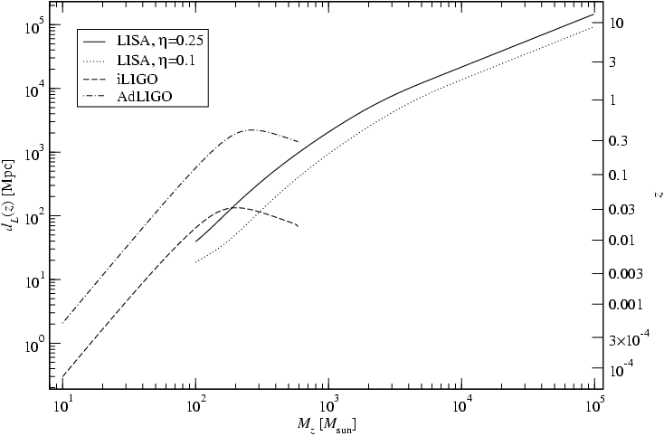
IMBH-IMBH Visibility
~1000 M_{sun} binary visible to z~1.
Reasonable rates: few tens per year at >1 Hz
Unique probe of dense cluster star formation
Fregeau et al. 2006

Slide 18
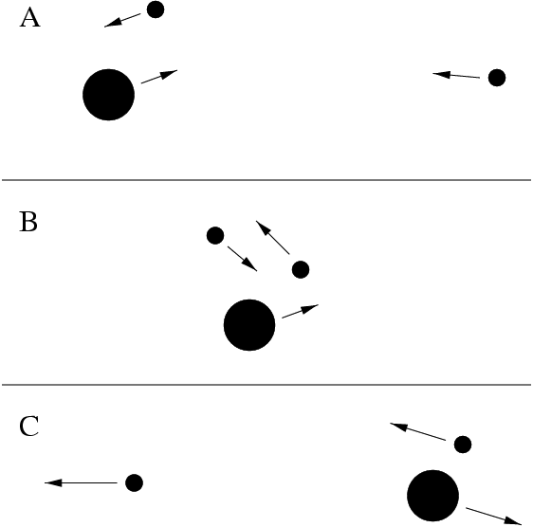
Formation of IMBHs
Problem: ~10³ M_{sun} too much from normal star!
Population III stars Low Z; weak winds
Collisions or mergers Needs dense clusters Young: collisions Old: three-body
Issue: ejections by 3-body or
GW recoil. If M_{init}>300 M_{sun},
seems safe.

Slide 19
Open Question: Mass Function?
Period, radial velocity of companion would give lower mass limit One example would establish IMBH
Issue: unique identification Nearest ULX are few Mpc away! Even O, B stars are ~24th mag
Maybe He II 4686A emission lines? Some candidates being pursued

