Slide 1
The reality of Mirrors?
GWADW May 15, 2012
GariLynn Billingsley
Liyuan Zhang
Zygo…
CSIRO…
Notes:
Originally asked to present the truth about the optics…

Slide 2
Overview
Initial LIGO
Some things we got wrong
Advanced LIGO
Some things we got right
Some things we’re still working on
Next Generation
Tools we have on hand

Slide 3
Error in iLIGO calibration file
11.7 nm PV over 150mm, Mostly power,
The instrument has been realigned, so the original error may be different

Slide 4
Power subtracted, analyzed over beam size
Rms = 0.35 nm
ILIGO
Optic figure is
Still better than
iLIGO metrology
Notes:
Specification is < 0.7nm rms

Slide 5
iLIGO too much cleaning before coating extreme example ~20 nm
Microroughness
was also
Measured
Before : 0.26 nm rms
After : 0.72 nm rms
Notes:
This mirror was never coated
Implies scatter loss Of ~ 70ppm

Slide 6
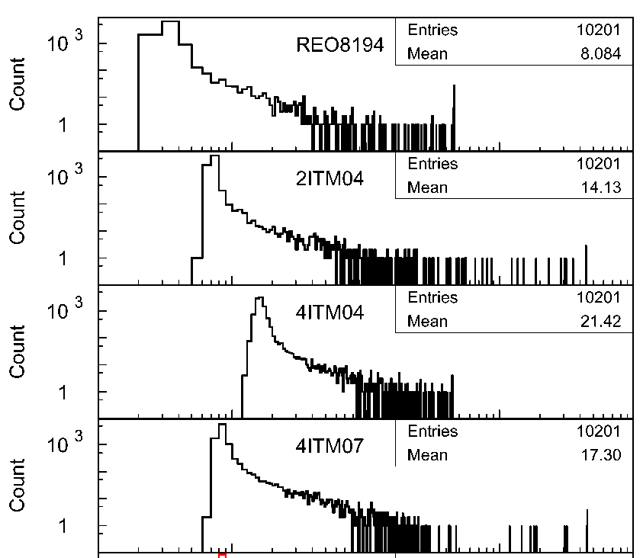
Scatter histograms An indication of etching
Lower end represents the base microroughness
High end represents point defects
See LIGO-G080162 for details
Notes:
This is not a full integration

Slide 7
Advanced LIGO
Status
Capability
Interesting coating behavior
Still in the speculation phase

Slide 8
aLIGO Arm Cavity Loss: Early results are in line with budget
Cavity loss – 2 surfaces (ppm) | Budget 2010 based on specs (ppm) | Actuals 2012 based on (n of 20) (ppm)
Microroughness scatter | 8 | 2.2 (avg. of 20)
Defects (Polish, Coating, Contamination) | 26 | 15 (sample of 2) pol, coat
Coating Absorption* | 0.6 | 0.6 (sample of 2)
Surface Figure Error & Diffraction | 24 | 3 ppm on coated ITM 21 ppm estimated on coated ETM
ETM Transmission | 5 | No data yet
Total ( required < 75 ppm) | 64 | 42+ ETM trans.
50ppm budget remaining for contamination and coating induced surface figure error.
* One TM trial surface had unexplained high absorption – no cause has been identified, no repeat of the problem
Notes:
Scatter: calculation based on 2 X 0.09 nm rms average (PSD integrated - Tinsley) microroughness over our requirement range.
Defects: Measured scatter from ETM04/ETM02
Surface error: Max ETM is 4.6, Max ITM is 2.5, cavity total 7.1
LMA does not yet have a trial run on ETM HR – no transmission data available

Slide 9
Quick summary of aLIGO ITM polish
Serial Number | ROC | Figure (-TPA)
ITM01 | 1939.32 | 0.10
ITM03 | 1939.52 | 0.08
ITM04 | 1938.61 | 0.15
ITM05 | 1939.18 | 0.10
ITM06 | 1937.60 | 0.09
ITM07 | 1938.53 | 0.10
ITM08 | 1938.44 | 0.16
ITM09 | 1938.15 | 0.11
ITM10 | 1938.15 | 0.14
ITM11 | 1939.39 | 0.18
Follow our progress at https://nebula.ligo.caltech.edu/optics/

Slide 10
Heraeus 3000 series Suprasil measurable absorption?
OH content for 3000 series is 100 times lower than for the 300 series glass
Signal (red): 0.21 ppm
Background: 0.10 ppm

Slide 11
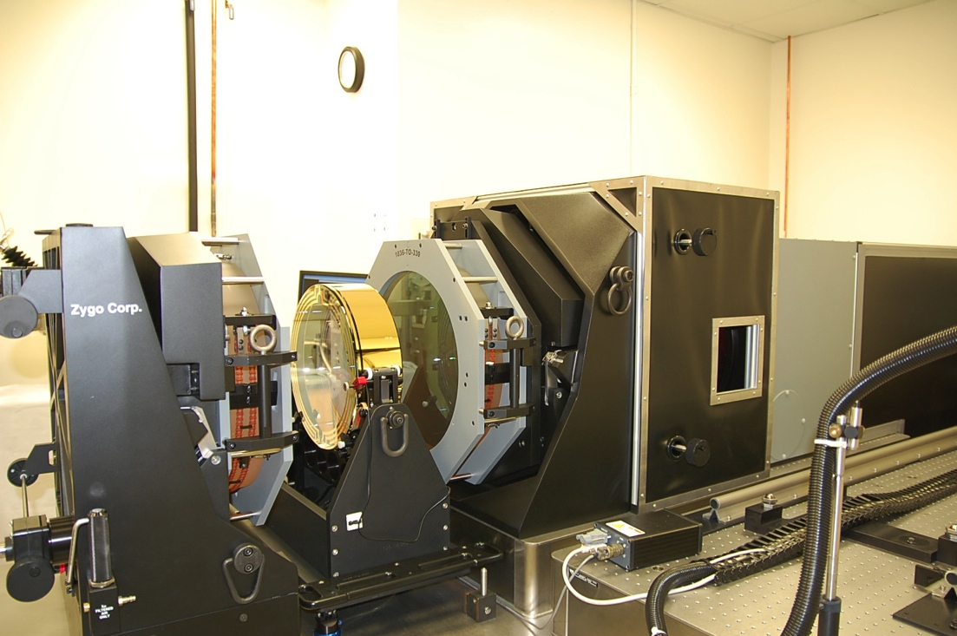
Metrology
Zygo full aperture interferometer is installed and operating at Caltech
All metrology flats and spheres are complete
The instrument and environment are quite stable, showing a uniform noise floor of 0.1 to 0.15 nm rms.
Polishing requirement is 0.3 nm rms
Vendor reports some surfaces at 0.08 nm rms
Good agreement with Polishing vendor measurements

Slide 12
Figure, before and after coating measured on different instruments
Same diameter same color scale
LIGO measurement after coating by CSIRO
9.8 nm PV 1.6 nm rms
Polisher (Zygo EPO) measurement
11.4 nm PV 1.7 nm rms

Slide 13
AR coating absorption surprise
AR coating absorption is not the same as HR
Most IBS HR absorption is now < 1 ppm, AR up to 10 ppm
Many samples used to explore the parameters
Film thickness – thinner is more sensitive to annealing temp
Annealing temperature – sensitive to 25 C° variations
Unintentional experiment:
~1nm of Silica added to top Silica layer AFTER the initial 400 C anneal (to tune reflectivity)
Second anneal at 300 C° → Absorption of 4 ppm
Third anneal at 400 C → Absorption < 0.5 ppm

Slide 14
AR Absorption – 300 C° Too much absorption
No initial anneal
Absorption of CSIRO AR test sample Measured by Zhang at Caltech Design < 1/20 wave Tantala + ¼ wave Silica
Notes:
As is = no post deposition anneal
WATCH THE BLUE LINE

Slide 15
AR Absorption – 350 C° still too much absorption
No initial anneal
Absorption of CSIRO AR test sample Measured by Zhang at Caltech Design < 1/20 wave Tantala + ¼ wave Silica
Notes:
As-Is = No post deposition anneal

Slide 16
AR Absorption – 375 C° better
350 C initial anneal
Absorption of CSIRO AR test sample Measured by Zhang at Caltech Design < 1/20 wave Tantala + ¼ wave Silica
Notes:
350C post deposition

Slide 17
AR Absorption – 400 C° even better
350 C initial anneal
Absorption of CSIRO AR test sample Measured by Zhang at Caltech Design < 1/20 wave Tantala + ¼ wave Silica
Notes:
350 C. post depsition anneal

Slide 18
AR Absorption – 425 C° too far!
350 C initial anneal
Absorption of CSIRO AR test sample Measured by Zhang at Caltech Design < 1/20 wave Tantala + ¼ wave Silica

Slide 19
Next generation
Thinking about non-spherical surfaces ….

Slide 20
Future – sculpt your own surface
Difference from a sphere
< 100 nm in any area where scatter loss is important
Surface slope up to ~ 20nm/mm
Current vendors can’t handle much larger optics
Ion beam figuring can sculpt silicon as well as silica… others.
This data is inverted for display,
ion beams removed material
Data and demonstration by CSIRO

Slide 21
Correcting inhomogeneity of Heraeus 3001 by Ion beam figuring of side 2
PV= 63 nm
Data and work by Zygo EPO
Notes:
This is surface 2
Represents the optical path length that had to be removed to create a flat transmitted wavefront

Slide 22
Resulting Transmitted wavefront Corrected s2 plus bulk
PV= 2 nm
rms = 0.24 nm
Data and work by
Zygo EPO

Slide 23
Summary
Part per million losses matter!!!
We know a lot more about cleaning and metrology
We are well positioned to handle an optical upgrade as long as the test mass size does not increase dramatically

