Slide 1
LAE Access Discussion
LAE Access Discussion – 20120511
by David Kinzel and Richard McCarthy, with input from Peter King and Michael Roderick
The purpose of this document is to show and explain a common user-access flow chart for the laser enclosure, one that will allow users to follow the same procedures at both LIGO sites (different access hardware and software notwithstanding), and will always allow a human being to force entry to the space for rescue without running around looking for keys or cards (and despite arbitrarily-malfunctioning computers and processors.)
It includes a narrative text that details thinking that informed the flow-chart, based on the principles that both sites follow in our rules and SOPs.
The intended outcome is enough information to allow both sites to complete design and execution of the laser enclosure access control system.
Access has two reciprocal sets of activities: entering an area, and exiting an area. There is an outline provided that expresses the subset of situations that are germane to entering and exiting the LAE – the Laser Area Enclosure – at the LIGO Observatories.
There follows a brief discussion of RLO responsibilities as they are major administrative considerations regarding access.
The flow chart is next and several subsequent slides narrate the flow chart.
The final slides are cartoons of locations of buttons and card readers.

Slide 2
LAE Access Outline
LAE Access Outline
Access – Entering
Normal Entering
RLO Responsibilities
Team Members
Visitors
Emergency Entering
E-Stop Buttons
Release-Door Buttons
Abnormal Entering
Consequences of Abnormal Entering
Access – Exiting
Normal Exiting
RLO Responsibilities
Team Members
Visitors
Emergency Exiting
E-Stop Buttons
Release-Door Buttons
More than one person trying to exit
Abnormal Exiting
There appears to be no abnormal exiting possible

Slide 3
LAE Access - RLO Emphasis
RLO Emphasis
The RLO - Responsible Laser Operator – is by policy a qualified laser operator for a specific laser system who has taken the responsibility for the safety and leadership of a team of people who have a specific task to perform on or with that laser system.
A Work Permit states the work to be done. The RLO is designated on the Work Permit. The Team Members are designated on the Work Permit.
The RLO contacts the Operator-in-the-Chair when work is to commence, when changes in scope are encountered, and when work is completed. Adding a new team member or a visitor is a change in scope, and the Operator-in-the-Chair must be informed of personnel changes.
The RLO transitions the NHZ to Hazard before introducing the hazard, or removes the hazard before transitioning to safe.
The RLO coordinates all activity according to the Work Permit.
Changes in the scope of work can and must be negotiated. The LSO – Laser Safety Officer – must be consulted.
The RLO determines the state in which the hazard is to be left.
The RLO is responsible for alog entries for specific events.
The RLO is relieved of the responsibilities when the Work Permit is completed.

Slide 4
LAE – Entering Flowchart
Swipe In LVEA or VEA
Type of Entering Access
b
Start
Normal Enter
Request RLO Permission
Emergency Enter
Abnormal (Breached Door)
Swipe In
8/1/86
Push any
E-Stop
RLO
Permission Granted?
No
P1
b
Yes
Yes
Allow Others To Enter
8/1/86
RLO Presses Air Shower Initiator Button
Qualified
Laser
Operator?
No
Does The
Outer Door
Open?
No
Respect RLO’s Judgment
Yes
Enter Air Shower and Wait for Cycle to Finish
Yes
Does The
Outer Door
Open?
No
Yes
Press the Outer Reset Button
Swiped In?
Swipe Out
Start
No
Enter LAE
Yes
Did The
Cycle Finish
Correctly?
No
Press the Middle Release Door Button
Exit Air Shower
No
Get The Air Shower Fixed
Swiped In?
Yes
Swipe Out

Slide 5
LAE – Exiting Flowchart
Type of Exiting Access
Start
Normal Exit
Emergency Exit - 2 Choices
Abnormal Exit
Open Inner Air Shower Door. Enter Air Shower. Wait for the Outer Air Shower Door to Open. Exit Air Shower
Open Inner Air Shower Door. Enter Air Shower. Press the Middle Reset Button. Open Outer Air Shower Door. Exit Air Shower.
Use Crash Bars on Cargo Doors
Not Applicable
Allow Others To Exit
Exit Via Cargo Doors
Exit Air Shower
Yes
Does The
Outer Door
Open?
No
Press the Middle Release Door Button
Does The
Laser Need to
be Shut Off?
Yes
Push any
E-Stop
Yes
Swipe Out LVEA or VEA
Swipe Out (If Swiped In)
Press the Outer Reset Button
Exit Air Shower
No
P2
P1
Yes
Anti-pass
Back Enabled?
Yes
Anti-pass
Back Signified?
No
Exit LVEA or VEA
No

Slide 6
LAE – E-Stop Flowchart
P2
P1
Disable ALL IFO Lasers
Unsecure All Appropriate Doors
Execute Alert Procedure
and Resolve Emergency.

Slide 7
LAE Access – Narrative 1
Normal Entering
The normal way to enter the LAE requires the use of a personalized swipe card in a card reader located at the air shower entrance door. To be successful, each card must have been assigned a level of access sufficient to trigger the opening sequence of the air shower door. If the door does not open it may be because the card does not have a sufficient access level, and the RLO should be contacted for entry.
The RLO designated on the Work Permit is normally the first person to enter the LAE. Subsequently, and one at a time, the Team Members follow the RLO, as do visitors. It is possible that Team Members are themselves qualified laser operators, but it is not required. When they are they each use their own swipe card to initiate the air shower opening sequence.
The RLO is responsible for the safety of each person in the NHZ, and in the case of non-qualified laser operators, gives or withholds permission for access for such personnel. To provide an opening sequence for non-qualified personnel, there are two Air Shower Initiator buttons located inside the LAE, one close to each phone, and the RLO must grant permission to such personnel for entrance by pressing one of these buttons. This triggers the opening sequence for the air shower.

Slide 8
LAE Access – Narrative 2
Normal Entering - continued
As of this writing, it is possible but unusual for the automated air shower sequence to be dysfunctional, and thus there must be provision for a mechanism whereby one caught between the outer and the inner air shower doors is able to free oneself. A Release Door button in this space between doors satisfies this need. It is important that this button merely unsecure the outer door – but not by attempting to reset the air shower logic.
Thus the trapped person must exit the air shower, where a Reset Air Shower button is located that when pressed recycles the air shower controller, but does not trigger the entrance sequence. This now untrapped person must initiate the entrance procedure again. In the case of a qualified laser operator, swiping out may have to occur to align the access system with the location of the person. In the case of non-qualified personnel, the RLO will need to be contacted again for the initiation of the opening sequence.

Slide 9
LAE Access – Narrative 3
Emergency Entering
When an emergency arises, it is possible to enter an enclosure without the need for keys or cards by pressing an E-Stop button. E-Stop buttons are RED mushroom buttons. They are located in a variety of places. If ANY E-Stop is pressed, ALL interferometer lasers are made incapable of lasing, including those at the End Stations. Lasers in enclosures will have their interlocks broken, causing them to cease lasing. Doors on all enclosures will all be unlocked.
When a corner station E-Stop is pressed, the LVEA entrance door, the LVEA man door, the LDR door, and ALL LAE doors will be unsecured allowing them to be opened from the outside without key or card. All tables and enclosures are isolated from the IFO and their doors may be opened without keys or cards.
The End Station VEA doors are unsecured only when the E-Stop button located in that VEA is pressed, while the Corner Station Doors are unaffected.
If an E-Stop button is pressed, there will be an investigation. All pertinent authorities will be notified, and work will stop until the emergency is resolved satisfactorily.

Slide 10
LAE Access – Narrative 4
Abnormal Entering (Breached Door)
When an abnormal condition with respect to the LAE is encountered, it will be treated as if an E-Stop button was pressed. Such conditions include a breached air shower door or a breached LAE cargo door.

Slide 11
LAE Access – Narrative 5
Normal Exiting
The normal way to exit the LAE is to open the inner air shower door when its signifying green light is lit, enter the air shower allowing the inner door to close, waiting for the outer air shower door to release signified by its own green light, and exiting the air shower. This is usually done one at a time.
If the person exiting is a qualified laser operator who swiped in to enter the LAE, then swiping out may have to occur to align the access system with the location of the person. In the case of non-qualified personnel no such swiping is necessary.
The RLO designated on the Work Permit is normally the last person to exit the LAE, and the last person to swipe out.

Slide 12
LAE Access – Narrative 6
Emergency Exiting
There are two alternatives for emergency exiting because there are two paths out of the LAE. The first path is through the air shower. This path is the same as the normal exit. But if the Release Door button located inside the air shower is pressed, the outer door is immediately unsecured, permitting a quicker exit. The second path is through the cargo doors. Use the crash bars on the cargo doors if more than one person is trying to leave hurriedly.
Once outside, the decision to disable all lasers can be made. Emergency exiting does not automatically act as an E-Stop button; this decision should be made judiciously consulting with the RLO, but if there is any question about safety, press the first encountered E-Stop button.
In all circumstances there will be an investigation. All pertinent authorities must be notified, and work will stop until the emergency is resolved satisfactorily

Slide 13
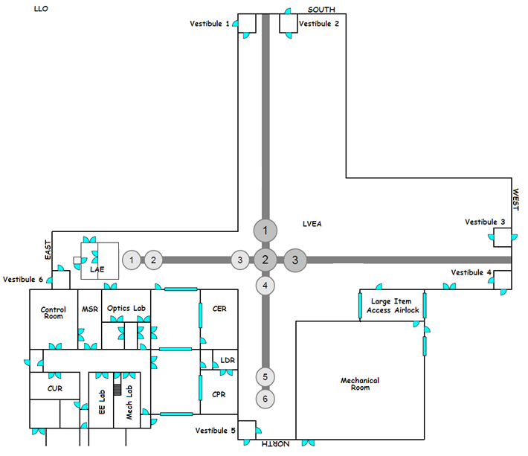
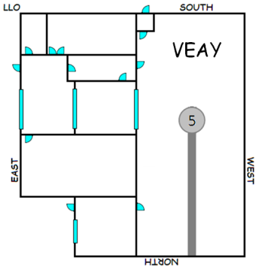
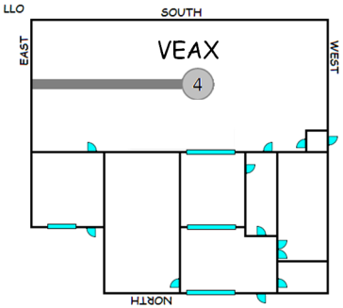
E-Stop Locations (ALL Lasers Shut Off)
E-Stop buttons are RED mushroom buttons. They are located in a variety of places.
If ANY E-Stop is pressed, ALL interferometer lasers lose power, including those at the End Stations.
When a corner station E-Stop is pressed, the LVEA entrance door, the LVEA man door, the LDR door, and ALL LAE doors will be unsecured allowing them to be opened from the outside.
The VEA doors are unsecured only when the E-Stop button located in that VEA is pressed, while the Corner Station Doors are unaffected.
VEAY Entrance Door
VEAY Garb Room Door
LAE Cargo Doors
LAE Air Shower Entrance Door
LAE-PSL Doors
VEAX Entrance Door
Control Room
LDR Entrance Door
LVEA Entrance Door
LVEA Man Door
VEAX Garb Room Door
LIGO-G1200383-V1+
13

Slide 14
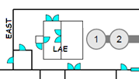
LAE Button Locations
E-Stop
Air Shower Control
Card Reader
LAE Cargo Doors
LAE-PSL Doors
Outer Door Release Button
Air Shower Reset
Air Shower Initiator
LAE Air Shower Entrance Door
LVEA Entrance Door
Control Room

Slide 15
Tables and Enclosures Discussion
Tables and Enclosures Discussion – 20120524
by David Kinzel and Richard McCarthy, with input from Peter King
The objective of a common methodology between sites must also include the various tables and enclosures that are part of the interferometer, but outside the LAE. In our thinking, it seems proper to design each table or enclosure to be as independent as possible. This simplifies all interfaces to the E-Stop buttons while simultaneously preventing hard shutdowns of sensitive electronics. Towards that end, we are proposing the following outline, flowchart, and narrative.
The intended outcome is enough information to allow the subsystems task groups to complete design and execution of their respective laser enclosure access control systems.
Again, access has two reciprocal sets of activities: entering an area, and exiting an area. The outline provided above expresses the subset of situations that are germane to entering and exiting each subsystem table or enclosure at the LIGO Observatories.
The brief discussion of RLO responsibilities is as applicable to these enclosures as they are major administrative considerations regarding access.
The flow chart is next and several subsequent slides narrate the flow chart.
The final slides are cartoons of locations of sensors and card readers.

Slide 16
Table or Enclosure - Entering Flowchart
Swipe In LVEA or VEA
Type of Entering Access
Start
Normal Enter
Emergency Enter
Abnormal (Breached Door)
Swipe In Enclosure
Push any
E-Stop
Sound Local Alarm
Qualified
Laser
Operator?
No
Ignore Swipe In
P1
P2
Yes
Allow Others To Enter
Enter Enclosure (Open Door)
Start
Do Work Permit Tasks

Slide 17
Table or Enclosure – Exiting Flowchart
Type of Exiting Access
Start
Normal Exit
Abnormal Exit
Emergency Exit
b
Close Enclosure Door
Push any
E-Stop
Allow Others To Exit
Swipe Out Enclosure
P1
Swipe Out LVEA or VEA
Exit LVEA or VEA
No
Anti-pass
Back Enabled?
Yes
Anti-pass
Back Signified?
Yes
b
No

Slide 18
Table or Enclosure – E-Stop Flowchart
P2
P1
Disable Table or Enclosure
Disable ALL IFO Lasers
Unsecure All Appropriate Doors
Execute Alert Procedure
and Resolve Emergency.

Slide 19
Table or Enclosure Access – Narrative 1
Normal Entering
The normal way to enter any table or enclosure requires the use of a personalized swipe card in a card reader located at or on the table or enclosure near its entrance door. To be successful, each card must have been assigned a level of access sufficient to trigger the opening sequence of the specific enclosure. If the door does not open it may be because the card does not have a sufficient access level, and the RLO should be contacted for entry.
The RLO designated on the Work Permit is normally the first person to enter an enclosure. Team Members who are themselves qualified laser operators may follow the RLO. (This is useful when a hand-off of RLO responsibilities is necessitated.) Non-qualified personnel, including visitors, do not swipe in to enclosures
The RLO is responsible for the safety of each person in the NHZ, and in the case of non-qualified laser operators, gives or withholds permission for access for such personnel.

Slide 20
Table or Enclosure Access – Narrative 2
Emergency Entering
When an emergency arises, it is possible to enter an enclosure without the need for keys or cards by pressing an E-Stop button. E-Stop buttons are RED mushroom buttons. They are located in a variety of places. If ANY E-Stop is pressed, ALL interferometer lasers are made incapable of lasing, including those at the End Stations. Lasers in enclosures will have their interlocks broken, causing them to cease lasing. Doors on all enclosures will all be unlocked.
When a corner station E-Stop is pressed, the LVEA entrance door, the LVEA man door, the LDR door, and ALL LAE doors will be unsecured allowing them to be opened from the outside without key or card. All tables and enclosures are isolated from the IFO and their doors may be opened without keys or cards.
The End Station VEA doors are unsecured only when the E-Stop button located in that VEA is pressed, while the Corner Station Doors are unaffected.
If an E-Stop button is pressed, there will be an investigation. All pertinent authorities will be notified, and work will stop until the emergency is resolved satisfactorily.

Slide 21
Table or Enclosure Access – Narrative 3
Abnormal Entering (Breached Door)
When an abnormal condition with respect to an enclosure is encountered, it will NOT be treated as if an E-Stop button was pressed.
Instead, the specific enclosure that has been breached will be disabled according to the type of enclosure that it is. To help identify the breach, a noisy horn will also be activated at the specific enclosure. A reset button will silence the horn.
There are three types of enclosures. Type 1 has laser light only entering it. Type 2 has laser light only leaving it. And Type 3 has light both entering and leaving it.
Type 1 enclosure breaches will cause a shutter to close preventing laser light from entering the enclosure.
Type 2 enclosure breaches will break the interlock of the laser in the enclosure, causing it to cease lasing.
Type 3 enclosure breaches will cause a shutter to close preventing laser light from entering the enclosure, and will break the interlock of the laser in the enclosure, causing it to cease lasing.

Slide 22
Table or Enclosure Access – Narrative 4
Normal Exiting
The normal way to exit an enclosure is to ensure that the door is closed and then to swipe out. If the person exiting is a qualified laser operator who swiped in to enter the enclosure, then swiping out may have to occur to align the access system with the location of the person. In the case of non-qualified personnel no such swiping is necessary.
The RLO designated on the Work Permit is normally the last person to exit the enclosure, and the last person to swipe out.
Where anti-pass-back is deployed, any personalized card that was last swiped in to an enclosure will be disallowed exiting at the anti-pass-back station. This is to alert the holder of that card that it must be swiped out at the enclosure to ensure integrity of the card system.

Slide 23
Table or Enclosure Access – Narrative 5
Emergency Exiting
When an emergency arises, it is possible to exit an enclosure without the need for keys or cards by pressing an E-Stop button. E-Stop buttons are RED mushroom buttons. They are located in a variety of places. If ANY E-Stop is pressed, ALL interferometer lasers are made incapable of lasing, including those at the End Stations. Lasers in enclosures will have their interlocks broken, causing them to cease lasing. Doors on all enclosures will all be unlocked.
When a corner station E-Stop is pressed, the LVEA entrance door, the LVEA man door, the LDR door, and ALL LAE doors will be unsecured allowing them to be opened from the outside without key or card. All tables and enclosures are isolated from the IFO and their doors may be opened without keys or cards.
The End Station VEA doors are unsecured only when the E-Stop button located in that VEA is pressed, while the Corner Station Doors are unaffected.
If an E-Stop button is pressed, there will be an investigation. All pertinent authorities will be notified, and work will stop until the emergency is resolved satisfactorily.

