Slide 1
Gravitational waves from known pulsars: past searches and future prospects
Matthew Pitkin (on behalf of the LIGO Scientific Collaboration & Virgo Collaboration)
University of Glasgow
matthew.pitkin@glasgow.ac.uk
LIGO DCC G1200546

Slide 2
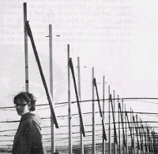
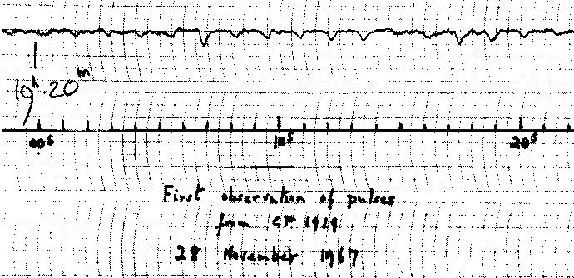
What are pulsars?
First pulsar discovered by accident in 1967 by Bell and Hewish who were trying to study interplanetary scintillation of radio sources - period of 1.3 seconds
Several more pulsars soon discovered including Crab pulsar with period of ~33ms [Cocke et al, et al, Nature, 221, 1969 – period seen in optical]
Pulse period and duration suggested a very small source (smaller than white dwarfs)
consistent with theorised neutron stars (first proposed by Baade & Zwicky in 1934)
Recording of first known pulsar CP1919

Slide 3
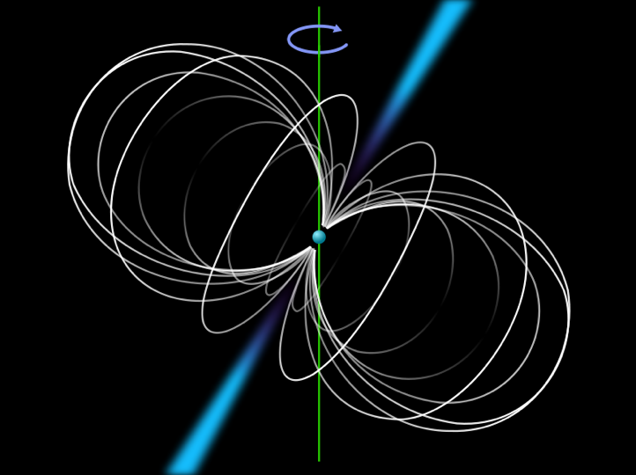
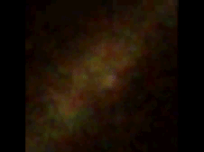
What are pulsars?
Rapidly rotating neutron stars
beamed radiation (radio through to γ-rays) from magnetic poles
periods from seconds to milliseconds
high magnetic fields (implied from spin-down)
~10¹² gauss - normal young neutron star; ~10¹⁰ gauss - old neutron star; ~10⁸ gauss - recycled millisecond pulsar
found in:
Globular clusters; binary systems (with other NSs, white dwarfs, main sequence stars, planets); supernova remnants; isolated
Fermi γ-ray observations of Vela pulsar. Credit: NASA/DOE/Fermi LAT Collaboration

Slide 4
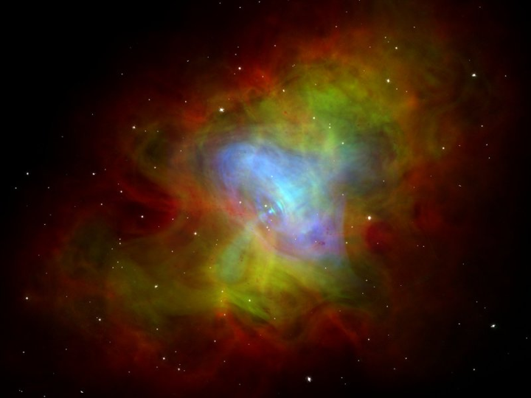
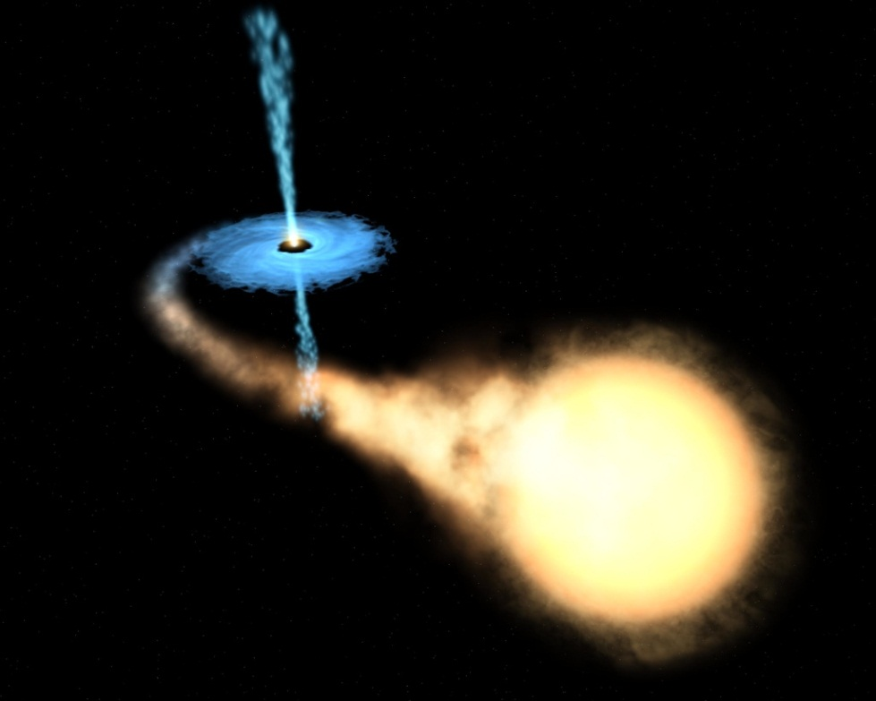
What are pulsars?
Young pulsars have large magnetic fields
spin-down rapidly
dipole radiation (often assumed to be the main loss mechanism to infer the magnetic field)
particle acceleration
gravitational radiation
other?
Old millisecond “recycled” pulsars (MPSs) (see review arXiv:0811.0762)
pulsars were/are part of a binary system and ‘spun-up’ from accreting material from companion
lose much of their magnetic field - spin-down slowly
Crab nebula. Credit: J. Hester (ASU), CXC, HST, NRAO, NSF, NASA

Slide 5
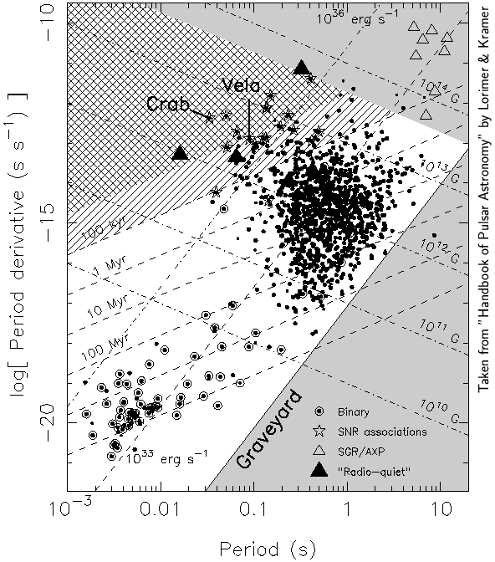
What are pulsars?
magnetars
?
“young” pulsars
Old recycled
pulsars

Slide 6
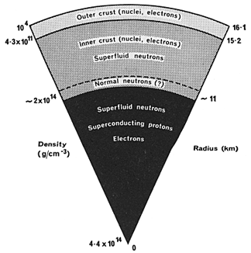
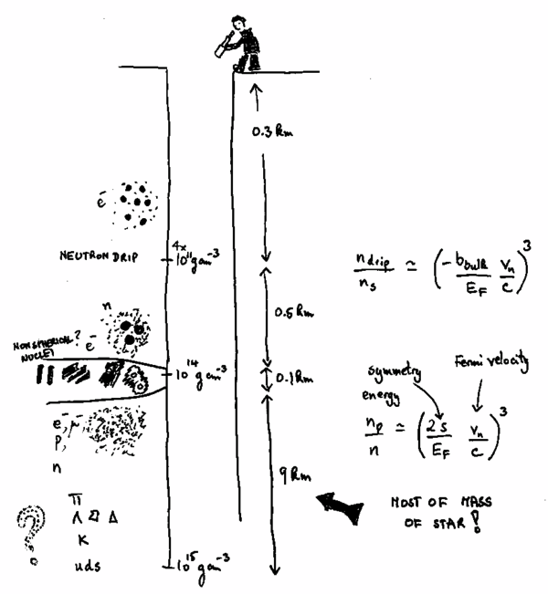
What are pulsars?
Neutron stars (big nuclei!):
mass ~1.4 M⊙
radius ~10km
mean density few 10¹⁷ kg/m³
quark stars?
harder equation of state
thinner crust
Credit: C. J. Pethick et al, Neutron Star Structure, arXiv:astro-ph/9905177
Theoretical /
unknown?
Credit: NASA

Slide 7
Gravitational waves from neutron stars
For GW emission NS must have a time varying quadrupole moment i.e. be deformed/aspherical:
triaxial - have a bump/mountain (emit at 2x rotation frequency) [continuous emission]:
from formation; from magnetic field (e.g. magnetic mountains); from stresses during relaxation
vibrational modes
fundamental mode (first resonant mass quadrupolar mode)
excited by glitch/nuclear explosion/SGR burst/impact(?)
r-modes (Rossby waves) wave-like mode (from the mass current quadrupole) in hot young/accreting NS
precession

Slide 8
GWs from neutron stars
rotation frequency (but GW signal will be at twice this value)
Emission estimates:
triaxial star
$$h∼4.2×{10}^{−26}\left(\frac{ε}{{10}^{−6}}\right)\left(\frac{I_{zz}}{{10}^{38}\text{kg} {\text{m}}^{2}}\right){\left(\frac{f}{100 \text{Hz}}\right)}^{2}\left(\frac{1 \text{kpc}}{r}\right)$$
quadrupole moment
ε = equatorial ellipticity
$$ε= \frac{I_{xx}−I_{yy}}{I_{zz}}$$
Izz = principle moment of inertia
Ellipticity also depends on equation of state and allowable sustainable crust breaking strains
$$I_{zz}≈\frac{2MR^{2}}{5}$$
uniform density sphere
Moment of inertia depends on equation of state - mass and radius

Slide 9
Theoretical expectations
Exotic forms of crystalline quark matter could sustain ellipticities of 10⁻⁴ [arXiv:astro-ph/0503399; arXiv:0708.2965; arXiv:0708.2984; arXiv:0901.4637]
Or, could be held up by (internal) magnetic fields of order 10¹⁶G (dependent on configuration and equation of state of star) [e.g. arXix:astro-ph/9602107, arXiv:gr-qc/0206051; arXiv:0705.2195; arXiv:0712.2162, arXiv:1204.3781]
Horowitz and Kadau [arXiv:0904.1986] suggest that normal neutron star crusts may sustain ellipticities of up to 10⁻⁵
Stars could be emitting gravitational waves near currently detectable level, but upper limits alone cannot constrain these various possibilities - stars may just be intrinsically smooth

Slide 10
Pulsars: spin-down limit
Pulsars lose energy and slow down:
Magnetic dipole radiation
Particle acceleration
Gravitational radiation
Braking index n:
3 for pure magnetic dipole
5 for pure gravitational radiation
Pulsars with measurable braking indices (only 4 or 5 objects) have n<3 suggesting some combination of processes
Pulsar | n
Crab pulsar | 2.51±0.01
B0540-69 | 2.28±0.02
B1509-58 | 2.837±0.001
Vela pulsar | 1.4±0.2
$$n= \frac{f \ddot{f}}{{\dot{f}}^{2}}$$
$$\dot{f}=kf^{n}$$
from Palomba, A&A, 354, 2000

Slide 11
Pulsars: spin-down limit
Assuming spin-down is all due gravitational waves we can set the so-called ‘spin-down limit’
For most millisecond pulsars (with very small spin-downs) this number is small and well below current sensitivities (but not future observatories)
For several young pulsars we can approach, or beat this limit
spin-down luminosity = gravitational wave luminosity
$$h_{\text{spin}\text{-}\text{down}}∼{\left(\frac{5}{2}\frac{G I_{zz}|\dot{f}|}{c^{3}r^{2}f}\right)}^{1/2}$$
spin-down rate
spin frequency
distance to pulsar
$$h_{\text{spin}\text{-}\text{down}}∼2.5×{10}^{−25}{\left(\frac{I_{zz}}{{10}^{38}\text{kg} {\text{m}}^{2}}\right)}^{1/2}{\left(\frac{|\dot{f}|}{{10}^{−11}\text{Hz} {\text{s}}^{−1}}\right)}^{1/2}{\left(\frac{100 \text{Hz}}{f}\right)}^{1/2}\left(\frac{1 \text{kpc}}{r}\right)$$

Slide 12
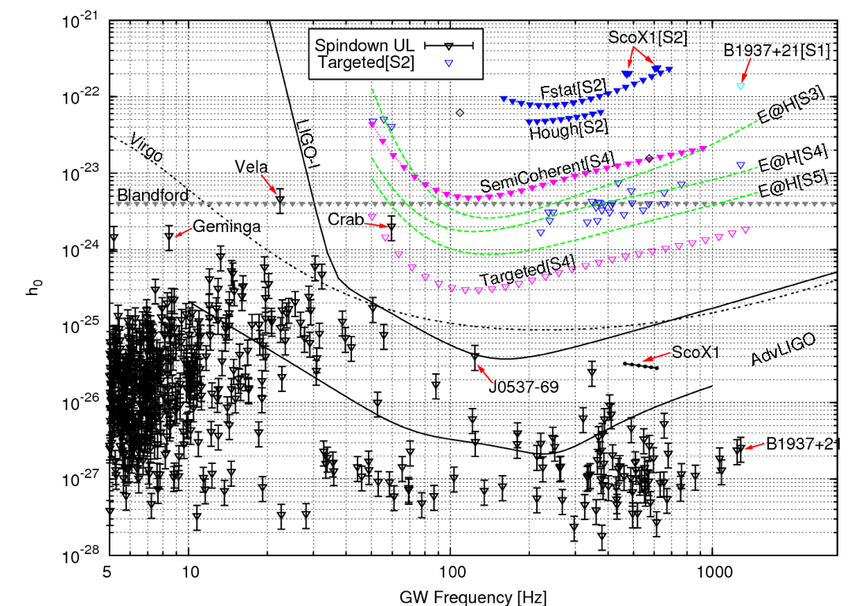
Credit: Reinhard Prix

Slide 13
Neutron star physics
What can we learn from direct observations (of continuous waves from a triaxial star)?
Direct observation would constrain the quadrupole moment:
Ellipticity
breaking strain of neutron star matter
large ellipticity - solid quark star?);
magnetic fields
Moment of inertia
neutron star equation of state
Unfortunately these parameters are highly degenerate
need input from theory/other observations to constrain individual parameters
Quantify energy budget of star’s spin-down
logε
log Izz

Slide 14
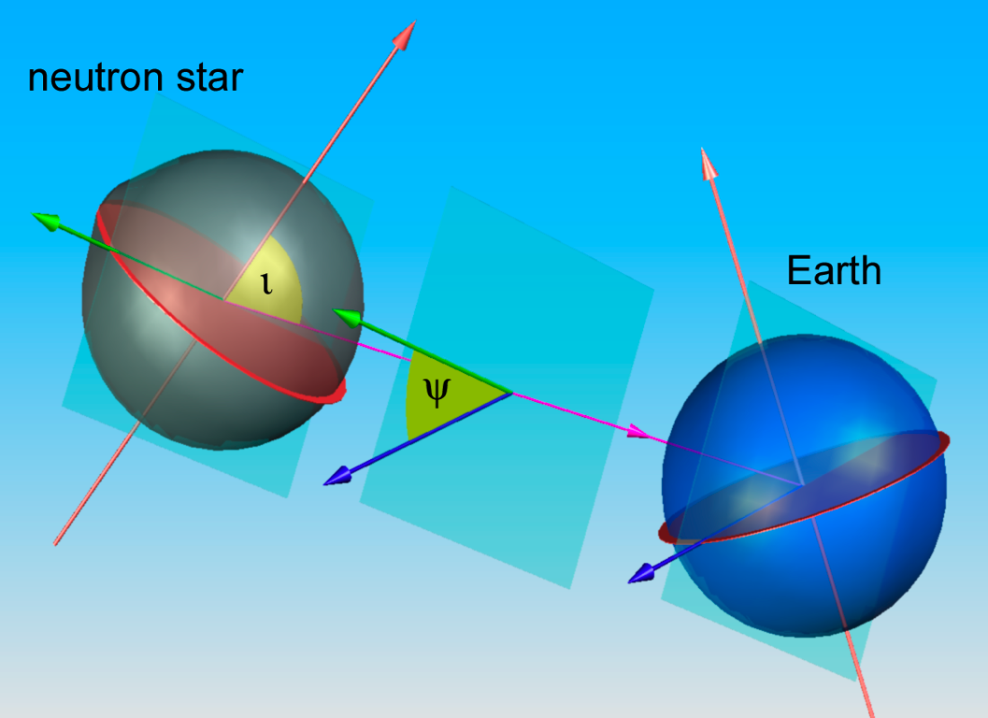
Data analysis: model
What does the signal model look like?
For a simple rigidly rotating triaxial star:
+ and x polarisation antenna
response for a given detector
$$h\left(t\right)=F_{+}(t,ψ)\frac{h_{0}}{2}(1+\cos^{2}{ι)\cos{2φ\left(t\right)}+F_{×}\left(t,ψ\right)h_{0}}\cos{ι\sin{2φ(t)}}$$
Polarisation angle
Inclination angle
Spin phase evolution

Slide 15
Data analysis: model
Phase model:
Doppler shift in signal due to detector motion
Earth’s orbital motion and rotation (depends on pulsar position)
pulsar motion w.r.t. the solar system barycentre (SSB) (e.g. if pulsar’s in a binary system)
relativistic effects (e.g. Shapiro delay, gravitational redshift)
Take this into account as a time delay (same at all frequencies)
$$φ\left(t\right)=φ_{0}+2π\left\{f\left(t+Δt\right)+\frac{\dot{f}}{2}{\left(t+Δt\right)}^{2}+\frac{\ddot{f}}{6}{\left(t+Δt\right)}^{3}+… \right\}$$

Slide 16
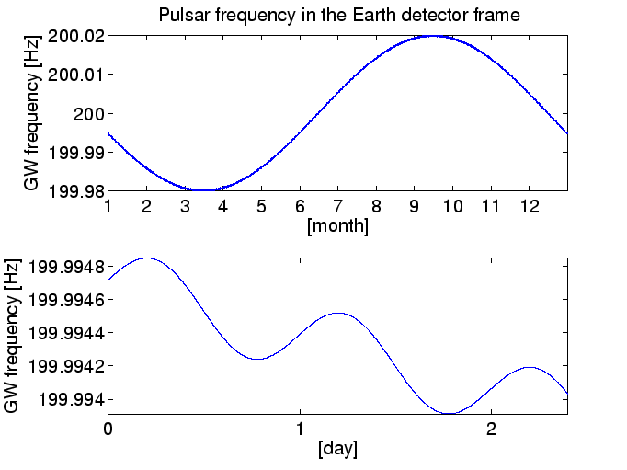
Data analysis: model
Phase model:
$Δt\left(t\right)=Δ{t\left(t\right)}_{\text{Roemer}}+{Δt\left(t\right)}_{\text{Shapiro}}+{Δt\left(t\right)}_{\text{Einstein}}+{Δt(t)}_{\text{Binary}}$\
Gravitational redshift
and time dilation
Binary system time delay
Position vector of
Earth w.r.t. the SSB
Shapiro delay
$${Δt(t)}_{\text{Roemer}}=\frac{r(t)∙\hat{n}(α, δ)}{c}$$
Propagation time across
orbit e.g. doppler delay
Unit vector towards
the pulsar
If r and n stay close to
orthogonal get minimum
time delay
Maximum solar system
doppler shift ~1x10⁻⁴f Hz

Slide 17
Data analysis
For known pulsars we know: sky position; spin frequency evolution; binary parameters
Phase model completely defined, so can perform coherent analysis of all data
We have a GW model defined by a set of 4 unknown parameters:
$$a=\{h_{0},ι,ψ, φ_{0}\}$$
Given a set of data we evaluate the (Gaussian) likelihood over the parameters
data
model
$$p\left(\left\{d_{i}\right\} | a_{i},I\right)∝\prod_{i}{\text{exp}}\left[−\frac{{(d_{i}^{2}−h\left(a_{i}^{}\right))}^{2}}{2σ_{i}^{2}}\right]$$
likelihood
log likelihood
noise variance
$$\text{ln} p\left(\left\{d_{i}\right\} | a_{i},I\right)=L∝\sum_{i}{−\frac{{\left(d_{i}−h(a_{i})\right)}^{2}}{2σ_{i}^{2}}}$$

Slide 18
Data analysis
Frequentist method:
Maximum likelihood (find values of a that maximise the (log) likelihood ratio) - some parameters can be maximised analytically:
With such a statistic and a given false alarm/false dismissal rate you can define a detection criterion
to produce an upper limit you need to perform many Monte Carlo simulations on different realisations of noise
More suitable for wider parameter spaces - maximisation can be cheaper than marginalisation
$${\left.\frac{∂L}{∂a}\right|}_{h_{0},ι,φ_{0},ψ}=0$$

Slide 19
Data analysis
Bayesian method (used in LSC known pulsar searches):
natural way of parameter estimation and setting upper limits
produce posterior from likelihood and priors
generally use uniform independent priors for all parameters
marginalise over 3 unwanted parameters to create a posterior probability density for the wanted parameter $h_{0}$
can combine likelihoods from multiple detectors
marginalise over amplitude to get model evidence
$$p\left(a_{i} | \left\{d_{i}\right\},I\right)∝p\left(\left\{d_{i}\right\} | a_{i},I\right)×p(a_{i}|I)$$
Priors
$$p\left(h_{0} | \left\{d_{i}\right\},I\right)∝\int_{−\frac{π}{4}}^{\frac{π}{4}}{\text{d}ψ}\int_{0}^{2π}{\text{d}φ_{0}}\int_{−1}^{1}{\text{d}\cos{ι}}p\left(\left\{d_{i}\right\} | a_{i},I\right)×p(a_{i}|I)$$

Slide 20
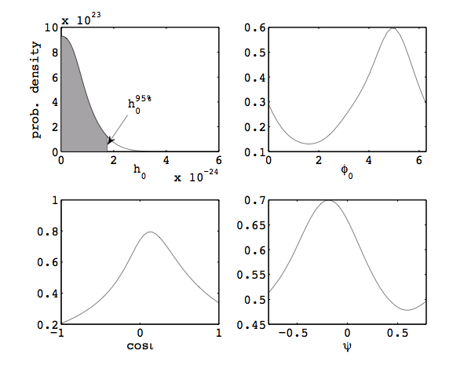
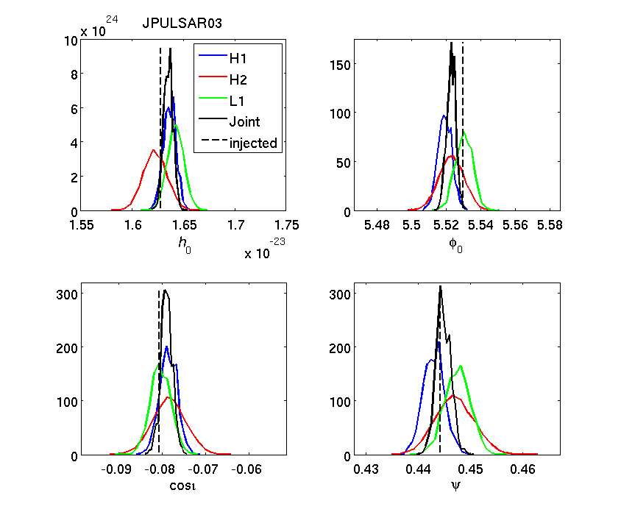
Data analysis: method
If no signal is seen we can use posterior to set an upper limit e.g. 95% degree of belief
$$0.95=\int_{0}^{h_{0}^{95\%}}{p(h_{0}|\left\{d_{i}\right\},I)}\text{d}h_{0}$$
Simulated signal

Slide 21
Data analysis
In future use Bayesian hypothesis testing as a detection statistic:
Calculate evidence ratio for signal versus noise/incoherent signal between detectors
$ℬ$-statistic [arXiv:0907.2569]
Marginalisation with uniform priors rather than maximisation with unphysical priors
Calculate evidence ratio between different signal models:
E.g. purely rigid triaxial star with emission at 2f vs. star with emission also at 1f [arXiv:0909.4035]

Slide 22
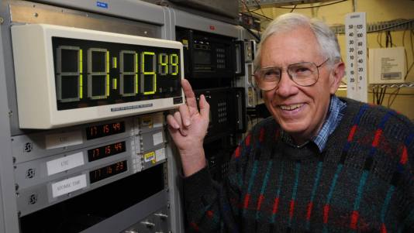
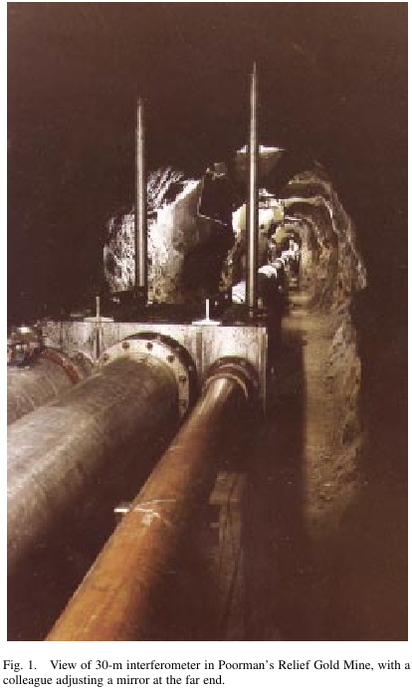
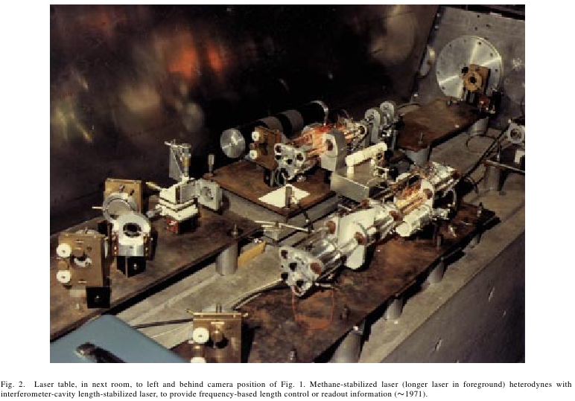
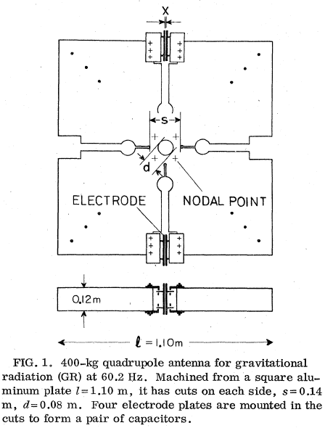
Known pulsar GW search history
Searches for GWs from pulsars did not begin with LIGO:
Looking for GWs from the Crab pulsar (optical pulsations at ~30Hz discovered in 1969 [Cocke et al, Nature, 221, Feb 1969]):
1972 – Levine and Stebbins (PRD, 6, 1972) [National Bureau of Standards and JILA] used a 30m laser interferometer (single arm Fabry-Perot cavity)
1978 – Hirakawa et al (PRD, 17, 1978 and PRD, 20, 1979) [Tokyo] searched for the Crab - specially designed ~1000kg aluminium quadrupole antenna with resonant frequency at 60.2 Hz
30 m interferometer at Poorman’s Relief Gold-mine, Boulder, CO.
Credit: J. L. Hall, “Optical Frequency Measurement: 40 years of Technology Revolutions”, IEEE Journal on Selected Topics in Quantum Electronics, Vol. 6, No. 6, 2000
Hirakawa et al, PRD, 17, 1978

Slide 23
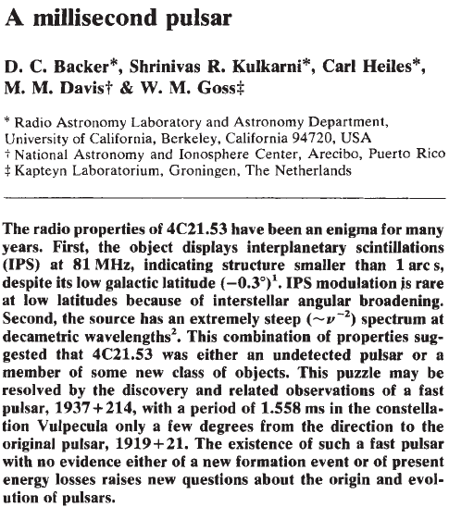
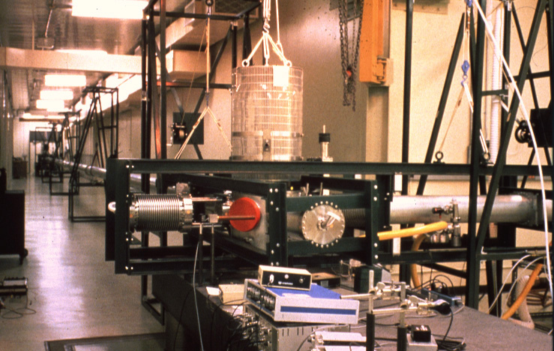
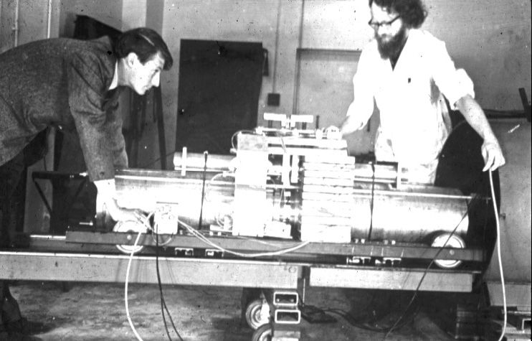
Known pulsar GW search history
Other interferometer and bar detector searches:
Then fastest millisecond pulsars PSRJ1939+2134 (~642 Hz)
1983 – Hereld [PhD thesis] at Caltech using 40 m interferometer
1983 – Hough et al [Nature, 303, 1983] at Glasgow using split bar detector
Nature, 300, Dec 1982
Caltech 40m proto-type
Glasgow split-bar (plus Jim!)

Slide 24
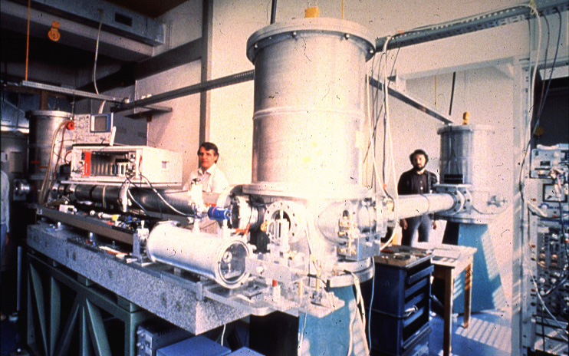
Known pulsar GW search history
The 90s:
1993 – Niebauer et al [PRD, 47, 1993] searched for GWs from a possible NS remnant of SN1987A using Garching 30m interferometer (100 hrs of data from 1989; searching around 2 and 4kHz): $h_{0}<9×{10}^{−21}$
1986-1995 – Tokyo group Crab pulsar search using torsion-type antenna Owa et al [1986mgm..conf..571O, 1988egp..conf..397O] using cooled (4.2K) 74 kg antenna, Suzuki [1995gwe..conf..115S] using cooled (4.2K) 1200kg antenna: $h_{0}<2×{10}^{−22}$ (~140 times greater than spin-down limit)
Garching 30m proto-type

Slide 25
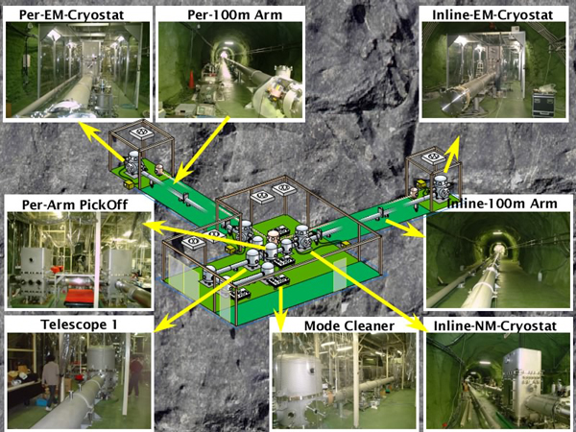
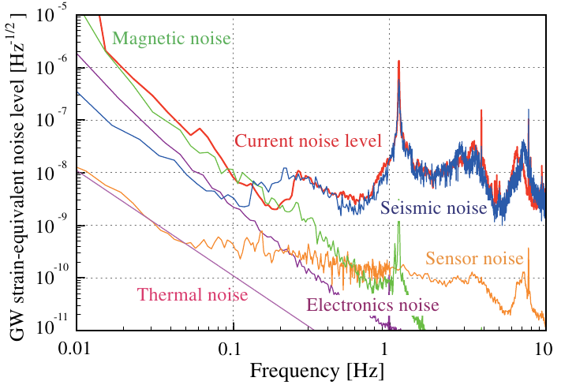
Known pulsar search history
Non-LVC searches (2000s):
2008 – CLIO search for GWs from Vela [Akutsu et al, CQG, 25, 2008]: $h_{0}<5.3×{10}^{−20}$ at 99.4% CL
2010 – Tokyo proto-type low-frequency mag-lev torsional bar antenna search for slowest pulsar (PSR J2144-3933 at $f_{\text{rot}}∼0.1 \text{Hz}$) [Ishidoshiro, PhD thesis, University of Tokyo]: $h_{0}<8.4×{10}^{−10}$ (Bayesian 95% UL with 10% calibration errors)
Various narrow-band all-sky, and galactic centre, blind searches have been performed using EXPLORER and AURIGA bar detectors [arXiv:gr-qc/0011072, arXiv:gr-qc/0304107]
Credit: http://www.icrr.u-tokyo.ac.jp/gr/clio/CLIOALL.jpg
Sensitivity of TOBA arXiv:1103.0346

Slide 26
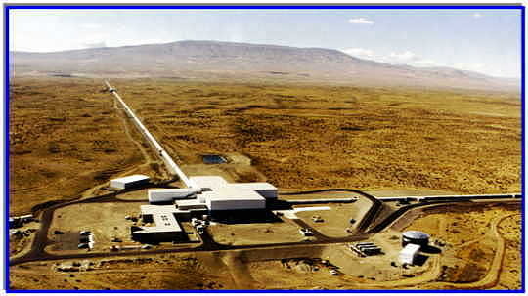
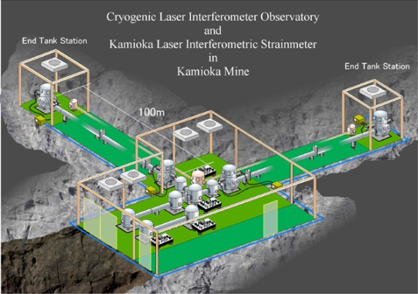
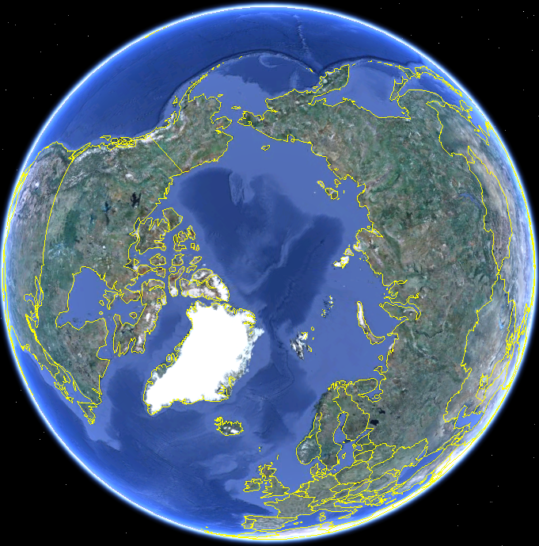
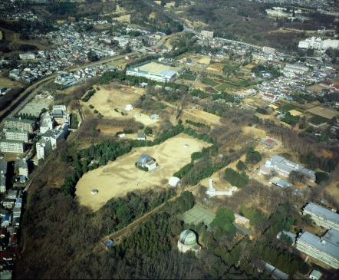
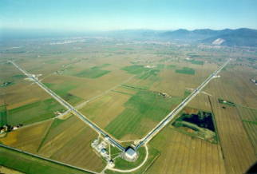
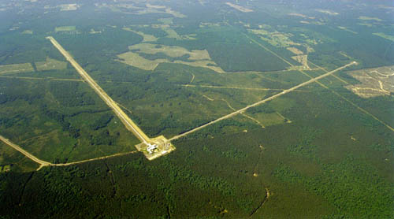
Gravitational wave detector network
CLIO
LIGO
GEO600
TAMA300
LIGO
Virgo

Slide 27
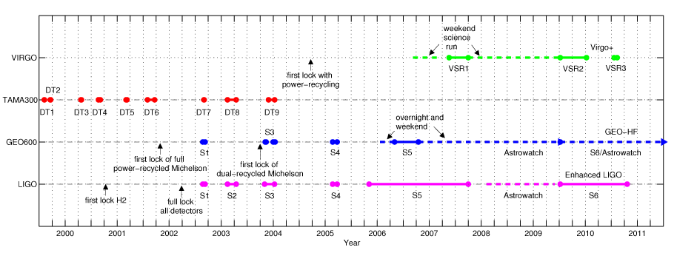
LVC Science runs
Since 2001 interferometric detectors have been through periods of science data taking
LIGO and GEO600 data have been analysed as part if the LIGO Scientific Collaboration
some joint analyses with TAMA and Virgo
In 2007 Virgo joined forces with the LSC for joint analyses
6 major science runs producing astrophysical results with data up to 2011
Credit: arXiv:1102.3355

Slide 28
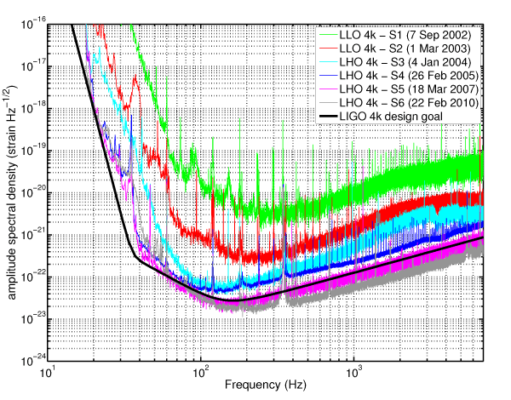
LIGO Science runs
The best strain sensitivities from the LIGO science runs S1 through S6
Credit: arXiv:1102.3355

Slide 29
Pulsars in LVC searches
Region excluded from current searches due to lack of detector sensitivity
Old millisecond
pulsars

Slide 30
LSC searches
Used LIGO and GEO600 science (S) run data for searches
S1 search for 1 pulsar (then fastest - J1939+2134) [arXiv:gr-qc/0308050]
S2 search for 28 isolated pulsars [arXiv:gr-qc/0410007]
S3 and S4 targeted 78 known (isolated and binary) radio pulsars with spin frequencies greater than 25Hz [arXiv:gr-qc/0702039]
pulsar parameter data supplied specifically for this search from Jodrell and Parkes observations, and the Australia Telescope National Facility (ATNF) online catalogue
S5 (4 Nov 2005-1 Oct 2007) produced a upper limit for the Crab pulsar using the first 9 months of data [arXiv:0805.4758]
single and multi-template searches
beat spin-down amplitude limit by a factor of ~5 and limit power in GWs to be less than 4% of spin-down limit

Slide 31
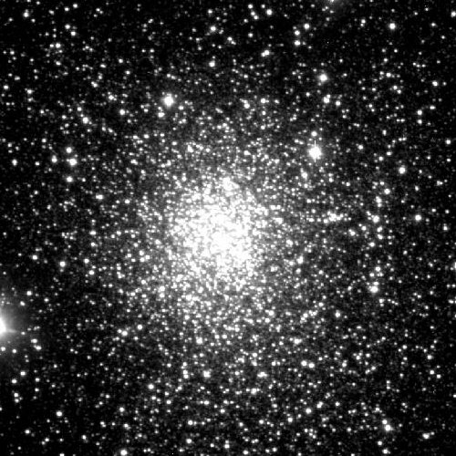
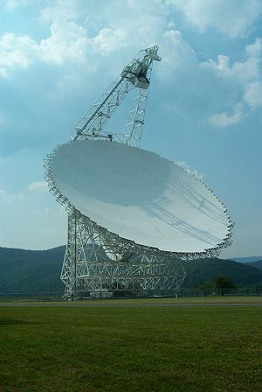
Searches: S5
Globular cluster Terzan 5
~200 known pulsars with spin frequencies greater than 20Hz (LIGO sensitive band)
Have parameters fit to radio observations of 115 pulsars (isolated, binaries and in globular clusters) covering all, or part, of S5 run
Jodrell Bank Observatory (e.g. Crab, etc)
Green Bank Observatory (Ter5, M28)
Parkes Telescope (e.g. PPTA)
Perform a targeted search for these pulsars using all S5 LIGO data
For one pulsar, J0537-6910, only have RXTE X-ray observations, covering entire run
Six glitches during this period

Slide 32
Searches: S5 results
~527 days H1, 535 days H2, 405 days L1 data
No signal seen for any pulsar (arXiv:0909.3583)
Highlights:
Lowest amplitude upper limit: 2.3x10⁻²⁶ for J1603-7202 at 135 Hz and distance 1.6 kpc
Lowest ellipticity limit: 7x10⁻⁸ for J2124-3358 at 406 Hz and distance 0.2 kpc (for moment of inertia of 10³⁸ kgm²)
Lowest amplitude relative to spin-down:
millisecond recycled pulsar: 10 times spin-down for J2124-3358
non-glitching young pulsar: 4 times spin-down for J1913+1011
glitching young pulsar: 0.18 times spin-down for Crab
Three young pulsars glitched during the run

Slide 33
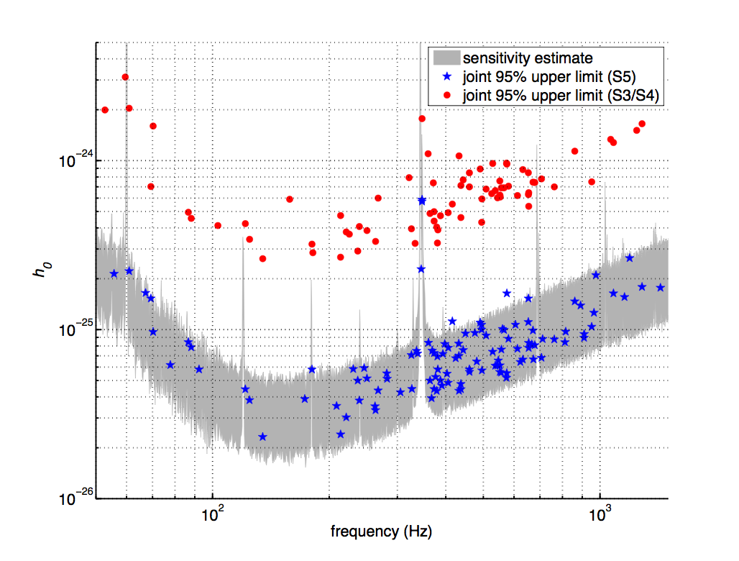

Slide 34
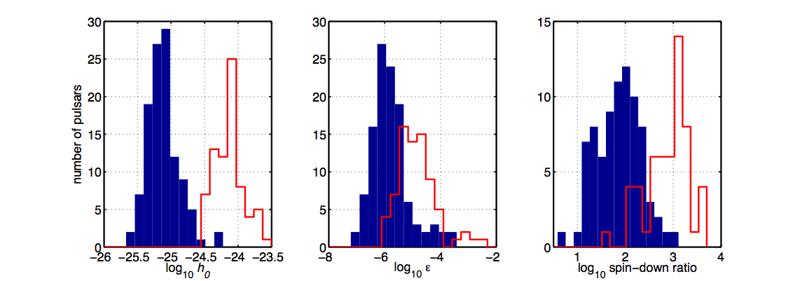
Searches: S5 results
S3/S4 limits
S5 limits

Slide 35
Glitching pulsars
Three young pulsars seen to glitch during S5
Crab pulsar - 1 glitch
J0537-6910 - 6 glitches
J1952+3252 - 1 glitch
Three scenarios:
Fully coherent signal over entire run (most likely case)
Glitch causes phase offset between EM and GW signals, so add as extra parameter
Perform independent coherent searches on stretches of data between glitches

Slide 36
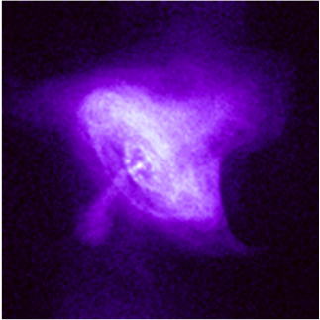
Crab pulsar search
Priors on polarisation and orientation angles from Pulsar Wind Nebula (PWN) observations ψ = 125.16±1.36º, ι = 62.17±2.20º [arXiv:0710.4168]
For scenario i) with priors as above we get:
h0 upper limit 2.0x10⁻²⁵
ellipticity upper limit 1.1x10⁻⁴
ratio to spin-down amplitude of 7
Assuming uniform priors increases upper limit by ~1.3 times (orientation given by priors is favourable)
Limit power in gravitational waves to less than ~2% of that available from spin-down
Credit: NASA/CXC/SAO

Slide 37
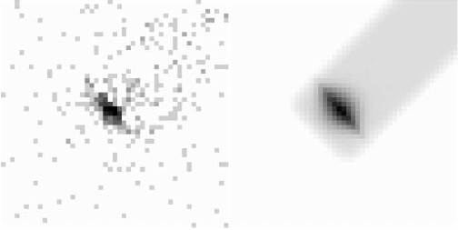
J0537-6910 and J1952+3252
PSR J0537-6910 (fgw = 124.0 Hz, r = 49.4 kpc)
Have RXTE 7 ephemerides for pulsar over whole of S5 (glitchy pulsar, with large timing noise)
Six glitches in this time – perform analysis in same scenarios as for the Crab
Priors on polarisation and orientation angles from Pulsar Wind Nebula observations ψ = 131.0±2.2º, ι = 92.8±0.9º (non-optimal orientation)
PSR J1952+3252 (fgw = 50.6 Hz, r = 2.5 kpc)
Observed to glitch once between 1-12th Jan 2007 - have timing solutions for the two epochs
No observational constraints on orientation
X-ray image (left) and best fit (right) of the Pulsar Wind Nebula around J0537-6910, Ng and Romani, Ap. J. 2009

Slide 38
Results
For J0537-6910 scenario i) gives (using orientation angle priors):
$h_{0}$ upper limit $4.4×{10}^{−26}$
ellipticity limit $1.3×{10}^{−4}$
Amplitude ratio to spin-down: ~1.5x spin-down (moment of inertia ${10}^{38}\text{kg} {\text{m}}^{2}$)
Using uniform priors gives improvements of about 1.4 – PWN gives unfavourable orientation
For J1952+3252 scenario i) gives:
$h_{0}$ upper limit $2.9×{10}^{−25}$
Ellipticity limit $2.7×{10}^{−4}$
Amplitude ratio to spin-down: ~2.5x spin-down

Slide 39
Crab multi-template search
$$f_{gw}=2f(1+δ)$$
Pulsar GW phase model may not be at precisely twice EM phase
free precession
two component model (EM and GW components spinning separately, but coupled by some torque)
Causes a small offset in frequency and spin-down (so perform a “fuzzy” search)
for long observation times (months/years) require a search over many different signal templates - a single phase model would not stay coherent with the signal
use the maximum likelihood frequentist search method
$$δ∼α\frac{(I_{zz}−I_{xx})}{I_{xx}}$$
$$δ∼\frac{τ_{\text{coupling}}}{τ_{\text{spin}\text{-}\text{down}}}$$
$$\left|δ\right|={10}^{−4}$$
~ maximum δ for free precession
$$τ_{\text{spin}\text{-}\text{down}}∼2500 \text{years}$$
spin-down timescale for Crab pulsar
$$τ_{\text{coupling}}∼{10}^{−4}τ_{\text{spin}\text{-}\text{down}}$$
typical recovery timescale after glitches

Slide 40
Crab multi-template search
For S5 search [arXiv:0805.4758] had:
Number of phase templates $3×{10}^{7}$ (ensuring only 5% loss between templates)
Results (with observational priors):
$h_{0}$ upper limit $1.2×{10}^{−24}$
~0.8x spin-down limit
$$δf= ±6×{10}^{−3}\text{Hz}$$
$$δ\dot{f}= ±1.5×{10}^{−13}\text{Hz} {\text{s}}^{−1}$$

Slide 41
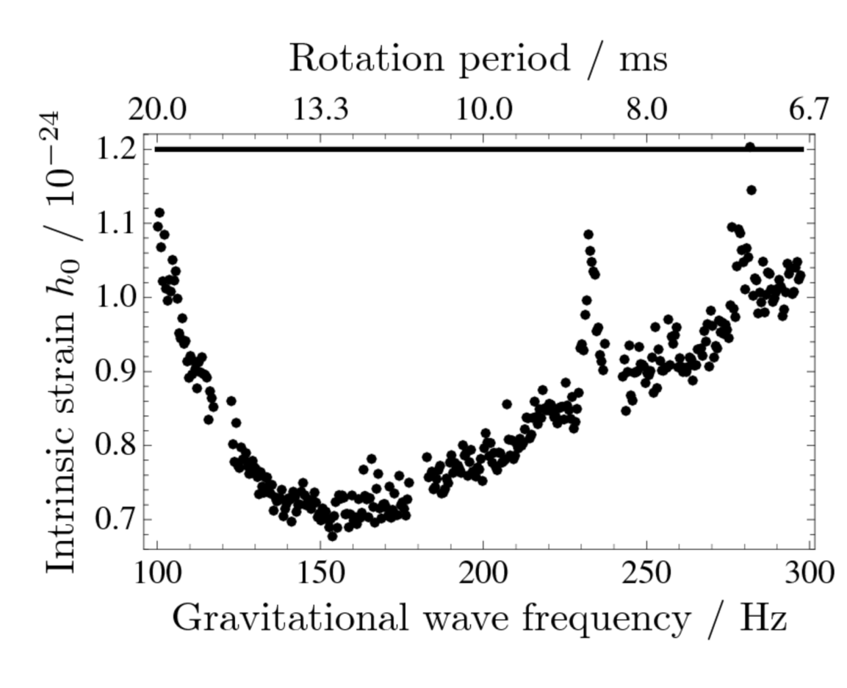
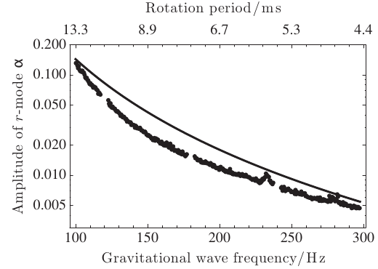
Cas A search
Cas A supernova remnant contains the youngest known neutron star (331 years old) [arXiv:1006.2535]
no spin period known
Set age-based limit on GWs
Search 12 days of S5 data coherently:
Between 100-300Hz
Spin-down range based on 2< n <7
Upper limit on r-mode amplitude
Age ~ spin-down age $−{\left(1−n\right)}^{−1}f/\dot{f}$
$$h_{sd}=1.2×{10}^{−24}\left(\frac{3.4 \text{kpc}}{r}\right)\left(\frac{I}{{10}^{38}\text{kg} {\text{m}}^{2}}\right){\left(\frac{300 \text{yr}}{τ}\right)}^{1/2}$$
$$α=0.14{\left(\frac{300 \text{yr}}{τ}\right)}^{1/2}{\left(\frac{100 \text{Hz}}{f_{\text{r}\text{-}\text{mode}}}\right)}^{3}$$
4/3 rotation frequency

Slide 42
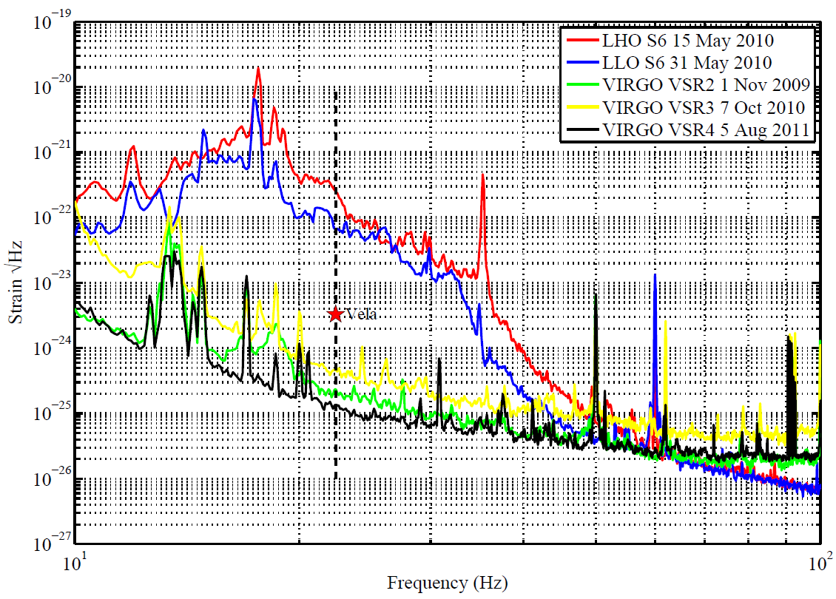
Vela search
Low frequency sensitivity of Virgo allowed search for the Vela pulsar (~22Hz) in VSR2 data [arXiv:1104.2712]
VSR2: 7 Jul 2009 – 8 Jan 2010
Search used 3 methods:
1 using time domain data and Bayesian PE
2 using frequency domain and frequentist detection statistics and UL estimators
Assumed known orientation angles
Credit: Colin Gill
$$h_{\text{spin}\text{-}\text{down}}=3.3×{10}^{−24}$$
$$h_{0}^{95\%}≈2×{10}^{−24}$$
$$ε≈1.1×{10}^{−3}$$
~0.6x spin-down limit, or less than ~ 40% of spin-down energy in GWs

Slide 43
Current search
Search underway using LIGO S6 and Virgo VSR2/3/4 for more pulsars
Getting pulsar ephemerides from radio groups, Fermi and RXTE (more young high spin-down objects particularly in Virgo band)
Vela should get factor 1.5 improvement
Search for GWs at rotation frequency and twice rotation frequency
Perform narrow-band search for all pulsars (like S5 Crab analysis)
Enables us to include pulsars without up-to-date, or precise, ephemerides

Slide 44
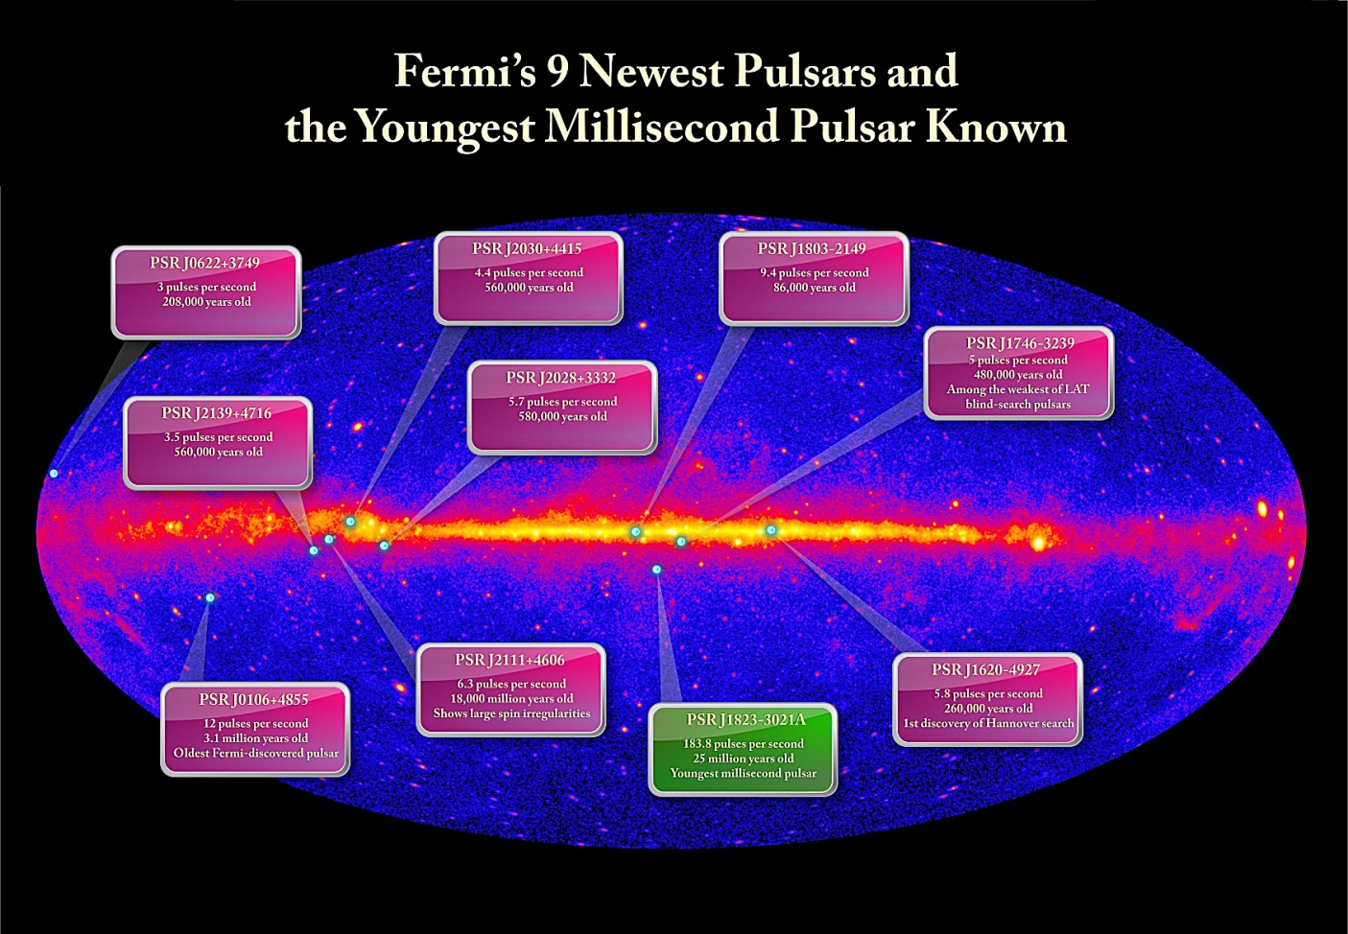
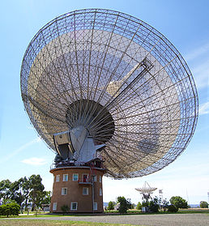
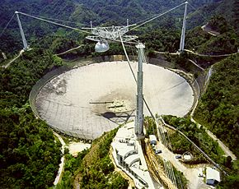
New pulsars
Fermi pulsars:
Detected 100 pulsars, 31 γ-ray only (radio quiet) pulsars [e.g. arXiv:1111.0523] – several young pulsars in GW band including youngest MSP (184 Hz)!
Now searching with Einstein@home blind pulsar search
New surveys:
HTRU (High Time Resolution Universe) N/S surveys discovering more pulsars with Parkes [e.g. arXiv:1109.4193] (12 new MSPs to date)
Searches of PALFA Arecibo data with Einstein@home – a few new MSP sources
Credit: NASA/DOE/Fermi LAT Collaboration

Slide 45
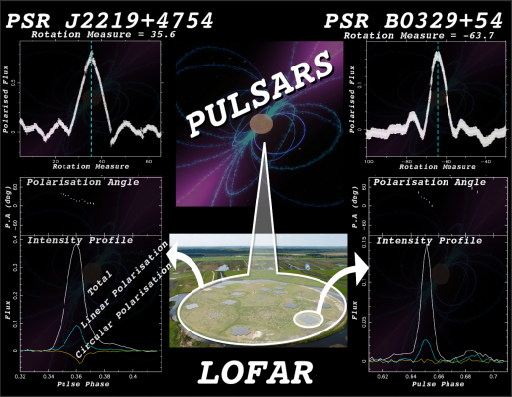
New pulsars
LOFAR:
LOFAR stations are coming online and the first pulsars have been observed (not new ones though)
Expect to discover ~1000 new pulsars (all Northern hemisphere observable objects within 2kpc) [arXiv:0905.5118, arXiv:1104.1577]
High sensitivity to millisecond pulsars
SKA:
Expect to observe 14000 normal pulsar and 6000 millisecond pulsars [arXiv:0811:0211]
Copyright: ASTRON

Slide 46
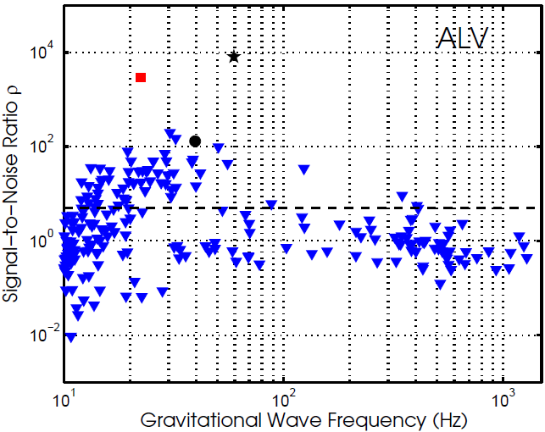
Prospects for future searches
Advanced LIGO/Advanced Virgo (upgrade of most detector systems for 2015)
~10 times increasing in sensitivity over initial LIGO/Virgo
Vela pulsar
Crab pulsar
Estimate of signal-to-noise ratio for known pulsars if emitting at spin-down limit for 3 aLIGO+AdVirgo detectors observing for 1 year. Plot shows orientation and polarisation angle averaged values [arXiv:1103.5867]
B0540-69
J0537-6910
Require “exotic” (unrealistic!) quadrupoles/ellipticties

Slide 47
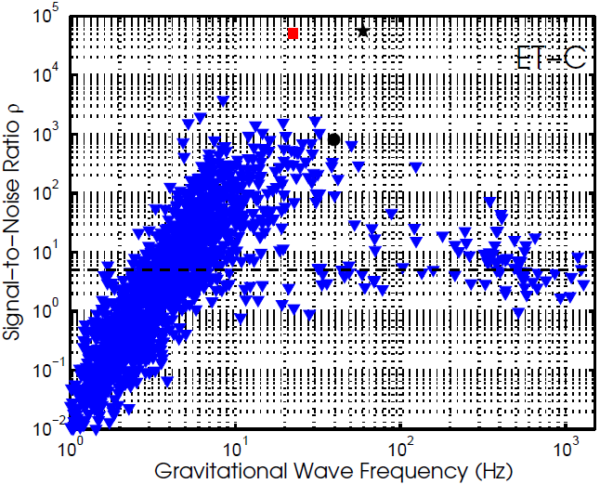
Prospects for future searches
Einstein Telescope (ET)
proposed European 3rd generation GW telescope another 10 times more sensitive than AdvLIGO
Vela pulsar
Crab pulsar
Estimate of signal-to-noise ratio for known pulsars if emitting at spin-down limit for 3 ET-C (xylophone configuration) detectors observing for 1 year. Plot shows orientation and polarisation angle averaged values [arXiv:1103.5867]
B0540-69
J0537-6910

Slide 48
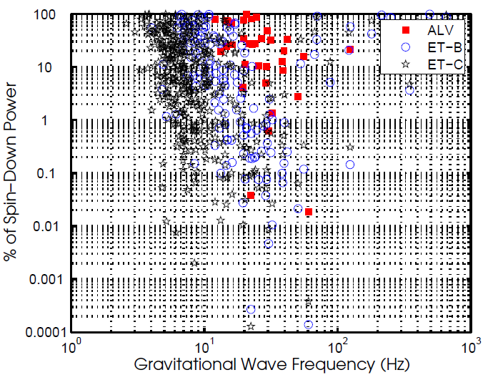
Prospects for future detectors
Assume that pulsars can be detected at signal-to-noise ratio (SNR) of 5
Scaling from the spin-down limit SNR what % of the spin-down power would be required to observe the pulsars?
We know a (triaxial) Crab is emitting < 2% of spin-down power in GWs, but for MSPs?

Slide 49
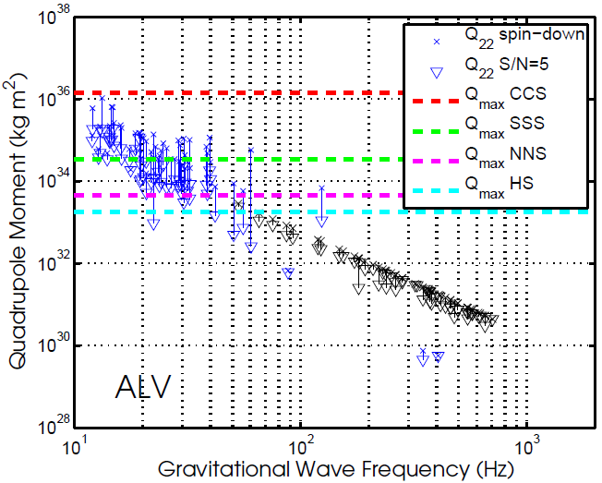
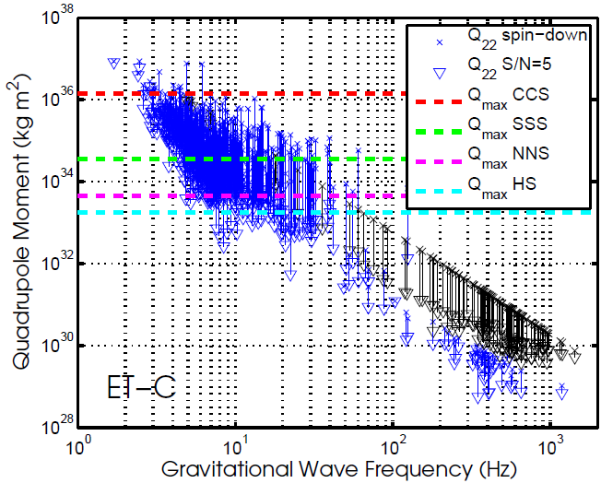
Quadrupole constraints
$$ε=\sqrt{\frac{8π}{15}}\frac{Q_{22}}{I_{zz}}$$
Constraints on quadrupole moment $Q_{22}$:
Maximum theoretical $Q_{22}$
Normal Neutron Star (NNS) | Hybrid Crystaline Colour Superconducting star (CCS) | Strange solid quark star (SSS) | Hybrid meson condensate stars (HS)
$$3.1×{10}^{33} \text{kg} {\text{m}}^{2}$$ | $$1.4×{10}^{36} \text{kg} {\text{m}}^{2}$$ | $$3.5×{10}^{34} \text{kg} {\text{m}}^{2}$$ | $$1.8×{10}^{33} \text{kg} {\text{m}}^{2}$$

Slide 50
Quadrupole constraints
Numbers of potentially detectable pulsars (at SNR $≥5$):
With SKA ~30 times more MSPs – 10s of detectable pulsars with realistic quadrupoles/ellipticities!

Slide 51
Magnetic field constraints
Constraints on internal poliodal and toriodal magnetic fields:

Slide 52
Conclusions
Searches for GWs from known neutron stars are well established
Currently (mainly) assume GWs and EM signals are phase locked and neutron star is triaxial rigid body emitting at twice the rotation frequency
expand upon these assumption:
perform searches at the rotation frequency
carry out more “fuzzy” multi-template searches
search at r-mode frequencies
Searches starting on S6/VSR4 data
improve spin-down limit for Vela, Crab et al
Newly found young pulsars (e.g. Fermi) being included
New detectors and extra pulsars promise far more!
detection and parameter estimation

