Slide 1
Multiwavelength Astronomy:
Examples of Astronomy Observations
Made with Different Kinds of Light
Amber L. Stuver
LIGO Livingston Observatory
LIGO-G1200501-v2

Slide 2
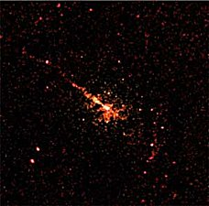
X-ray

Slide 3
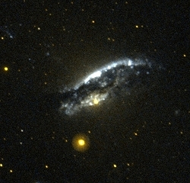
Ultraviolet

Slide 4
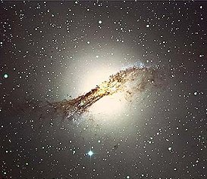
Visible Light

Slide 5
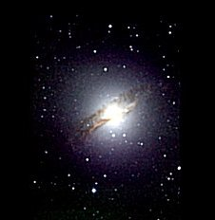
Near-Infrared

Slide 6
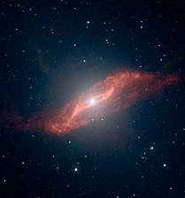
Mid-Infrared

Slide 7
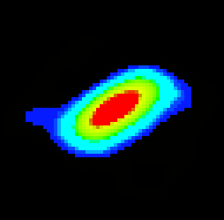
Far-Infrared

Slide 8
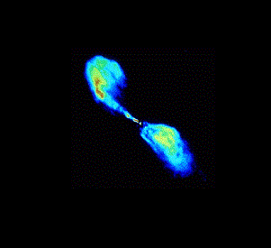
Radio

Slide 9
These are all observations of the same object: the galaxy Centaurus A.
When all of these observations are combined, a more complete picture of this galaxy forms…

Slide 10
Notes:
Size, position, and rotation of this image done to match the visible image on the next slide.

Slide 11
Visible Light

Slide 12
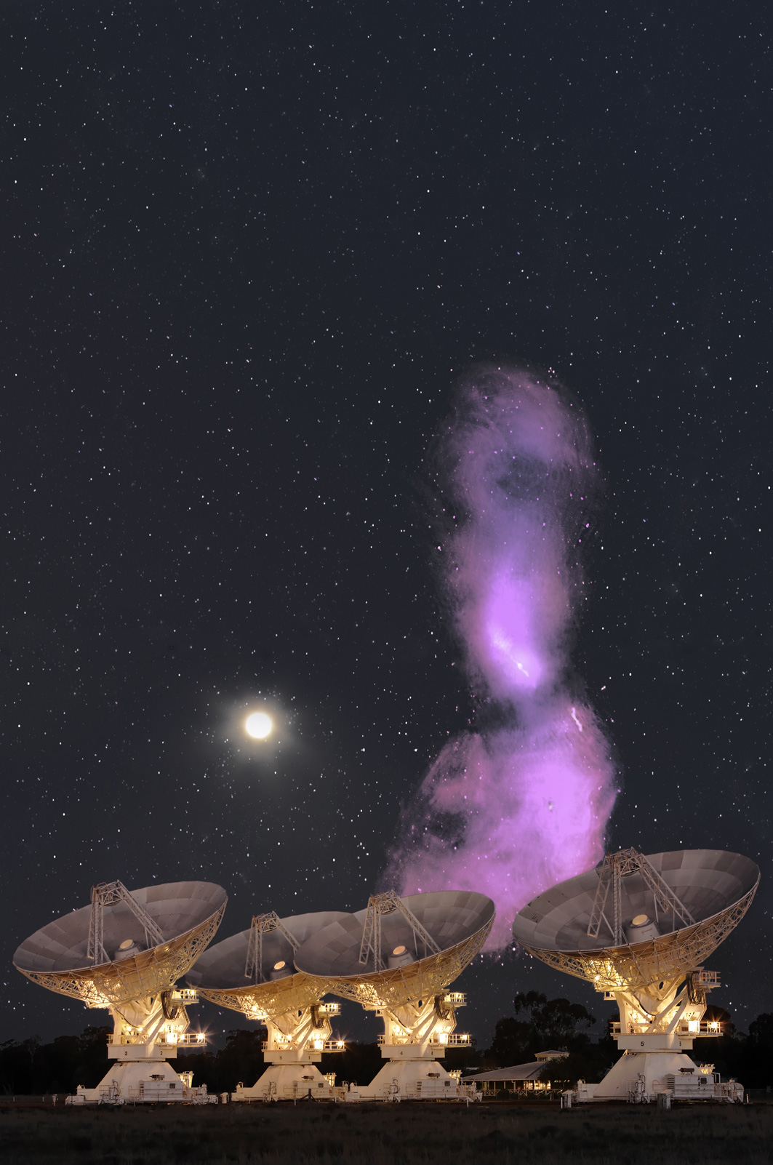
The radio plumes of Cen A are ~20× the size of the full Moon.
Notes:
(VLA in foreground)

Slide 13
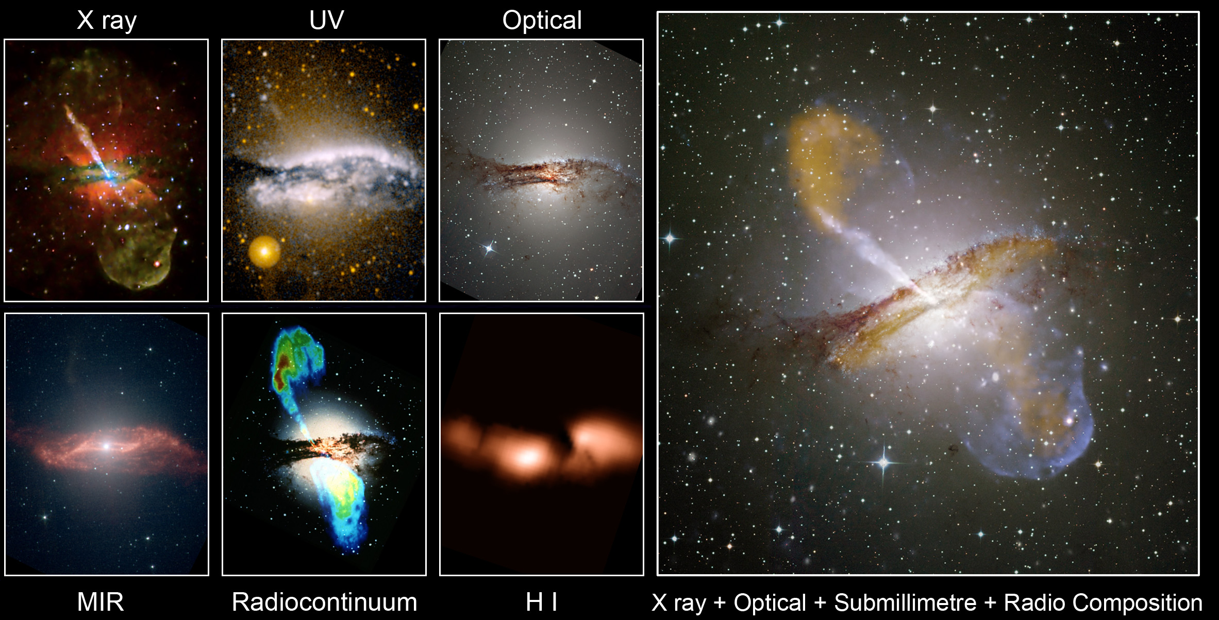
Multiwavelength Views of Cen A

Slide 14
Venus:
The Penetrating Power of Different Wavelengths

Slide 15
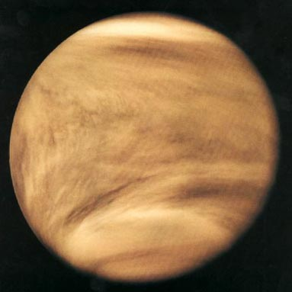
Ultraviolet
Reveals the thick, dense upper atmosphere

Slide 16
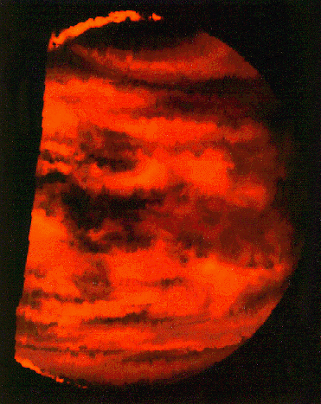
Infrared
Reveals the clouds of sulfuric acid (dark areas) lower in the atmosphere

Slide 17
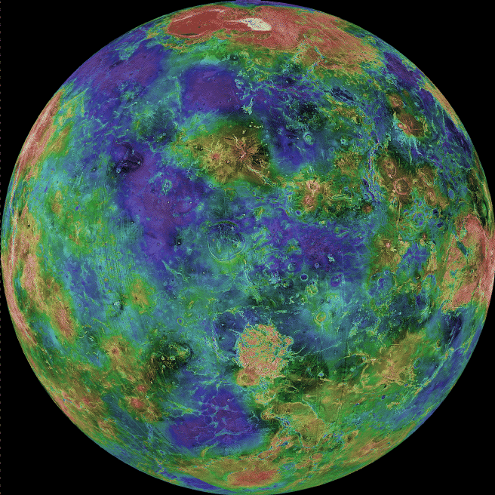
Radio
Reveals the surface of the planet

Slide 18
Seeing the Whole Symphony:
What if each kind of light were an octave of music?

Slide 19
Notes:
Seeing the Whole Symphony: http://ccnmtl.columbia.edu/projects/helfand/

