Slide 1
Multi-messenger Astronomy: Expanding Astronomy's "Senses"
Amber L. Stuver
LIGO Livingston Observatory

Slide 2
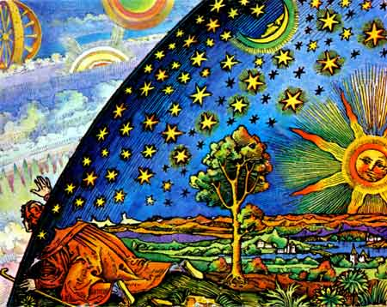

Slide 3
Examples of Astronomy Observations
Made with Different Kinds of Light…

Slide 4
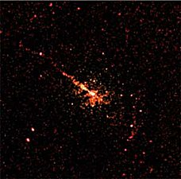
X-ray

Slide 5
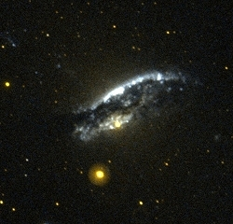
Ultraviolet

Slide 6
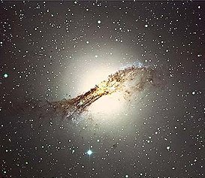
Visible Light

Slide 7
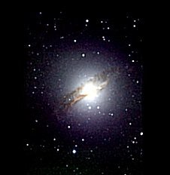
Near-Infrared

Slide 8
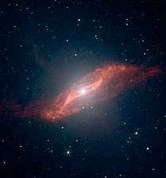
Mid-Infrared

Slide 9
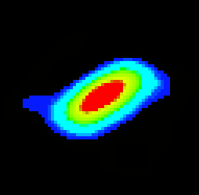
Far-Infrared

Slide 10
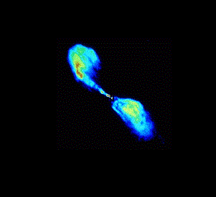
Radio

Slide 11
These are all observations of the same object: the galaxy Centaurus A.
When all of these observations are combined, a more complete picture of this galaxy forms…

Slide 13
Visible Light

Slide 14
What would music sound like if limited to specific octaves?

Slide 16
Neutrinos
Are essentially massless particles, without charge, and travel at the “speed of light”
So weakly interact with matter they can travel through it unchanged
Are produced by nuclear reactions including those in stars
The detection of neutrinos has already led to discoveries about supernovas (more on this later).

Slide 17
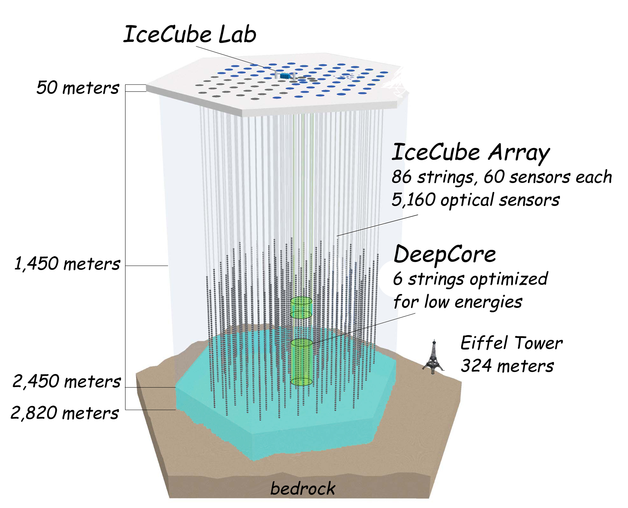
IceCube Neutrino Observatory

Slide 18
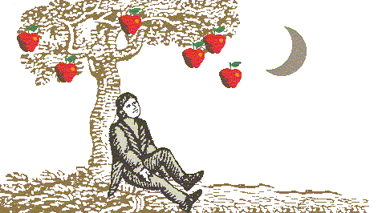
Newton’s Gravity

Slide 19
Einstein’s Gravity
Nothing in the universe can travel faster than the speed of light, including information on the distribution of mass.

Slide 20
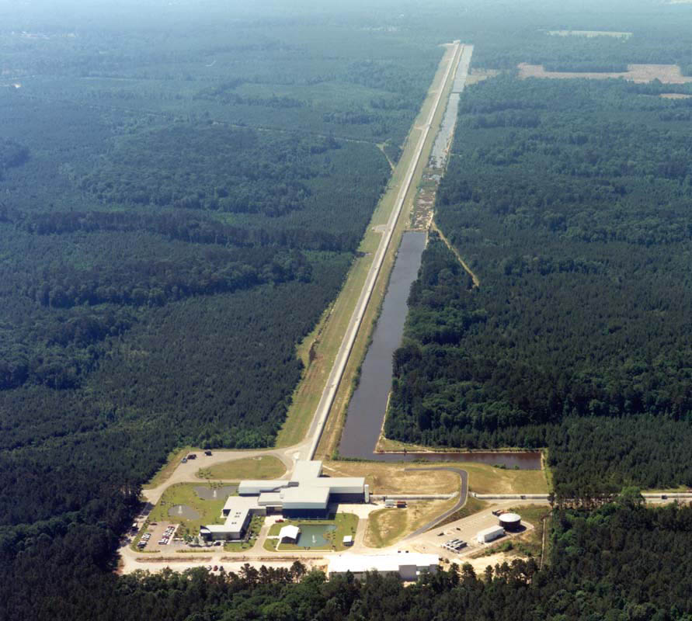
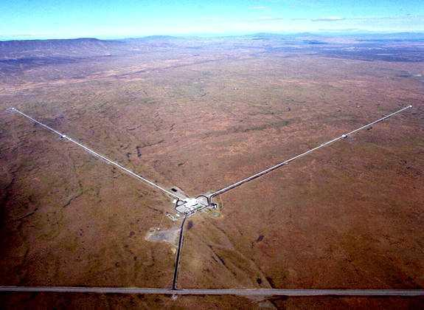
The LIGO Observatories
Livingston, Louisiana
Hanford, Washington

Slide 21
Gravitational-Wave Astronomy
The physics of the system that produced the gravitational wave is encoded in the wave itself.
The universe is transparent to gravitational waves.
Will be able to see the universe as never before:
The earliest moments of after the Big Bang
Systems that are not light producing
Systems that are otherwise obscured
The unexpected…
Notes:
Make sure to emphasize the LIGO is sensitive to almost all of the sky (including the sky on the other side of the planet) at once and we continually record and archive our data. This give LIGO the ability to search times in the past that may be of interest.

Slide 22
Case Study: Core Collapse Supernova

Slide 23
Abstract
Every time humans have looked at the Universe in a new way, we have found something that was unexpected that revolutionized our understanding of the Universe. Light has been the primary tool for doing astronomy since ancient times. Only recently have other ways of looking at the Universe become available, notably neutrinos and gravitational waves. Observing the Universe with different media is a growing field of astronomy called multi-messenger astronomy. This conversation will describe how astronomy revolutionized how we see the Universe and how multi-messenger astronomy will expand our "senses" to observe the Universe in fundamentally new ways. Multi-messenger astronomy examples used will be from the experience of the LIGO gravitational wave observatories. The potential of this new field of astronomy will be discussed, but the unexpected is expected to be the most exciting!
LIGO-G1200499-v1

