Slide 1
A history of Gravitational Waves, inspired by Josh Goldberg
Peter R. Saulson
Syracuse University

Slide 2
Josh Goldberg
Josh earned his Ph.D. from Syracuse in 1952, with Peter Bergmann.
Among many other topics, he made important contributions to the question of whether a binary star emitted gravitational waves.

Slide 3
Josh’s mentor Peter Bergmann

Slide 4
Josh Goldberg in 1957
Josh was working at Wright Patterson AFB. In addition to his own research (searching for anti-gravity?), he was the funding officer for the USAF’s support for research in relativity.
Josh made it possible for relativity to thrive worldwide.

Slide 5
The Chapel Hill Conference
In January 1957, Josh sponsored the Conference on the Role of Gravitation in Physics, a.k.a. the Chapel Hill Conference, a.k.a. GR1. The organizers were Bryce and Cecile DeWitt. 44 of the world’s leading relativists attended.
Much of the future of gravitational physics was launched then. (Numerical relativity was prefigured in a remark by Charles Misner.)
The “gravitational wave problem” was solved there, and the quest to detect gravitational waves was born.

Slide 6
The “gravitational wave problem”
Were gravitational waves real, or were they “pure gauge”?
Before Chapel Hill, debate raged. Einstein wavered. Eddington suggested that gravitational waves “traveled at the speed of thought.”
One main approach was to solve the equations of motion of a binary star, and show that they generated waves that couldn’t be transformed away.
Josh worked on this. It was hard. People were still hard at work on it when Hulse and Taylor found the binary pulsar in 1974 …

Slide 7
Felix Pirani
Felix Pirani had been a student of Alfred Schild’s and then of Hermann Bondi’s. In 1957 he was a junior colleague of Bondi at King’s College, London.
At Chapel Hill, he announced the solution of the gravitational wave problem, although Bondi usually gets the credit.
Photo by Josh Goldberg

Slide 8
Pirani’s mentors Alfred Schild and Hermann Bondi

Slide 9
Pirani’s 1957 papers
Pirani’s breakthrough was to analyze the reception of gravitational waves, not their generation.
He showed that, in the presence of a gravitational wave, a set of freely-falling particles would experience genuine motions with respect to one another. Thus, gravitational waves must be real.
He made this case in two papers submitted before the Chapel Hill conference, and presented there.

Slide 10
Pirani’s set of neighboring freely-falling test masses

Slide 11
They respond in a measurable way to a gravitational wave

Slide 12
Bondi clarifies Pirani’s point
Pirani’s mentor Bondi arrived at Chapel Hill unsure about gravitational waves.
Listening to Pirani’s talk, he asked whether you could connect two nearby masses with a dashpot, thus absorbing energy from the wave.
Energy absorption is the ultimate test of physical reality.
Pirani replied: “I have not put in an absorption term, but I have put in a ‘spring’. You could invent a system with such a term quite easily.”
Bondi is credited with the “sticky bead argument.”

Slide 13
Joe Weber at Chapel Hill
Joe Weber, co-inventor of the maser, was working with John Wheeler at Princeton on gravitational waves.
The two of them were at Chapel Hill, and listened well to Pirani’s talk.

Slide 14
Weber’s mentor John Wheeler

Slide 15
Joe Weber starts GW detection
Weber and Wheeler recapped Pirani’s argument in a paper written within weeks of the Chapel Hill conference. By 1959, Weber wrote his first paper laying out the program to build gravitational wave detectors.
By the late ‘60’s, Weber was seeing things.

Slide 16
Weber’s bar
Weber’s gravitational wave detector was a cylinder of aluminum. Each end is like a test mass, while the center is like a spring. PZT’s around the midline are Bondi’s dashpots, absorbing energy to send to an electrical amplifier.

Slide 17
Rainer Weiss, not at Chapel Hill
In 1957, Rai Weiss was a grad student of Jerrold Zacharias at MIT, working on atomic beams.
In the early ‘60’s, he spent two years working with Bob Dicke at Princeton on gravity experiments.

Slide 18
Rai Weiss’s mentors, Jerrold Zacharias and BobDicke

Slide 19
Rainer Weiss and Joe Weber
In 1964, Rai was back at MIT as a professor. He was assigned to teach general relativity. He didn’t know it, so he had to learn it one day ahead of the students.
He asked, What’s really measurable in general relativity? He found the answer in Pirani’s papers presented at Chapel Hill in 1957.

Slide 20
What Pirani actually proposed
In Pirani’s papers, he didn’t “put in” either a spring or a dashpot between the test masses. Instead, he said:
“It is assumed that an observer, by the use of light signals or otherwise, determine the coordinates of a neighboring particle in his local Cartesian coordinate system.”
Zach’s lab at MIT was in the thick of the new field of lasers. Rai read Pirani, and knew that lasers could do the job.

Slide 21
Rai Weiss envisions LIGO in 1972
Weiss knew of Weber’s claimed detections. True or not, he saw how to do many orders of magnitude better, by implementing Pirani’s free-test-masses-measured-by-lasers as a Michelson interferometer. Arms could be kilometers long. Lasers could measure sub-nuclear distances. ΔL/L ~ 10⁻²¹.

Slide 22
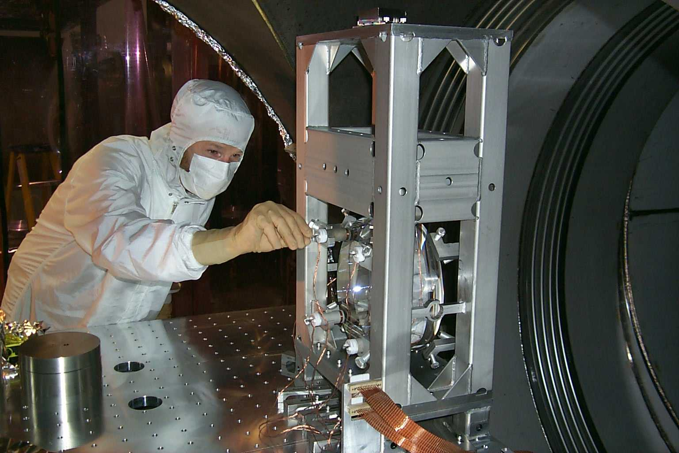
Thought experiment becomes reality Laser Interferometer Gravitational Wave Observatory (LIGO)

Slide 23
1972: Concept 2005: 4 km interferometers observe
LIGO Hanford Observatory, WA
LIGO Livingston Observatory, LA

Slide 24
In Europe, Virgo and GEO600 observed with LIGO

Slide 25
Meanwhile, we’ve learned how to calculate the waveform from a binary star

Slide 26
LIGO searched for gravitational waves, 2005-2010. Syracusans who’ve continued Josh’s legacy in the search for binary signals include:
Gabriela Gonzalez, Syracuse Ph.D. 1995, first co-Chair of binary inspiral search group; now LSC Spokesperson
Duncan Brown, Syracuse faculty member, wrote inspiral search code, now co-Chair of inspiral search group

Slide 27
On 16 Sept 2010, we thought we’d found an inspiral signal
It swept up in frequency and strength just like our calculations.
We checked everything, then wrote a paper. Just before submission to the journal, we learned that the signal had been injected to test us.
Oh, well …

Slide 28
Advanced LIGO, coming soon
We’re upgrading now. New interferometers will see 10 times farther.
By 2015, we should be back on the air. This time, we really ought to see neutron star binary signals.
A good 90th birthday present for Josh!

