Slide 1
Auxiliary Optical Systems - AOS
Stray Light Control and Viewports – SLC
Eric Gustafson, Lisa Austin (Lead) and Michael Smith (Cognizant Optical Engineer)
aLIGO NSF Review
LIGO Hanford Observatory
April 11-13, 2012

Slide 2
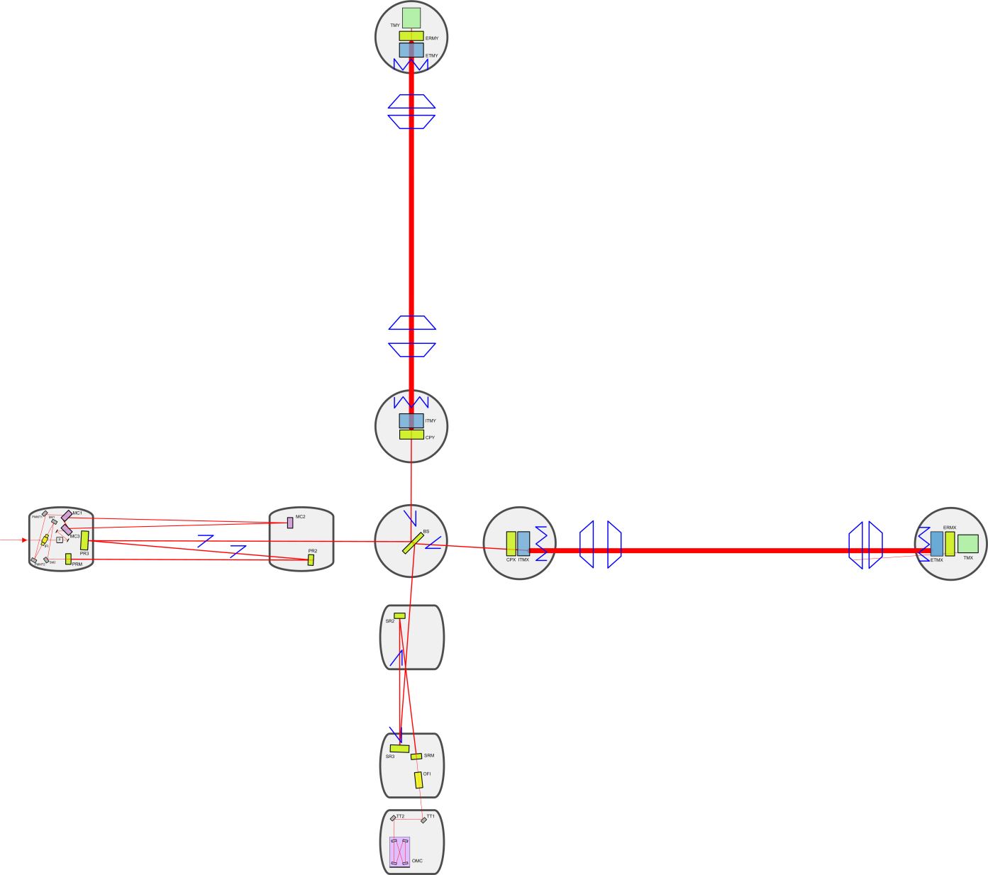
Stray Light Control - SLC
Arm Cavity Baffles
Manifold/Cryopump Baffles
ITM Elliptical Baffle
Mode Cleaner Tube
Baffles
HAM Scraper Baffles
SR2 Scraper Baffle
SRM Flat Baffle
SR3 Flat Baffles
Output Faraday Isolator

Slide 3
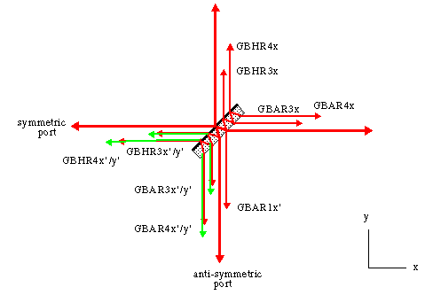
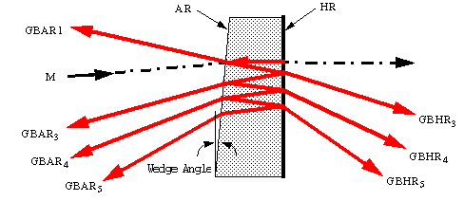
Stray Light Control Functions
Control stray light scatter in the interferometer using baffles, beam dumps, and attenuators
Reduce scattered light displacement noise
Ghost beams

Slide 4
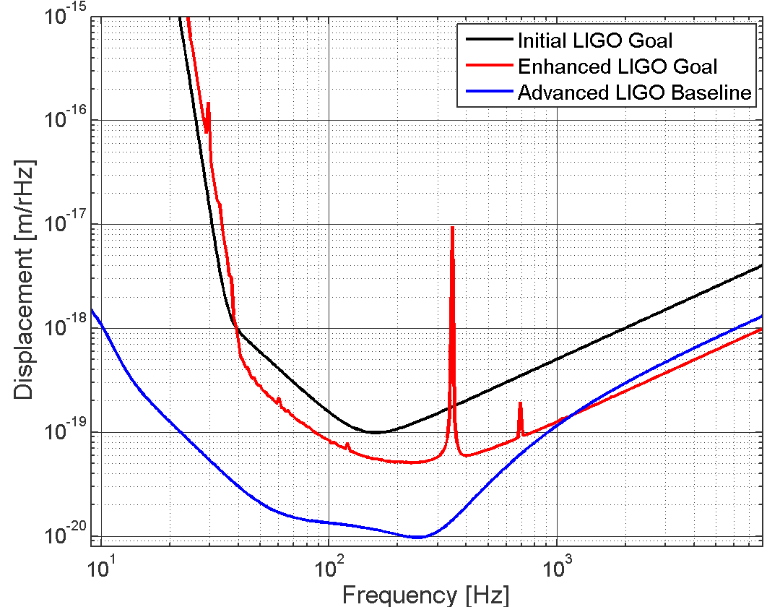
Stray Light Control Requirements
Total stray light displacement noise <1/10 Thermal noise (Coatings and suspensions)

Slide 5
Stray Light Control Design Concept
Oxidized, polished SS, low BRDF stable surface baffles
Small, Core Optic wedge angles simplify/consolidate many baffles and beam dumps in the recycling cavities
  Cavity Mirror Wedge angles
    ITM, 0.076 deg vertical wedge angle causes ghost beams to separate from the main beam in the vicinity of PR2 and SR2 for interception with beam dumps
    BS, 0.074 deg horizontal wedge angle provides the ITMX Hartmann beam in vicinity of SR2
Suspended baffles reduce scattered light displacement noise for critical scattering paths
  Arm Cavity Baffle (ACB), ITM Elliptical Baffle, Manifold/Cryopump Baffle
  Output Faraday Isolator
ACB catches narrow and wide-angle scatter from ITM and ETM
ACB photodetectors aid initial alignment and measure scattered light from TM
Mode Cleaner Tube Baffle mitigates recycling cavity scatter and errant beams

Slide 6
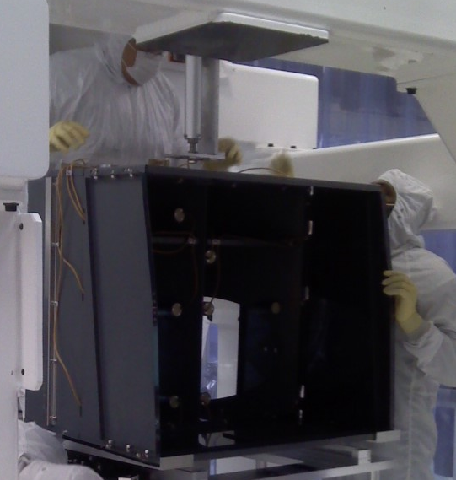
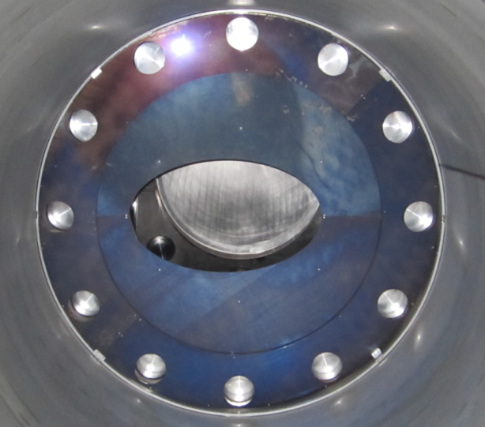
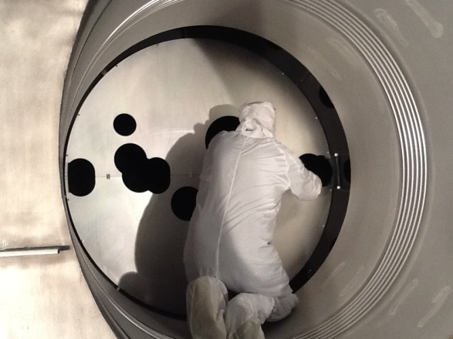
Scattered Light Control
Development Accomplishments - I
Measured vibration of suspended Output Faraday Isolator (OFI) and Arm Cavity Baffle (ACB) with eddy current-damping at Caltech and LASTI - meet SLC displacement noise requirement
Measured the BRDF of oxidized, polished stainless steel baffles and beam dumps for stable, low BRDF surfaces
Arm cavity baffle design mitigates wide-angle scatter from Test Mass
Mode Cleaner Tube
baffles for recycling
cavities

Slide 7
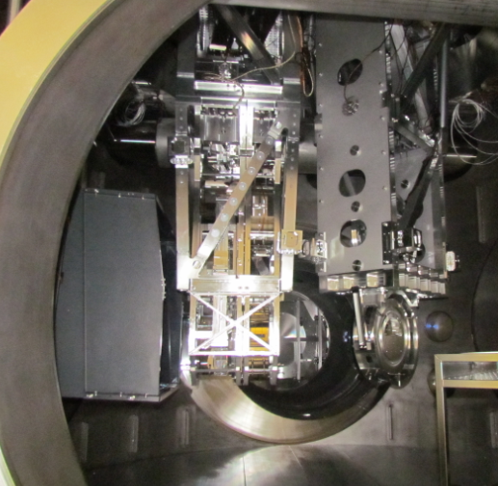
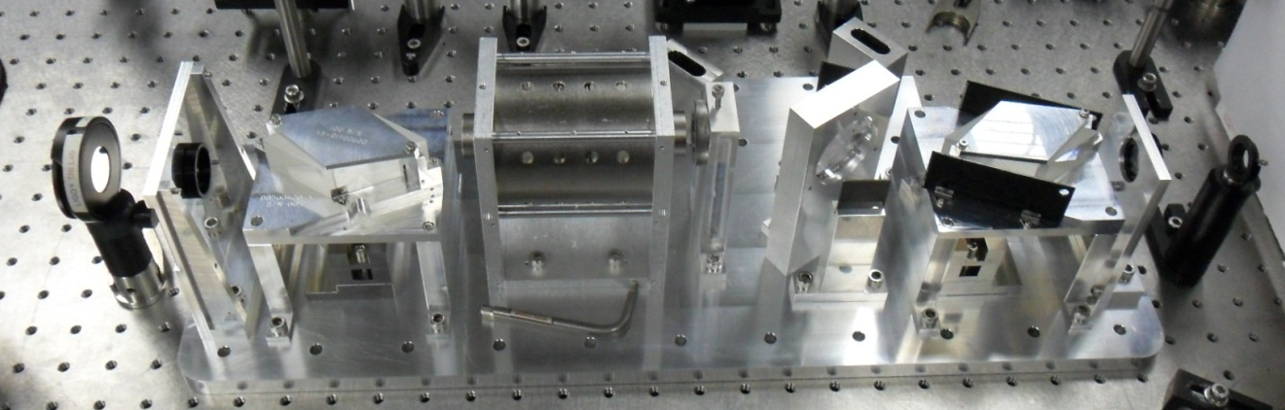
Scattered Light Control
Development Accomplishments – II
Completed Installations:
  Fold Mirror Elliptical Test Plate – BSC8, LHO
  Mode Cleaner Tube Baffles, LLO
  Arm Cavity Baffle – BSC8, LHO
  OFI in Squeezer test at LHO

Slide 8
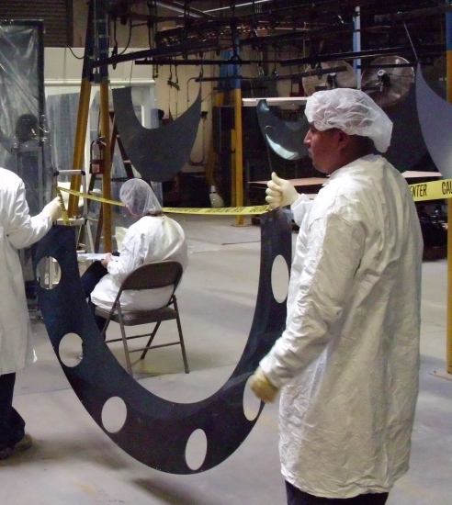
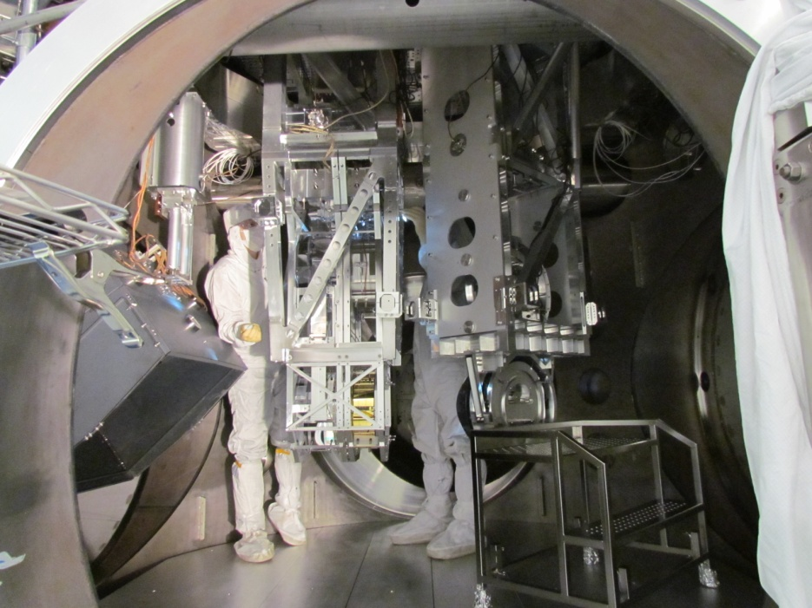
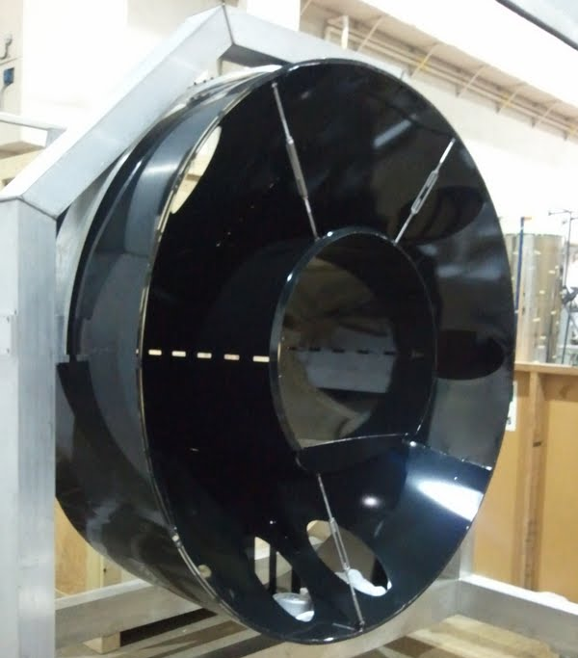
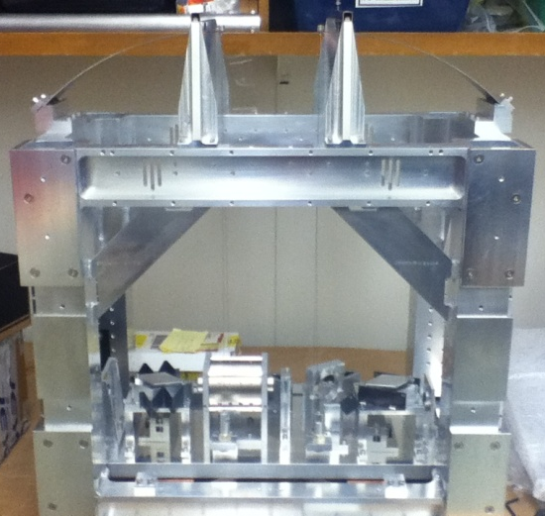
Scattered Light Control
Development Accomplishments – II
Oxidized stainless steel processing
Assembly and vibration testing of prototype, suspended Manifold/Cryopump Baffle at Caltech
Air Cavity Baffle in swing back position
OFI
1st article
assembly

Slide 9
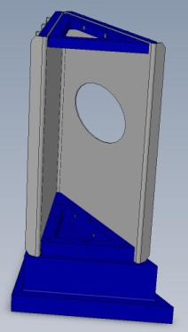
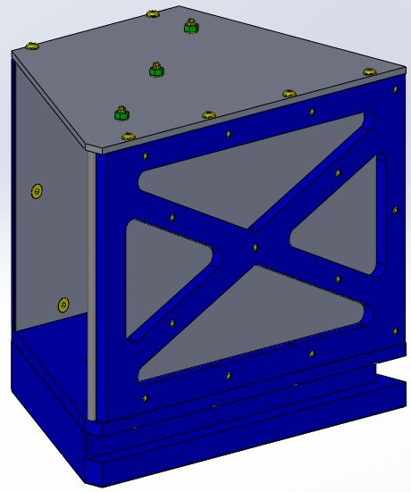
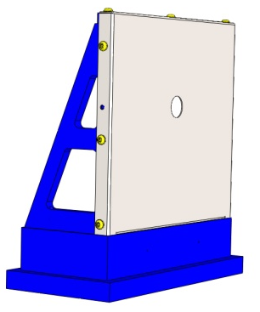
Stray Light Control Development Status
All designs and drawings are complete
Completed Final Design Reviews
  Arm Cavity Baffle
  Mode Cleaner Tube Baffle
  Manifold Cryopump Baffle
  Signal Recycling Cavity Baffles and Beam Dumps
  ITM Elliptical Baffle
  SRC - HAM Scraper Baffle
  SRC - SRM HR Baffle
  SRC - SR2 Scraper Baffle

Slide 10
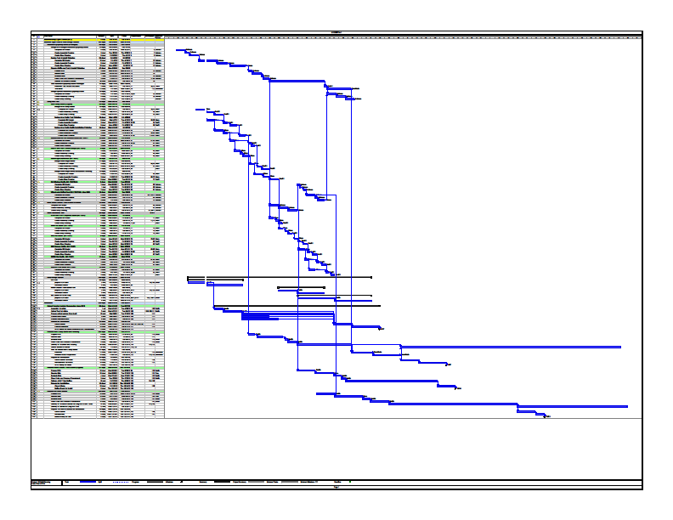
Stray Light Control
Project Plans and Organization
Project Plans
  Baffles and Beam Dumps for Michelson Integration ready – April 2012
  All Baffles and Beam Dumps for aLIGO Installation – complete by November 2012
Project Organization - Caltech
  Team Leader – Lisa Austin
  Cognizant Engineer – Michael Smith
  Coordinator – Nichole Washington
  Suspensions Testing - Virginio Sannibale
  Mechanical Designer - Heidy Kelman
  Mechanical Designer – Manuel Ruiz
  Mechanical Designer – Tim Nguyen

Slide 11
Scattered Light Control
LIGO-India Impact
Arm Cavity Baffle
  Two hole baffle option no longer required
  Re-evaluation of baffle weight for spring blades
  Re-configure ACB in H2-BSC8 for move to H1-BSC1
Reduced scope
  H2 Baffles no longer required – Manifold Flat, Fold Mirror Beam Dumps and Fold Mirror Elliptical
Manifold Cryopump Baffles will not be provided.
11

Slide 12
Scattered Light Control
Challenges, Risks, and Mitigations
Delivering SLC in time for the Michelson Integration
  On critical path to meet Installation Schedule
On-time delivery of procurements
  Continuous monitoring of manufacturing progress
No remaining known risks

Slide 13
Stray Light Control
Near Term Activities
Procurements – April 2012
  Signal Recycling Cavity Baffles
  Manifold Cryopump Baffles
  Remaining Arm Cavity Baffles
Completed Final Design Review – April 2012
  Remaining SLC baffles and beam dumps
Installation Underway
  Signal Recycling Cavity Baffles – LLO
  Output Faraday Isolator - LLO
  Mode Cleaner Tube Baffles - LHO
Developing installation procedures
Modifying tooling for installation variations between sites - Done

Slide 14
Viewport Functions
Provide optical viewports for the passage of optical beams in and out of the vacuum region(s) of the Interferometer.
  Optical lever beams
  Chamber illumination beams
  Video camera beams
  Optical beams for interferometer sensing and control
  Hartmann Sensor beams
  Photon Calibrator beams
  Septum Viewports
Double glass safety viewports for high power beams
Provide safety covers for all installed viewports
14

Slide 15
Viewport (VP) Requirements
Video camera VP—transmit visible light spectrum
Chamber illumination VP—uncoated viewports
OpLev VP—635 nm, similar to iLIGO
Septum Plate (to isolate input and output HAM chambers) VP— similar to eLIGO
ISC and Hartmann VP—super-polished, low scattering, < 1/10 wave , special AR coatings
  Hartmann AR coating: 800nm – 1080nm
  ISC AR coating: 532nm and 1064nm
Safety covers to protect viewports during installation and commissioning
High Power double glass design; High Power, Reducer & Septum Safety covers
15

Slide 16
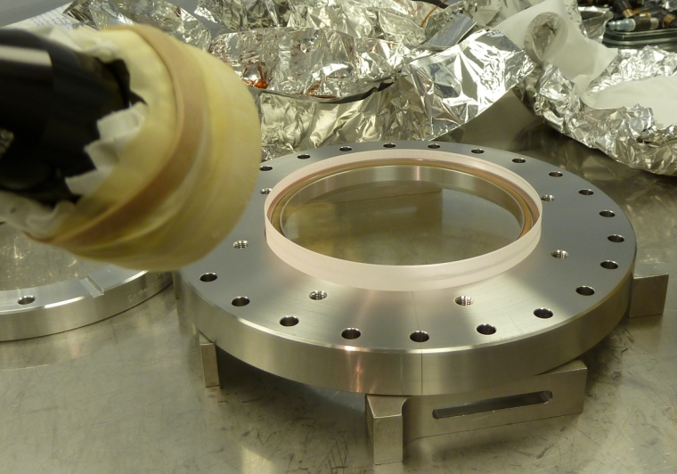
Viewport Design Concept
Reuse iLIGO VP wherever possible
New O-ring-sealed 6.0 inch VP for Interferometer Sensing and Control, and Hartmann beams
Wedged Septum VP similar to eLIGO design
Additional standard catalog VPs needed for new Mode Cleaner Tube VPs
Double glass for high power VP
Special AR coatings for Video, ISC,
and Hartmann beams
16

Slide 17
Viewport
Development Accomplishments
Analyzed VP scattered light for Hartmann beams
Determined new viewport locations in mode cleaner tubes using ZEMAX beam layout
Established proper names for all viewports according to LIGO naming convention & created a catalog of VP requirements and part numbers for all subsystems
Developed specification for 6.0 inch ISC/Hartmann VP
New – Develop/modify Safety Covers for High Power VPs, Septum VPs, and VPs with flange reducers
Completed VP Final Design Review
Implemented over-pressure and leak testing of VPs at LLO & LHO
Set up testing facility at Caltech for measuring VP coatings
17

Slide 18
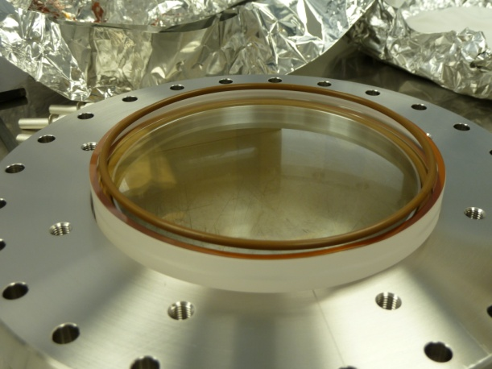
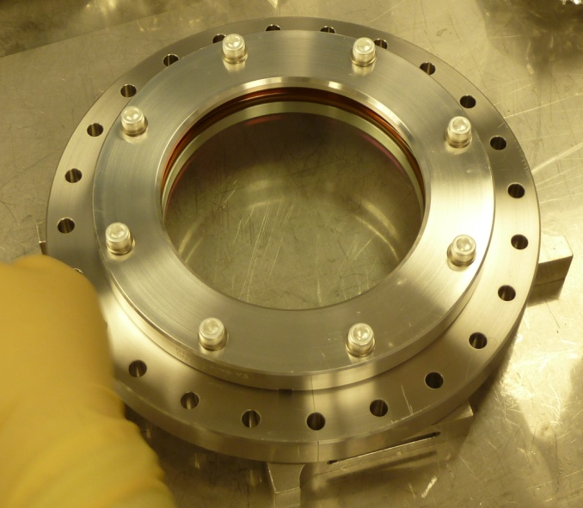
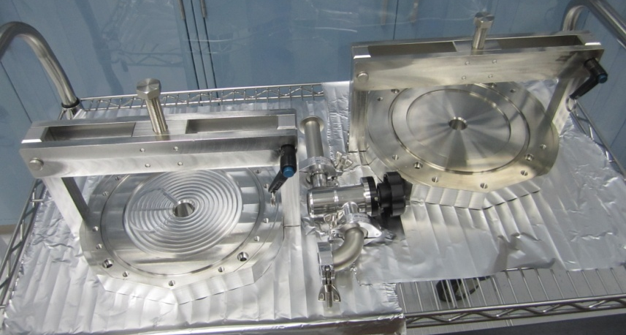
Viewport Development Status
Drawings and assemblies for custom 6.0 inch VP and Septum VPs - complete
Final Design Review - complete
VP Procurements on schedule for installation– complete
Assembly and Test of LHO custom VP for one arm test – complete
Assembly of LLO custom VP for SMI – complete
Over-pressure and leak testing facility at LLO & LHO - complete
Testing facility at Caltech for measuring VP coatings – complete
Testing fixtures
18

Slide 19
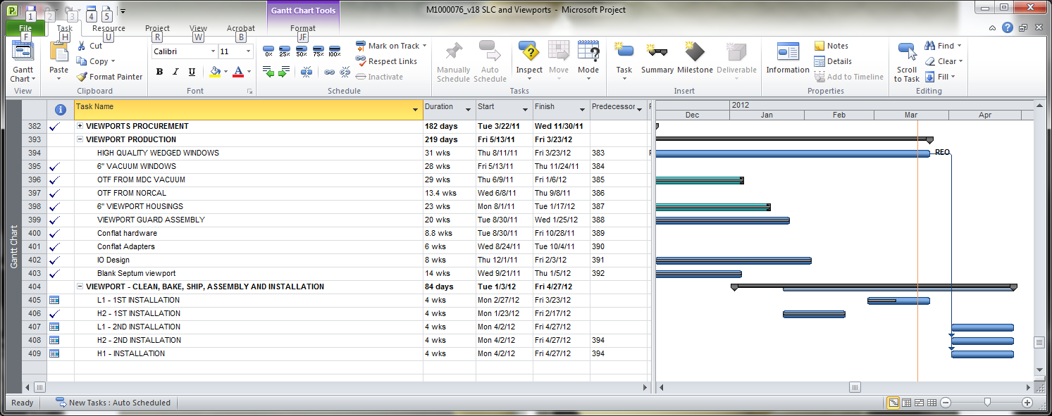
Viewport Project Plans and Organization
Project Plans
  On schedule for deployment of three aLIGO IFOs
Project Organization
  Leader – Lisa Austin
  Cognizant Optical Engineer – Michael Smith
  Coordinator – Nichole Washington – Caltech
  Assembly – Daphen Pino - Caltech
  Installation Leads –
    Thomas Vo – Hanford
    Chris Guido– Livingston
19

Slide 20
Viewport
Challenges, Risks, and Mitigations
Viewport damage during over pressure testing
  Fixture redesigned to eliminate stress to support ring.
Other VPs mostly catalog items
  No known technical or schedule risks
20

Slide 21
Viewport
LIGO-India Impact
No impact on design, cost or schedule.
21

Slide 22
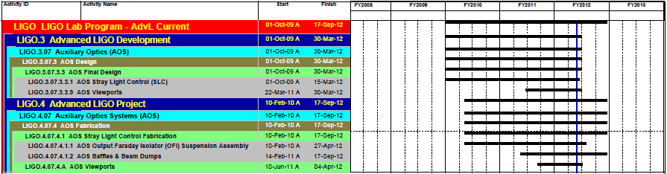
AOS SLC Schedule Highlights
SLC Scope of Work – Includes the Output Faraday Isolator, Baffles and Beam Dumps, and Viewports.
Schedule Highlights: All Final Designs were completed as of March 2012. All procurement and assembly are anticipated to be complete in September 2012.

Slide 23
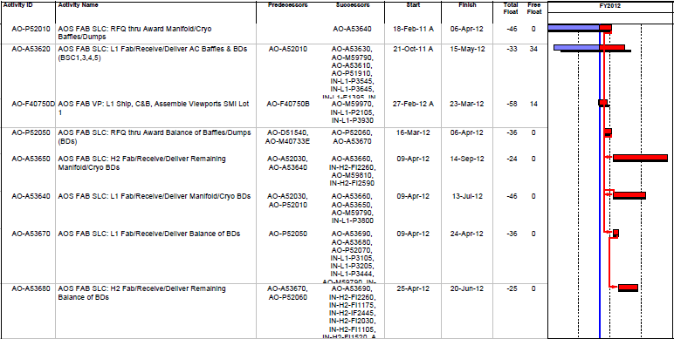
AOS SLC Critical Path
Manifold Cryopump Baffles were impacted by introduction of Oxidation Process and other design changes.
Arm Cavity Baffle - L1 lessons learned from BSC 8.
Viewports - L1 SMI assembly is in process.
Balance of Beam Dumps Final Design was recently completed.

Slide 24
AOS SLC Tracking Milestones
SLC Schedule delays caused by design changes and delayed completion of Final Designs.

Slide 25
AOS SLC Performance and Variances
Schedule Variance (SV) is due to delays in completion of Final Designs, First Article rework, design changes, and a material change.
Cost Variance (CV) is not significant or less than 10%.
Estimate At Completion (EAC) all less than 3% of the Budget at Completion (BAC).

Slide 26
AOS SLC Contingency Adjustments
Past Adjustments –
  ACR-110020 Rescheduled Viewport procurements
  ACR-110033 revised the SLC and Viewport schedule due to vendor delays
  ACR-110041 added budget
    $1,012K to SLC for failed first articles, baffle oxidizing, design changes, external cleaning, tooling, and suspension costs.
    $136K to Viewports for hardware, clamps, flanges, testing equipment and high power assemblies.
Anticipated Adjustments for Cost and Schedule - None

Slide 27
Summary of AOS SLC Status
Working to plan and within the current EAC.
Efforts being made to expedite deliveries for Install, as needed.
SLC and Viewports anticipated to complete September 2012.

