Slide 1
BSC Cable Trays … again:
Evaluation of an LLO Proposal for an Alternative Design

Slide 2
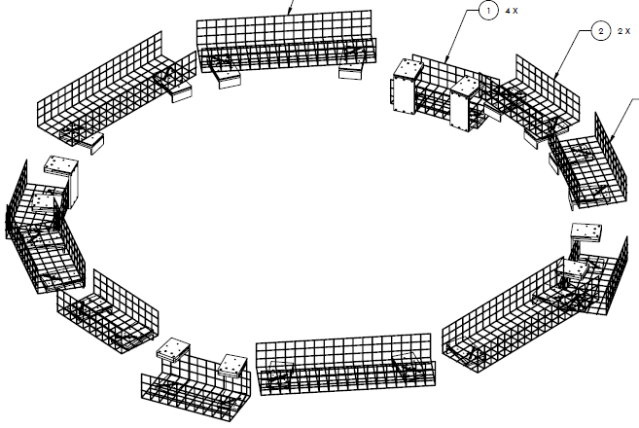
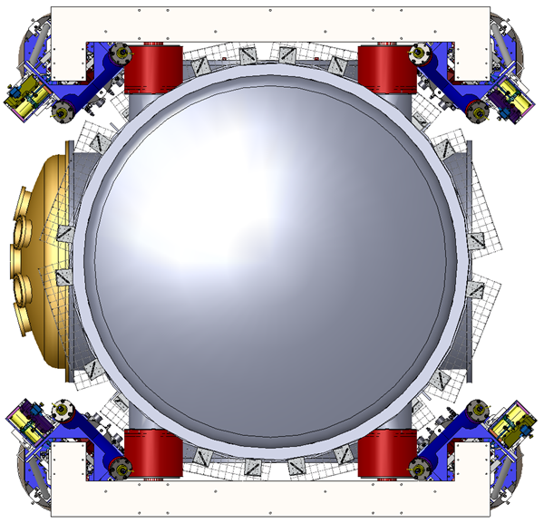
Baseline BSC Cable Tray Design
Design calls for wire frame tray cut in sections, supported from the welded stiffener ring (just below the electrical feed-through ports) via custom machined brackets
Tray sides are cut away in front of feed-throughs
Tray proximity to feed-throughs provides strain relief (cable weight does not hang from the connector as in iLIGO)
D1100430-v1
D1100024-v2

Slide 3
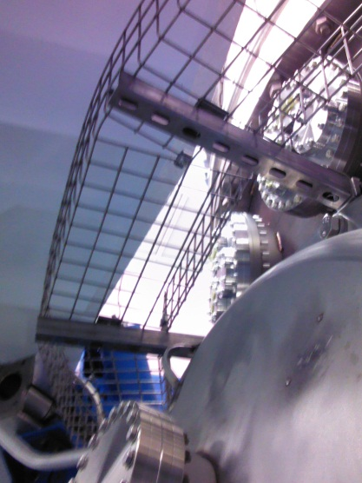
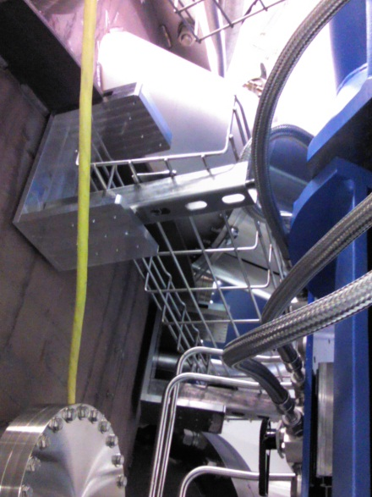
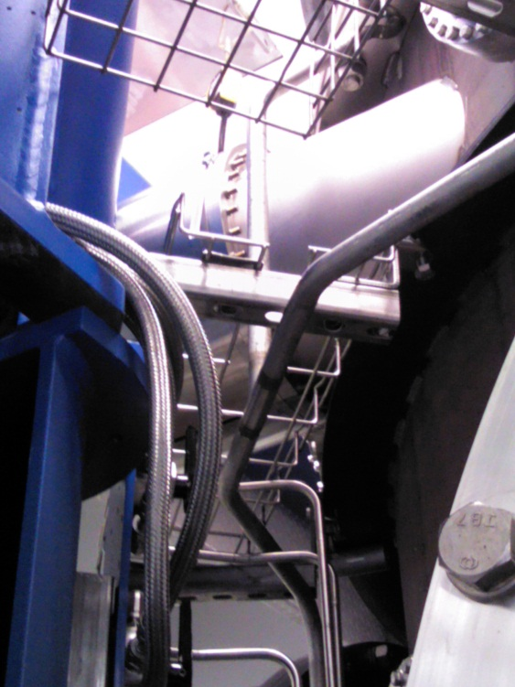
Baseline BSC Cable Tray Design
Implementation at LHO on WBSC8 and WBSC6 uses a mix of custom machined brackets and use of off-the-shelf hardware
Design approach is flexible enough to accommodate chamber-to-chamber differences, e.g. annulus ion plumbing interference
Found location for SEI CPS Demodulation modules on extended tray supports just outboard of tray (photo would help)
LHO experience?
Any problems? No
Adequate capacity? Yes
Difficulties implementing? No
Difficulty replacing conflat flange feed-throughs with tray in place? No
Difficulty removing BSC chamber door with the engine hoist? No, but the engine hoist end was modified.

Slide 4
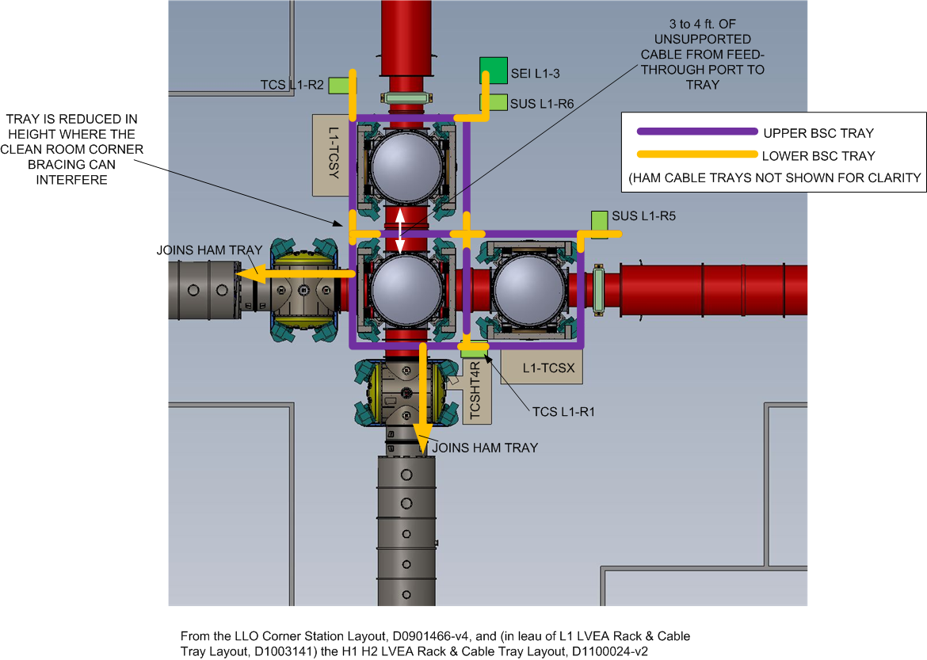
Alternative BSC Cable Tray Design proposed by LLO Staff

Slide 5
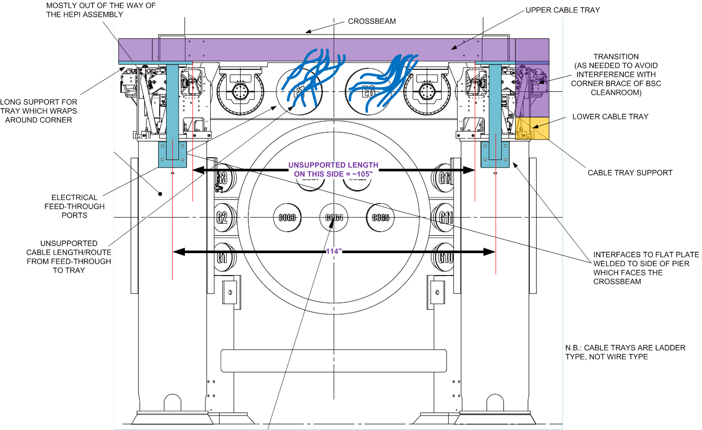
Alternative BSC Cable Tray Design

Slide 6
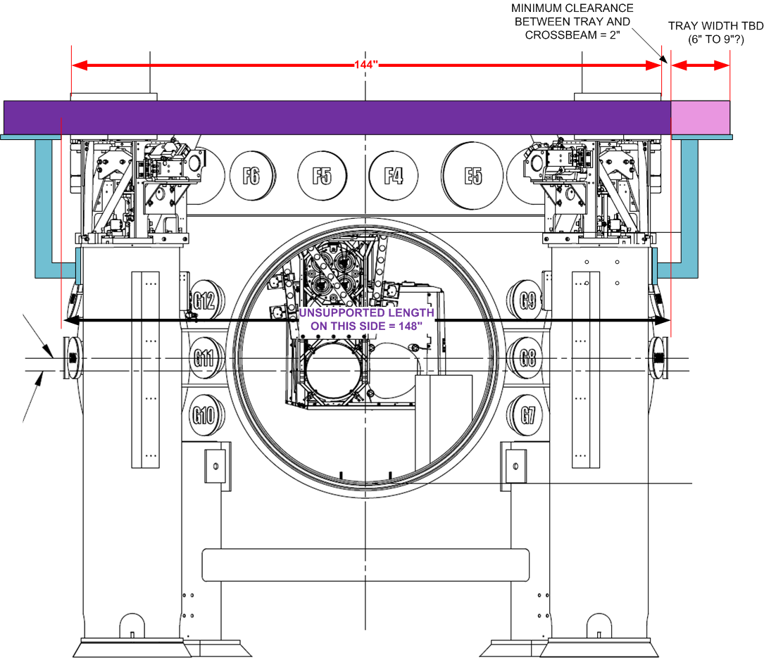
Alternative BSC Cable Tray Design

Slide 7
Alternative BSC Cable Tray Design
Pros
Easier installation
Easier access to the feed-throughs
Easier to route cable?
Easier to clean (will we ever clean the cable/tray?)
When cabling is disturbed, the accumulated particulates which will shower down are further from BSC door
Less expensive (iff we can re-use iLIGO tray)
Potentially allows for greater cable tray capacity (assuming no interference with Cleanroom or Work Platform, etc.)
Cons
No cable restraint
3 to 4 ft long unsupported cable lengths from feed-through to tray
Limits the positioning of the BSC Cleanroom – OK?
Interferes with Work Platform → Fatal Flaw, but see possible modifications
Interferes with BSC Cleanroom corner braces → Fatal Flaw, but see possible modification
Unsupported tray length likely too long → but see possible modification
Adds significant mass to HEPI support piers which effect dynamics → potentially fatal flaw

Slide 8
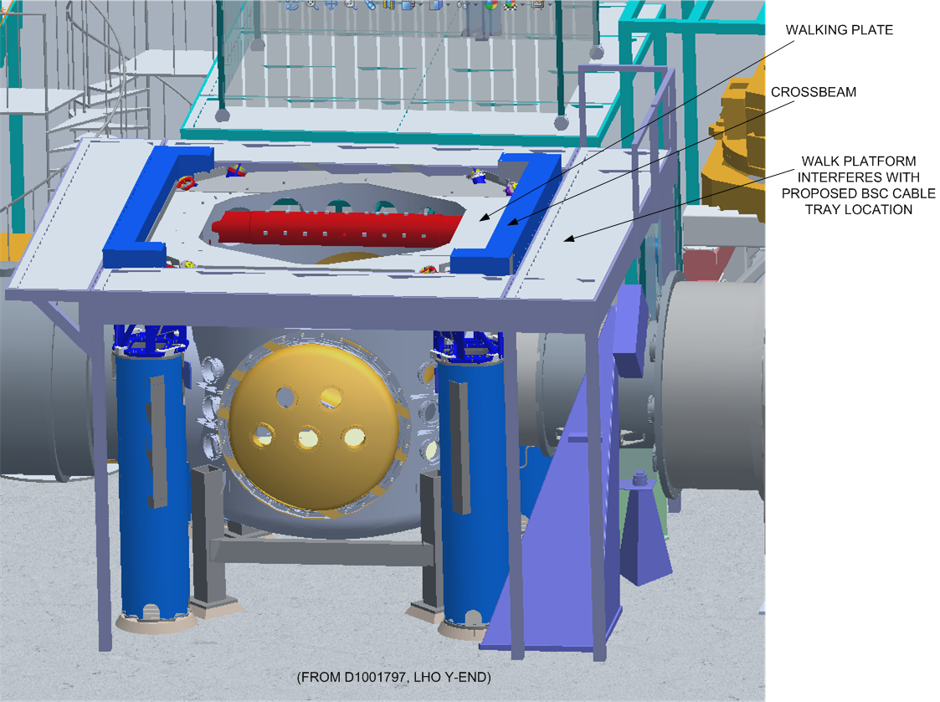
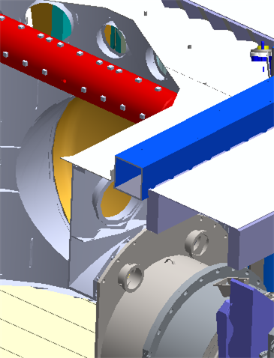
Interference with Work Platform (D1001990)
CROSS-SECTION

Slide 9
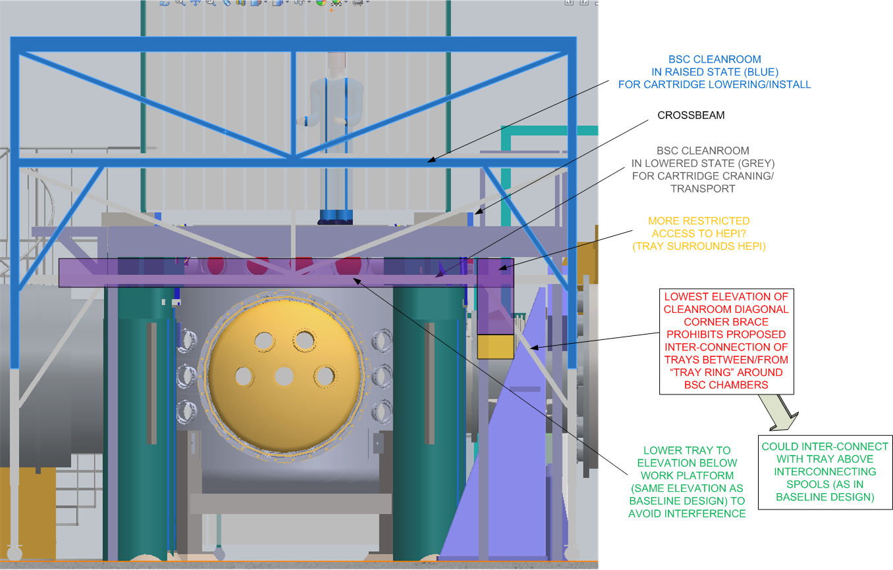
Lower the tray to avoid interference with Work Platform?

Slide 10
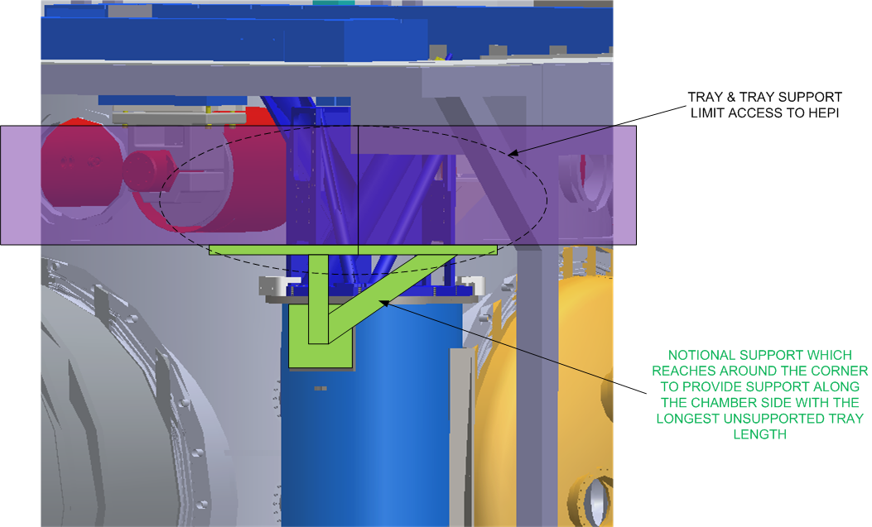
Reduce Unsupported Tray Length

Slide 11
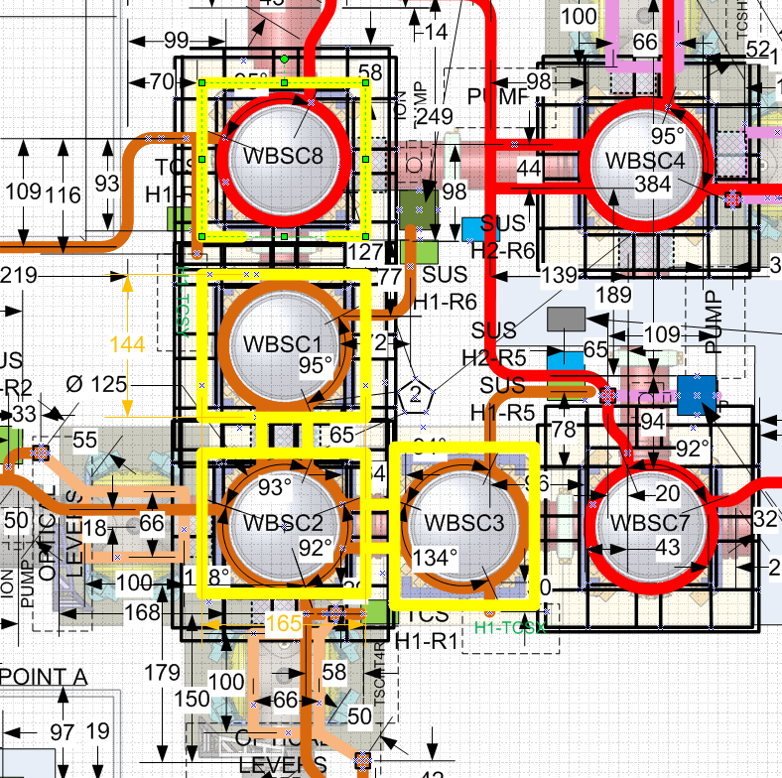
Cable Lengths OK?
Cable lengths in E1000760 (corner) and E1100385 (end) are based on ½ circumference around BSC for baseline design, or 125”
Alternative design adds ~113” per BSC, so ~19 ft for LBSC1 to electronics room
Cable lengths margin/contingency for LBSC1 & LBSC3 is 19 ft, so length is probably OK – but with no margin
Now that the specific feed-through ports have been assigned, one could look at each & every specific cable run, rather than worst case cable length

Slide 12
Modified, Alternative BSC Cable Tray Design
Possible problems:
Is ~3-4 ft. of unsupported cable length OK? Not if there is no cable restraint at feed-through
Can cable restraint be added to this design concept? Likely yes, but no design or concept in hand
Limits the positioning of the BSC Cleanroom – is this OK? Don’t know

Slide 13
Evaluation of Modified, Alternative BSC Cable Tray Design
Is the alternative proposal an attempt to solve any problem(s) with the baseline design?
Not really. Confusion about what the baseline design is. Follow-up actions:
Revise BSC tray drawing set (D1100430) to indicate final design, as implemented at LHO
Complete the drawings specifically for LLO (don’t rely upon LHO versions) and cite minimum tray size & point to BSC tray drawing set (D1100430)
Are there any significant risks with the baseline design?
No
We need a decision now (can’t wait for additional evaluation)
Decision is to proceed with the baseline design

