Slide 1
DC Power Supply Acceptance Noise Testing
The following slide is a plot of all the measurements taken from Rich Abbott’s excel file, on unit H210618 converted to Vrms/rtHz.
As per T1100478; “Acceptance Testing of aLIGO DC Power Supplies”
The 25V 12A plot is the one we use as the ‘Reference’ in our comparison plots.

Slide 2
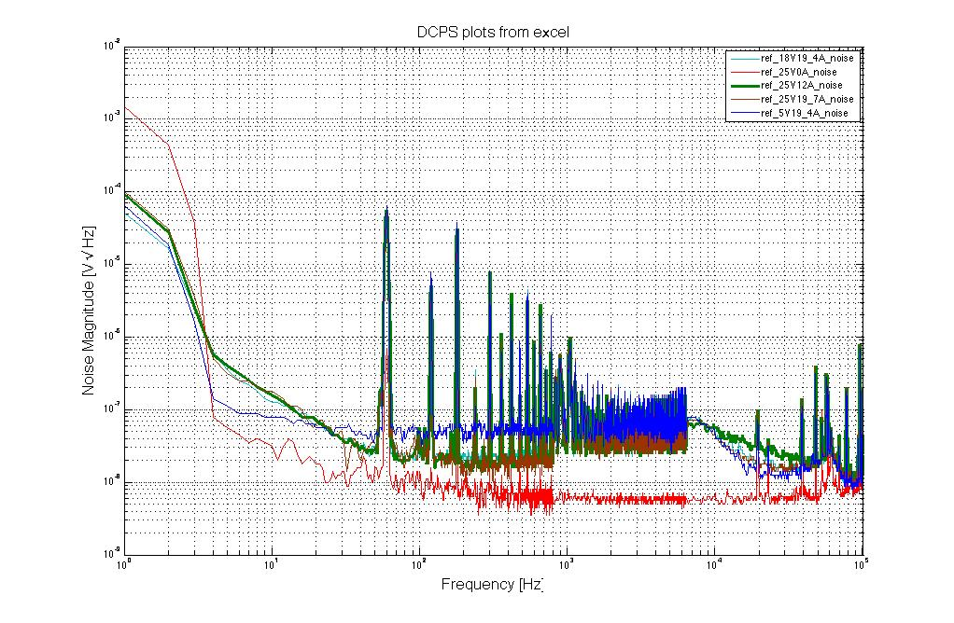
Serial Number H210618 Plots from KEPCO Trip

Slide 3
DC Power Supply Plots from KEPCO Trip
The following slide is a plot of new measurements taken on unit H210618 with our current test setup.
This is the same unit used for evaluation at Kepco for the measurements performed by Rich Abbott and David Kinzel.
As per T1100478; “Acceptance Testing of aLIGO DC Power Supplies”
This plot shows the difference in noise due to our testing setup compared to the measurements taken at Kepco.
The subsequent plot is 3 consecutive measurements plotted together to show the consistency of the measurements.

Slide 4
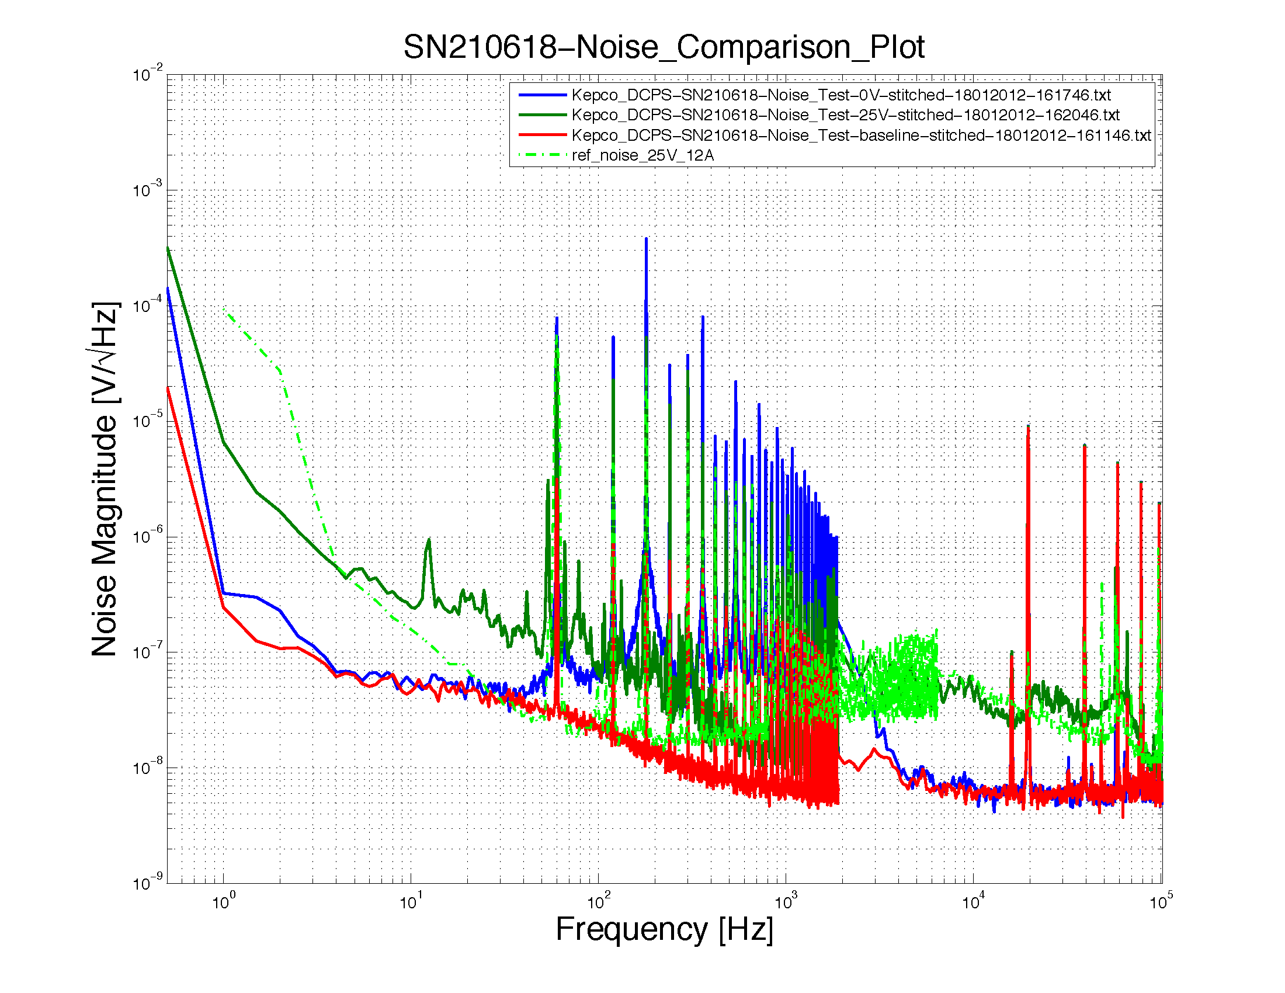
Serial Number H210618 on LLO Equipment

Slide 5
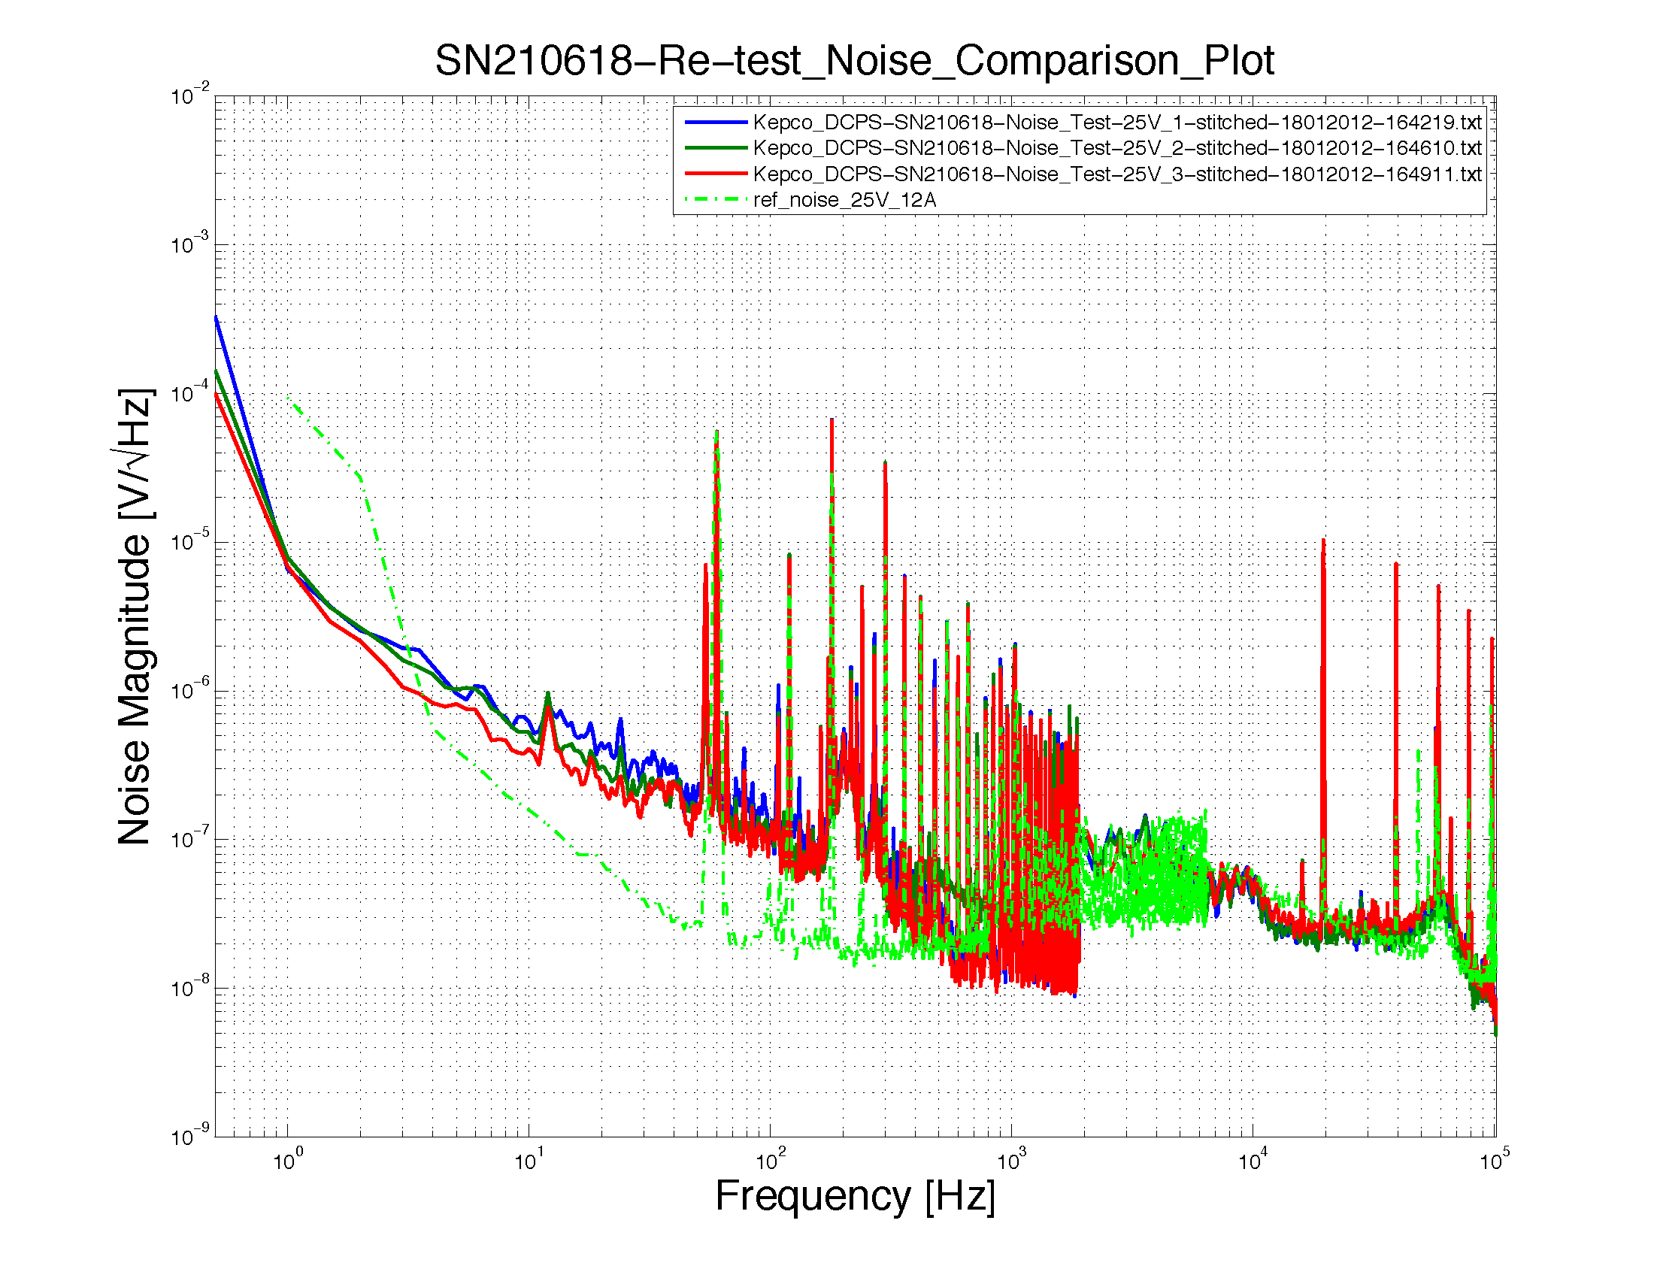
Serial Number H210618 Consistency Plot

Slide 6
Serial Number H210618 Consistency Plot
The following slides show the comparison plots generated by the automated scripts for a sample of DC Power supplies:
The power supplies are connected to a 2 ohm 600 watt load.
Steven Petree has compiled the following notes:
Here are my notes on instructions for testing the supplies.
Here is my summary of the current test status of the supplies.
This page is a collection of the Noise Comparison plots.
This page is a collection of the Monitor plots.

Slide 7
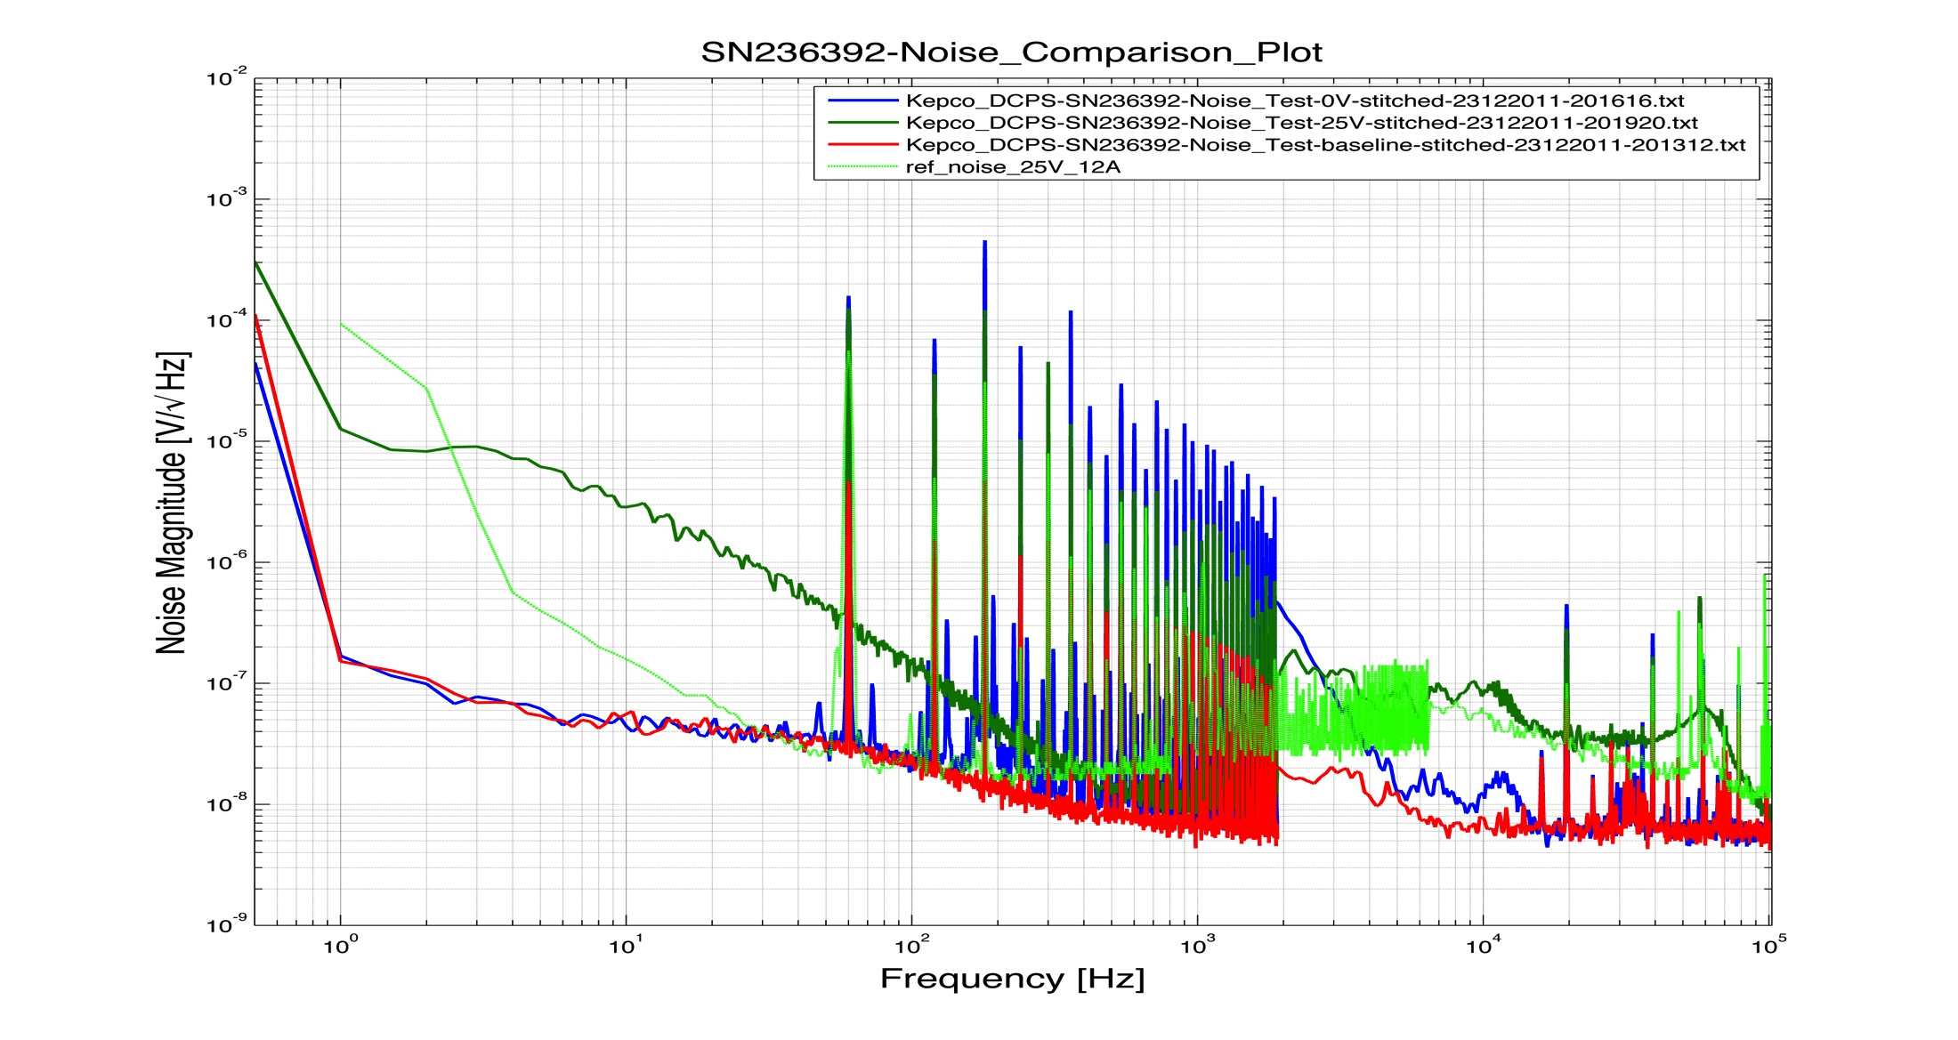
Serial Number H236392

Slide 8
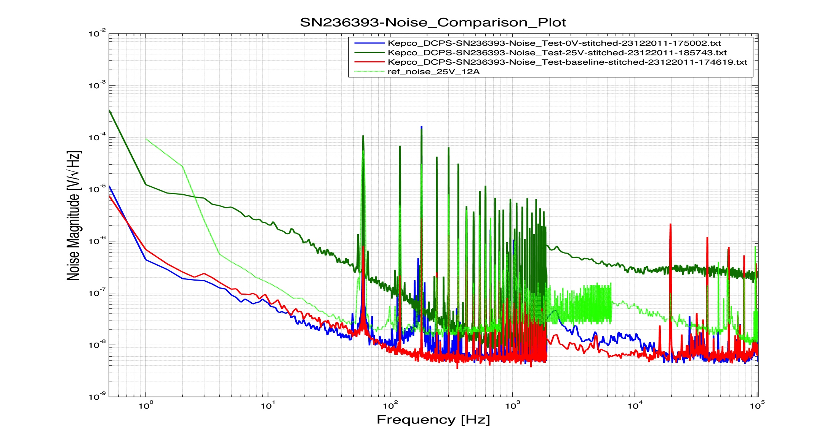
Serial Number H236393

Slide 9
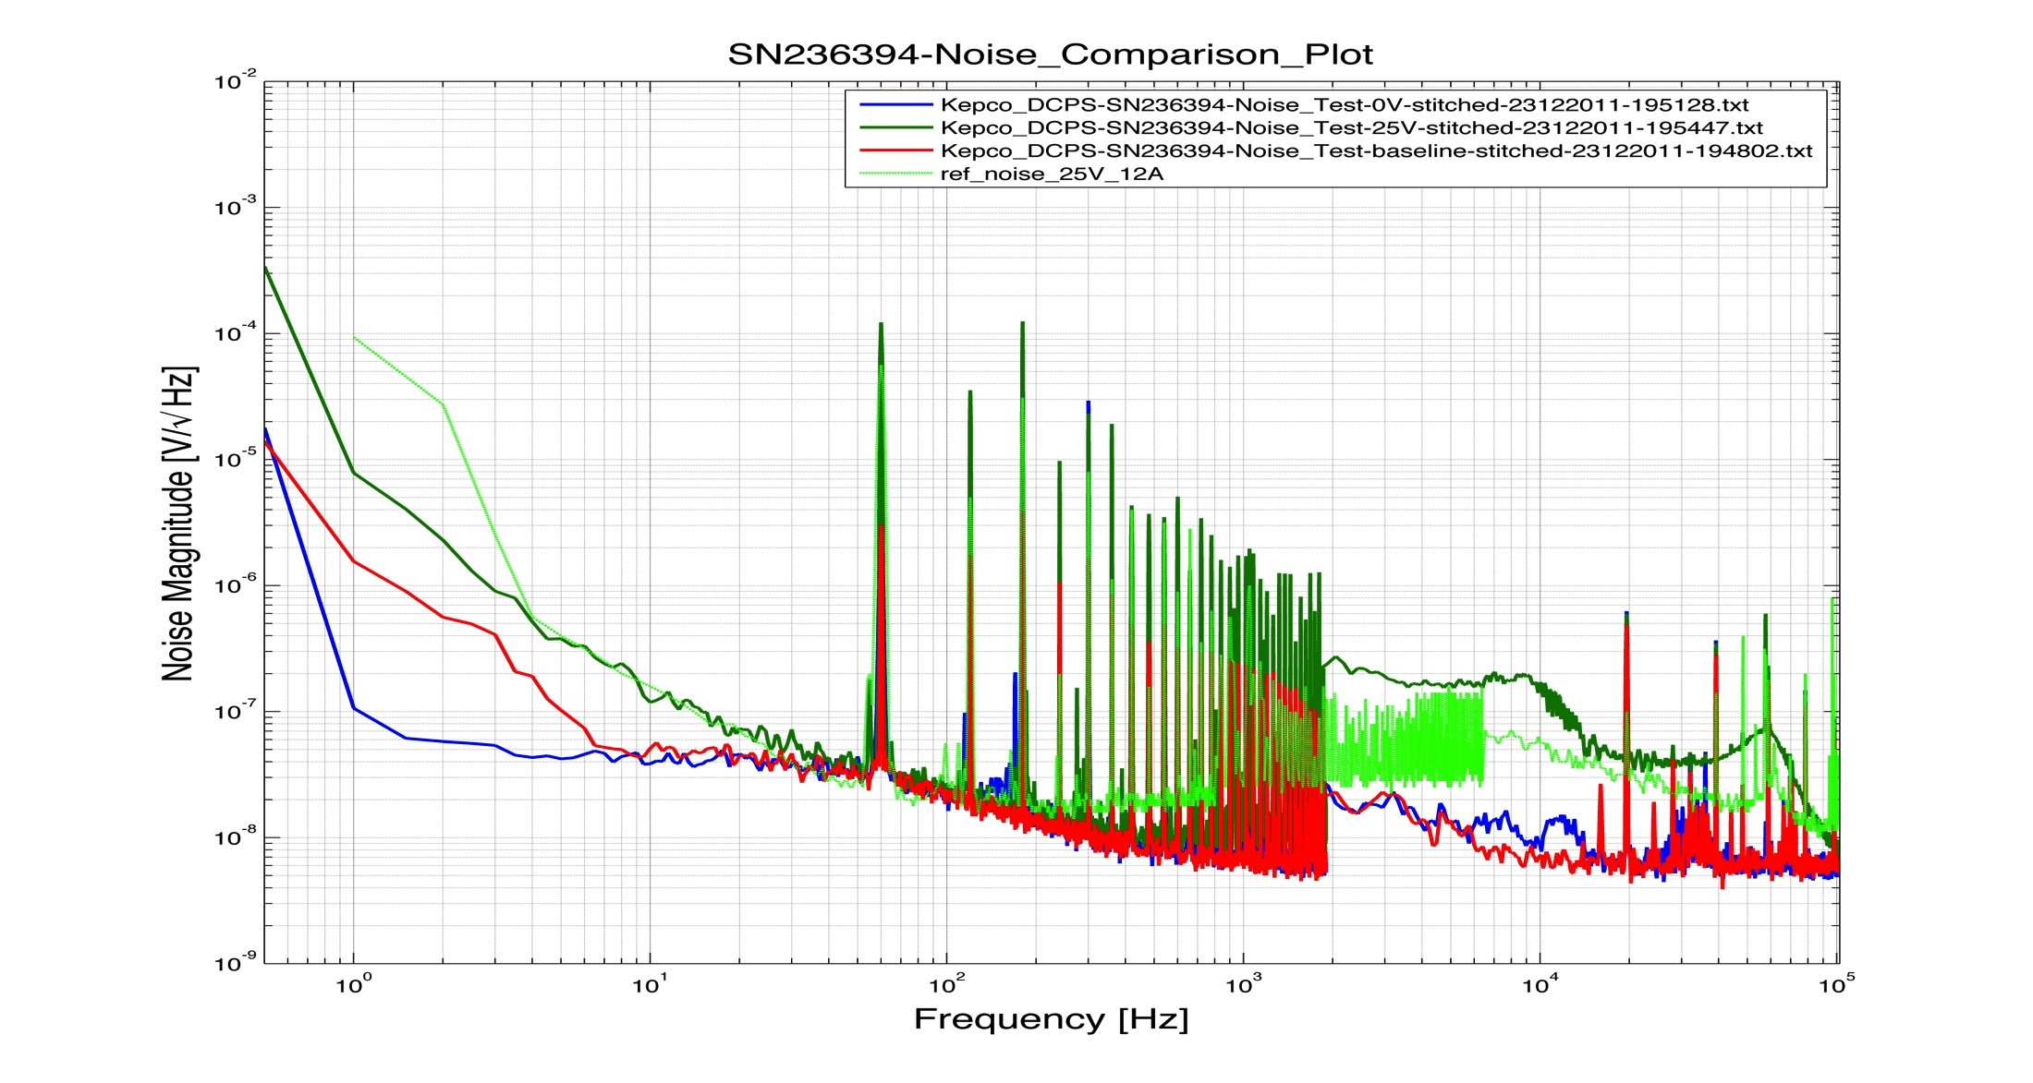
Serial Number H236394

Slide 10
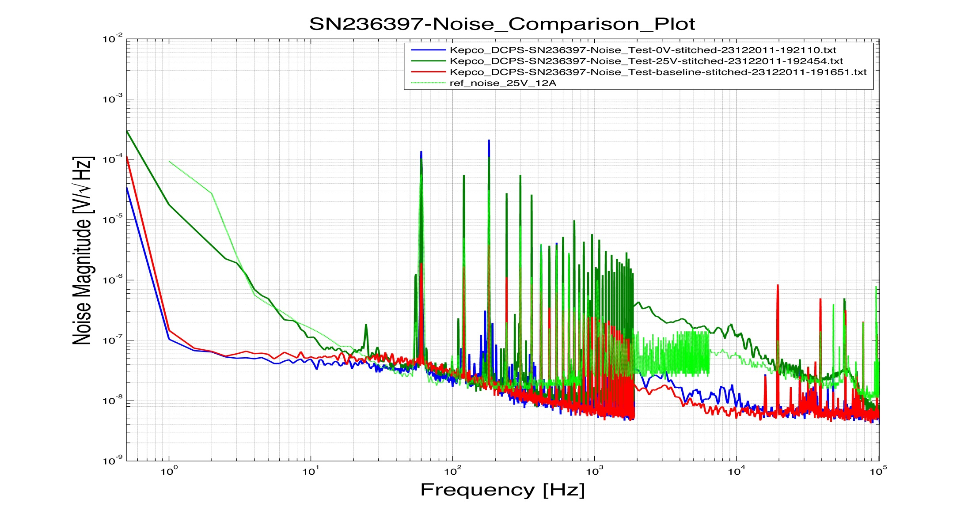
Serial Number H236397

Slide 11
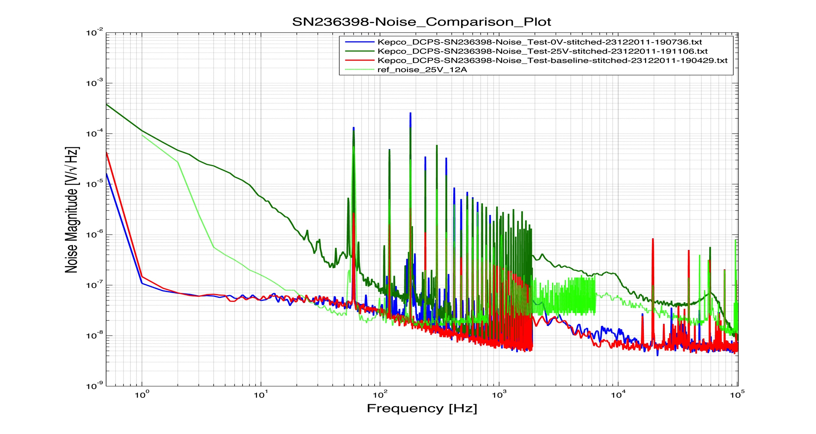
Serial Number H236398

Slide 12
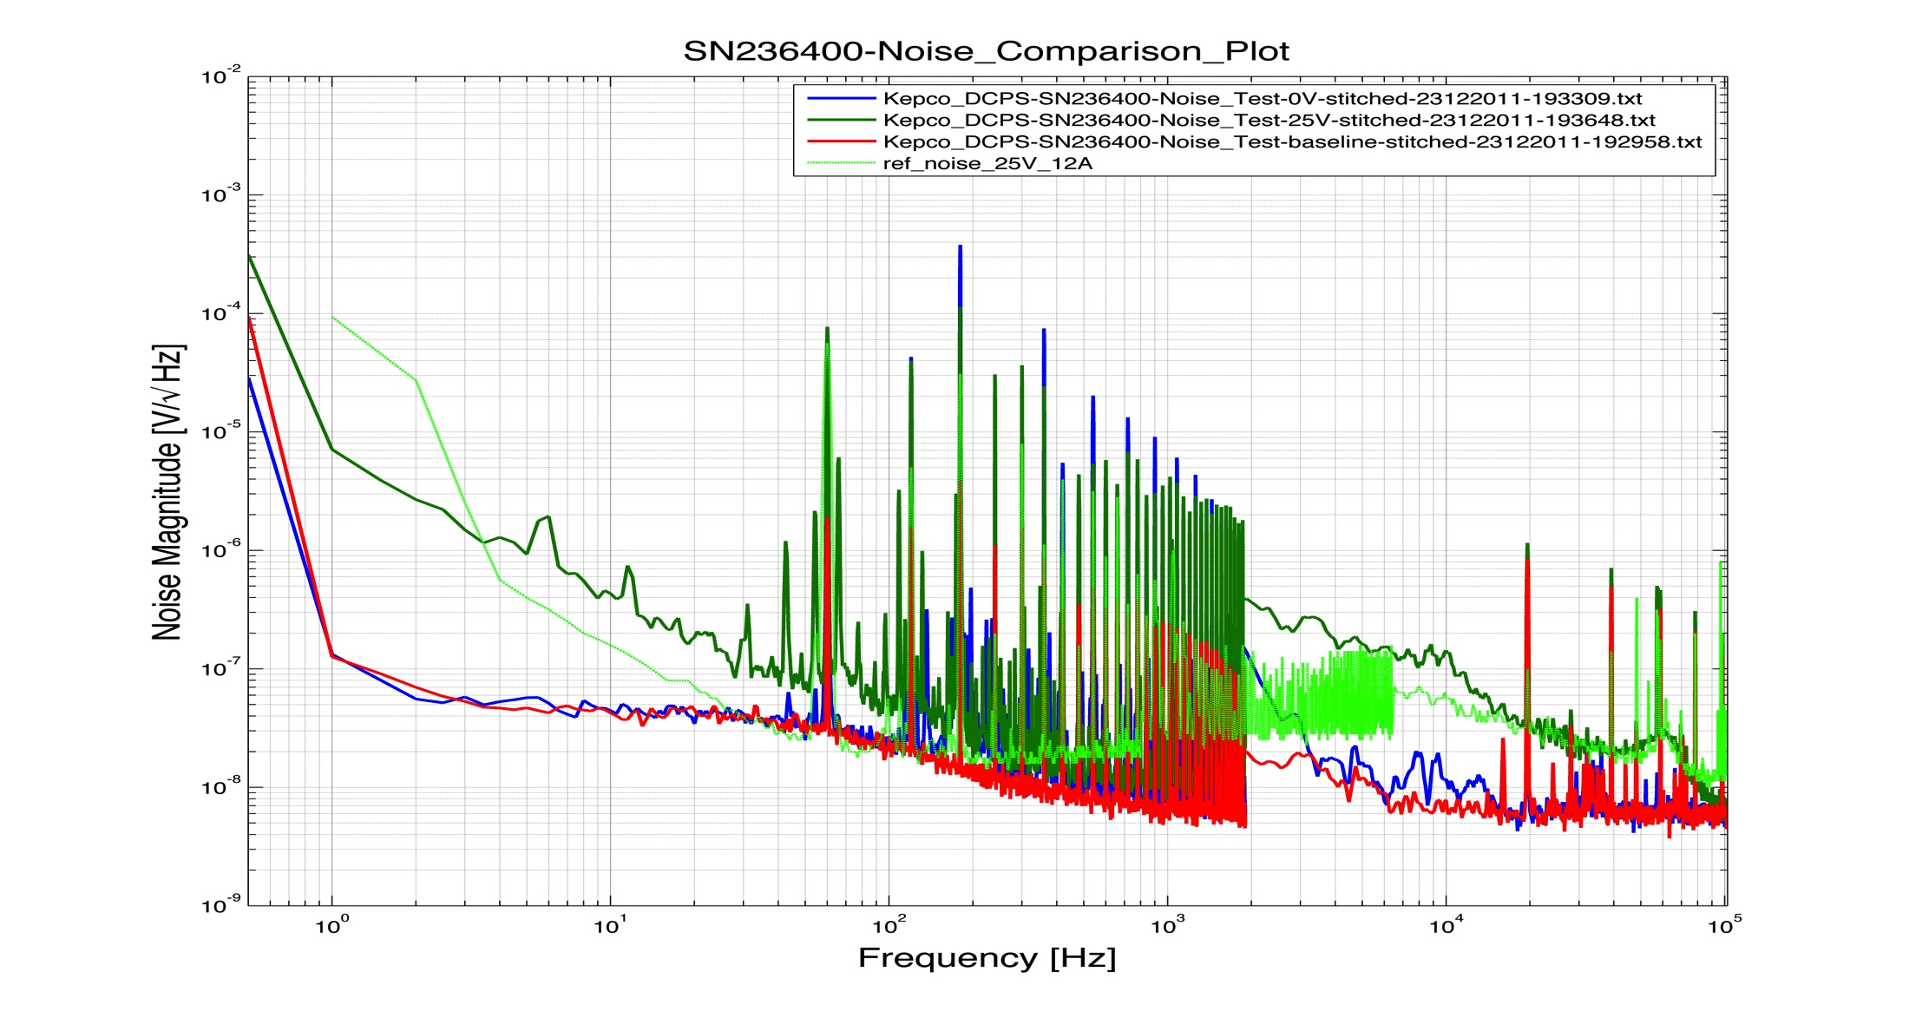
Serial Number H236400

Slide 13
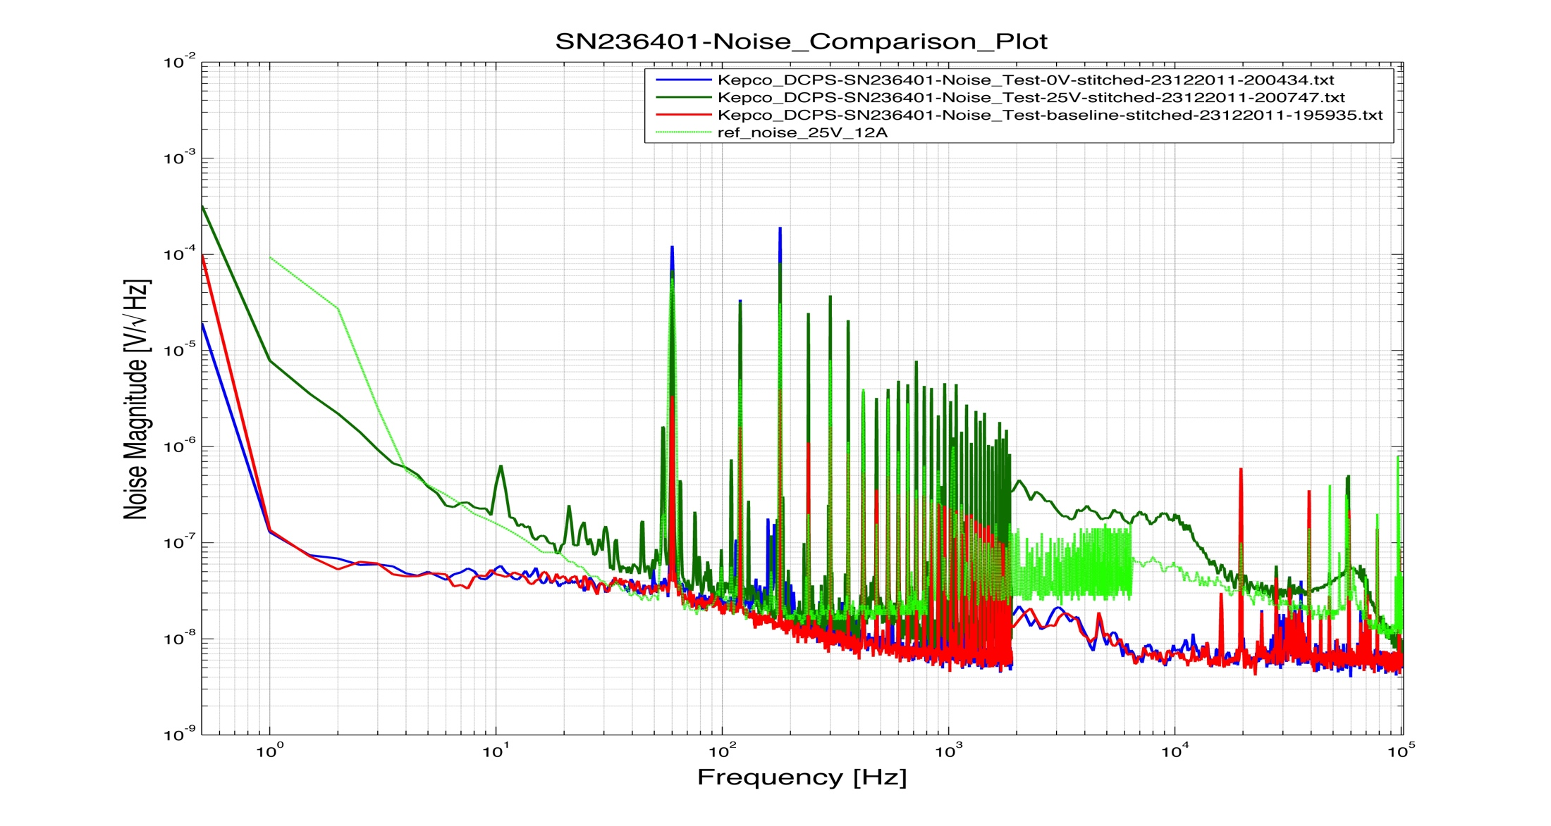
Serial Number H236401

Slide 14
Summary
The difference in noise measured, for example at 10 Hz, between the reference and actual at 25V and 12.5A varies between 0.3 x 10^-6Vrms (SN H236400) and 5.5 x 10^-6Vrms (SN H236398).
This difference may be due to different environmental noise, or the use of different loads at the Kepco factory vs. here at LLO.
Based on these observations, we propose that we choose the local reference measurement as a guideline for acceptance. (Note that the guideline shown on all of our measurements presented here is still the measurement made at KEPCO.)

