Slide 1
EtherCAT for Advanced LIGO
January 4, 2012
Advanced LIGO
Implementation

Slide 2
Motivation
Need to replace VME based EPICS system
100’s of slow controls channels (tags) in ISC alone
Vacuum system is still running legacy hardware
Preferably a commercial solution
High reliability
Long term availability
Operator friendly (documentation, external support, etc.)
Separate the computer from analog
Need a field bus, lot to choose from: Proprietary, Modbus, CANopen, Profibus/ProfiNet, EtherCAT, Sercos III, Ethernet IP, Devicenet, …

Slide 3
Why EtherCAT?
PSL is using it
Experience in H1 squeezing experiment
Modern design (Ethernet done right)
100base Ethernet (no expensive backbone)
Low latency: Datagrams processed on the fly
Fast: 1-10 ms readout standard; 100us possible
Software: IEC 61131-3 with EPICS interface
Cost effective for large number of slow channels
Stackable, DIN-rail mounted units with 1-4 channels typical
16 bit analog channel: ~$50-$100
Binary channel: ~$10-$20

Slide 4
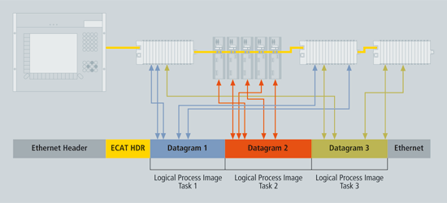
What is EtherCAT?

Slide 5
What is EtherCAT?
Protocol: (Raw) Ethernet frames
Memory mapped access (4GB)
UDP/IP encapsulation possible
Performance
Real-time kernel on PC
1000 distributed I/Os in only 30 µs
Topology
Line, star or tree; hot connect of branches possible
up to 65,535 devices
E-bus (LVDS) for DIN mounted modules
Stand-alone modules (IP67)
Distributed Clock
Special Safety Terminal
Useful information video

Slide 6
Where does it fit in?
Goal: Run slow controls hardware through EtherCAT
Mode cleaner board, common mode board, RF distribution system, HWS, picomotors, shutters, timing system readback, etc.
Slow controls channels are connected to the fast system where it makes sense.
No VME based systems in the long run
No stand-alone EPICS RS232/Ethernet/Modbus controls computer
Need to port legacy systems: dust monitor, weather station, PC/104(?), etc.
Modbus: Use gateway to EtherCAT, see wiki.
Boot into the correct state → no burt restore!
EPICS:
Soft IOC and transport layer
Screens (medm for now)

Slide 7
Implementation in Advanced LIGO
Controller: TwinCAT
Running on rack mounted PCs; 1 controller per building
Full featured Programmable Logic Controller (PLC)
OPC and EPICS OPC server for controls interface
IO Chassis
3U, 24” deep; with 3 DIN rails
Equipped with EtherCAT Terminals (mostly from Beckhoff)
Stackable DIN mounted modules
Field wiring to rear mounted interface connectors
Mostly D-sub, direct, or
DB37 to external signal concentrators
Networking
Fiber between corner and ends (synchronization, data exchange)
Separate controls network for vertex and ends, see D1102294-v1.

Slide 8
Long-Haul Connections
MSR
H2
H1/L1
EX CR
CAT5
MM Fiber
SM Fiber
4km
EY CR
PTP
4km
Corner Electronics Room
EY Electronics room
EX Electronics room

Slide 9
3U Chassis Design

Slide 10
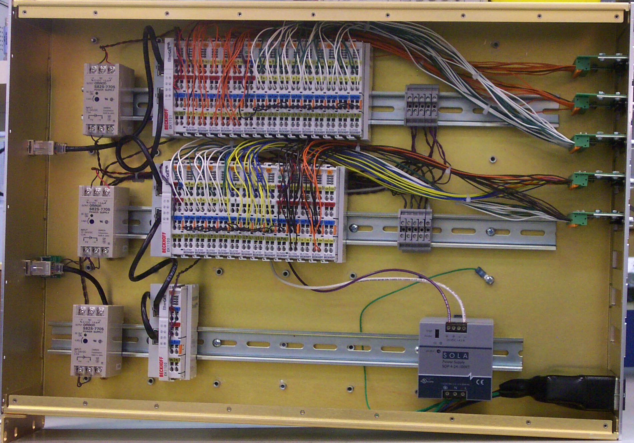
3U Chassis Design

Slide 11
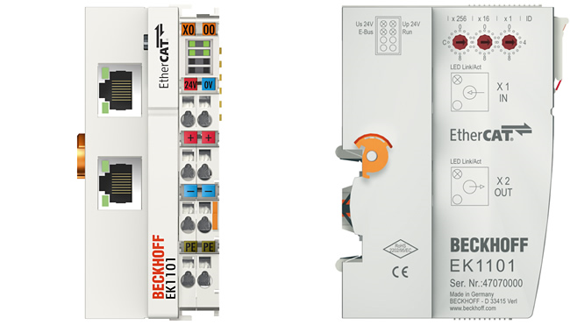
EtherCAT Coupler
E-Bus
IN
Ethernet
NEXT
DIN rail
Power
E-Bus:
– Ethernet OUT (LVDS)
– Ethernet IN (LVDS)
– 5V Power
Power:
– Positive (24V/5V)
– Ground
– Shield
Coupler requires +24V
to power E-Bus
Separate power for terminals

Slide 12
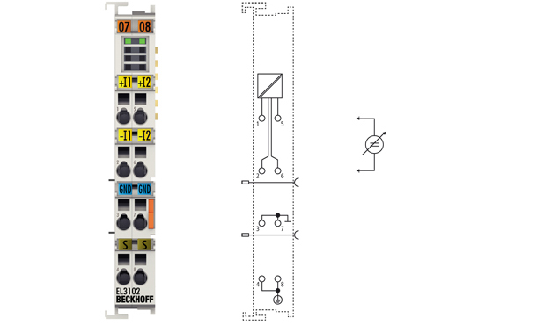
EtherCAT Terminal
4-channel binary TTL output
2-channel 16-bit analog input

Slide 13
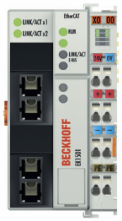
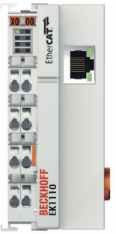
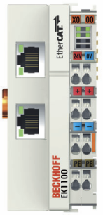
Ethernet Configuration
Fiber IN
Aux 1
Aux 2
Fiber OUT
Unconnected ports are automatically closed

Slide 14
TwinCAT Software (IEC 61131-3)
Local user screen
Process variables
Shared Memory
Real-time task
EtherCAT
OPC Server
PLC:
Periodic
user task
PLC: Periodic
user task
External:EPICS Interface
EPICS

Slide 15
OPC and the EPICS OPC Server
OPC: Industrial standard for exchanging controls data and events as well as their history
OPC classic: efficient transport requires Windows DCOM
OPC UA: modern, platform independent, strong security, information models (i.e., types and hierarchical organization)
Has been widely adapted by the automation industry A wide selection of software and hardware solutions are available that are supporting it
EPICS OPC Server
OPC device support maintained at Bessy
Can we run OPC and EPICS in parallel to leverage existing software and also profit from commercial packages?

Slide 16
Outlook
Deploy the first system in January/February 2012
Easy to expand; easy to add a few more channels
Logic controllers and slow servos can be directly implemented in the TwinCAT PLC
The next TwinCAT will support 64bit OS, multi-core and C++/Matlab
Opens a way forward to adopt commercial solutions

Slide 17
Further Information
EtherCAT
EtherCAT Technology Group
Wikipedia
Hardware and Software
Beckhoff website
IEC 61131-3:
R.W. Lewis, “Programming Industrial Control Systems Using IEC 1131-3”
OPC
OPC Foundation
EPICS OPC Server

