Slide 1
TMSY Telescope focal tuning results
Bram, Matt and Keita
20 Oct. 2011
LIGO-G1101254

Slide 2
TMS Telescope
Folded off-axis parabolic telescope
Primary – 9” diameter (228.6 mm)
Front telescope aperture 8.5”
Secondary – 1.5” diameter (38.1 mm)
Folding mirror 1 – 6” diameter
Folding mirror 2 – 3.5” diameter (with flat mods)

Slide 3
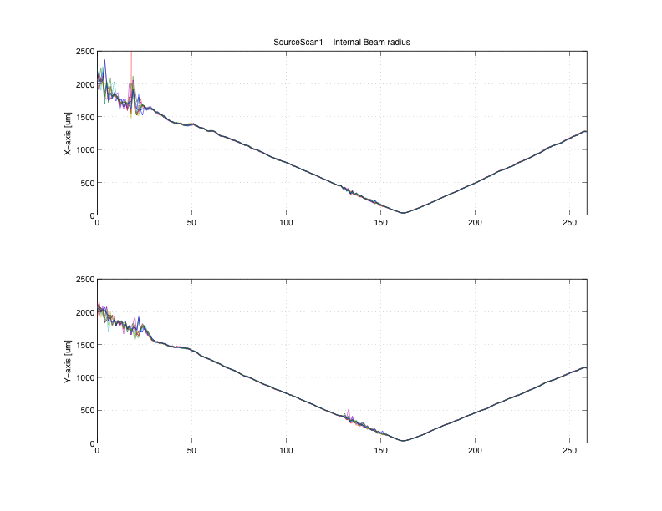
Source Parameters (MM results)
IR beam retro reflected using the last steering mirror on the Pedestal breadboard. MM to Retro mirror is 47cm.
The RED marked values are used for the model.
[EXTERNAL RESULTS]
Min Max Mean Std Dev Dim
---------------------------------------------------------
M≤x 0.97 0.99 0.98 0.007 -
M≤y 1.03 1.06 1.04 0.007 -
M≤r 1.00 1.02 1.01 0.006 -
2Wox 5.529 5.717 5.658 0.0637 mm
2Woy 5.728 5.879 5.821 0.0494 mm
2Wor 5.652 5.799 5.741 0.0540 mm
2Wex 5.754 5.790 5.777 0.0110 mm
2Wey 5.889 5.911 5.898 0.0066 mm
2Wer 5.826 5.843 5.838 0.0058 mm
Zox 6.911 3.317 4.813 -1.1608 m
Zoy 5.592 2.476 3.778 -1.0532 m
Zor 5.937 2.918 4.279 -1.0849 m
Zrx 23.059 24.669 24.038 0.5409 mm
Zry 23.326 24.371 23.961 0.3954 mm
Zrr 23.237 24.518 24.005 0.4566 mm
Divergence-x 0.23 0.24 0.24 0.003 mr
Divergence-y 0.24 0.25 0.24 0.002 mr
Divergence-r 0.24 0.24 0.24 0.003 mr
Astigmatism(Zoy-Zox)/Zrr -8.6 -3.0 -4.3 1.96 %
Waist Asymmetry(2Woy/2Wox) 1.025 1.042 1.029 0.0058
Divergence Asymmetry Thetay/Thetax 1.024 1.041 1.032 0.0056

Slide 4
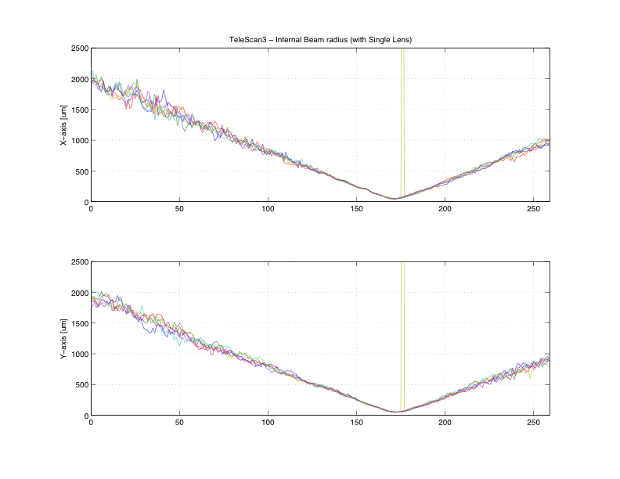
Tele Measurement - 3 (Single Lens)
IR beam from the Pedestal breadboard into the Tele, retro-reflected by the 8” flat ETM, back to the breadboard into the MM.
The RED marked values are used in the model are return values.
[EXTERNAL RESULTS]
Min Max Mean Std Dev Dim
---------------------------------------------------------------
M≤x 1.27 1.36 1.32 0.036 -
M≤y 1.25 1.39 1.32 0.046 -
M≤r 1.29 1.39 1.33 0.037 -
2Wox 0.608 0.675 0.638 0.0249 mm
2Woy 0.625 0.665 0.639 0.0163 mm
2Wor 0.632 0.665 0.645 0.0140 mm
2Wex 3.028 3.191 3.081 0.0641 mm
2Wey 2.740 3.009 2.926 0.0989 mm
2Wer 2.932 3.060 3.005 0.0475 mm
Zox -1.048 -1.098 -1.076 -0.0163 m
Zoy -0.992 -1.044 -1.022 -0.0198 m
Zor -1.039 -1.055 -1.049 -0.0058 m
Zrx 0.215 0.246 0.228 0.0123 mm
Zry 0.218 0.236 0.229 0.0075 mm
Zrr 0.224 0.238 0.230 0.0051 mm
Divergence-x 2.74 2.85 2.80 0.047 mr
Divergence-y 2.69 2.87 2.79 0.064 mr
Divergence-r 2.76 2.84 2.80 0.034 mr
Astigmatism(Zoy-Zox)/Zrr 1.5 39.7 23.7 14.47 %
Waist Asymmetry(2Woy/2Wox) 0.934 1.058 1.003 0.0515
Divergence Asymmetry Thetay/Thetax 0.953 1.046 0.998 0.0316

Slide 5
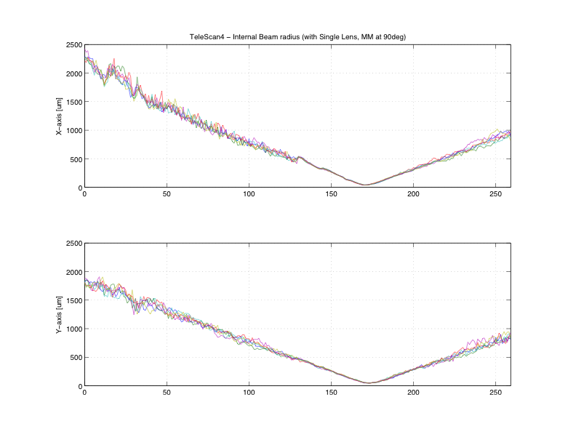
Tele Measurement – 4 (Single Lens)
Same as ‘Tele Measurement – 3’, but with the ModeMaster rotated (roll) by 45 degrees, to sample the beam differently.
The RED marked values are used as the return values.
[EXTERNAL RESULTS]
Min Max Mean Std Dev Dim
--------------------------------------------------------------
M≤x 1.16 1.21 1.17 0.020 -
M≤y 1.17 1.21 1.19 0.014 -
M≤r 1.21 1.25 1.23 0.015 -
2Wox 0.560 0.605 0.577 0.0163 mm
2Woy 0.575 0.594 0.585 0.0076 mm
2Wor 0.593 0.621 0.603 0.0092 mm
2Wex 3.027 3.218 3.100 0.0732 mm
2Wey 2.711 2.878 2.788 0.0600 mm
2Wer 2.882 3.053 2.949 0.0615 mm
Zox -1.081 -1.132 -1.103 -0.0190 m
Zoy -0.968 -1.003 -0.986 -0.0147 m
Zor -1.025 -1.062 -1.044 -0.0147 m
Zrx 0.200 0.224 0.209 0.0083 mm
Zry 0.203 0.217 0.211 0.0051 mm
Zrr 0.213 0.228 0.218 0.0052 mm
Divergence-x 2.70 2.80 2.76 0.033 mr
Divergence-y 2.73 2.84 2.77 0.039 mr
Divergence-r 2.73 2.82 2.76 0.031 mr
Astigmatism(Zoy-Zox)/Zrr 42.1 64.8 53.7 7.85 %
Waist Asymmetry(2Woy/2Wox) 0.982 1.039 1.014 0.0227
Divergence Asymmetry Thetay/Thetax 0.988 1.017 1.002 0.0128

Slide 6
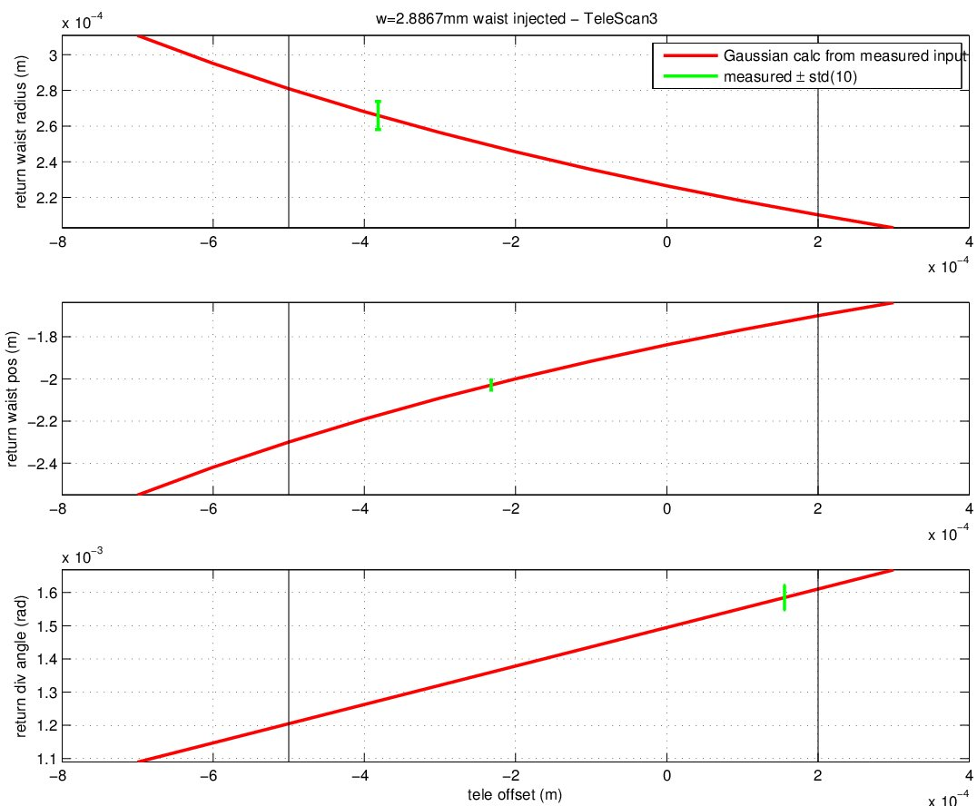
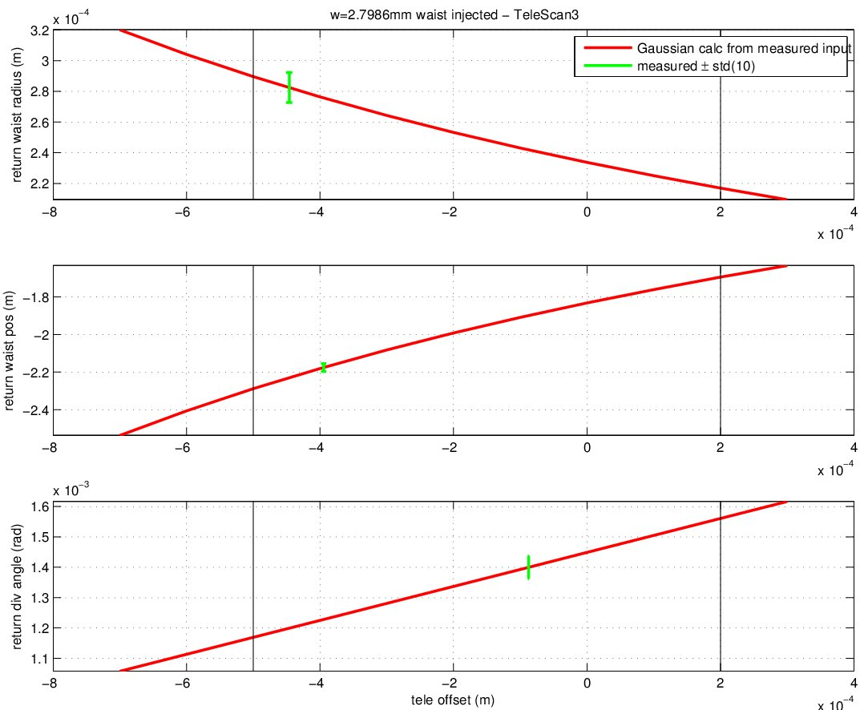
Telescope de-tuning Results (using TeleScan3 measurements)
Input into the TeleModel are the measured Source Parameters from the ModeMaster.
The GREEN markers are from the measured ModeMaster results from ‘Tele Measurement 3’ (they should be crossing the red calculated line).
The vertical lines indicate the tolerance.
X-axis
Y-axis

Slide 7
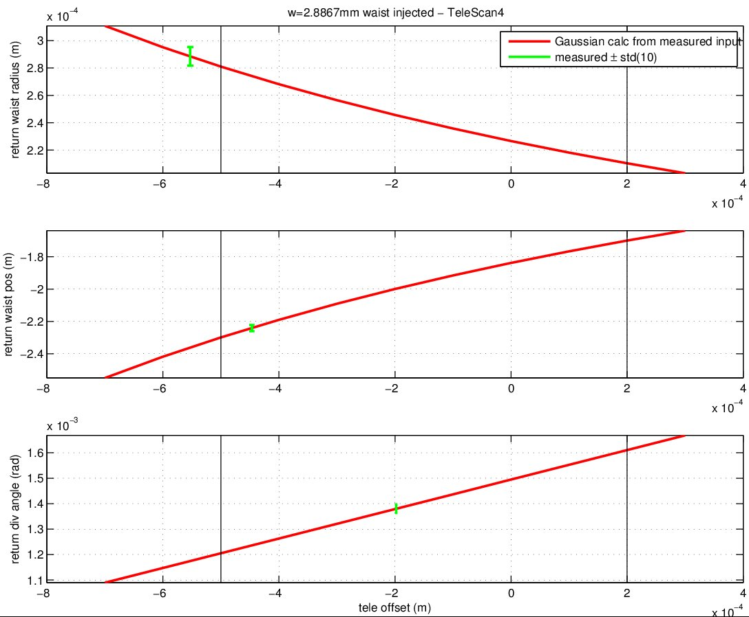
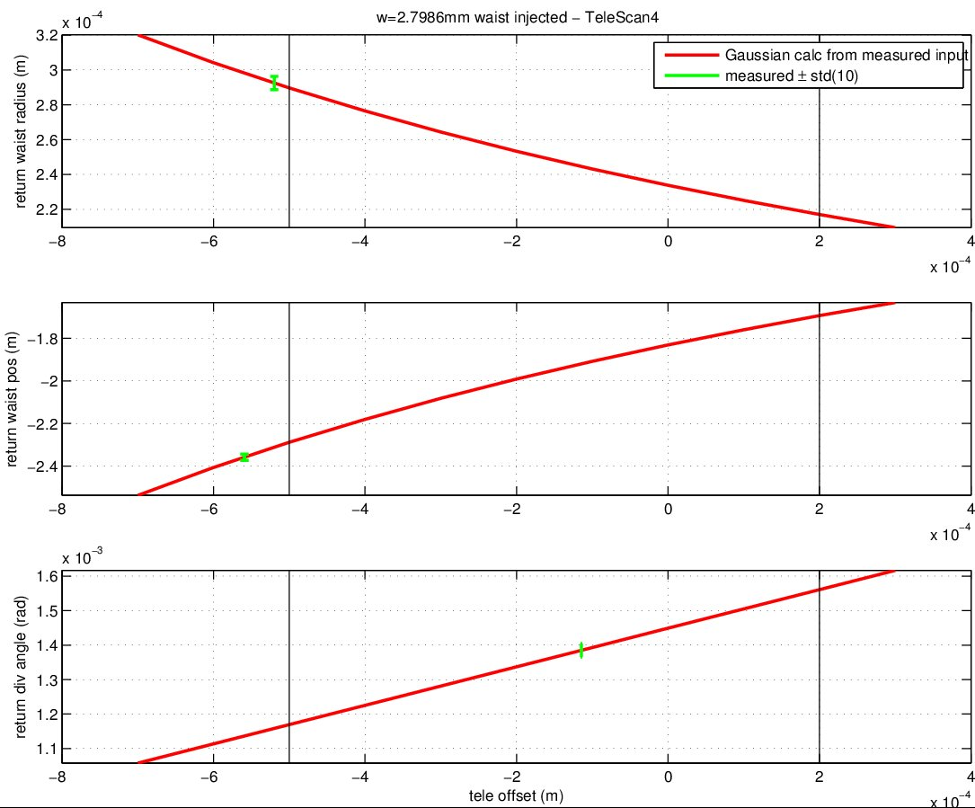
Telescope de-tuning Results (using TeleScan4 measurements)
Input into the TeleModel are the measured Source Parameters from the ModeMaster.
The GREEN markers are from the measured ModeMaster results from ‘Tele Measurement 4’ (they should be crossing the red calculated line).
The vertical lines indicate the tolerance.
X-axis
Y-axis

