Slide 1
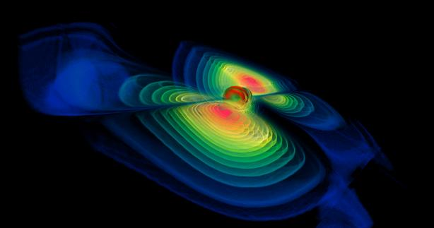
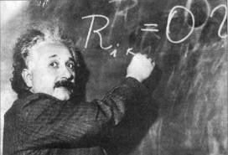
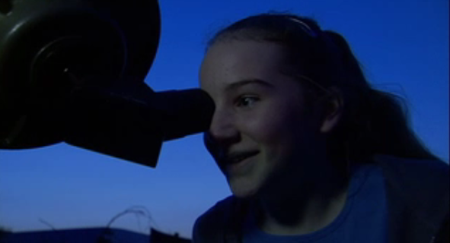
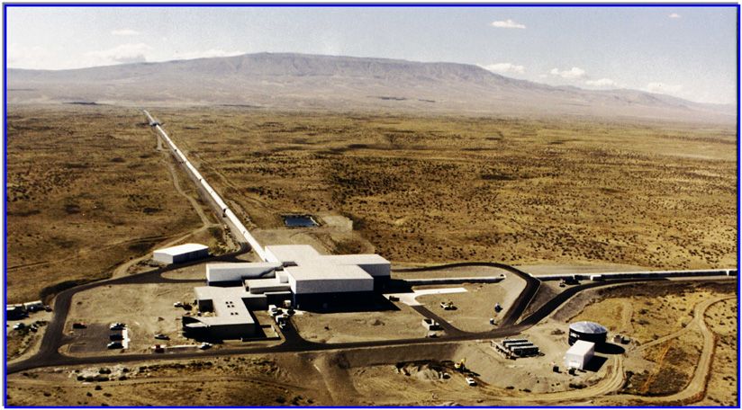
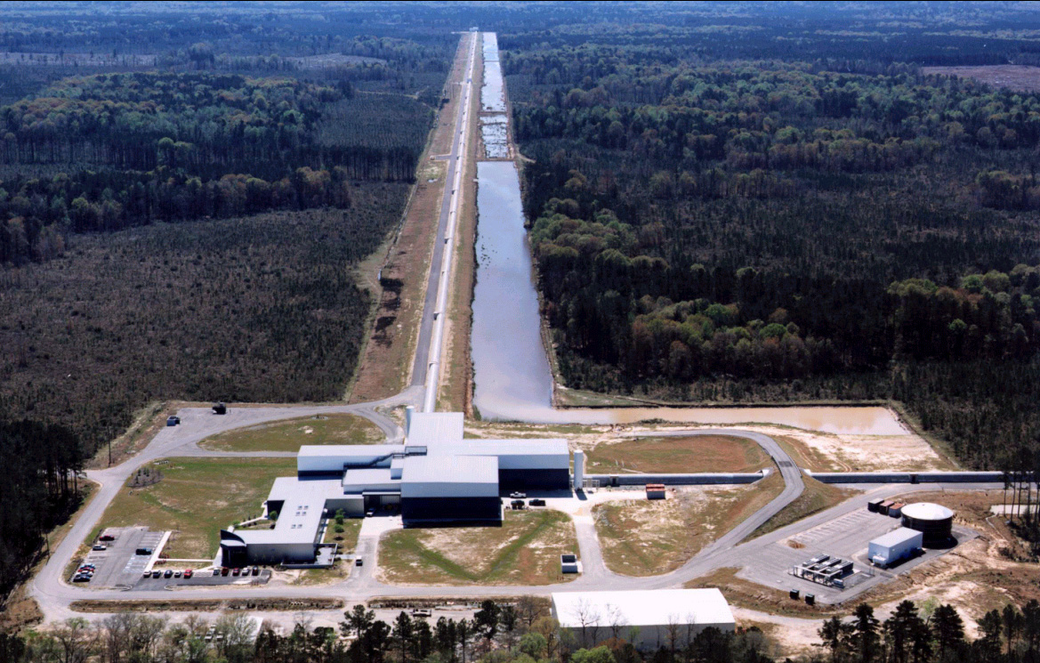
Catching Einstein's waves
Werner Berger, ZIB, AEI, CCT
Gabriela González
Louisiana State University
Science Unwrapped
Utah State University
October 7, 2011
LIGO Livingston
LIGO Hanford

Slide 2
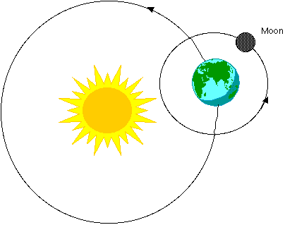
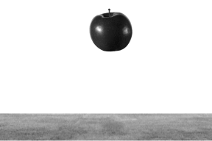
Newtons’ gravity
“Newton’s law”: F = Gm₁m₂/r²
Explains why apples fall, why the planets move around the Sun,…

Slide 3
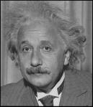
Einstein’s gravity
sciencebulletins.amnh.org
And in YouTube!

Slide 4
Einstein’s gravitation
When masses move, they wrinkle the space time fabric, making other masses move…
Explains just as well as Newtons’ why things fall and planetary motion…
Einstein’s messengers, National Science Foundation video
www.einsteinsmessengers.org
.. but it also predicts traveling away from moving masses!
gravitational waves

Slide 5
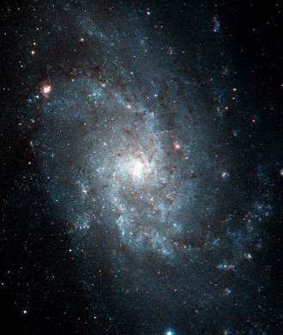
Where do gravitational waves come from?
From stars living in galaxies…

Slide 6
Where do gravitational waves come from?
From stars living in galaxies…
Supernova explosions
Credits: Animation: NASA/CXC/D.Berry & A.Hobart

Slide 7
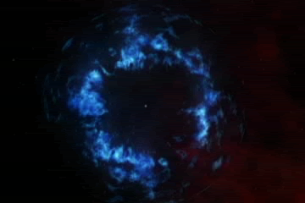
Where do gravitational waves come from?
From stars living in galaxies…
Supernova explosions
Rotating stars (pulsars)
Credit: NASA/CXC/ASU/J.Hester et al.

Slide 8
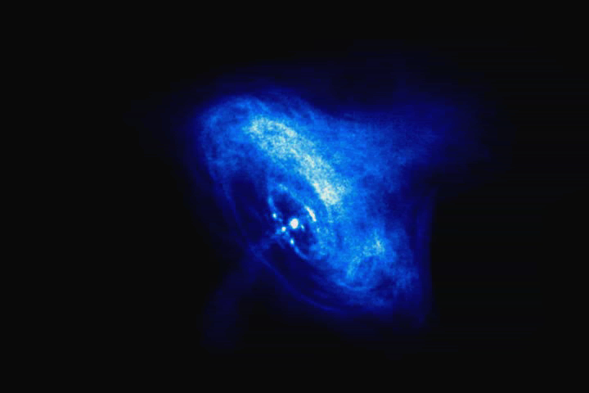
Where do gravitational waves come from?
From stars living in galaxies…
Supernova explosions
Rotating stars (pulsars)
Binary systems (black holes, neutron stars)
Credit: John Rowe

Slide 9
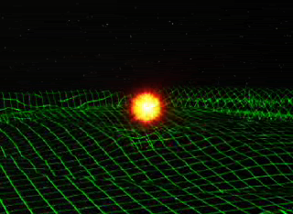
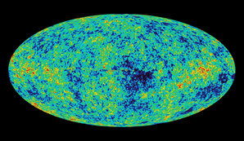
Where do gravitational waves come from?
From stars living in galaxies…
Supernova explosions
Rotating stars (pulsars)
..and from the beginning of the Universe!
Binary systems (black holes, neutron stars)
Credit: NASA/WMAP

Slide 10
How to detect gravitational waves with an interferometer
Einstein’s messengers, National Science Foundation video
http://www.einsteinsmessengers.org/

Slide 11
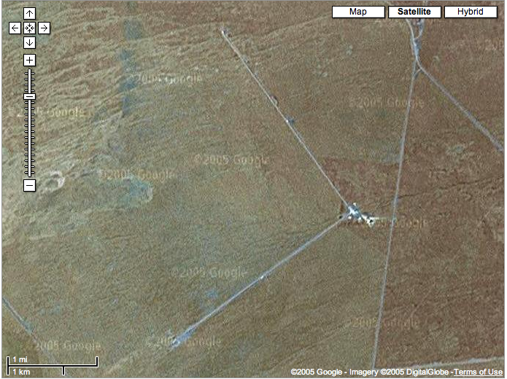
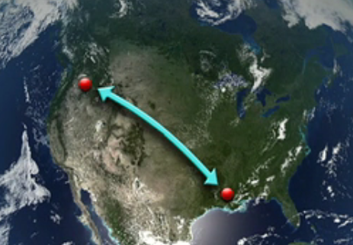
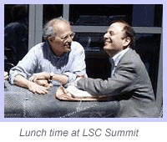
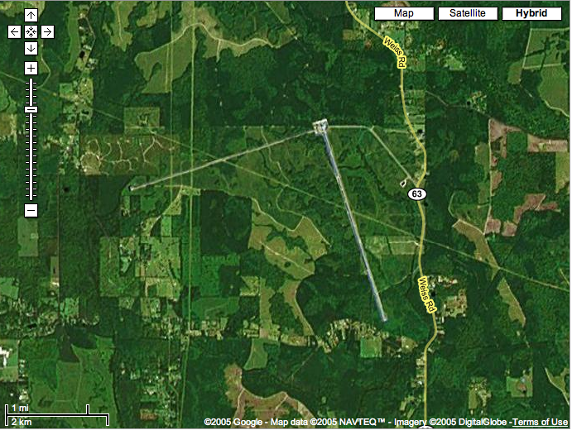
The LIGO Observatories
Hanford, WA
Rai Weiss
Peter Saulson
Livingston, LA
Hundreds of people in 15 countries working on the experiment and looking at the data: LIGO Scientific Collaboration
www.ligo.org

Slide 12
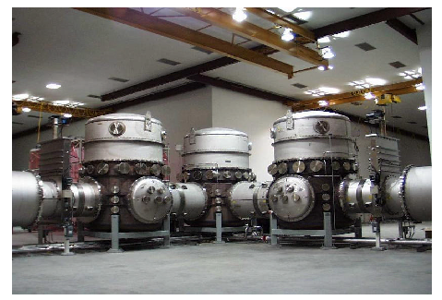
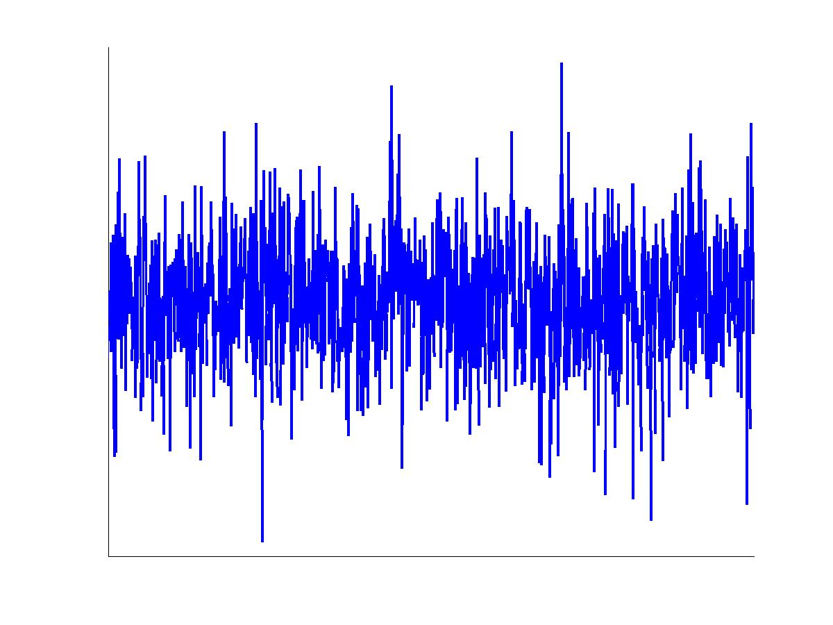
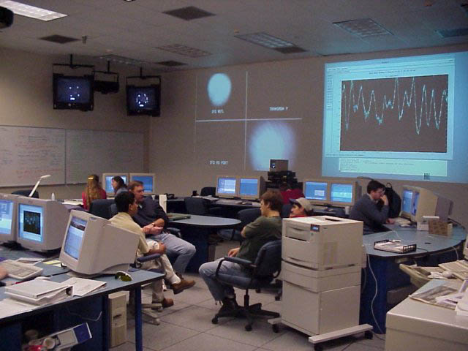
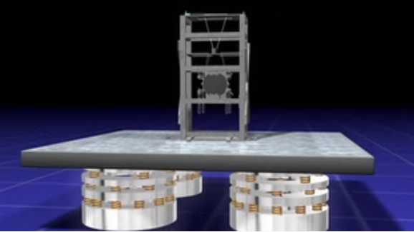
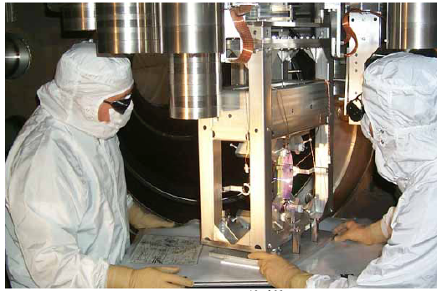
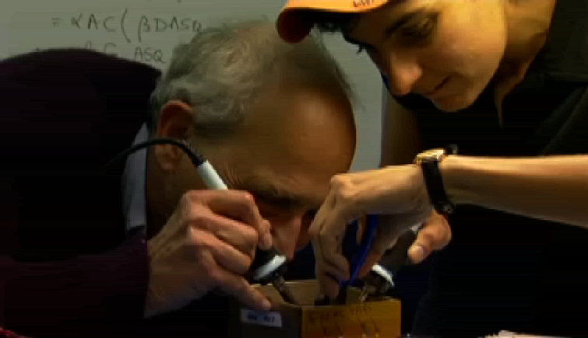
GW Detection: a difficult and fun experiment

Slide 13
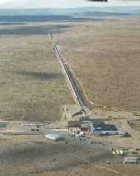
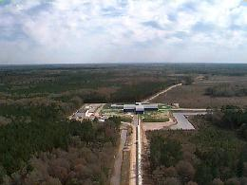
Building LIGO
Vacuum system
Your taxes at work!

Slide 14
Detecting GWs a difficult and fun experiment
Nergis Mavalvala
Rai Weiss

Slide 15
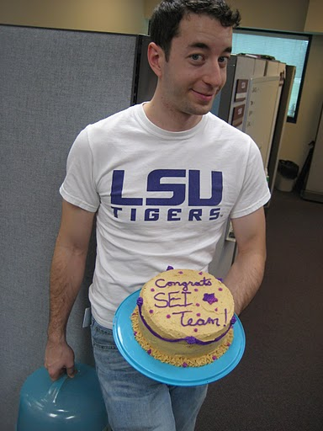
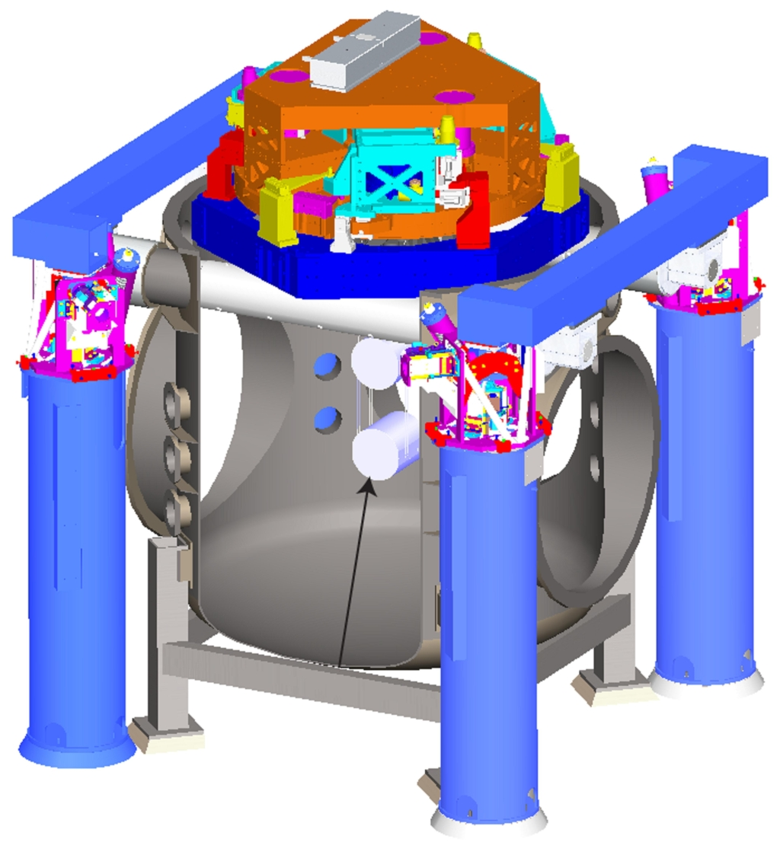
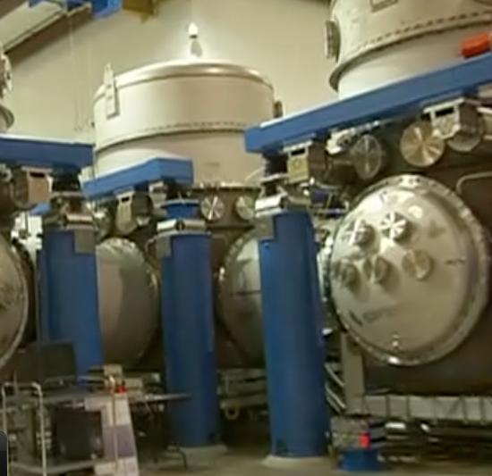
Detecting GWs a difficult and fun experiment
Jeff Kissel, 2008
SEI=“seismic isolation”

Slide 16
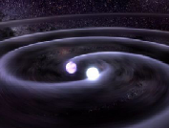
GW Detection: a difficult and fun experiment
Find signal:
In noise:
You can try after the talk!
Black Hole Hunter game

Slide 17
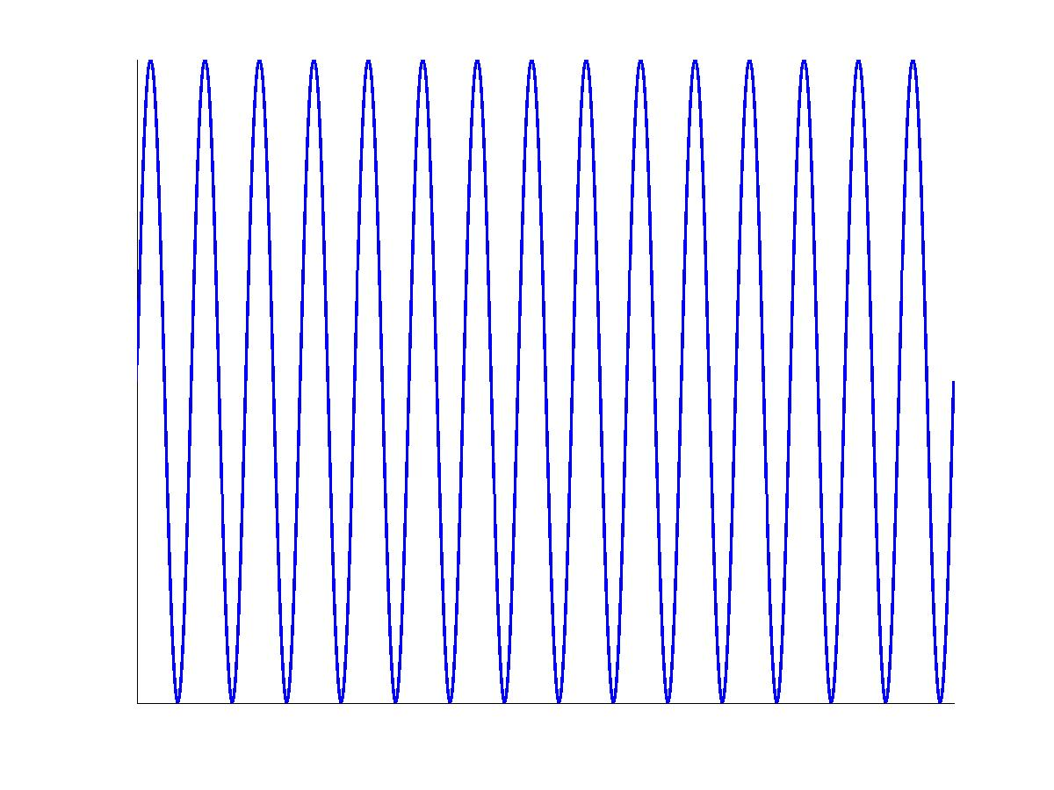
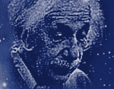
GW Detection: a difficult and fun experiment
Find signal:
In noise:
You can help!
http://www.einsteinathome.org/

Slide 18
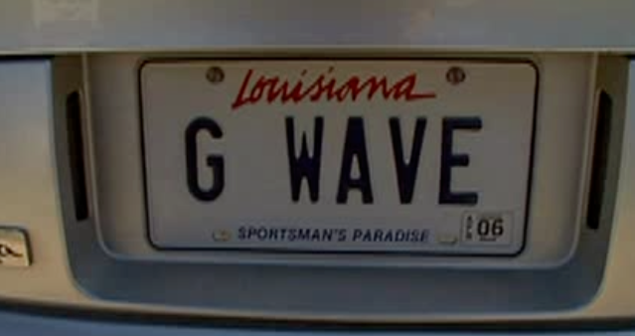
Gravitational waves are coming… are you ready?
Werner Berger, ZIB, AEI, CCT
LIGO Livingston
LIGO Hanford

