Slide 1


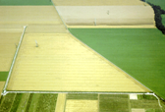

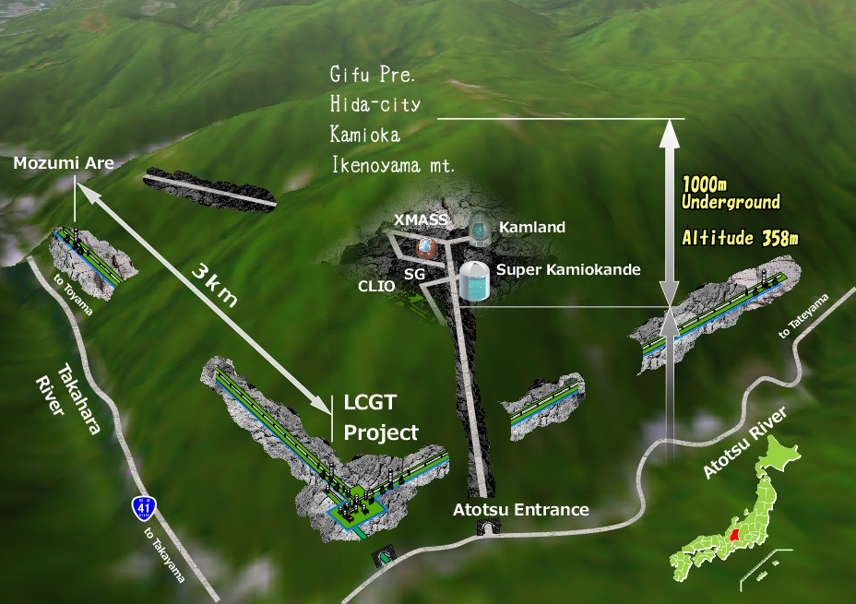



Towards Advanced LIGO
and the global gravitational-wave detector network
David Reitze
Executive Director
LIGO Laboratory
1
LIGO G1101200-v2

Slide 2
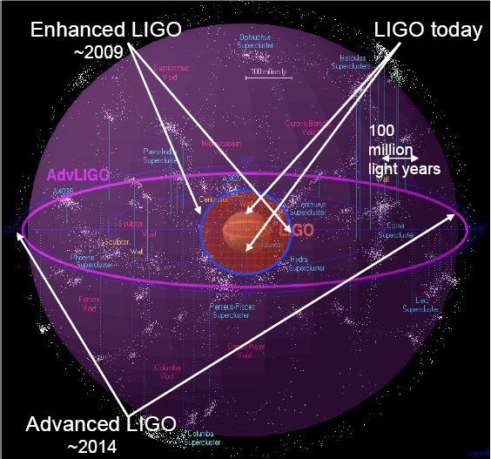
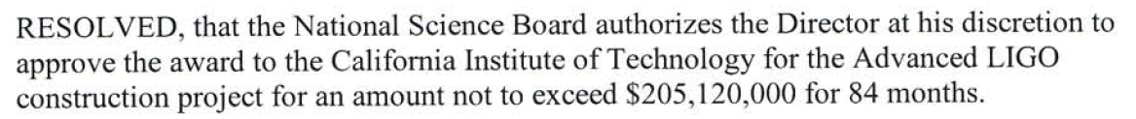
Advanced LIGO History
Began in 1999 as an LSC concept paper
Major R&D from 1999-2006
  In anticipation of positive funding outcome, many subsystems through preliminary design phase by 2006
Final baseline review by NSF in November 2007
Advanced LIGO Project officially began on April 1, 2008
Initial LIGO
Image courtesy of Beverly Berger
Cluster map by Richard Powell

Slide 3
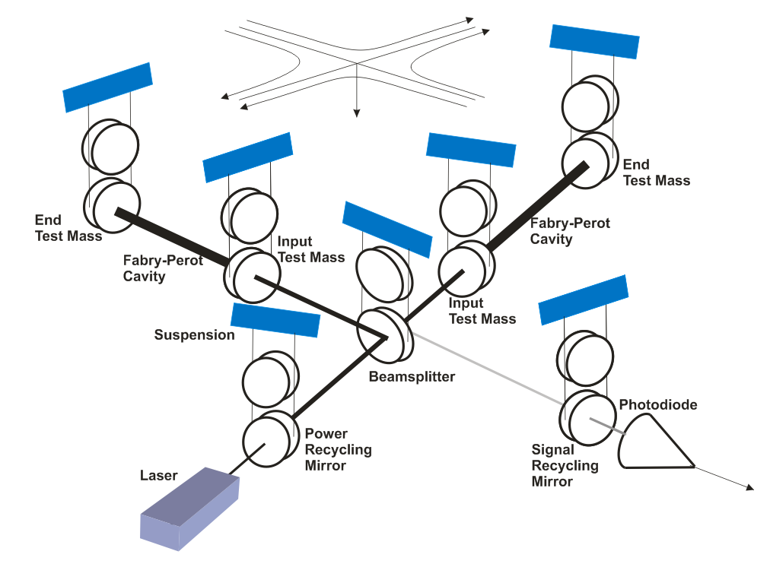
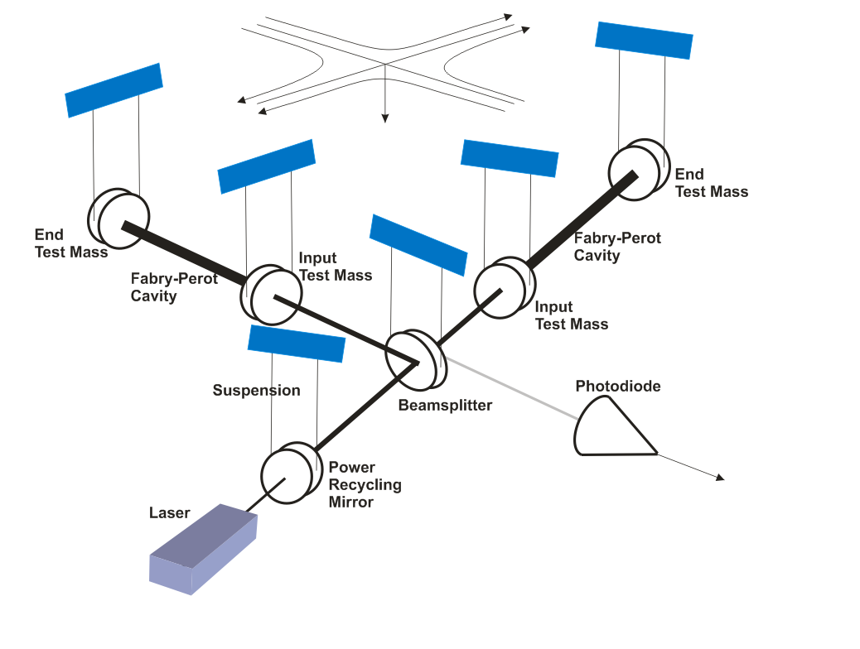
Initial LIGO
Advanced LIGO
10 kW
700 kW
700 kW
10 kW
250 W
4 kW
LIGO
5 W
Advanced LIGO
125 W

Slide 4
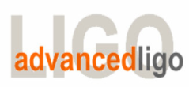
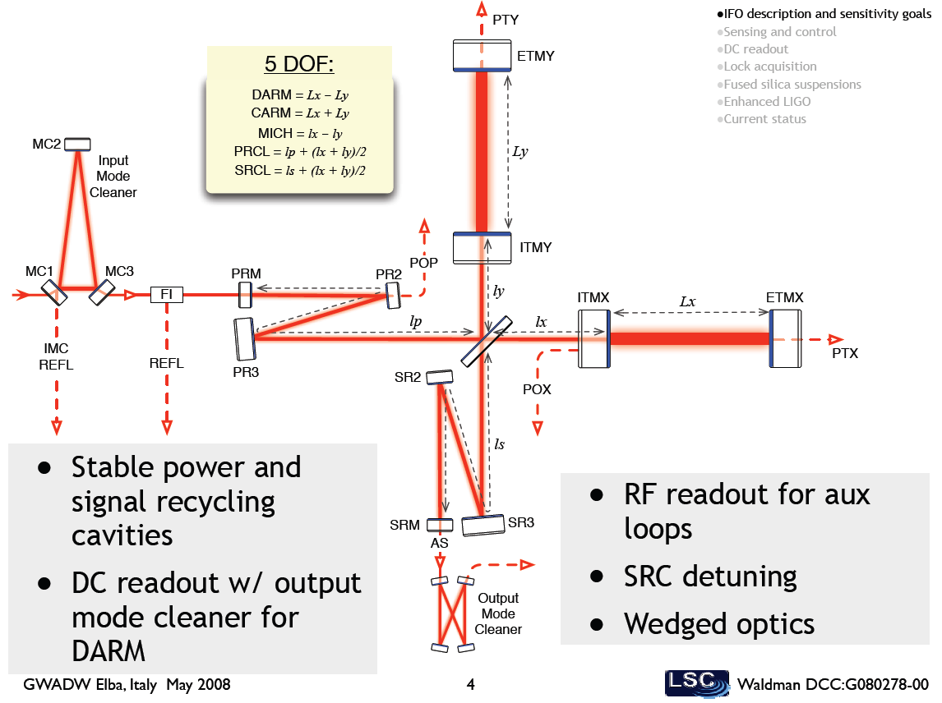
Advanced LIGO overview
What is Advanced?
Parameter | Initial LIGO | Advanced LIGO
Input Laser Power | 10 W (10 kW arm) | 180 W (>700 kW arm)
Mirror Mass | 10 kg | 40 kg
Interferometer Topology | Power-recycled Fabry-Perot arm cavity Michelson | Dual-recycled Fabry-Perot arm cavity Michelson (stable RC)
GW Readout Method | RF heterodyne | DC homodyne
Optimal Strain Sensitivity | 3 x 10⁻²³ / rHz | Tunable, better than 5 x 10⁻²⁴ / rHz in broadband
Seismic Isolation Performance | f_{low} ~ 50 Hz | f_{low} ~ 12 Hz
Mirror Suspensions | Single Pendulum | Quadruple pendulum

Slide 5
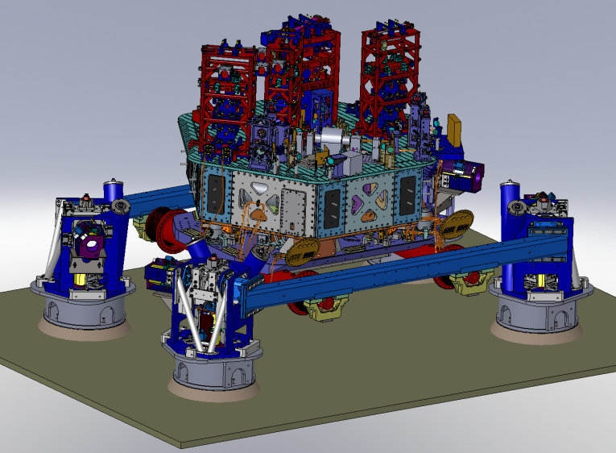
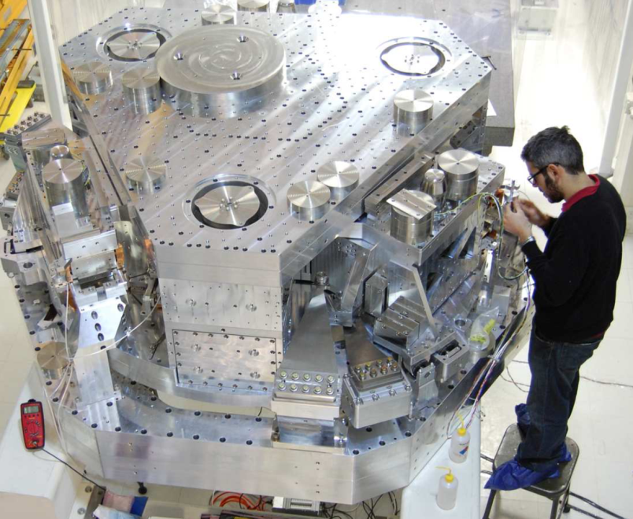
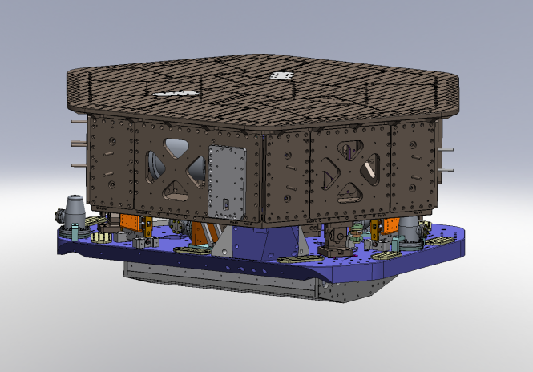
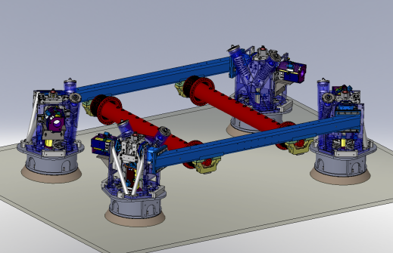
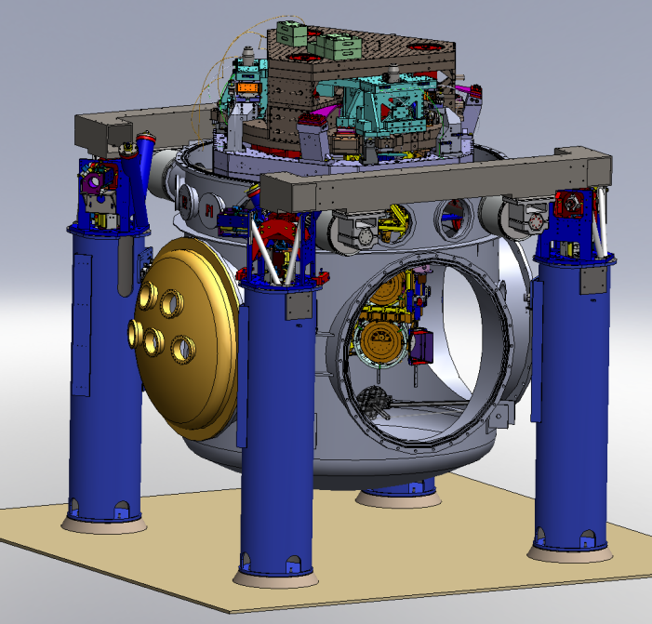
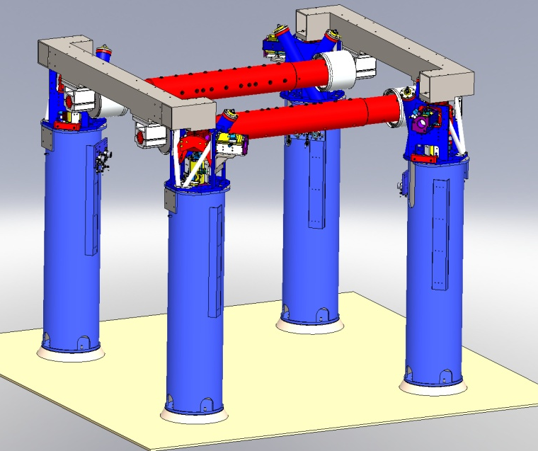
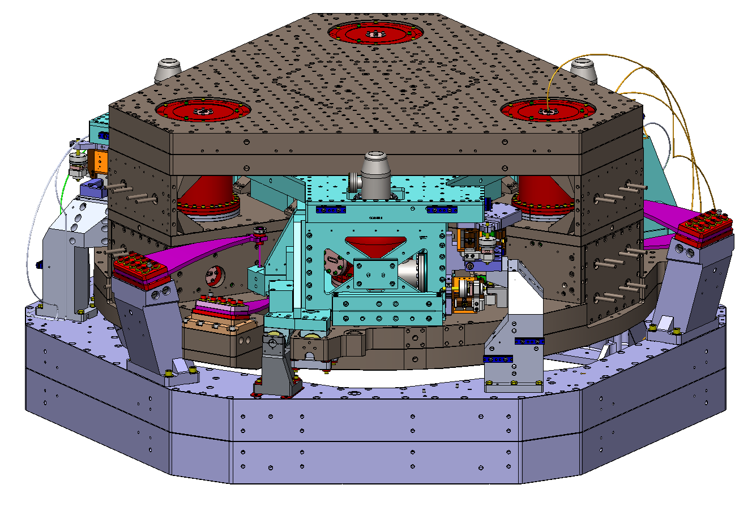
Advanced LIGO Seismic
Isolation
  ISI:
  Single Stage
  Internal Seismic Isolator
  HEPI:
  Hydraulic External
  Pre Isolator
  HAM Chambers Equipment
  ISI:
  Two-Stage
  Internal Seismic Isolator
  HEPI:
  Hydraulic External
  Pre Isolator
  BSC Chambers Equipment
5

Slide 6
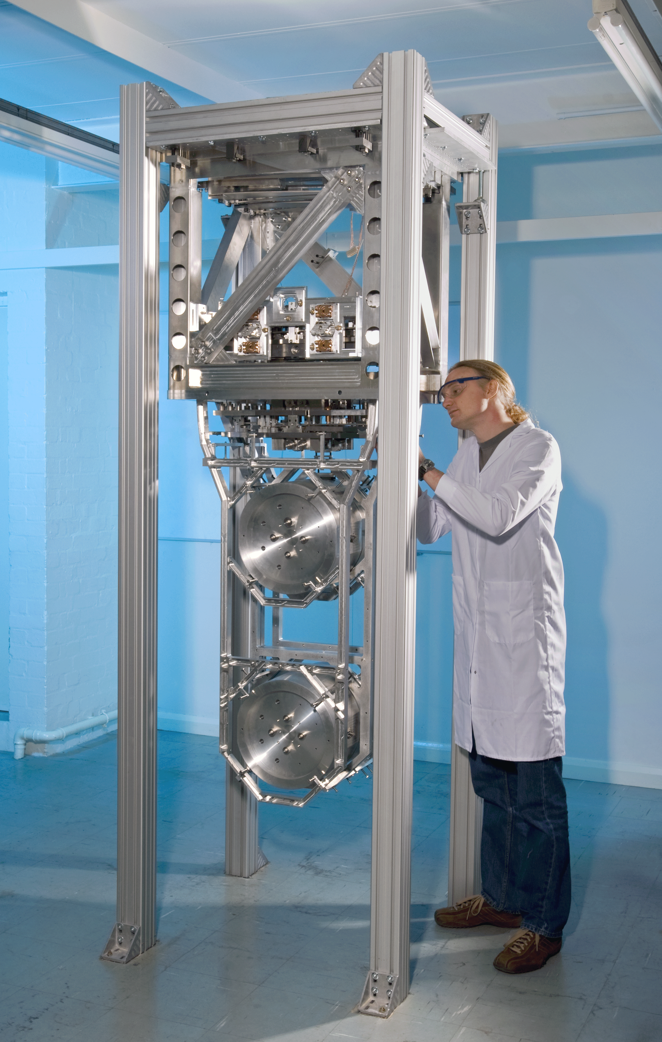
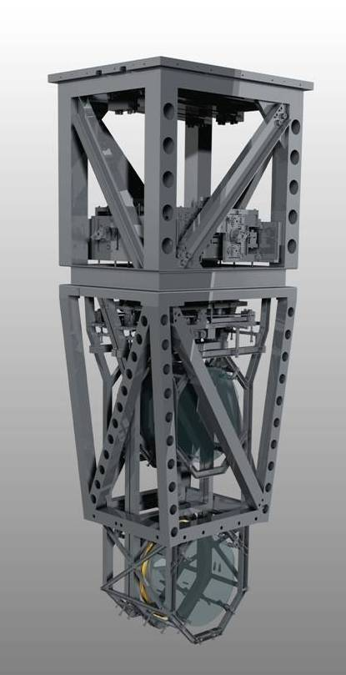
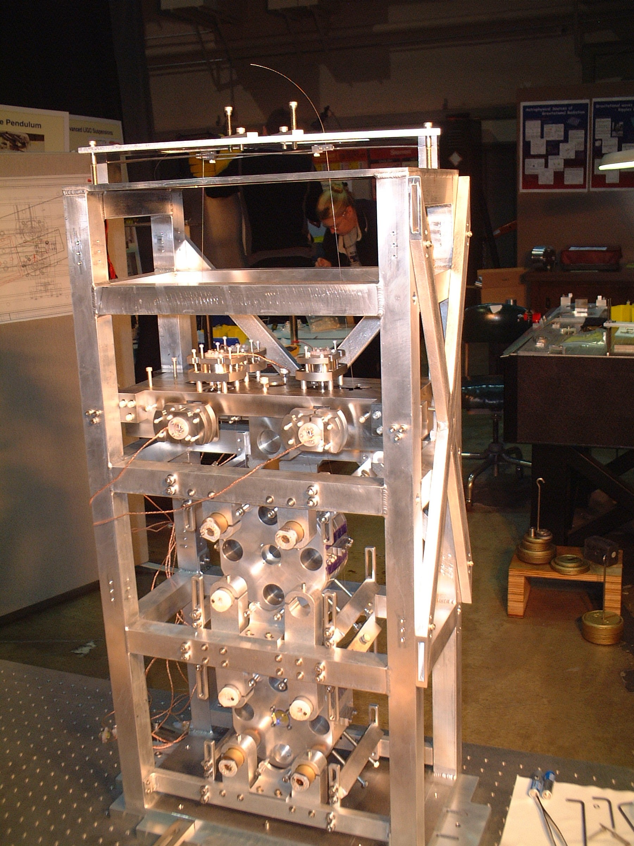
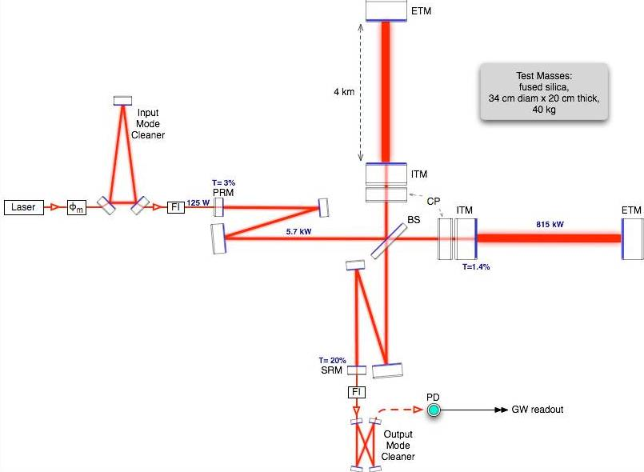
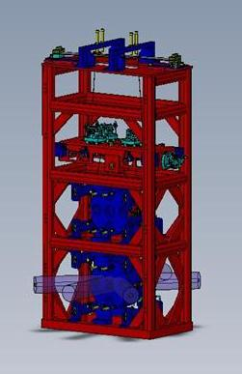
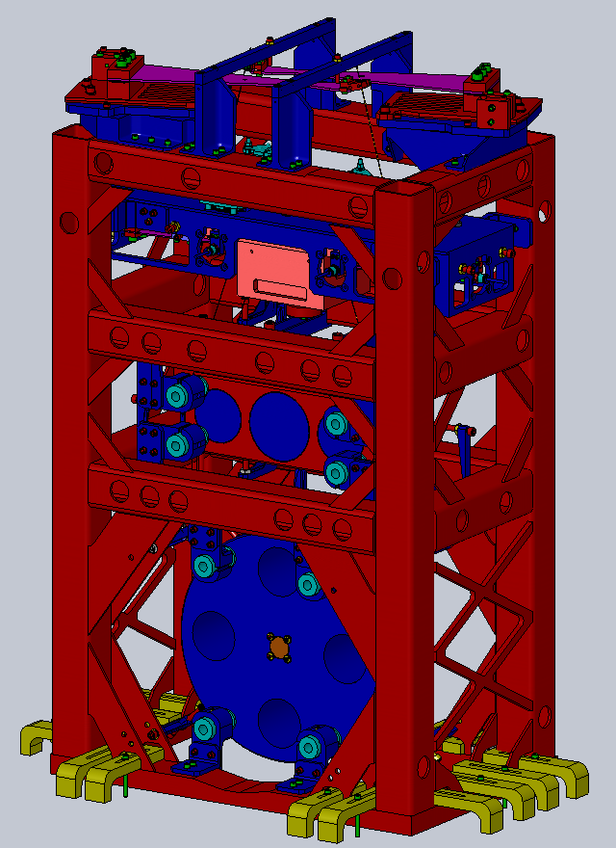
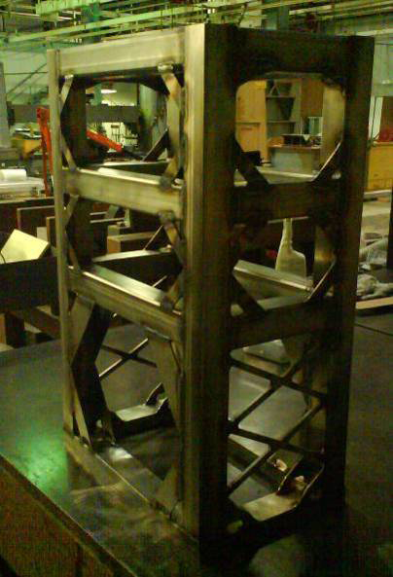
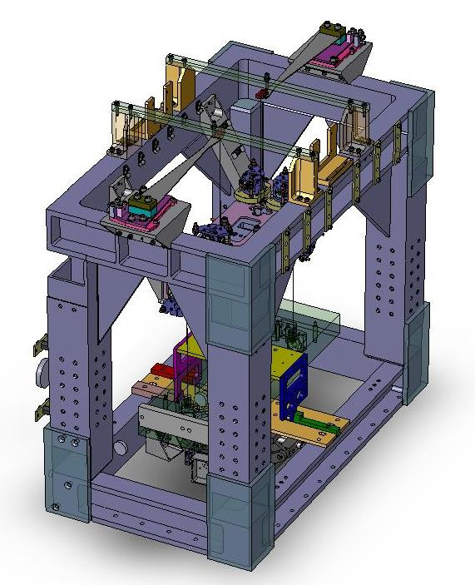
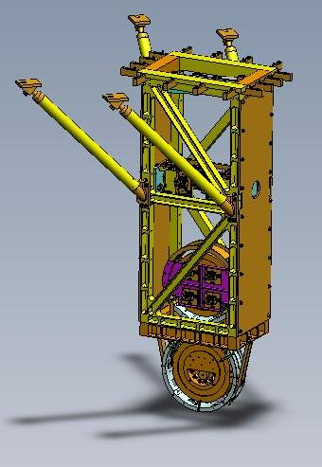
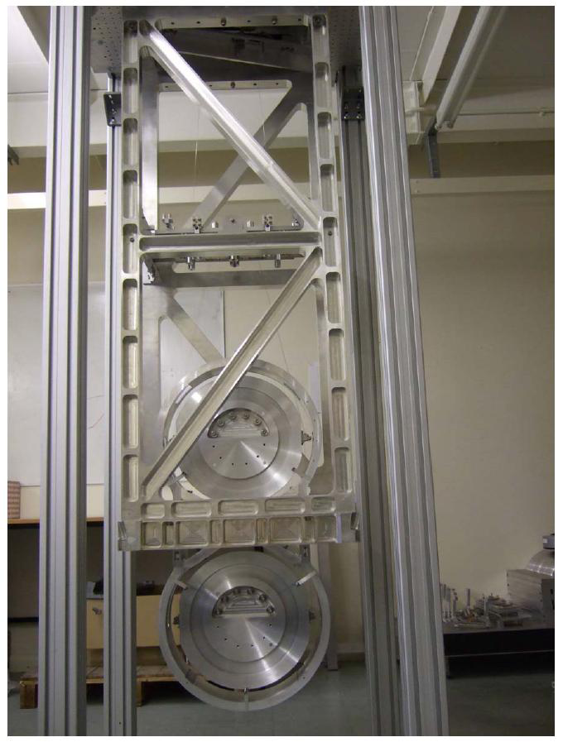
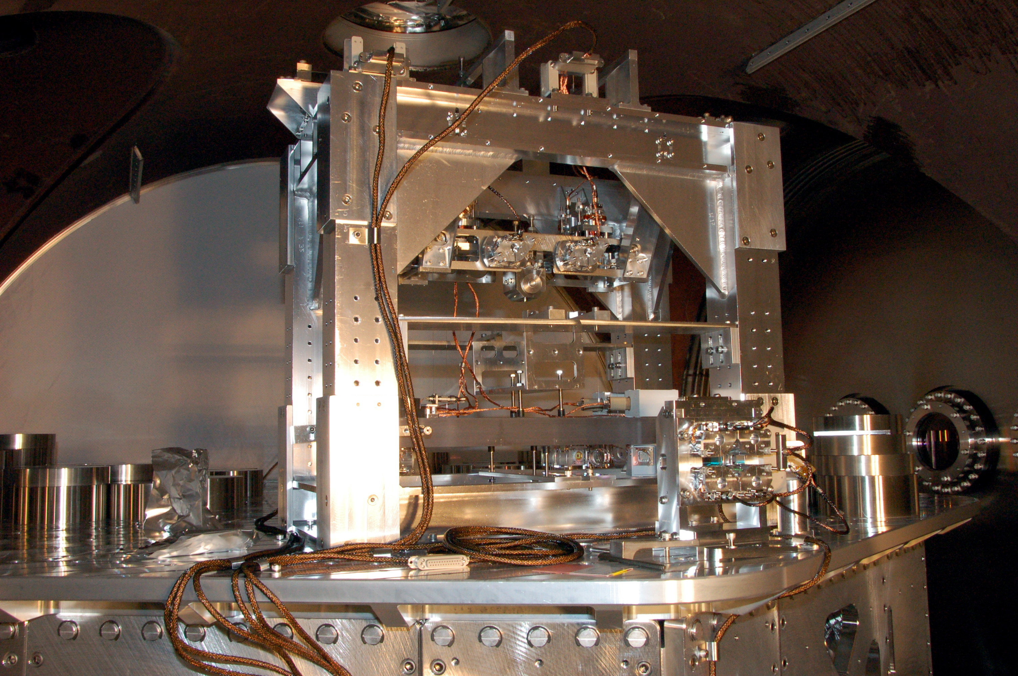
Advanced LIGO Suspensions

Slide 7

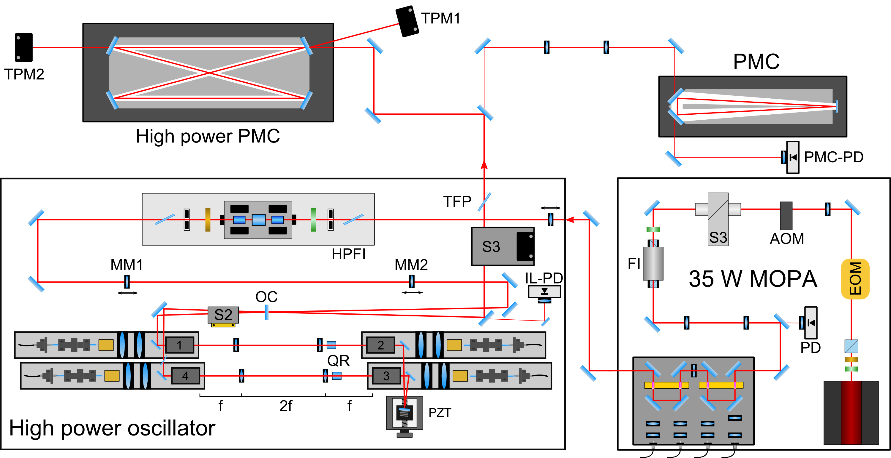

Advanced LIGO Pre-stabilized Laser

Slide 8
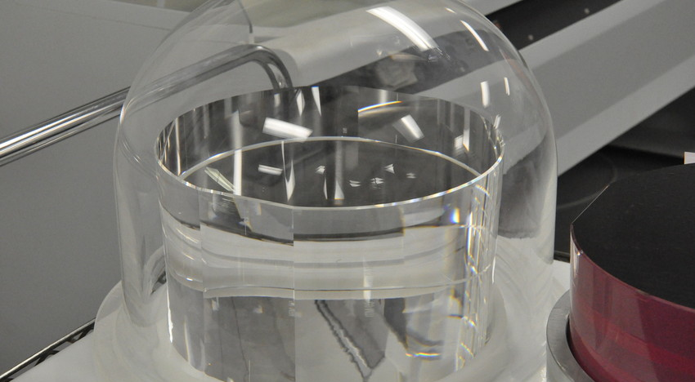
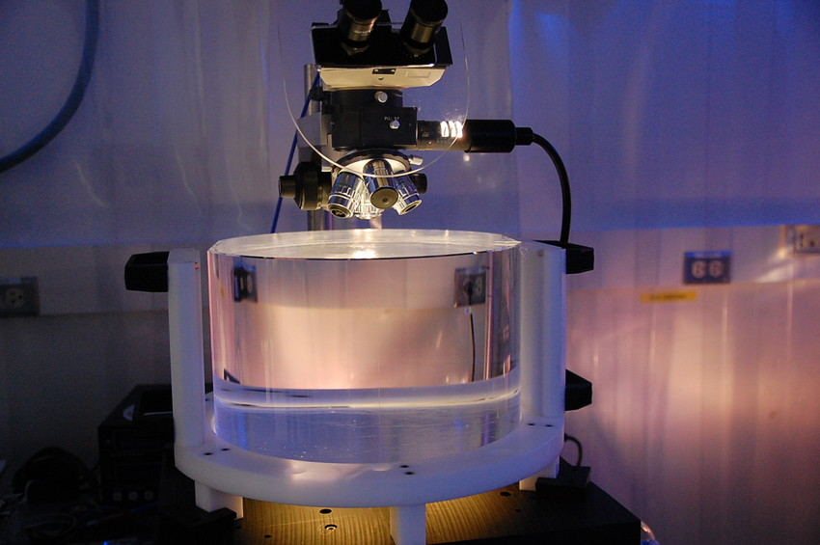
Advanced LIGO Core Optics

Slide 9
Strain = ΔL(f)/L
Displacement = ΔL(f)

Slide 10
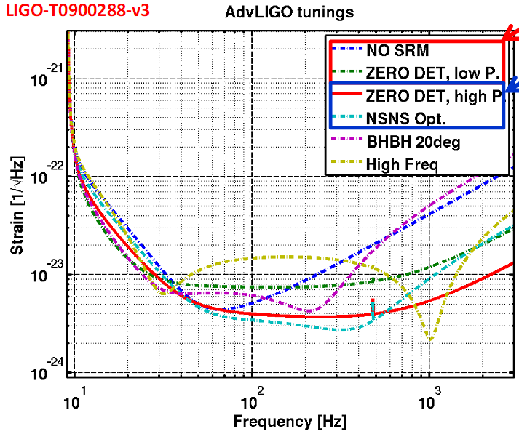
Coalesence rates /yr for different configurations
m₁ / m₂ | No SRM, low power | zero detune, low power | zero detune, high power | NSNS Optimal
NS / NS | 17 (358 Mpc) | 12 (323 Mpc) | 32 (445 Mpc) | 40 (481 Mpc)
NS / BH | 5 (757 Mpc) | 3 (680 Mpc) | 9 (926 Mpc) | 11 (1001 Mpc)
BH / BH | 11 (1834 Mpc) | 8 (1632 Mpc) | 19 (2187 Mpc) | 23 (2325 Mpc)
m_{NS} = 1.4 M, m_{BH} = 10 M
Realistic Rates; actual
rates may vary!
0.4/yr < R_{NS/NS} < 400 (NSNS Opt)
A, Weinstein, 2011
Abadie, et al., CQG 2010

Slide 11
CW sources
(AdvLIGO zero detuning high P)
Advanced LIGO can beat the spin-down limit on these red pulsars in 1 year:
5
10
J0537-6910 (LMC)
4
10
Galactic diameter
J1913+1011
B1951+32 (CTB80)
Crab
3
J0737-3039A
10
reach, distance (pc)
Vela
10
-4
J0437-4715
2
10
10
-5
10
-6
single aL
detector
ε
-7
1
=10
10
10
-8
0
Nearest star
10
1
2
3
10
10
10
gravitational frequency (Hz)
Graham Woan, Ben Owen, 2010

Slide 12
Advanced LIGO Project Schedule
Commission/
Science Ops

Slide 13
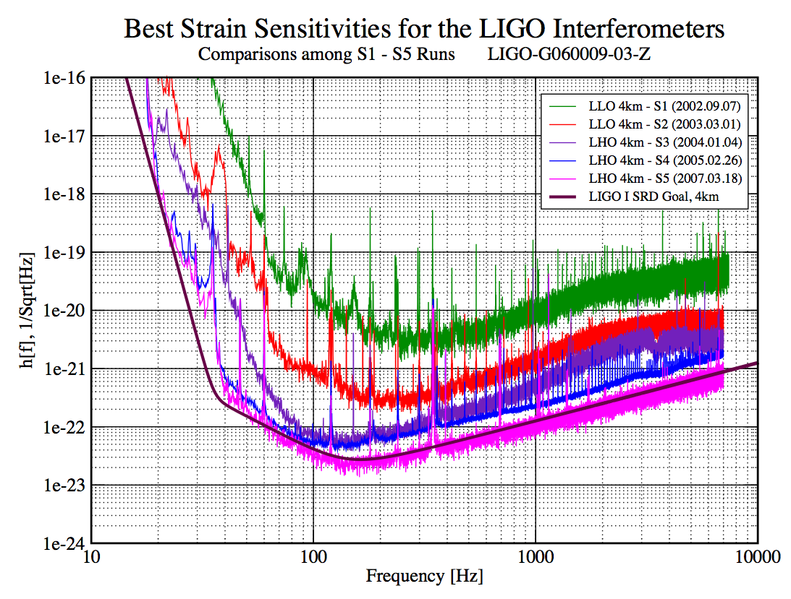
Sept 2002
March 2007

Slide 14
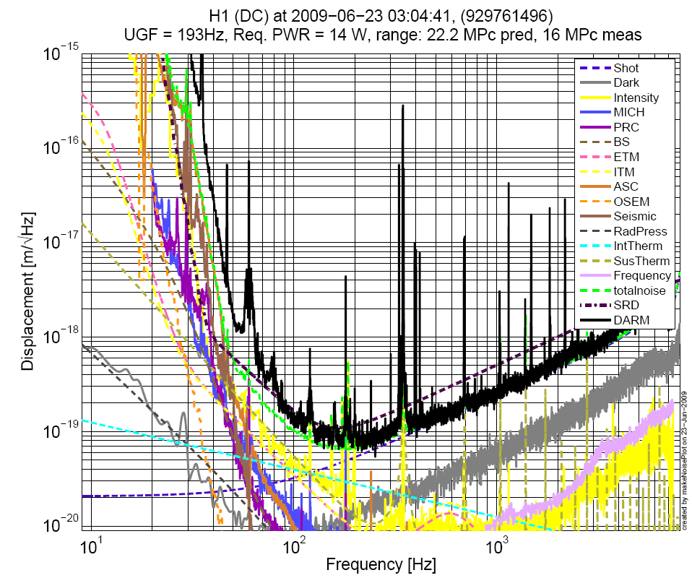

Slide 15
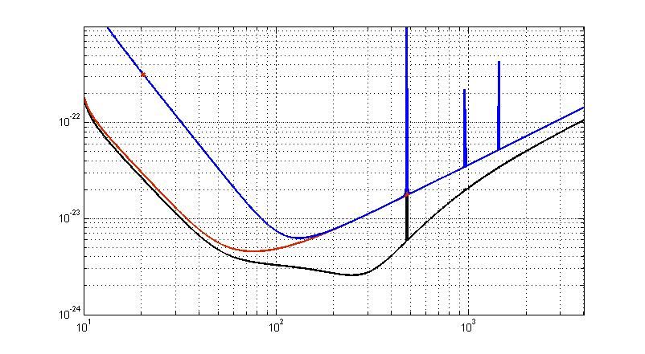


Sketch of possible progression for Advanced LIGO sensitivity
CAVEAT:
reaching LF target
sensitivity is challenging
Early short run:
25w laser input, no signal recycling
~10x excess low frequency noise
BNS Inspiral Range: 60 Mpc
BBH Inspiral Range: 227 Mpc
Stochastic Omega: 1.5e-7
DRAFT
DRAFT
Not yet an official plan for the aLIGO
configuration evolution!
DRAFT
D. Shoemaker, 2011
First extended run:
25w laser input, no signal recycling
BNS: 142 Mpc
BBH: 1400 Mpc
Stochastic Omega: 3e-9
125w laser input, signal recycling
BNS Inspiral Range: 200 Mpc
BBH Inspiral Range: 1640 Mpc
Stochastic Omega: 2.25e-9
DRAFT

Slide 16
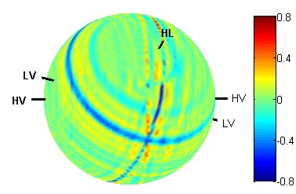
Advanced GW Networks
Gravitational-wave astronomy is greatly enhanced by having a multiplicity of interferometers distributed over the globe.
  GW ‘Aperture synthesis’
Advantages include:
  Source localization in near real time
  Enhanced Network Sky Coverage
  Maximum Time Coverage – a fraction of the detectors are‘always listening’
  Detection confidence
  Source parameter estimation
4 properly distributed detectors is better than 3; 5 is even better than 4
ΔL = c δt
θ
1
2
source
location

Slide 17
Initial GW detector network
B. Sathyaprakash,
S. Fairhurst, Cardiff U., 2011

Slide 19
Advanced GW detector network
B. Sathyaprakash,
S. Fairhurst, Cardiff U., 2011

Slide 23
The Advanced GW Detector Network
GEO 600 (HF)
2011
Advanced LIGO
Hanford
2015
Advanced LIGO
Liviingston
2015
Advanced
Virgo
2015
LCGT
2017
LIGO India
2020?
23
23

Slide 24
LIGO-Australia → LIGO-India
Original plan was to put one of the Hanford interferometers in Australia
  LIGO provides the detector; Australia provides the facility/operations staffing
A major campaign by the LIGO Laboratory, ACIGA, and the NSF to fund LIGO-Australia
  It didn’t work…
As it became clear LIGO-Australia was unlikely to be funded, IndIGO asked the LIGO Laboratory to consider relocating one of the Hanford interferometers to India
Momentum has been building – LIGO-India is under serious consideration as a ‘Mega-Project’ by the Planning Commission
  Mega-Project budget cycle occurs every 5 years, and it’s happening now
  $200M proposed expenditure (infrastructure and operations) over 15 years
Serious evaluation now underway
Lab Go/No-go decision before March 31, 2012

Slide 25
Conclusions
We are moving toward Advanced LIGO
  Challenges ahead, but we are on time and on budget!
Expect commissioning operations to begin in 2015
Virgo will join in 2015, LCGT in 2017
  Four node GW network
LIGO-India may become a reality by ~2020

Slide 26

Conclusions
This has been an excellent workshop!
Thanks to the organizers Roy Williams, Christian Ott, Steve Groom and our LIGO Livingston hosts

Slide 27
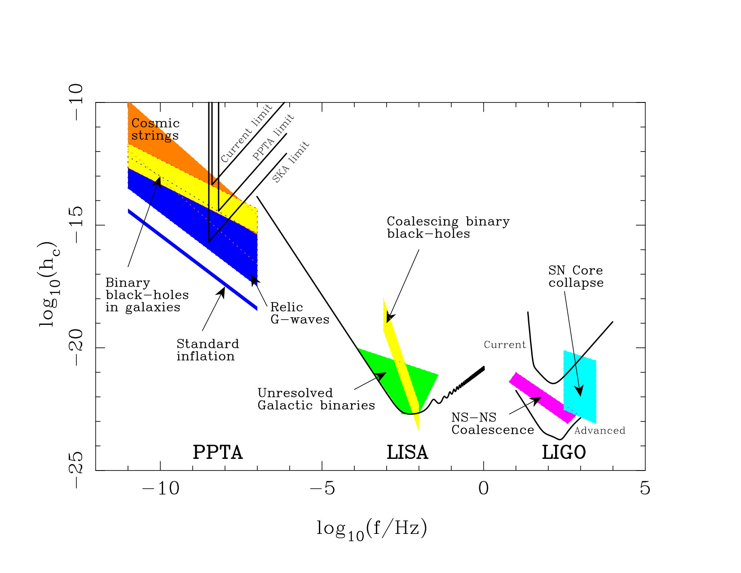
The Gravitational Wave Spectrum
George Hobbs,
Dick Manchester, CSIRO
NGO
LIGO/VIRGO

