Slide 1
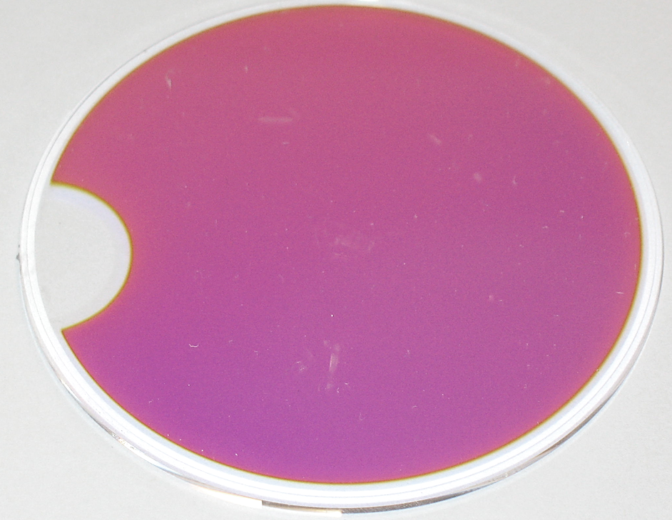


Optical Coatings and Thermal Noise in Precision Measurements
Embry-Riddle Aeronautical University Physics Colloquium
October 25, 2011
Gregory Harry
American University
LIGO-G1101150

Slide 2
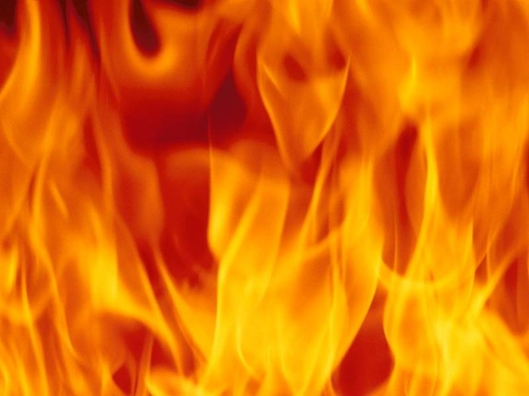
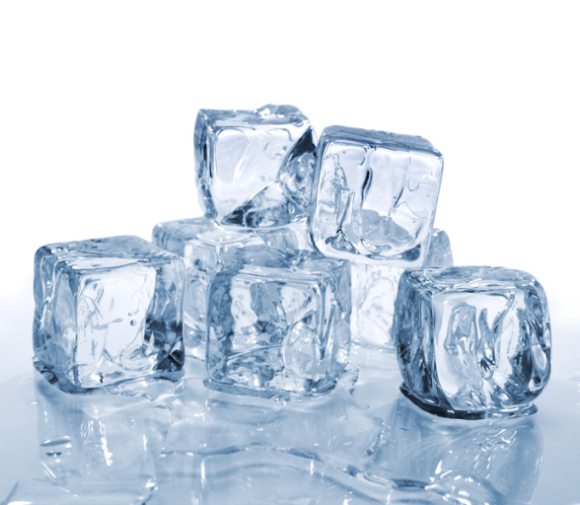
Thermal Noise
Random motion when not at 0 Kelvin
  Can also appear as random voltage, force, pressure, optical properties, etc.
Energy in thermal noise increases with temperature
  Cooling is a way, but not the only way, to reduce these thermal fluctuations
Thermal Energy
These random motions set a lower limit on measuring signals
  This is the “noise” part of thermal noise
Not random fluctuations in temperature
  Although these can play a role in thermal noise (thermo-optic, thermoelastic, etc.)
Cooling

Slide 3
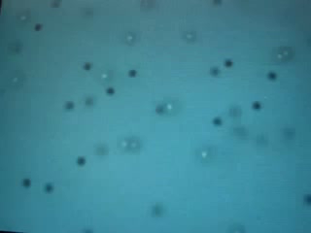
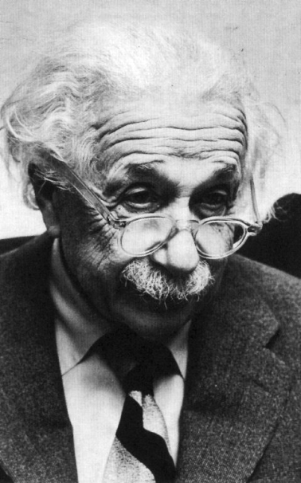
Brief History of Thermal Noise: I
Robert Brown: Botanist (1827)
Microscope pioneer
Observed pollen moving in water
Saw dust from Sphinx moving as well
Brownian Motion
Albert Einstein: Physicist (1905)
Mathematics of Brownian motion
Linked motion to fluid viscosity
Most cited of Einstein’s papers
Einstein

Slide 4
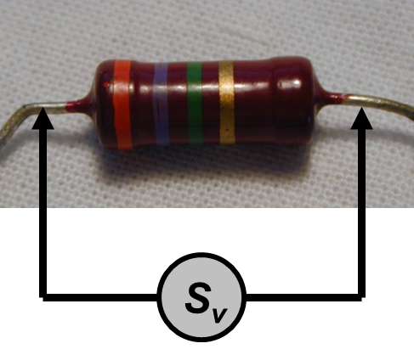
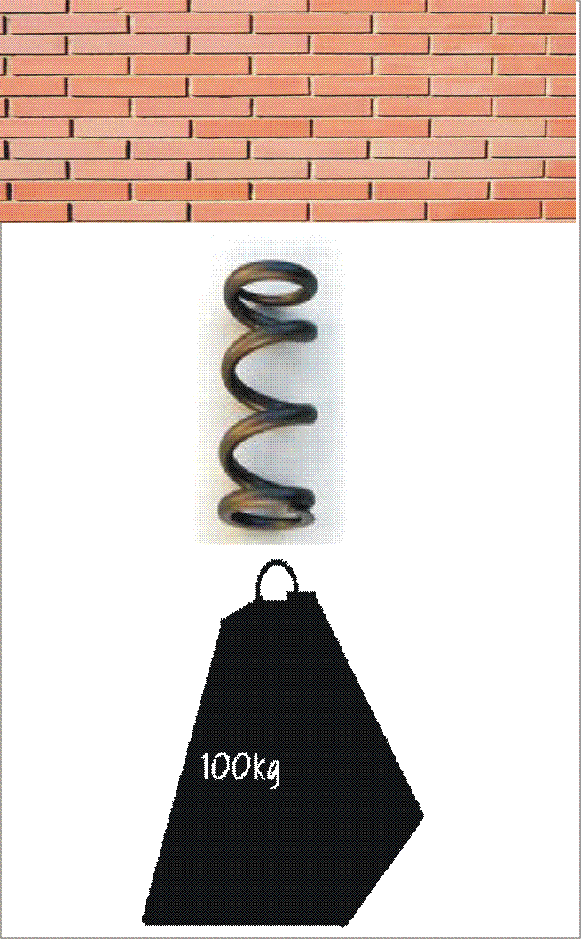
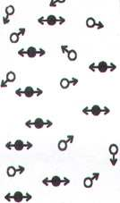
Brief History of Thermal Noise: II
Johnson Noise
Johnson and Nyquist (1926)
Voltage noise around resistors
Seemingly separate to Browns motion
Callen, Welton, and Greene (1950s)
Tie everything together
Relates random motion to energy loss
Fluctuation-Dissipation Theorem
Fluctuation
Dissipation
Fluctuation-Dissipation Theorem

Slide 5
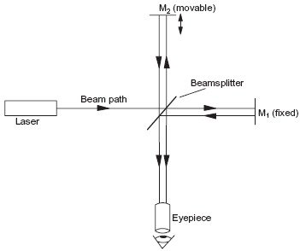
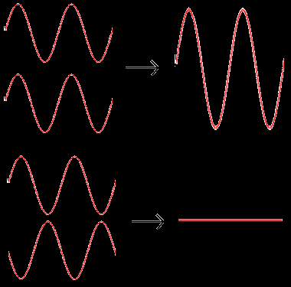
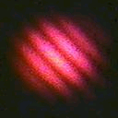
Interferometry
Interferometer
High precision measurement
Wavelength of light yardstick
  Visible light 500 nm ( 5 X 10⁻⁷ m)
  Can use even shorter waves
Uses interference
Measures position of reflection
  Want mirror center of mass
Thermal noise in coatings on mirror limits sensitivity
  Other limits may exist as well
Interference of Light

Slide 6
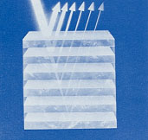
Optical Coatings
Often made of alternating layers of different materials
Layer reflections interfere to cause coating reflection
  Optimize layer thicknesses
  Depends on indices of refraction
  Can design for transmission
Coating Reflectivity
Higher reflection
  Increased number of layers
  Bigger index (n) separation
Scatter causes loss of light
Absorption causes heating
High n
Low n
Alternating Layers

Slide 7
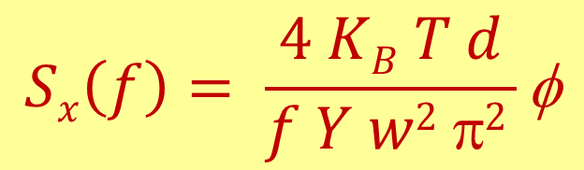
Coating Thermal Noise I
Levin’s Formula
From Fluctuation-Dissipation Theorem
Describes random motions of surface of coating relative to mirror center of mass
$$Sx\left(f\right)= \frac{4 KB T d}{f Y w2 π2 }\text{f}$$
K_{B}: Boltzmann’s constant
T: temperature in Kelvin
f: frequency
d: coating thickness
Y: Young’s modulus
w: beam width
φ : mechanical loss

Slide 8
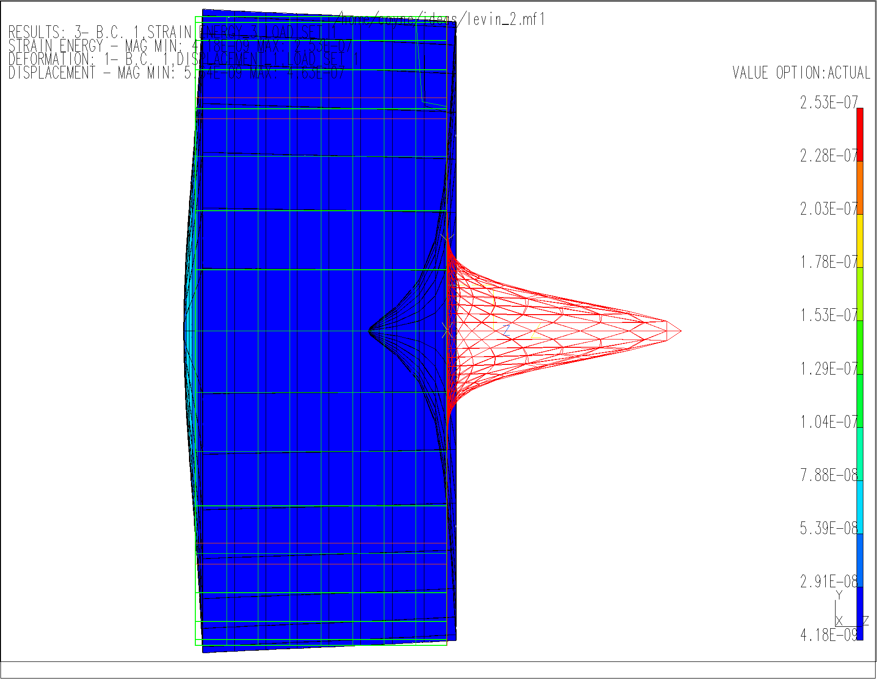
Coating Thermal Noise II
Side View of Optic
w: how well noise is averaged
d: how much coating
Y: how stiff is the coating
φ: how much heat energy can affect coating motion
w
Coating
d
Y,φ
Substrate

Slide 9
Mechanical Loss of Coating Materials
High Index Materials
Tantala Ta₂O₅ 3 10⁻⁴
Titania-Tantala 1.5 10⁻⁴
Niobia Nb₂O₅ 5 10⁻⁴
Low Index Materials
Silica SiO₂ 1 10⁻⁵
Alumina Al₂O₅ 2 10⁻⁵
High index materials have higher mechanical loss
  Always? Generally? Still under study
  Focus on finding new and better high index materials
Many materials show different mechanical loss from different coating companies
  Process is known to have some affect
  Most coating companies keep process secret

Slide 10
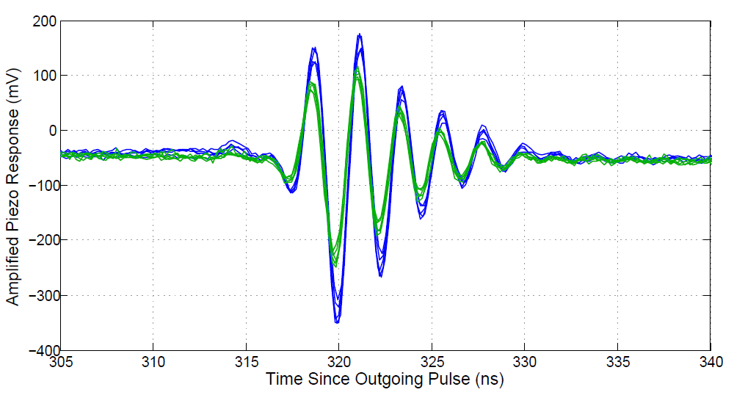
Young’s Modulus Measurement
Thermal noise is a force noise
Stiffness converts force to position
Young’s modulus of both coating and substrate important
Water
1” dia. optic
Coating
Glass Slide
Spacer
Transducer
Y Experiment
Work at ERAU on Y
Green trace from silica
Blue trace from sapphire
Also studying high index coating materials
Pulse from Young’s Modulus Measurement

Slide 11
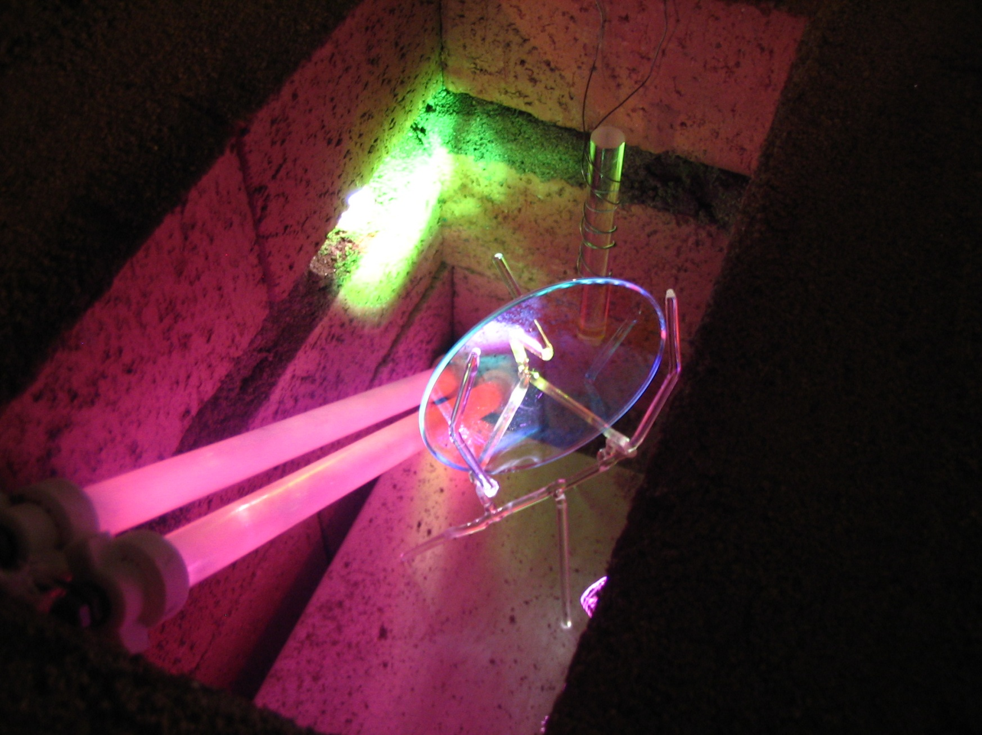
Thermo-optic Noise
Different form of coating thermal noise
Thermal fluctuations cause change in index of refraction and layer thickness
Does not depend on φ, but on dn/dT and dL/dT
Generally less than Brownian thermal noise
ERAU center of thermo-optic noise research
Measuring dn/dT from changing reflectivity with temperature
Difficult data analysis from multiple layers
Experimental Setup at ERAU

Slide 12
Applications Limited by Coating Thermal Noise
Gravitational Wave Detection
  First concerned with coating thermal noise
  Not limiting right now, probably about 3 years
  Focus of ERAU (and American University) efforts
Frequency stabilization
  Precise timing measurements
  Frequency combs
Quantum optomechanics
  Quantum behavior of macroscopic objects
Cavity quantum electrodynamics
  Single atom and photon interactions

Slide 13
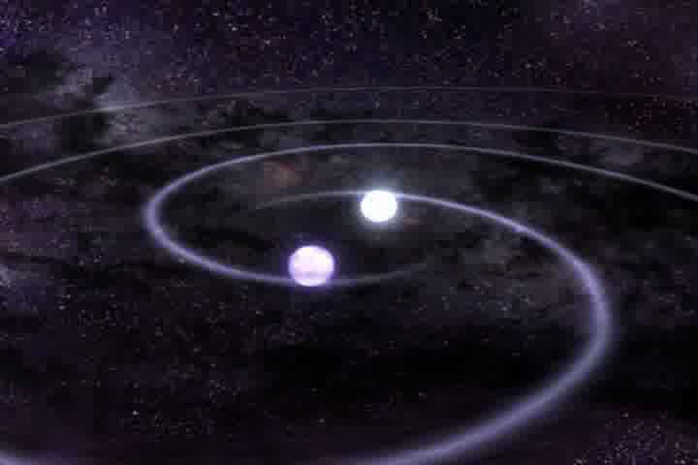
Gravitational Wave Detection
Measure prediction of Einstein’s theory of gravity
  Moving masses produce waves in space and time
Astronomical sized objects needed
  Still very tiny effect, about 10⁻¹⁸ m at Earth
Interferometer measures separation between two coated optics; need to boost signal
  High laser power: hundreds of kilowatts
  Long arms: 4 kilometers
Inspiraling Neutron Stars
LIGO Gravitational Wave Detectors

Slide 14
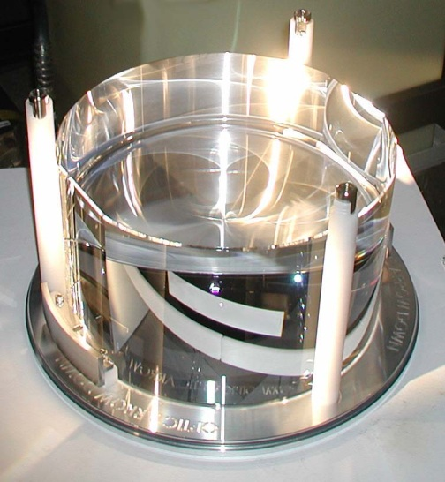
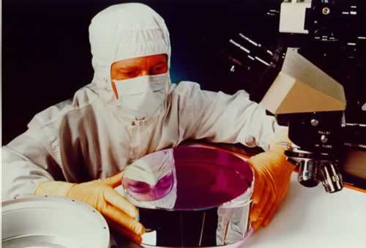
Gravitational Wave Optics
40 kilograms with 6 cm spot size
  Increased w reduces coating thermal noise
High optical power
  Low scatter to keep light in arms
  Low absorption to reduce temperature
  Low optical loss allows for squeezed light
Large LIGO Optic
Titania-Tantala/Silica Coatings
Design to preserve reflectivity but reduce amount of titania-tantala
Large index contrast, to keep coating thickness d low
Reduced absorption, low scatter
Coated LIGO Optic

Slide 15
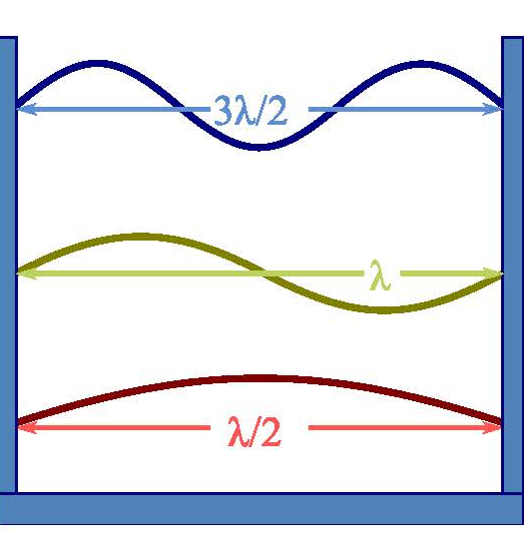
Frequency Stabilization
Optical cavities used as frequency reference
  Cavities have coated mirrors on each end
Light of certain frequency will resonate in cavity
Length stability determines frequency stability
Coating thermal noise will limit cavity length
  Currently limited to proton radius over 1 second
Optical Cavity
Cavity Resonance

Slide 16
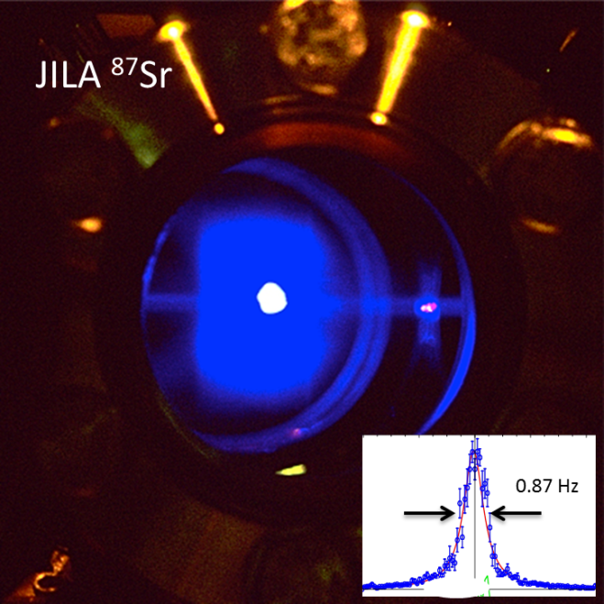
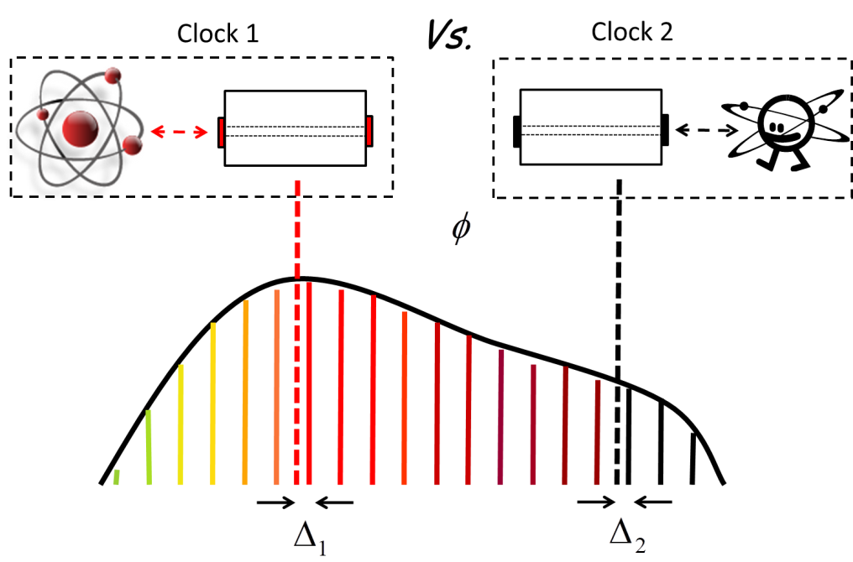
Frequency Stabilization Applications
Atomic clocks
Metrology of optical surfaces
Improved spectroscopy
Global positioning (GPS) technology
Gravitational redshift measurement over 1 meter
Sr Atomic Clock
Frequency combs
Link across frequencies
Connects atomic clocks based on different species
Optical frequency comparison to microwave standards
Study changes in fundamental constants
Frequency Comb

Slide 17
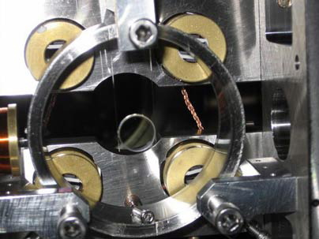
Cavity Optomechanics
Measure motion of small, but macroscopic objects
  Nano to milli grams
Some samples made by etching
  Only coatings, no substrates
  Coating properties crucial
Often cryogenic
Mini-mirror in Suspension
Light acts as spring
  Radiation pressure
Exchange energy between mirrors and light
  Doppler shift
Micron Scale Oscillator

Slide 18
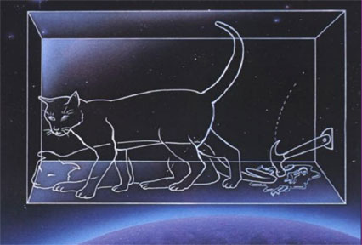
Cavity Optomechanics Experiments
Single electron spin detection
Quantum information theory (Qubits)
Quantum limits of force, mass, and position
Quantum mechanical behavior of large objects
  Coupling of large resonator to single atom
  Schrödinger’s cat experiments
Schrödinger’s Cat
Radioactive decay breaks poison bottle or not
Macroscopic state depends of quantum event
Just thought experiment until recently
Schrödinger’s Cat Experiment

Slide 19
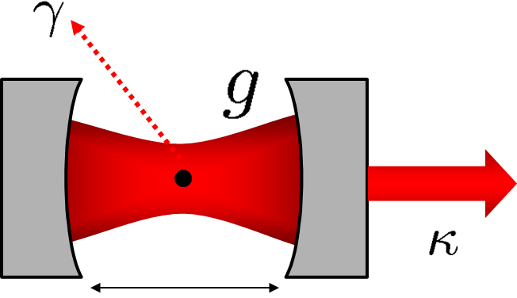
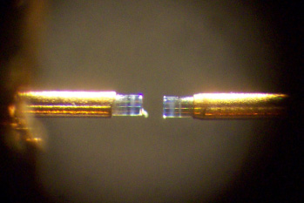
Cavity QED
Single atom (ion) in cavity
  Also quantum dot
  Bose Einstein condensate
Secondary beam traps atom
Thermal noise can influence trapping
Cavity with Single Atom
Coating scatter very low
  Chance of interaction with atom >> chance of scatter
Can use optical fibers to define cavity
Generate single photons
Fiber Optic Cavity

Slide 20
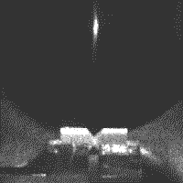
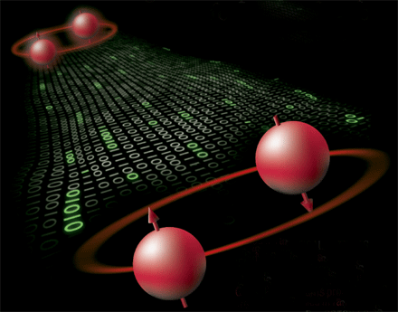
Cavity QED Applications
Study fundamental quantum systems
  Interaction of light and matter
Single atom lasers
Single Atom Loaded Into Cavity
Measure entanglement between different atoms
  Secure quantum cryptography
Quantum computation
Quantum networks
Quantum Computer

Slide 21
Reducing Coating Thermal Noise
Reducing temperature
  Directly lowers T in thermal noise equation
  Material properties (φ, Y, etc.) can also change
Beam shaping
  Effectively increase beam size
  Can cause difficulty with interferometry
Coating free mirrors
  Eliminate need for coatings
  Hard to get high reflectivity
Khalili cavities
  Get lower thickness coatings
  Need extra mirrors

Slide 22
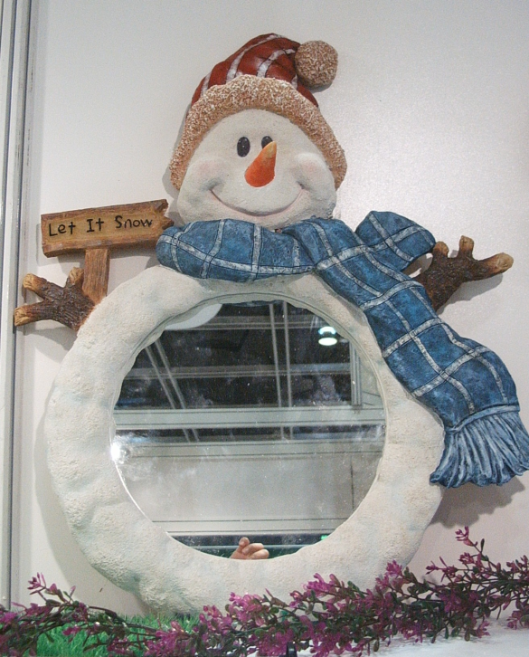
Cryogenics
Reduction in T directly lowers thermal noise
Need to study materials at low temperatures
  Properties can improve, worsen, or stay same
  New materials may become possible
Engineering challenges
High thermal conductivity materials to get heat out
High light power can add heat to optics
Refrigerators can cause vibration and other noise
Cooled Mirror

Slide 23
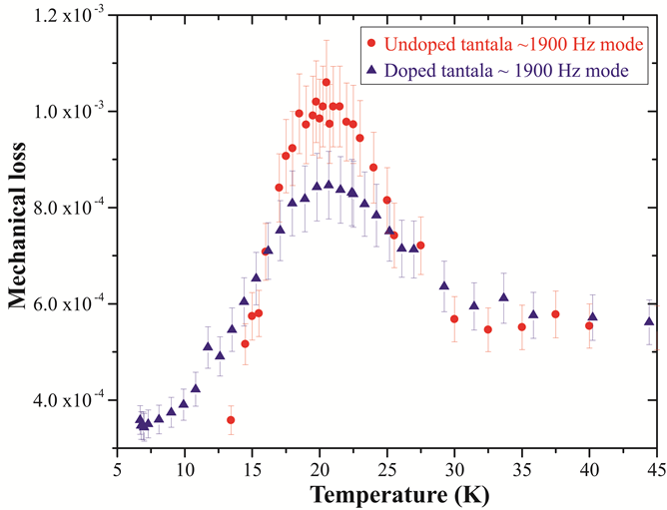
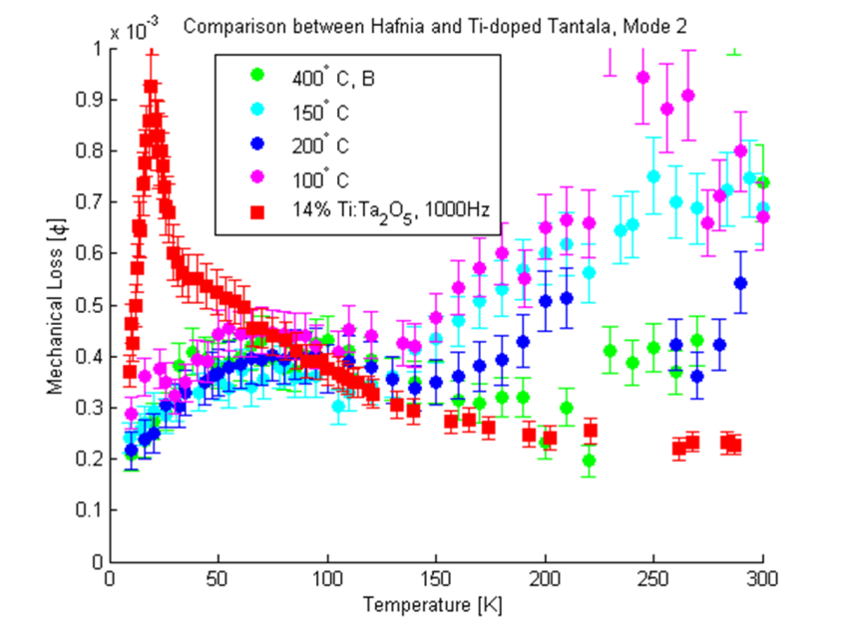
Cryogenics and Materials
Loss Peaks in Ta and Ti-Ta
Material φ’s change with T
Often have loss peaks
  Tantala, titania-tantala, silica
  Help understand source of mechanical loss
Very low T, φ’s become low
Many loss peaks different with annealing/doping
Hafnia (HfO₂) poor at room temperature but continually improves with low T
Hafnia Mechanical Loss

Slide 24
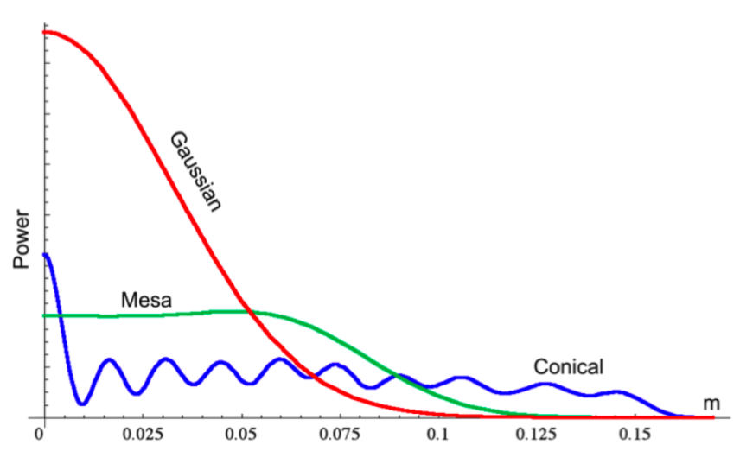
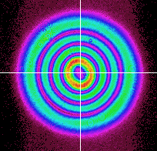
Beam Shaping
Different Shaped Beams
Averaging across mirror gives lower thermal noise
Effectively increasing w value
Brings up optical problems
  Optical loss at edge of mirror
  Cavity stability at high power
Many experimental attempts
Mesa beams
  Requires special shaped mirror
Laguerre Gauss beams
  Use spherical mirrors
  Plans for use in prototype
Laguerre Gauss 3,3 Mode

Slide 25
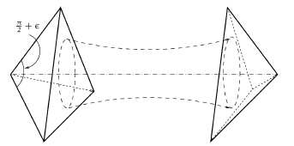
Coating Free Mirrors
Coating Free Mirrors
Can use total internal reflection effect for mirror
Need an anti-reflective coating on face
  Much thinner than reflective
Beam travels inside mirror
  Scatter, absorption concerns
Mostly theory and modeling work
Concerns with level of reflectivity achievable
Experiment using Brewster angle mirror
Brewster’s Angle Reflector

Slide 26
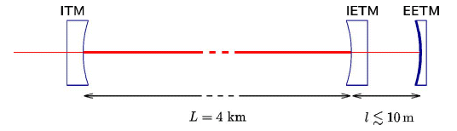
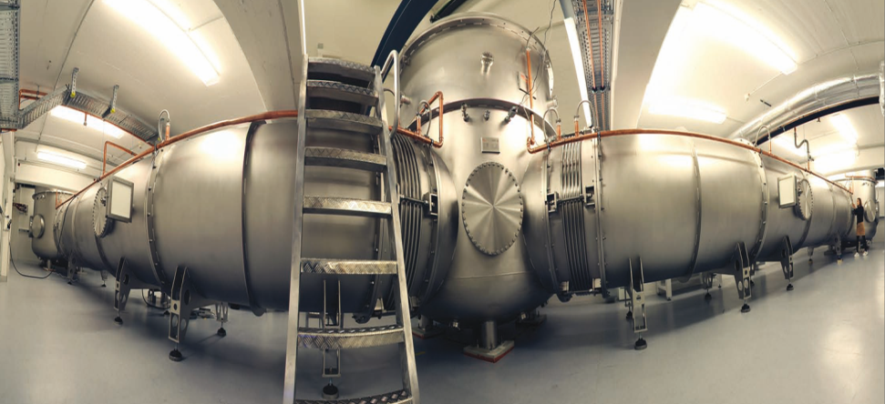
Khalili Cavities
Make one mirror of cavity itself a cavity
Thick coating (EETM) sensed by less light
Thin coating (IETM) sensed by more light
Khalili Cavity
Planned for use in prototype interferometer
Added complexity due to additional mirror
Hope to study quantum noise and squeezed light
10 m Interferometer Prototype

Slide 27
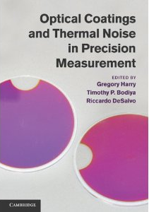
Summary and Conclusion
Coating properties limitation on many precision optical measurements
Coating thermal noise limiting noise source
Cutting edge physics and astronomy
  Gravitational waves, atomic clocks, Schrödinger’s cat, quantum computing
Many ways to improve thermal noise
  Cryogenics one option
  Much research needed
Book from Cambridge University Press January 2012

Slide 28
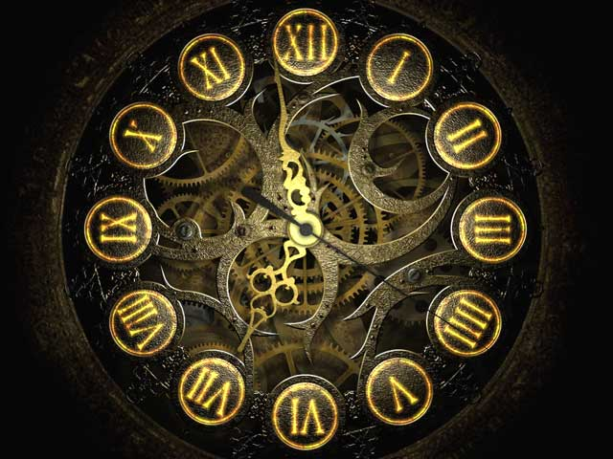
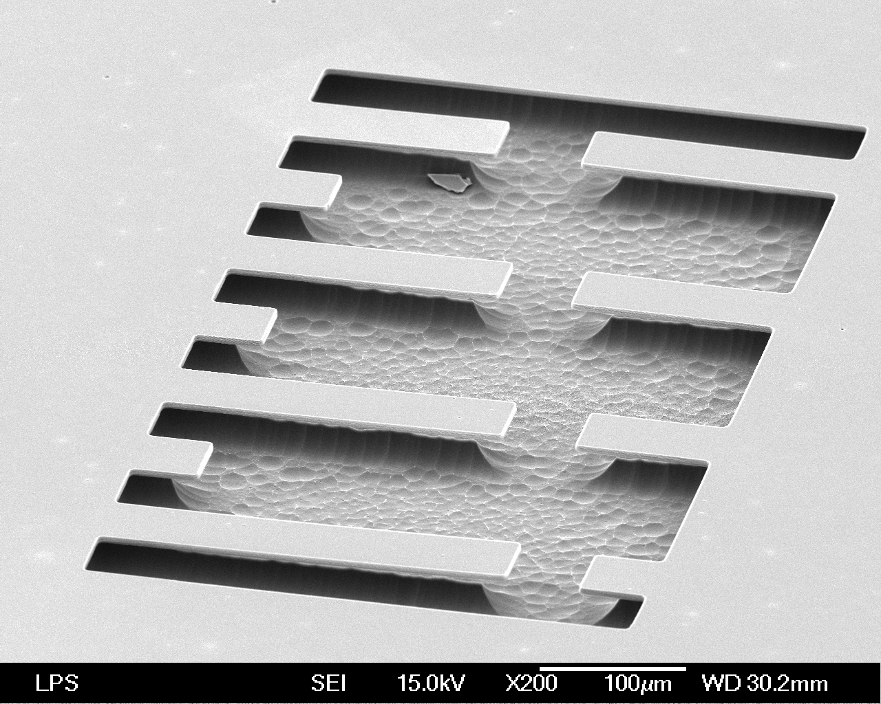

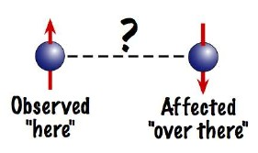
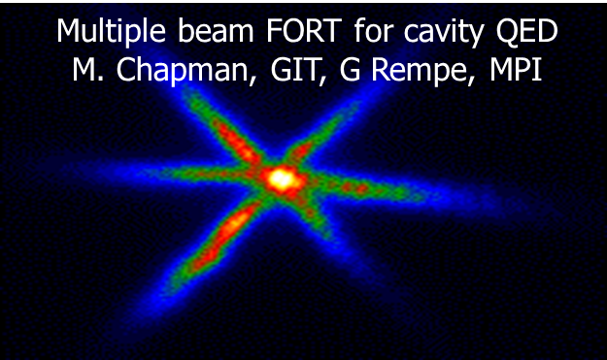

Slide 29
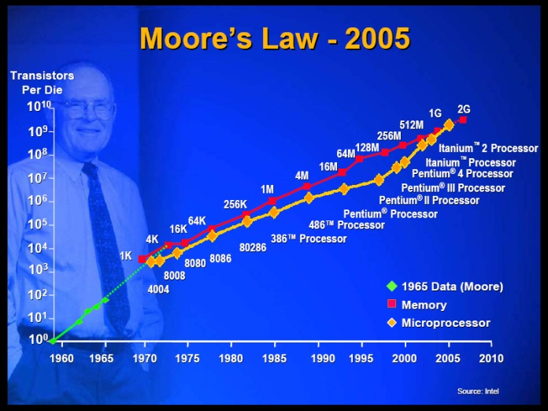
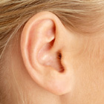
Processes Limited by Thermal Noise
Electronics – Johnson Noise
  Possible end to Moore’s Law
  Can be used as source of signal
Moore’s Law
Human hearing – pressure noise
Atomic force microscopes
Precision measurement with interferometry
Hearing

Slide 30
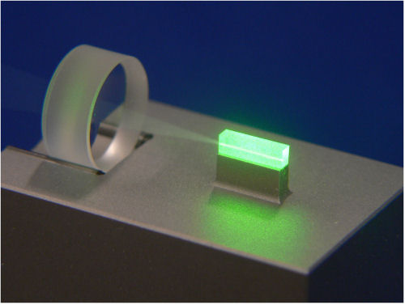
Coatings in Precision Measurement
More light for more signal
  Higher reflectivity
  Low scatter
Quantum squeezing
  Lowers quantum noise
  Limited by coating optical loss
Squeezed Light
Heating issues
  Absorption turns light to heat
  Heat can deform mirrors
  Extreme heat causes damage
Thermal noise
Thermal Deformation of Light in Heated Optic

Slide 31
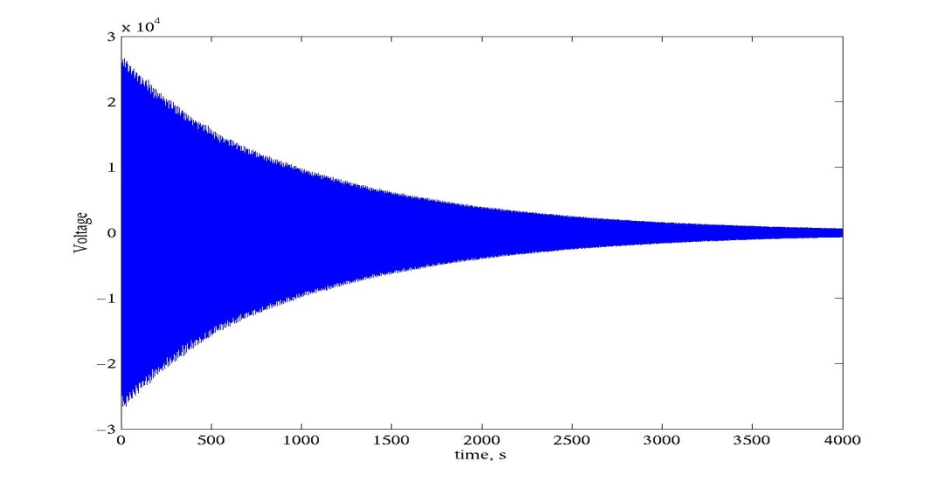
Measurements of Coating φ
Q Measurement
Mechanical loss φ also causes ringdown of normal modes
  Test samples rings like a bell
  Energy slowly leaves ringing
Can measure φ more easily than measuring thermal noise
e^{-π f tφ} Sin(2 π f t)
Ringdown

Slide 32
Direct Thermal Noise Measurements
Coating Thermal Noise Data
Interferometer can directly measure coating thermal noise
Very difficult
  Years to perfect
  Months to measure
See 1/f dependence
Tantala
Titania-Tantala
Clear improvement from tantala to titania-tantala
  Reasonable agreement with Q measurements
Seen improvement from using less tantala
Can (and have) also study substrate thermal noise

