Slide 1
A Brief Discussion of Lockout-Tagout for the Wave Plate Rotation Stage Controller
David Kinzel

Slide 2
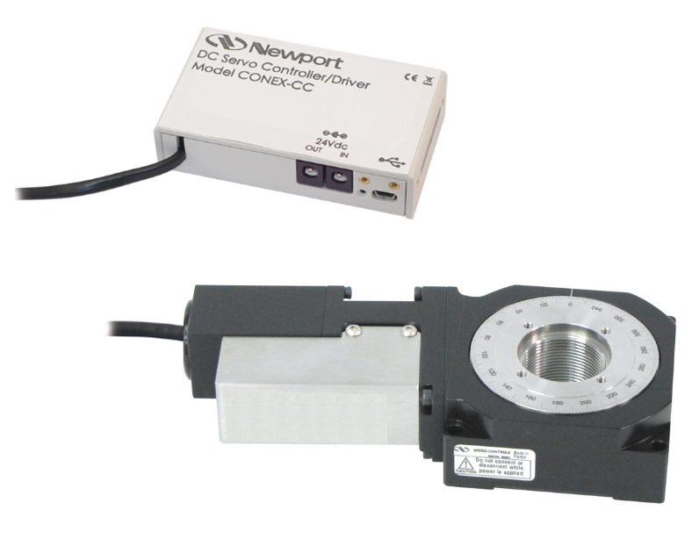
CONEX-CC Integrated Rotation Stages and DC-Servo Controller
Pasted from <http://www.newport.com/CONEX-CC-Integrated-Rotation-Stages-and-DC-Servo-/934126/1033/catalog.aspx>

Slide 3
Assessment of Requirements and Behaviours
Setup: A wave plate is mounted on a rotation device. This mechanism is used to regulate laser light power.
Objective: Provide a safe working condition down-stream of the wave plate that does not depend on software.
The safety objective will be met when:
The wave plate is moved to an arbitrary but user-specific location
The controls for the wave plate are disconnected in some fashion so that while they are disconnected the wave plate cannot be moved
Work down-stream of the wave plate is done in safety as long as required
And the wave plate is reconnect without the act of reconnecting it moving it.
Mark White, an application engineer at Newport asserted that breaking the DC connection between the power supply and the rotation stage prohibits the rotation stage (and thus the wave plate) from moving. David Feldbaum and I (David Kinzel) explored this behaviour and empirically determined it to be true.
Conclusion: The safety objective can be met by taking advantage of this behaviour by inserting a lockout-tagout switch between the DC power supply and the rotation stage power connector.
Suggestion for implementation:
Deploy two switches in series – one inside the PSL enclosure and one outside. The switch outside can be used for a far down-stream operation without requiring the additional step of garbing for entrance to a single switch inside the clean-room environment, while the switch inside can be used for a near down-stream operation without requiring un-garbing and re-garbing to manage the switch. While it is true that for the inside operation the cable can be pulled out of the rotation stage to break the connection, it is not true that this state satisfies the conditions of lockout-tagout.

Slide 4
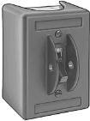
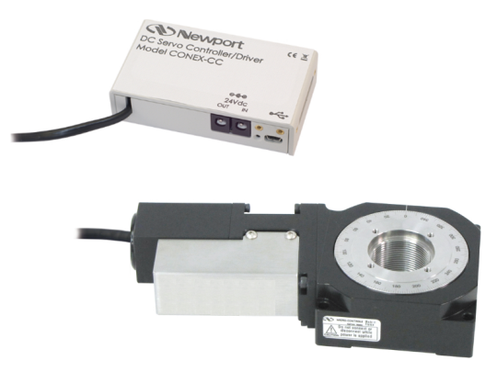
Serial Lockout-Tagout Switchs
Outside Lockout - Tagout
Inside Lockout - Tagout
USB to Computer
+24VDC Power
PSL Enclosure

Slide 5
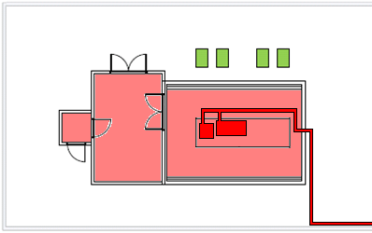
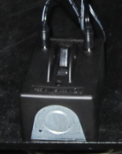
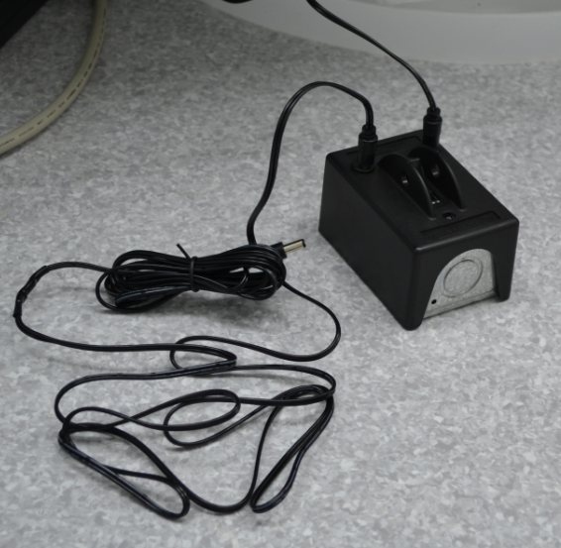
Switch Locations for Wave Plate Lockout/Tagout
This external switch is located in the rack PSL-R2. One cable attaches to the 24VDC Power Distribution Strip, the other enters the enclosure and attaches to the internal switch located inside the PSL enclosure.
LVEA Control Box
NHZs
LAE Cargo Doors
LAE Airlock Entrance Door
Acoustic enclosure
Air shower
Armoured Fiber Optics Cable
Anteroom
FE
HPO
PSL Table
Laser Warning Signs
Laser Warning Signs
This internal switch is located inside the PSL enclosure. One cable attaches to the Wave Plate Controller, the other exits the enclosure and attaches to the external switch located in the rack PSL-R2.

Slide 6
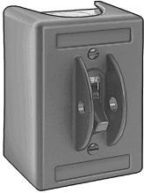
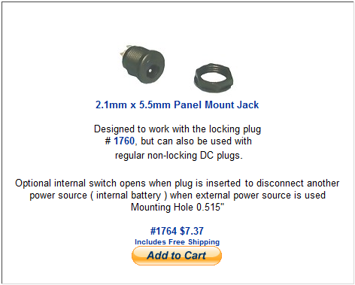
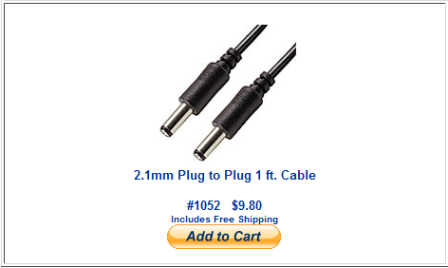
Some Components for Lockout-Tagout Switchs
http://www.mcmaster.com/#7657k21/=ecd5op
3PST-NO for 3-Phase Motors - Toggle Operator Indoor
http://www.mcmaster.com/#7657k31/=ecd5op
DPST-NO for 1-Phase Motors - Toggle Operator Indoor
http://www.cordsplus.com/pages/2.1mm_extension.html

