Slide 1
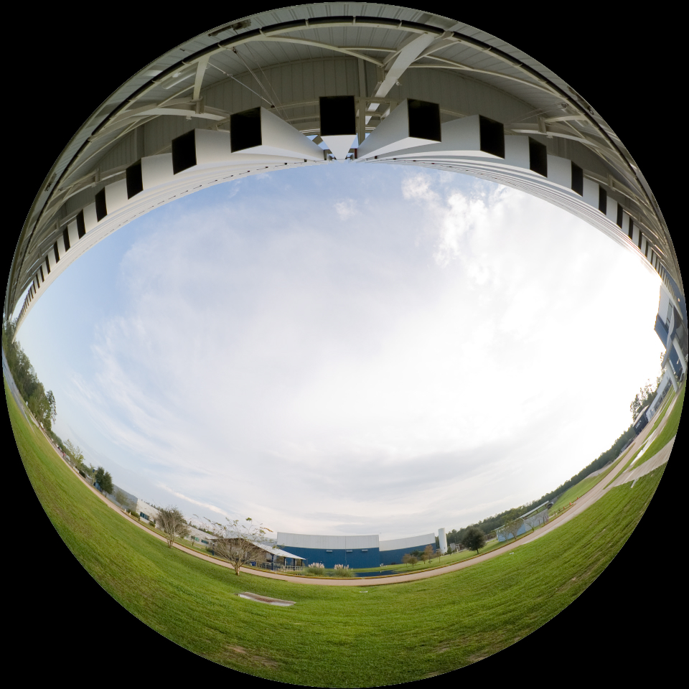
The LIGO Science Education Center and its partnership
J. Giaime, D. Shoemaker, W. Katzman, representing:
The Laser Interferometer Gravitational-wave Observatory
Funded by the National Science Foundation, jointly operated by Caltech & MIT, with over 850 scientists from 50+ institutions participating through the LIGO Scientific Collaboration (LSC).
The LIGO SEC partnership in Louisiana
LIGO, Southern University, the San Francisco Exploratorium, the Louisiana Board of Regents and the Baton Rouge Area Foundation.
…with contributions from M. Cavaglià and D. Ingram.
LIGO-G1101114-v3

Slide 2
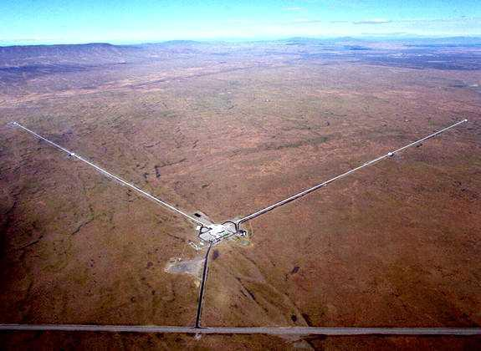
LIGO Outreach Objectives
Improving science literacy in the general
population
Increasing participation in science,
especially among under-represented and under-served groups
Helping to reduce existing disparities in the access to
educational resources
Advocating the intellectual and social / socio-economic benefits of
careers in science
Providing and coordinating resources for the design and delivery
of outreach and education activities by others within the collaboration
• Improving understanding by the citizenry of frontier science and
large scientific projects
• Inspiring future generations of scientists and engineers

Slide 3
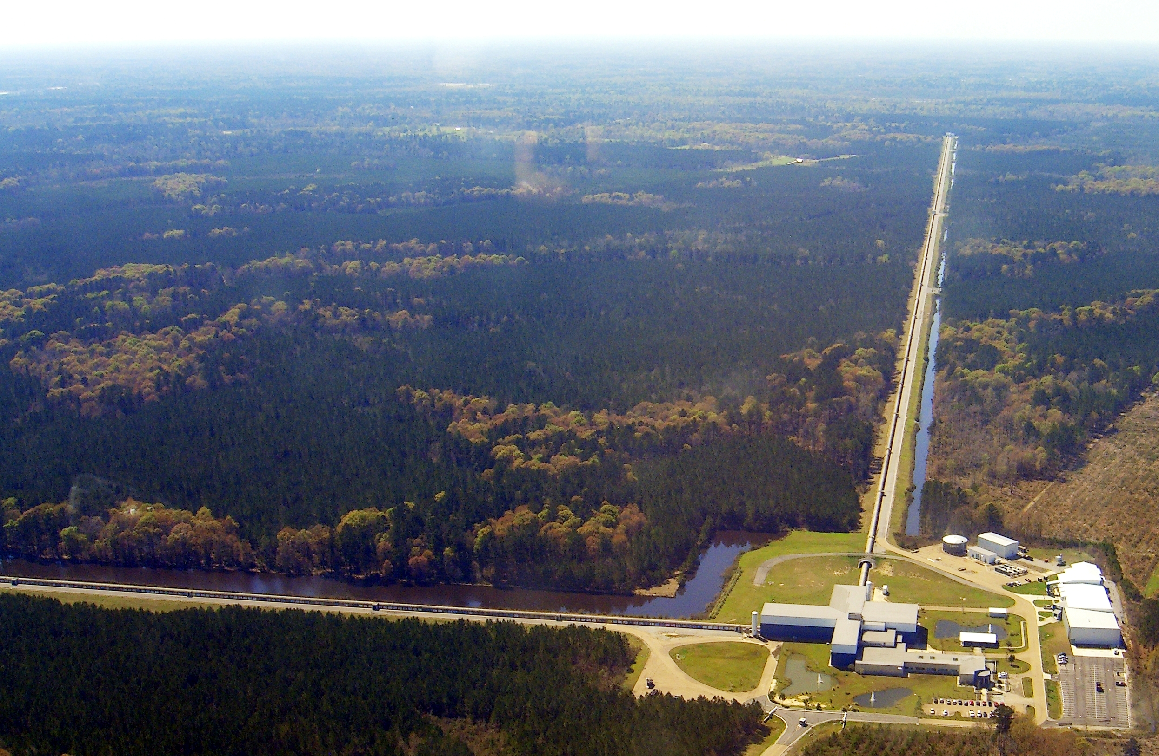
LIGO Outreach Efforts –
Centered at Observatories
Hanford, Washington
Livingston, Louisiana

Slide 4
LIGO Livingston activities

Slide 5
LIGO Livingston
Outreach
LIGO Livingston Observatory
  Standard tours – consisting of the Control Room and/or the facility grounds.
  Customized (‘VIP’) tours – visiting other areas of the Observatory such as clean areas, and having a closer look at the vacuum system.
  Scientists, graduate students and technicians interact with the public during:
    Tours through the control room – seeing scientists at work
    Open Public Days
    Informal talks with teachers
    VIP tours

Slide 6
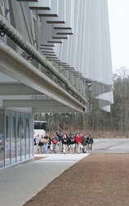
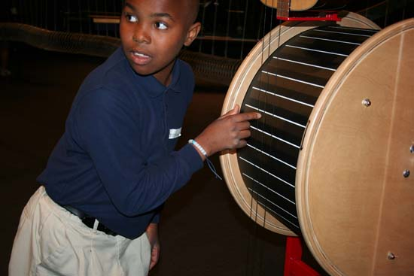
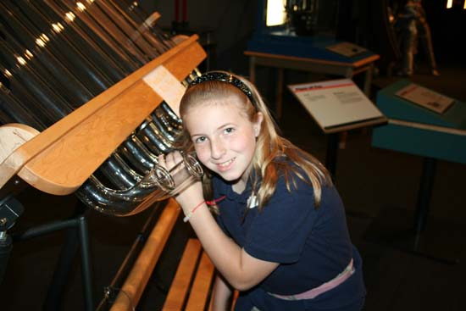
LIGO Livingston
Science Education Center
5000 Square foot exhibition hall filled with over 50 professional exhibits. Developed in conjunction with the Exploratorium (San Francisco).
1 Fully-equipped classroom (32 students)
1 State-of-the-art Auditorium
Lobby area with interferometer display elements
Three full time staff; supplemented by one Postdoc
The front of the SEC with the Wave-Wall

Slide 7




LIGO Livingston
Science Education Center
Partnerships
Fully supported by the National Science Foundation
The Exploratorium
Southern University, Baton Rouge
LaSIP / La GEAR UP
(Louisiana Dept. of Education)
Baton Rouge Area Foundation (BRAF)
Tulane University
5 Local school systems

Slide 8
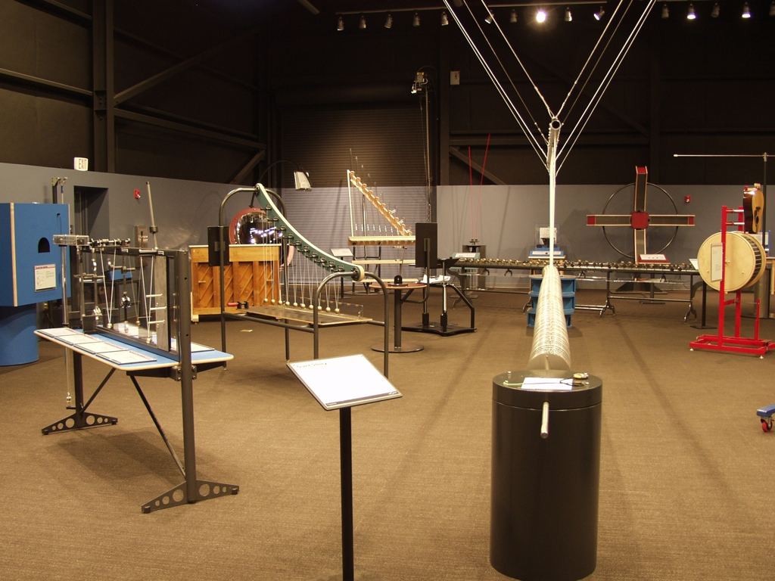
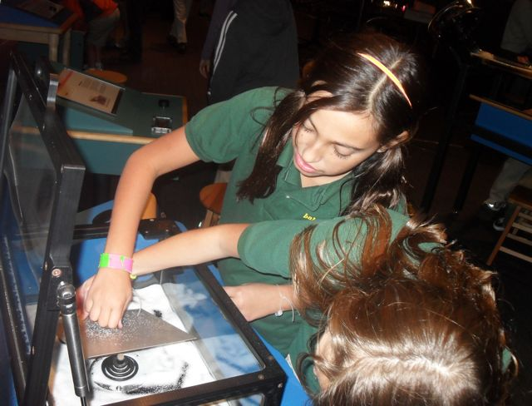
LIGO Livingston
Science Education Center
Partnerships – Exploratorium
The Exploratorium
  Partners in developing 5000 Square foot exhibition hall filled with over 50 professional interactive science center quality exhibits.
  Provides training for SEC staff in informal educational methods
  “ExNet partnership” loans the SEC 10-12 new exhibits that rotate each year.

Slide 9
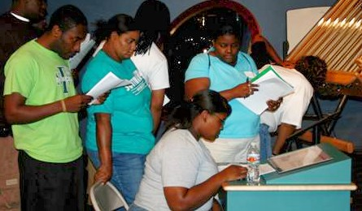
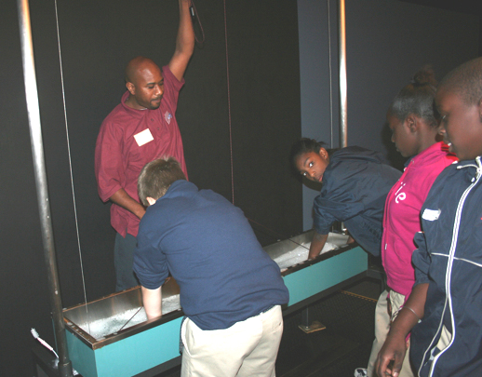
LIGO Livingston
Science Education Center
Partnerships - SUBR
Southern University of Baton Rouge
  Provides Docents to help facilitate experiences at the Science Education Center.
  Docents are undergraduates who major in Science, Technology, Engineering, Mathematics (STEM) or Education fields.
  Docents are trained by LIGO SEC staff to
    Better understand underlying science concepts
    Learn how to facilitate visitor interactions
    Better understand the research done at LIGO
  Docents receive financial aid (similar to a work-study) for their services.
  Docents represent a step in the pathway to being a scientist and serve as role models to students from underrepresented groups in the STEM fields
  17 docents in training

Slide 10
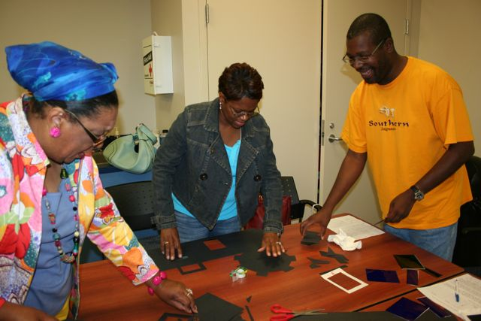
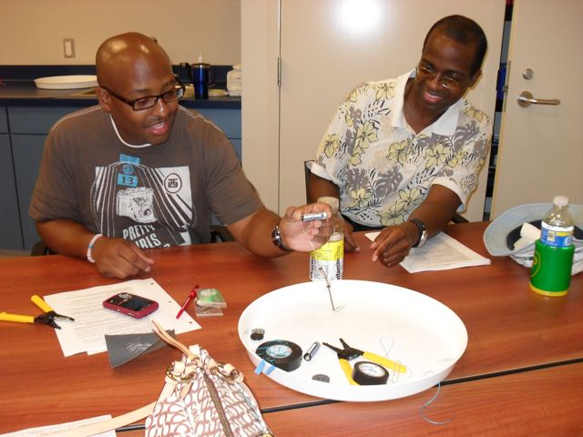
LIGO Livingston
Science Education Center
Partnerships – LaSIP / La GEAR UP
LaSIP / La GEAR UP funds teacher training programs. (Louisiana Systemic Initiative Program / Gaining Early Awareness and Readiness for Undergrad Programs)
Programs train Middle & High school teachers in science & science methods
  Teachers are primarily from disadvantaged regions
  Teachers use interactive exhibits, or inexpensive miniature exhibits (known as ‘snacks’), to illustrate science concepts & increase learning.

Slide 11
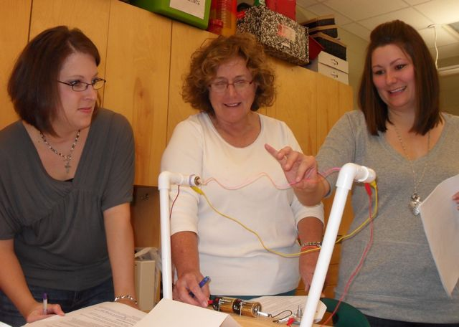
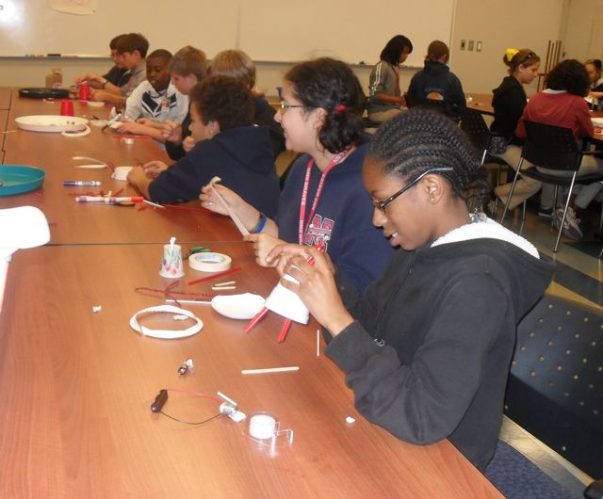
LIGO Livingston
Science Education Center
Partnerships – BRAF
Baton Rouge Area Foundation (BRAF) manages grant funds from the NSF and uses these funds to support:
  The partnership with the Exploratorium
  Supporting educational research through Tulane University
  Supporting 5 school systems for longitudinal contact with LIGO-SEC:
    Two school systems that concentrate efforts on 9th grade science teachers and students for a prolonged duration
    Three school systems where we follow one class of students from 5th grade through 9th grade – providing the students with field trips and each of their teachers with professional development.

Slide 12
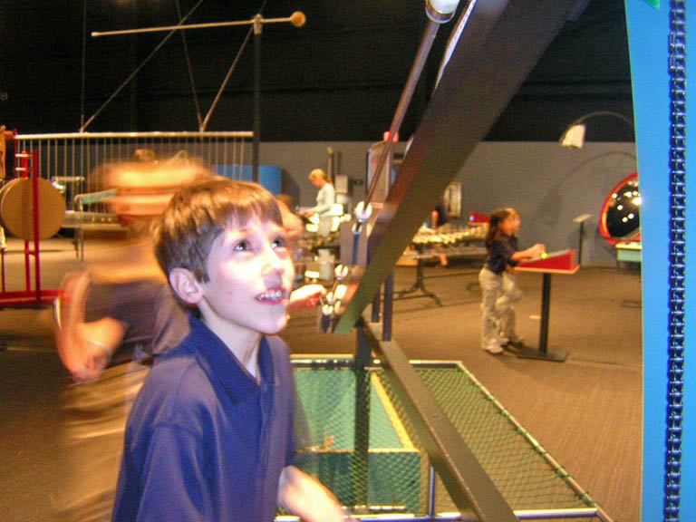
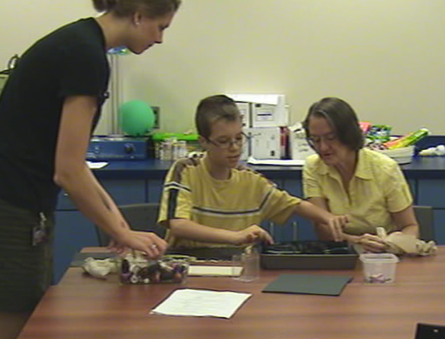
LIGO Livingston
Science Education Center
Partnerships – Tulane
Dr. Lisa Szechter uses LIGO Science Education Center to conduct research on the way people learn in Informal Environments
Results showed correlations between personal interest in science and actions at a particular exhibit
Results show that participation in inquiry activities resulted in:
  Students asking more questions in the exhibit hall
  Students making more observations
  Parents using more science terms
  Parents making more predictions
Notes:
For item 2 the exhibit in question was the Gravity Well....oddly enough these correlations did not occur strongly at other exhibits.
Across all grades, students’ personal interest in science was positively correlated with a number of behaviors at the Gravity Well. Participants with greater personal interest in science more often:
Read signage, r=.16, p=<.05, n=227,
Expressed enthusiasm (e.g., “That’s cool!”), r=.24, p<.05, n=227,
Made observations (e.g., “The white one is moving more slowly.”), r=.21, p<.05, n=227, and
Made predictions (e.g., “I think the heavier one will go faster.”), r=.18, p=<.05, n=227.

Slide 13
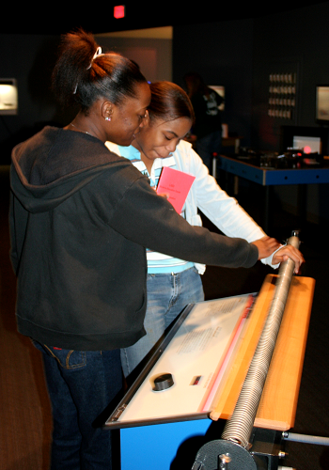
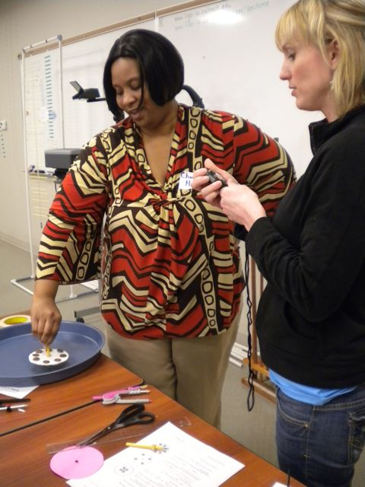
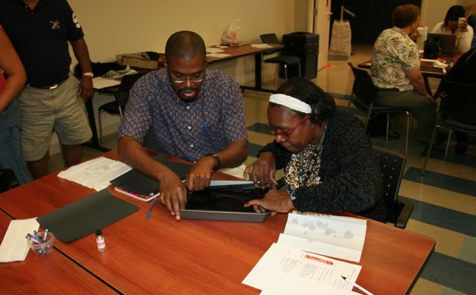
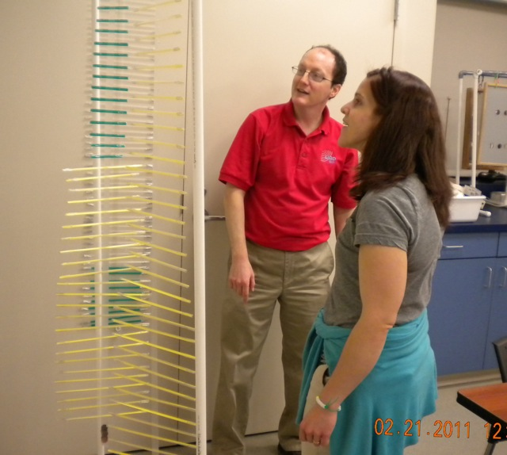
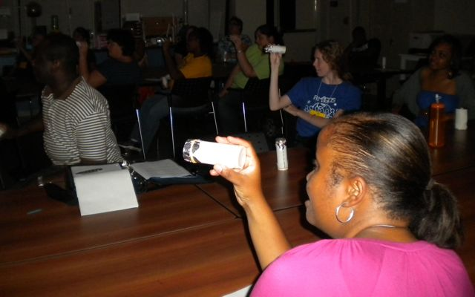
LIGO Livingston
Science Education Center
Teacher Professional Development
Emphasize science inquiry
Include tours of the site
Utilize related LIGO science concepts such as waves, etc.
Utilize science interactive exhibits that can be built inexpensively
(< $20) that often mirror exhibits within the SEC.
Partners – LaTech and SUBR conduct long-term teacher PD that includes one or more visits to LIGO SEC for tours and training.
Provide PD as part of Math & Science Partnership programs.
5 school systems participate through the BRAF NSF grant

Slide 14
LIGO Livingston
Science Education Center
The Tour Experience
Pre-control Room Tour
  Visitors are introduced to a cut-away of a turbo-molecular vacuum and shown a full scale mirror suspension to make the connection to the actual mirrors that will be seen through IR cameras in the control room.
Control Room Tour
  Visitors then visit the LIGO control room where staff are currently working; led by SEC staff or a LIGO scientist.
  The need for a control room is explained, the positions that staff the control room are explained and a live video tour of the site is given.
  Wall projections and monitor displays of data and real-time views of the Interferometer are explained.
External Tour
  These occur depending on weather and time frames. External tours make use of an overpass bridge, or occasionally (for smaller groups) a building-top view, in order to see the beam tubes, and other elements.
Visitors are encouraged to ask questions and interact!

Slide 15
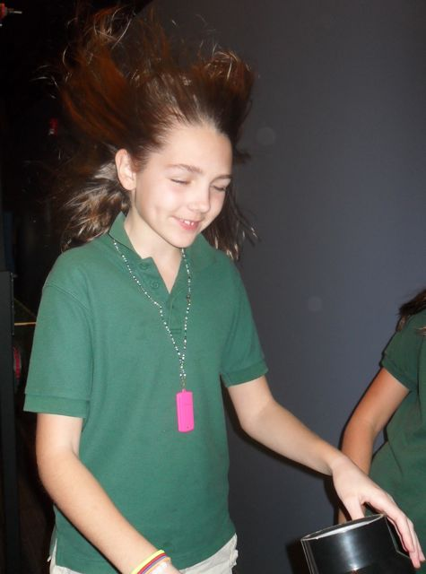
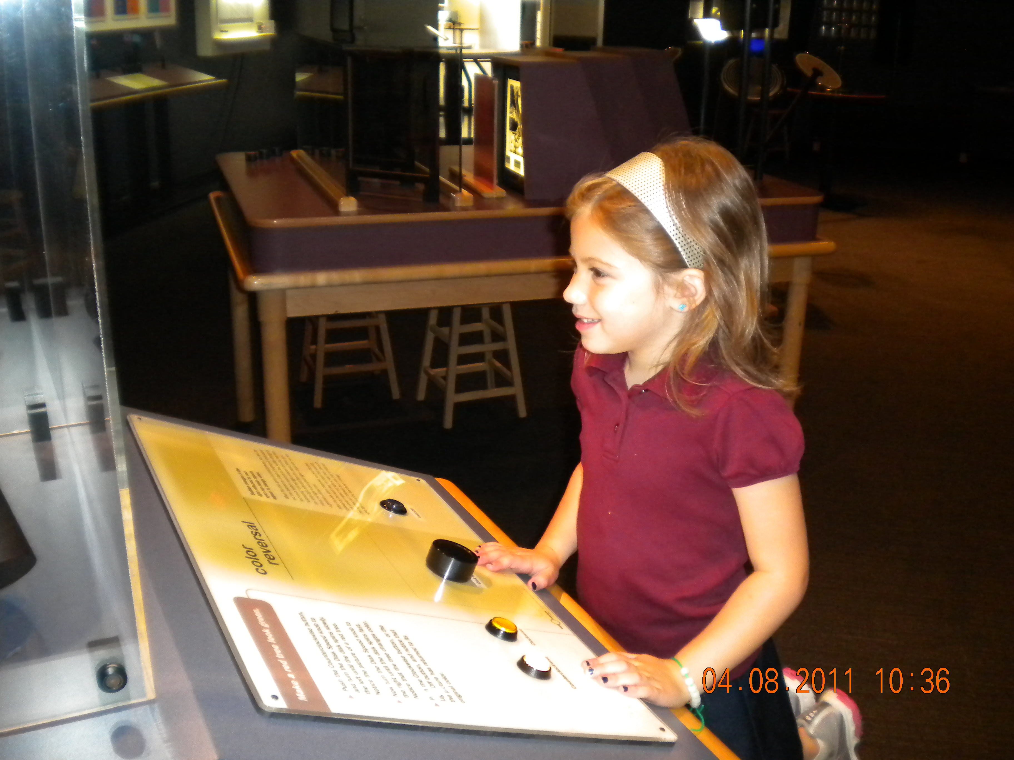
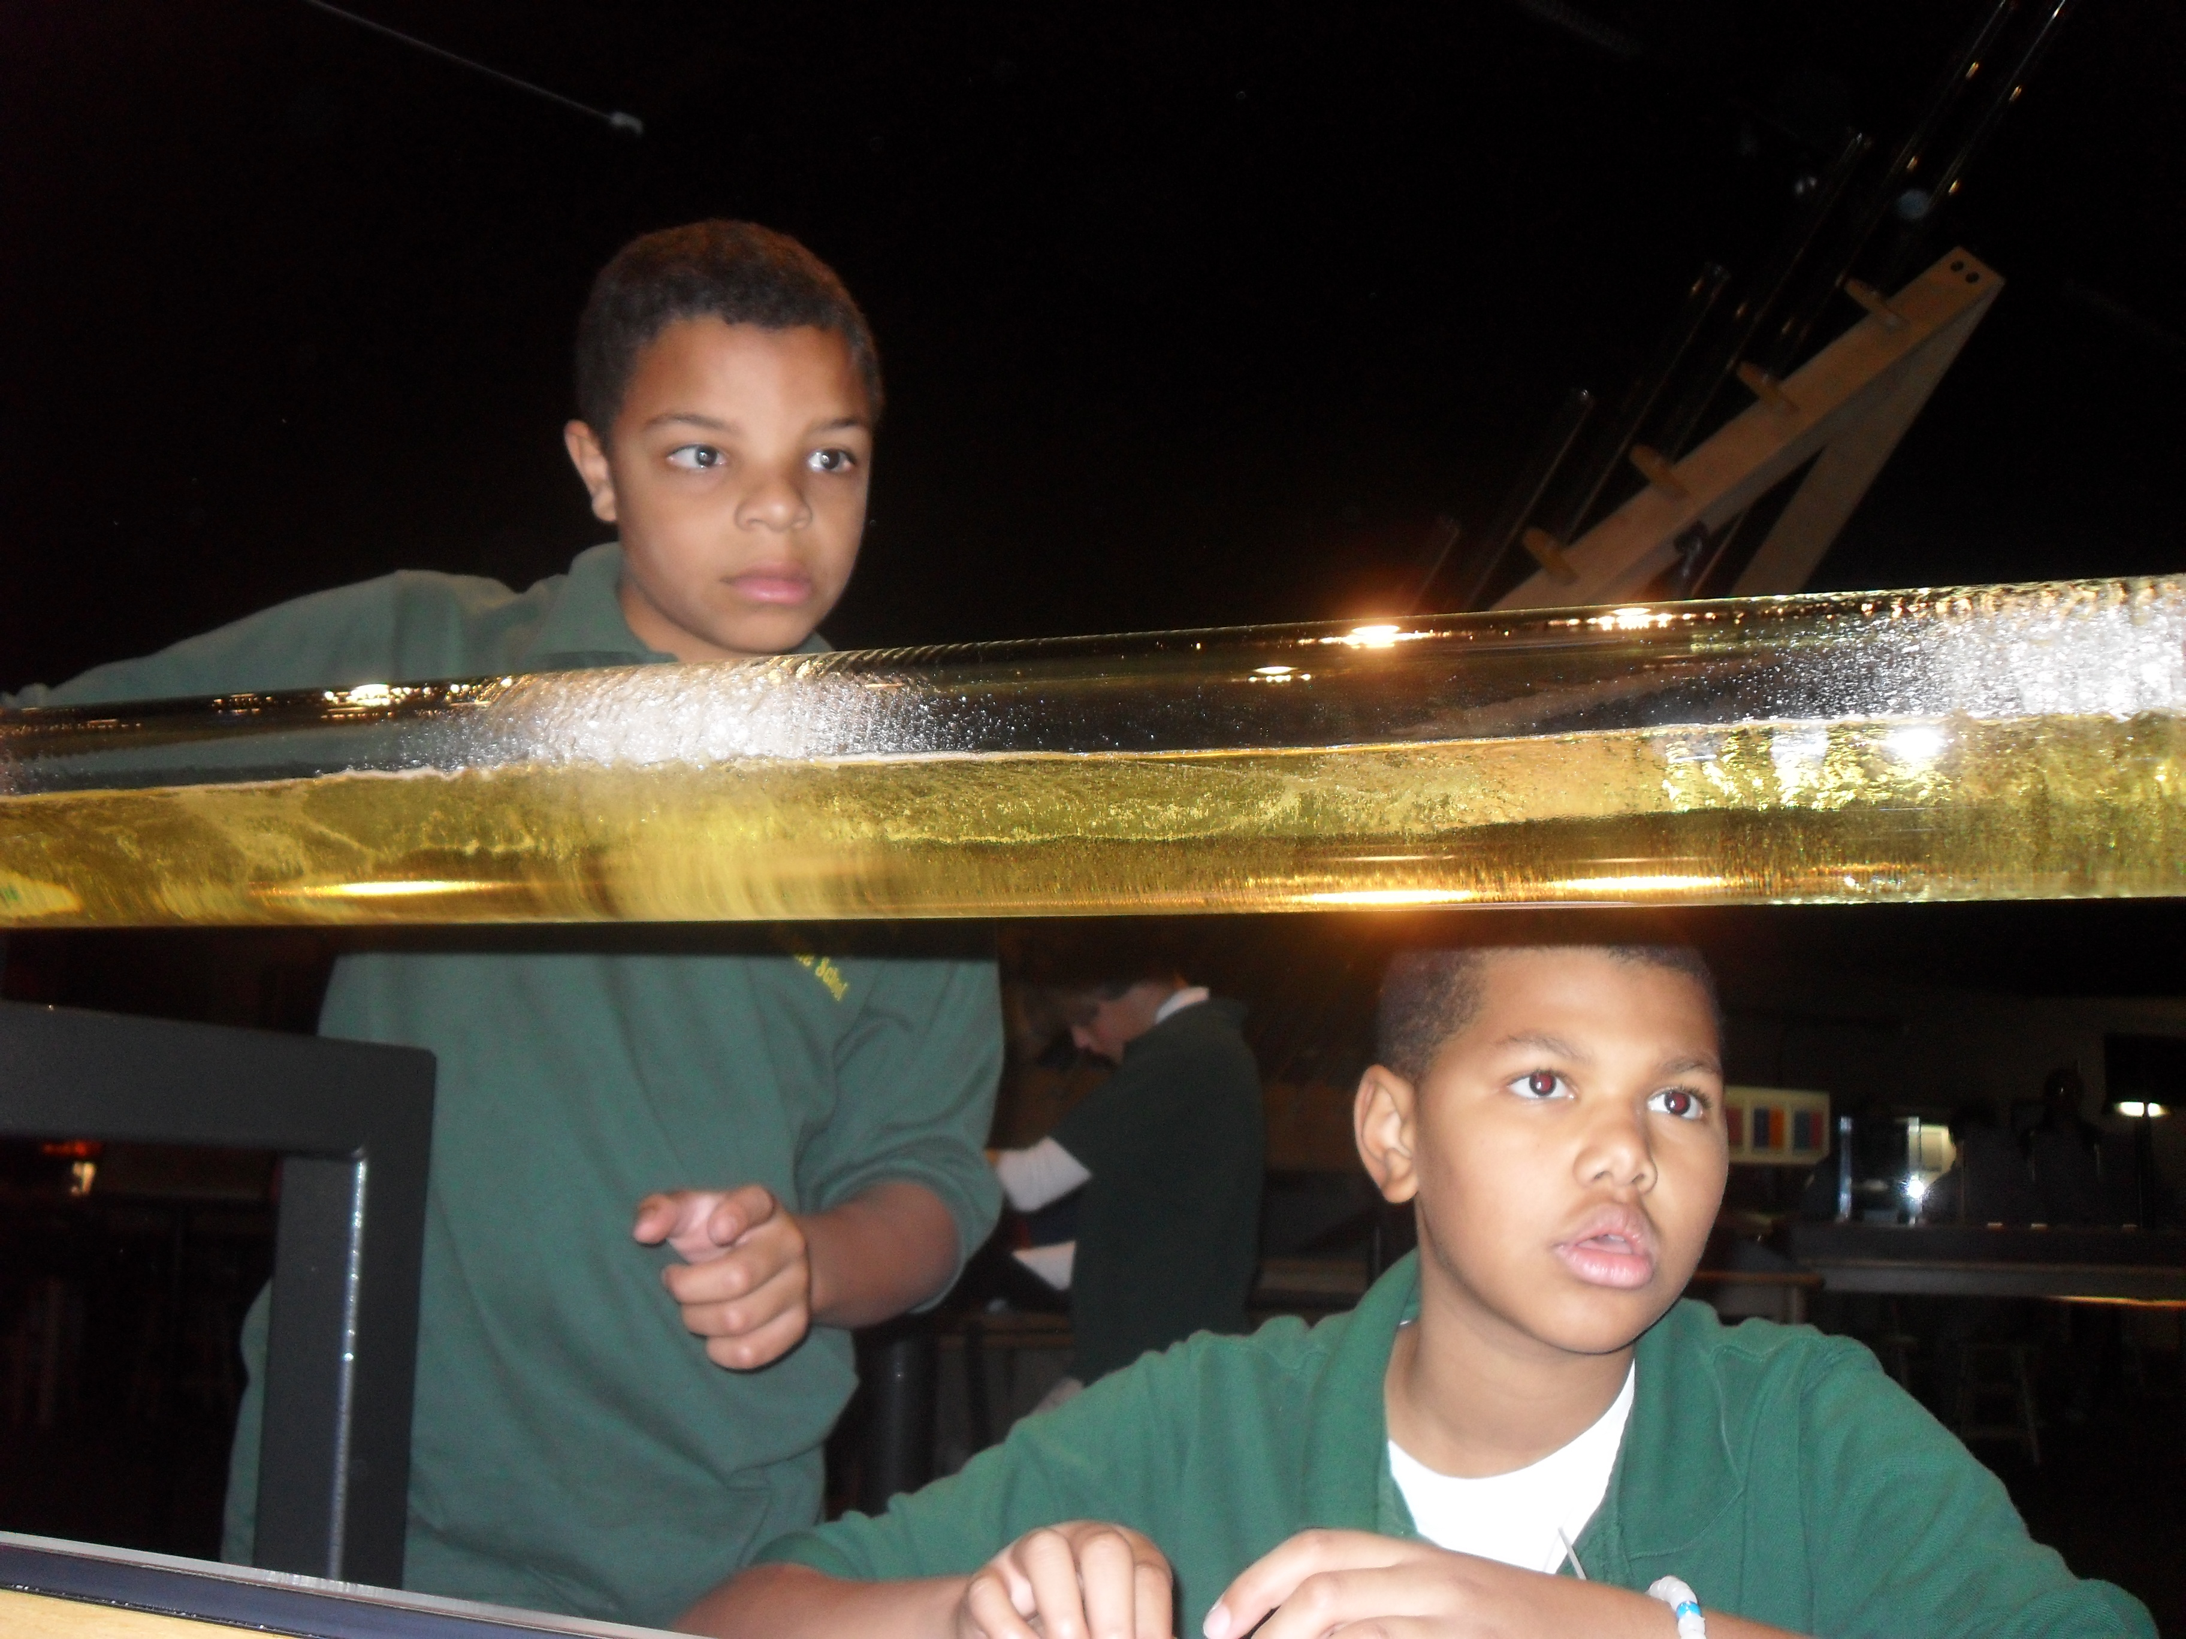
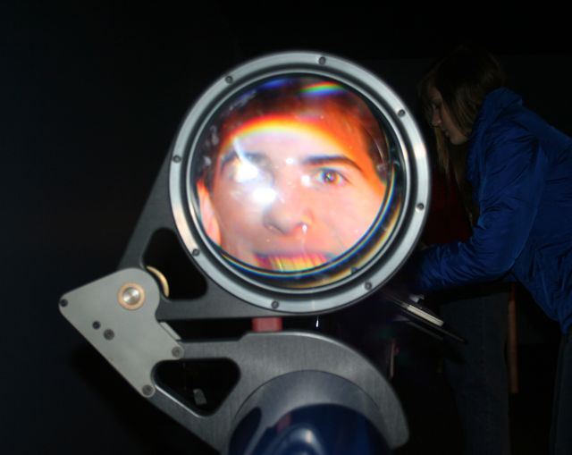
LIGO, Livingston
Science Education Center
School Field Trips
When students visit the SEC, they get the opportunity to explore the science of waves and gravity through inquiry based activities and exhibits as well as see science at work.
  All activities and experiences are tailored to address points in the Louisiana Grade Level Expectations.
Programs are targeted to middle school students.
  Programs are also offered to elementary, secondary and post-secondary students.

Slide 16
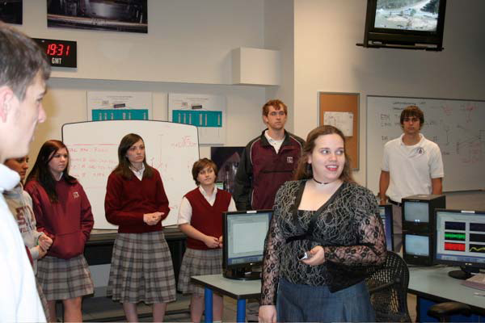
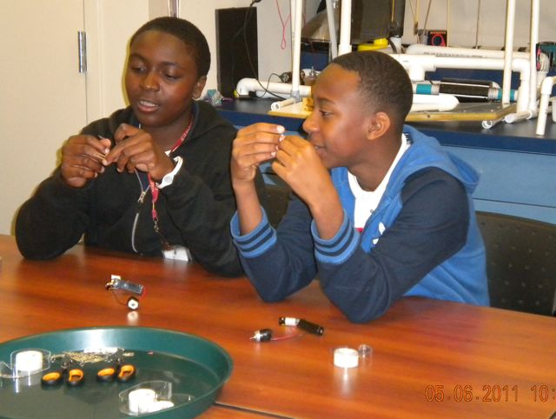
LIGO, Livingston
Science Education Center
School Field Trips
Tours
  Groups are provided tours according to size, etc.
Classroom Activities are provided when requested
  Hands-on, staff member facilitated inquiry activities
  Most focus on light and wave properties (e.g. interference, refraction, etc); other topics also exist (gravity)
Exhibit Hall Exploration
  Time is allotted for free exploration of the hands-on exhibits in the SEC.
  Students are given four “rules” for their experience: interact with the exhibits, learn something, share something, and have fun.
  A short exhibit demo is performed by a staff member not only to teach a targeted concept, but to show students that there are multiple ways to use the exhibits.

Slide 17
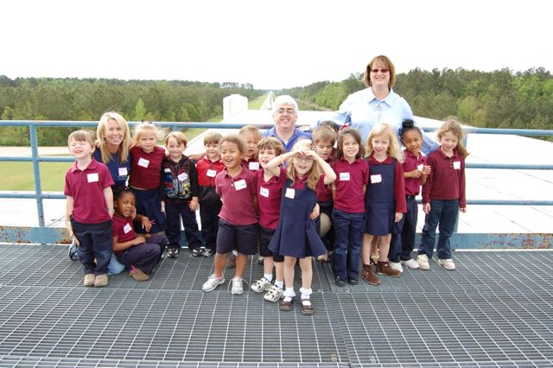
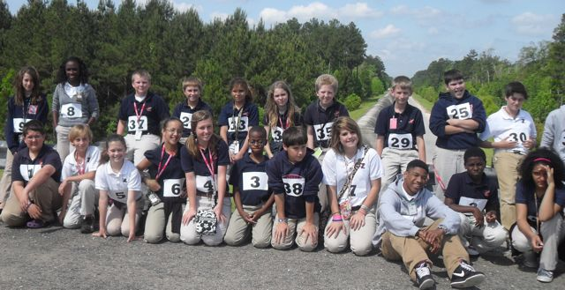
LIGO, Livingston
Science Education Center
School Field Trips
Pre-visit materials are mailed to teachers prior to the field trip.
  Includes the opportunity to view a ~20 min. documentary, Einstein’s Messengers, to introduce students to the science of LIGO.
When students arrive on site, they are briefly introduced to LIGO, and Gravitational Waves
Students typically view the Making Waves video
Docents who are closer to the students age are used to help students realize that they too can participate in science

Slide 18
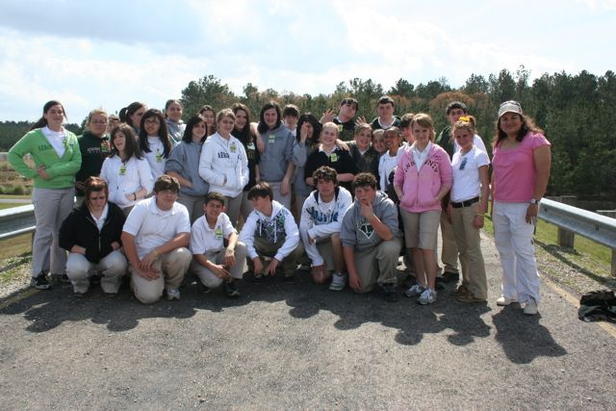
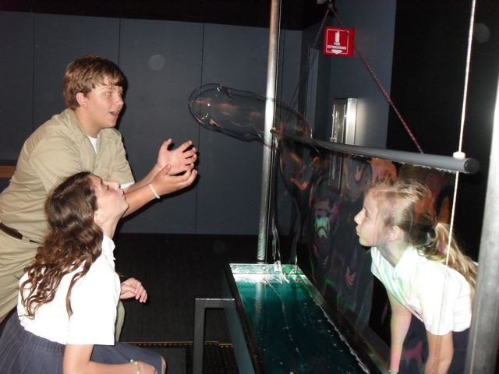
LIGO, Livingston
Science Education Center
Public Tours
The public is generally encouraged to visit during monthly ‘Science Saturdays’
Special requests for other tours (larger groups, or inability to make it out on Saturdays) are accommodated as possible.
The public is greeted and given a brief introduction to LIGO and gravitational waves.
A gravitational wave video is watched (either the 8 minute Making Waves video (for Science Saturdays), or the 20 minute Einstein’s Messenger video.
Tours of the site are given followed by time for free exploration in the exhibit hall.

Slide 19
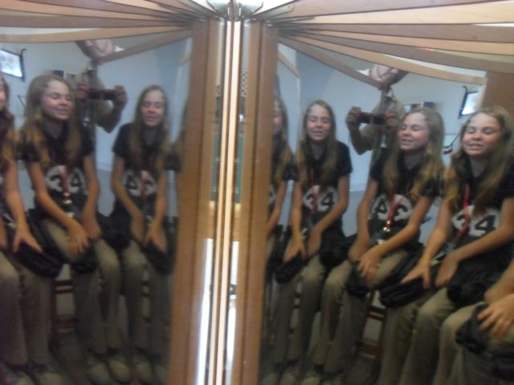
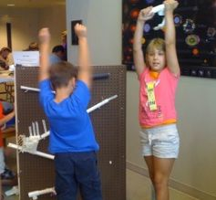
LIGO, Livingston
Science Education Center
Science Saturdays
Open for people to drop in any time from 1PM - 5 PM on 3rd Saturday of each month
Have activities that concentrate on a different topic each month to encourage repeat visitation
Tours occur several times throughout the afternoon
Tours are preceded by the 8 minute Making Waves video
The 20 minute Einstein’s Messengers video is available for viewing at specific times throughout the afternoon
Special presentations are sometimes given on the monthly topic

Slide 20
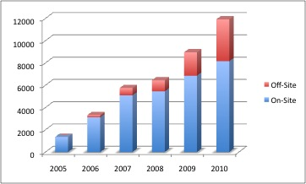
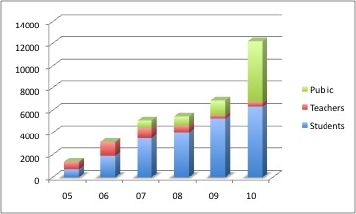
LIGO, Livingston
Science Education Center
Trends
Demand is growing:
Outreach in each area expands each year – except for the teacher PDs. We believe this to be due to a combination of factors including market saturation, and the winding down of Math Science Partnership programs. Recently teacher PDs started growing again.
In the past year Science Saturday (public) attendance increased from an average of 50 to an average of 250 per day.

Slide 21
LIGO Hanford activities

Slide 22
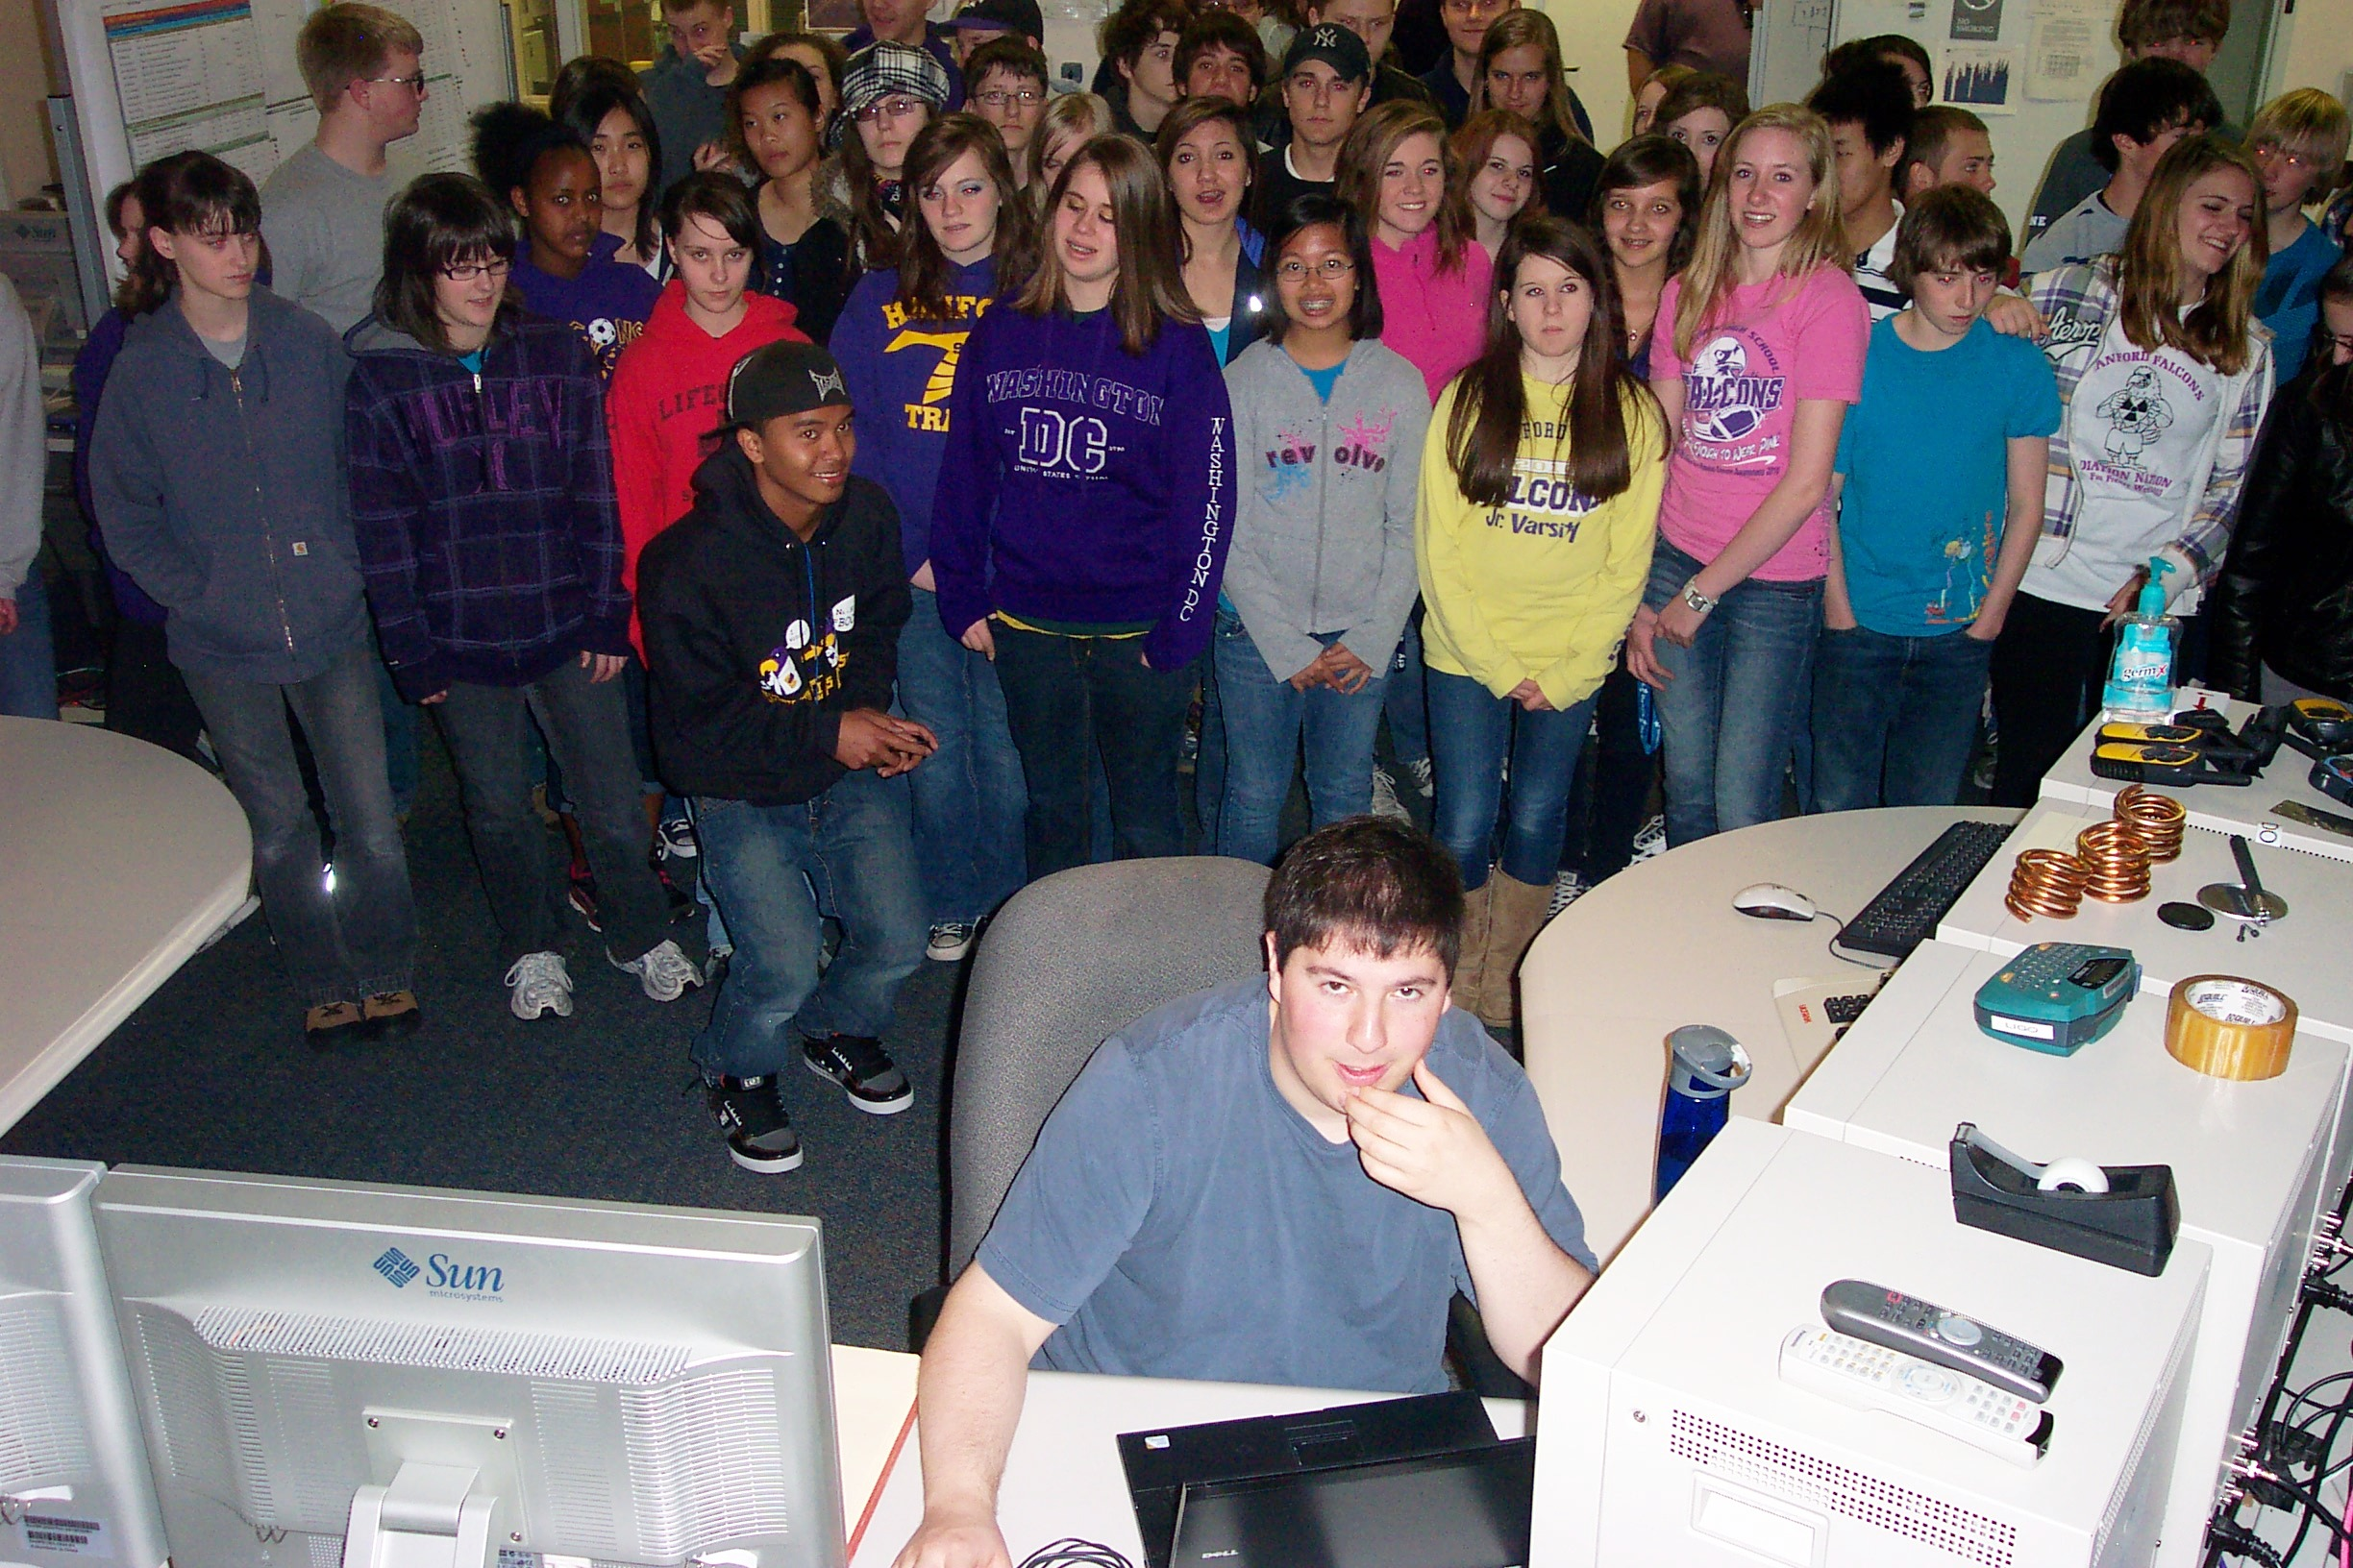
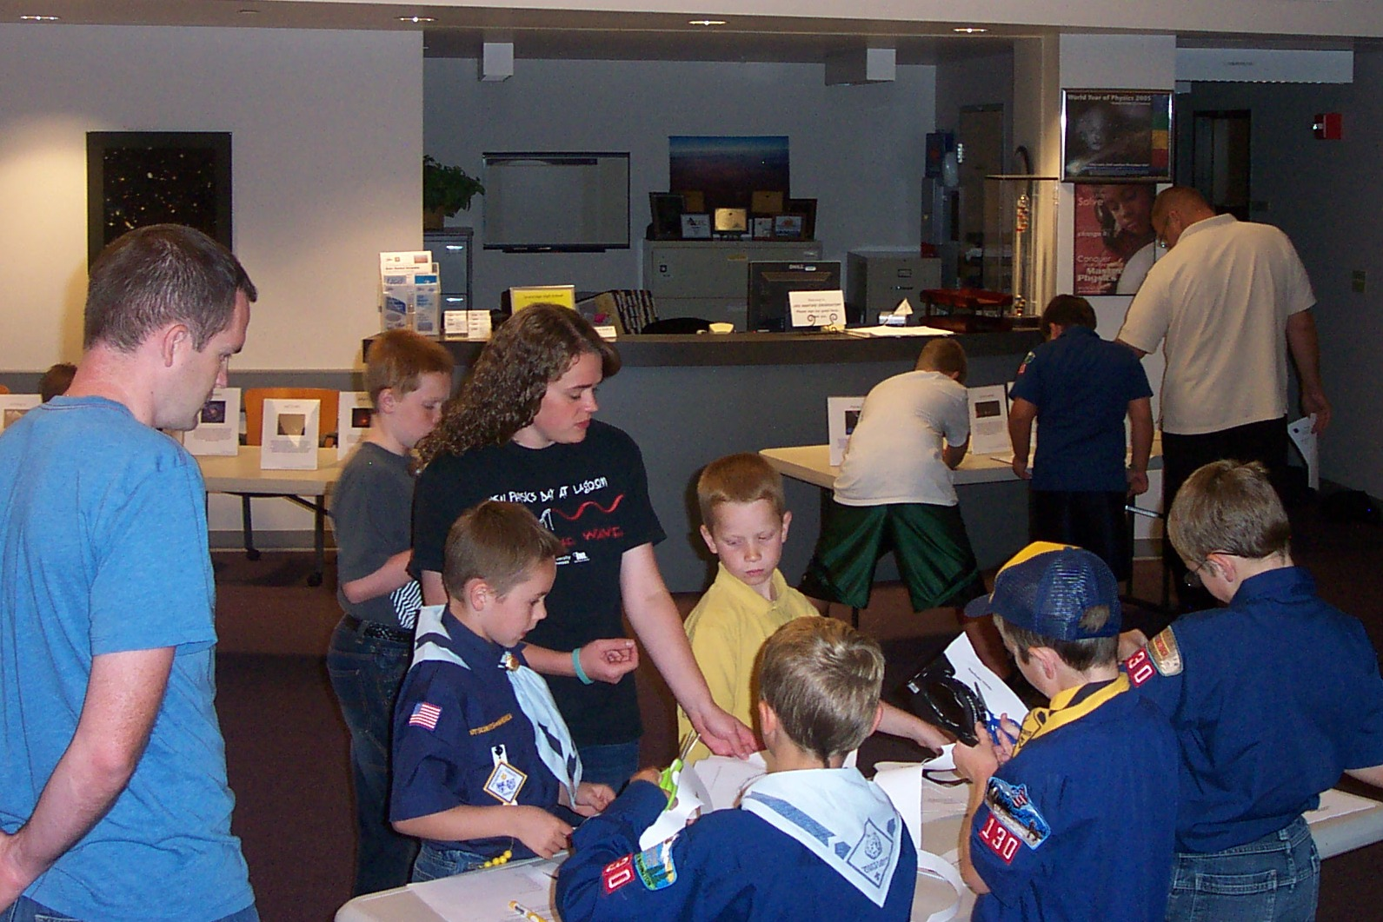
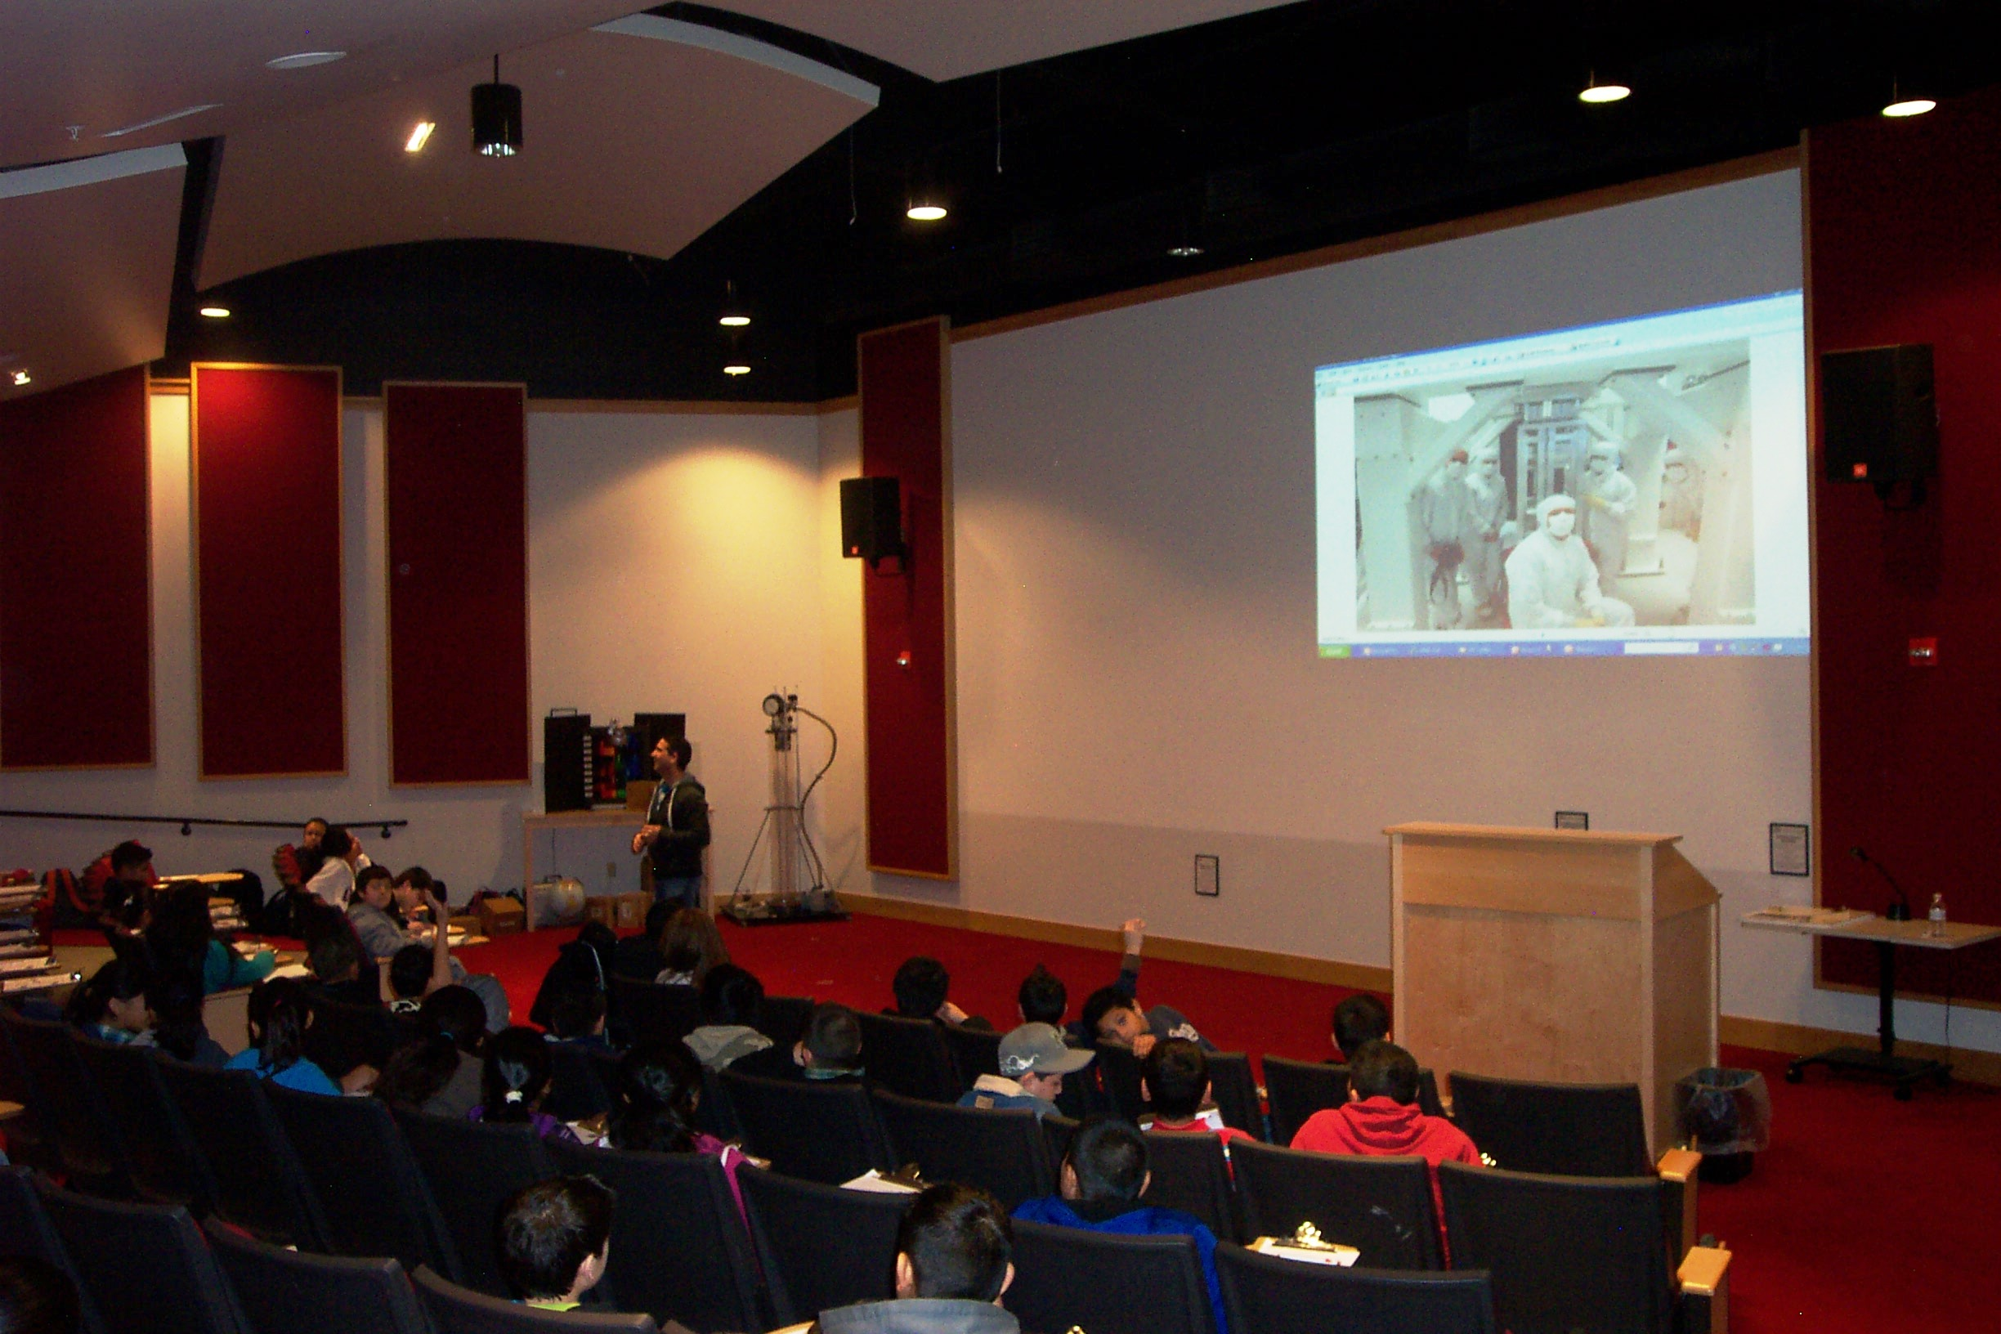
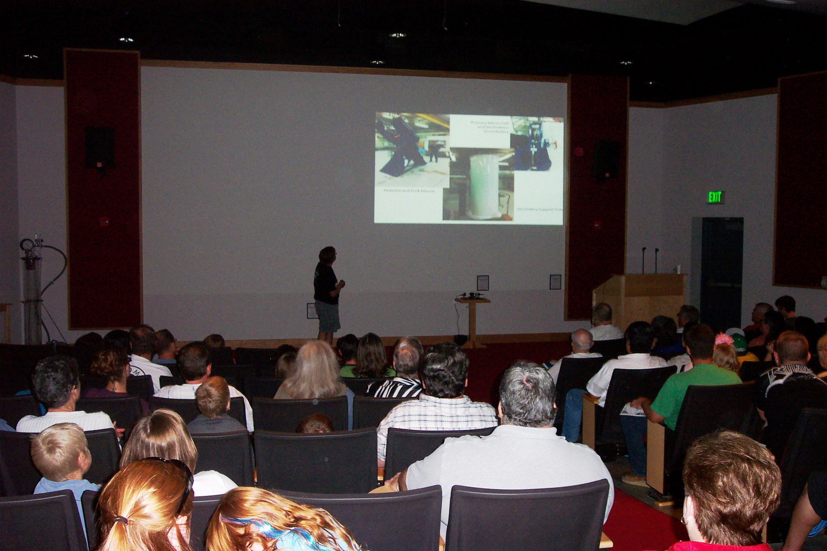
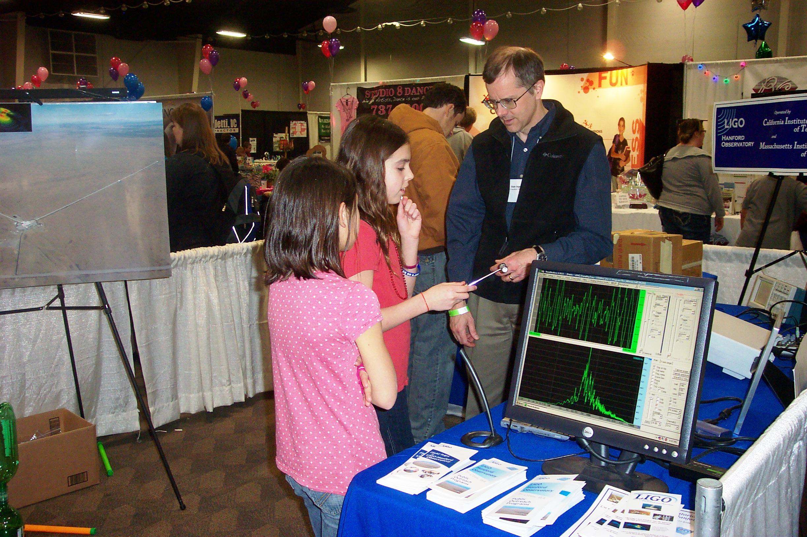
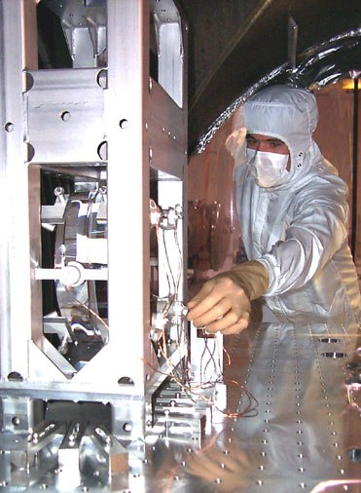
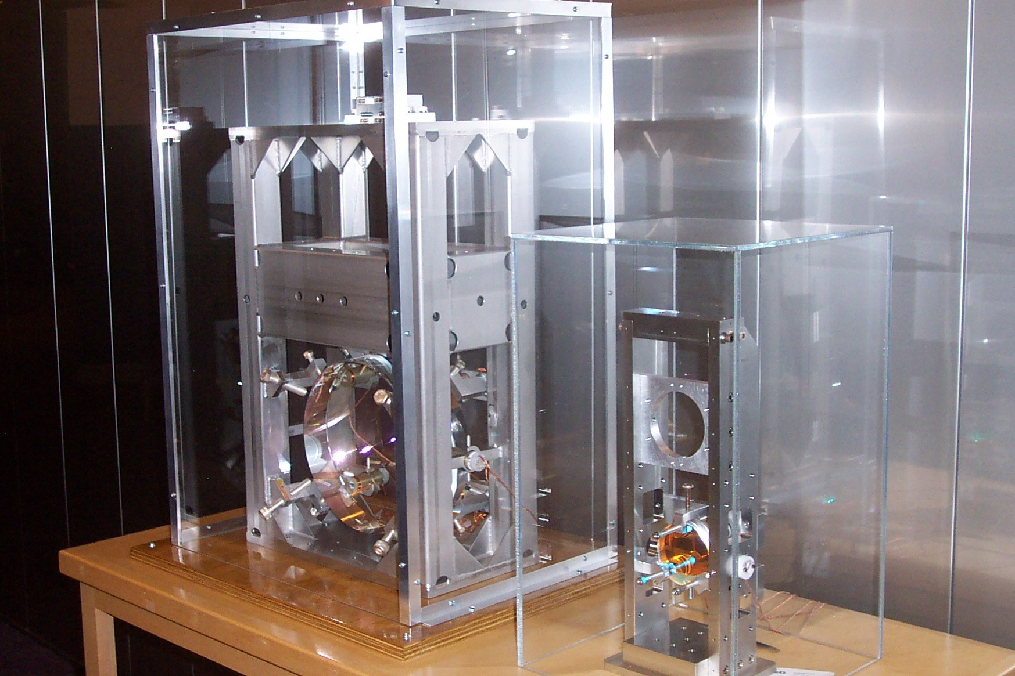
LIGO Hanford Outreach
Audiences
School field trips
Special interest programs (Cub Scout astronomy pin)
The construction of Advanced LIGO adds a new dimension to a LIGO visitor experience
Public astronomy events
Off-site activities

Slide 23
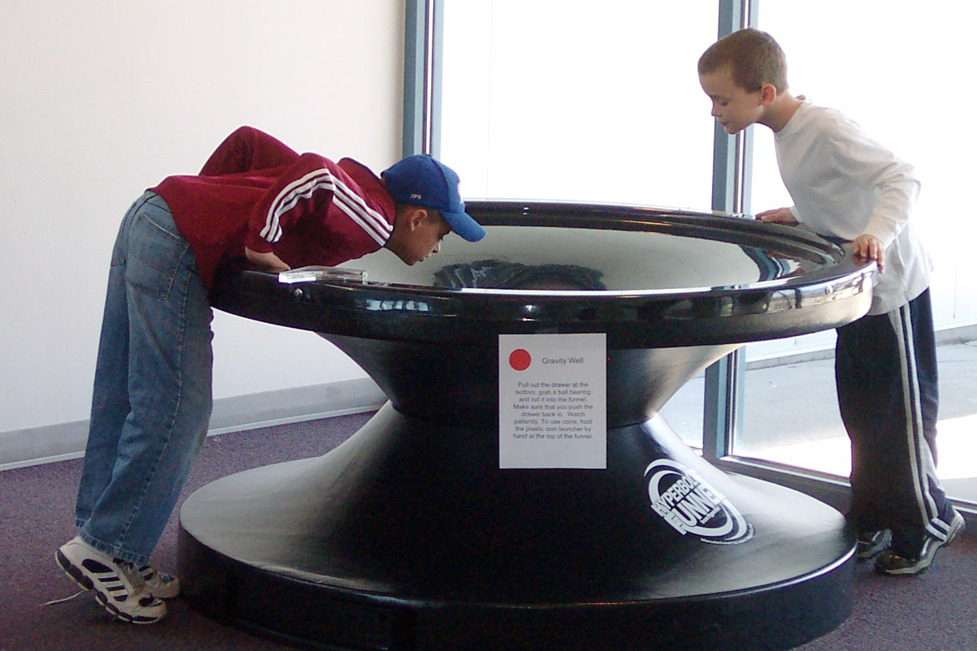
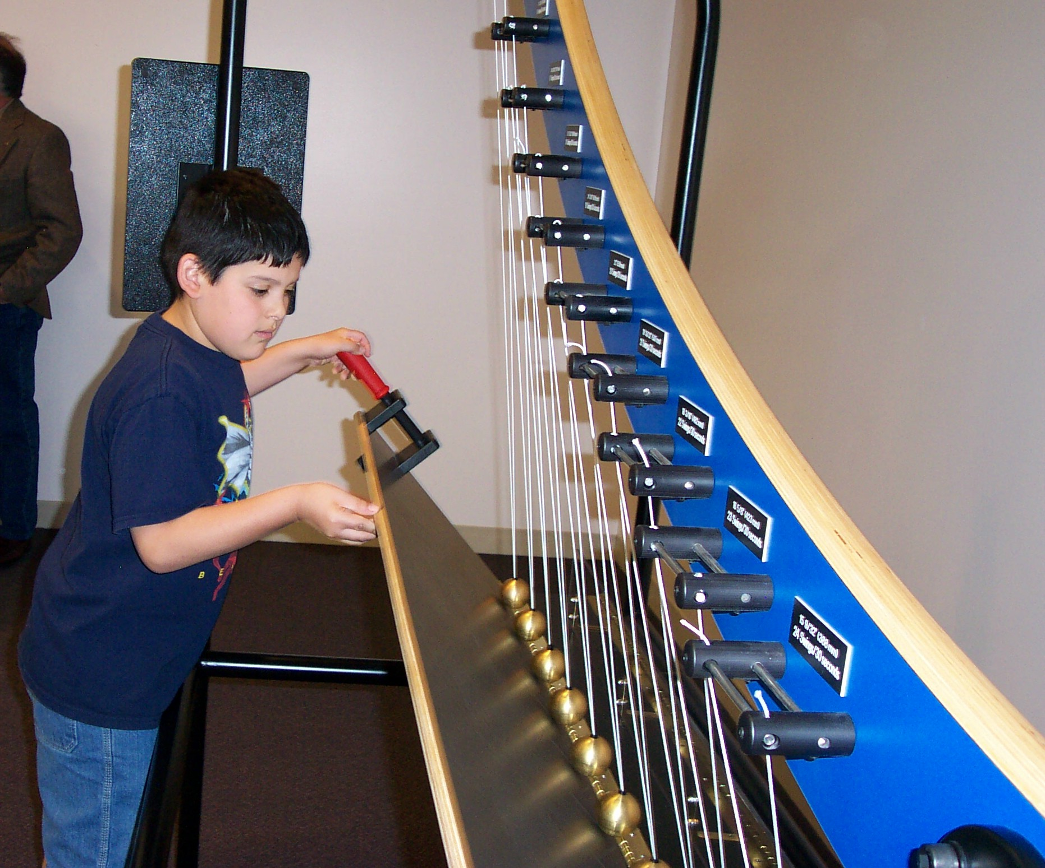
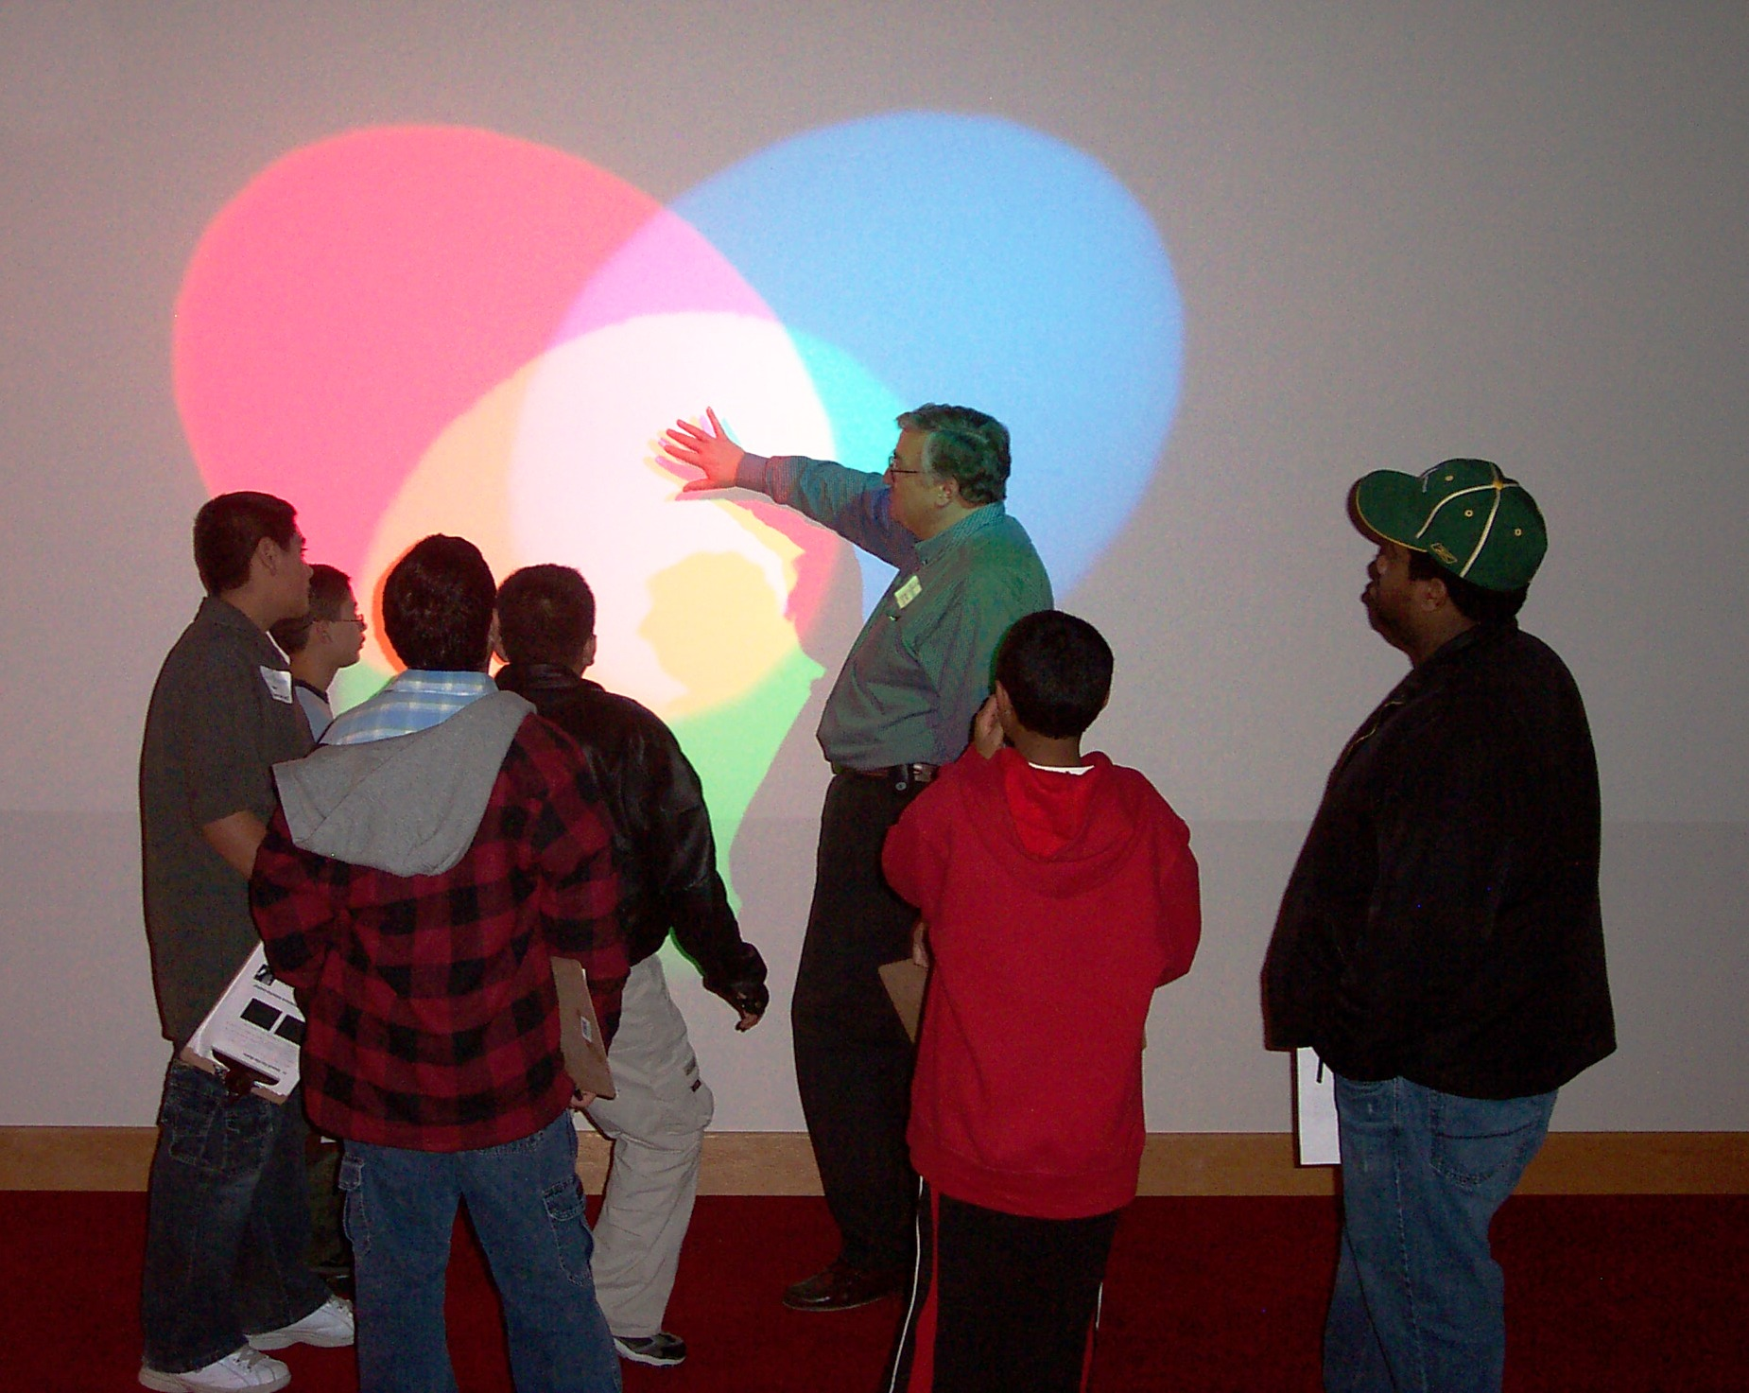
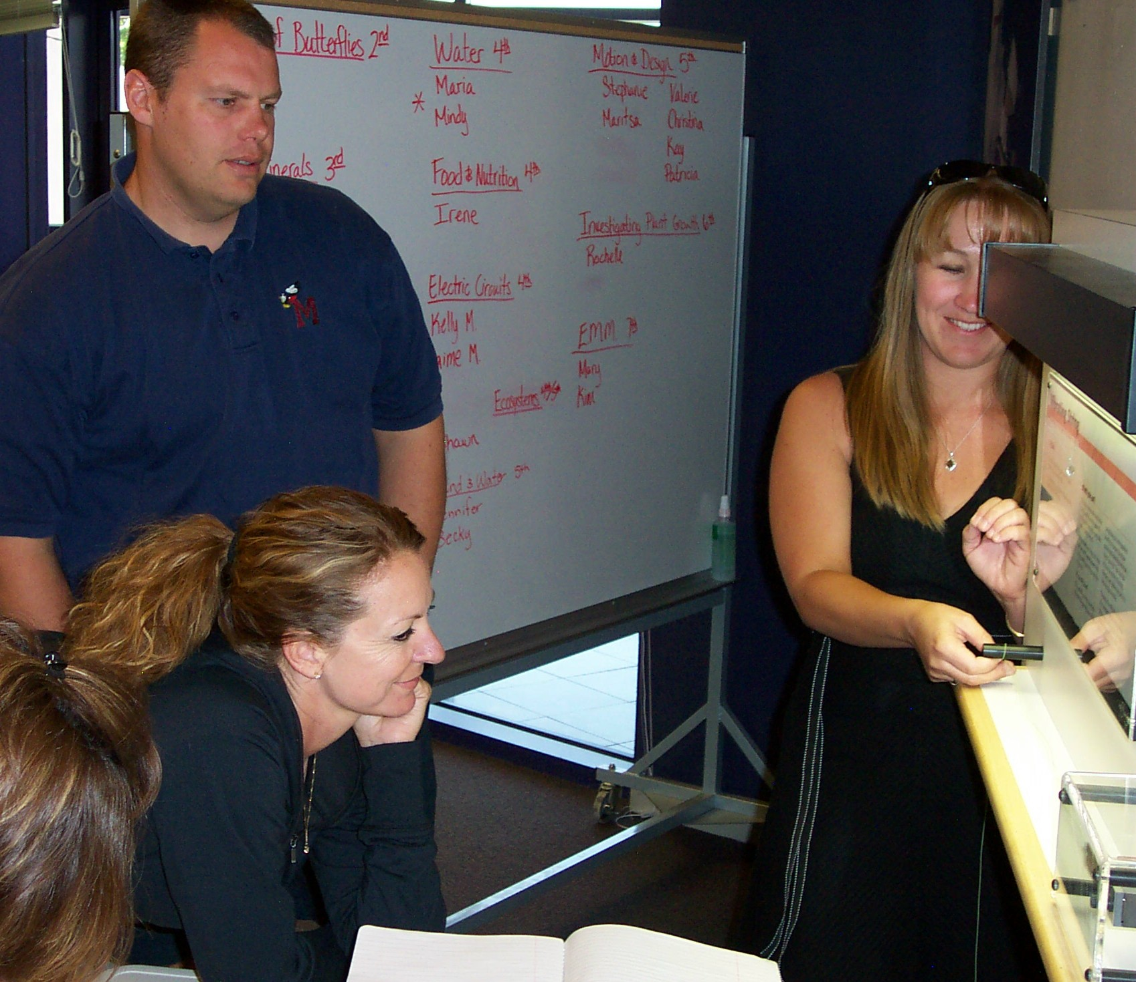
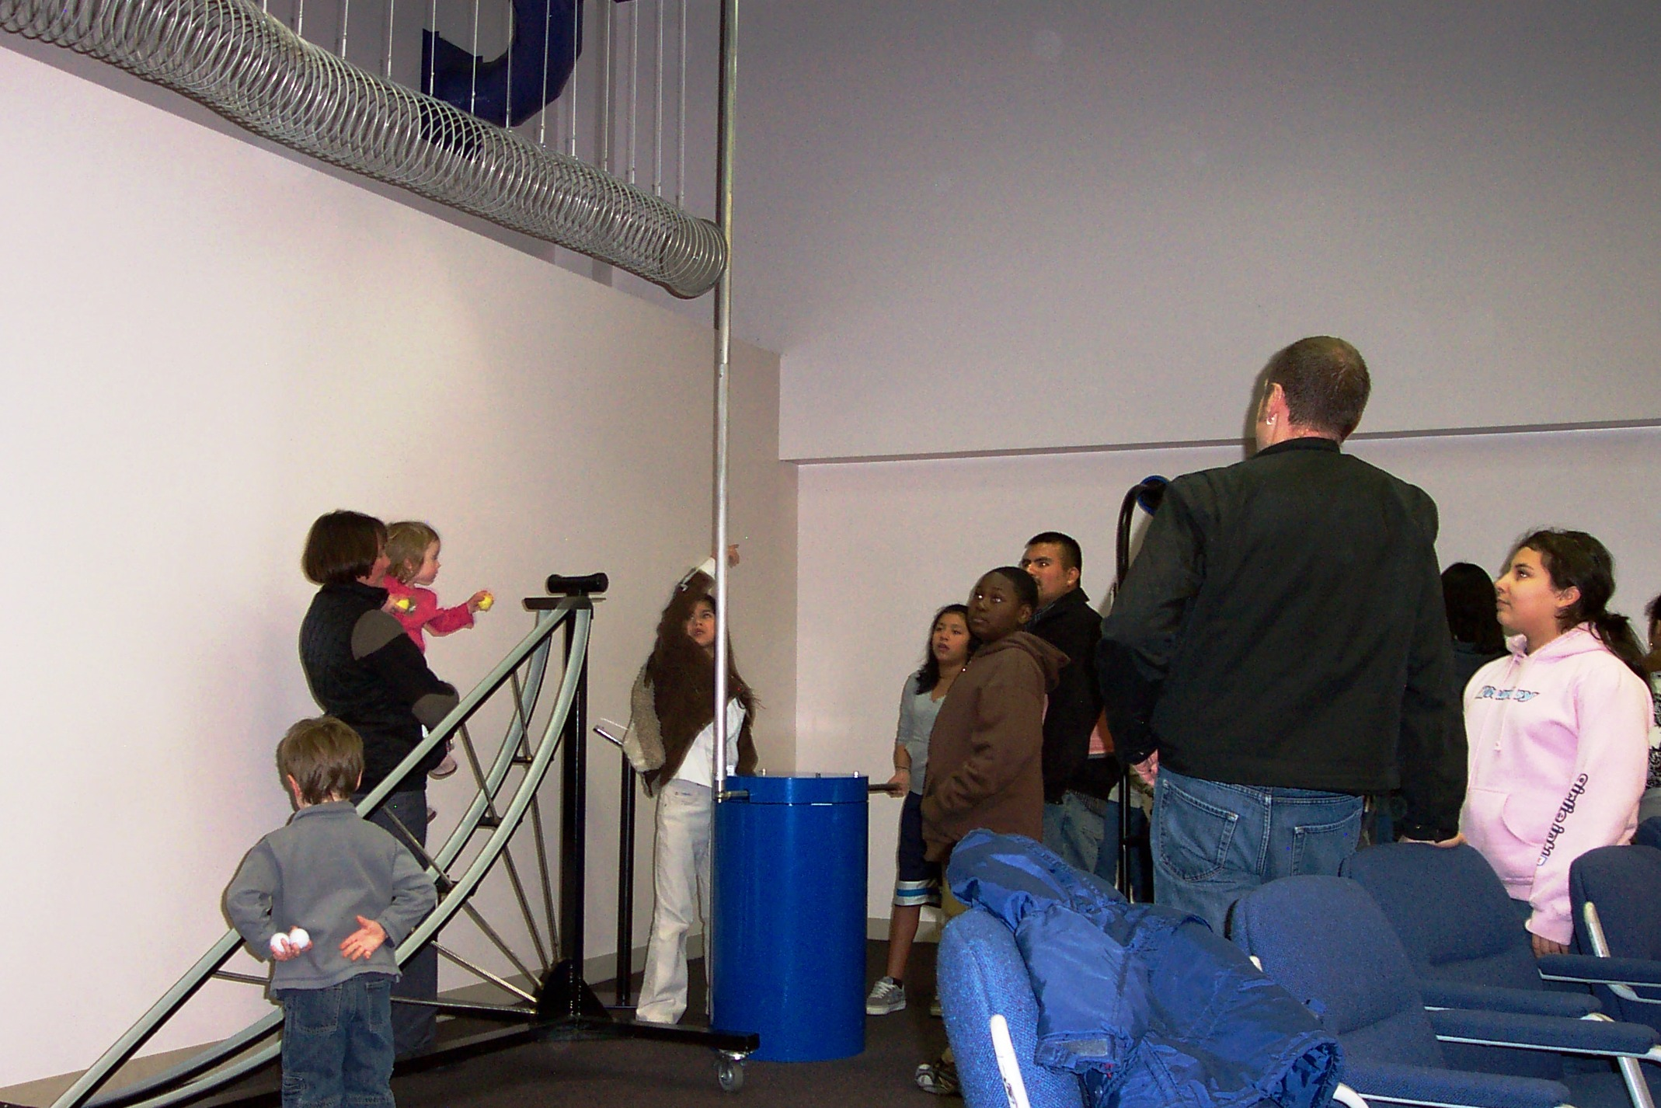
15 permanent exhibits add hands-on flavor to on-site events
LIGO Hanford Outreach
Exhibits
LIGO Hanford exhibits and field trip activities are correlated to Washington State science instructional standards.

Slide 24
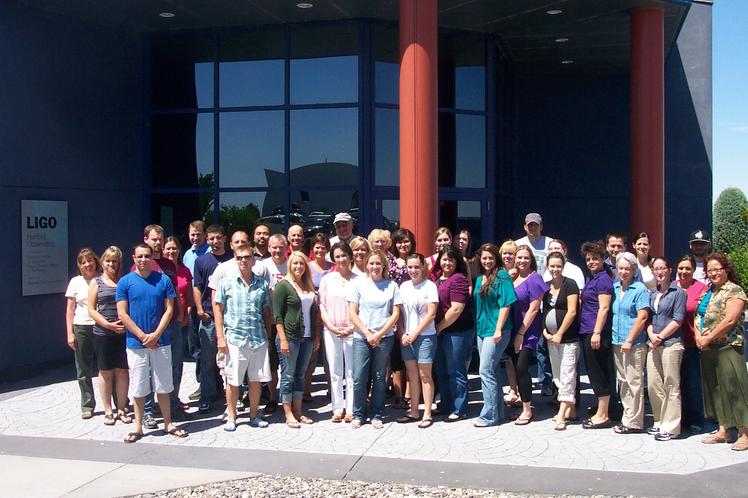
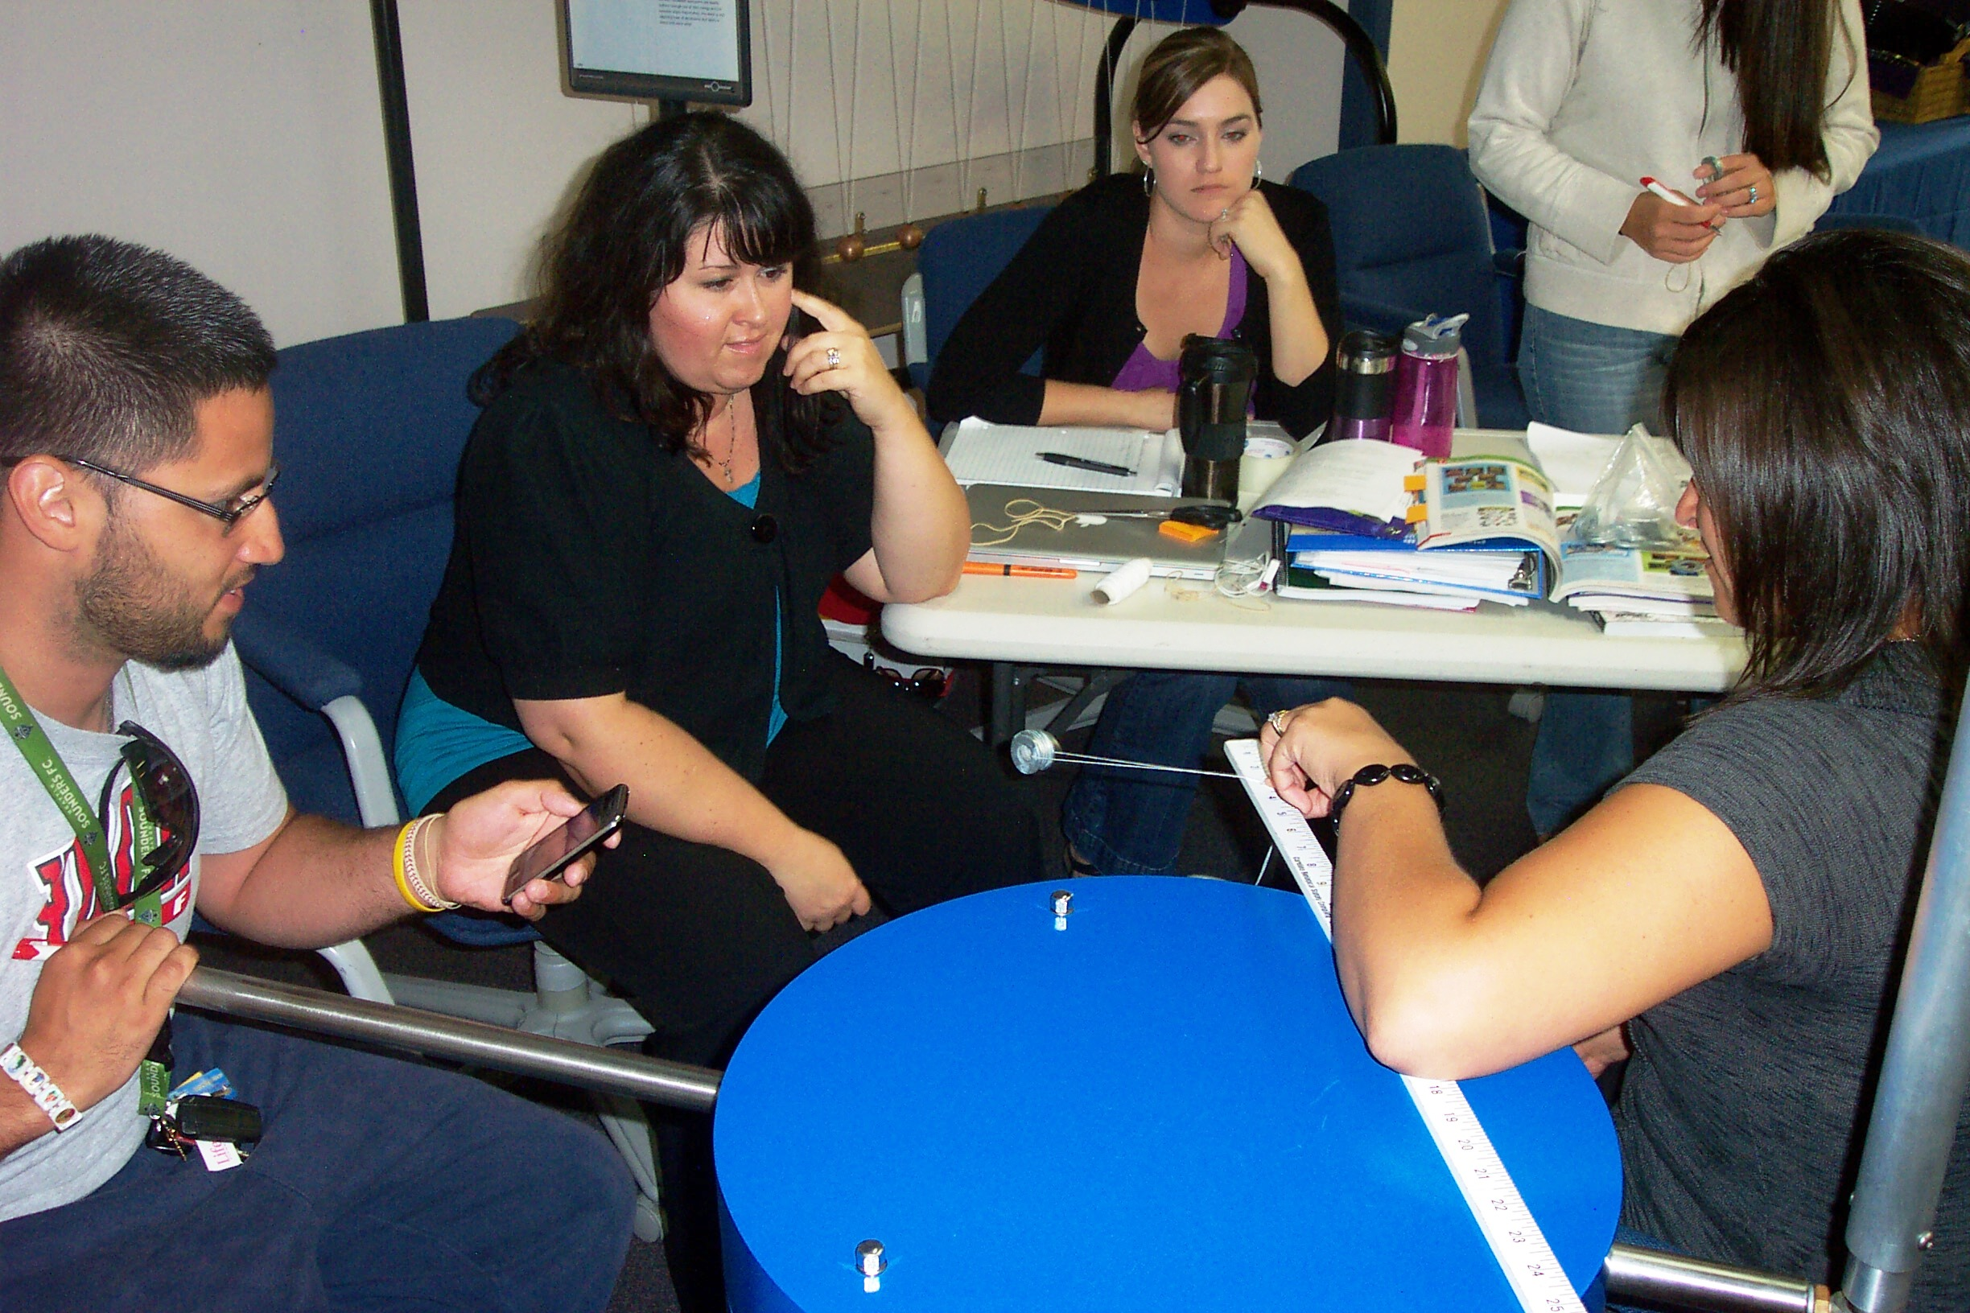
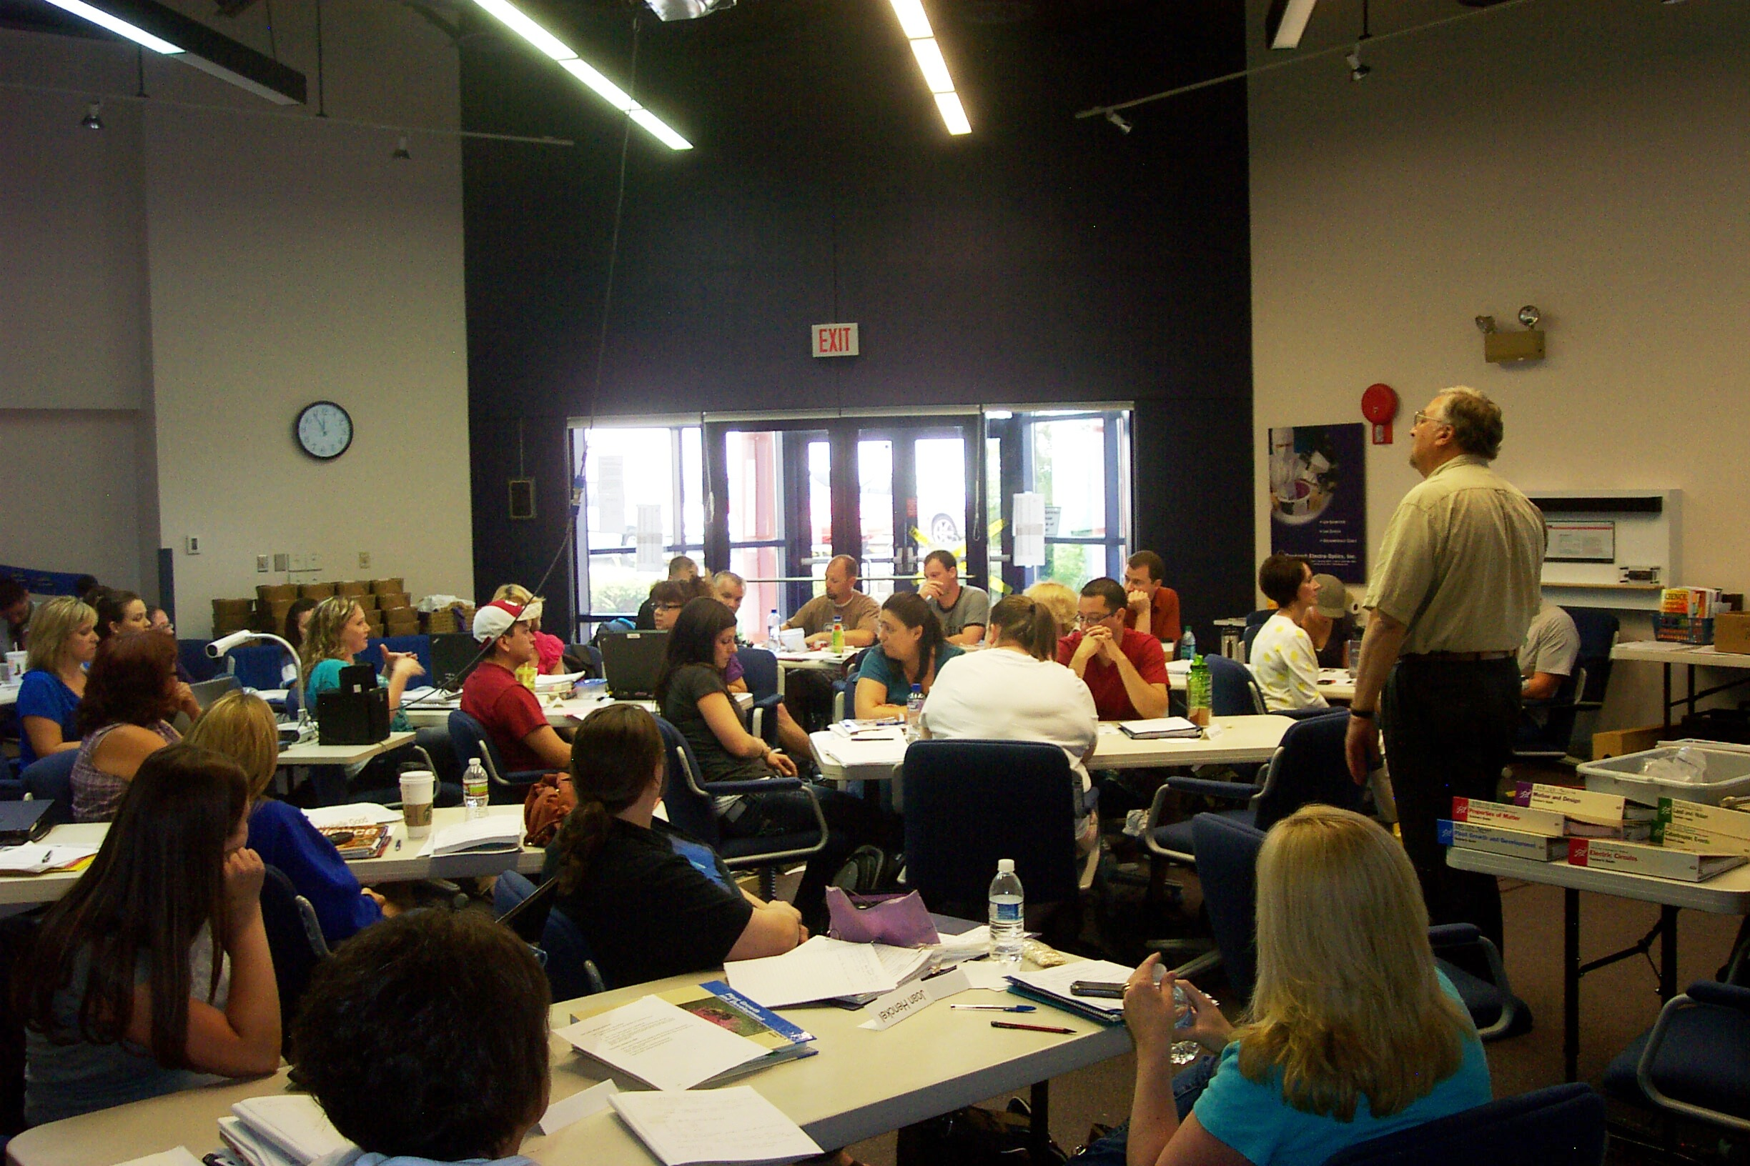
Teacher training:
LIGO Hanford has collaborated on the Southeast WA Math and Science Partnership (MSP) program since 2007.
MSP partners include K-12 local school districts as well as Community Colleges
LIGO Hanford Outreach
Teacher Professional Development
~35 teachers participated in the 2011 MSP Summer Academy at LHO. The MSP focuses on improving teachers’ understanding of the nature of scientific inquiry.

Slide 25


LIGO - I2U2 Collaboration
NSF-funded effort to provide large-project data sets to students and teachers for science research
The LIGO e-Lab is now in the third year of a three-year cycle of field testing
The e-Lab includes a full suite of paperless server-side features such as pre- and post-tests, an online student logbook and tools for generating online interactive posters.
Recruiting teachers for training and classroom implementation is the biggest challenge going forward.
The August 23, 2011 Virginia earthquake as seen on a LIGO Hanford seismometer via the I2U2 Web interface

Slide 26
LIGO Lab Outreach
Numbers
 | Livingston | Hanford | Total
On-Site Contacts | 8209 | 3500 | 11,709
Off-Site Contacts | 3760 | 7500 | 11,260
Total Contacts | 11,969 | 11,000 | 22,969
Teacher Training (PD) | 382 | 175 | 557
# of events | 201 | 225 | 426
Papers/Presentations | 13 | 2 | 15

Slide 27

LIGO Scientific Collaboration
Education and Outreach
Collaboration focused on LIGO instruments and data
850 persons, 50+ institutions, mostly in US but also Europe, Asia, Australia, the Americas
Many institutions have their own education and outreach programs
All also contribute to, and draw
from, the LSC-developed and
coordinated activities
Central coordination, web
presence, Collaboration meeting
sessions, ‘credit’ earned in
Collaboration for Outreach

Slide 28








M. Cavaglià
LIGO Scientific Collaboration activities
Exhibits
Web
Science
Fairs
and
Festivals
Blogs
Games
Student training

Slide 29

Astronomy's New Messengers
A LIGO Traveling Exhibit
http://ligo.phy.olemiss.edu/LIGOexhibit
Shawnee State University, Portsmouth (OH) (April 2011 – Sept 2011)
Science Central Fort Wayne (IN) (from September 2011)

Slide 30



Internet broadcasts and web

Slide 31
LIGO Outreach
Robust program centered at the Observatories
  Happily geographically located in regions of under-served populations
Science Education Center at Livingston our ‘star’ facility with production teaching of students and teachers
Hanford also quite active; future potential for second Science Center
LIGO Scientific Collaboration providing material and hosting activities, tuned to capabilities and local needs
A vital element of the LIGO mission

