Slide 1
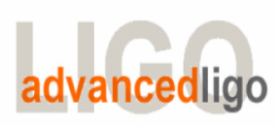
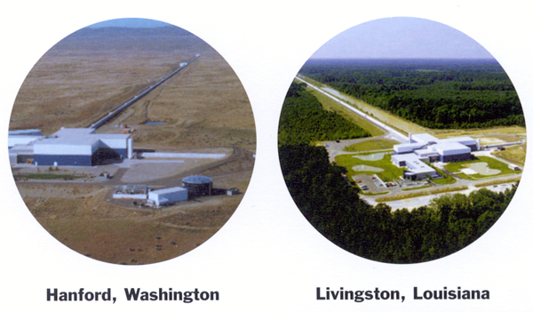
Advanced LIGO, nouvelle génération d’interféromètres pour la détection d’ondes gravitationnelles.
Présentation du projet - Isolation des sources de bruits - Focus sur les méthodes d’isolation sismique.
Fabrice Matichard, Caltech-MIT
05 janvier 2010, à l’ENSIM, Le Mans.
Contact: fabrice@ligo.mit.edu

Slide 2
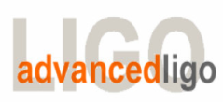
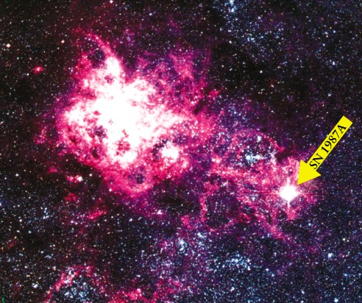

Astrophysical searches
SN 1987 A
Coalescence of binary compact objects
(neutron stars, black holes, primordial BH)
Core collapse supernovae
Black hole normal mode oscillations
Neutron star rotational instabilities
Gamma ray bursts
Cosmic string cusps
Periodic emission from pulsars
(esp. accretion driven)
Stochastic background
(incoherent sum of many sources
or very early universe)
Expect the unexpected!
Transient
Modeled & Unmodeled waveforms
High duty cycle
WMAP 2003
2

Slide 3
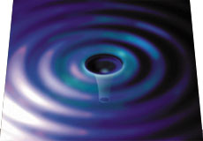
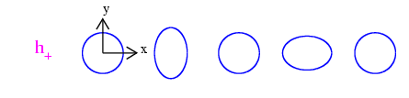
Gravitational Waves
Gravitational Waves
“Ripples in space-time”
Stretch and squeeze the space transverse to direction of propagation
Example:
Ring of test masses responding to wave propagating along z
For a binary neutron star
~1.4 Mo pair in Virgo cluster
M
R
M
r
h ~10⁻²¹
3

Slide 4

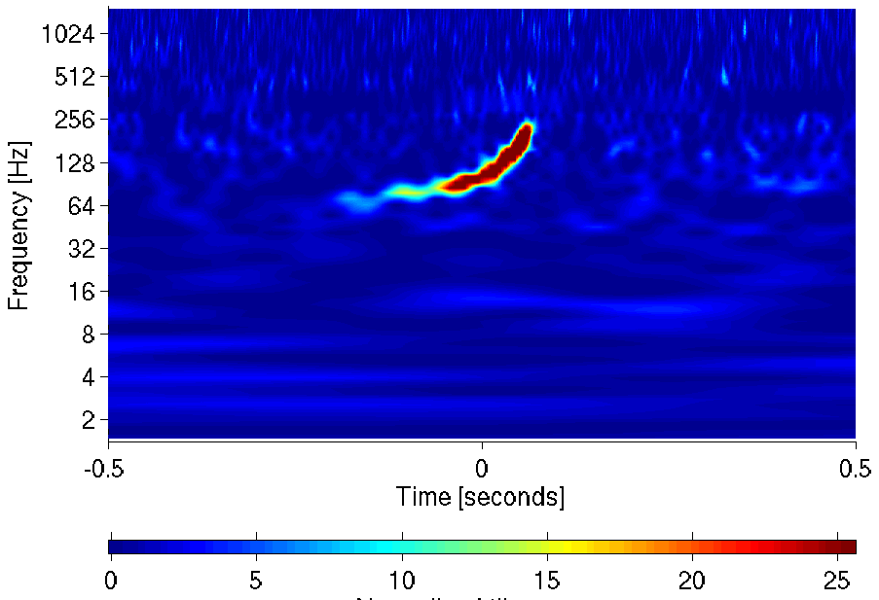
Astrophysical searches
Coalescing Binary Systems
Neutron stars, black holes
‘chirped’ waveform
Credit: AEI, CCT, LSU
4

Slide 5
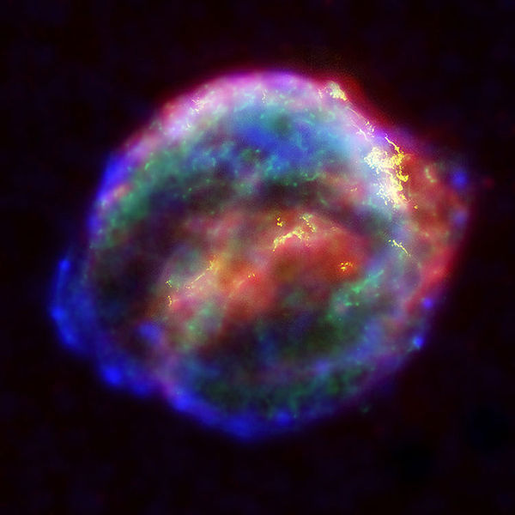
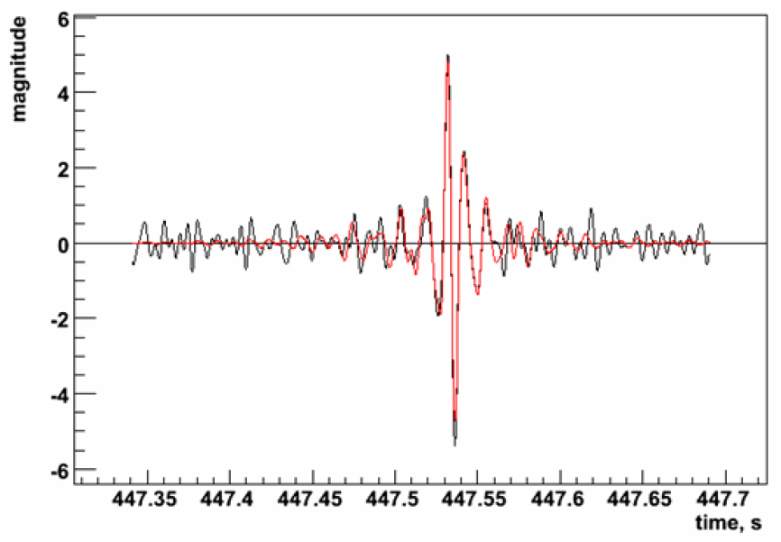
Astrophysical searches
‘Bursts’
asymmetric core collapse supernovae
cosmic strings
? (sources we haven’t thought about)
Credit: Chandra X-ray Observatory
5

Slide 6

Astrophysical searches
Continuous Sources
Spinning neutron stars
monotone waveform
Casey Reed, Penn State

Slide 7
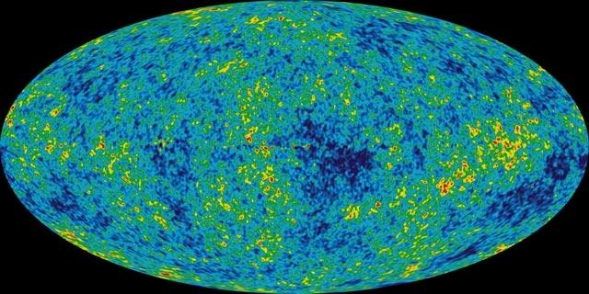
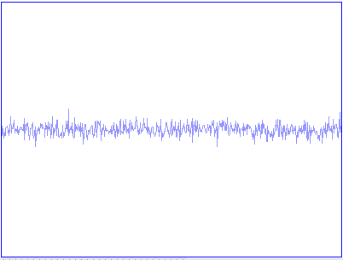
Astrophysical searches
Cosmic GW background
residue of the Big Bang
probes back to 10⁻²¹ s after the birth of the universe
stochastic, incoherent background
NASA/WMAP Science Team

Slide 8
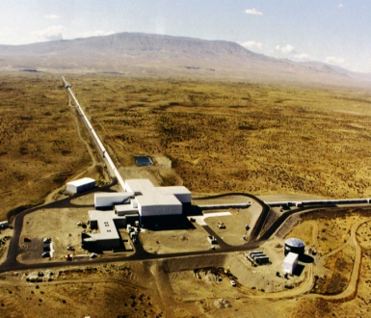
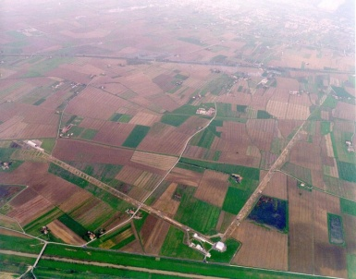
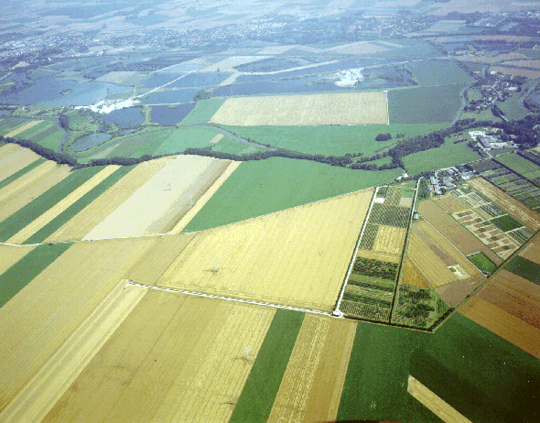
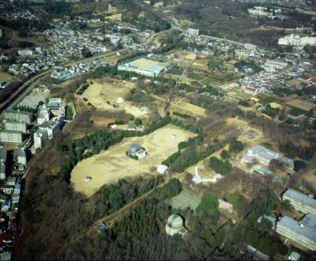

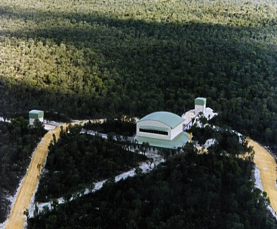

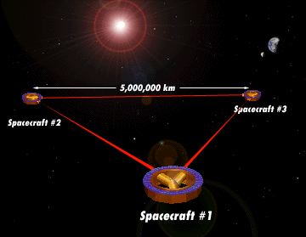
Global network of detectors
LIGO
GEO
VIRGO
TAMA
Hanford, WA
4 km interferometer
2 km interferometer
Hannover, Germany
600 m interferometer
Pisa, Italy
3 km interferometer
Tokyo, Japan
300 m interferometer
AIGO
LIGO
Livingston, LA
4 km interferometer
LISA
Coincident detection to eliminate instrumental artifacts
Source localization in the sky
Wave polarization
8

Slide 9
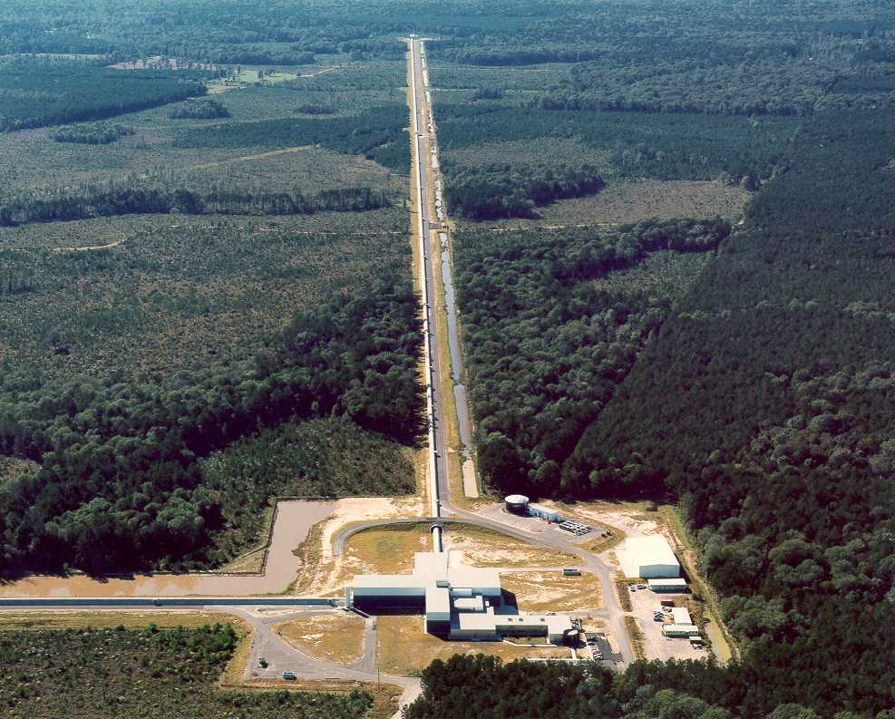
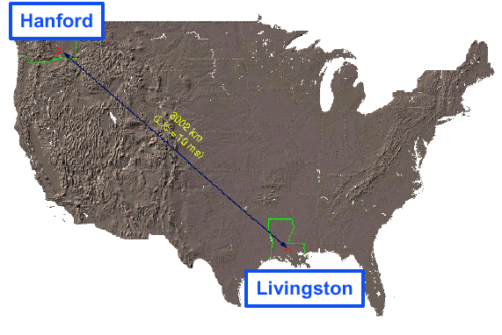

LIGO
LIGO Livingston Observatory
1 interferometers
  4 km arms
LIGO Hanford Observatory
2 interferometers
  4 km, 2 km arms
LIGO Observatories are operated
by Caltech and MIT
9

Slide 10
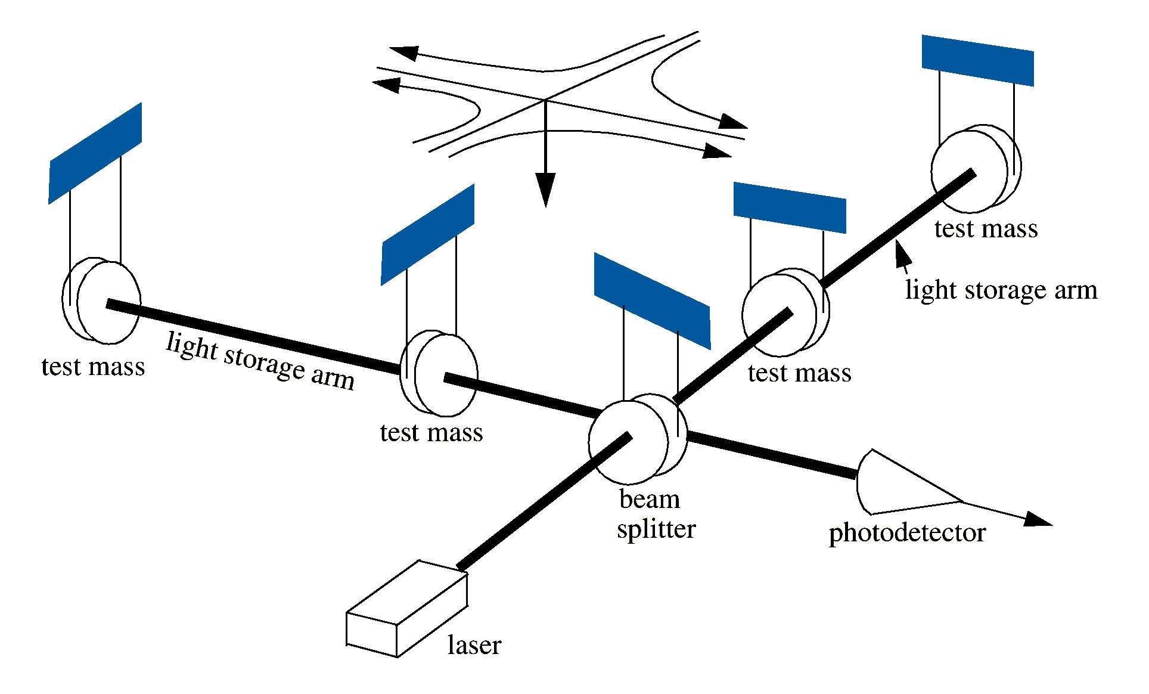
GW detector at a glance
h = ΔL/L
L ~ 4 km
We need h ~ 10^{–21}
We have L ~ 4 km
We see ΔL ~ 10⁻¹⁸ m
Seismic motion --
ground motion due to natural and anthropogenic sources
Thermal noise --
vibrations due to finite temperature
Shot noise --
quantum fluctuations in the number of photons detected
10

Slide 11
Optical Configuration
- Power Recycled
- Michelson Interferometer
- with Fabry-Perot Arm Cavities
End Test Mass
4 km Fabry-Perot
arm cavity
Recycling
mirror
Input Test Mass
225 W
15000 W
Laser
5 W
50/50 beam splitter
Signal
11

Slide 12
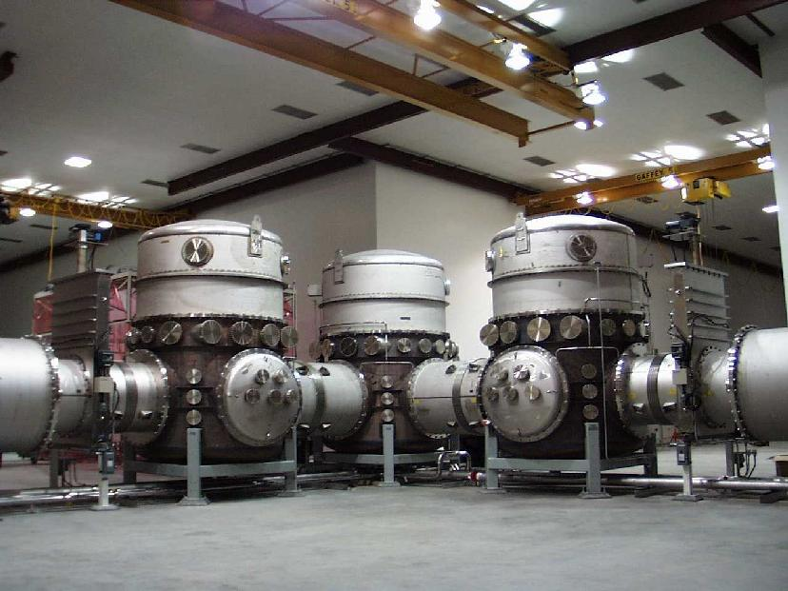

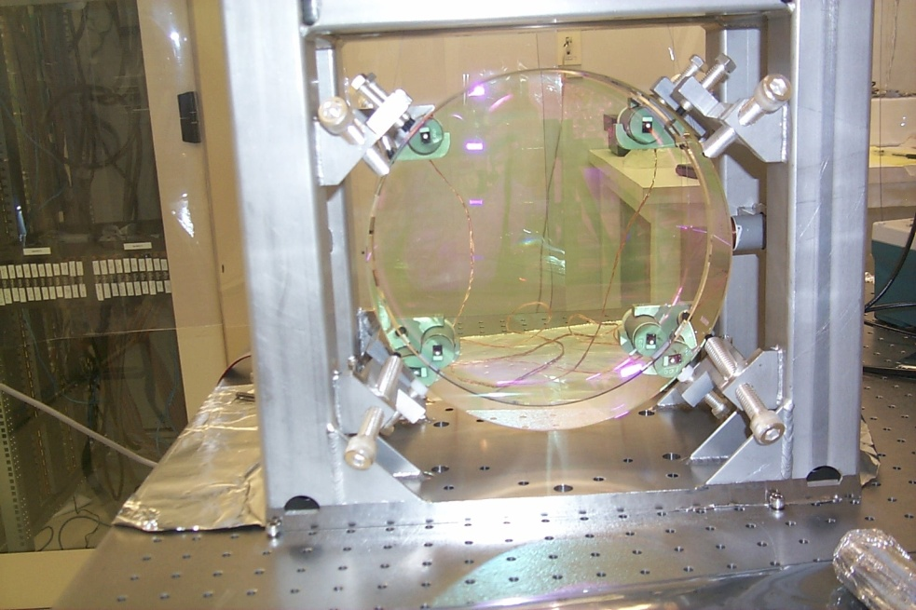
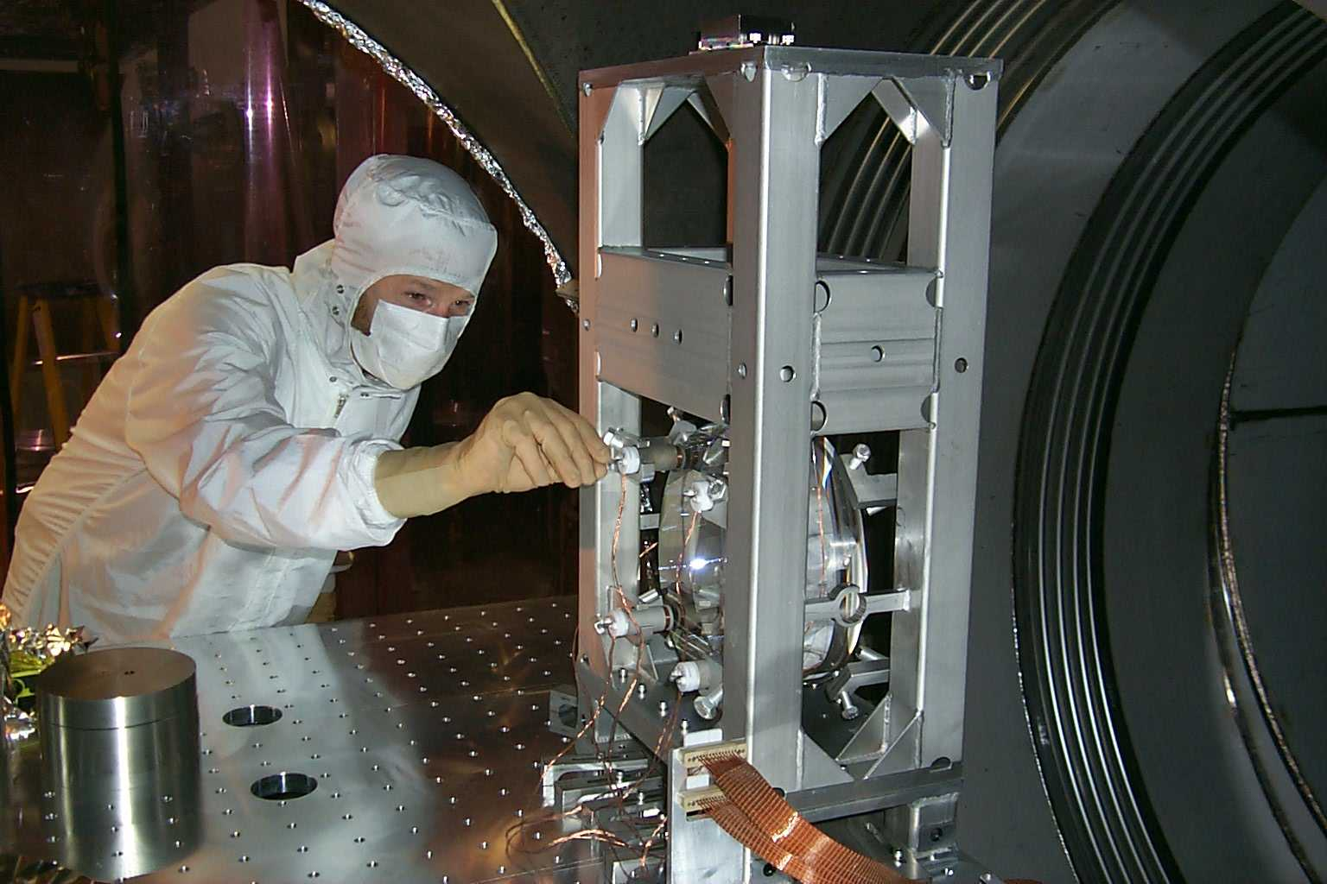
Infrastructures and systems
18,000 m³ of vacuum at 10⁻⁹ torr.
Beam Tubes: 1.2 m diameter - 3mm stainless, 50 km of weld….
and not one leak!
12

Slide 13
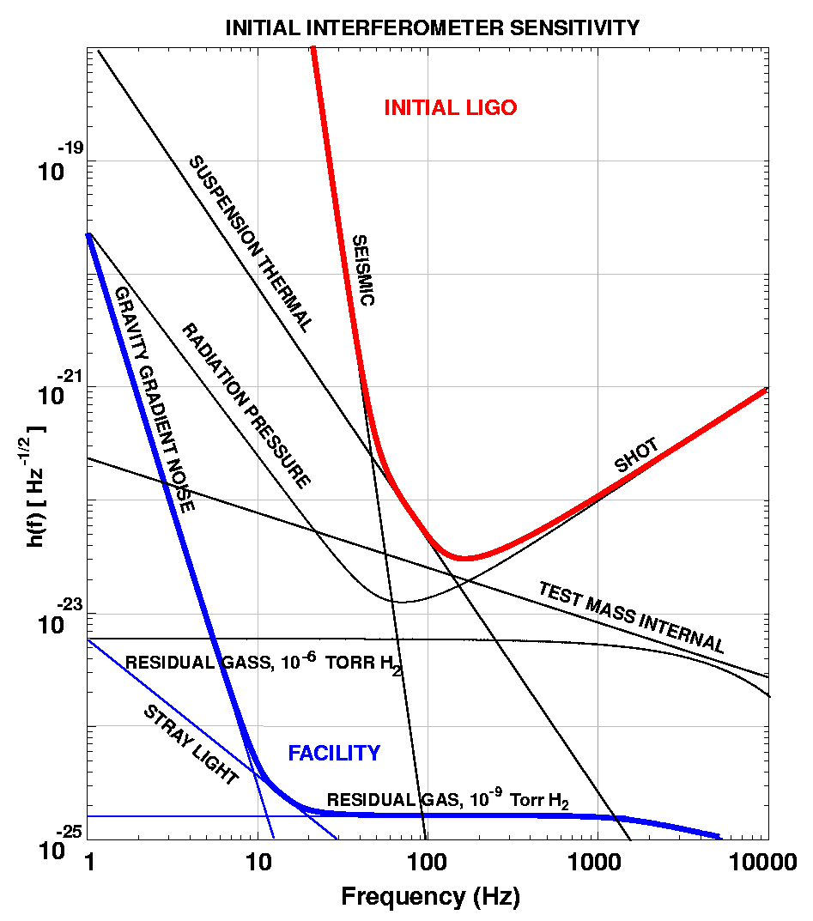
Initial LIGO Sensitivity Goal
Strain sensitivity:
10⁻²¹ rms in a 100 Hz bandwidth
Instrument strain noise density:
3x10⁻²³ /Hz^{1/2}
at 150 Hz
Displacement Noise
  Seismic motion
  Thermal Noise
  Radiation Pressure
Sensing Noise
  Photon Shot Noise
  Residual Gas
13

Slide 14
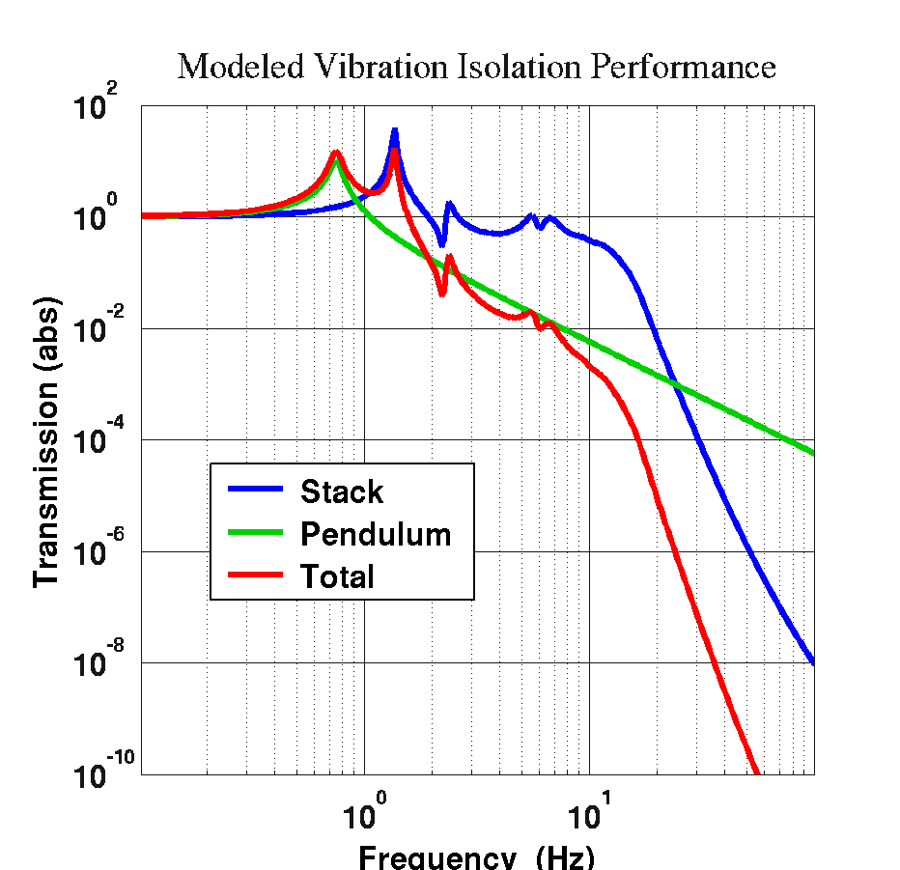
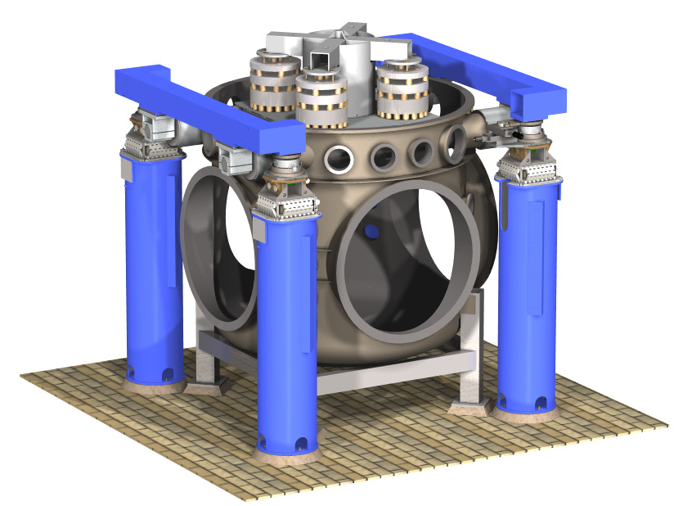
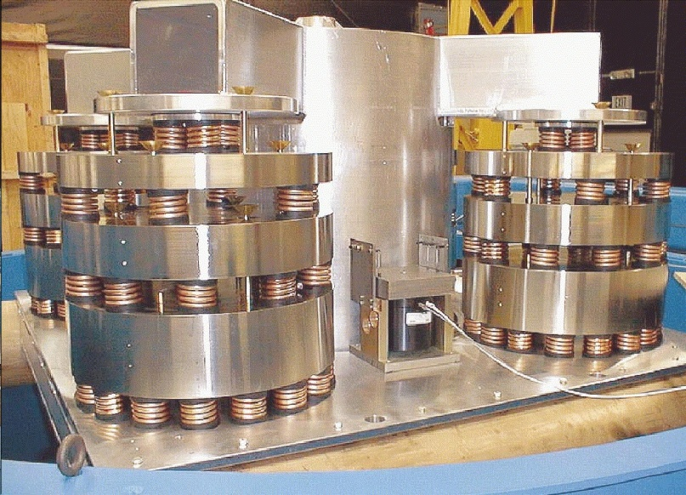
Seismic Isolation
stack of
mass-springs
14

Slide 15
Advanced LIGO Seismic Isolation
15

Slide 16
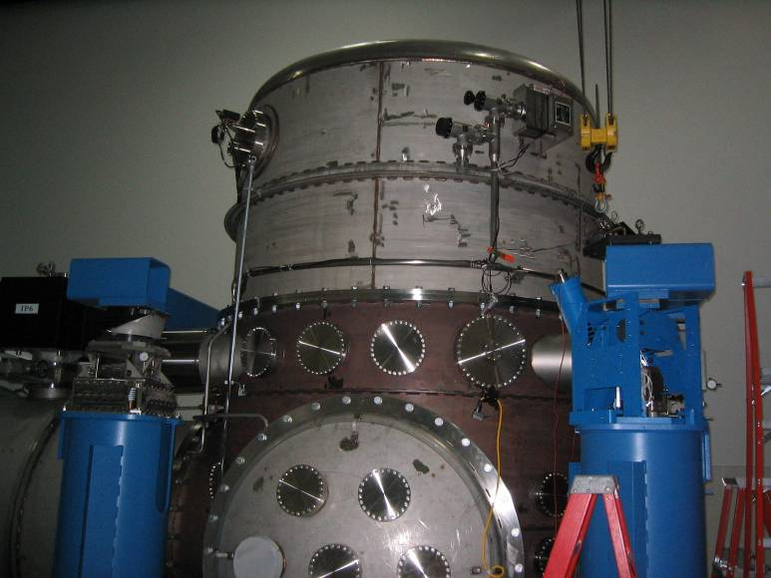
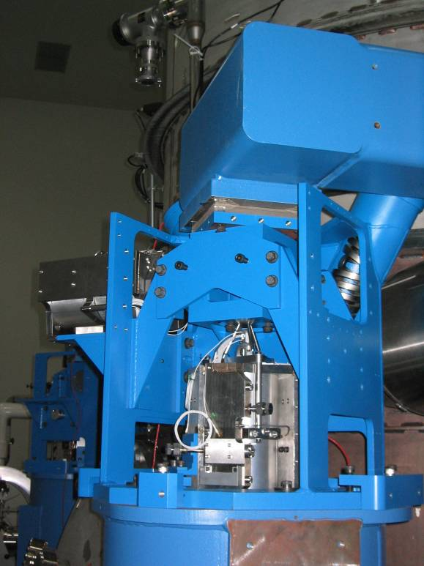
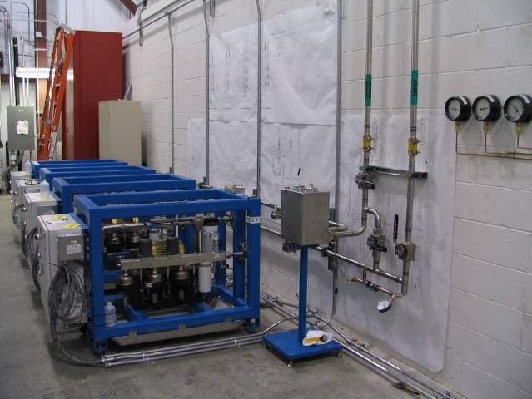
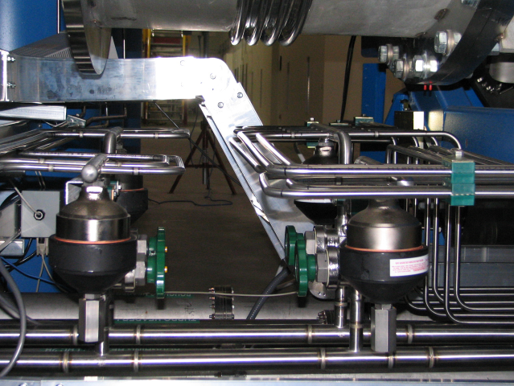
Seismic Isolation, HEPI Subsystem
Installation at LIGO Livingston Observatory
Horizontal
Actuator
HEPI
Crossbeam
Helical Spring
(1 of 2)
Vertical Actuator
Pier
16

Slide 17
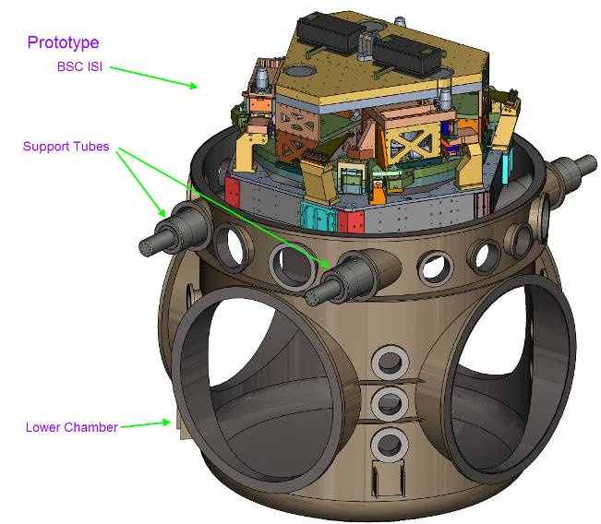
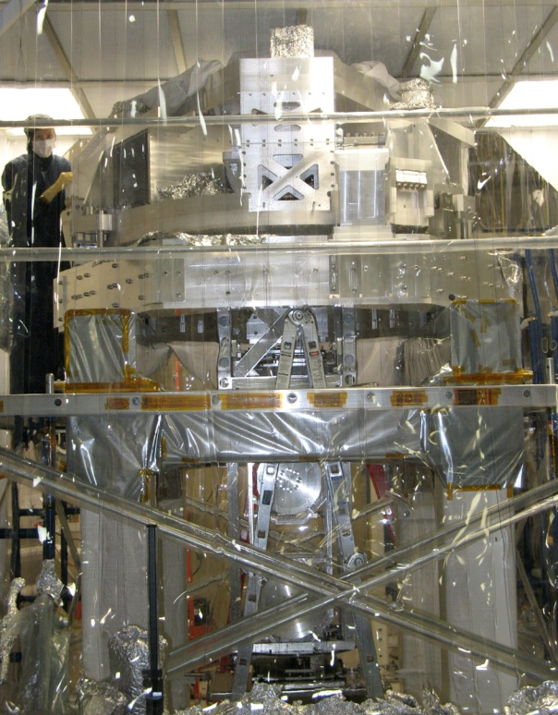
BSC Internal Seismic Isolation (BSC-ISI) system
BSC Internal Seismic Isolation (BSC-ISI) system
A support structure (Stage 0) and Two suspended active stages (Stage 1 & 2).
Will be installed for Advanced LIGO into the BSC chambers.
A BSC-ISI system in each of the 15 BSC chambers.
Optic table supports the test masses and beam splitters.
17

Slide 18
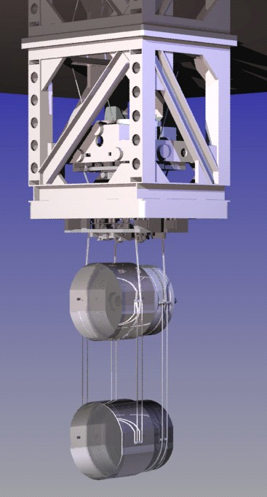
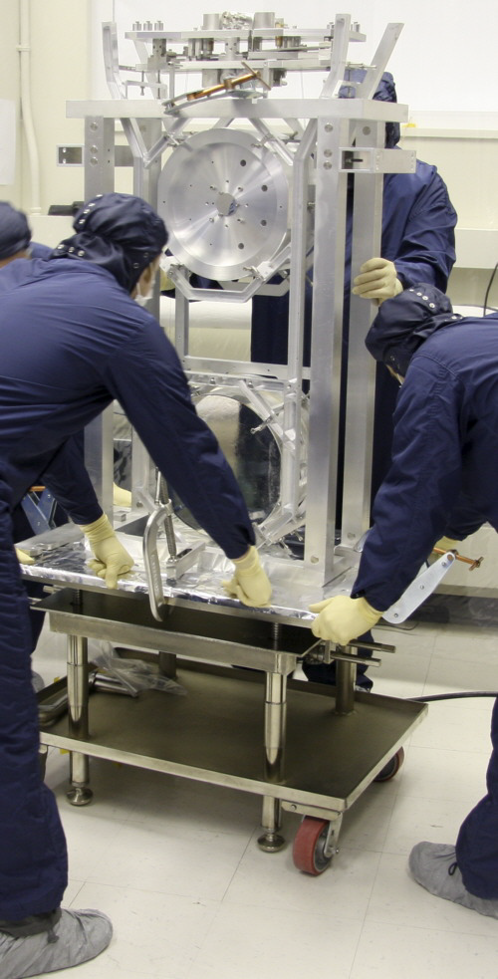
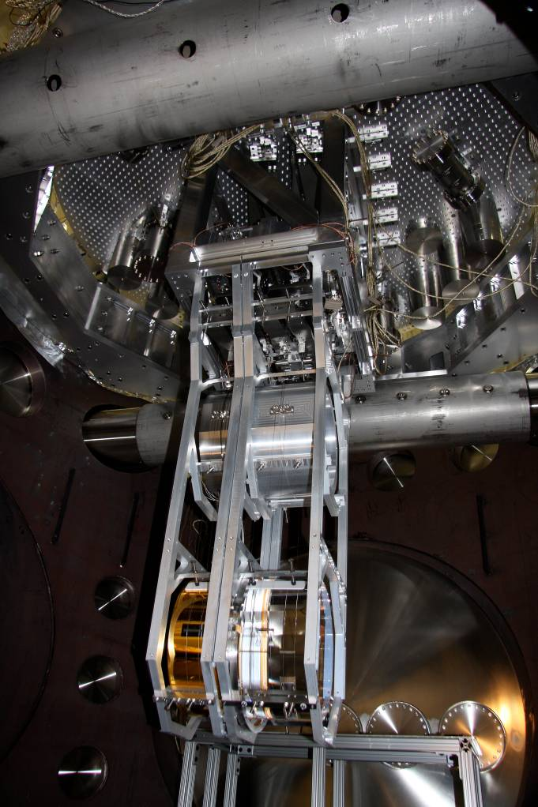
2. Advanced LIGO
parallel reaction chain for control actuation
four stages
40 kg silica test mass
18

Slide 19
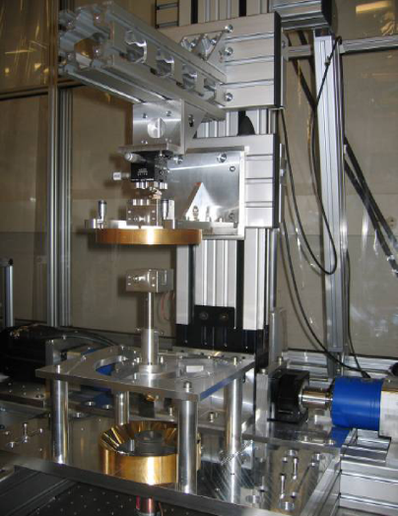
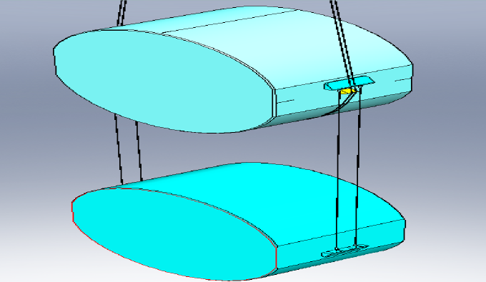
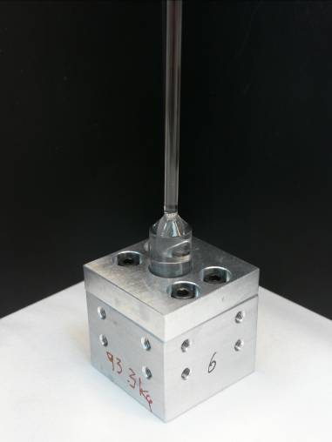
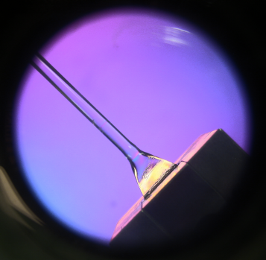
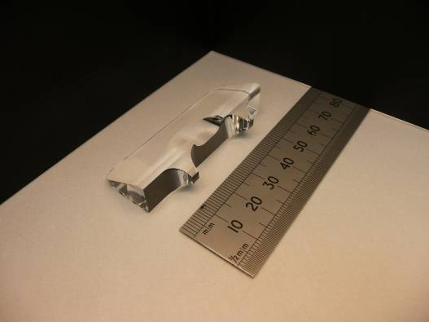
Development of Monolithic Suspensions for Advanced LIGO
Fibre pulling machine at MIT
Detail of fibre shape close to weld: thick flexure region used to minimise thermoelastic noise
Silica fibres 600 mm long, 0.4 mm diam.
Welding test at Glasgow
Visual inspection of test weld using crossed polarisers at Glasgow
Mirror: 40 kg silica mass
Example of ear to be bonded to silica mass
19

Slide 20
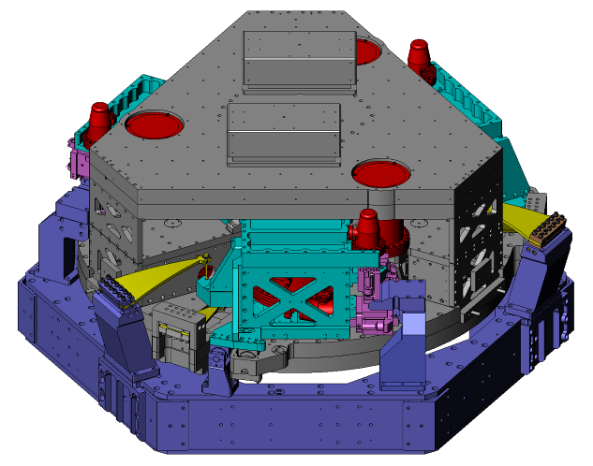
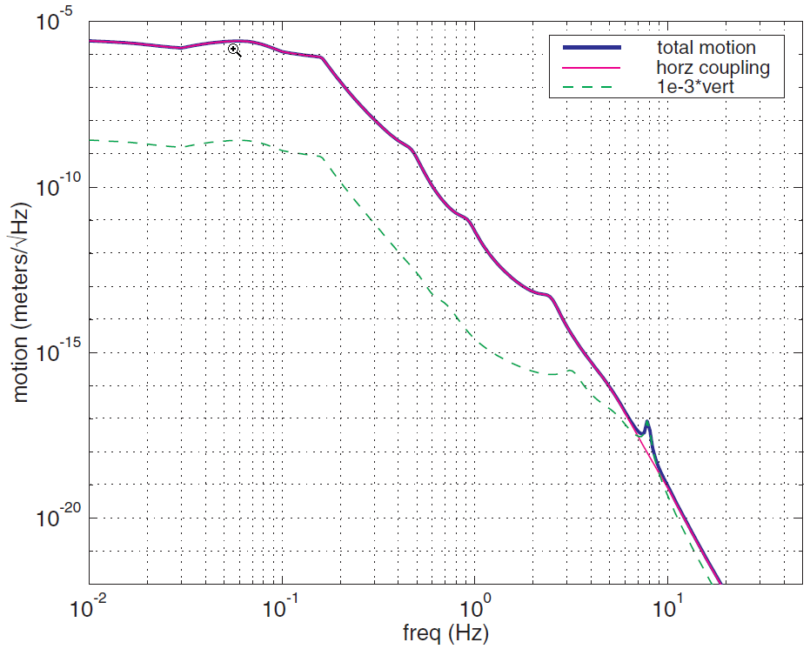
2. Advanced LIGO
Test mass suspension complements seismic isolation
All instruments using several pendulums in series for improved isolation, staging of control forces and dynamic range
Combined attenuation of seismic noise
~10 orders of magnitude at 10 Hz
20

Slide 21
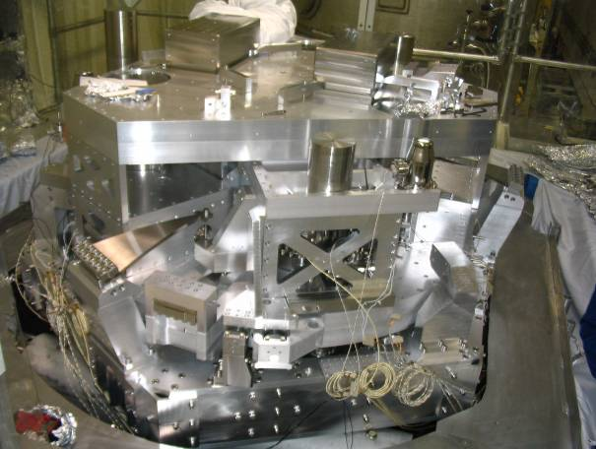
BSC Internal Seismic Isolation (BSC-ISI) system
Both suspended stages and have 6 degrees of freedom:
Blades provide the vertical flexibility
Rods provide the horizontal one
Suspension frequencies in the 1Hz-7Hz range
Passive isolation from few Hz to ~ 100Hz
Active isolation in the 0.1Hz-20Hz range.
Active control positioning
Stage 0 in violet
Stage 1 in cyan
Stage 2 in grey
Blades and flexure in yellow
Sensors in Red
Actuators in Pink
BSC-ISI as built for the prototype installed at MIT
21

Slide 22
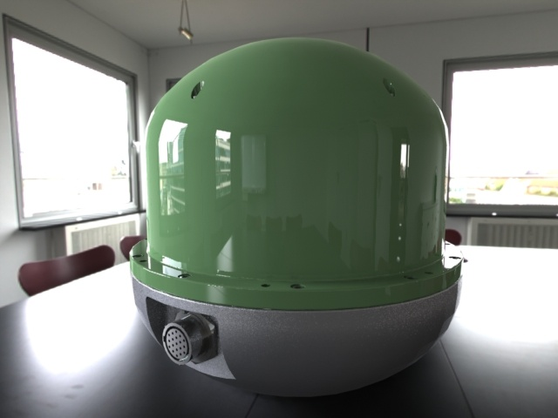
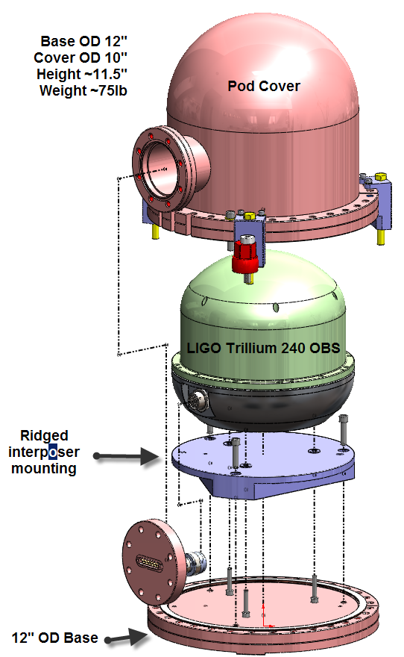
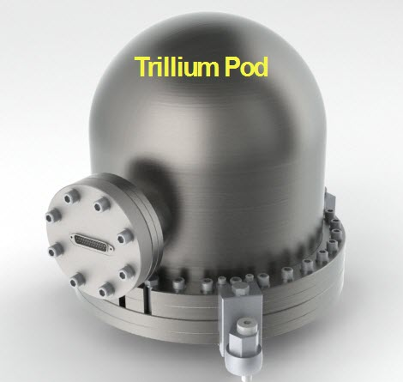
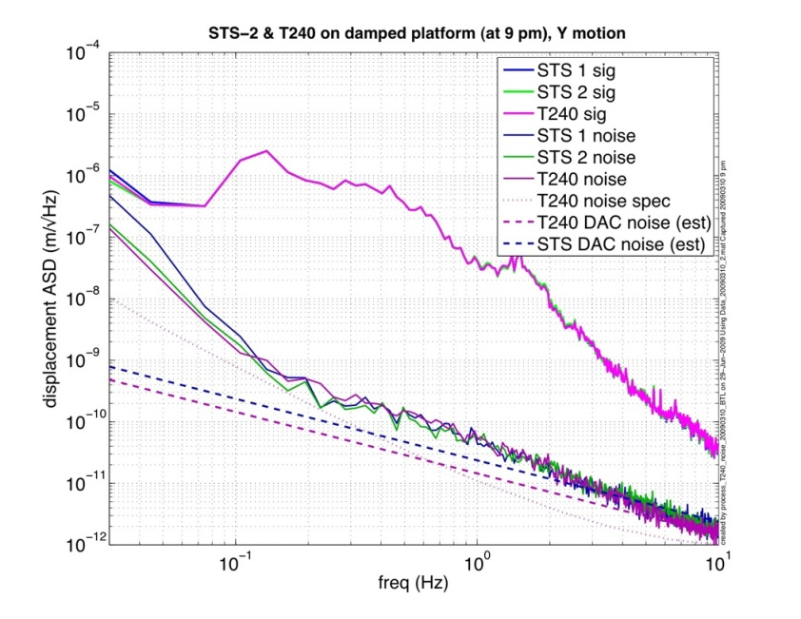
BSC-ISI seismometers
Trillium Diameter: 9.5 in
Height: 8.9 in
Weight: 21 lb
(No Locker needed)
22

Slide 23
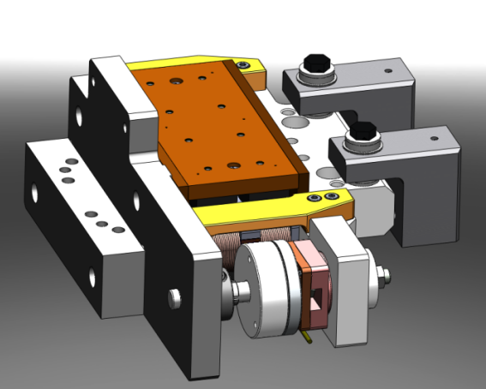
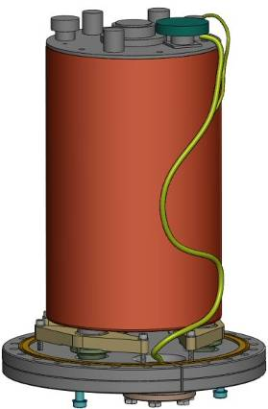





Sensors and actuators
23

Slide 24





Du cahier des charges a la fabrication en serie
1- Cahier des
charges
2- Conception
3- Prototypage
4- Test
5- Developement
6- Fabrication en serie
7- Assemblage
8- Installation
9- Mise en service

Slide 25







Tests – Part 1
F_{c}
v
25

Slide 26
Tests – Part 2
Control Strategy
26

Slide 27
Tests – Part 2
1st Step: Local to General coordinates
V3
V1
H3
Z , RZ
H1
V2
Y, Ry
X, Rx
Local Coordinate
H2
General Coordinate
Position Sensors
Position Sensors
L. To G.
Local Coordinate
General Coordinate
To filtering
ADC
Seis-mometer
Seis-mometer
L. To G.
27

Slide 28
Tests – Part 2
2nd Step: Damping loops
Damping
Filters
Seismometer
G. To L.
DAC
General Coordinate
X , Y , Z, Rx, Ry, Rz
28

Slide 29
Tests – Part 2
3rd step: Sensor Blend
Low Pass
PS
General Coordinate
High Pass
Seism.
General Coordinate
29

Slide 30
Tests – Part 2
4th Step: Controller
Low Pass
PS
+
+
Super Sensor
Control Filter
G. To L.
DAC
Seism.
High Pass
Plant
Compensator
Open Loop
Isolation
30

Slide 31
Tests – Part 2
Control Strategy for each degree of freedom:
PS
L2G
PS
Low Pass
2
Local
General
+
+
Control
Filters
1
ADC
High Pass
+
+
L2M
DAC
SEISM.
L2G
SEISM.
Local
General
Damping
Filters
3
31

Slide 32
Tests – Part 2
5th Step: Tilt decoupling
Stage
X To Ry
Measure
Trans. Model
Rot. Model
32

Slide 33

Tests – Part 2
5th Step: Tilt decoupling
X to Ry Decoupling – Stage 2
X to Ry Decoupling – Stage 2
Amplitude
Ry
X
Frequency (Hz)
Tilt decoupling Matrix

Slide 34
Tests – Part 2
6th Step: Low-Frequency Blend
Low Pass
PS
Seism.
High Pass

Slide 35
Tests – Part 2
ISI System Performance
35

Slide 36
Tests – Part 2
BSC Global Performance
36

Slide 37
Test - Part 3
Three major problems identified:
The first deformation resonances were much lower in frequencies than required.
The modal density at high frequencies was higher than expected.
The plant was variant in time.
Low frequency modes
High modal density
Plant variation
37

Slide 38
Test - Part 3
97.6Hz Q=650
F = 45Hz

Slide 39



Test - Part 3
Quad Modal Testing
3 Axis Accelerometer
The Quad
Structure
Impact Force Sensor

Slide 40
Test - Part 3
Experimental Meshing
Transfer Functions

Slide 41

Test - Part 3
First
modes measured on the Quad structure :

Slide 42


Test - Part 3
B.Lantz - Tech Demo - Stanford

Slide 43




Test - Part 3
ISI Modal Testing :
Optical Table
Instrumentation
Experimental Meshing
Transfer Functions
Domain of Interpolation

Slide 44

Test - Part 3
First
modes measured on the optical table:

Slide 45


Test - Part 3
GS13 Attachment
Counter weights
Transfer function
45

Slide 46
Test - Part 3
At low frequencies (around 0.1Hz) there is very little motion amplification.
The isolation starts as low as 0.1Hz which is good.
The isolation at 1Hz is close to a factor of 100.
The control provides isolation up to 20Hz, which is good.
46

Slide 47
Test - Part 3
Global isolation (Active & Passive)
- The ground motion is shown in Black. It is measured with a STS.
- The HEPI motion is shown in Blue. It is measured with HEPI L4Cs.
- The motion of stage2 when the control is off is presented in Red
- The motion of stage2 when the control is on is presented in Purple
- The relative requirements are presented in Grey
47

Slide 48

Test - Part 3
48

Slide 49



Step 4: Development
Stage1
The close out plate studied and analyzed to optimize the stiffness of Stage1
Successive conceptual design and Finite Element analysis.
18 iterations led to the design presented below.
All analysis and concepts presented E0900389
 | V1, 237 Lbs | V18, 376 Lbs
1 | 195 Hz | 254 Hz
2 | 195 Hz | 254 Hz
3 | 229 Hz | 302 Hz
4 | 229 Hz | 302 Hz
5 | 287 Hz | 326 Hz
6 | 319 Hz | 364 Hz
- The first two modes at 195Hz were in plane bending modes. They have moved to 302Hz.
- The next modes at 229Hz were torsion modes. They have moved to 254Hz.
The final design of the close plate and its new plate cover.
49

Slide 50
Step 5: Production
D0901182, Top Assembly Drawing:

Slide 51
5. Drawings
D09000896, Stage 0 Assembly and D09000895, Stage 0 Bottom part
D0901180, Stage 1 Assembly

Slide 52

7- Assemblage
8- Installation
9- Mise en service

Slide 53






Coming up at MIT
Triple Quad Cavity
With
BSC and HAM ISI
LASTI BSC
LASTI HAM X-End
53

