Slide 1
Advanced LIGO Suspensions
Brett Shapiro, for the SUS Group
Detector Characterization Telecon
25 August 2011

Slide 2

Contents
iLIGO to aLIGO
Seismic Isolation
Sensors and Actuators: BOSEMs and AOSEMs
Suspension Overview
Signals and Control
SUS Testing
What can you do?

Slide 3
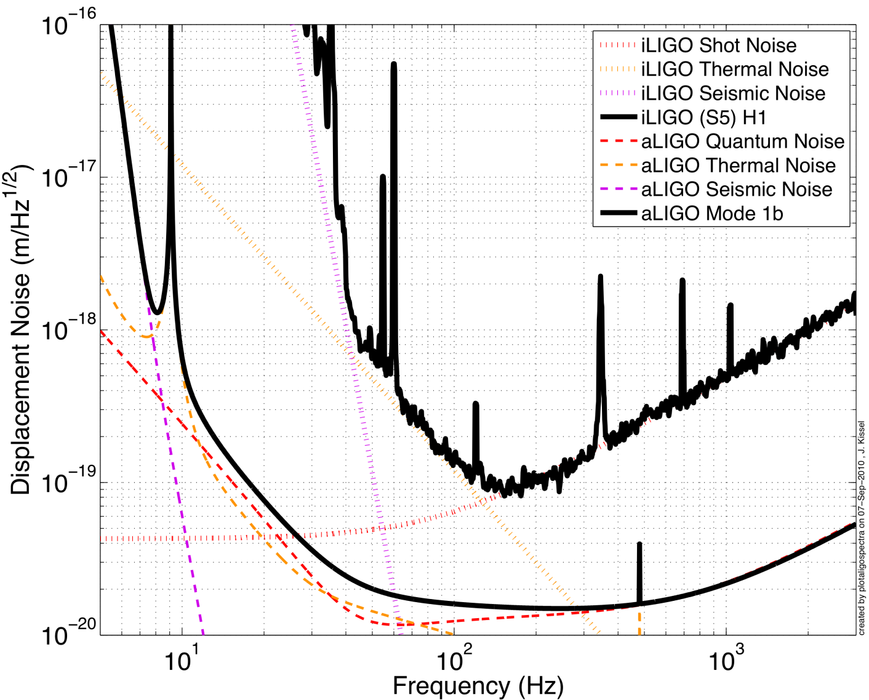
iLIGO to aLIGO
Better
Seismic
Isolation
Increased
Laser Power
and Signal Recycling
Reduced
Thermal
Noise
Kissel – thesis defense, P1000103

Slide 4
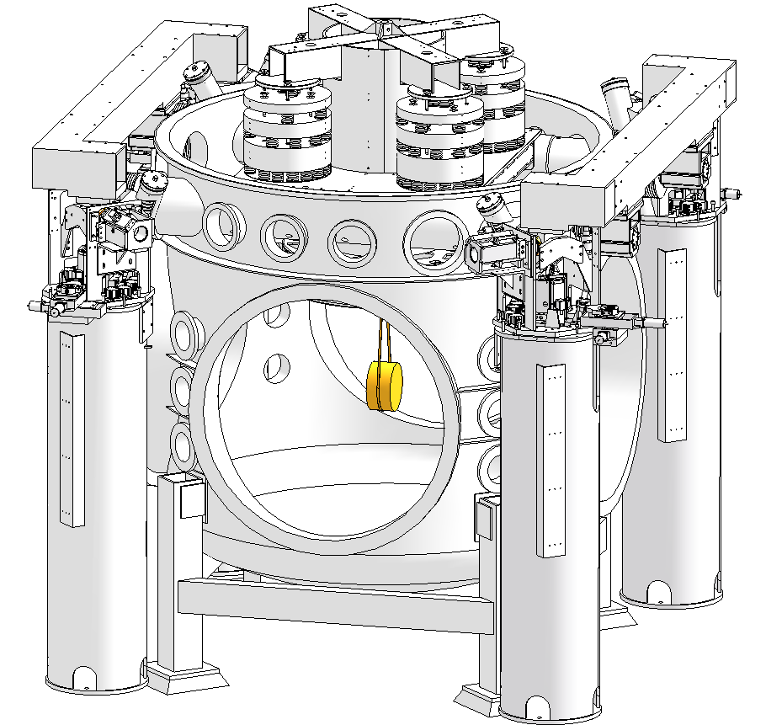
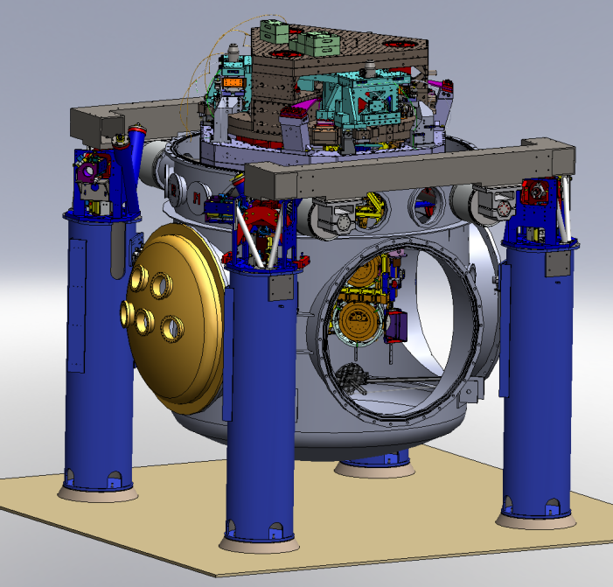
Suspensions and Seismic Isolation – From Initial to Advanced LIGO
LIGO
Advanced LIGO
active isolation platform (2 stages of isolation)
coarse & fine actuators
hydraulic external pre-isolator (HEPI) (one stage of isolation)
4 layer passive isolation stack
quadruple pendulum (four stages of isolation) with monolithic silica final stage
single pendulum on steel wire
Ref: LIGO-G1000469-v1; Kissel PhD thesis

Slide 5
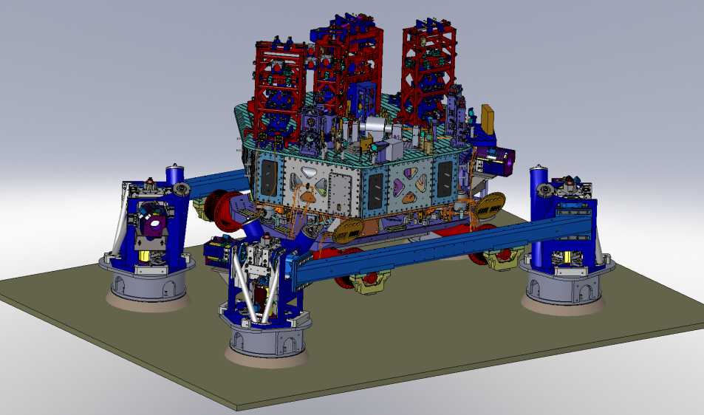
An aLIGO HAM Chamber
z
x
y
HAM2 (Chamber hidden for clarity)

Slide 6
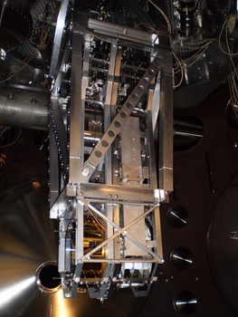
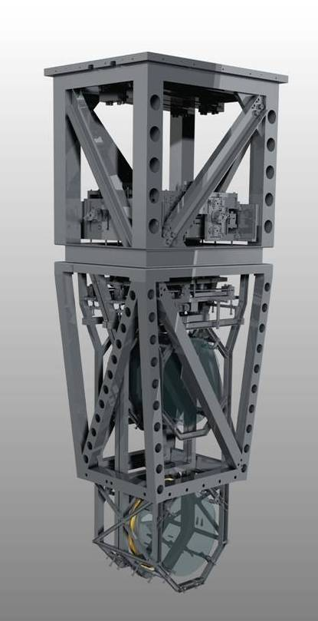
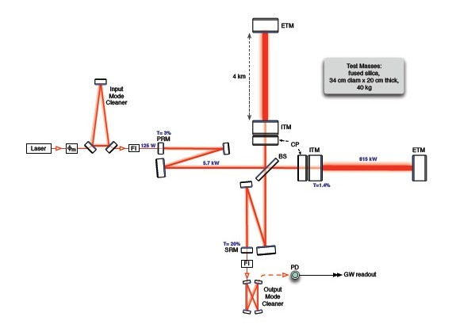
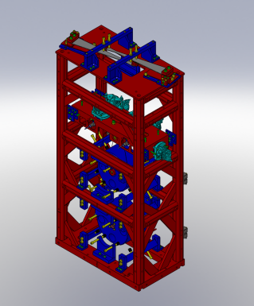
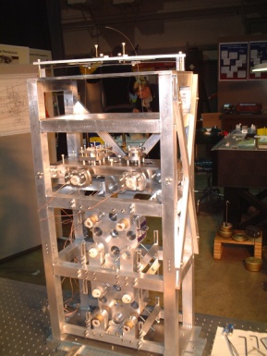
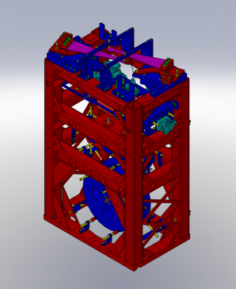
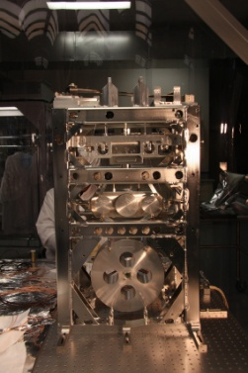
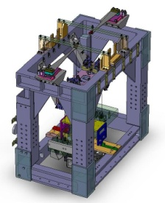
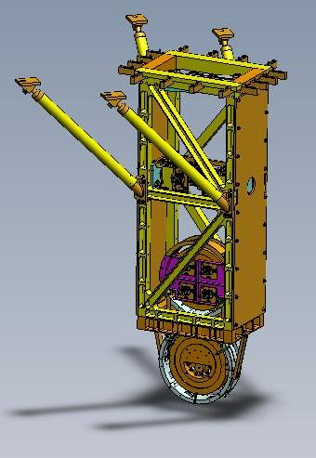
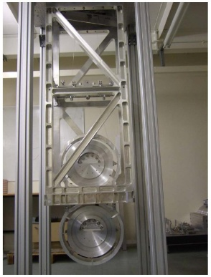
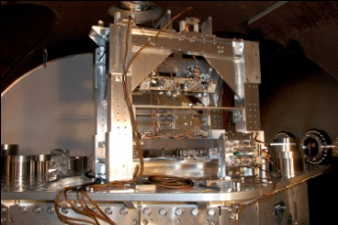
Five Suspension Designs
Ref: G100434

Slide 7
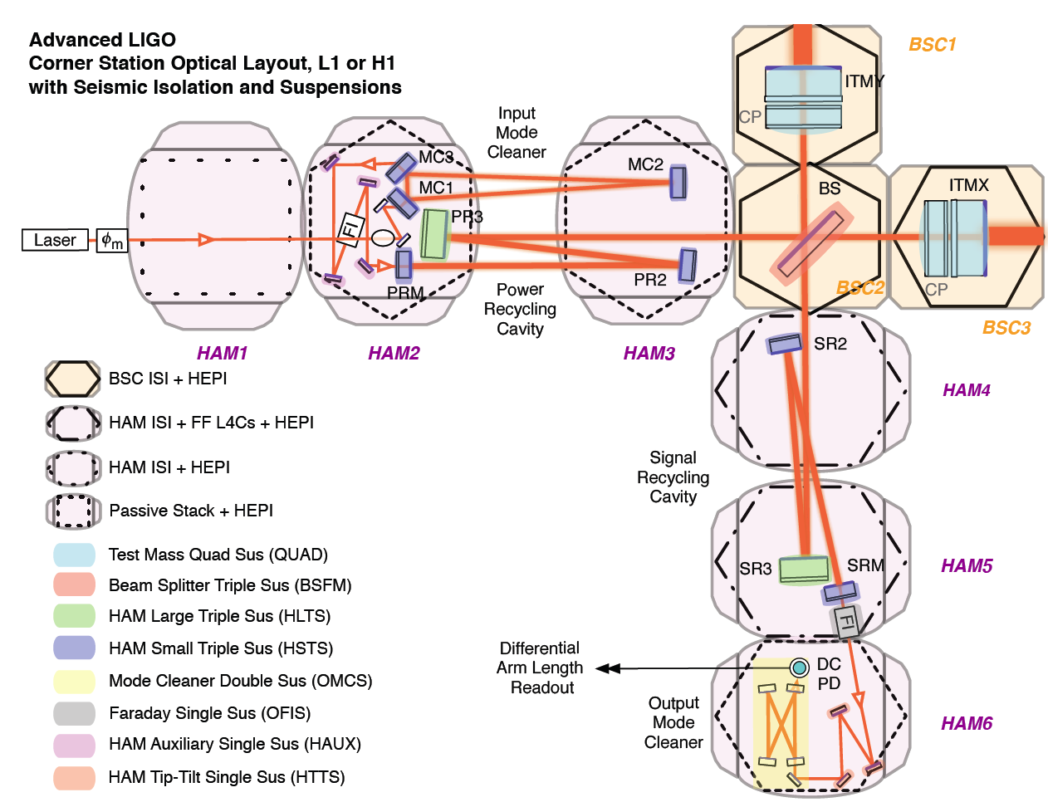
SUS group
ITM, ETM
PR3, SR3
PRM, PR2, SRM, SR2, IMC
Other suspensions
+ TransMon

Slide 8
Suspension Isolation Performance
1/f²
1/f⁴
Each stage provides 1/f² isolation
1/f⁶
1/f⁸

Slide 9
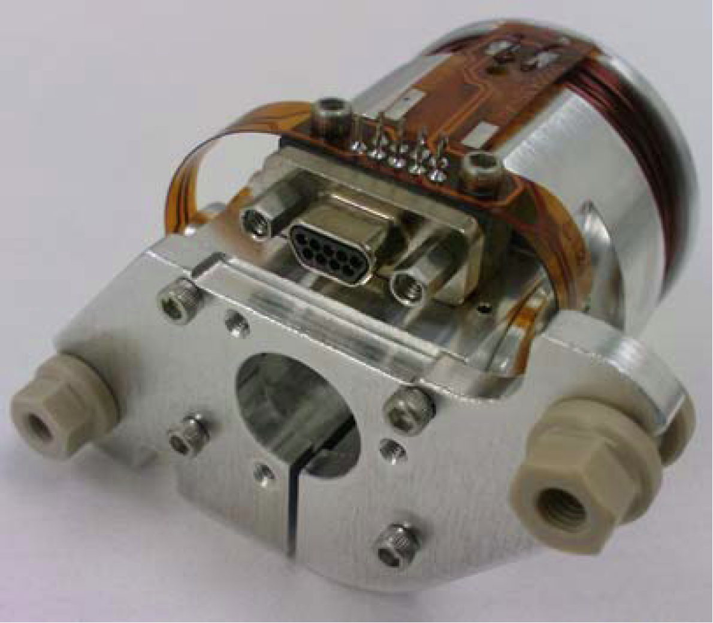
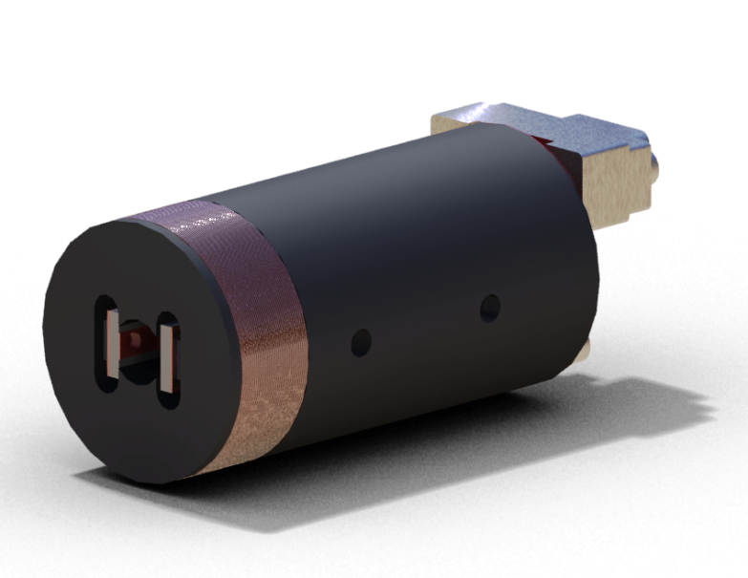
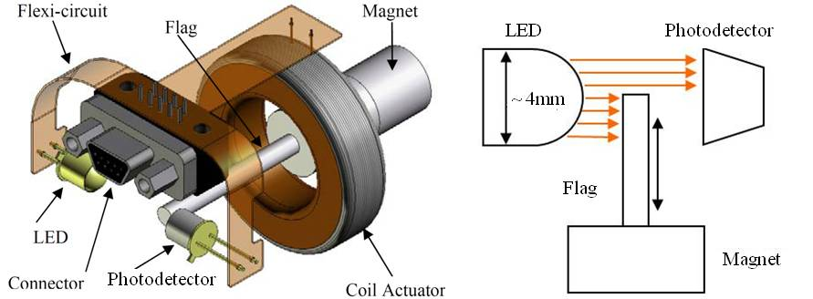
Optical Sensor ElectroMagnet (OSEM)
Birmingham OSEM (BOSEM)
Advanced LIGO OSEM (AOSEM)
- modified iLIGO OSEM
Magnet Types (M0900034)
BOSEM – 10 X 10 mm, NdFeB , SmCo
10 X 5 mm, NdFeB, SmCo
AOSEM – 2 X 3 mm, SmCo
    2 X 6 mm, SmCo
    2 X 0.5 mm, SmCo
BOSEM Schematic

Slide 10
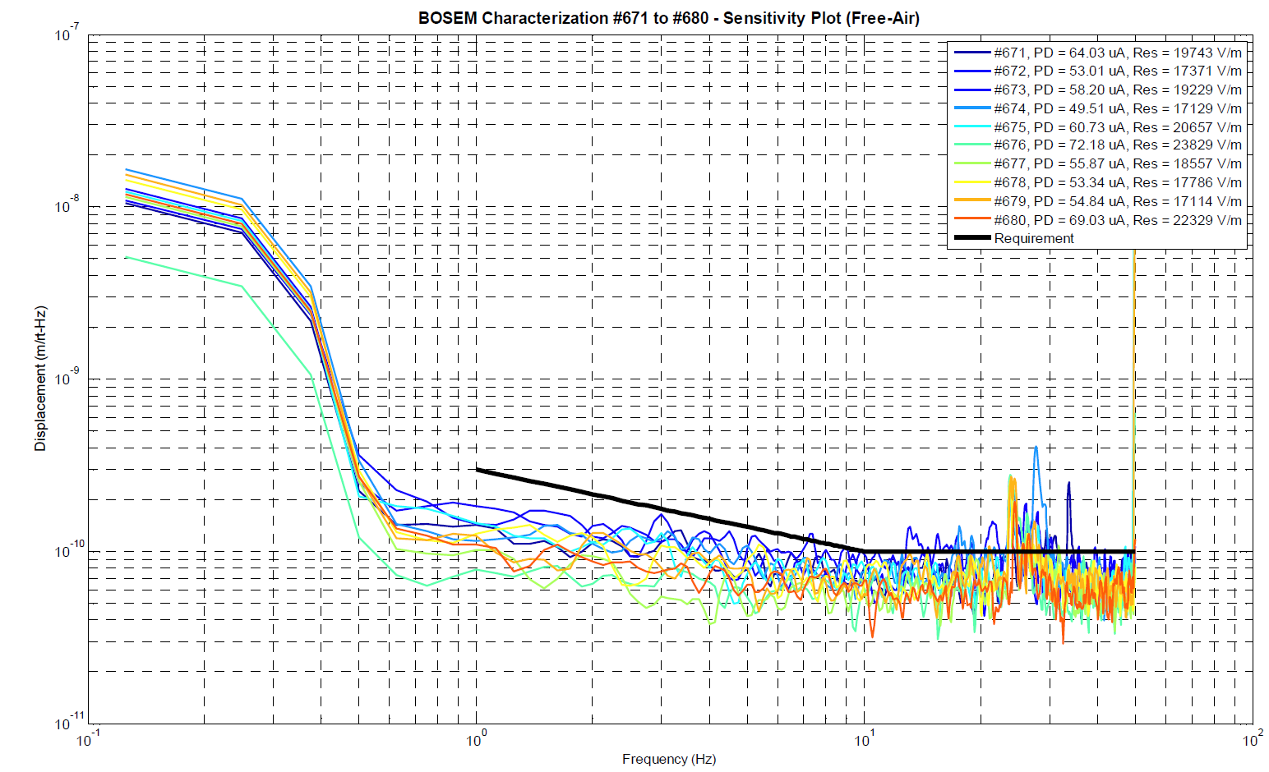
BOSEM Sensor Noise
Displacement (m/Hz^{0.5})
aLIGO 10 Hz goal: 10⁻¹⁹ m/Hz^{0.5}
Ref: T090496-v4
Frequency (Hz)

Slide 11
Sensor Feedback Only to Top Mass
10000 times higher!
aLIGO 10 Hz goal: 10⁻¹⁹ m/Hz^{0.5}

Slide 12
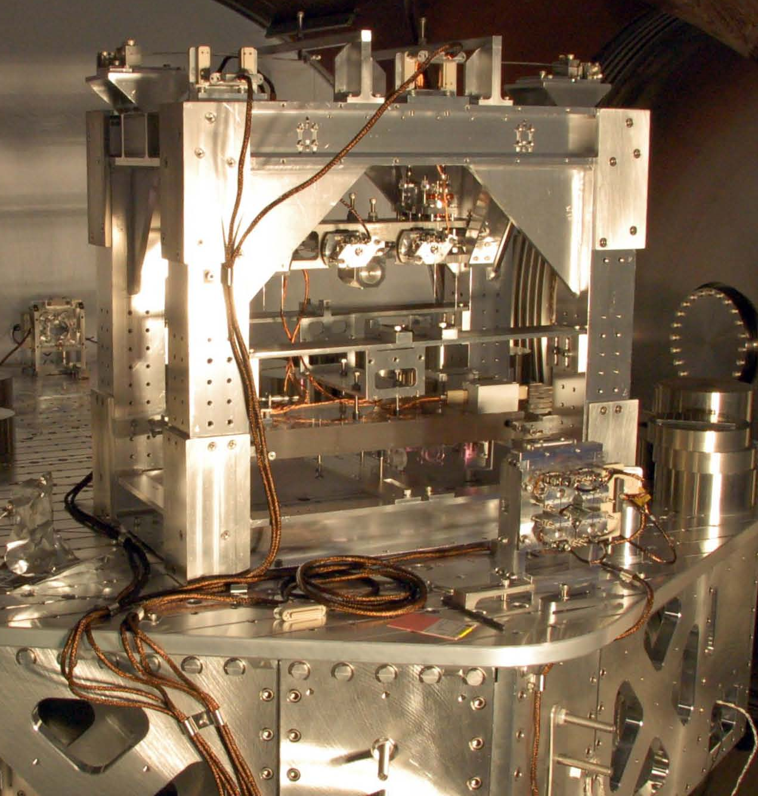
Output Mode Cleaner Double (OMCS)
Location
HAM 6, (12)
Control
Local – damping at M1
(true for all SUS’s)
Sensors/Actuators
BOSEMs at top mass
Top mass naming convention
L1:SUS-OMC_M1…
In use during S6
T3
T1
T2
SD
LF
M1
RT
M2
Optics
site subsystem unit stage
2
3
3,4
2
Documentation
Final design review - T0900060
HAM SUS controls arrangement – E1100109
V
Local coordinates
T
L

Slide 13
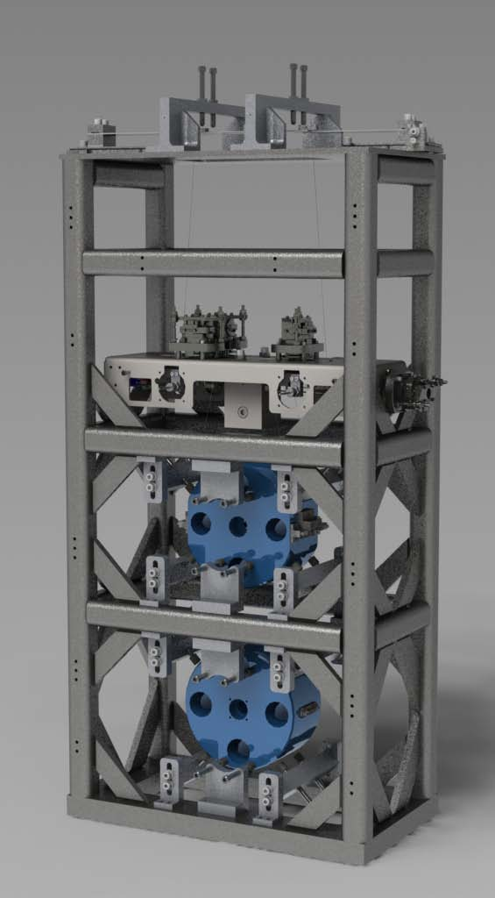

HAM Small Triple Suspension (HSTS)
Purpose
PRM, PR2, SRM, SR2
MC1, MC2, MC3
Location
HAM 2, 3, 4, 5, (8, 9, 10, 11)
T1
T2
T3
SD
LF
M1
RT
Control
Local – damping at M1
Global – LSC & ASC at all 3
Sensors/Actuators
BOSEMs at M1
AOSEMs at M2 and M3
Optical levers and interferometric signals on M3
Naming: L1:SUS-PRM_M1…
Documentation
Final design review - T0900435
Controls arrangement – E1100109
UL
UR
M2
LL
LR
UL
UR
M3
LL
LR
V
T
L

Slide 14
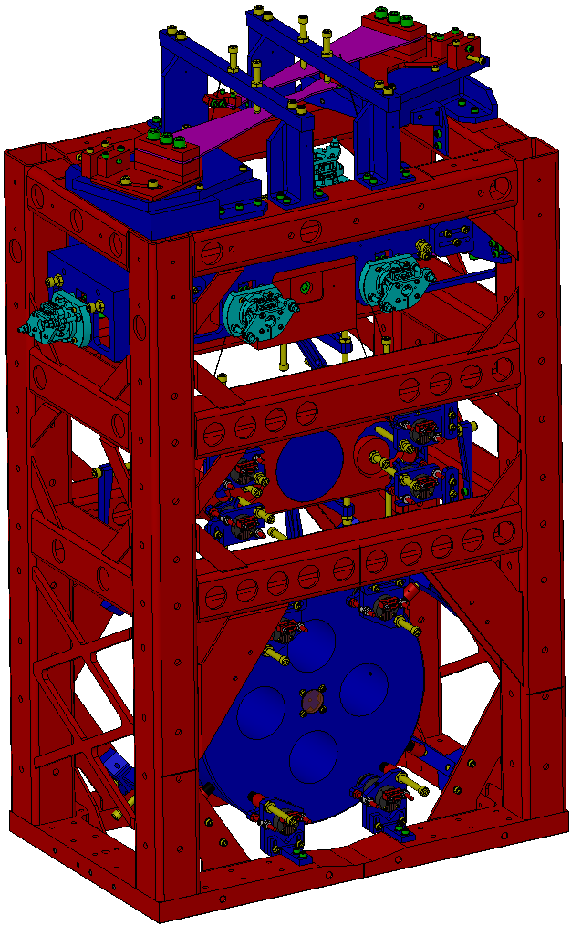
HAM Large Triple Suspension (HLTS)
Purpose
PR3, SR3
Location
HAM 2, 5, (8, 11)
M1
Control
Local – damping at M1
Global – LSC & ASC at all 3
Sensors/Actuators
BOSEMs at M1
AOSEMs at M2 and M3
Optical levers and interferometric signals on M3
Naming: L1:SUS-SR3_M1…
Documentation
Final design review – T1000012
Controls arrangement – E1100109
UL
UR
M2
LL
LR
UL
UR
M3
LL
LR
V
T
L

Slide 15
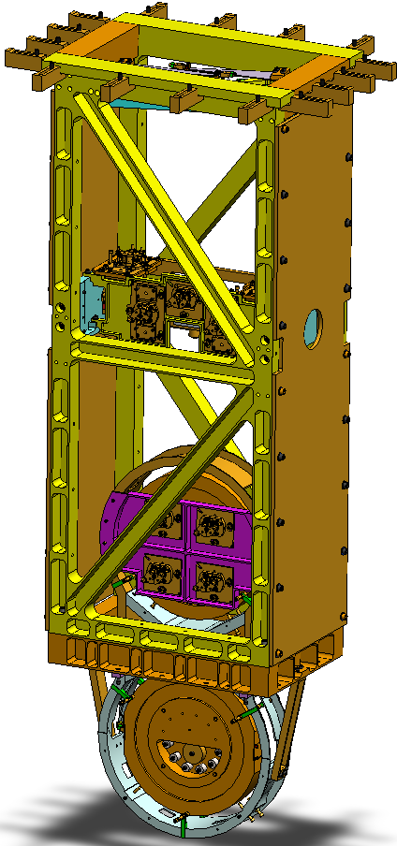
Beamsplitter/Folding Mirror (BSFM)
Purpose
BS, (FMX and FMY)
Location
Beamsplitter – BSC 2, (4)
(Fold Mirror – BSC 6, 8)
RT
LF
F1
SD
F2
F3
M1
Control
Local – damping at M1
Global – LSC & ASC at M2
Sensors/Actuators
BOSEMs at M1 and M2
Optical levers and interferometric signals on M3
Naming: L1:SUS-FMX_M1…
Documentation
Final design review - T080218
Controls arrangement – E1100108
UL
UR
M2
LL
LR
M3
V
T
L

Slide 16
Quadruple Suspension (Quad)
Reaction Chain
Main (test) Chain
Purpose
Input Test Mass (ITM, TCP)
End Test Mass (ETM, ERM)
Location
H1 - BSC 1, 3, 9, 10
H2 - BSC 7, 8, 5, 6
L1 – BSC 1, 3, 4, 5
R0, M0
Control
Local – damping at M0, R0
Global – LSC & ASC at all 4
Sensors/Actuators
BOSEMs at M0, R0, L1
AOSEMs at L2
Opt. levs. and interf. sigs. at L3
Electrostatic drive (ESD) at L3
Documentation
Final design review - T1000286
Controls arrang. – E1000617
L1
L2
L3

Slide 17
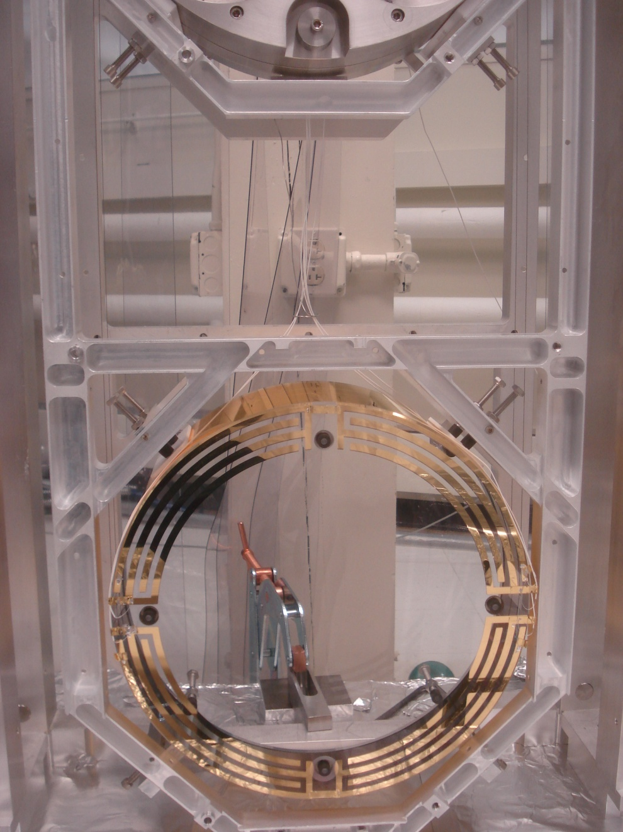
Quadruple Suspension ESD
Reaction Chain
Main (test) Chain
The electrostatic drive (ESD) acts directly on the test ITM and ETM test masses.
± 400 V (ΔV 800 V)
  ≈ 100 μN
Each quadrant has an independent control channel
Common bias channel over all quadrants
UR
UL
LR
LL

Slide 18
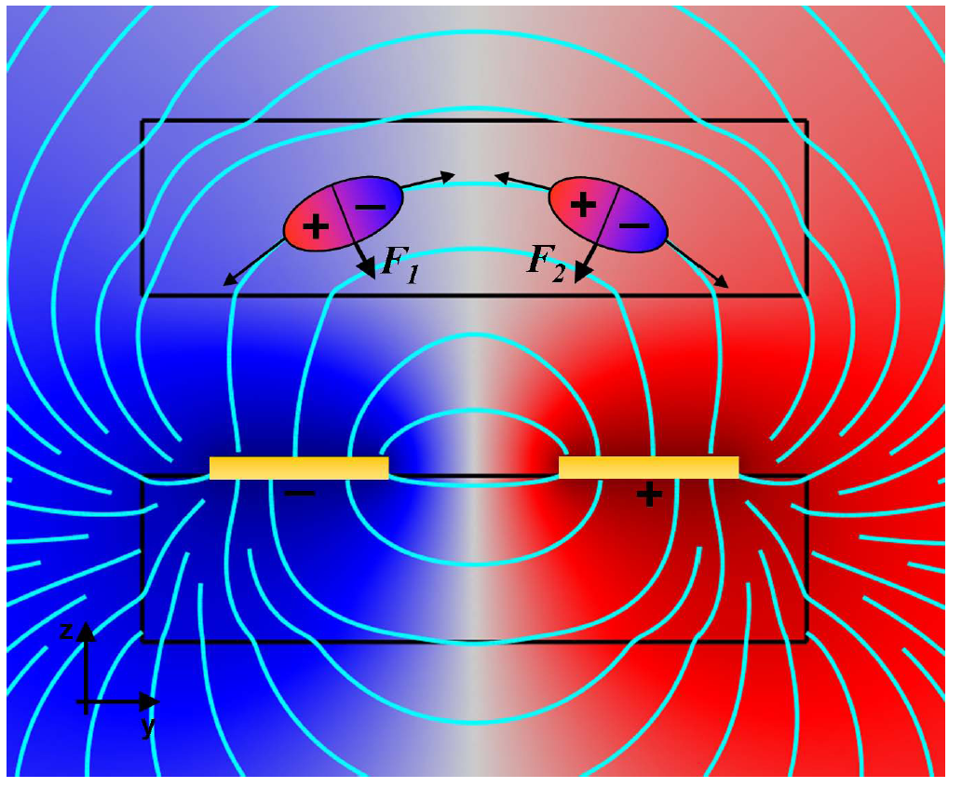
Quadruple Suspension ESD
F = αΔV²
α = coupling coefficient, depends on geometry
ΔV = differential voltage across traces
Test mass
5 mm
Reaction mass
Linearization occurs in the control!
Cartoon diagram illustrating the working principle of the ESD. The upper rectangle represents the test mass containing two polarized molecules; the lower rectangle represents the reaction mass bearing two electrodes. Surface plot shows electrical
potential with electric field lines shown in cyan (John Miller PhD thesis, P1000032).

Slide 19
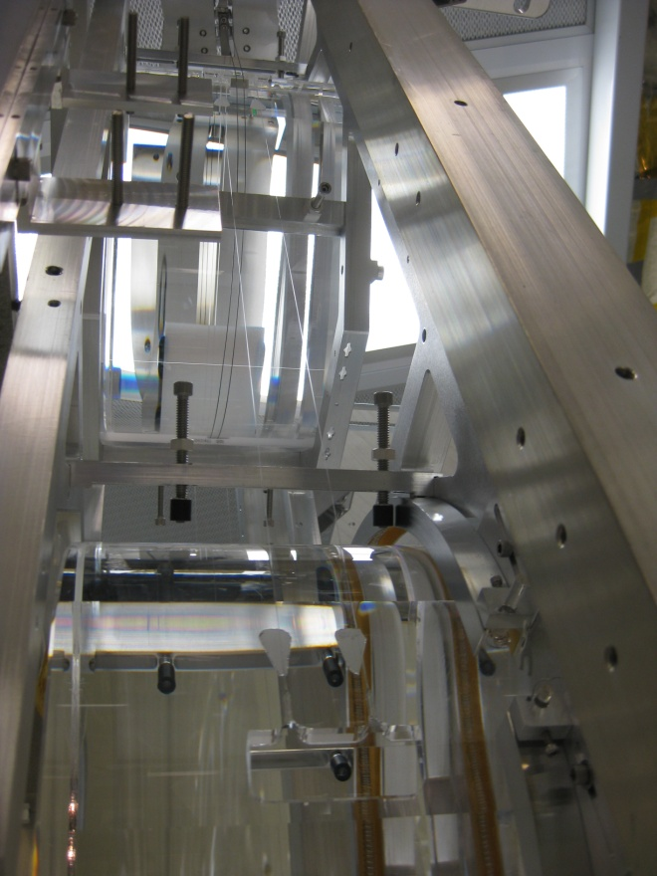
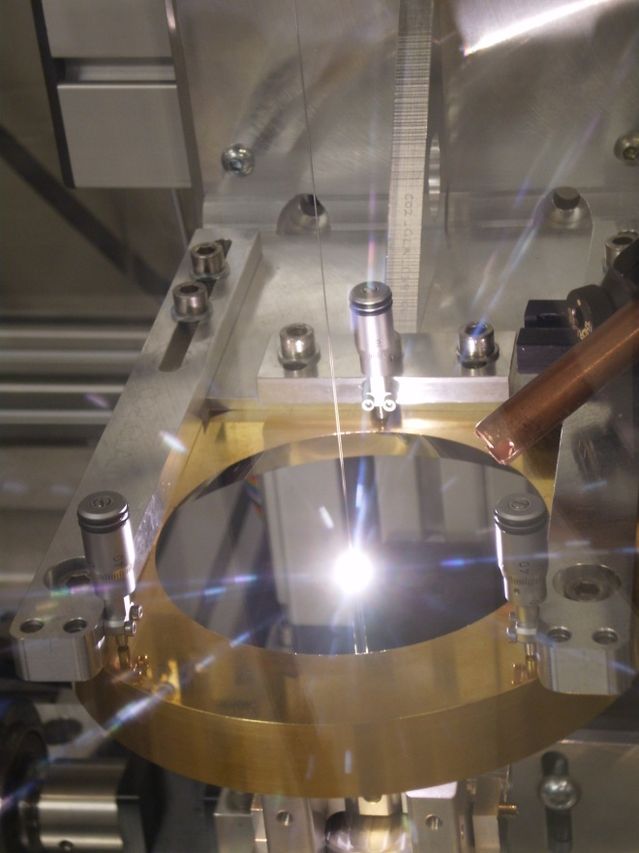
Quadruple Suspension (Quad)
Reaction Chain
Main (test) Chain
R0, M0
Fibers
L1
L2
Newly welded monolithic quad at MIT
11 May 2010
L3
Pulling a fiber at MIT
7 May 2010

Slide 20
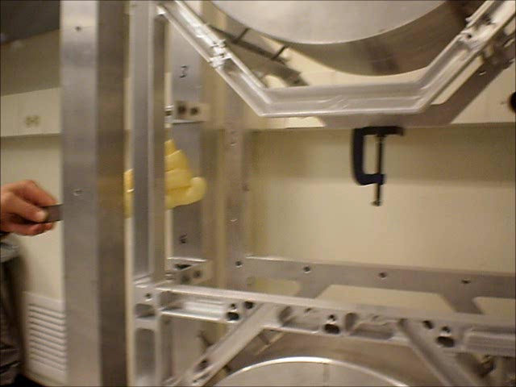
Delicate Fibers
Video of breaking the monolithic test suspension fibers at MIT, 5 Nov 2010.
To see how robust they are when they are not touched see http://www.youtube.com/watch?v=qlJ0o7R4-LU

Slide 21
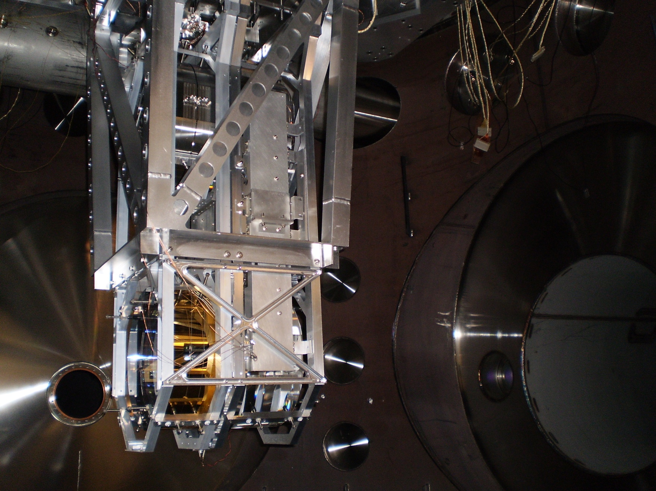
Quadruple Suspension (Quad)
MIT monolithic quad in BSC
June 2010

Slide 22
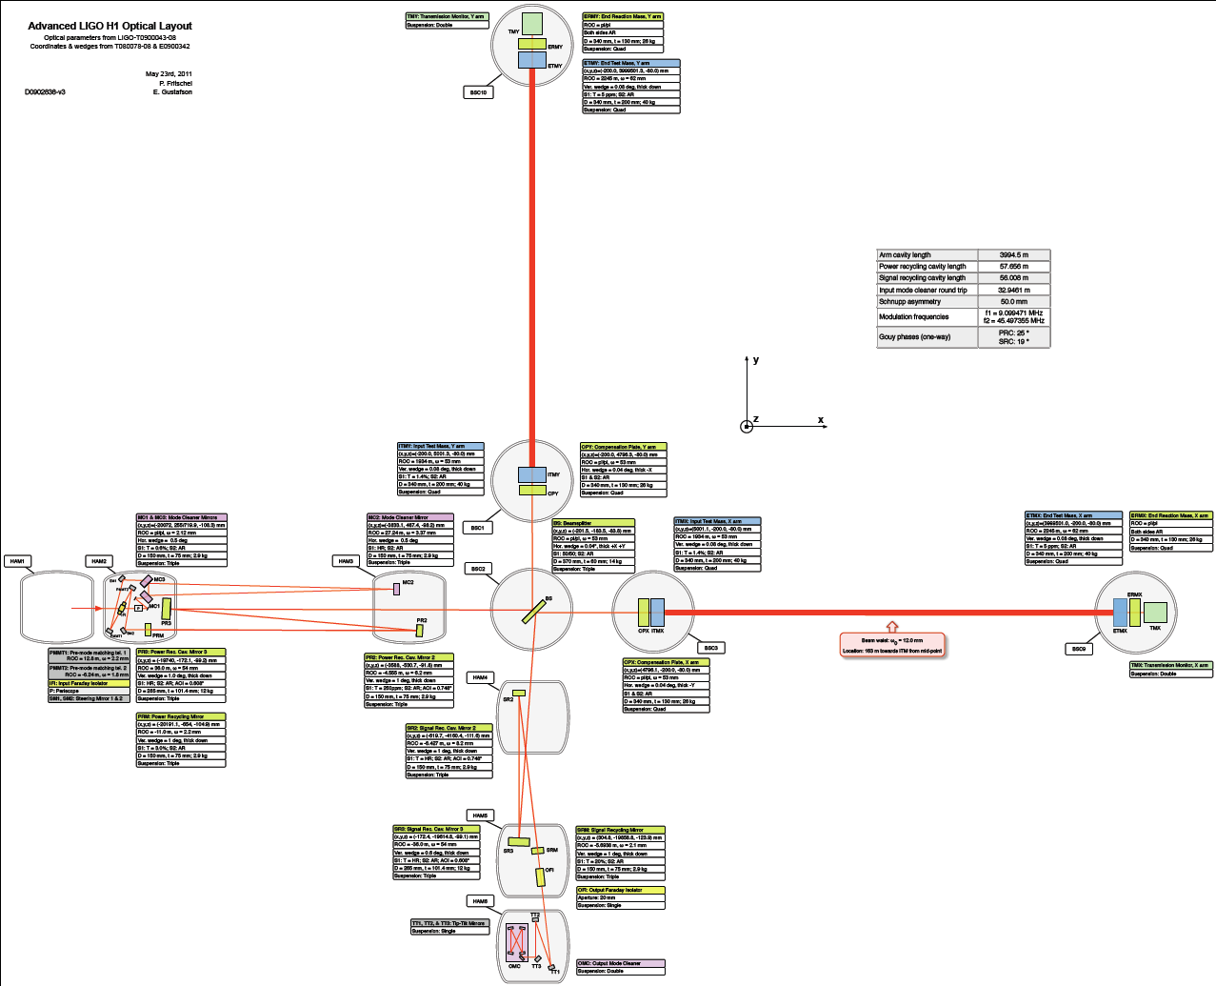
Pendulum Coordinates
Reaction Chain
Main (test) Chain
SUS control follows local pendulum coordinates
The ‘beam line’ does not always correspond to the IFO coordinates
Interferometer coordinates
y
z
x
Vertical (V)
Local Coordinates
Transverse (T)
Yaw (Y)
Pitch (P)
Longitudinal (L)
Roll (R)
Main chain top mass longitudinal: L1:SUS-ITMX_M0_L

Slide 23


Signal Flow – HSTS Bottom Stage
Offload to next stage
ADC
Control
DAC
ISC Input Filters
Lock Filters
DOF Decoupling Matrix
Output calibrated to nm (nrad)
Frequency dependent
Test Filters
+
Euler to OSEM
OSEM Out Filters
Coordinate transform
OSEM Input Filters
OSEM to Euler
Witness Filters
Actuator Outputs
Output calibrated to nm (nrad)
Coordinate transform
Tests
Sensor Inputs
WIKI reference: https://awiki.ligo-wa.caltech.edu/aLIGO/NamingConventions

Slide 24
Signal Flow – HSTS Middle Stage
Offload to next stage
ADC
Control
DAC
Inputs from previous stage
Lock Filters
DOF Decoupling Matrix
Frequency dependent
Test Filters
+
Euler to OSEM
OSEM Out Filters
Coordinate transform
OSEM Input Filters
OSEM to Euler
Witness Filters
Actuator Outputs
Output calibrated to nm (nrad)
Coordinate transform
Tests
Sensor Inputs
WIKI reference: https://awiki.ligo-wa.caltech.edu/aLIGO/NamingConventions

Slide 25
Signal Flow – HSTS Top Stage
Offload to next stage
ADC
Control
DAC
Inputs from previous stage
Lock Filters
DOF Decoupling Matrix
Frequency dependent
Damping Filters
+
Euler to OSEM
OSEM Out Filters
Coordinate transform
OSEM Input Filters
OSEM to Euler
Test Filters
Actuator Outputs
Output calibrated to nm (nrad)
Coordinate transform
Tests
Sensor Inputs
WIKI reference: https://awiki.ligo-wa.caltech.edu/aLIGO/NamingConventions

Slide 26
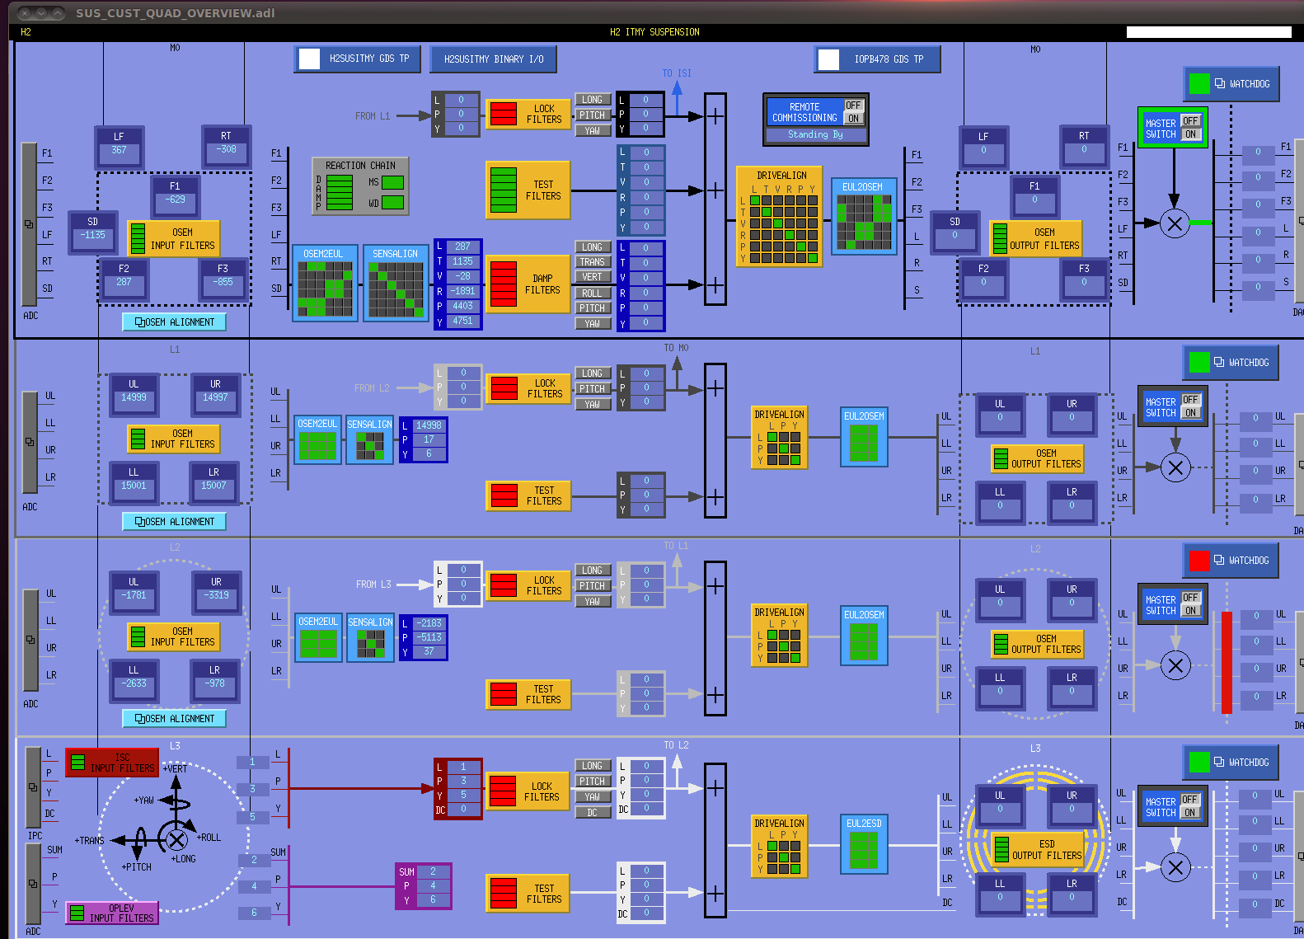
Quad MEDM Overview Screen

Slide 27
Global Cavity Control (LSC)
C₄
C₃
Each stage has limited range, so the control is distributed up the chain with:
Increasing control force
Lower frequency control
C₂
Cavity Length
C₁
ITM
ETM

Slide 28
Parallel Control of Cavity Length
With parallel feedback, changing one loop requires changing the others to account for changes in gain and stability.
The stability of all stages are coupled
C₂
Cavity Length
C₁
ITM
ETM

Slide 29
Hierarchical Control of Cavity Length
If each stage’s input is the output of the previous stage, any feedback change is automatically registered by the rest of the loop.
The stability at each stage is independent from the others.
Detailed discussion in T1000242.
C₂’
Cavity Length
C₁
ITM
ETM

Slide 30
SUS Testing – G1100693
Top mass transfer functions
Sub-pendulum resonance measurements (lock stages down)
OSEM calibration – sensors and actuators
Cross-coupling tests
Magnet polarity checks
Active damping tests
Alignment range tests (drive OSEMs)
Structure resonances
The testing plan is still a work in progress!

Slide 31
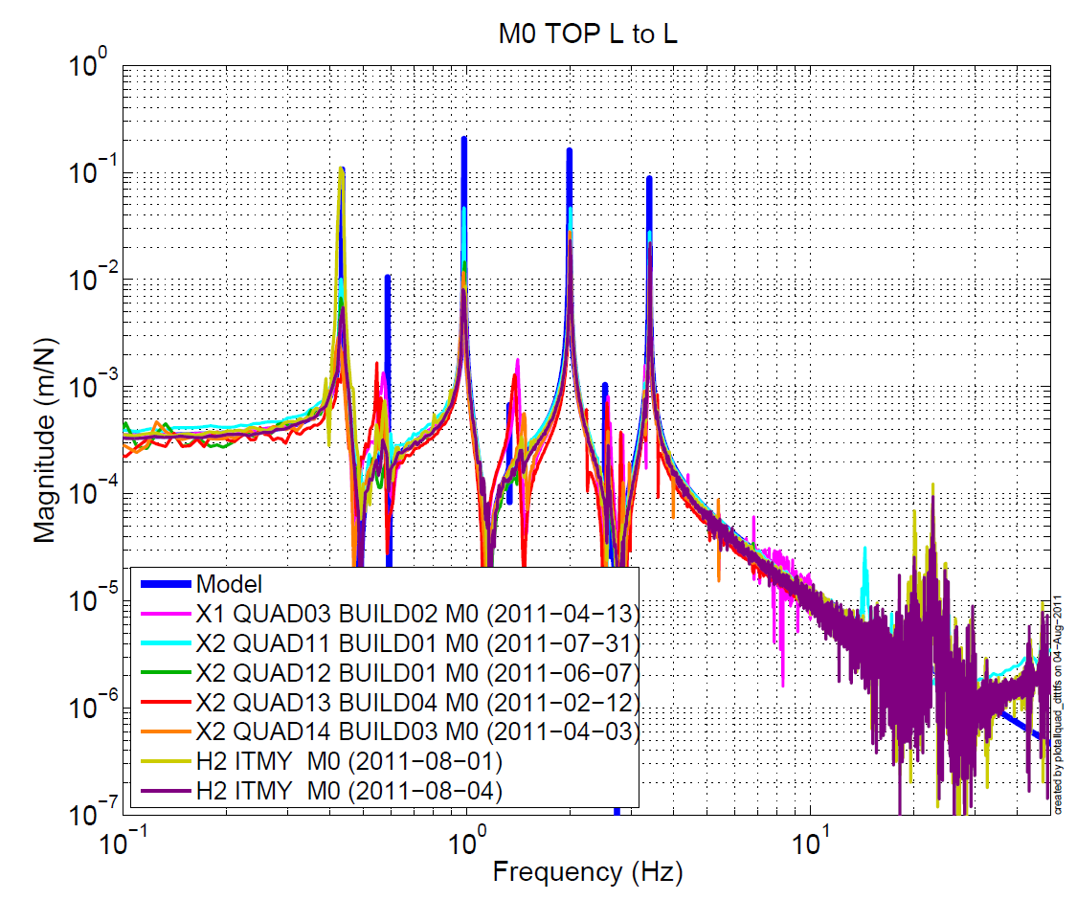
Recent Transfer Functions
H2 ITMY just installed on BSC-ISI last week!

Slide 32
What can DetChar do?
Damping: measure how much OSEM sensor noise makes it to DARM; look for pendulum resonant frequencies and Q’s. This will tell us how optimal our damping control is.
Study impact of undamped bounce and roll modes. Each triple and quad has a pair. How big are the peaks, do they ring up often? What are the Q’s?
Study impact of wire and fiber violin modes and acoustic modes of the optics. How big are the peaks? Ring up often? Some of these will have active damping.
Look for actuator saturation and RMS history; will tell us if the global control is distributed properly between stages.
Monitor long term alignment drifts in the suspensions. Ex. The masses rise and fall slightly with variations in temperature and pressure (quad mirror drops 1/3 mm under vacuum).
More ideas welcome.

Slide 33
aLIGO SUS Team
LLO SUS Team:
Janeen Romie – HAM SUS lead eng
Gary Traylor – SUS Install lead
Carl Adams
Anna Aitken
Richard Biedenharn
Derek Bridges
Virginia Brocato
William Elliott
Anamaria Effler
Matt Heintze
Ed Merilh
Mike Meyer
Ralph Moffatt
Bobby Moore
Danny Sellers
Gene Winton
LHO SUS Team:
Mark Barton – HAM-SUS cog scientist
Betsy Bland – SUS Install lead
Jeff Bartlett
Doug Cook
Jesse Garner
Robert Lane
Gerardo Moreno
Andres Ramirez
Travis Sadecki
Vern Sandberg
Caltech SUS Team:
Norna Robertson – SUS Leader
Jay Heefner – SUS Electronics Lead
Jay Copti
Phillip Croxton
Todd Etzel
Kate Gushwa
Alastair Heptonstall
Kristen Holtz
Tim MacDonald
Gary McIntyre
Margot Phelps
University of Glasgow (UK):
Angus Bell
Nicola Beveridge
Alan Cumming
Liam Cunningham
Giles Hammond
Jim Hough
Russell Jones
Rahul Kumar
Sheila Rowan
Ken Strain
Marielle Van Veggel
Rutherford Appleton Lab (UK):
Justin Greenhalgh
Joe O’Dell
MIT SUS Team:
Jeff Kissel – Testing lead
Rich Mittleman – LASTI lead
Sam Barnum
Michael Hillard
Brett Shapiro
Sam Waldman
University of Strathclyde (UK):
Nick Lockerbie
Kirill Tokmakov
University of Birmingham (UK):
Stuart Aston
Ludovico Carbone
Ron Cutler

Slide 34
Back Ups

Slide 36
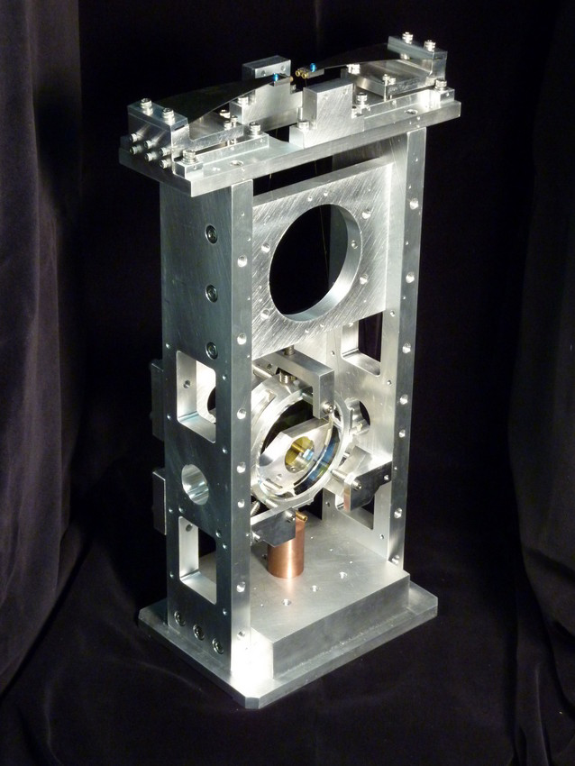
Single Suspensions
Modified iLIGO SOS’s (Small Optic Suspension)
  Addition of blade springs
  Removal of side OSEM
  Addition of eddy current damping
Steering and focusing auxiliary mirrors.
Located in HAM 2, 8
AOSEM

Slide 37
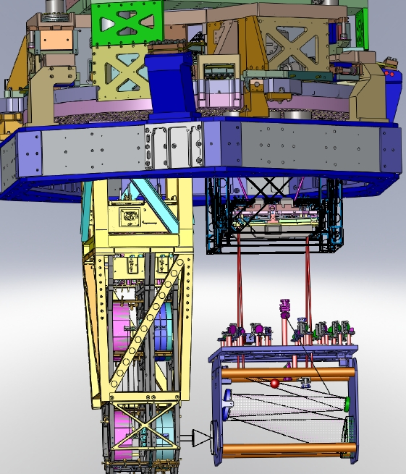
TransMon Double
Location
BSC 9, 10
Control
Local – damping at top mass
Sensors/Actuators
BOSEMs at top mass
Top mass naming convention
L1:SUS-TRMX_M1…
Ref: E1000040

Slide 38
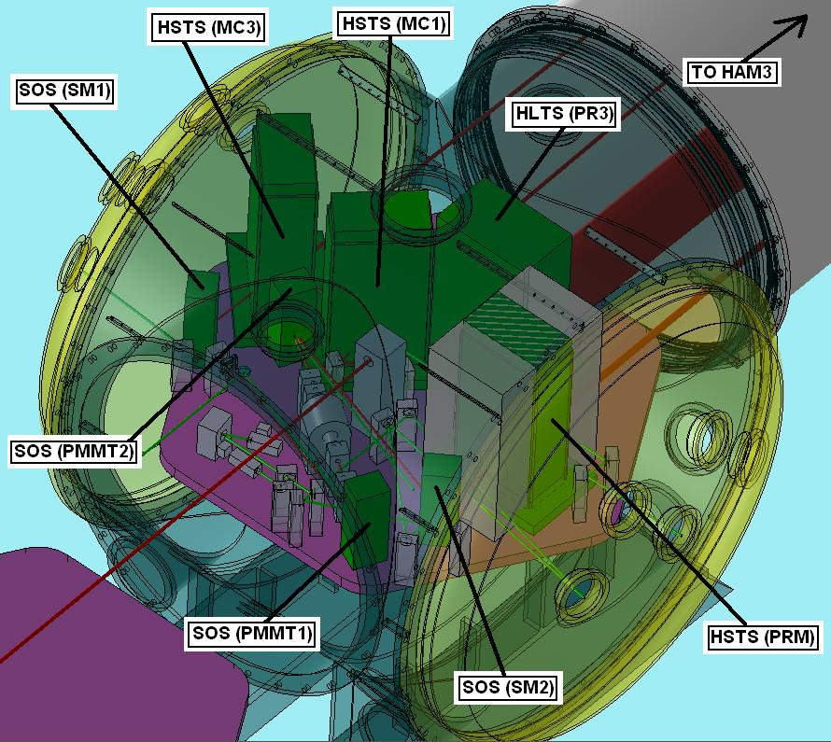
HAM2 Layout
Luke Williams, 22 Sept
Ref: G0900788
Notes:
Get updates from Luke

Slide 39
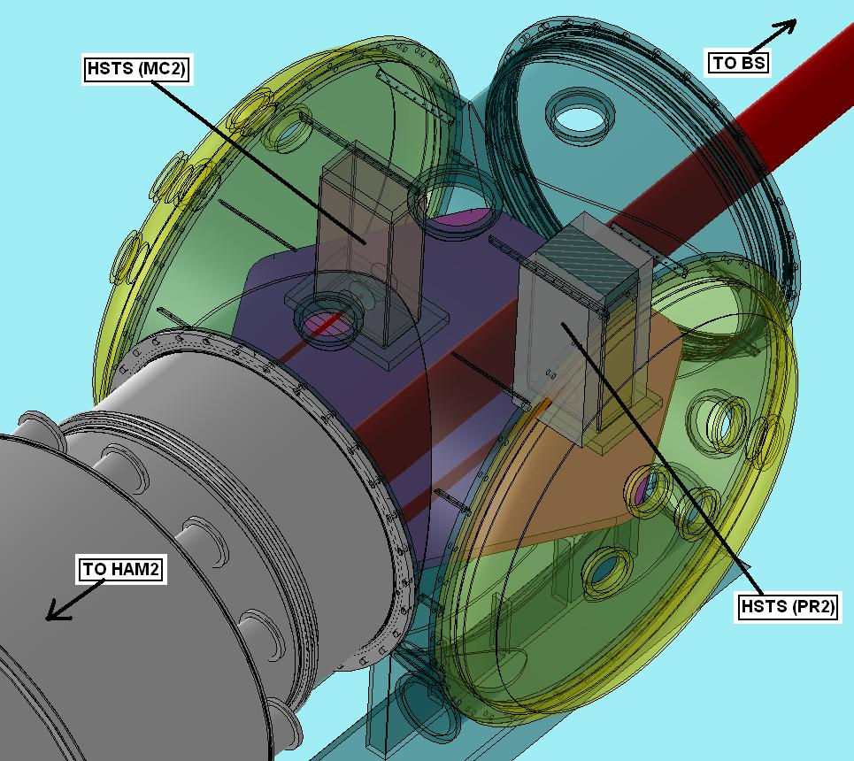
HAM3 Layout
Luke Williams, 22 Sept
Ref: G0900788
Notes:
Get updates from Luke

Slide 40
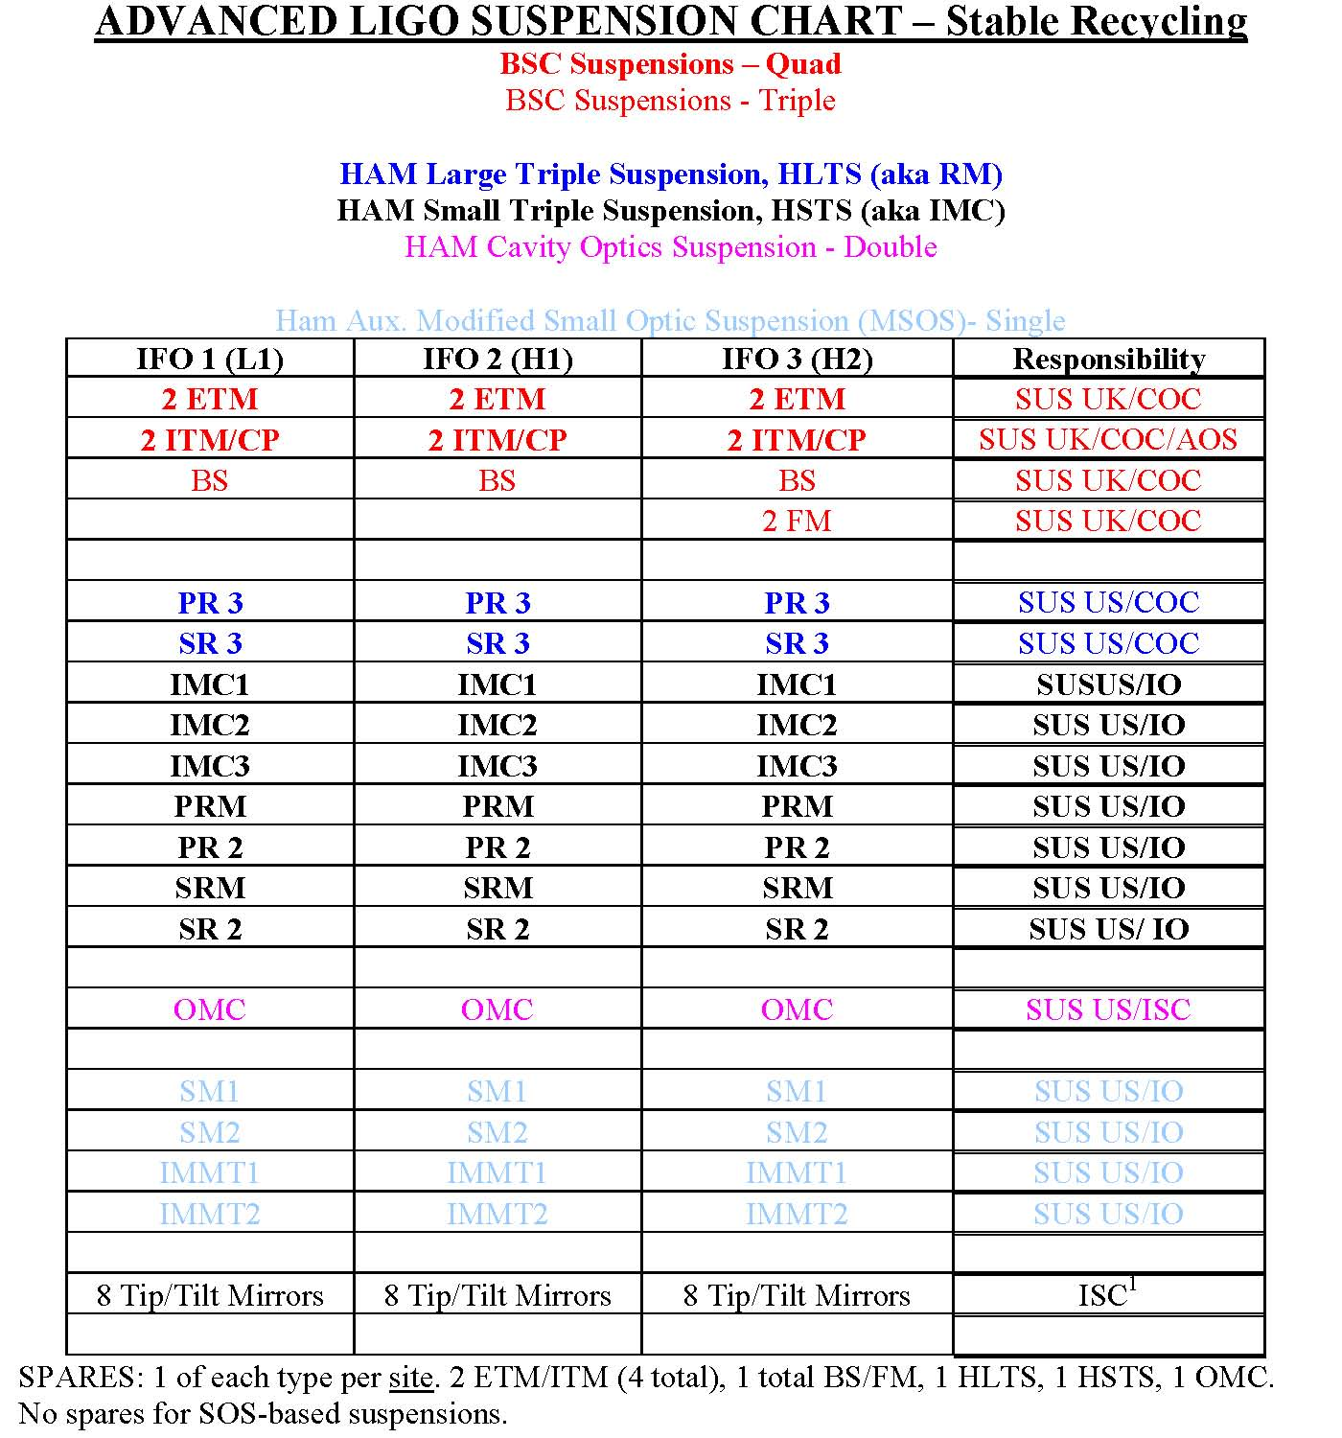
Different Suspensions
ETM = end test mass
ITM = input test mass
BS = beamsplitter
FM = folding mirror
CP = compensator plate
PR = power recycling mirror
SR = signal recycling mirror
IMC = input mode cleaner
OMC = output mode cleaner
SM = steering mirror
IMMT = input mode matching telescope
Ref: LIGO-G1000469-v1

Slide 41
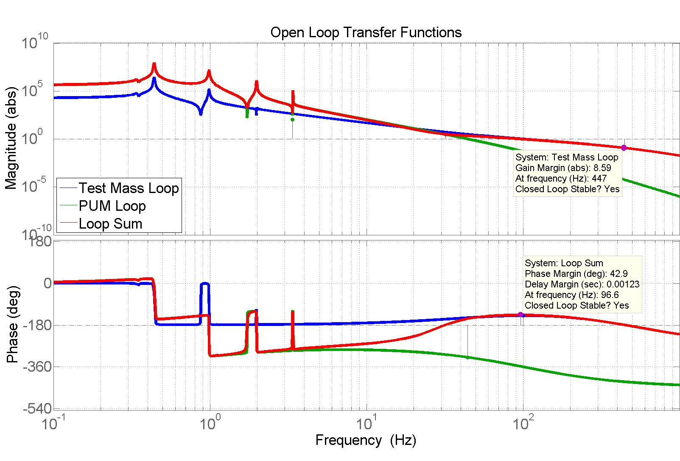
Example Loop Gain of Cavity Control
Cross over frequencies

Slide 42
SUS SVN
T1100117-File_Directory Naming Convention

Slide 43
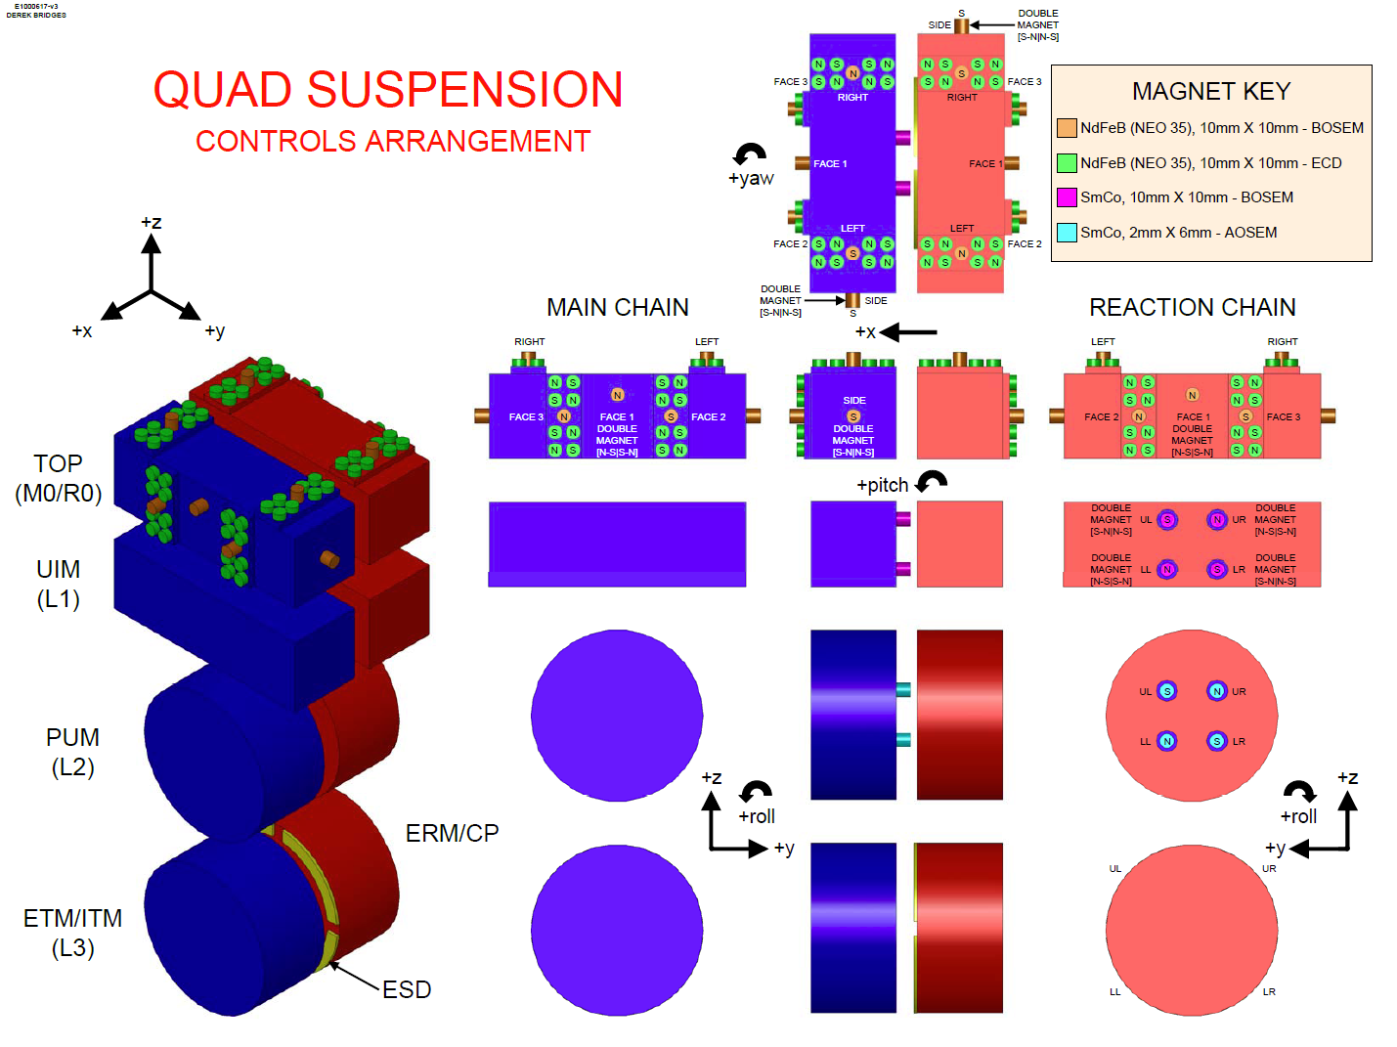
E1000617-v3

