Slide 1
So far…
Signals to sequences
Convolution $y(n)$ between sequences $a(n)$ and $b(n)$ is defined as
$$y\left(n\right)=\sum_{k=−∞}^{∞}{a\left(k\right)} b\left(n−k\right)$$
or
$$y\left(n\right)=a\left(n\right)⋆b\left(n\right)$$
Correlation $r_{x,y}\left(l\right)$ between two sequences $x(n)$ and $y(n)$
$$r_{x,y}\left(l\right)=x(l)⋆y(−l)$$
Impulse response of a system $h(n)$
Where $h\left(n\right)$ is the unit sample or impulse response of the LTI system
System is stable if
$$\sum_{−∞}^{+∞}{\left|h(n)\right|<∞}$$
In general, the response sequence $y(n)$ to the input sequence $x(n)$ can be re-written as
$$y\left(n\right)=\sum_{k=−∞}^{∞}{x\left(k\right)} h\left(n−k\right)=x\left(n\right)⋆h\left(n\right)$$

Slide 2
So far…
Differential to difference equations
$$y\left(t\right)=\frac{dx(t)}{dt} → y(n)=x(n)−x(n−1)$$
General form of a difference equation
$$\sum_{k=0}^{N}{a_{k} y\left(n−k\right)=\sum_{m=0}^{M}{b_{m}x\left(n−m\right)}}$$
MATLAB’s filter command to numerically solve difference equations:
>> y = filter(b, a, x)
In particular the impulse response $h(n)$ of a system can be found
>> h = filter(b, a, delta)

Slide 3
Digital Signal Processing 2
In the analog domain, the Laplace transform L
Relates time-functions to frequency-dependent functions
For the digital domain, the Z transform
Relates time-sequences to (a different, but related type of) frequency-dependent function

Slide 4
The Z Transform
This discrete-time equivalent of the Laplace transform is defined as
$$X\left(z\right)=\text{Z}\left[x\left(n\right)\right]=\sum_{n=−∞}^{∞}{x\left(n\right) z^{−n}}$$
$$x\left(n\right)={\text{Z}}^{−1}\left[X\left(z\right)\right]=\frac{1}{2πj}\oint{X\left(z\right)} z^{n−1}dz$$
where $z=\left|z\right|e^{jω}$ is the complex frequency.
The values of $z$ for which the sum converges define a region in the $z$-plane referred to as the region of convergence (ROC).

Slide 5
Region of convergence (ROC)
The set of z values for which $X\left(z\right)$ exists is called the region of convergence (ROC)
$$R_{x−}<\left|z\right|<R_{x+}$$
ROC
$$\text{Im}\left(z\right)$$
$$R_{x+}$$
$$\text{Re}\left(z\right)$$
$$R_{x−}$$

Slide 6
The Z Transform
This transformation is useful in
Solving constant coefficient difference equations
Evaluating the response of an LTI system to a given input, and
Designing linear filters

Slide 7
Example
Geometric series:
$$\sum_{n=0}^{∞}{∝^{n}}=\frac{1}{1−∝} \text{if} \left|∝\right|<1$$
Let $x\left(n\right)=1 \text{for} n=0,1,2…$ .
Find its Z transform and its ROC.
$$X\left(z\right)=\sum_{n=0}^{∞}{x\left(n\right) z^{−n}}=\sum_{n=0}^{∞}{z^{−n}}=1+z^{−1}+z^{−2}+…=\frac{1}{1−z^{−1}}$$
$\text{if} \left|z^{−1}\right|<1$ or $\left|z\right|>1$
$$X\left(z\right)=\frac{z}{z−1}$$
$$\text{Im}\left(z\right)$$
ROC
Transfer function: zero at the origin, pole at 1
$$\text{Re}\left(z\right)$$
$$\left|z\right|=1$$

Slide 8
Example
Let $x\left(n\right)=2^{n} \text{for} n=0,1,2…$ Find its Z transform and its ROC.
$$X\left(z\right)=\sum_{n=0}^{∞}{x\left(n\right) z^{−n}}=\sum_{n=0}^{∞}{{2^{n} z}^{−n}}=1+2 z^{−1}+4 z^{−2}+…=\frac{1}{1−2 z^{−1}}$$
$\text{if} \left|2 z^{−1}\right|<1$ or $\left|z\right|>2$
$$X\left(z\right)=\frac{z}{z−2}$$
$$\text{Im}\left(z\right)$$
ROC
Transfer function: zero at the origin, pole at 2
$$\text{Re}\left(z\right)$$
$$\left|z\right|=2$$

Slide 9
Example
Let $x_{1}\left(n\right)=a^{n} u\left(n\right), 0<\left|a\right|<∞$. Find its Z transform and its ROC.
$$X_{1}\left(z\right)=\sum_{0}^{∞}{a^{n} z^{−n}=\sum_{0}^{∞}{{\left(\frac{a}{z}\right)}^{n}}}=\frac{1}{1−az^{−1}}$$
$$\text{if} \left|\frac{a}{z}\right|<1$$
$$X_{1}\left(z\right)=\frac{z}{z−a}$$
Pole at $z=a$
Zero at origin
$$\text{Im}\left(z\right)$$
$$a$$
$$×$$
o
$$\text{Re}\left(z\right)$$

Slide 10
In general
Many of the signals in DSP have Z transforms that are rational (ratio of two polynomials) functions of $z^{−1}$:
$$X\left(z\right)=\frac{b_{0}+b_{1}z^{−1}+…+b_{M}z^{−M}}{a_{0}+a_{1}z^{−1}+…+a_{N}z^{−N}}=C\frac{\prod_{l=1}^{N}{\left(z−z_{l}\right)}}{\prod_{k=1}^{N}{\left(z−p_{k}\right)}}$$
where $p_{k}$ is the k-th pole and $z_{l}$ is the l-th zero of $X\left(z\right)$. Each pole is indicated by an ”x” and each zero by an “o” in the $z$-plane.

Slide 11
Special properties of the Z Transform
Convolution
Given two sequences $x_{1}\left(n\right)$ and $x_{2}\left(n\right)$, their time-domain convolution becomes a multiplication process in the frequency domain
$$\text{Z}\left[x_{1}\left(n\right)∗x_{2}\left(n\right)\right]=X_{1}\left(z\right)∙X_{2}\left(z\right)$$
Sample shifting
$$\text{Z}\left[x\left(n−n_{0}\right)\right]=z^{−n_{0}}X\left(z\right)$$

Slide 12
(Some) Z Transform pairs
$$x\left(n\right)$$ | $$X(z)$$ | ROC
$$δ\left(n\right)$$ | $$1$$ | Any z
$$u\left(n\right)$$ | $$\frac{1}{1−z^{−1}}$$ | $$\left|z\right|>1$$
$$a^{n} u\left(n\right)$$ | $$\frac{1}{1−{a z}^{−1}}$$ | $$\left|z\right|>\left|a\right|$$
$$n a^{n} u\left(n\right)$$ | $$\frac{a z^{−1}}{{\left(1−{a z}^{−1}\right)}^{2}}$$ | $$\left|z\right|>\left|a\right|$$

Slide 13
And back to sequences: The Inverse Z Transform
Just like in the Laplace domain
Use the partial fraction method to reduce a complex $X(z)$ to simpler parts.
Use the table of transform pairs to determine the sequence.
In general
$$X\left(z\right)=\frac{b_{0}+b_{1}z^{−1}+…+b_{M}z^{−M}}{a_{0}+a_{1}z^{−1}+…+a_{N}z^{−N}}=\sum_{k=1}^{N}{\frac{R_{k}}{1−p_{k}z^{−1}}}+\sum_{k=0}^{M−N}{C_{k} z^{−k}}$$
If $M≥N$

Slide 14
Example
Compute the inverse Z-transform of
$$X\left(z\right)=\frac{z}{3 z^{2}−4 z+1}, \left|z\right|>1$$
Sol:
Re-write $X\left(z\right)$ in terms of powers of $z^{−1}$.
$$X\left(z\right)=\frac{z^{−1}}{3−4 z^{−1}+z^{−2}}$$
At the MATLAB prompt
>> b=[0 1];a=[3 -4 1];
>> [R,p,C]=residuez(b,a)
R =
0.5000
-0.5000
p =
1.0000
0.3333
C =
[]
$$X\left(z\right)=\frac{1/2}{1−z^{−1}}−\frac{1/2}{1−\frac{1}{3}z^{−1}}$$
Using the table of transform pairs
$$x\left(n\right)=\frac{1}{2} u\left(n\right)−\frac{1}{2}{\left(\frac{1}{3}\right)}^{n}u(n)$$

Slide 15
Example
Compute the inverse Z-transform of
$$X\left(z\right)=\frac{1}{{\left(1−0.9 z^{−1}\right)}^{2}\left(1+0.9 z^{−1}\right)}, \left|z\right|>0.9$$
Sol:
Using MATLAB to do the partial fraction
>> b = 1; a = poly([0.9, 0.9, -0.9])
a =
1.0000 -0.9000 -0.8100 0.7290
$$X\left(z\right)=\frac{1}{1+0.9 z^{−1}−0.81 z^{−2}+0.729 z^{−3}}$$

Slide 16
Example
>> [R,p,C]=residuez(b,a)
R =
0.2500
0.2500 + 0.0000i
0.5000 - 0.0000i
p =
-0.9000
0.9000 + 0.0000i
0.9000 - 0.0000i
C =
[]

Slide 17
Example
Sample shifting
$$X\left(z\right)=\frac{0.25}{1−0.9 z^{−1}}+\frac{0.5}{{\left(1−0.9 z^{−1}\right)}^{2}}+\frac{0.25}{1+0.9 z^{−1}}=\frac{0.25}{1−0.9 z^{−1}}+\frac{0.5}{0.9}z\frac{\left(0.9 z^{−1}\right)}{{\left(1−0.9 z^{−1}\right)}^{2}}+\frac{0.25}{1+0.9 z^{−1}}$$
Using the Z Transform pair table
$$x\left(n\right)=0.25∙{0.9}^{n}∙u\left(n\right)+$$
$$\frac{0.5}{0.9}∙\left(n+1\right)∙{0.9}^{\left(n+1\right)}∙u\left(n+1\right)+$$
$$0.25∙{\left(−0.9\right)}^{n}∙u\left(n\right)$$

Slide 18
Exercise
Determine the Z-transform of the impulse response
$h\left(n\right)=2 δ\left(n−2\right)+3 u(n−3)$

Slide 19
Exercise
Determine the Z-transform of the impulse response
$h\left(n\right)=2 δ\left(n−2\right)+3 u(n−3)$
Sol:
$$\text{Z}\left[h(n)\right]=2\text{Z}\left[δ\left(n−2\right)\right]+3\text{Z}\left[u(n−3)\right]$$
Using the sample shift property
$$\text{Z}\left[h(n)\right]=2 z^{−2}\text{Z}\left[δ\left(n\right)\right]+3 z^{−3}\text{Z}\left[u(n)\right]$$
$$H\left(z\right)=2 z^{−2}+3 z^{−3}\frac{1}{1−z^{−1}}$$
$$H\left(z\right)=\frac{2 z^{−2}−2 z^{−3}+3z^{−3}}{1−z^{−1}}$$

Slide 20
System function $H(z)$
The system function $H(z)$ is simply the Z transform of the impulse response of the system
$$H\left(z\right)=\text{Z}\left[h(n)\right]=\sum_{−∞}^{+∞}{h\left(n\right)z^{−n}}$$
This means that, given input $X\left(z\right)$ the output $Y\left(z\right)$ is
$$Y\left(z\right)=H\left(z\right)X(z)$$

Slide 21
System function $H(z)$ from a difference equation
When an LTI system is represented by the difference equation
$$y\left(n\right)+\sum_{k=1}^{N}{a_{k} y\left(n−k\right)=\sum_{l=0}^{M}{b_{l} x\left(n−l\right)}}$$
it can be shown that
$$H\left(z\right)=\frac{\sum_{l=0}^{M}{b_{l}} z^{−l}}{1+\sum_{k=1}^{N}{a_{k}} z^{−k}}$$
where $a_{0}=1$

Slide 22
System function $H(z)$ and MATLAB implementation
The MATLAB implementation, given
$$H\left(z\right)=\frac{\sum_{l=0}^{M}{b_{l}} z^{−l}}{1+\sum_{k=1}^{N}{a_{k}} z^{−k}}$$
The impulse response $h(n)$ is simply
>> h = filter(b, a, delta)
While the response $y(n)$ to input $x(n)$ is
>> y = filter(b, a, x)

Slide 23
For example
Given the LTI system represented by the difference equation, the determine the impulse response $h(n)$.
$$y\left(n\right)=0.9 y\left(n−1\right)+x\left(n\right)$$
Sol: let’s find the system function $H(z)$ first.
$$y\left(n\right)−0.9 y\left(n−1\right)=x(n)$$
Taking the Z transform
$$\text{Z}\left[y(n)\right]−0.9\text{Z}\left[y\left(n−1\right)\right]=\text{Z}\left[x(n)\right]$$
$$Y\left(z\right)−0.9 z^{−1} Y\left(z\right)=X(z)$$

Slide 24
$$H\left(z\right)=\frac{Y(z)}{X(z)}=\frac{1}{1−0.9 z^{−1}}$$
Taking the inverse transform
$$h\left(n\right)={\text{Z}}^{−1}\left[H(z)\right]={0.9}^{n} u(n)$$
Let’s verify with MATLAB
>> b = [1]; a = [1 -0.9];
>> h = filter(b,a,delta);
and lets plot the two responses.

Slide 25
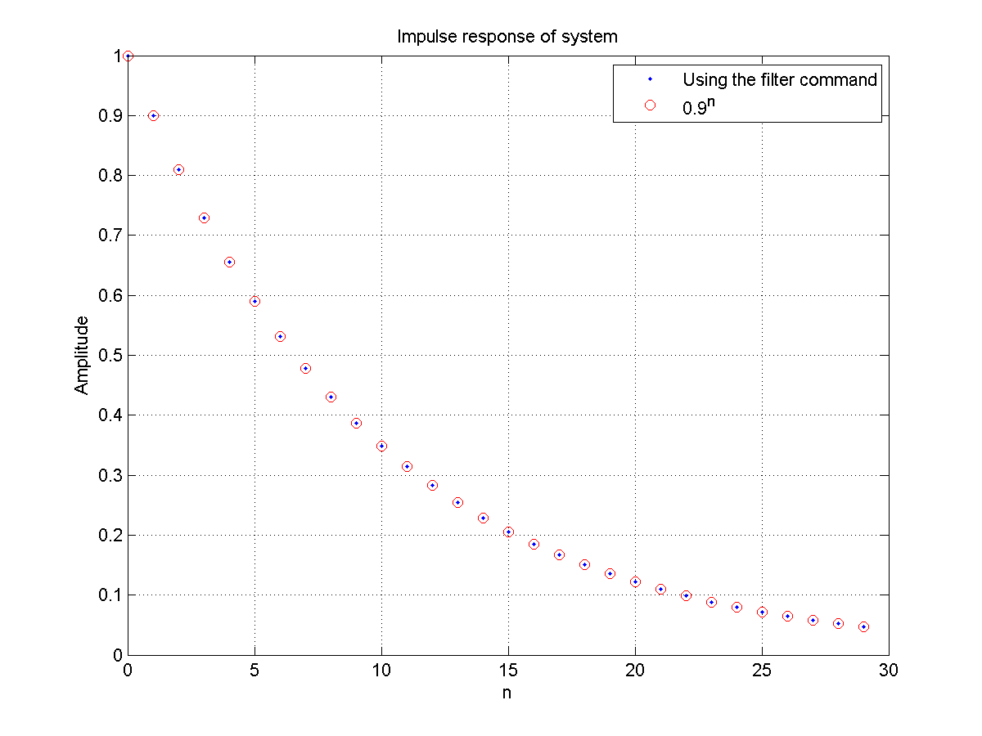
ex411.m

Slide 26
To recap
The Z transform is the digital equivalent of the Laplace transform:
It facilitates the solving of constant coefficient difference equations
It allows to easily evaluate the system’s response
It is critical in designing linear filters
MATLAB commands used
filter, residuez

Slide 27
A different transform: DTFT $\text{F}$
A very different but very useful representation of a sequence or system is the Discrete-time Fourier Transform (DTFT)
Setting $\left|z\right|=1$ in the $\text{Z}$-transform
$$X\left(z\right)=\text{Z}\left[x\left(n\right)\right]=\sum_{n=−∞}^{∞}{x\left(n\right) z^{−n}}$$
$$x\left(n\right)={\text{Z}}^{−1}\left[X\left(z\right)\right]=\frac{1}{2πj}\oint{X\left(z\right)} z^{n−1}dz$$
where $z=\left|z\right|e^{jω}$ is the complex frequency.

Slide 28
A different transform: DTFT $\text{F}$
The DTFT of sequence $x(n)$ is defined as
$$X\left(e^{jω}\right)=\text{F}\left[x\left(n\right)\right]=\sum_{n=−∞}^{∞}{x\left(n\right) e^{−jωn}}$$
$$x\left(n\right)={\text{F}}^{−1}\left[X\left(e^{jω}\right)\right]=\frac{1}{2π}\int_{−π}^{+π}{X\left(e^{jω}\right)}e^{jωn}dω$$
where
$X\left(e^{jω}\right)$ is a complex valued function
$ω$ is a digital frequency ranging from $−π$ to $+π$

Slide 29
Special property of the DTFT
Just like the Z transform
Convolution
Given two sequences $x_{1}\left(n\right)$ and $x_{2}\left(n\right)$, their convolution is a multiplication process in the frequency domain
$$\text{F}\left[x_{1}\left(n\right)∗x_{2}\left(n\right)\right]=\text{F}\left[x_{1}\left(n\right)\right] ∙\text{F}\left[x_{2}\left(n\right)\right]=X_{1}\left(e^{jω}\right)∙X_{2}\left(e^{jω}\right)$$

Slide 30
Frequency domain representation of LTI systems
The DTFT of the unit sample response is called the Frequency Response or Transfer Function of an LTI system
$$H\left(e^{jω}\right)=\sum_{n=−∞}^{∞}{h\left(n\right) e^{−jωn}}$$

Slide 31
Frequency response from difference equations
When an LTI system is represented by the difference equation
$$y\left(n\right)+\sum_{l=1}^{N}{a_{l} y\left(n−l\right)=\sum_{m=0}^{M}{b_{m} x\left(n−m\right)}}$$
Then
$$H\left(e^{jω}\right)=\frac{\sum_{m=0}^{M}{b_{m}e^{−jωm}}}{1+\sum_{l=1}^{N}{a_{l}e^{−jωl}}}$$

Slide 32
Example
Given difference equation
$$y\left(n\right)=0.8 y\left(n−1\right)+x\left(n\right)$$
determine transfer function $H\left(e^{jω}\right)$ and plot its magnitude and phase

Slide 33
Example
$$y\left(n\right)=0.8 y\left(n−1\right)+x\left(n\right)$$
$$a_{0}=1, a_{1}=−0.8, b_{0}=1$$
$$H\left(e^{jω}\right)=\frac{1}{1−0.8e^{−jω}}$$

Slide 34
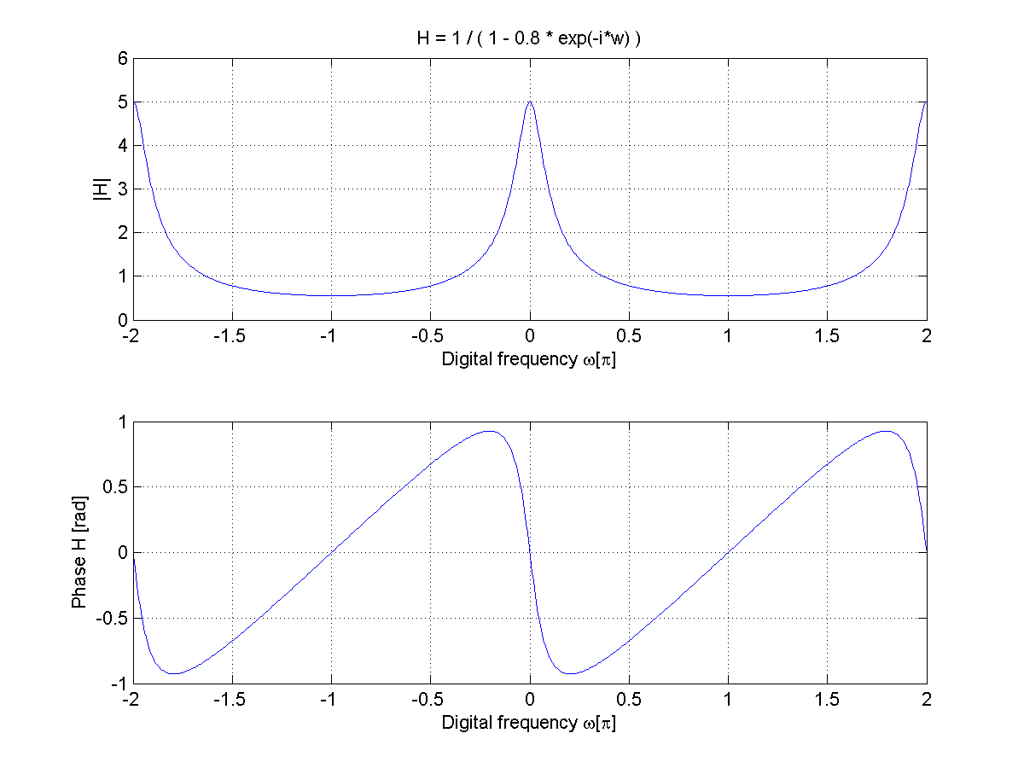
dtft_example3.m
>> w=linspace(-2*pi,2*pi,800);
>> H=1./(1-0.8*exp(-1i*w) );
>> plot(w/pi, abs(H))
>> plot(w/pi,phase(H))

Slide 35
Example 3.16
A 3rd order low pass filter is described by the difference equation
$$y\left(n\right)=0.0181 x\left(n\right)+0.0543 x\left(n−1\right)+0.0543 x\left(n−2\right)+0.0181 x\left(n−3\right)+1.76 y\left(n−1\right)−1.1829 y\left(n−2\right)+0.2781 y\left(n−3\right)$$
Plot the magnitude and the phase response of this filter and verify that it is a low pass filter.

Slide 36
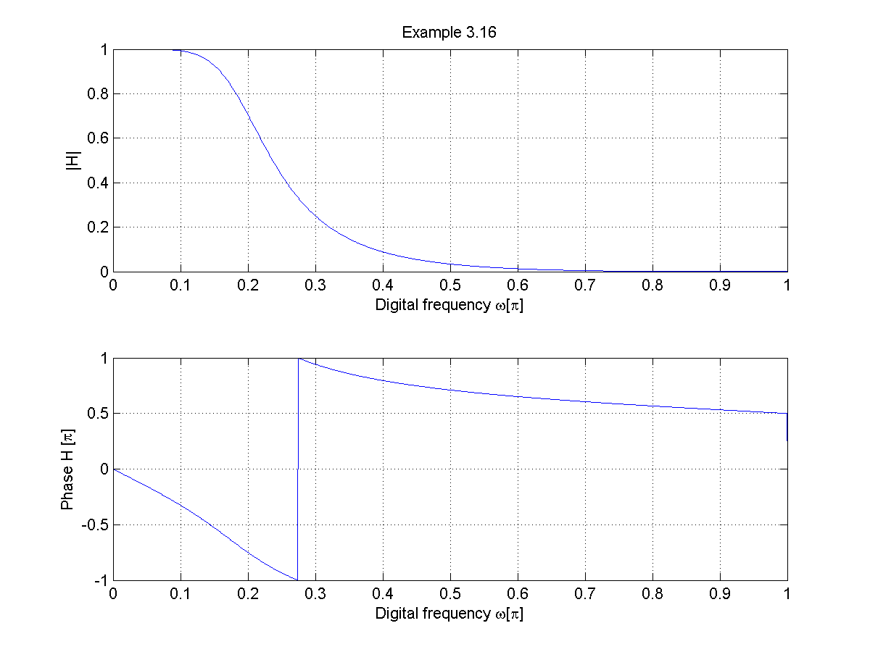
>> b=[0.0181, 0.0543, 0.0543, 0.0181];
>> a=[1.0, -1.76, 1.1829, -0.2781];
>> w=linspace(-2*pi, 2*pi, 1000);
>> num=b * exp(-1i*m'*w);
>> den=a * exp(-1i*l'*w);
>> H=num ./ den;
>> plot(w/pi, abs(H))
>> plot(w/pi,phase(H))
dtft_example316.m

Slide 37
Example 4.13
An LTI system is described by the following difference equation
$$y\left(n\right)=0.81 y\left(n−2\right)+x\left(n\right)−x(n−2)$$
Plot the magnitude and the phase response of this filter.

Slide 38
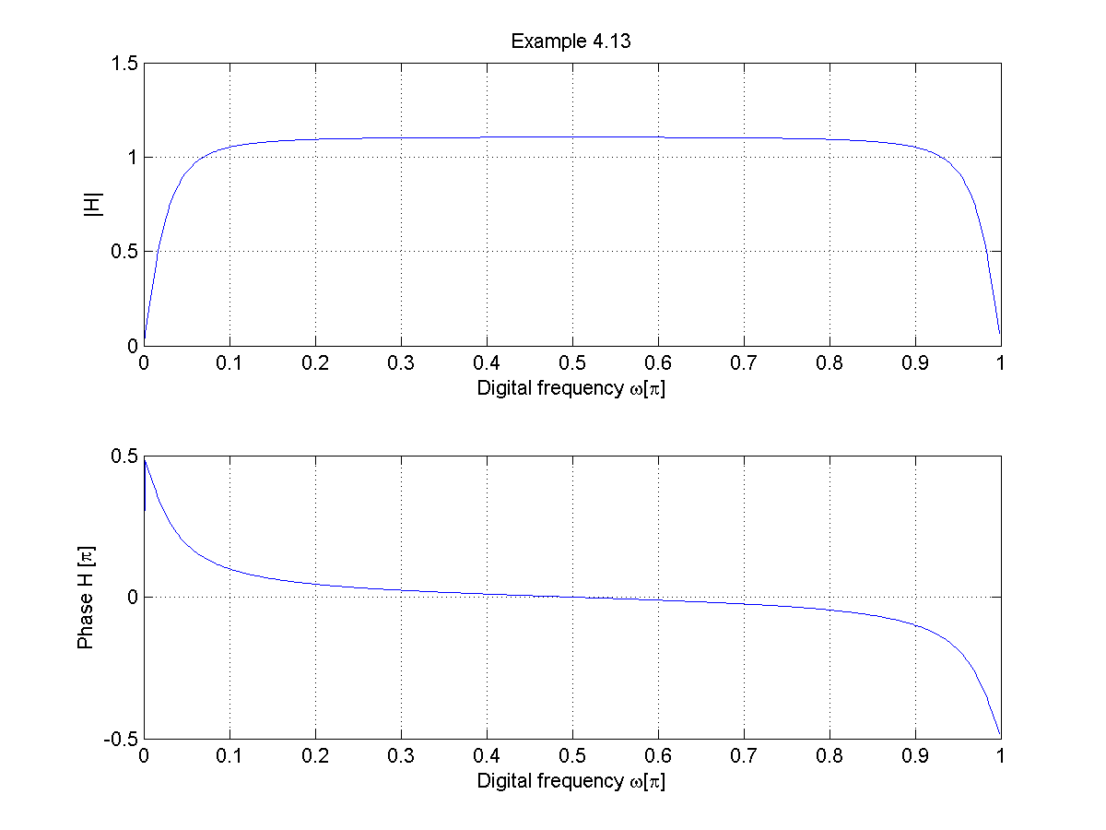
>> a = [1 0 -0.81];
>> b = [1 0 -1];
>> [H,w]=freqz(b,a,500);
>> plot(w/pi, abs(H))
>> plot(w/pi, phase(H))
dtft_example413.m

Slide 39
Another transform: The Discrete Fourier Transform (DFT)
The FFT falls into this category
Why more transforms? What is the problem?
The DTFT and the $\text{Z}$transform are not numerically computable transforms
They have infinite sums at uncountably infinite frequencies
The Discrete Fourier Transform (DFT)
Obtained by sampling the Discrete-Time Fourier Transform (DTFT) in the frequency domain
“the DFT is just equally-spaced samples of the DTFT”
Time-consuming numerical computation
Fast-Fourier Transform
Algorithm for the efficient computation of DFTs

Slide 40
Example: highlighting the difference between the DTFT and DFT
Let
$$x\left(n\right)=1 \text{for} 0≤n≤8$$
The corresponding DTFT is
$$X\left(e^{jω}\right)=\frac{\sin\left({ωM}/2\right)}{\sin\left(ω/2\right)} e^{−jω\left(M−1\right)/2}$$

Slide 41
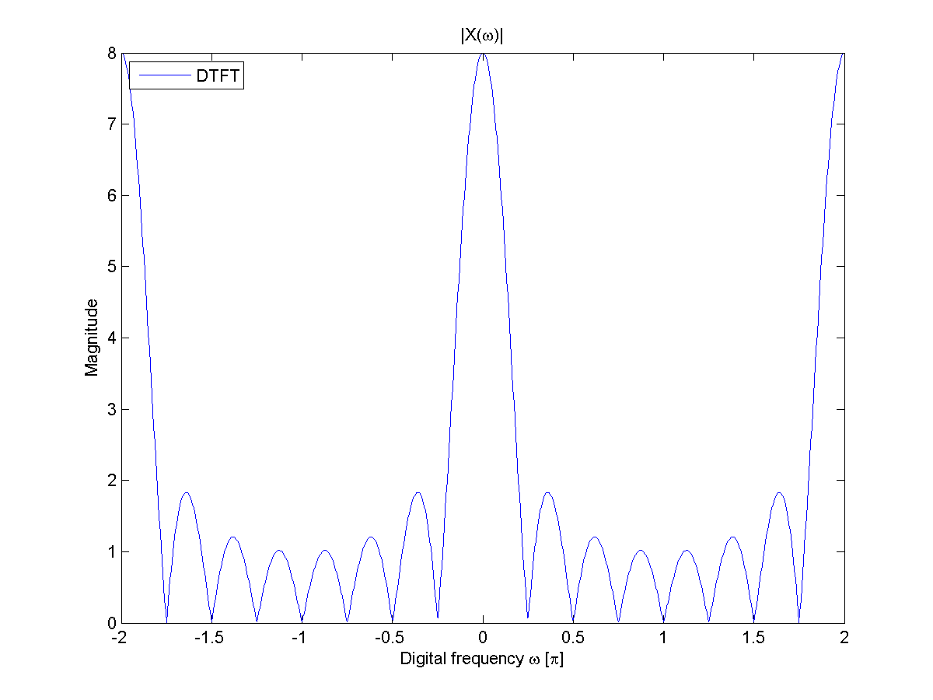
$X\left(e^{jω}\right)=\frac{\sin\left({ωM}/2\right)}{\sin\left(ω/2\right)} e^{−jω\left(M−1\right)/2}$ with M=8
dtft_example.m

Slide 42
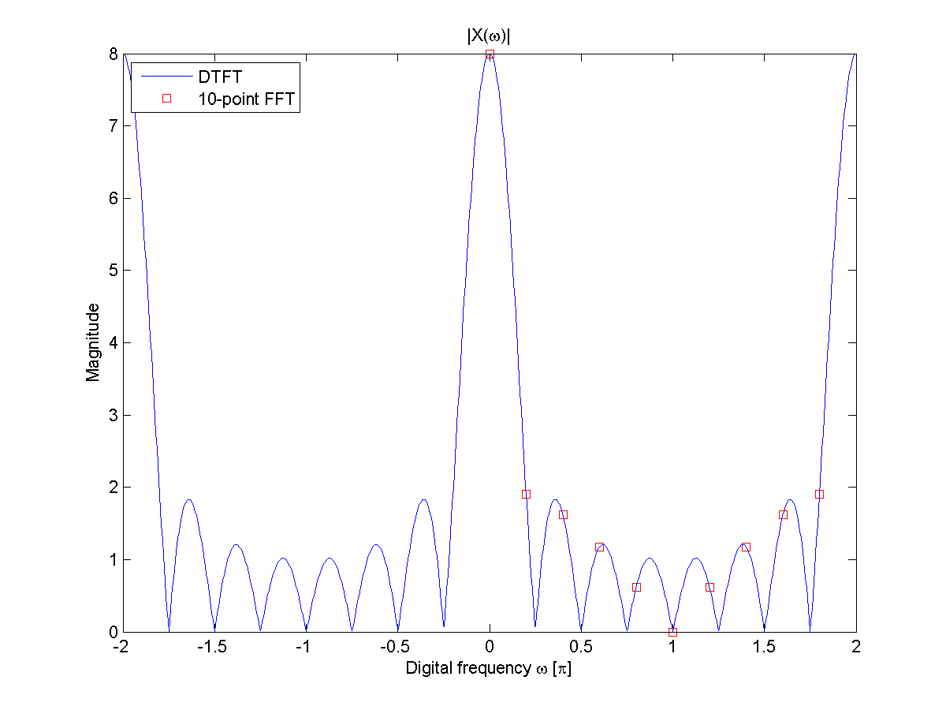
>> P=10;
>> wk=(0:P-1) * (2*pi/P);
>> Xfft =fft(x, P);
>> plot(wk/pi, mag(Xfft),’rs’)
$X\left(e^{jω}\right)=\frac{\sin\left({ωM}/2\right)}{\sin\left(ω/2\right)} e^{−jω\left(M−1\right)/2}$ with M=8
dtft_example.m

Slide 43
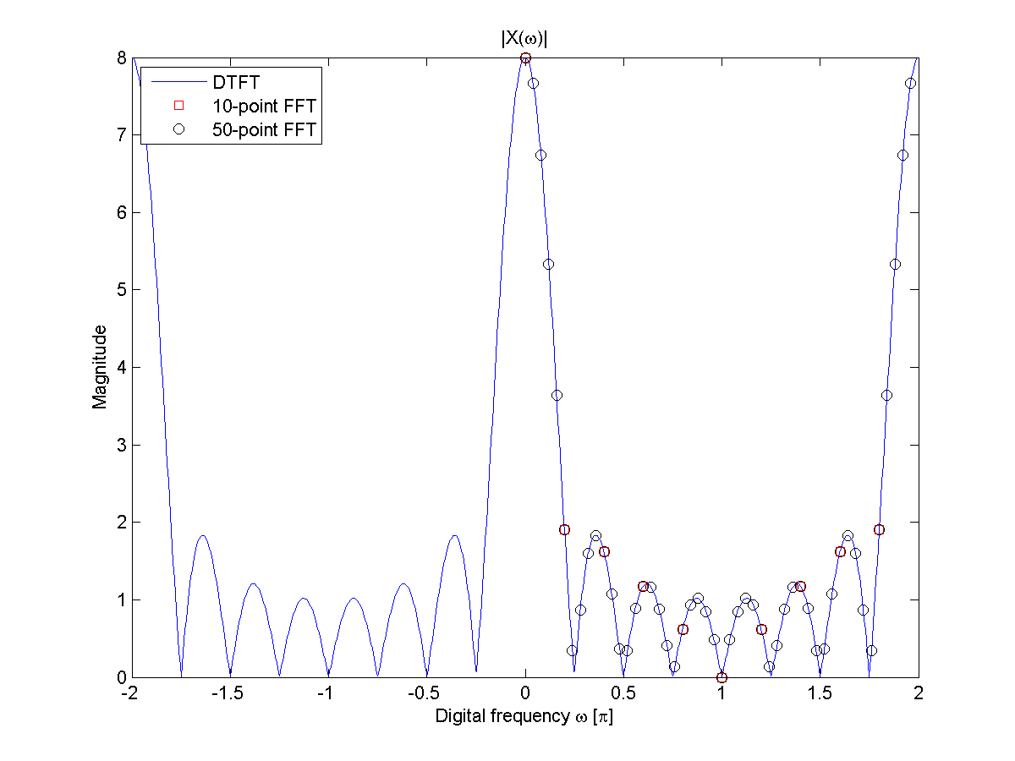
>> P=50;
>> wk=(0:P-1) * (2*pi/P);
>> Xfft =fft(x, P);
>> plot(wk/pi, mag(Xfft),’rs’)
$X\left(e^{jω}\right)=\frac{\sin\left({ωM}/2\right)}{\sin\left(ω/2\right)} e^{−jω\left(M−1\right)/2}$ with M=8
The DFT is just the DTFT at discrete frequency intervals
dtft_example.m

Slide 44
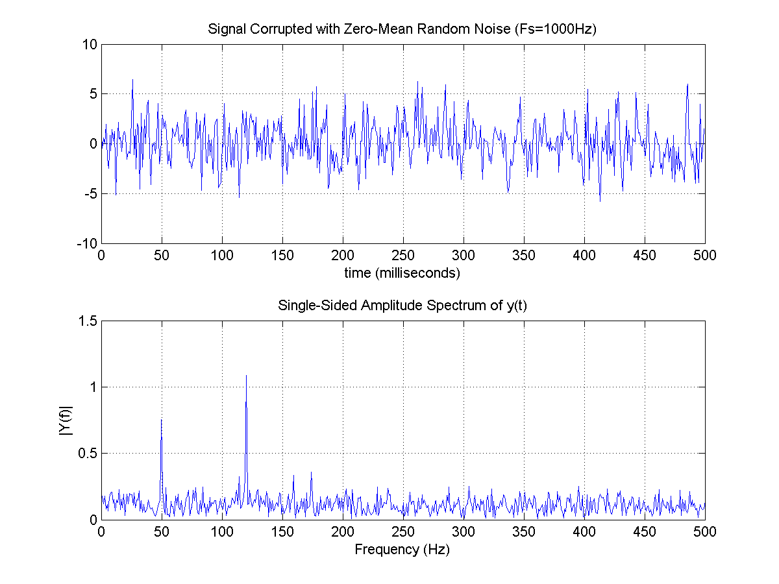
Lines at 50 Hz and 120 Hz, contaminated by noise.
dtft_example.m
Advantage of the FFT signal representation: the lines at 50 Hz and 120 Hz are not visible in the time domain representation, but are clear in the FFT representation.

Slide 45
Power Spectral Density
A graphical representation to easily determine the power of a signal over a particular frequency band.
Uses the fft algorithm
Unfortunately there are many conventions for the normalization, can be confusing…
Let’s use the example of a cosine at 200 Hz
spectraldensity_example.m

Slide 46
Power Spectral Density (PSD)
In this example, power is computed using
w=hamming(length(x))
[Pxx,f]=periodogram(x,wi,'onesided',NFFT,Fs)
Data windowing
In the fft process, power in one frequency bin “leaks” to nearby bins.
Filter (with a window filter) the input data stream
The RMS of a sinusiod: $1/\sqrt{2}$
The (running) RMS computed using the PSD (and shown in red)
$$RMS=\sqrt{\sum{P_{xx}}∙∆f}$$
The computed RMS agrees with the theoretical $1/\sqrt{2}$
spectraldensity_example.m

Slide 47
Amplitude Spectral Density (ASD)
Plotting the amplitude:
simply the square root of the power spectral density $\sqrt{P_{xx}}$
spectraldensity_example.m

Slide 48
Finally – the question on sampling
The Discrete-time Fourier Transform (DTFT) was defined as
$$X\left(e^{jω}\right)=\sum_{n=−∞}^{∞}{x\left(n\right) e^{−jωn}}$$
where digital frequency $ω$
$$ω=s T_{s}=2πf∙T_{s}$$
and sampling frequency $F_{s}$
$$F_{s}=\frac{1}{T_{s}}$$

Slide 49
Finally – the question about sampling
The Discrete-time Fourier Transform (DTFT) is defined as
$$X\left(e^{jω}\right)=\sum_{n=−∞}^{∞}{x\left(n\right) e^{−jωn}}$$
where $ω$ is the digital frequency.
If you inspect previous plots of DTFTs, you notice a periodicity of $2π$.

Slide 50
Finally – the question about sampling
The $x(n)$ sequence represents a continuous-time signal $x_{a}(t)$ sampled every $T_{s}$ seconds:
$$x\left(n\right)=x_{a}(nT_{s})$$
where the digital frequency $ω$ is
$$ω=2π f T_{s}$$
and $f$ is frequency in $Hz$.
Defining the sampling frequency $F_{s}=1/T_{s}$, the periodicity is
$$ω=2π f T_{s}=2π$$
$$→f=F_{s}$$
The signal repeats every $F_{s}$ Hz.
$F_{s}/2$ is defined as the Nyquist frequency.

Slide 51
$$F_{0}=0 \text{Hz}≪{F_{s}}/2$$
$$F_{0}=1 \text{Hz}<{F_{s}}/2$$
$$F_{0}=3 \text{Hz}<{F_{s}}/2$$
$$F_{0}=15 \text{Hz}>{F_{s}}/2$$
Aliasing

Slide 52
Sampling Principle
A band-limited signal $x_{a}\left(t\right)$ with bandwidth $F_{0}$ can be reconstructed from its sample values $x\left(n\right)=x_{a}\left(n T_{s}\right)$ if the bandwidth $F_{0}$ is less than the Nyquist frequency $F_{n}=F_{s}/2$
$$F_{0}<F_{n}$$
Otherwise aliasing (or distortion) would result in the reconstruction of $x_{a}\left(t\right)$.

Slide 53
Effect of sampling
$$x_{a}(t)$$
Continuous-time Fourier Transform (CTFT)
$$X_{a}(jΩ)$$
$$Ω$$
$$t(s)$$
Bandwidth
$$F_{0}$$
Sample
$$F_{0}<F_{n}=\frac{F_{s}}{2}$$
$$x(n)$$
Discrete-time Fourier Transform (DTFT)
$$X(e^{jω})$$
$$T_{s}$$
$$ω$$
$$n$$
$$−2π$$
$$−π$$
$$π$$
$$2π$$
Bandwidth

Slide 54
Effect of sampling
$$x_{a}(t)$$
Continuous-time Fourier Transform (CTFT)
$$X_{a}(jΩ)$$
$$Ω$$
$$t(s)$$
Bandwidth
$$F_{0}$$
Sample
$$F_{0}{>F}_{n}=\frac{F_{s}}{2}$$
Aliasing
$$x(n)$$
Discrete-time Fourier Transform (DTFT)
$$X(e^{jω})$$
$$T_{s}$$
$$ω$$
$$n$$
$$−2π$$
$$−π$$
$$π$$
$$2π$$
Bandwidth

Slide 55
Let’s simulate aliasing
Suppose having an analog signal of the form
$$x_{a}\left(t\right)=e^{−1000 \left|t\right|}$$
Its Fourier transform is
$$X_{a}\left(f\right)=\int_{−∞}^{+∞}{x_{a}}\left(t\right)e^{−i2πft}dt=\frac{0.002}{1+{\left(\frac{2πf}{1000}\right)}^{2}}$$

Slide 56
Aliasing
Plot of $x_{a}(t)$ vs. time
For $t>5ms$ and $t<−5ms$
No significant energy left
Let’s set $x_{a}=0$
aliasing_example.m

Slide 57
Aliasing
Plot of $X_{a}(f)$ vs. frequency
For $f>2 \text{kHz}$
No significant energy left
Set $X_{a}=0$
Reasonable to set the signal’s bandwidth to
$$F_{0}=2 \text{kHz}$$
To avoid aliasing the sampling frequency $F_{s}$ must satisfy
$$F_{0}<\frac{F_{s}}{2}$$
$$F_{s}>2 F_{0}=4 \text{kHz}$$
aliasing_example.m

Slide 58
Aliasing
Plot of $x_{a}$ vs. time along with a sampled sequence ($F_{s}=5$ kHz)
According to the sampling principle
$$F_{s}=5 kHz>2 F_{0}=4 \text{kHz}$$
Should not have aliasing…
aliasing_example.m

Slide 59
Plot of $X_{a}(f)$ vs. frequency $f$
Plot of DFT
No aliasing is visible
aliasing_example.m

Slide 60
Aliasing
Plot of $x_{a}$ vs. time along with a sampled sequence ($F_{s}=1$ kHz)
According to the sampling principle
$$F_{s}=1 kHz≯2 F_{0}=4 \text{kHz}$$
Should have aliasing…
aliasing_example.m

Slide 61
Plot of $X_{a}$ vs. frequency $f$ along with the computed DFT
Aliasing is visible
aliasing_example.m

Slide 62
Recap
The Discrete-time Fourier Transform (DTFT)
A very different but very useful representation of a sequence or system
Mapping into frequency space
$z=e^{jω}$ in the $\text{Z}$ transform
The Discrete Fourier Transform (DFT)
Obtained by sampling the DTFT in the frequency domain
FFT: Fast Fourier Transform
Algorithm for the efficient computation of DFTs
Power Spectral Density
power of a signal over a particular frequency band.
Sampling principle
The signal’s bandwidth $F_{0}$ must be less than the Nyquist frequency $F_{n}=F_{s}/2$ in order to avoid aliasing
Modeling Aliasing

