Slide 1
To recap
Control theory builds on differential equations
The Laplace transform is a tool to facilitate solving for ODEs.
No need to do actually do the transform
Lookup tables
System G(s) is stable if
Its response is bounded and finite
poles must have negative real parts
Still, how does the cruise control example work?
Getting there…

Slide 2
Recall
What is the transfer function of a system whose input $u$ and output $y$ are related by the following differential equation?
$$\frac{d^{2}y}{dt^{2}}+3\frac{dy}{dt}+2y=u+\frac{du}{dt}$$

Slide 3
Recall
Given the system’s transfer function
$P\left(s\right)=\frac{2 s+1}{s^{2}+s+1}$
determine the system’s differential equation to input $u\left(t\right)$.

Slide 4
Recall
Determine which of the following transfer functions represent stable systems and which represent unstable systems. Use MATLAB’s step to verify your answer.
$P\left(s\right)=\frac{s−1}{\left(s+2\right)\left(s^{2}+4\right)}$
$P\left(s\right)=\frac{s−1}{\left(s+2\right)\left(s+4\right)}$
$P\left(s\right)=\frac{\left(s+2\right)\left(s−2\right)}{\left(s+1\right)\left(s−1\right)\left(s+4\right)}$
$P\left(s\right)=\frac{6}{\left(s^{2}+s+1\right){\left(s+1\right)}^{2}}$
$P\left(s\right)=\frac{5 \left(s+10\right)}{\left(s^{2}−s+10\right)\left(s+5\right)}$

Slide 5
Another example
A simple mechanical accelerometer is shown below. The position y is with respect of the case, the case’s position is x. What is the transfer function between the input acceleration $A (a={d^{2}x}/{dt^{2}})$ and the output Y?
$$−B\frac{dy}{dt}−ky=M \frac{d^{2}}{dt^{2}}\left(y−x\right)$$
y
B
M
k
x

Slide 6
Control Theory 2
The response of a stable system G(s) is characterized by its
Amplitude and Phase shift
to a sinusoidal excitation

Slide 7
Frequency response
It can be shown that if
$$x\left(t\right)=X\sin\left(ωt\right)$$
then
$$y\left(t\right)=\left|G(s)\right|∙X∙\sin\left(ωt+φ\left(s\right)\right)$$
where
$\left|G(s)\right|$ is the amplitude response and
$φ\left(s\right)$ is the phase shift
This is how we measure transfer functions
X$(s)$
$$Y(s)$$
$$G(s)$$

Slide 8
Frequency response
The dynamic behavior of a physical system can be determined by measuring its transfer function with a sinusoidal excitation
Magnitude and phase response are a function of frequency ($s=jω)$
Frequency-response helps to understand the stability criteria

Slide 9
Graphical analysis tool: Bode Plot
Common graphical representation of transfer function $G\left(s\right)$
$G\left(s\right)$is complex
plot of magnitude $\left|G\left(jω\right)\right|$ and phase $\text{∠}G\left(jω\right)$
Convention
Log-log scale for magnitude vs. frequency (Hz)
Semi-log scale for phase (deg) vs. frequency (Hz)
Other conventions
Magnitude in dB ($X\left(dB\right)=20 {\text{log}}_{10}X$) vs. angular frequency (rad/s)

Slide 10
Bode plot: $G\left(s\right)=1/s$
$$G\left(s\right)=\frac{1}{s}$$ | → | $$G\left(jω\right)=\frac{1}{jω}=−j\frac{1}{ω}$$
 |  | $$\left|G\left(jω\right)\right|=GG^{∗}=\frac{1}{ω}$$
 |  | $$\text{∠}G\left(jω\right)=\tan^{−1}\left(\frac{\text{Im}\left(G\right)}{\text{Re}\left(G\right)}\right)=−\frac{π}{2}$$
 |  | $$\left|G\left(jω\right)\right|=\frac{1}{ω}$$ | $$\text{∠}G\left(jω\right)=−\frac{π}{2}$$

Slide 11
$$\text{Bode} \text{plot}\text{: }G\left(s\right)=1/s$$
$$\text{slope}: {−10×}/{\text{decade}}$$
$$=1/f$$
$$\left|G\left(jω\right)\right|=\frac{1}{2πf}$$
$$−10$$
$$1 \text{decade}$$
bodeexamples.m
$$\text{∠}G\left(jω\right)=−\frac{π}{2}$$

Slide 12
Bode plot: $G\left(s\right)=1/{s^{2}}$
$$G\left(s\right)=\frac{1}{s^{2}}$$ | → | $$G\left(jω\right)=\frac{1}{{\left(jω\right)}^{2}}=−\frac{1}{ω^{2}}$$
 |  | $$\left|G\left(jω\right)\right|=GG^{∗}=\frac{1}{ω^{2}}$$
 |  | $$\text{∠}G\left(jω\right)=\tan^{−1}\left(\frac{\text{Im}\left(G\right)}{\text{Re}\left(G\right)}\right)=−π$$
 |  | $$\left|G\left(jω\right)\right|=\frac{1}{ω^{2}}$$ | $$\text{∠}G\left(jω\right)=−π$$

Slide 13
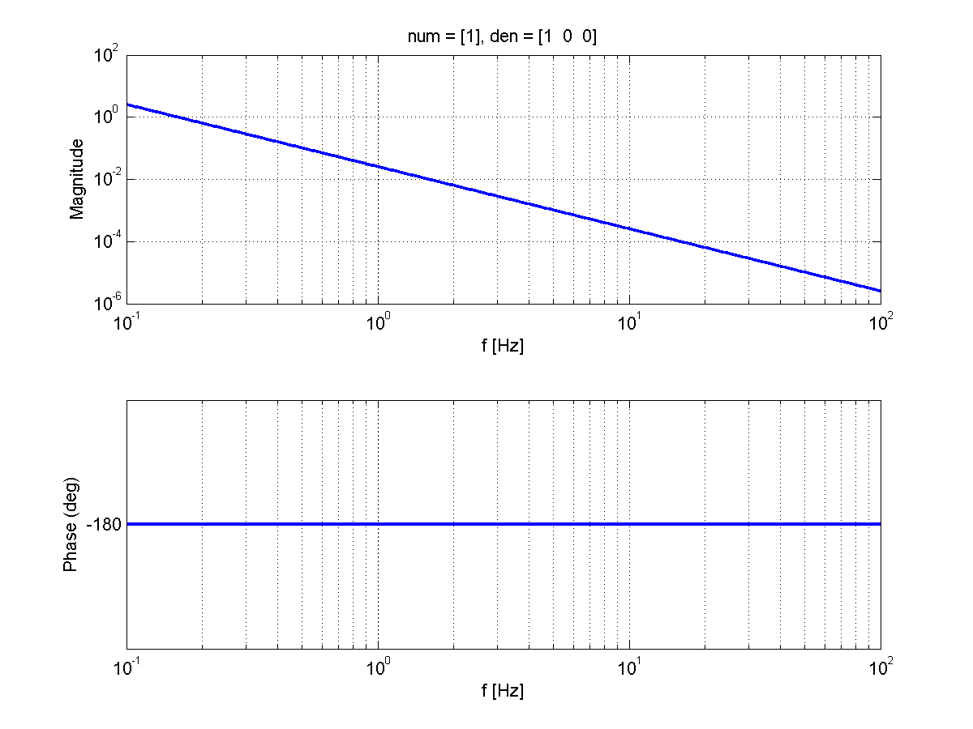
$$\text{Bode} \text{plot}\text{: }G\left(s\right)=1/{s^{2}}$$
$$\left|G\left(jω\right)\right|=1/{{\left(2πf\right)}^{2}}$$
$$\text{slope}: {−100×}/{\text{decade}}=1/f^{2}$$
$$−100$$
$$1 \text{decade}$$
bodeexamples.m
$$\text{∠}G\left(jω\right)=−π$$

Slide 14
Bode plot: $G\left(s\right)=s$
$$G\left(s\right)=s$$ | → | $$G\left(jω\right)=jω$$
 |  | $$\left|G\left(jω\right)\right|=GG^{∗}=ω$$
 |  | $$\text{∠}G\left(jω\right)=\tan^{−1}\left(\frac{\text{Im}\left(G\right)}{\text{Re}\left(G\right)}\right)=\frac{π}{2}$$
 |  | $$\left|G\left(jω\right)\right|=ω$$ | $$\text{∠}G\left(jω\right)=\frac{π}{2}$$

Slide 15
$$\text{Bode} \text{plot}\text{: }G\left(s\right)=s$$
$$\text{slope}: {+10×}/{\text{decade}}=f$$
$$+10$$
$$1 \text{decade}$$
$$\left|G\left(jω\right)\right|=2πf$$
bodeexamples.m
$$\text{∠}G\left(jω\right)=+\frac{π}{2}$$

Slide 16
Bode plot: $G\left(s\right)=s^{2}$
$$G\left(s\right)=s^{2}$$ | → | $$G\left(jω\right)={\left(jω\right)}^{2}=−ω^{2}$$
 |  | $$\left|G\left(jω\right)\right|=GG^{∗}=ω^{2}$$
 |  | $$\text{∠}G\left(jω\right)=\tan^{−1}\left(\frac{\text{Im}\left(G\right)}{\text{Re}\left(G\right)}\right)=+π$$
 |  | $$\left|G\left(jω\right)\right|=ω^{2}$$ | $$\text{∠}G\left(jω\right)=+π$$

Slide 17
$$\text{Bode} \text{plot}\text{: }G\left(s\right)=s^{2}$$
$$\text{slope}: {+100×}/{\text{decade}}=f^{2}$$
$$+100$$
$$1 \text{decade}$$
$$\left|G\left(jω\right)\right|={\left(2πf\right)}^{2}$$
bodeexamples.m
$$\text{∠}G\left(jω\right)=+π$$

Slide 18
Bode plot: $G\left(s\right)=a/{(s+a)}$
$$G\left(s\right)=\frac{a}{s+a}$$ | $$G\left(jω\right)=\frac{a}{jω+a}$$
 | $$\left|G\left(jω\right)\right|=GG^{∗}=\frac{a}{\sqrt{ω^{2}+a^{2}}}$$
 | $$\text{∠}G\left(jω\right)=\tan^{−1}\left(\frac{\text{Im}\left(G\right)}{\text{Re}\left(G\right)}\right)=−\tan^{−1}\left(\frac{ω}{a}\right)$$
 | $$\left|G\left(jω\right)\right|==\frac{a}{\sqrt{ω^{2}+a^{2}}}$$ | $$\text{∠}G\left(jω\right)==−\tan^{−1}\left(\frac{ω}{a}\right)$$

Slide 19
$$\text{Bode} \text{plot}\text{: }G\left(s\right)=a/{(s+a)}$$
$$ω≪a→\left|G\left(jω\right)\right|≈1$$
$$a/{2π}=1 \text{Hz}$$
bodeexamples.m
$$ω≪a→\text{∠}G\left(jω\right)≈0$$

Slide 20
$$\text{Bode} \text{plot}\text{: }G\left(s\right)=a/{(s+a)}$$
$$a/{2π}=1 \text{Hz}$$
$$ω≫a→\left|G\left(jω\right)\right|≈a/ω,$$
$$\text{slope}: {−10×}/{\text{decade}}=1/f$$
bodeexamples.m
$$ω≫a→\text{∠}G\left(jω\right)≈−π/2$$

Slide 21
$$\text{Bode} \text{plot}\text{: }G\left(s\right)=a/{(s+a)}$$
$$a/{2π}=1 \text{Hz}$$
$$ω=a→\left|G\left(jω\right)\right|=1/{\sqrt{2}}$$
bodeexamples.m
$$ω=a→\text{∠}G\left(jω\right)=−π/4$$

Slide 22
Bode plot: SHO
$$G\left(s\right)=\frac{{\left(ω_{0}\right)}^{2}}{(s^{2}+2δω_{0}∙s+{\left(ω_{0}\right)}_{}^{2})}$$
$$\left|G\left(jω\right)\right|=\frac{{\left(ω_{0}\right)}^{2}}{\sqrt{{\left({\left(ω_{0}\right)}^{2}−ω^{2}\right)}^{2}+{\left(2δω_{0}ω\right)}^{2}}}$$
$$\text{∠}G\left(jω\right)={−tan}^{−1}\left(\frac{2δω_{0}ω}{{\left(ω_{0}\right)}^{2}−ω^{2}}\right)$$

Slide 23
$\text{Bode} \text{plot}\text{:}$ $G\left(s\right)=\frac{{\left(ω_{0}\right)}^{2}}{(s^{2}+2δω_{0}∙s+{\left(ω_{0}\right)}_{}^{2})}$
$$ω≪ω_{0}→\left|G\left(jω\right)\right|≈1$$
$${ω_{0}}/{2π}=1 \text{Hz}\text{, }δ=0.1$$
bodeexamples.m
$$ω≪ω_{0}→\text{∠}G\left(jω\right)≈0$$

Slide 24
$\text{Bode} \text{plot}\text{:}$ $G\left(s\right)=\frac{{\left(ω_{0}\right)}^{2}}{(s^{2}+2δω_{0}∙s+{\left(ω_{0}\right)}_{}^{2})}$
$${ω_{0}}/{2π}=1 \text{Hz}\text{, }δ=0.1$$
$$ω≫ω_{0}→\left|G\left(jω\right)\right|≈{{\left(ω_{0}\right)}^{2}}/{ω^{2}}$$
bodeexamples.m
$$ω≫ω_{0}→\text{∠}G\left(jω\right)≈−π$$

Slide 25
$\text{Bode} \text{plot}\text{:}$ $G\left(s\right)=\frac{{\left(ω_{0}\right)}^{2}}{(s^{2}+2δω_{0}∙s+{\left(ω_{0}\right)}_{}^{2})}$
$${ω_{0}}/{2π}=1 \text{Hz}\text{, }δ=0.1$$
$$ω=ω_{0}→\left|G\left(jω\right)\right|=1/{2δ}$$
bodeexamples.m
$$ω=ω_{0}→\text{∠}G\left(jω\right)=−π/2$$

Slide 26
Bode plots for more complicated TFs? Break it into simpler parts
In general a transfer function $G\left(s\right)$ can be re-written in terms of simpler ones (of 2nd order at most)
$$G\left(s\right)=G_{1}(s){∙G}_{2}(s){⋯G}_{n}(s)$$
then
$$\left|G\left(jω\right)\right|=\left|G_{1}(jω)\right|∙\left|G_{2}(jω)\right|∙…∙\left|G_{n}(jω)\right|$$
$$\text{∠}G\left(jω\right)={\text{∠}G}_{1}\left(jω\right)+{\text{∠}G}_{2}\left(jω\right)+…+{\text{∠}G}_{n}(jω)$$

Slide 27
Example
Let’s draw the bode plot for
$$G\left(s\right)=k\frac{\left(s+ω_{0}\right)}{\left(s+ω_{1}\right)\left(s+ω_{2}\right)}$$
where
$$k=500$$
$$ω_{0}=2π∙0.1 \text{Hz}$$
$$ω_{1}=2π∙1 \text{Hz}$$
$$ω_{2}=2π∙10 \text{Hz}$$

Slide 28
Example
$$G\left(s\right)=k\frac{\left(s+ω_{0}\right)}{\left(s+ω_{1}\right)\left(s+ω_{2}\right)}=k∙G_{0}(s)∙G_{1}(s)∙G_{2}\left(s\right) \left\{\begin{aligned}G_{0}\left(s\right)=s+ω_{0} \\ G_{1}\left(s\right)=\frac{1}{s+ω_{1}} \\ G_{2}\left(s\right)=\frac{1}{s+ω_{2}}\end{aligned}\right.$$
$$\left|G\left(jω\right)\right|=\left|G_{0}(jω)\right|∙\left|G_{1}(jω)\right|∙\left|G_{2}(jω)\right|$$
$$\text{∠}G\left(jω\right)={\text{∠}G}_{0}\left(jω\right)+{\text{∠}G}_{1}\left(jω\right)+{\text{∠}G}_{2}(jω)$$

Slide 29
$$G_{0}\left(s\right)=s+2π 0.1Hz$$
$$\left|G\left(jω\right)\right|$$
$$G_{0}\left(s\right)∝f$$
$$G_{1}\left(s\right)=\frac{1}{s+2π 1Hz}$$
$$G_{1}\left(s\right)∝1/f$$
$$G_{2}\left(s\right)∝1/f$$
Log(f)
$$\text{∠}G\left(jω\right)$$
$$G_{2}\left(s\right)=\frac{1}{s+2π 10Hz}$$
$$π/2$$
0.1Hz
1Hz
10Hz
Log(f)
$$−π/2$$

Slide 30
$$\left|G\left(jω\right)\right|$$
$$G_{0}\left(s\right)∝f$$
$$G_{1}\left(s\right)∝1/f$$
$$G_{2}\left(s\right)∝1/f$$
Log(f)
$$\text{∠}G\left(jω\right)$$
$$G\left(s\right)=G_{0}(s)∙G_{1}(s)∙G_{2}\left(s\right)$$
$$π/2$$
0.1Hz
1Hz
10Hz
Log(f)
$$−π/2$$

Slide 31
$$k=500, z=0.1 Hz, p=1Hz, 10Hz$$
$$G_{2}\left(s\right)=\frac{1}{s+2π 10Hz}$$
$$G_{0}\left(s\right)=s+2π 0.1Hz$$
bodeexamples.m
$$G\left(s\right)=500∙G_{0}(s)∙G_{1}(s)∙G_{2}\left(s\right)$$
$$G_{1}\left(s\right)=\frac{1}{s+2π 1Hz}$$

Slide 32
$$k=500, z=0.1 Hz, p=1Hz, 10Hz$$
>> z=-2*pi*0.1;
>> p=-2*pi*[1 10];
>> k=500;
>> G=zpk(z,p,k);
>> [m,p]=bode(G, w);
bodeexamples.m

Slide 33
Exercise
Sketch bode plot for the following TF
$$G\left(s\right)=100\frac{s+50}{s+100}$$
What is the DC gain (gain for $ω→0$)? What is the gain for $ω→∞$? Confirm results with MATLAB

Slide 34
Exercise
Sketch bode plot for the following TF
$$G\left(s\right)=100\frac{\left(s+1\right)}{\left(s+10\right)\left(s+20\right)\left(s+30\right)}$$
What is the DC gain (gain for $ω→0$)? What is the gain for $ω→∞$? Confirm results with MATLAB

Slide 35
Exercise
Sketch bode plot for the following TF
$$G\left(s\right)=30\frac{s+30}{s^{2}+2s+40}$$
What is the DC gain (gain for $ω→0$)? What is the gain for $ω→∞$? Confirm results with MATLAB

Slide 36
So far…
A system’s TF is a complex function
Can be represented in terms of its magnitude and phase
Bode plots
Help visualize the TF
Plot of magnitude vs. frequency and phase vs. frequency.
Different conventions
We have explored Bode plots of basic TFs
$\frac{1}{s},\frac{1}{s^{2}}, s, s^{2}, \frac{a}{s+a} \text{and} \text{SHO}$
Bode plot of more complex TFs can be expressed in terms of simpler terms
$$\left|G\left(jω\right)\right|=\left|G_{1}(jω)\right|∙\left|G_{2}(jω)\right|∙…∙\left|G_{n}(jω)\right|$$
$$\text{∠}G\left(jω\right)={\text{∠}G}_{1}\left(jω\right)+{\text{∠}G}_{2}\left(jω\right)+…+{\text{∠}G}_{n}(jω)$$

Slide 37
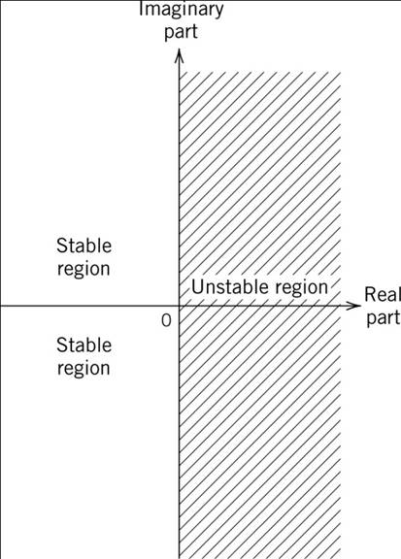
General Stability Criterion
The feedback control system is stable if and only if all the poles of the closed loop transfer function $G_{CL}$ have a negative real part. Otherwise the system is unstable.

Slide 38
In general
$$\frac{e}{r}=\frac{1}{1+GH}$$
r
+
e
G(s)
-
c
Open loop gain $G_{OL}$
H(s)
$$\frac{c}{r}=\frac{GH}{1+GH}$$
Stability: the poles’ real part of $G_{CL}$ must be negative
Closed loop gain $G_{CL}$

Slide 39
Loop stability and design
If the system is unstable,
We can’t change $G\left(s\right)$ but
We can design a different controller $H$ so as to make the system stable
But how should we change H? Let’s look closely at the root of the problem
r
+
e
G(s)
-
c
H(s)

Slide 40
The problem
r
+
e
G(s)
-
$$\frac{e}{r}=\frac{1}{1+GH}=\frac{1}{1+G_{OL}}$$
c
H(s)
$$\frac{c}{r}=\frac{GH}{1+GH}=\frac{G_{OL}}{1+G_{OL}}=G_{CL}$$
If $G_{OL}$ ever becomes $−1$ then system is unstable

Slide 41
The general shape of $G_{OL}$
r
+
e
$$\frac{e}{r}=\frac{1}{1+G_{OL}}$$
G(s)
-
c
$G_{OL}$ has a limited bandwidth.
H(s)
Within bandwidth:
$$G_{OL}≫1$$
Outside bandwidth:
$$G_{OL}≪1$$
$$\frac{e}{r}≅0$$
$$\frac{e}{r}≅1$$

Slide 42
The general shape of $G_{OL}$
$$\left|G_{OL}\right|$$
“Bandwidth”
DC gain
$${10}^{0}$$
Unity gain
Log(f)
$$\text{∠}G_{OL}$$
Unity Gain Frequency (UGF): $G_{OL}=1$
Log(f)
$$−π$$
$${−180}^{0}$$

Slide 43
Stability Criteria
A closed loop system is stable if the unity gain frequency is lower than the ${−180}^{0}$ crossing.
$$\left|G_{OL}\right|$$
$${10}^{0}$$
UGF
Log(f)
Stable
$$\text{∠}G_{OL}$$
$−{180}^{0}$ crossing
Log(f)
$$−π$$

Slide 44
Stability Criteria: Rule of Thumb
$$\left|G_{OL}\right|$$
The system is (almost always) stable if $\left|G_{OL}\right|∝\frac{1}{f}$ at the unity gain frequency.
$${10}^{0}$$
Slope at UGF: $\frac{1}{f}$
Log(f)
Stable
$$\text{∠}G_{OL}$$
Log(f)
$$−π$$

Slide 45
Nyquist stability criterion
The closed loop system is stable if the polar plot of the open loop transfer function$\left(\text{Im}\left(G_{OL}\right) \text{vs} \text{Re}\left(G_{OL}\right)\right)$ does not encircle the $−1$ point.
nyquist_example1.m
>> G=10*tf(10,[1 10];
>> nyquist(G)

Slide 46
Nyquist stability criterion
The closed loop system is stable if the polar plot of the open loop transfer function$\left(\text{Im}\left(G_{OL}\right) \text{vs} \text{Re}\left(G_{OL}\right)\right)$ does not encircle the $−1$ point.
Checking the step response of 1/(1+Gol)
nyquist_example1.m

Slide 47
Back to cruise control
Let’s inspect the system’s loop stability. Recall
$H=1000N/{\left(m/s\right)}$
$G=\frac{1/m}{s+b/m}$
Mass m = 1000 kg
Coefficient for air friction b = 50 kg/s
$$G_{OL}\left(s\right)=\frac{1}{s+2π∙8 \text{mHz}}$$
$$e=\frac{1}{1+G∙H}v_{r}+\frac{K∙G}{1+G∙H}θ$$
θ
K
v_{r}
+
e
f
+
-
v
H
G
-
c

Slide 48
Cruise control: Bode plot of $G_{OL}$
cruise_freqdomain.m
UGF @160 mHz
$$8 \text{mHz}$$
$$G_{OL}\left(s\right)=\frac{1}{s+2π∙8 \text{mHz}}$$

Slide 49
Cruise control: Nyquist plot of $G_{OL}$
cruise_freqdomain.m

Slide 50
$$G_{CL}$$
With a little algebra:
$$G_{CL}=\frac{G_{OL}}{1+G_{OL}}=\frac{1/{(s+a)}}{1+1/{(s+a)}}=\frac{1}{s+a+1}=\frac{1}{s+2π 8\text{mHz}+1}=\frac{1}{s+2π 170\text{mHz}}$$
$$G_{CL}\left(s\right)=\frac{1}{s+2π∙\text{170 }\text{mHz}}$$

Slide 51
Let’s check step response of $G_{CL}$
$$G_{CL}\left(s→0 \text{Hz}\right)=\frac{1}{2π∙\text{170 }\text{mHz}}=0.95$$
cruise_freqdomain.m
$$G_{CL}\left(s\right)=\frac{1}{s+2π∙\text{170} \text{mHz}}$$
$$τ=\frac{1}{2π∙170 \text{mHz}}=0.95 \text{s}$$

Slide 52
Example
Is the system with open loop transfer function $G_{OL}$ stable?
$$G_{OL}(s)=k∙\frac{1}{s^{2}}∙\frac{\left(s+2π 10\right)}{\left(s+2π 100\right)\left(s+2π 500\right)}$$
$$k=3.8×{10}^{8}$$

Slide 53
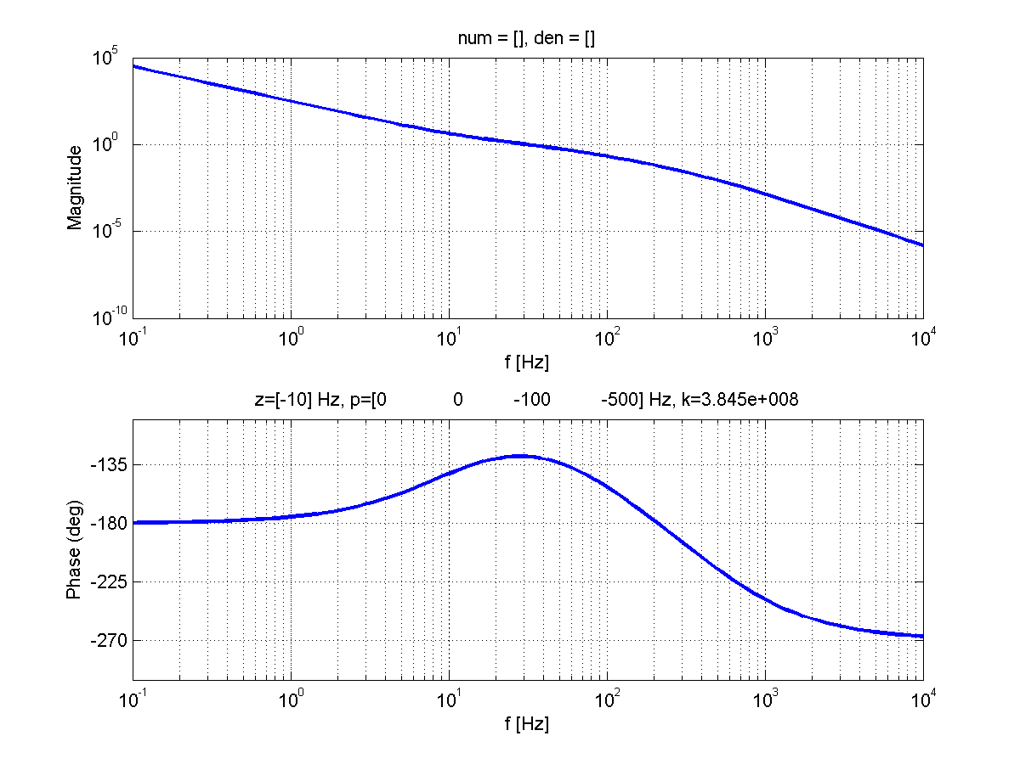
Two poles at 0 Hz
Zero at 10 Hz
Pole at 100 Hz
feedback_example4.m
Pole at 500 Hz
$$G_{OL}(s)=k∙\frac{1}{s^{2}}∙\frac{\left(s+2π 10\right)}{\left(s+2π 100\right)\left(s+2π 500\right)}$$

Slide 54
$$G_{OL}(s)=k∙\frac{1}{s^{2}}∙\frac{\left(s+2π 10\right)}{\left(s+2π 100\right)\left(s+2π 500\right)}$$
$$1/f$$
$$1/{f^{2}}$$
Stable
$$1/{f^{3}}$$
feedback_example4.m
$$−π/2$$
$$−π$$
$$−π+π/4$$
by how much?
$$−3π/2$$

Slide 55
Problem
If a system has an open loop transfer function
$$G_{OL}=\frac{k}{\left(s+10\right)\left(s+100\right)}$$
what values of $k$ make it stable? Use MATLAB to confirm this.

Slide 56
Relative stability
Gain and phase margin
Measure of “relative” stability
The larger they are → the “safer we are”
Gain margin
By how much can the gain increase until the system becomes unstable?
Defined as $GM=\frac{1}{\left|G_{OL}(ω_{π})\right|}$
Phase margin
By how much can the system tolerate a phase change at UGF?
Defined as $PM=\text{∠}G_{OL}\left(ω_{UGF}\right)+180$
Rule of thumb: keep the phase margin above $40°$

Slide 57
$$G_{OL}(s)=k∙\frac{1}{s^{2}}∙\frac{\left(s+2π 10\right)}{\left(s+2π 100\right)\left(s+2π 500\right)}$$
$$1/f$$
Gain margin: 20
UGF @30 Hz
feedback_example4.m
Phase margin: 50⁰

Slide 58
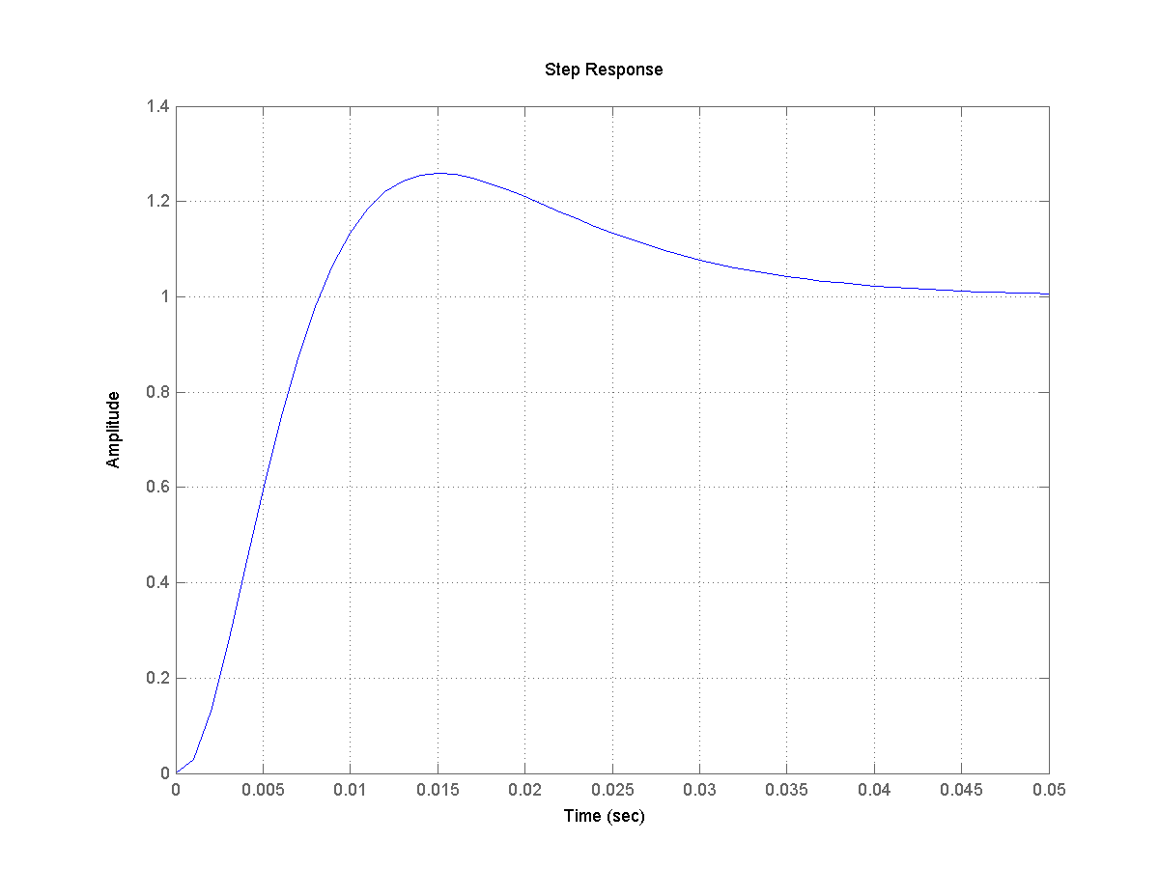
$$G_{OL}(s)=k∙\frac{1}{s^{2}}∙\frac{\left(s+2π 10\right)}{\left(s+2π 100\right)\left(s+2π 500\right)}$$
feedback_example4.m
Step response of $G_{CL}=\frac{1}{1+G_{OL}}$

Slide 59
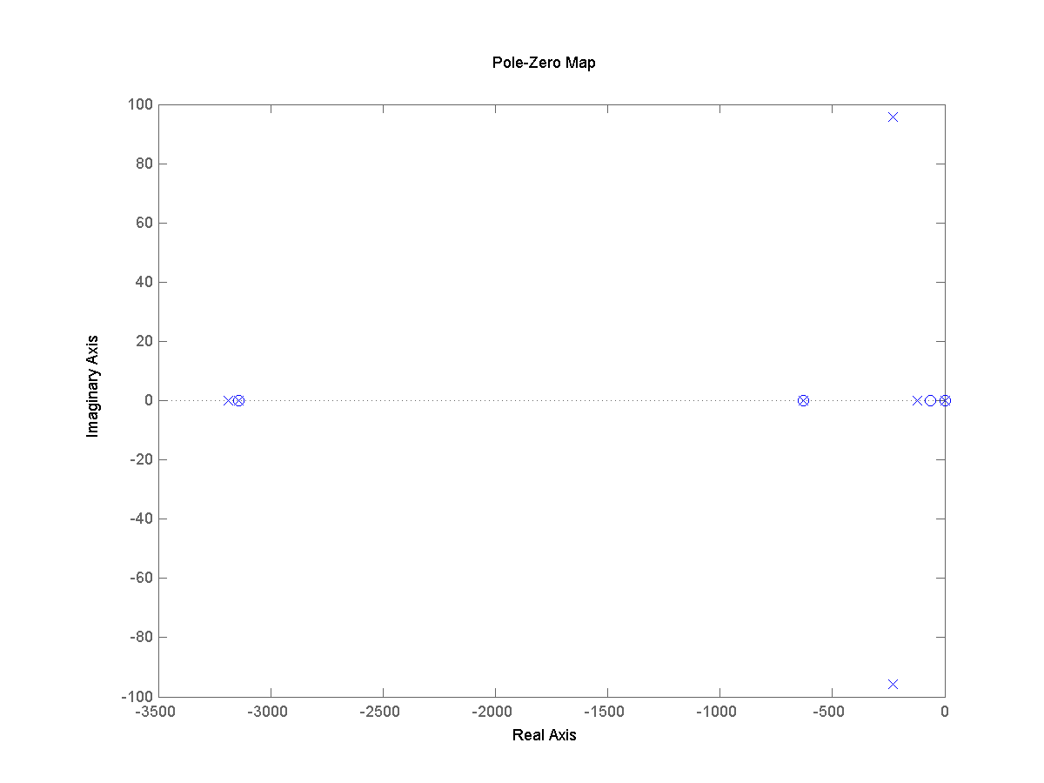
$$G_{OL}(s)=k∙\frac{1}{s^{2}}∙\frac{\left(s+2π 10\right)}{\left(s+2π 100\right)\left(s+2π 500\right)}$$
Pole-zero map of $G_{CL}=\frac{1}{1+G_{OL}}$
feedback_example4.m

Slide 60
Performance to noise input d: with no feedback
d
r
+
e
+
c
G₁
G₂
-
+
H
Noise contribution to signal c
$$c=\left(G_{1}G_{2}\right)r+\left(G_{2}\right)d$$
$$e=r$$

Slide 61
Performance to noise input d: with feedback
Noise contribution to signal c
d
r
+
e
+
c
G₁
G₂
-
+
H
$$c=\left(\frac{G_{1}G_{2}}{1+G_{OL}}\right)r+\left(\frac{G_{2}}{1+G_{OL}}\right)d$$
Controlled signal
$$e=\left(\frac{1}{1+G_{OL}}\right)r+\left(\frac{HG_{2}}{1+G_{OL}}\right)d$$
Suppression factor

Slide 62
Setting the parameters
d
r
+
e
+
c
G₁
G₂
-
+
H
$G_{1}=$ zeros at 1, 10Hz; poles at 0, 100 Hz, k = 300
$$G_{2}=\frac{\tilde{ω}}{s^{2}+2δ\tilde{ω}s+{\tilde{ω}}^{2}} with \tilde{ω}=2π 1\text{Hz}, δ=0.1$$
$$H=1$$

Slide 63
$$G_{OL}=G_{1}∙G_{2}∙H$$
feedback_example6.m

Slide 64
$$G_{OL}=G_{1}∙G_{2}∙H$$
Controller $G_{1}$ has a low pass filter at 1kHz
feedback_example6.m

Slide 65
Suppression factor $1/{1+G_{OL}}$
No suppression
Noise term suppression
If the DC gain is increased, so is the suppression
feedback_example6.m
Bandwidth

Slide 66
$$G_{CL}={G_{OL}}/{1+G_{OL}}$$
feedback_example6.m
Control signal, at the output of H.

Slide 67
How can we correct an unstable loop? Typical compensators
Integral controller
$$G\left(s\right)=\frac{1}{s}$$
The output is proportional to the time integral of the input
Derivative controller
$$G\left(s\right)=s$$
The output is proportional to the time derivative of the input

Slide 68
Phase-lag compensator
$$f_{2}<f_{1}$$
$$G\left(s\right)=\frac{f_{2}}{f_{1}}\frac{s+2πf_{1}}{s+2πf_{2}}$$
compensator_phaselag.m

Slide 69
Phase-lead compensator
$$f_{1}<f_{2}$$
$$G\left(s\right)=\frac{f_{2}}{f_{1}}\frac{s+2πf_{1}}{s+2πf_{2}}$$
compensator_phaselead.m

Slide 70
“Boost”
$$G\left(s\right)=\frac{1}{s}(s+2πf_{1})$$
compensator_boost.m

Slide 71
Problem
If a system has an open loop transfer function
$$G_{OL}=\frac{{10}^{3}}{{\left(s+10\right)}^{3}}$$
design a compensator that would make the system stable with an UGF at 100 Hz. Use MATLAB to confirm this.

Slide 72
Example: locking one LIGO arm
Reference signal $ν_{laser}$: the cavity “locks” to the laser frequency. For simplicity, units of length.
Noise term $n_{s}$: Mirror motion due to seismic noise, units of length
$$n_{s}$$
$$ν_{laser}$$
+
+
e
C
-
+
S
H
$$n_{c}$$

Slide 73
Example: locking one LIGO arm
Ligo arm cavity C: a cavity length change is converted to electronic signal e
$$n_{s}$$
$$ν_{laser}$$
+
+
e
C
-
+
Suspension S: receives the signal from H and drives the mirror, units of length
S
H
Controller H: designed in the control room, processes signal e and sends commands to the suspension S
$$n_{c}$$
Noise term $n_{c}$: Noise from coil drivers

Slide 74
Example: no lock
$$e=C n_{s}+C ν_{laser}$$
$$n_{s}$$
$$ν_{laser}$$
+
+
e
C
-
+
S
H
$$n_{c}$$

Slide 75
Example: locking one LIGO arm
$$e=\left(\frac{1}{1+CHS}\right)∙\left(C∙ n_{s}+C∙ ν_{laser}−S∙C∙n_{c}\right)$$
Suppression factor :$\frac{1}{1+CHS}$
$$n_{s}$$
Open Loop gain: $C H S$
$$ν_{laser}$$
+
+
e
C
-
+
Note on noise term $n_{c}$: Noise term appears only when mirrors are driven → limited bandwidth desired
S
H
$$n_{c}$$

Slide 76
Example: locking one LIGO arm
Need to design H so as to have
Enough suppression of noise terms
Stable
“Small” bandwidth

Slide 77
Example: locking one LIGO arm
Cavity transfer function C:
Pole at 100 Hz
Suspension transfer function S
Simple harmonic oscillator (SHO) with $f_{0}=1Hz$ and quality factor $Q=2$
Shown is $C∙S$
What controller H can we use?
cavityfeedback_exampleA.m

Slide 78
Example: locking one LIGO arm
Set UGF at 100 Hz
Need H with a zero after 1 Hz and before 100 Hz
Try phase lead
$$H\left(s\right)=k∙\frac{s+ω_{1}}{ω_{1}}$$
with $k=1500$ and $ω_{1}=2π 10\text{Hz}.$
Bode plot of OL
UGF at 100 Hz
PM ~40 deg
Stable
cavityfeedback_exampleA.m

Slide 79
Example: locking one LIGO arm
Double check stability
Step response plot of
$$\frac{1}{1+CHS}$$
Step is driven to zero as it should (it is a suppression factor)
In about 10 ms (~1/UGF) response is close to zero
Two oscillation cycles – little ringing
cavityfeedback_exampleA.m

Slide 80
Example: locking one LIGO arm
Bode plot of the suppression factor
$$\frac{1}{1+CHS}$$
Suppression of ~1500x at 100 mHz
No suppression above 100 Hz
Notice spike at 100 Hz
This spike is responsible of the ringing in the step response
decreased if phase margin is increased
cavityfeedback_exampleA.m

Slide 81
Example: locking one LIGO arm
Let’s increase the low frequency gain with a “boost”
Try H
$$H\left(s\right)=k∙\frac{1}{s}∙\frac{s+ω_{1}}{ω_{1}}∙\frac{s+ω_{2}}{ω_{2}}$$
with $k=7000$, $ω_{1}=2π 10\text{Hz}$ and $ω_{2}=2π 1 \text{Hz}$
OL bode plot
UGF at 100 Hz
PM ~40 deg
Stable
cavityfeedback_exampleB.m

Slide 82
Example: locking one LIGO arm
Double check stability
Step response plot of
$$\frac{1}{1+CHS}$$
Very similar response
Step is driven to zero as it should (it is a suppression factor)
In about 10 ms (~1/UGF) response is close to zero
Two oscillation cycles – little ringing
cavityfeedback_exampleB.m

Slide 83
Example: locking one LIGO arm
Bode plot of the suppression factor
$$\frac{1}{1+CHS}$$
More suppression at low frequencies: $\sim {10}^{4}$ at 100 mHz
No suppression above 100 Hz
Notice spike at 100 Hz
Similar ringing
cavityfeedback_exampleB.m

Slide 84
Example: locking one LIGO arm
Let’s also “cut-off” the drive to the coils at high frequency
Introduce a low pass LP 6th order Butterworth filter with cut-off frequency at 2 kHz.
Try H
$$H\left(s\right)=k∙\frac{1}{s}∙\frac{s+ω_{1}}{ω_{1}}∙\frac{s+ω_{2}}{ω_{2}}∙\text{LP}$$
with $k=7000$, $ω_{1}=2π 10\text{Hz}$ and $ω_{2}=2π 1 \text{Hz}$
OL bode plot
UGF at 100 Hz
PM ~30 deg
Stable
cavityfeedback_exampleC.m

Slide 85
Example: locking one LIGO arm
Double check stability
Step response plot of
$$\frac{1}{1+CHS}$$
Very similar response
Step is driven to zero as it should (it is a suppression factor)
In about 10 ms (~1/UGF) response is close to zero
~Two oscillation cycles
cavityfeedback_exampleC.m

Slide 86
Example: locking one LIGO arm
Bode plot of the suppression factor
$$\frac{1}{1+CHS}$$
Same suppression: $\sim {10}^{4}$ at 100 mHz
No suppression above 100 Hz
Notice spike at 100 Hz
A little higher than before
Similar ringing
cavityfeedback_exampleC.m

Slide 87
Example: locking one LIGO arm
Increasing the gain by 2x: $k=14000$
OL bode plot
UGF at ~133 Hz
Should have gone to 200 Hz but the slope is not 1/f (because of the cavity pole at 100 Hz)
PM ~20 deg
Stable but with little phase margin left
cavityfeedback_exampleD.m

Slide 88
Example: locking one LIGO arm
Step response plot of
$$\frac{1}{1+CHS}$$
Ringing has increased
cavityfeedback_exampleD.m

Slide 89
Example: locking one LIGO arm
Bode plot of the suppression factor
$$\frac{1}{1+CHS}$$
Suppression has increased
Gain was increased by factor 2
Notice spike at 100 Hz is more pronounced
cavityfeedback_exampleD.m

Slide 90
Summary
We have explored the stability criteria
The feedback control system is stable if and only if all the poles of the closed loop transfer function $G_{CL}$ have a negative real part. Otherwise the system is unstable.
Stability in terms of the open loop gain
A closed loop system is stable if the unity gain frequency is lower than the ${−180}^{0}$ crossing.
Rule of thumb: the system is (almost always) stable if $\left|G_{OL}\right|∝\frac{1}{f}$ at the unity gain frequency

Slide 91
Summary
Noise suppression
How close to instability is a system? Gain and phase margin
Measure of “relative” stability
The larger they are → the “safer we are”
Rule of thumb: keep the phase margin to more than $40°$
Typical compensators
Phase-lag
Phase-lead
“Boost”
Cavity lock example

Slide 92
Problem for the afternoon
Identify a (single-input-single-output) control system at LIGO – its plant TF along with its controller TF (LSC, ASC, SUS, MC, PSL, …)
Sketch the block diagram and model the system with MATLAB. Generate the corresponding bode plot.
Can you measure its OL TF? Where is the UGF and how does it compare with the model?
For what range of frequencies can the UGF be placed at by simply adjusting the systems’ gain? What DC gain does it have, what suppression?

Slide 93
Problem for the afternoon
Optical levers are/were used to damp the fundamental mode of the suspensions. The controller has no DC gain (check this).
Sketch the block diagram and model the system with MATLAB. Generate the corresponding bode plot.
Can you measure its OL TF? Where is the UGF and how does it compare with the model?
For what range of frequencies can the UGF be placed at by simply adjusting the systems’ gain? What DC gain does it have, what suppression?
opticallever.m

Slide 94
Solutions to problems

Slide 95
What is the transfer function of a system whose input $u$ and output $y$ are related by the following differential equation?
$$\frac{d^{2}y}{dt^{2}}+3\frac{dy}{dt}+2y=u+\frac{du}{dt}$$
Sol: Taking the Laplace transform of the equation
$$s^{2} Y\left(s\right)+3 s Y\left(s\right)+2 Y\left(s\right)=U\left(s\right)+s U\left(s\right)$$
Which can be re-written as
$$\frac{Y\left(s\right)}{U\left(s\right)}=\frac{s+1}{s^{2}+3 s+2}$$

Slide 96
Given $P\left(s\right)=\frac{2 s+1}{s^{2}+s+1}$, determine the system’s differential equation to input $u\left(t\right)$.
Sol:
$$y=\left(\frac{2 D+1}{D^{2}+D+1}\right) u$$
or
$$D^{2}y+Dy+y=2 D u+u$$
or
$$\frac{d^{2}y}{dt^{2}}+\frac{dy}{dt}+y=2\frac{du}{dt}+u$$

Slide 97
Determine which of the following transfer functions represent stable systems and which represent unstable systems. Use MATLAB’s step to verify your answer.
$P\left(s\right)=\frac{s−1}{\left(s+2\right)\left(s^{2}+4\right)}$, unstable
$P\left(s\right)=\frac{s−1}{\left(s+2\right)\left(s+4\right)}$, stable
$P\left(s\right)=\frac{\left(s+2\right)\left(s−2\right)}{\left(s+1\right)\left(s−1\right)\left(s+4\right)}$, unstable
$P\left(s\right)=\frac{6}{\left(s^{2}+s+1\right){\left(s+1\right)}^{2}}$, stable
$P\left(s\right)=\frac{5 \left(s+10\right)}{\left(s^{2}−s+10\right)\left(s+5\right)}$, unstable

Slide 98
A simple mechanical accelerometer is shown below. The position y is with respect of the case, the case’s position is x. What is the transfer function between the input acceleration $A (a={d^{2}x}/{dt^{2}})$ and the output Y?
$$−B\frac{dy}{dt}−ky=M \frac{d^{2}}{dt^{2}}\left(y−x\right)$$
y
Sol:
$$\frac{Y}{A}=\frac{1}{s^{2}+\left(B/M\right) s+K/M}$$
B
M
k
x

Slide 99
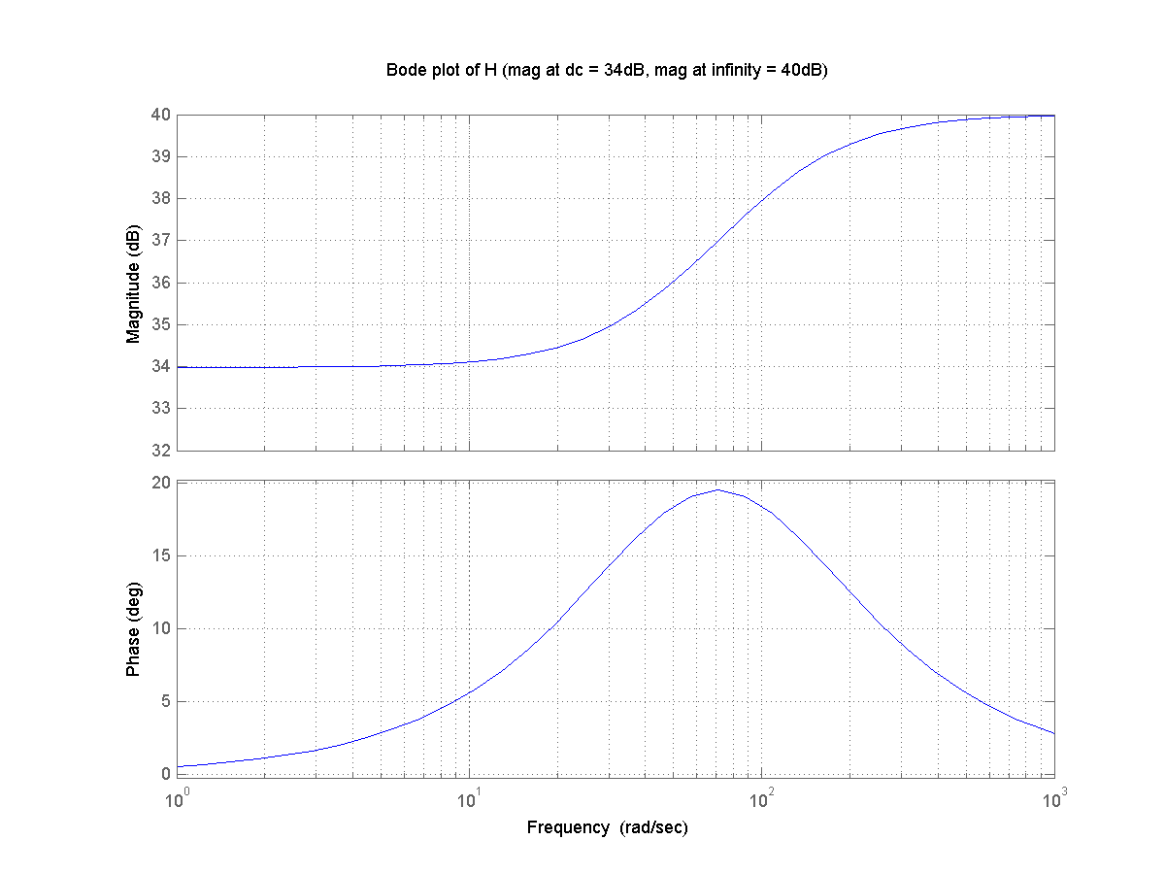
Sketch bode plot for the following TF
$$G\left(s\right)=100\frac{s+50}{s+100}$$
What is the DC gain (gain for $ω→0$)? What is the gain for $ω→∞$? Confirm results with MATLAB
bodeexcercise1.m

Slide 100
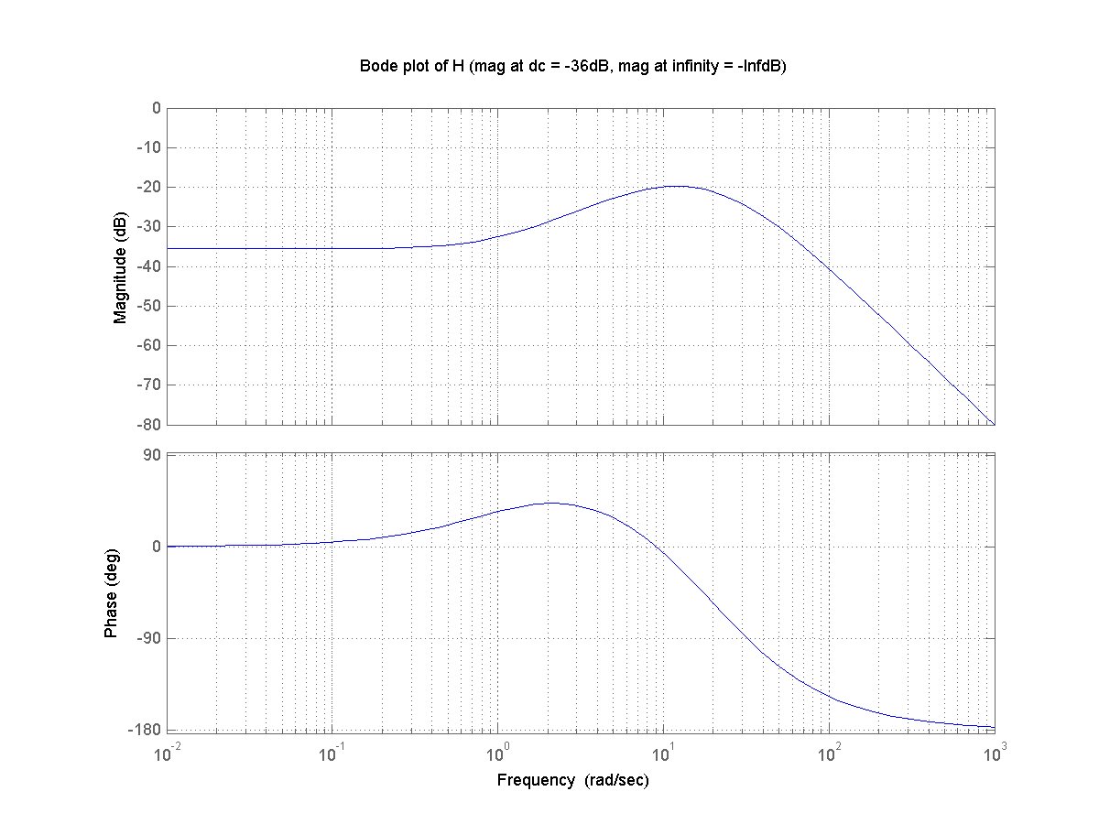
Sketch bode plot for the following TF
$$G\left(s\right)=100\frac{\left(s+1\right)}{\left(s+10\right)\left(s+20\right)\left(s+30\right)}$$
What is the DC gain (gain for $ω→0$)? What is the gain for $ω→∞$? Confirm results with MATLAB

Slide 101
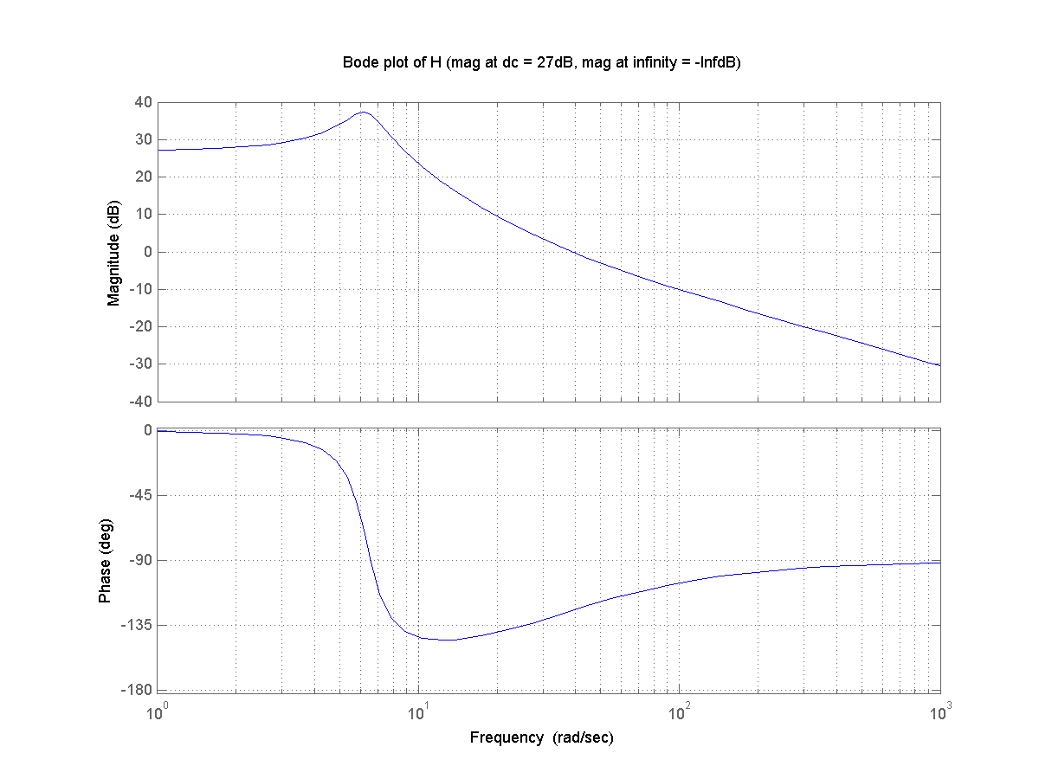
Sketch bode plot for the following TF
$$G\left(s\right)=30\frac{s+30}{s^{2}+2s+40}$$
What is the DC gain (gain for $ω→0$)? What is the gain for $ω→∞$? Confirm results with MATLAB

Slide 102
Solution
If a system has an open loop transfer function
$$G_{OL}=\frac{k}{\left(s+10\right)\left(s+100\right)}$$
what values of $k$ make it stable?
Sol: UGF can be set after the pole at 10 and before pole at 100
$$\left|G_{OL}\right|=k\frac{1}{\sqrt{ω^{2}+{10}^{2}}}∙\frac{1}{\sqrt{ω^{2}+{100}^{2}}}$$
Set $\left|G_{OL}\right|=1$ and $ω=10$. Find corresponding k.
Set $\left|G_{OL}\right|=1$ and $ω=10$0. Find corresponding k

Slide 103
Solution
If a system has an open loop transfer function
$$G_{OL}=\frac{{10}^{3}}{{\left(s+10\right)}^{3}}$$
design a compensator that would make the system stable with an UGF at 100 Hz. Use MATLAB to confirm this.
Sol: two zeros at 10, decreasing the gain by 3x
H=zpk([],[-10 -10 -10],1e3) * zpk([-10 -10],[],0.3)

