Slide 1
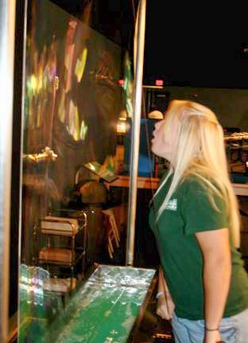
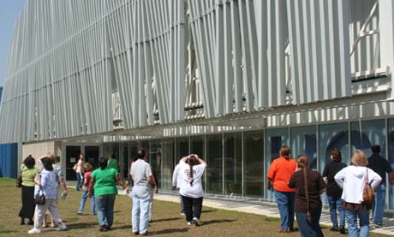
Gravitational Waves from the Ground Up
Kathy Holt & Amber L. Stuver
LIGO Livingston Observatory

Slide 2
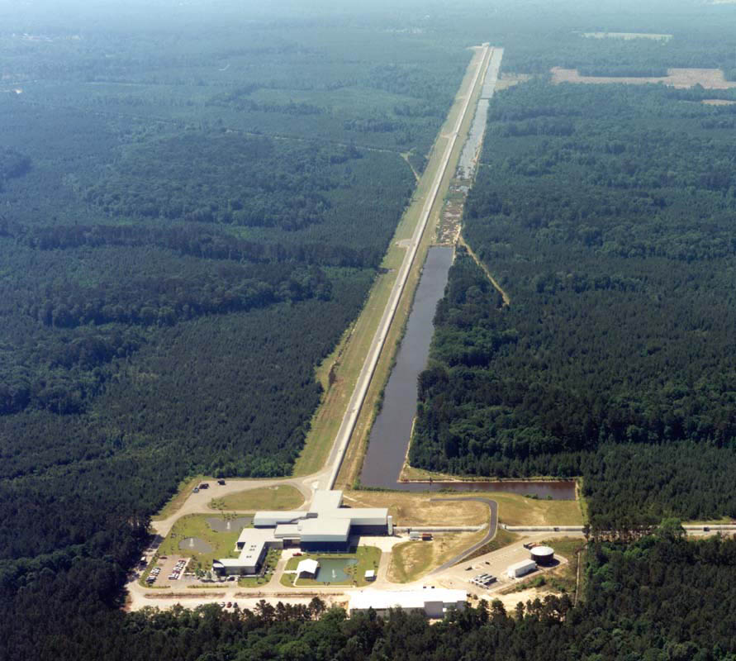
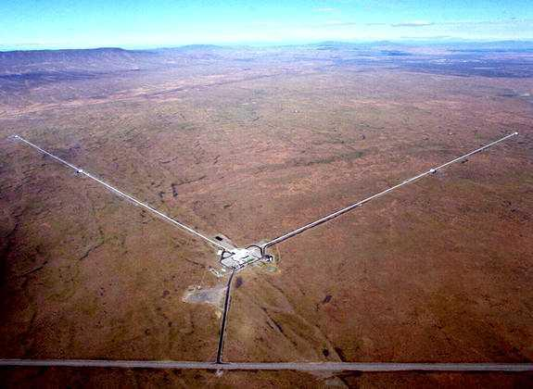
LIGO
NSF large facility seeking to directly detect gravitational waves (GW) originating from massive, energetic events in the universe.
Two facilities:
Hanford, WA Livingston, LA
Along with detection, education is one of LIGO’s central goals.

Slide 3
LIGO Science Education Center (SEC)
First class outreach program complements LIGO as an NSF large facility
Built on a partnership with the Exploratorium, SUBR, LaSIP and La GEAR UP
Informal learning environment housing 50 hands-on exhibits focusing on LIGO science, all but ~10 made by the Exploratorium
Exposes students, teachers and the public to LIGO concepts and scientists while being a platform for educational research
Notes:
* All of the staff have been trained at the Exploratorium’s Institute for Inquiry.

Slide 4
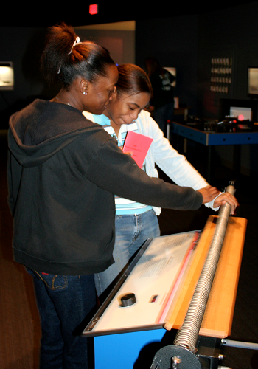
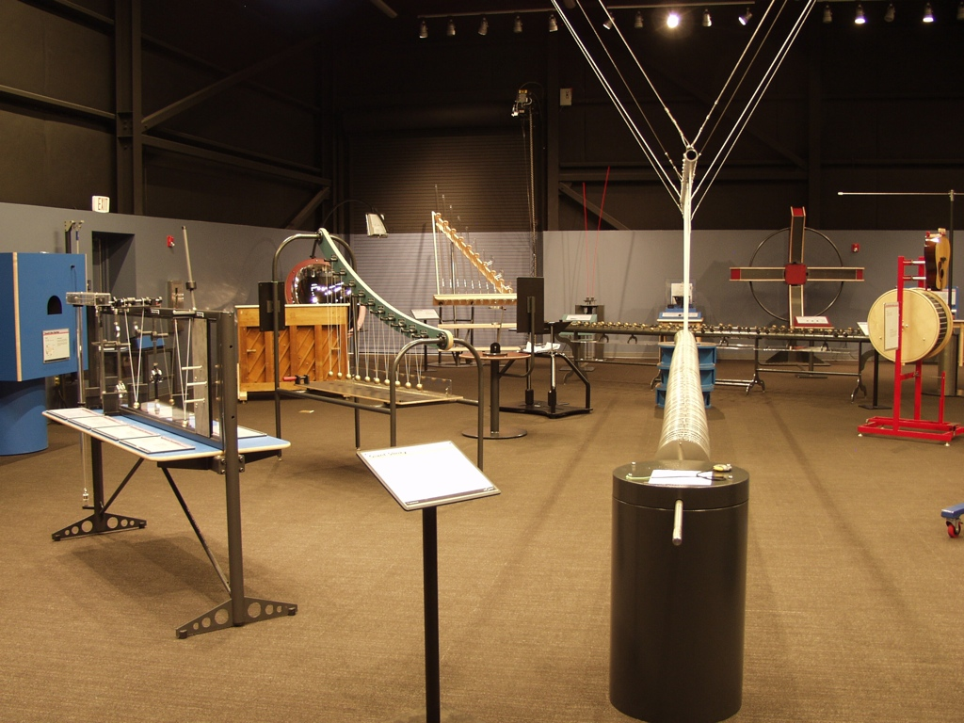
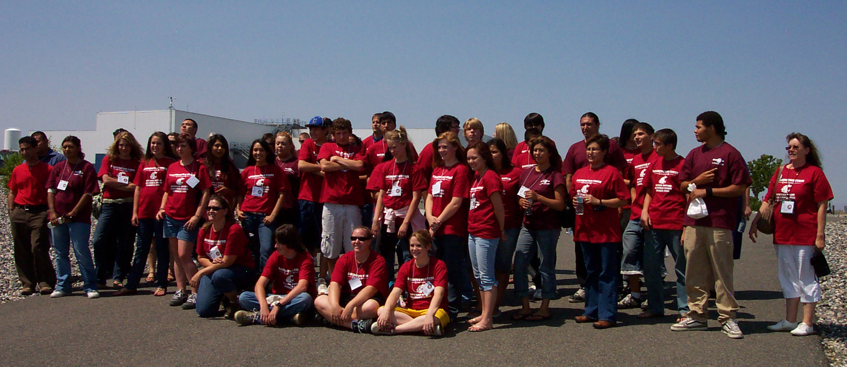
Mission and Structure
Leverage the scale, technology and science backdrop
of the Observatories to create rich visitor
experiences:
Student field trips integrate hands-on standards-based activities with explorations of LIGO science and technology.
Teacher professional development programs emphasize science inquiry along with key LIGO science concepts.
Programs for the general public address a variety of interests and ages.
Outreach programs are built on partnerships.

Slide 5
Inquiry Based Activities
Classroom Activities
Hands-on, staff member facilitated inquiry activities are available
Most focus on light and wave properties (e.g. interference, refraction, etc.) with a few on gravity (e.g. gravity blanket)
Exhibit Hall Exploration
About 45 minutes is allotted for free exploration of the hands-on exhibits housed in the SEC.
Students are given 4 “rules” for their experience: interact with the exhibits, learn something, share something, and have fun.
A short exhibit demo is performed by a staff member not
only to teach a targeted concept, but to show students
that there are multiple ways to use the exhibits.
Notes:
Orally note again that the exhibits were designed by the Exploratorium.

