Slide 1

Squeezing in
Gravitational Wave Detectors
Lisa Barsotti
(LIGO-MIT)
LIGO-G1100827

Slide 2
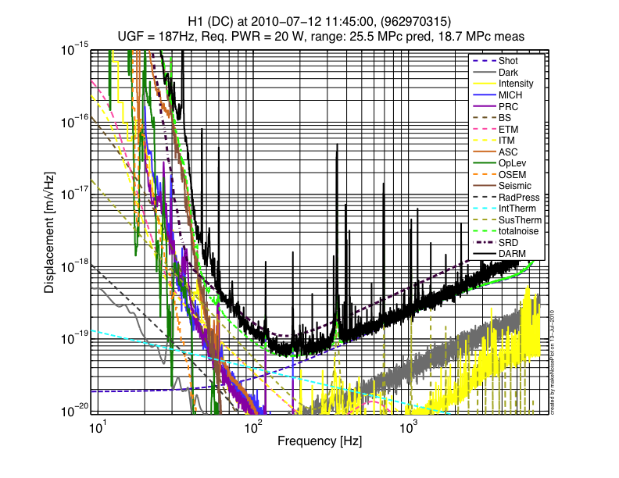
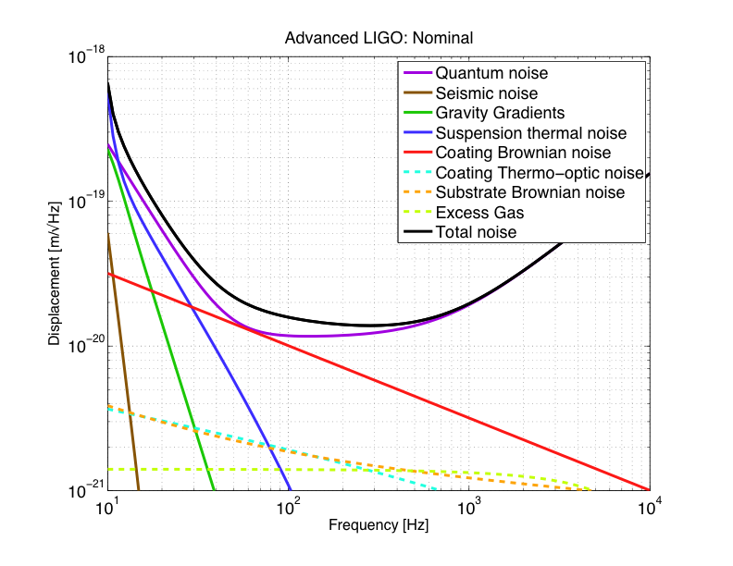
Quantum Noise limits the Sensitivity of GW Detectors
1st Generation (Enhanced LIGO – H1)
2nd Generation (Advanced LIGO)
Shot Noise
Squeezing can beat quantum noise

Slide 3

Btw, Squeezing What?
Nothing, really…
….but it takes a lot of work anyway!

Slide 4
Quantum Noise and Vacuum
Quantum noise is produced by vacuum fluctuations entering the open ports
Vacuum fluctuations have equal uncertainty in phase and amplitude:
  Phase: Shot-Noise
(photon counting noise)
  Amplitude: Radiation Pressure Noise
  (back-action)
LASER
Phase
IFO Signal
Amplitude

Slide 5
Vacuum Getting Squeezed
Reduce quantum noise by injecting squeezed vacuum: less uncertainty in one of the two quadratures
Heisenberg uncertainty principle:
if the noise gets smaller in one quadrature, it gets bigger in the other one
One can choose the relative orientation between the squeezed vacuum and the interferometer signal (squeeze angle)
LASER
Squeezed Field
Phase
IFO Signal
Amplitude

Slide 6
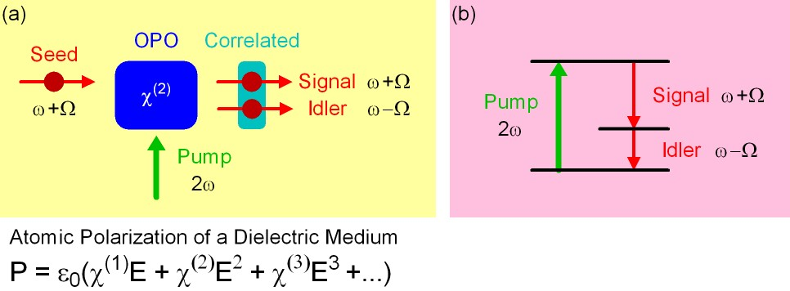
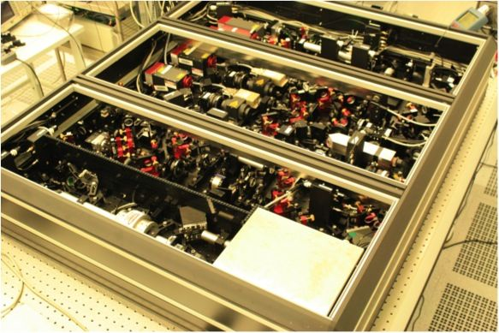
How to make squeezed fields..
…. in theory
Non linear medium with a strong second order
polarization component
Correlation of upper and lower quantum sidebands
…. in practice
Lasers, mirrors, control loops,..
Courtesy of Alexander Khalaidovski (AEI)

Slide 7
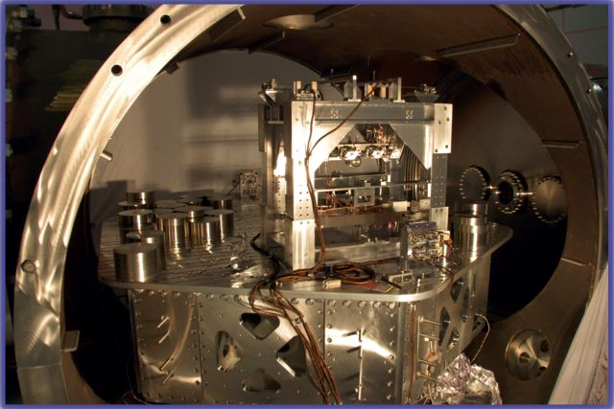
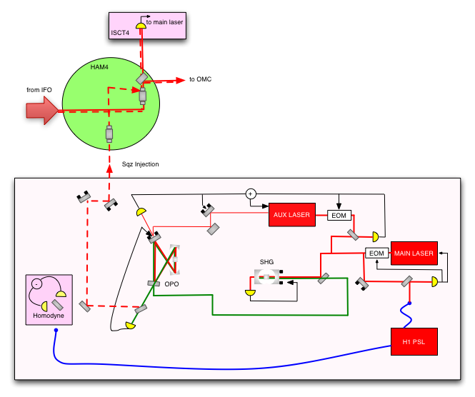
Squeezing Injection
H1 Squeezing Experiment

Slide 8
Squeezing in GW detectors: happening now!
World wide effort to produce squeezing in the audio-frequency band and study applications for GW detectors (ANU, AEI, Caltech/MIT)
Squeezer installed in GEO HF in 2010:
    Already one year of experience!
Advanced LIGO R&D: H1 squeezing experiment this year
    Squeezer just installed in H1
    First squeezing injection by the end of this summer

Slide 9
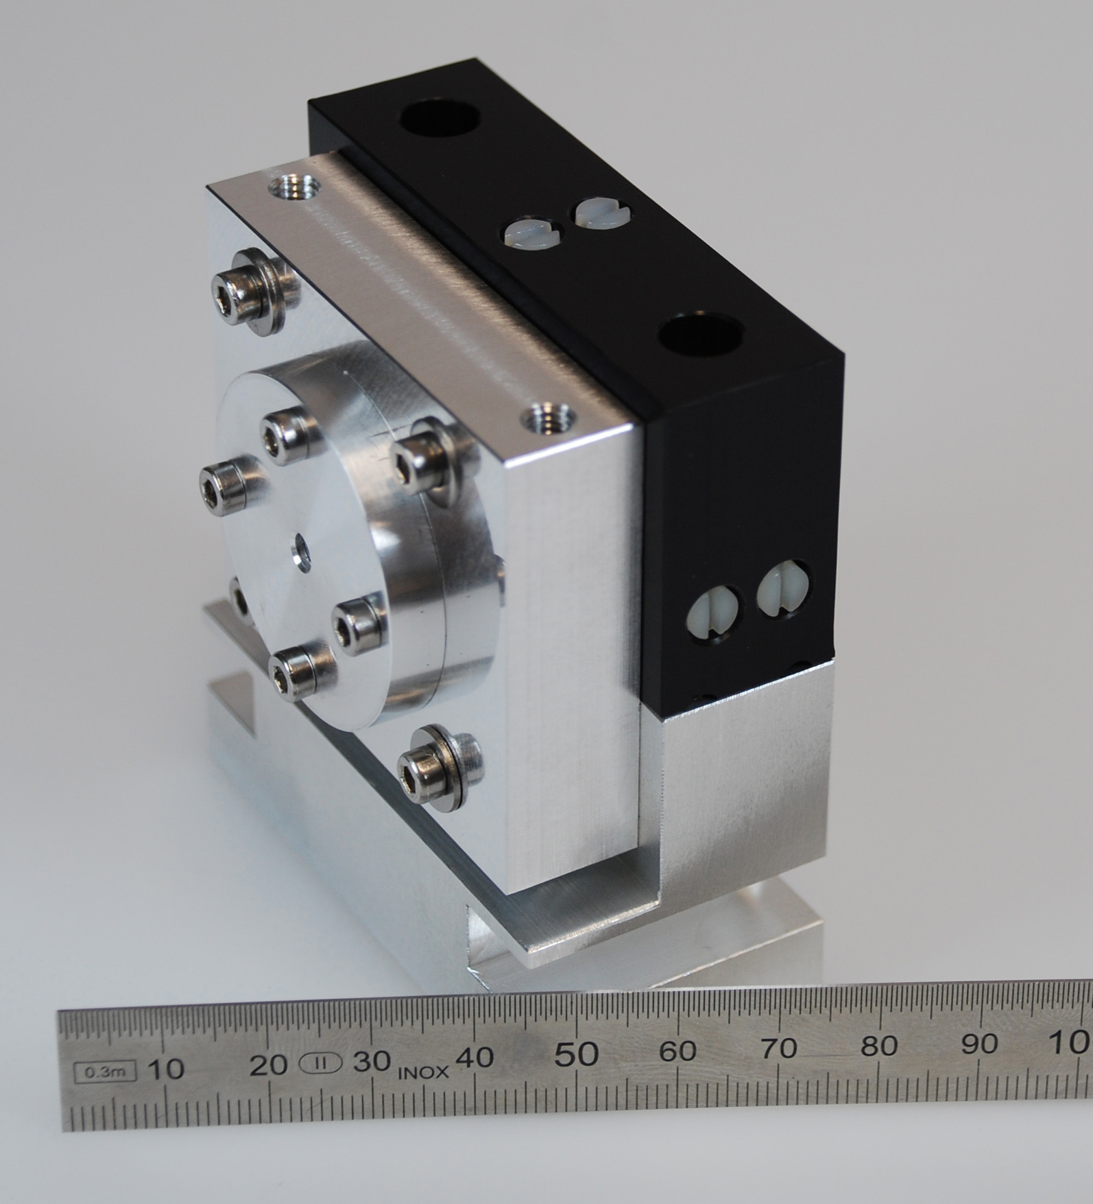
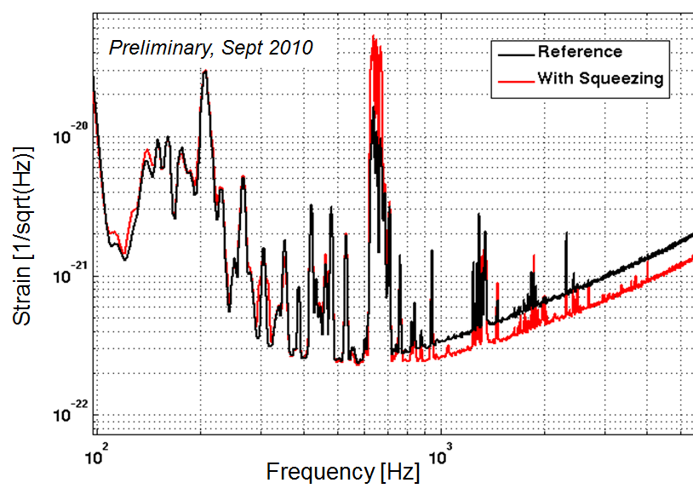
GEO HF: 1 year of Squeezing
This afternoon:
“Status of the GEO 600 squeezed light laser”
Alexander Khalaidovski (AEI)
Advanced Detector Technology
GEO Squeezer: more than 10 dB available
3.5 dB of squeezing measured with GEO
About 40% losses (Faradays, mode-matching)
➔ Linear OPO
Courtesy of Alexander Khalaidovski (AEI)

Slide 10
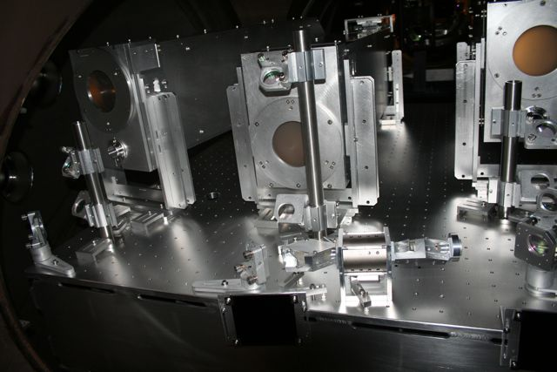
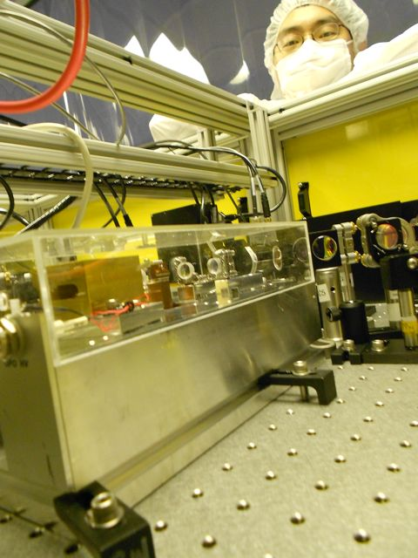
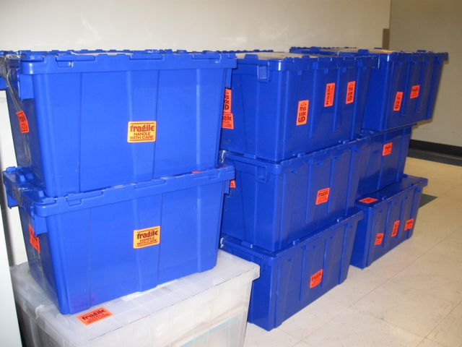
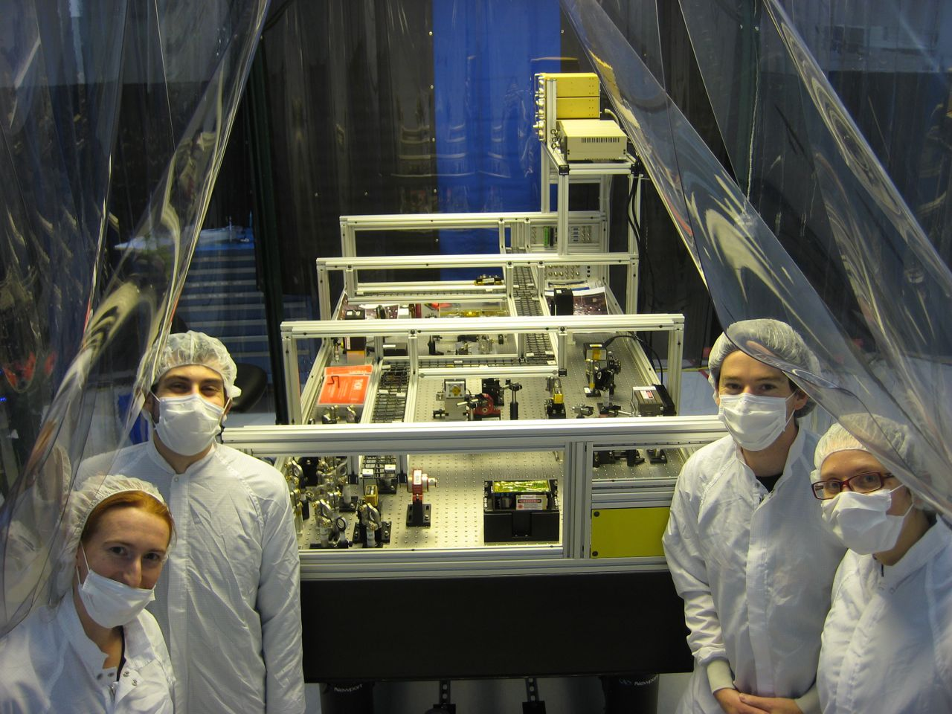
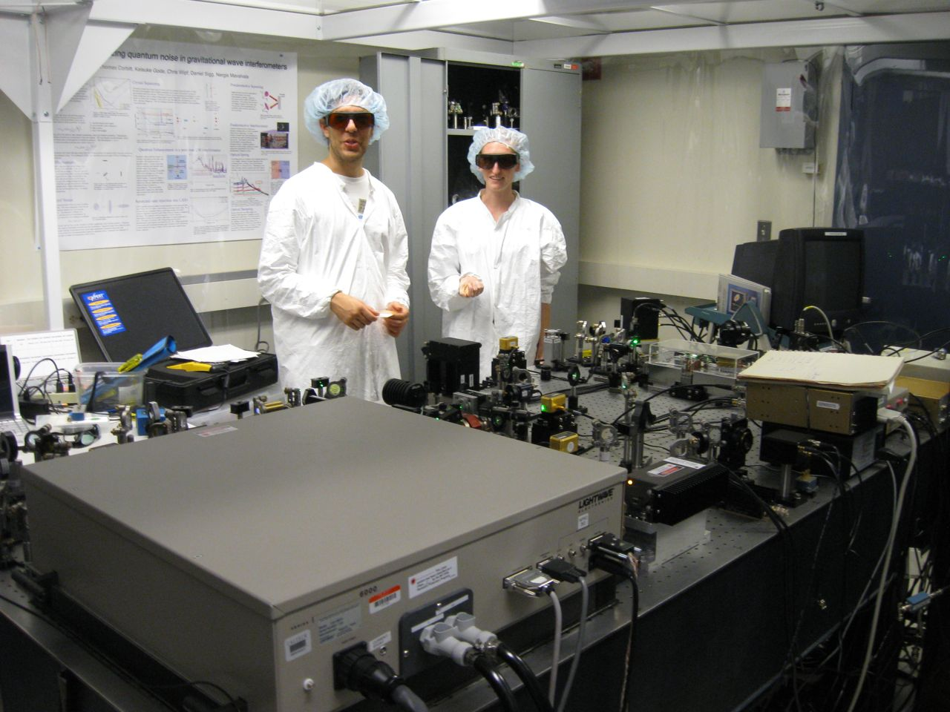
H1 Squeezer Experiment Timeline
October 2010
End of S6
June 2011
August
2011
December 2011
1) OPO Designed at ANU, squeezer assembled at MIT
2) Reassembling of
the squeezer at LHO
3) Sqz installation
4) Sqz injection with short Michelson and full IFO
* Back scattering?
* Losses?
* Anti-Squeezing?
* Control noises?
aLIGO H1 installation starting in January 2012

Slide 11
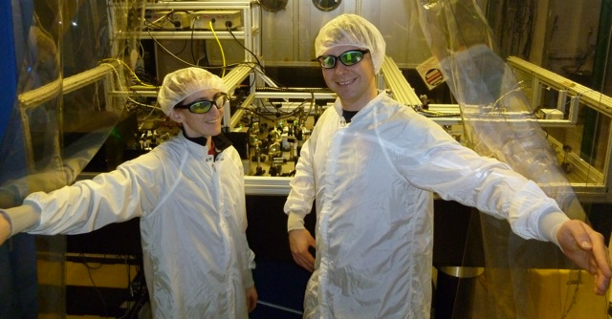
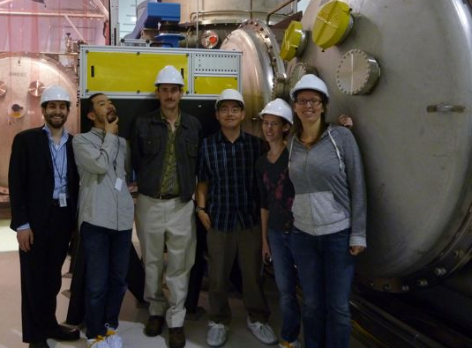
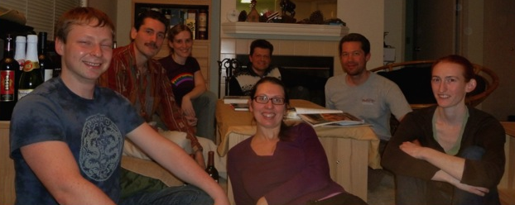
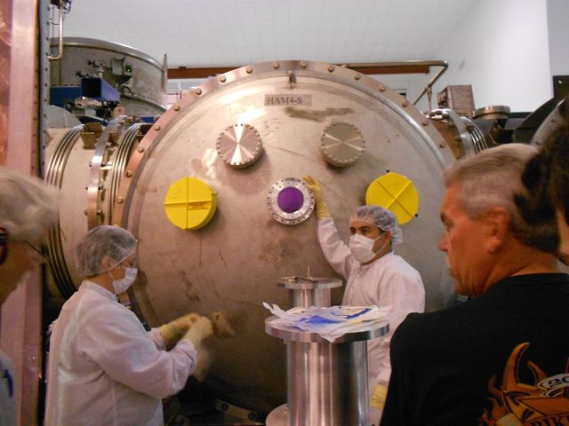
H1 Squeezing Experiment Test
Acknowledgements
LHO/MIT/Caltech/AEI
ANU (Chua, Stefszky, Mow-Lowry, Shaddock, Lam, McClelland)
M. Factourovich (Columbia University)
G. Meadors, D. Gustafson (Univ. of Michigan)

Slide 12
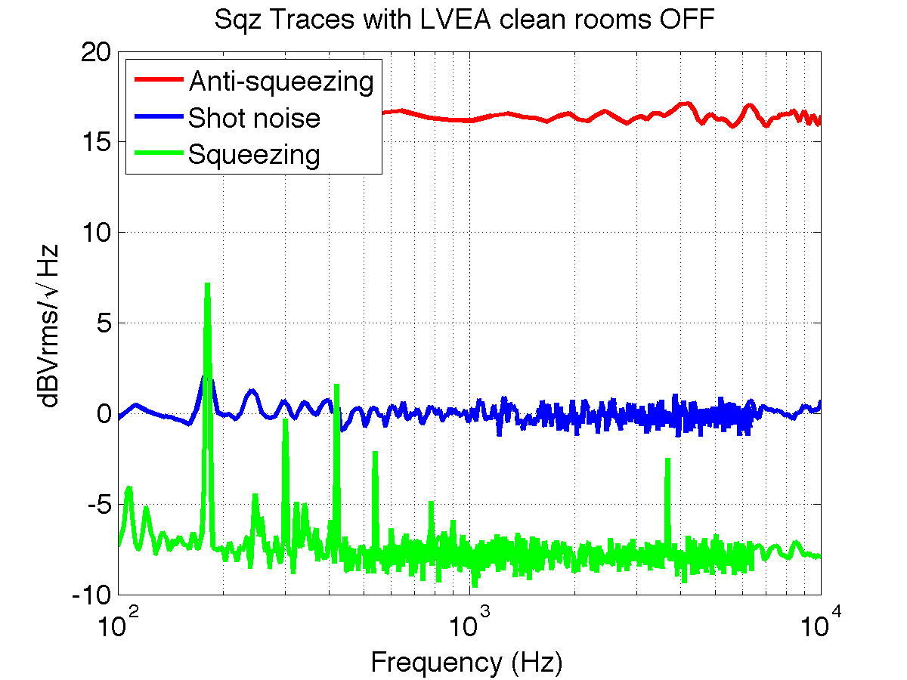
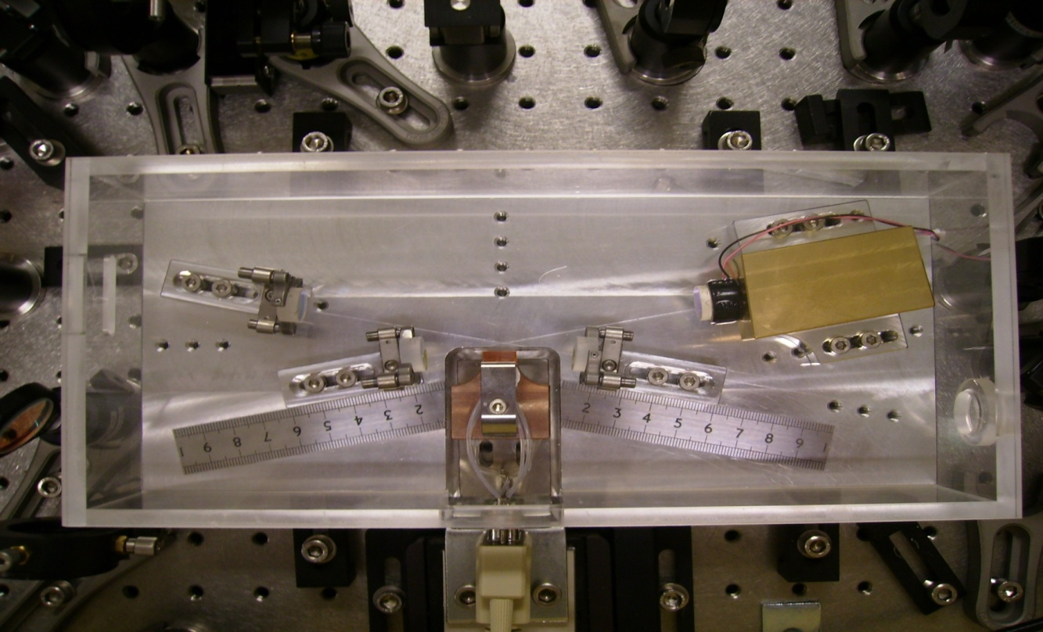
H1 Squeezing Experiment:
The Squeezer
Bow tie-cavity OPO:
This afternoon:
“A back scatter tolerant squeezer for future generation GW detectors”
Michael Stefszky (ANU)
Advanced Detector Technology
> 6 dB measured on the homodyne detector
Advanced LIGO electronics
Squeezer integrated in the LIGO Control System

Slide 13
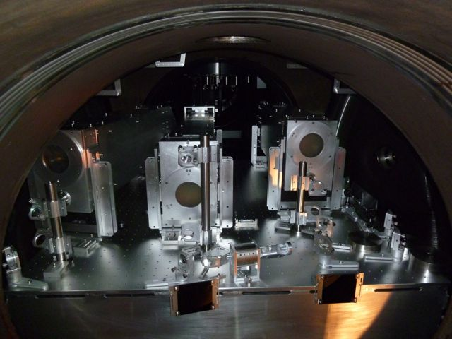
H1 Squeezing Experiment:
(Old) Readout In-Vacuum Layout
from the IFO
Output Mode Cleaner

Slide 14
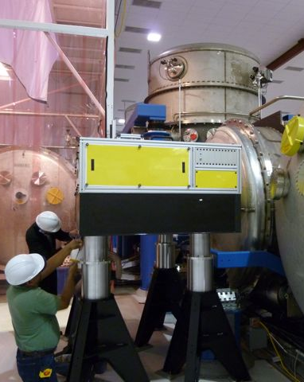
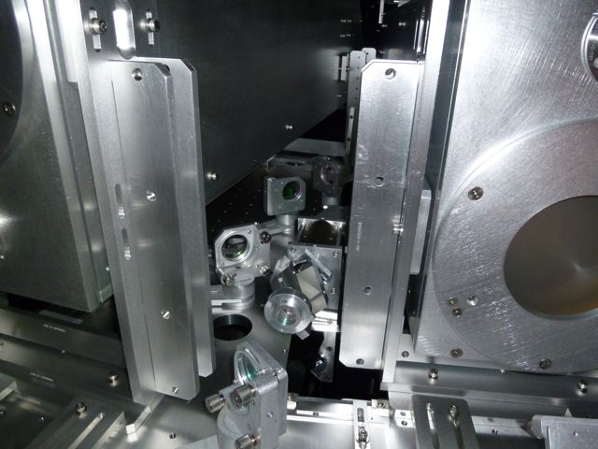
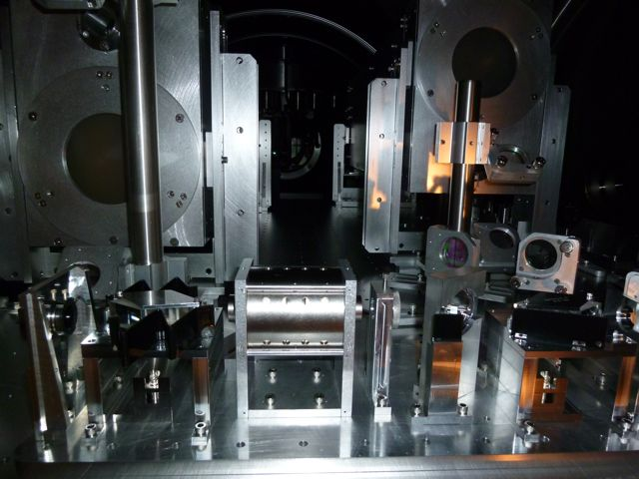
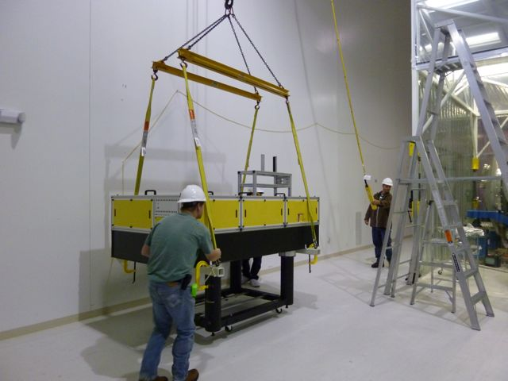
H1 Squeezing Experiment:
Squeezer Installation (just done!)
Additional Faraday installed in the squeezed beam path
New H1 Output Faraday
(first aLIGO unit)
Squeezer table craned to its final location
Relocking H1 now
First squeezing injection in August
Plans depend on Advanced LIGO schedule
  aLIGO installation on H2 started in October

Slide 15
Open Questions/Problems
Back Scattering
Losses
Interferometer stability with squeezing
    Analysis on going in GEO right now
In principle they are all “just” technical problems
In practice, they need to be understood (now) to make squeezing ready for Advanced Detectors

Slide 16
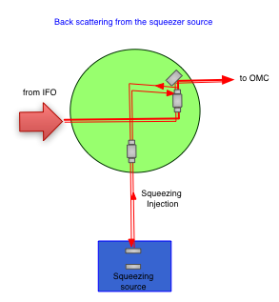
Noise from Back Scattered Light
Fraction of the light from the IFO is scattered back to the IFO by the squeezer
Modulated by the squeezer motion
it makes noise in the GW channel in the
hundred Hz region
(where we care the most!)

Slide 17
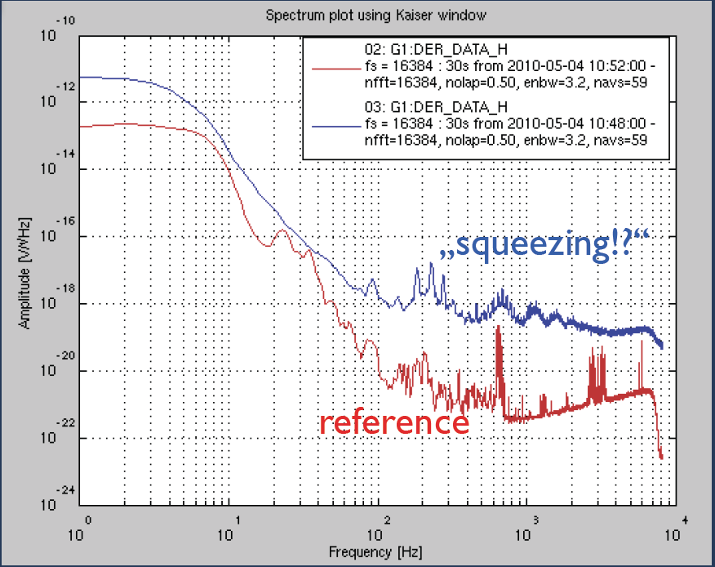
Back Scattering in GEO
First squeezing injection: back scattered noise limits the sensitivity
Additional Faraday to reduce back scattering and measure squeezing
Courtesy of Alexander Khalaidovski (AEI)
GWADW 2010

Slide 18
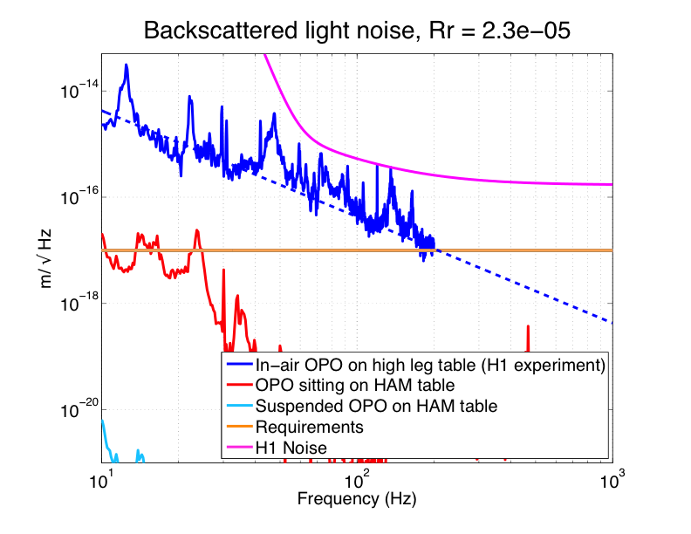
Back Scattering in H1
(Model! No data yet)
Motion of the
scattering surface
➔ 46 dB of back scattering suppression from the bow-tie OPO measured at ANU (Michael’s talk)
Power reflectivity of
the scattering surface
?
Current set-up ok for H1, it might be not optimal for Advanced LIGO
Waiting for the actual measurement to evaluate the best strategy to deal with it

Slide 19
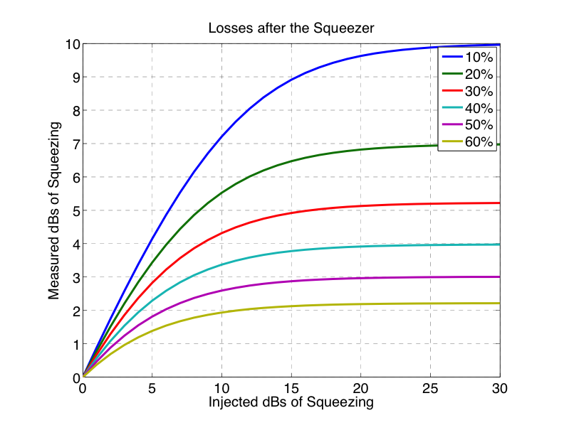
Losses are Bad
Losses degrade squeezing (“un-squeezed” vacuum gets in)
At some point it doesn’t matter anymore how much squeezing we are injecting

Slide 20
Losses are Bad
Plenty of losses in the squeezed beam path (from the squeezer to the GW photodiode):
    Mode matching
    Faradays
    (less back scattering = more Faradays = more losses)
    Optical components (windows, mirrors, ..)
➔ Need to learn how to mode match more efficiently
➔ Need to be ready to make very low loss Faradays!

Slide 21
Where we are going from here
Squeezing is not the baseline for Advanced Detectors (except GEO HF!), but..
…recent progresses make squeezing closer than ever
The GW community is “thinking” about it
Courtesy of Nobuyuki Matsumoto (University of Tokyo)

Slide 22
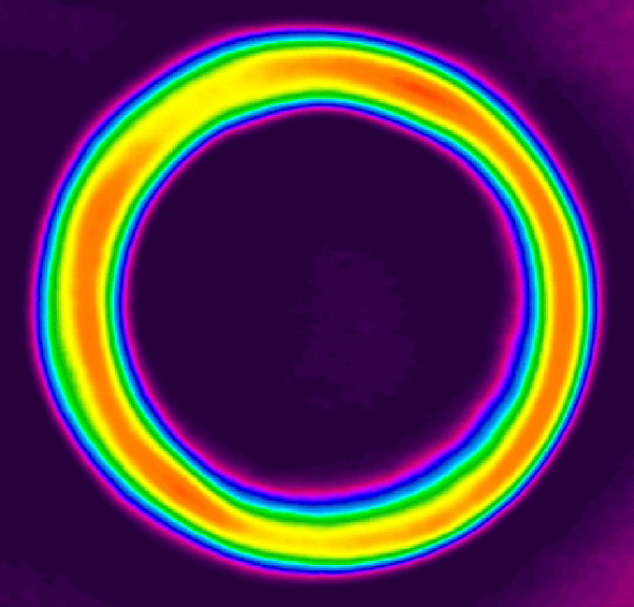
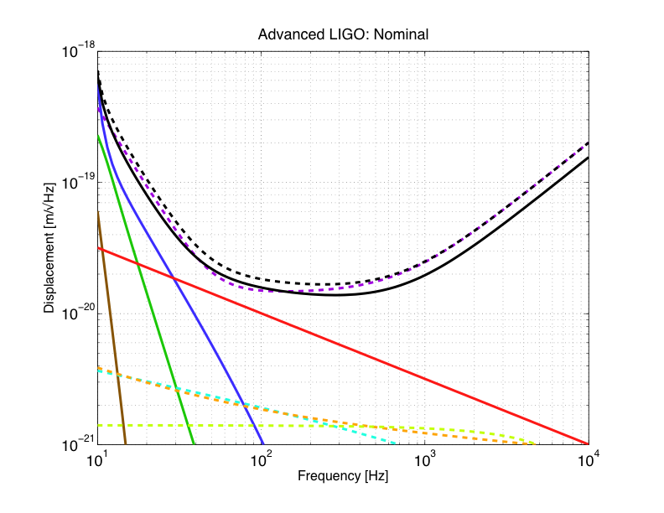
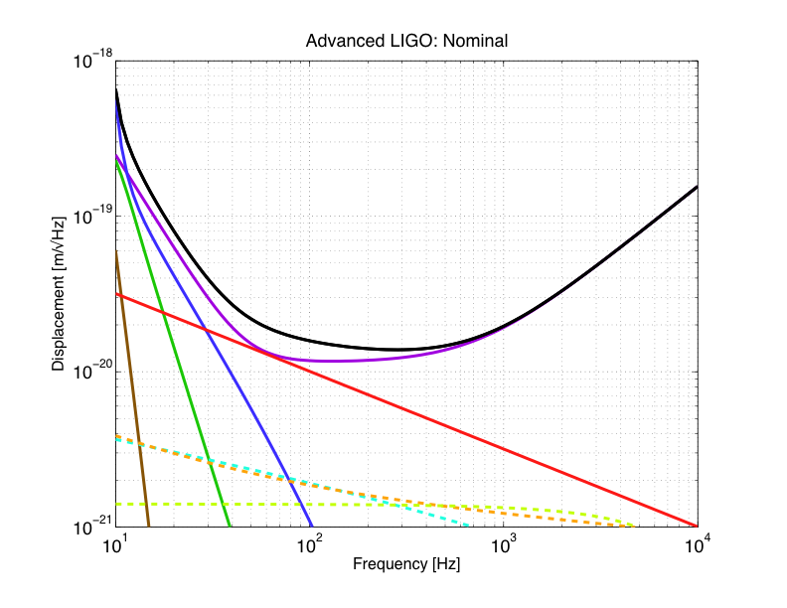
Advanced LIGO:
Risk mitigation for high power
With 6 dB of perfect squeezing:
need 4 time less power!
31 W + 6 dB of Sqz (10 dB of anti-Sqz, Total Losses ~ 20%)
We will have a squeezer ready
to be installed if needed

Slide 23
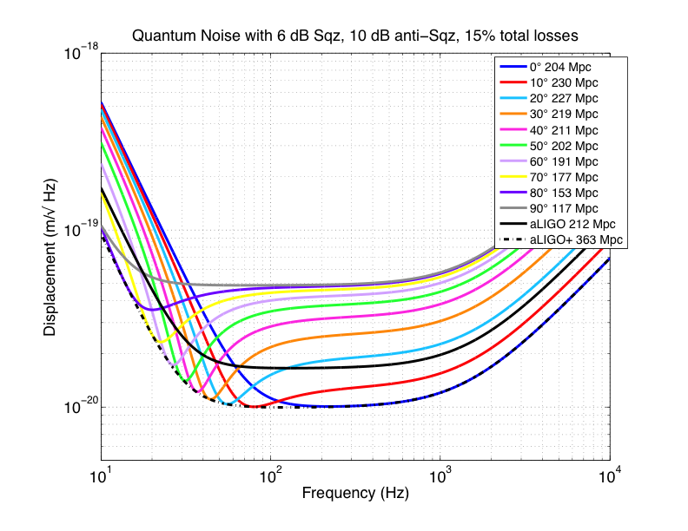
Advanced LIGO and Beyond
Quantum noise shaped by tuning the squeeze angle
Filter cavities to beat quantum noise at all the frequency at the same time

Slide 24
The Message
Large scale interferometers with squeezing: happening now!
We need to understand issues / fix problems to be ready for Advanced Detectors…
…that’s what we are trying to do!
THANKS!

Slide 25
Shot Noise &
Photon Arrival Time
Shot noise is the fundamental noise limiting the GW detector sensitivity at “high” frequency
Shot noise originates from the Poissonian statistics of the arrival time of the photons on a photo-detector
The minimal phase variation in the arms which can be measured is:
LASER
AS port
Photo-Detector
N number of photons incident on the mirrors in the measurement time

Slide 26
H1 Experiment Goal:
Design the aLIGO Squeezer
Inject 6 dB of squeezing at the asymmetric port of H1
Improve the sensitivity by 3 dB (due to losses) above 400 Hz
Understand the impact of squeezing at low frequency
Find/fix “technical problems”

Slide 27
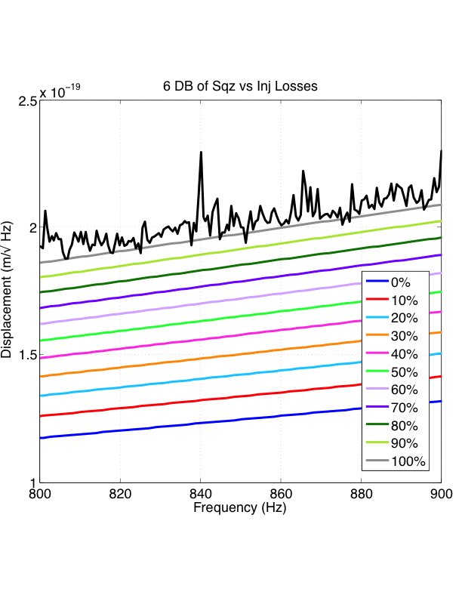
Squeezing Injection in H1
About 20% losses
in the output path (OMC, Faraday)
About 10% losses in the sqz injection path
3 dB of Sqz observed with 6 dB of Sqz produced

Slide 28
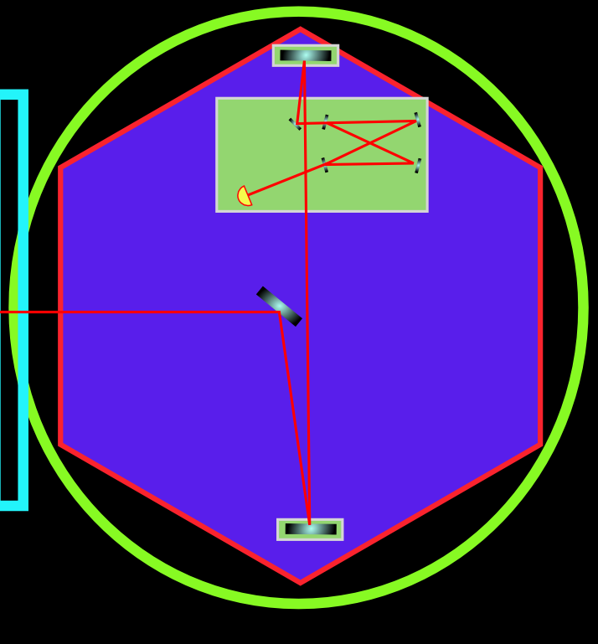
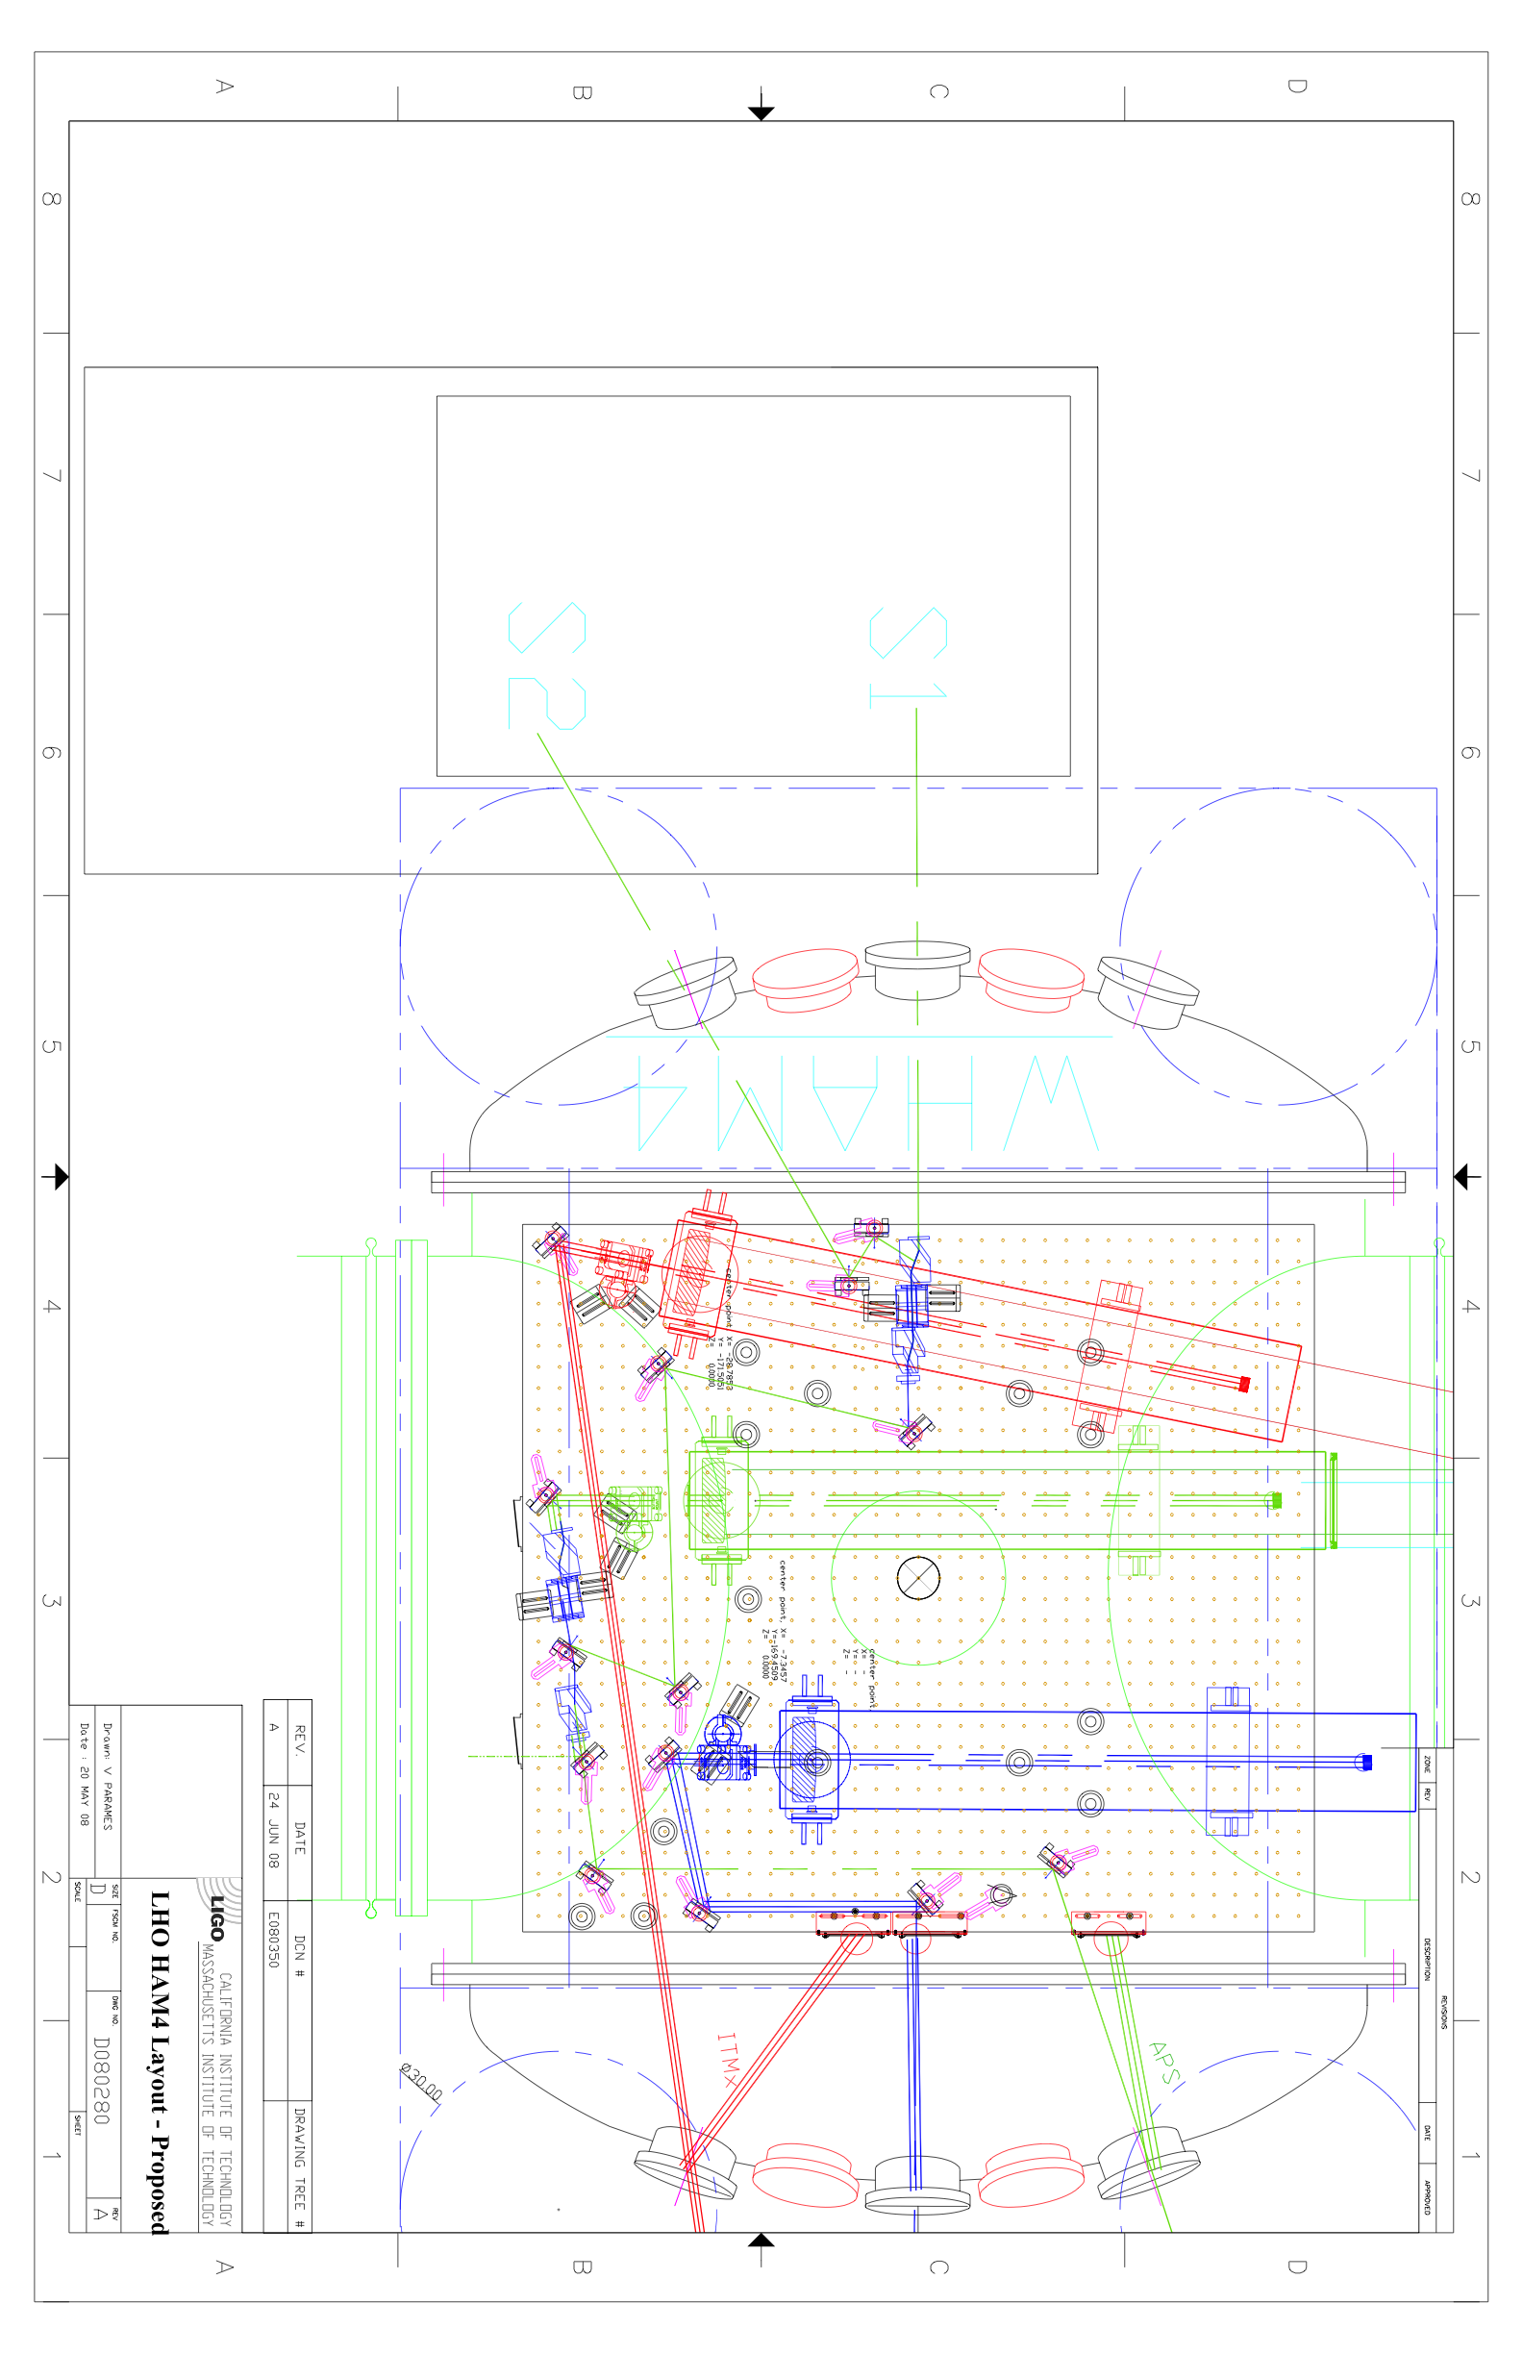
Losses
~20% losses in the IFO output path
IFO
~10% losses in the sqz injection path
HAM 4
Squeezing Table
~ 30% TOTAL LOSSES

Slide 29
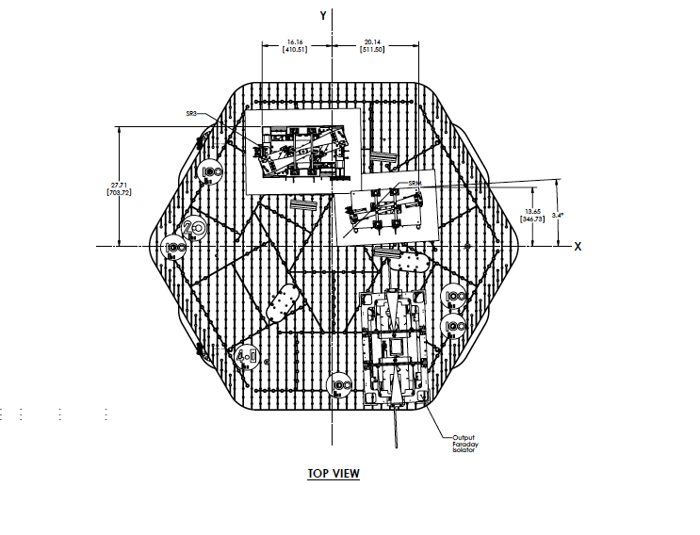
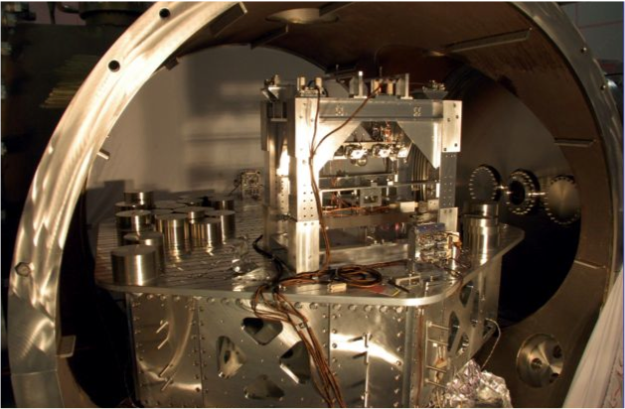
Speculations on the
Advanced Squeezer
Two directions:
  Reduce the light back to the squeezer
  (more Faradays, but Faraday=losses)
  Reduce the motion of the scattering surface (OPO)
OPO
Sqz Faraday
Output Faraday
Advanced LIGO HAM5

