Slide 1
Modal Damping Notes
Brett Shapiro
8 June 2011
G1100755

Slide 2
Low Gain Modal Damping Noise

Slide 3
Low Gain Modal Damping Ringdown

Slide 4
Low Gain Modal Damping Loop Gain

Slide 5
High Gain Modal Damping Noise

Slide 6
High Gain Modal Damping Ringdown

Slide 7
High Gain Modal Damping Loop Gain

Slide 8
Modal Damping Filters
The filter includes 2 low passing poles at twice the resonance frequency and a 2 pole, 2 zero gain bump at the resonance. Total of 4 poles and 2 zeros per mode.

Slide 9
Modal Damping Block Diagram
Real
World
Pendulum
Estimator
G₁
Modal
World
G₂
G₃
G₄
x = sensor signals
q = vector of modal signals
P_{m} = modal damping force vector
P = Euler damping force

Slide 10
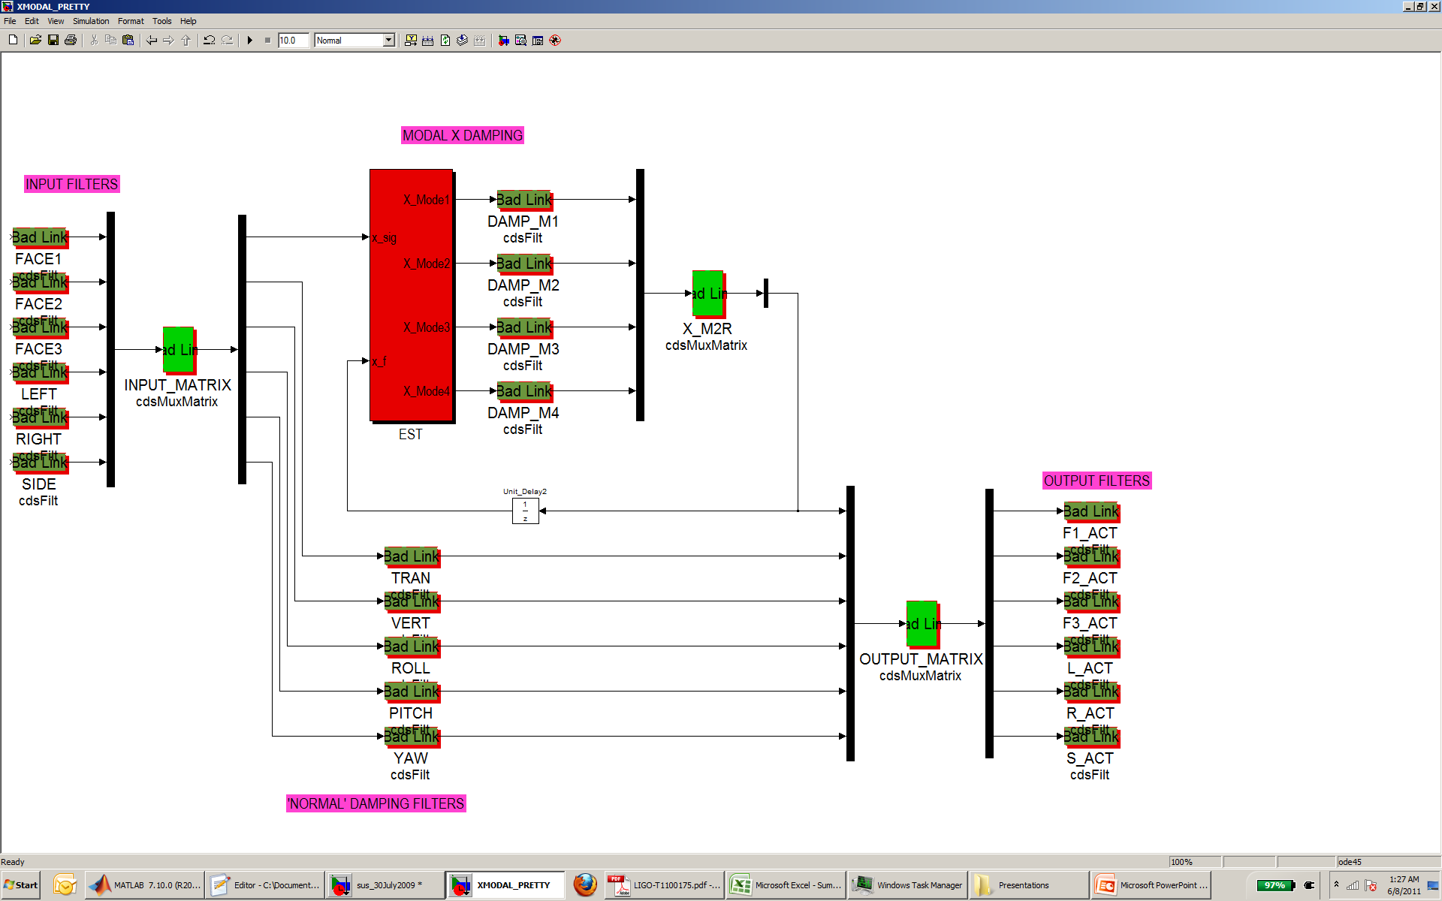
X Modal RCG Implementation
Pole count for X damping: Estimator = 8 per filter, Dampers = 4 per filter -> Total = 80.

