Slide 1
Data Quality Studies
Methods and Milestones
J. McIver for the
LIGO Scientific Collaboration
and the Virgo Collaboration

Slide 2
Outline
An introduction to “glitches”
How loud are they and how often do we see them?
How do they limit the searches?
Methods used to abate glitches
Hunting down the source
Data quality vetoes
Virgo
eLIGO
Milestones in enhanced detector data quality
The advanced detector era

Slide 3
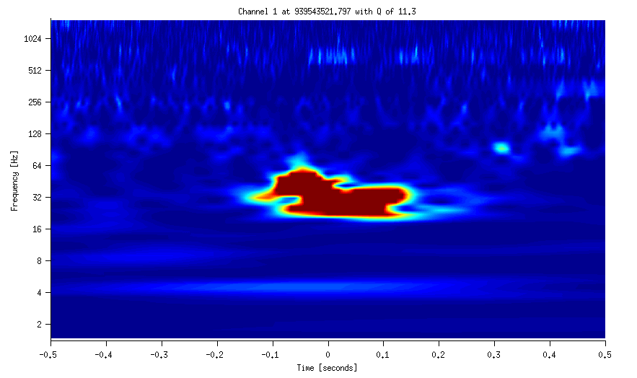
Introduction to Glitches
What is a “glitch”?
Gravitational wave data channel
Noise transient
Characterized by
SNR (signal to noise ratio)
Central freq
Shape in spectrogram plot
Frequency (Hz)
Time (seconds)

Slide 4
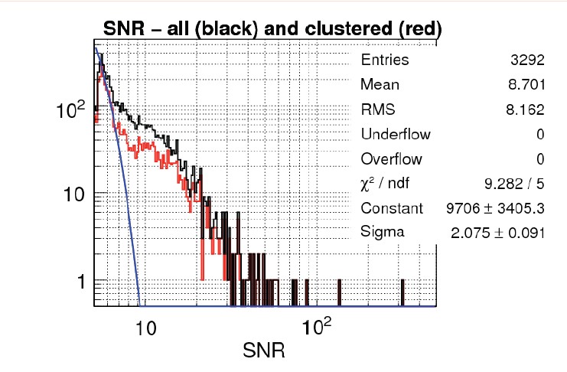
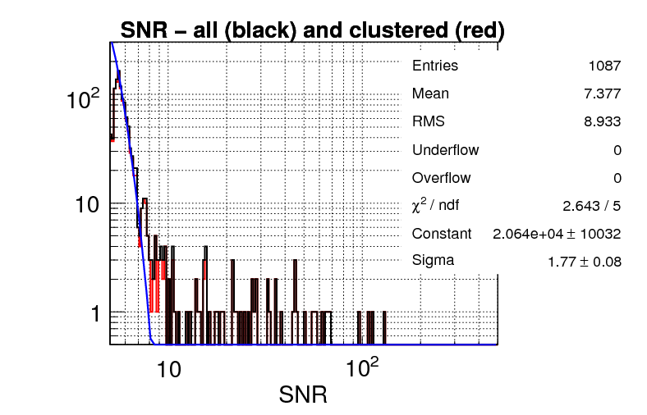
Introduction to Glitches
How loud are they?
It depends on the weather, seismic noise, ocean waves, human movement, traffic, trains, instrumental/electronic malfunctions etc.
A “bad” day at Hanford during S6
A “good” day at Hanford during S6
Num. Events vs SNR Histogram
Num. Events vs SNR Histogram
Gaussian noise prediction
Gaussian noise prediction
S6D July 25 2010 LHO
S6D Aug 21 2010 LHO

Slide 5
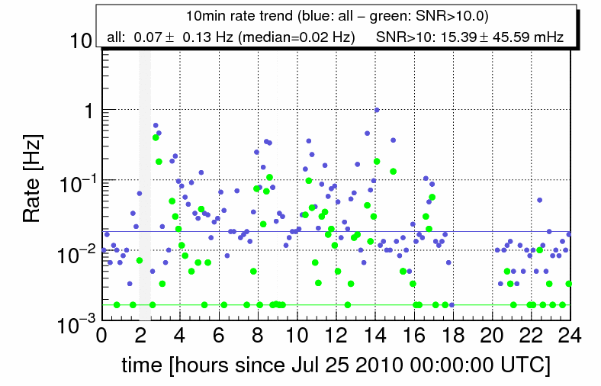
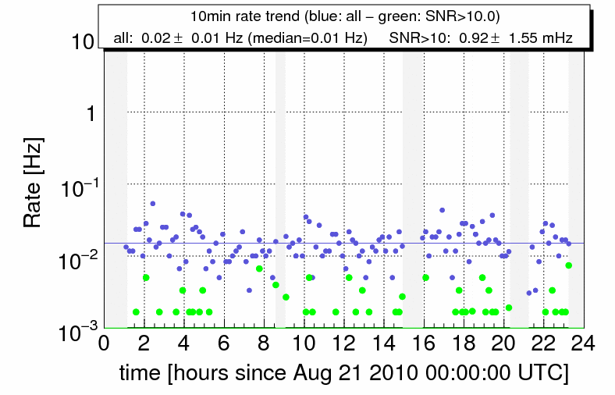
Introduction to Glitches
How often do we see them?
A “bad” day at Hanford during S6
A “good” day at Hanford during S6
S6D July 25 2010 LHO
S6D Aug 21 2010 LHO

Slide 6
How do glitches limit the searches?
Coherent or coincident searches are much less sensitive to glitches
Coincidence in time is the first line of defense against falsely claiming a detection
But, glitches are common enough that coincidence does still happen

Slide 7
How do glitches limit the searches?
Low mass compact binary coalecence vs. burst searches
The low mass compact binary coalescence (CBC) search requires candidate signals to match a template of known waveforms as well as coincidence
Limited by loud glitches that blind the searches, and glitches that mimic the template forms
Searches for astrophysical “burst” sources require coincidence
Limited by frequent glitches (increased likelihood of coincidence)

Slide 8
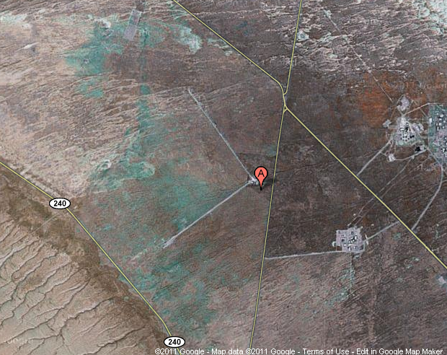
Methods used to abate glitches
Google maps image of Hanford detector and surrounding highways

Slide 9
Hunting Glitches
Glitch hunting targets:
Glitches that are having the most impact on the searches
Patterns, anomalies, or unusual behavior seen in glitches found by the searches
Glitches that cause lock loss
Prominent sources of glitches could be:
a problem with the physical equipment
a digital signal processing artifact,
an environmental issue, etc.
The optimal solution is to fix these instrumentally

Slide 10
Hunting Glitches
How do we find patterns/anomalies in glitch behavior?
We look at the characteristics of glitches (i.e. common frequency, signal to noise ratio (SNR), etc.)
We look at glitches’ coincidence with auxiliary channels
Detector characterization groups within the LVC use tools that statistically rank the coupling between the gravitational wave channel and auxiliary channels to look for the source of the unusual glitches
See J. Smith et al. “A hierarchical method for vetoing noise transients in gravitational-wave detectors”

Slide 11
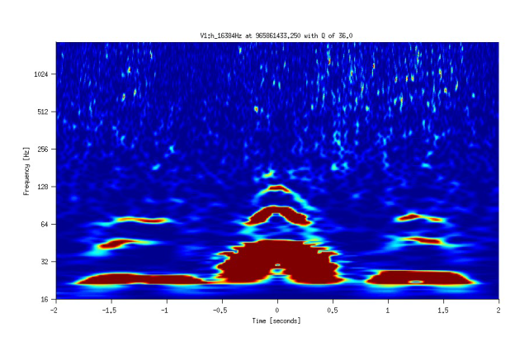
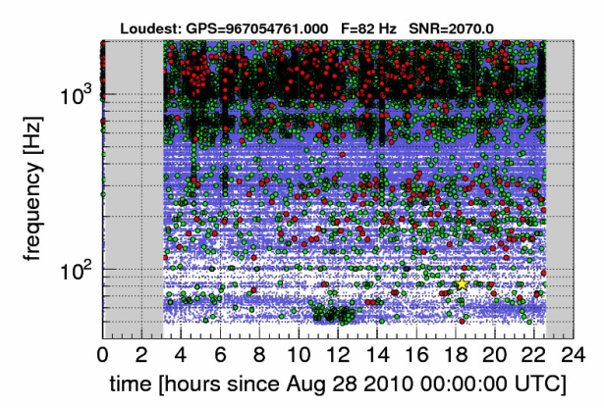
Hunting Glitches
Useful tools
Frequency line finder
Weekly statistical results
Low-latency burst algorithm (Omega)
Other Strategies
Looking at the SNR of glitches in environmental channels coincident with the gravitational wave data channel
Other glitch characteristic studies
Example: how do higher SNR glitches behave vs lower SNR
Example of Omegascan
Example of Glitchgram

Slide 12
Data Quality Flags
Data quality (DQ) flags mark periods of time when a detector is suffering from a known problem or a period of suspect data quality
Flags are assigned categories that dictate how the flag is to be used in analysis
Category 1 - Serious problem with the detector occurred – remove this data before analyzing
Category 2 – Known problem with the detector occurred – remove this data before searching for signals
Category 3 – Indicates an incompletely understood statistical correlation– don’t use these times for “clean” data

Slide 13
Evolution of Data Quality Flags
Some automatically generated DQ flags are a constant presence
Example:
High wind (wind speed over a certain threshold)
Some DQ flags are tailor-made to individual detectors or certain glitch classes
Examples:
Glitch-rate (rate of glitches over a certain SNR over a certain frequency threshold)
“SeisVeto” (tuned search algorithm to flag low-frequency seismic noise)
Tailor-made flags tend to be more effective, until the glitch population shifts again

Slide 14
Evolution of Data Quality Flags
Online Veto Production
Virgo uses the same tools and architecture developed for data acquisition for online veto production.
LIGO data acquisition and flag generation were separate during eLIGO
Day or week latency vetoes:
Produced by statistical ranking algorithms and based on triggers produced by the a burst search algorithm. Output segments are stored offline in a database.

Slide 15
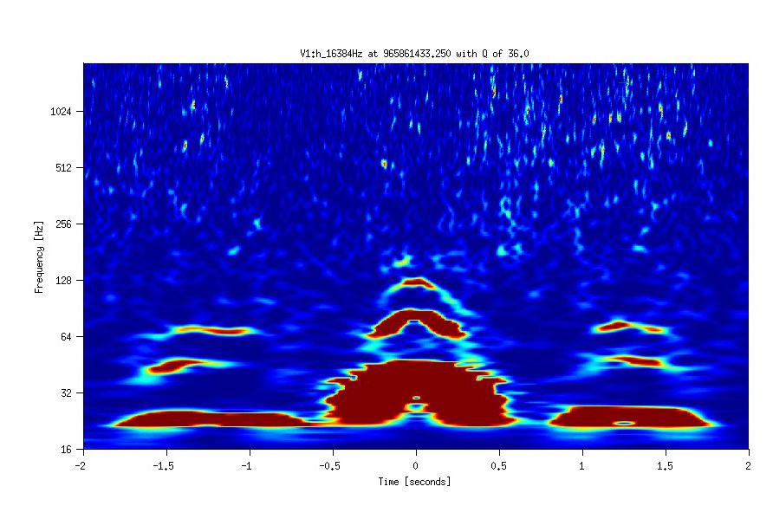
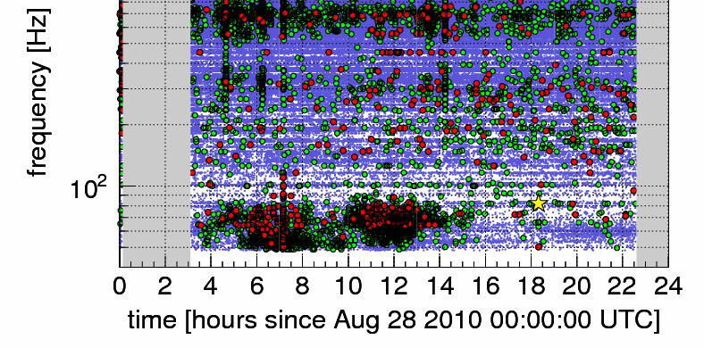
An Example of Well
Understood Virgo Glitches
Micro-seismic <-----> scattered light
The stronger the "shaking", the more arches are seen.
Virgo has a very good seismic data quality flag
but with a large dead-time
105 Hz
70 Hz
35 Hz
DQ flag applied

Slide 16
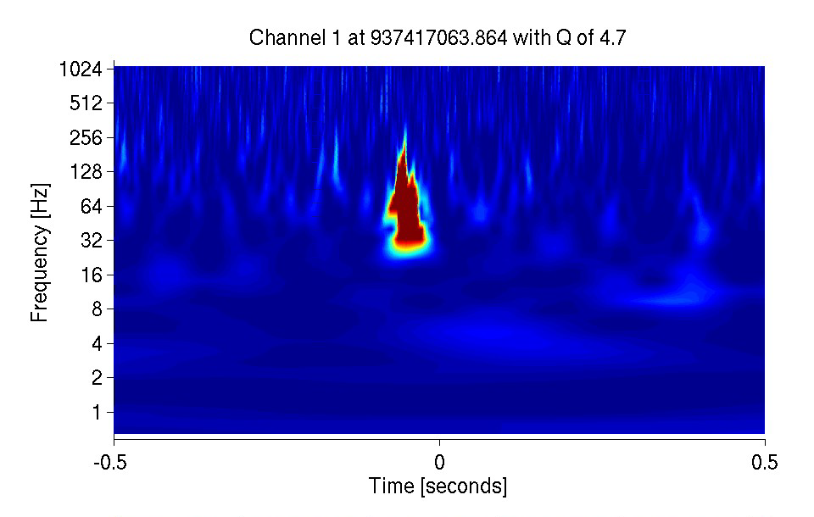
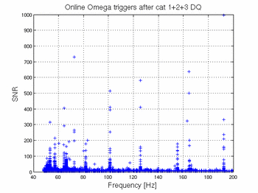
An Example of Virgo Glitches of Unknown Origin
They cover the full VSR2 run with a peak in September 2009:
They are usually loud for Virgo (SNR>15)
No auxiliary channel found containing glitches in coincidence useful to produce vetoes against those glitches

Slide 17
An Example of Well Understood eLIGO Glitch: Seisveto
Time series showing seismic noise during a weekday at the Hanford detector
Seismic counts (min average)
Time series showing low-frequency glitches created by this seismic noise affecting the entire spectrum of inspiral templates in the low mass compact binary coalescent search template bank.
Macleod et al. 'Removing the effect of seismic noise from LIGO data by targeted veto generation’. In preparation.

Slide 18
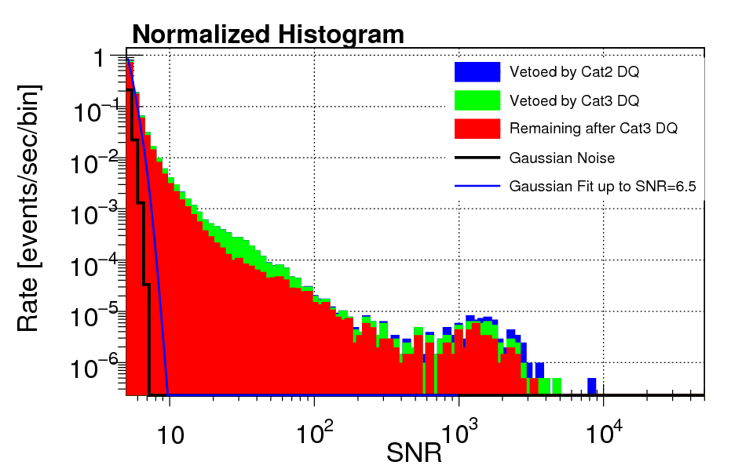
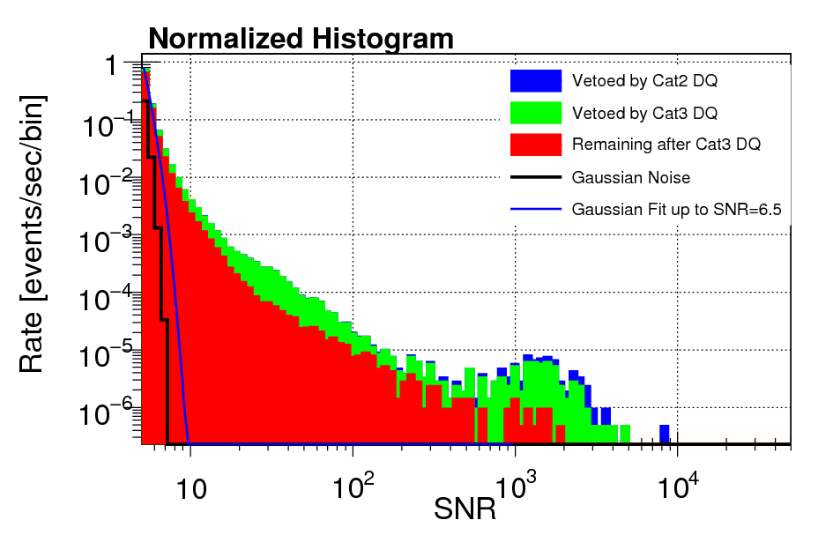
Example of eLIGO glitch well understood
The “Seisveto” data quality flag targeted these seismic glitches
A rate histogram of Hanford detector data during S6D without Seisveto applied
Same data as left plot with Seisveto applied as a cat3 DQ veto

Slide 19
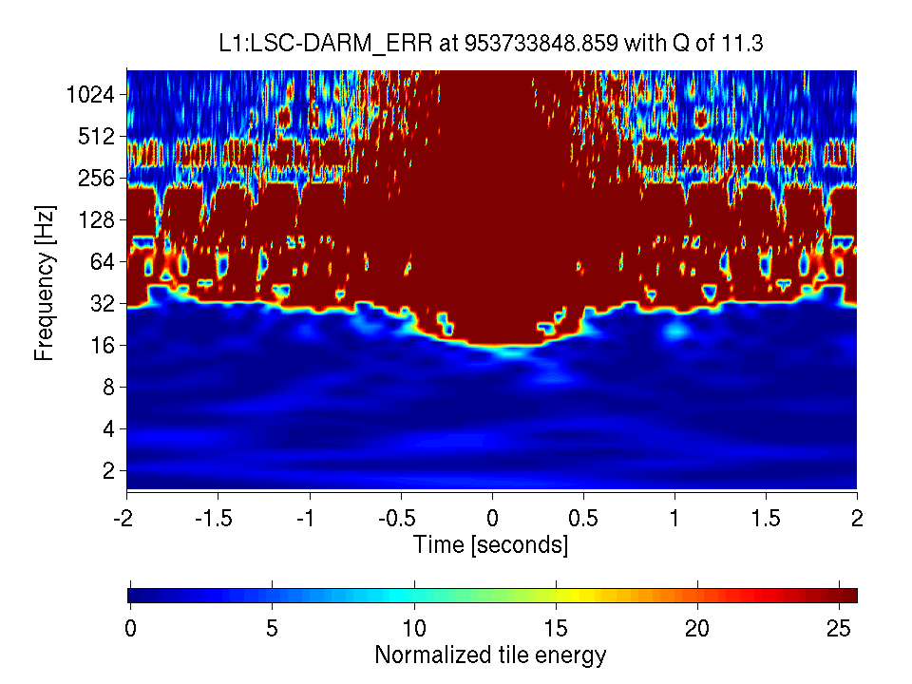
Example of eLIGO glitch of unknown origin: spike glitches
Biggest issue in S6 for Livingston
Common and loud – problematic for low mass compact binary coalescent search

Slide 20
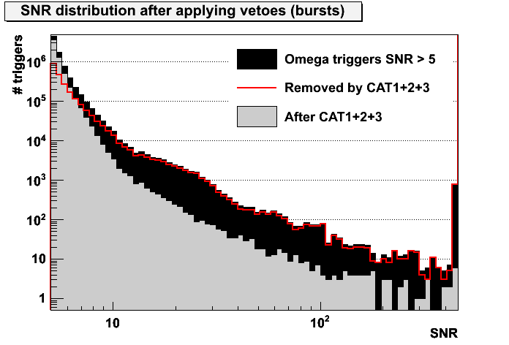
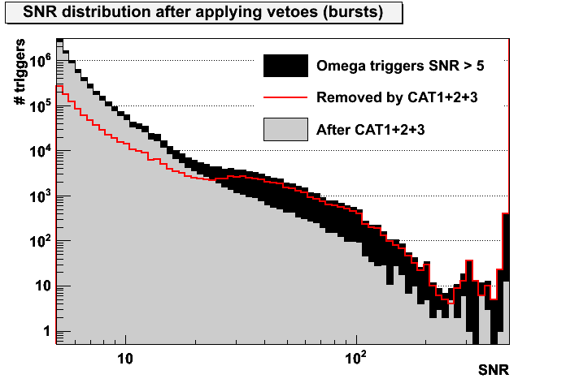
Virgo DQ Flag Performances
Overall performances of Burst DQ vs Omega triggers with SNR>8
VSR2
VSR3
cat1+2 cat1+2+3
Efficiencies: 61.7% 74.6%
Deadtimes: 5.0% 8.1%
cat1+2 cat1+2+3
Efficiencies: 19.3% 27.1%
Deadtimes: 4.2% 8.8%

Slide 21
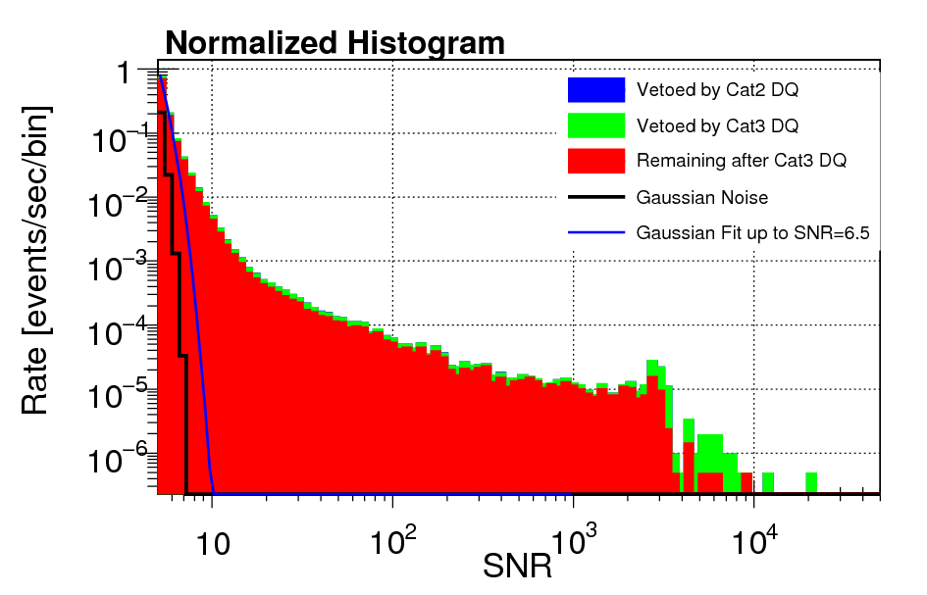
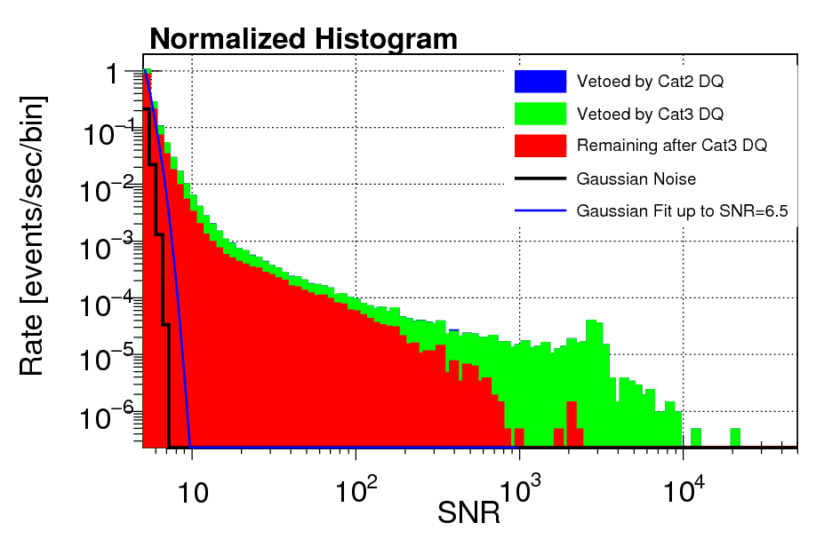
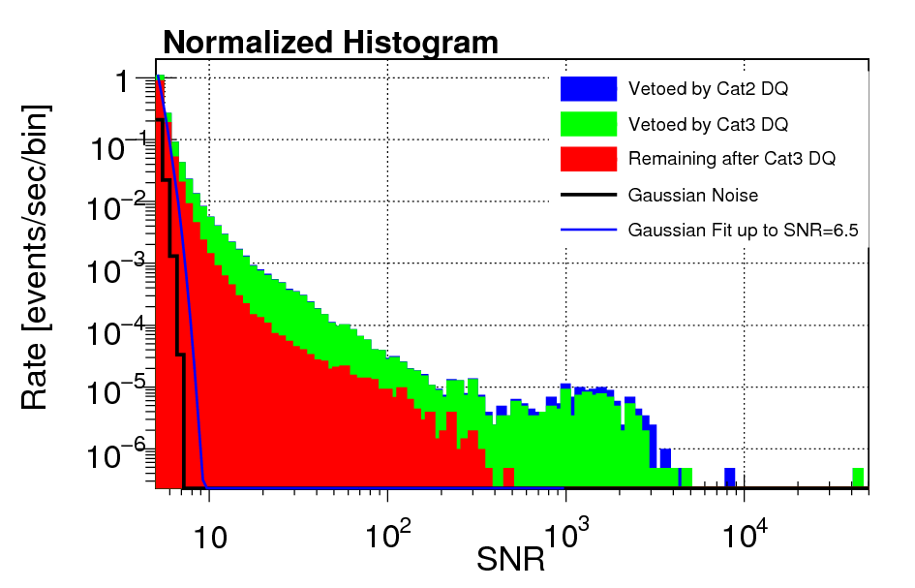
S6 DQ Veto eLIGO Summary
With only pre-S6D (online) DQ vetoes applied
With DQ vetoes tailor-made for S6D applied
Livingston rate histograms during S6D
Hanford rate histograms during S6D

Slide 22
S6 DQ Veto eLIGO Summary
S6D final statistics
Hanford
Livingston
Cat2
Cat3

Slide 23
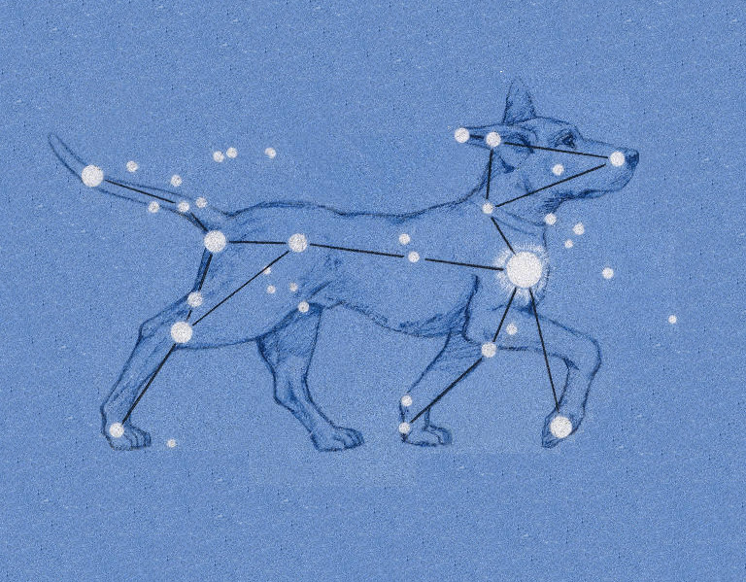
Milestones in enhanced detector era data quality

Slide 24
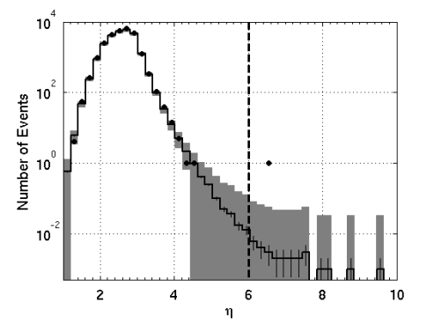
The equinox event
The “equinox” event was the only event in the coherent wave burst search above threshold in S5
Later turned out to be a blind injection
DQ’s role in lack of confidence in a detection:
The glitch rate with data quality vetoes applied was still too high to make a confident detection
Equinox event

Slide 25
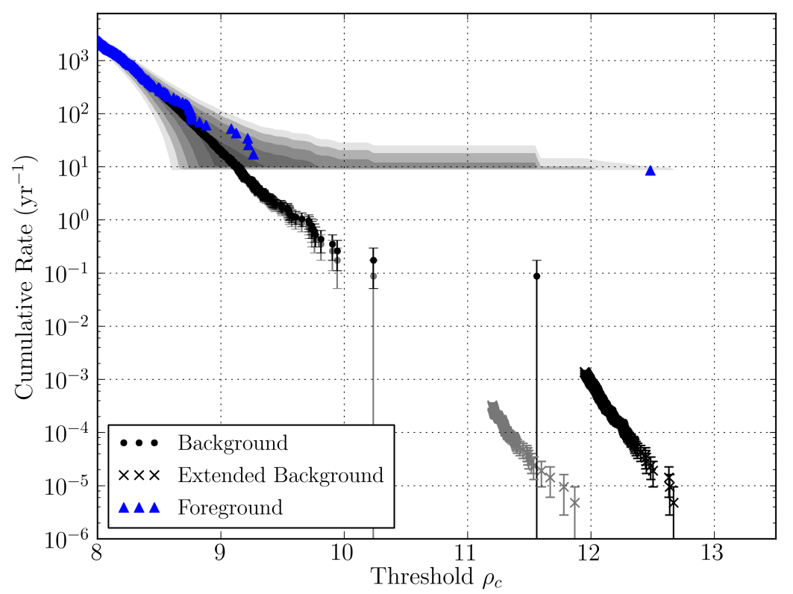
“Big Dog” Blind Injection
The good news: the low mass CBC search was able to set a very low false alarm rate on this blind injection
GW 100916

Slide 26
Virgo: Summary and
Next Steps
Fairly good results in VSR2 and VSR3
but several unexplained and/or unvetoed loud glitches remain
VSR4 run has started since June 3rd 2011, in coincidence with GEO detector
Glitchiness back to VSR2 level ~ 0.7 Hz
Detchar activities concentrate on low frequency (<50 Hz) where noisy lines may prevent pulsar searches and high frequency (>800 Hz) where glitches may pollute GEO-Virgo coincident burst searches
VSR4 will be also useful to test new ideas for vetoes in Adv. Virgo (glitch families, vetoes categorization, information about non-stationary frequency lines much more exploited…)
More details about Virgo Data Quality and glitch investigations in http://wwwcascina.virgo.infn.it/DataAnalysis/VDBdoc
More details about noise monitoring and spectral lines investigations in specific Virgo talks at this conference.

Slide 27
The advanced detector era
Low-latency detector characterization enabled us to rapidly point telescopes during the latest science run
In the advanced detector era, the detector characterization groups at LIGO and Virgo are preparing for whatever new populations of glitches we may see, and are improving DQ tools for lower latency DQ
See Duncan Macleod’s poster: “Detector Characterisation for the Advanced LIGO detectors”

Slide 28
Questions?

Slide 29
Additional Information

Slide 30
Virgo DQ Flags
Online production and access
Virgo data are sent via Ethernet to DQ monitors
DQ monitors produce DQ flags sent online to the DQ segments production
DQ flags segments are stored in a database (VDB) and in ASCII files
Virgo data from DAQ
DQ monitors
Segments production
VDB
ASCII Files
VDB provides also
VDBtk_segments : a line command to access segments lists in VDB
VDB web interface : a web interface to access segments lists in VDB (https://vdb.virgo.infn.it/VDB/main.php)

Slide 31
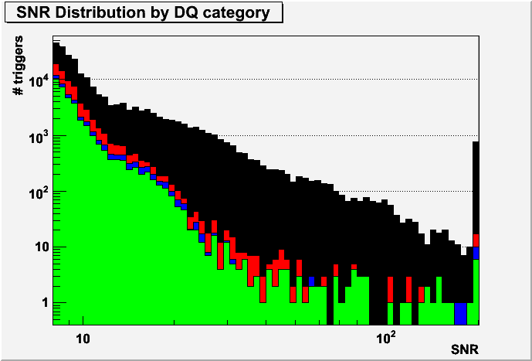
KW-based vetoes
KW-based vetoes (UPV and hveto) have low deadtime and allows to get rid of few loud glitches not vetoed by the DQ flags
UPV on all mbta triggers
UPV on mbta triggers after cat123
eff use perc. eff/dt
SNR> 5.0 42033 / 1534162 = 2.7 % 45.9 % 2.4
SNR> 8.0 6785 / 27903 = 24.3 % 13.4 % 21.5
SNR> 15 1659 / 5342 = 31.1 % 3.6 % 27.4
SNR> 30 145 / 1257 = 11.5 % 0.3 % 10.2
deadtime: 146230 / 12903048 = 1.133 %
eff use perc. eff/dt
SNR> 5.0 6123 / 963256 = 0.6 % 9.6 % 0.56
SNR> 8.0 75 / 4152 = 1.8 % 0.2 % 1.59
SNR> 15 13 / 627 = 2.1 % 0.0 % 1.83
SNR> 30 9 / 148 = 6.1 % 0.0 % 5.37
deadtime: 146230 / 12903048 = 1.133 %
hveto : eff use percentage
SNR> 8.0 3.2 % 20.2 %
SNR> 15 1.7 % 2.0 %
SNR> 30 1.3 % 0.3 %
Deadtime=0.06%
All events
After cat12
After cat123
After DQ+hveto

Slide 32
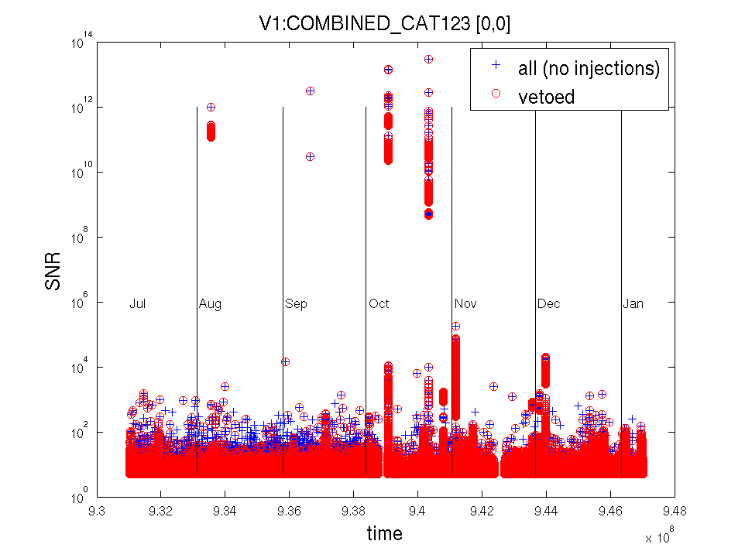
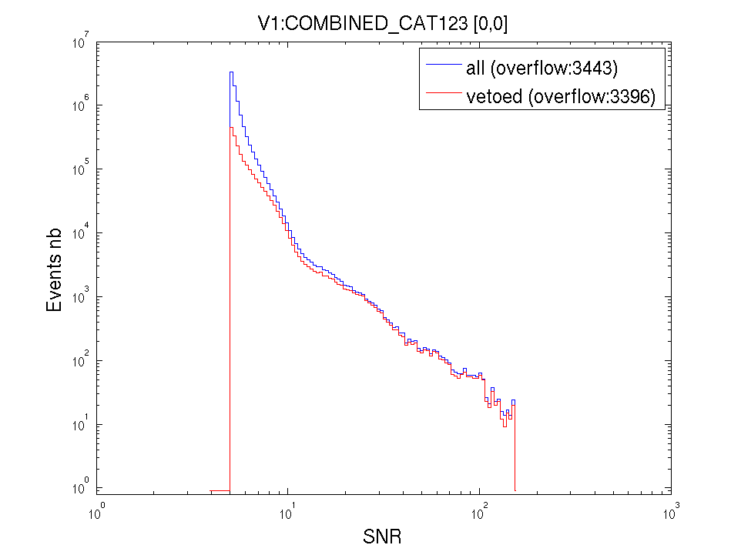
DQ performances on Omega triggers
Cat1+Cat2+Cat3 deadtime=8.1%
efficiency use percentage efficiency/deadtime
SNR> 5 22.635 % 78.33 % 2.80
SNR> 8 74.644 % 22.26 % 9.22
SNR> 15 88.635 % 4.81 % 10.95
SNR> 30 94.018 % 0.60 % 11.62

Slide 33
Example of good DQ flags
The SEISMIC flags
SEISMIC_WE_ZLVDT
SEISMIC_NE_ZLVDT

Slide 34
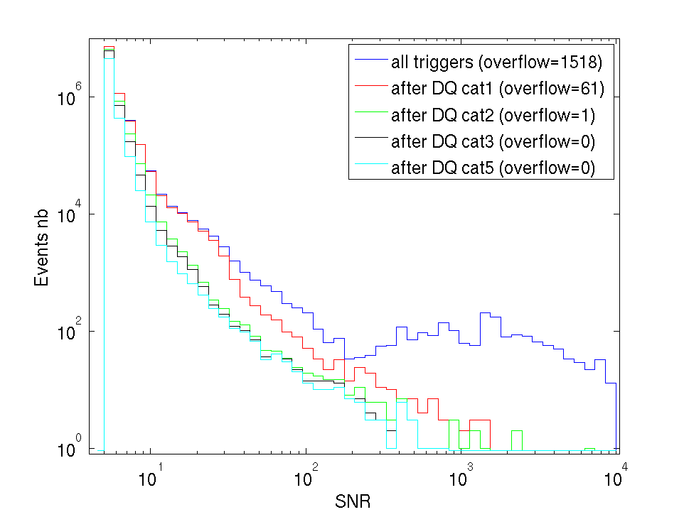
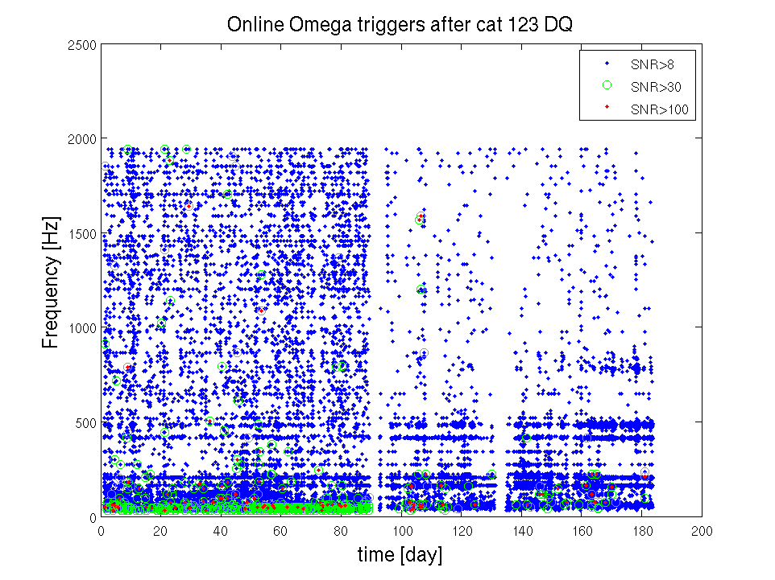
VSR2 remaining glitches

Slide 35
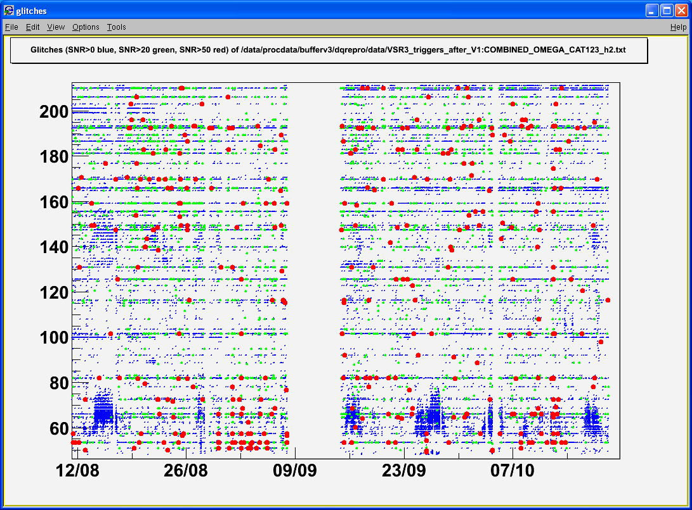
VSR3 Remaining glitches
Low frequency Omega triggers after cat123 (green:SNR>20, red:SNR>50)

Slide 36
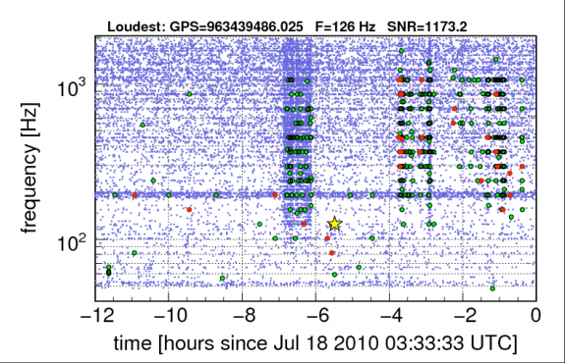
A case study: “grid” glitches
Very frequent glitches plaguing the Hanford detector for about two months late in eLIGO

Slide 37
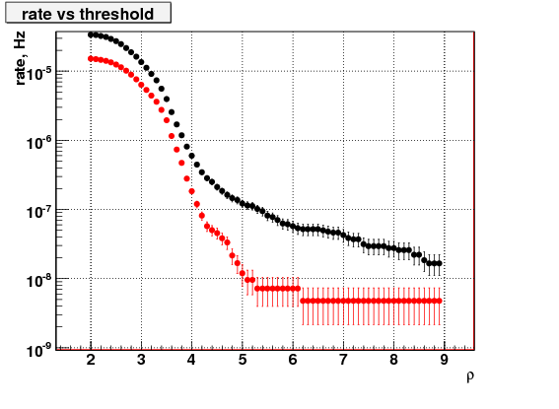
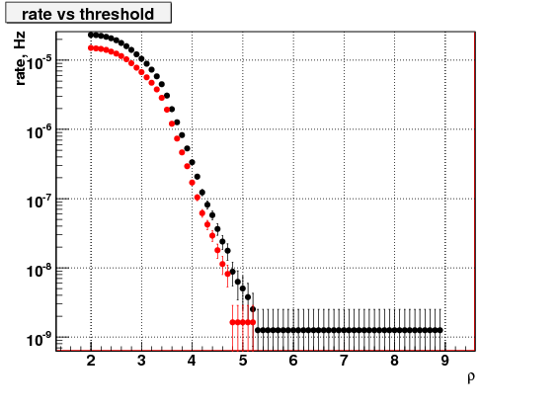
A case study: “grid” glitches
How grid glitches limited the searches
Impact on the LIGO network coherent wave burst search search
L1, H1 Before Aug 17, 2010
L1, H1 After Aug 17, 2010
Post cat 2
Post cat 3
Post cat 2
Post cat 3
Rho out to 30, 21

Slide 38
A case study: “grid” glitches
The glitch rate flags
A series of DQ flags designed to combat grid glitches
Search groups adopted flags vetoing times containing glitches over a certain SNR occurring more often than a certain frequency
Resolved by re-soldering of Piezo heater driver chassis
Hanford detector during grid glitches (June 26 – Aug 21)
Histogram of glitches found by a single detector burst search after the burst group adopted a conservative glitch rate flag as a cat 3 veto

Slide 39
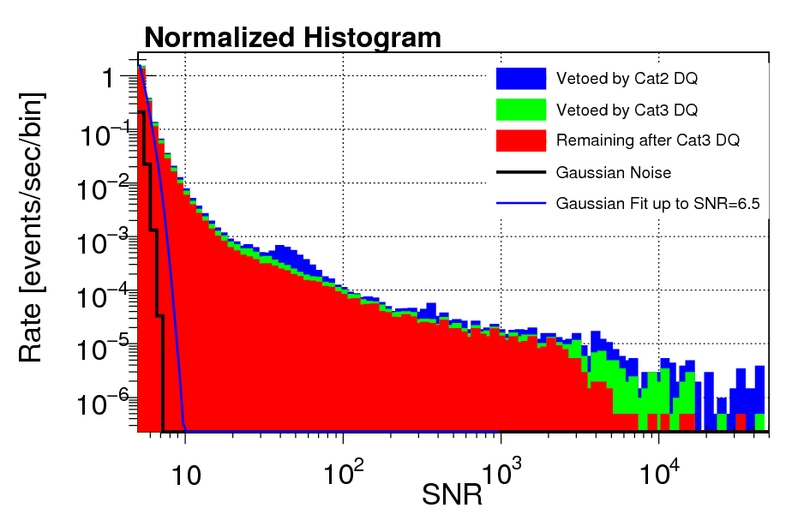
Data Quality Vetoes
The interferometers are constantly changing
We see a major shift in how effective individual DQ flags are after a commissioning period
A rate histogram of the Livingston detector for “S6C” (Jan–May 2010)
A rate histogram of the Livingston detector for “S6D” (June–October 2010)

Slide 40
Seisveto stats

