Slide 1

An updated crash course in Newtonian noise
Jan Harms

Slide 2
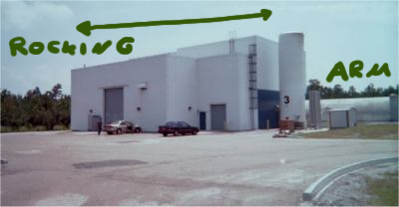
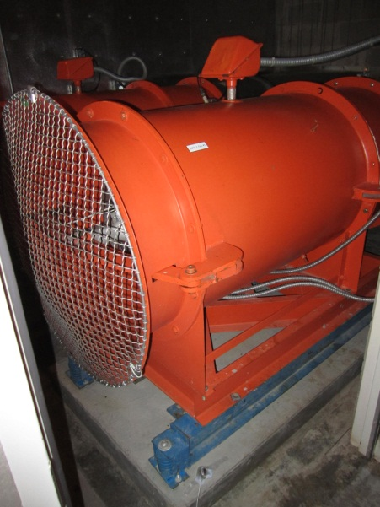
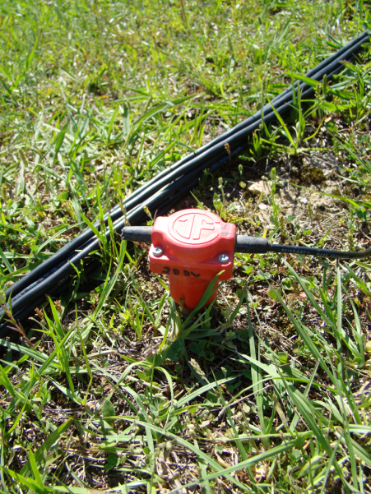
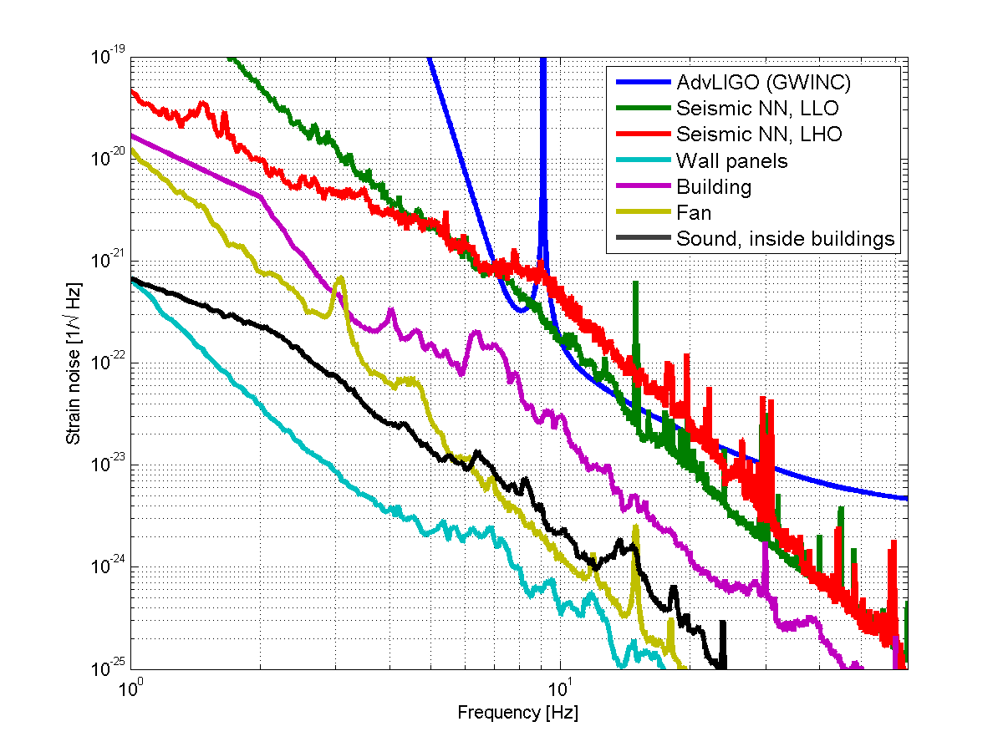
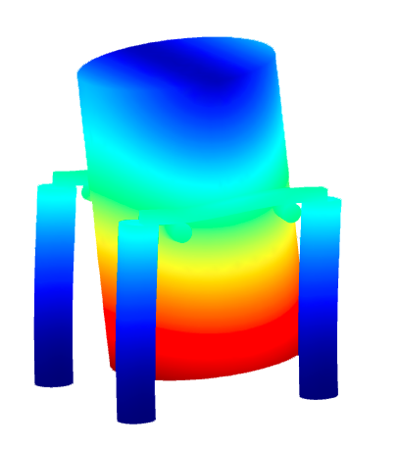
NewtonianNoise::aLIGO
Building
Fan
Seismic
Chamber

Slide 3
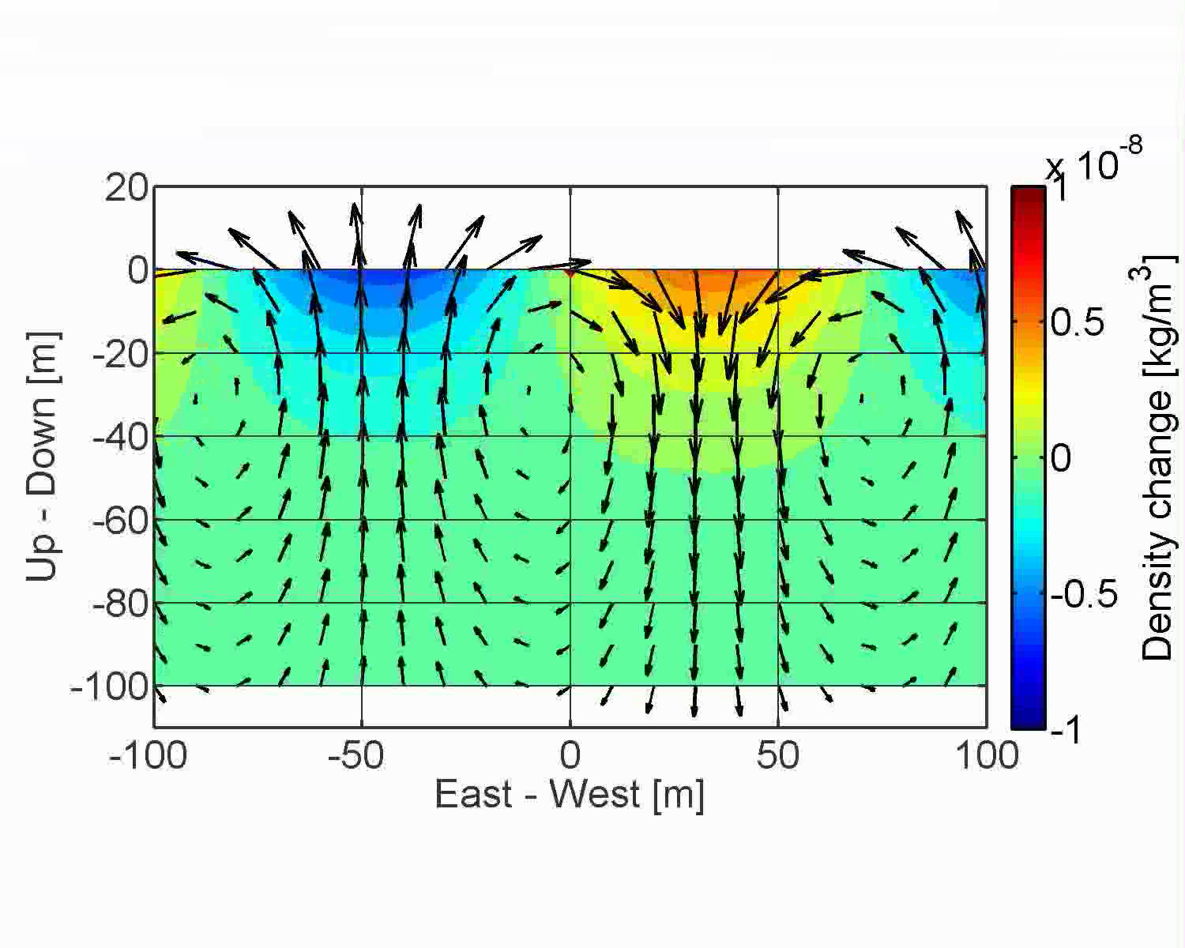
SeismicNoise::RayleighWaves

Slide 4
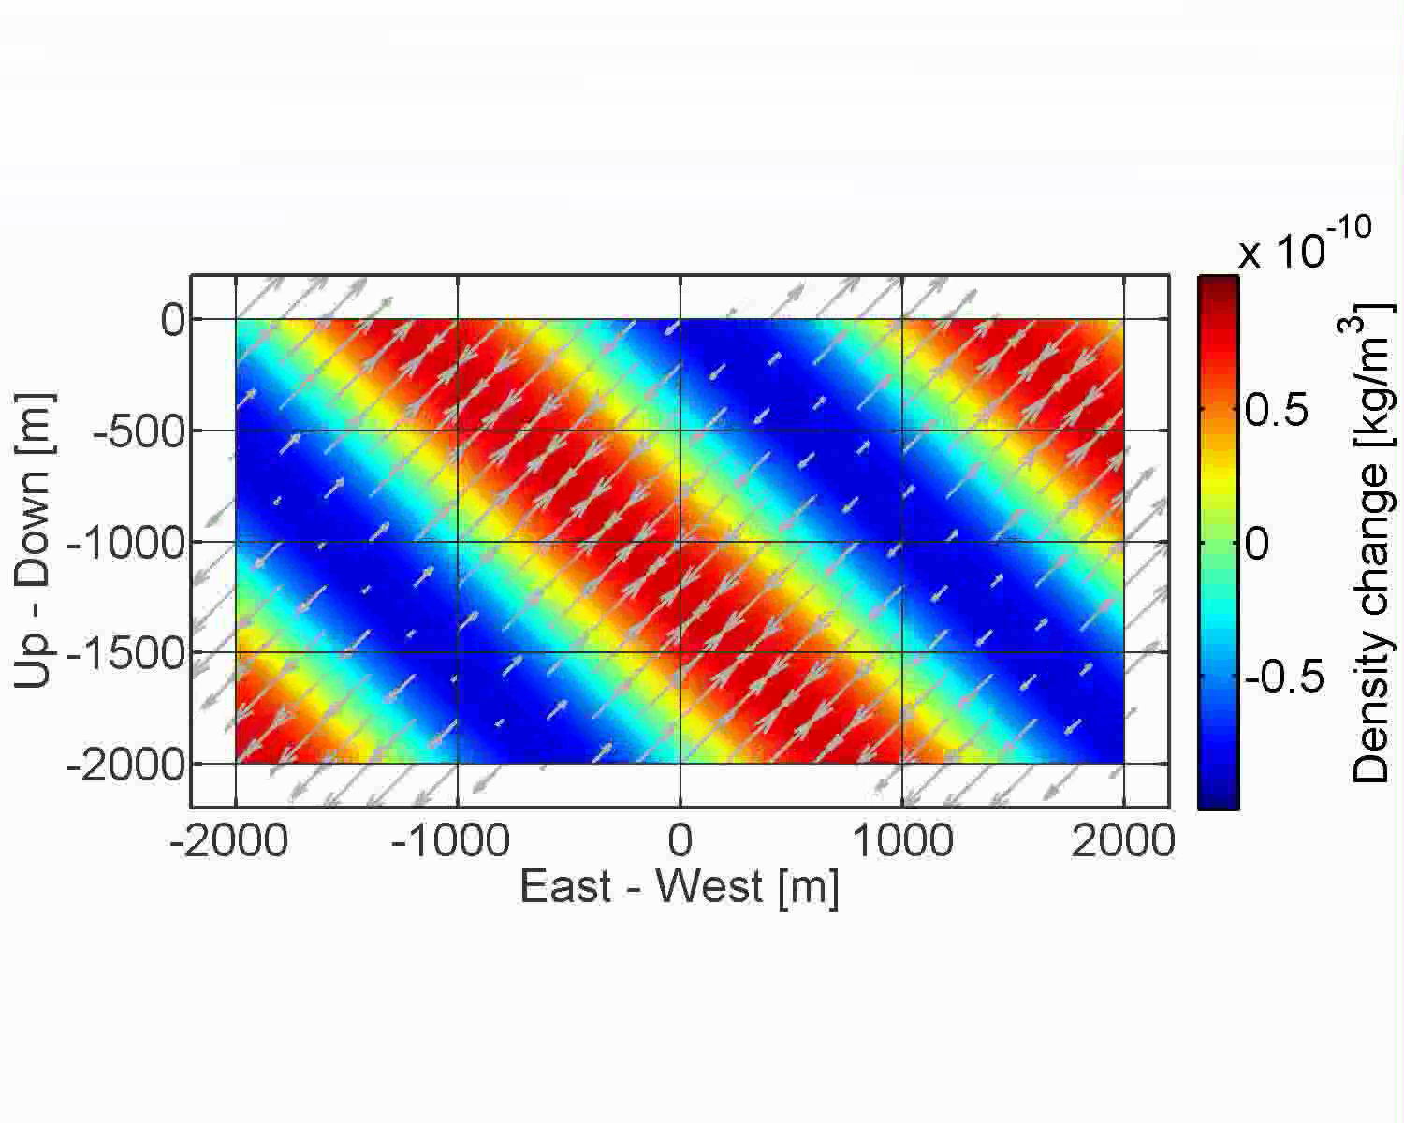
SeismicNoise::
CompressionalWaves

Slide 5
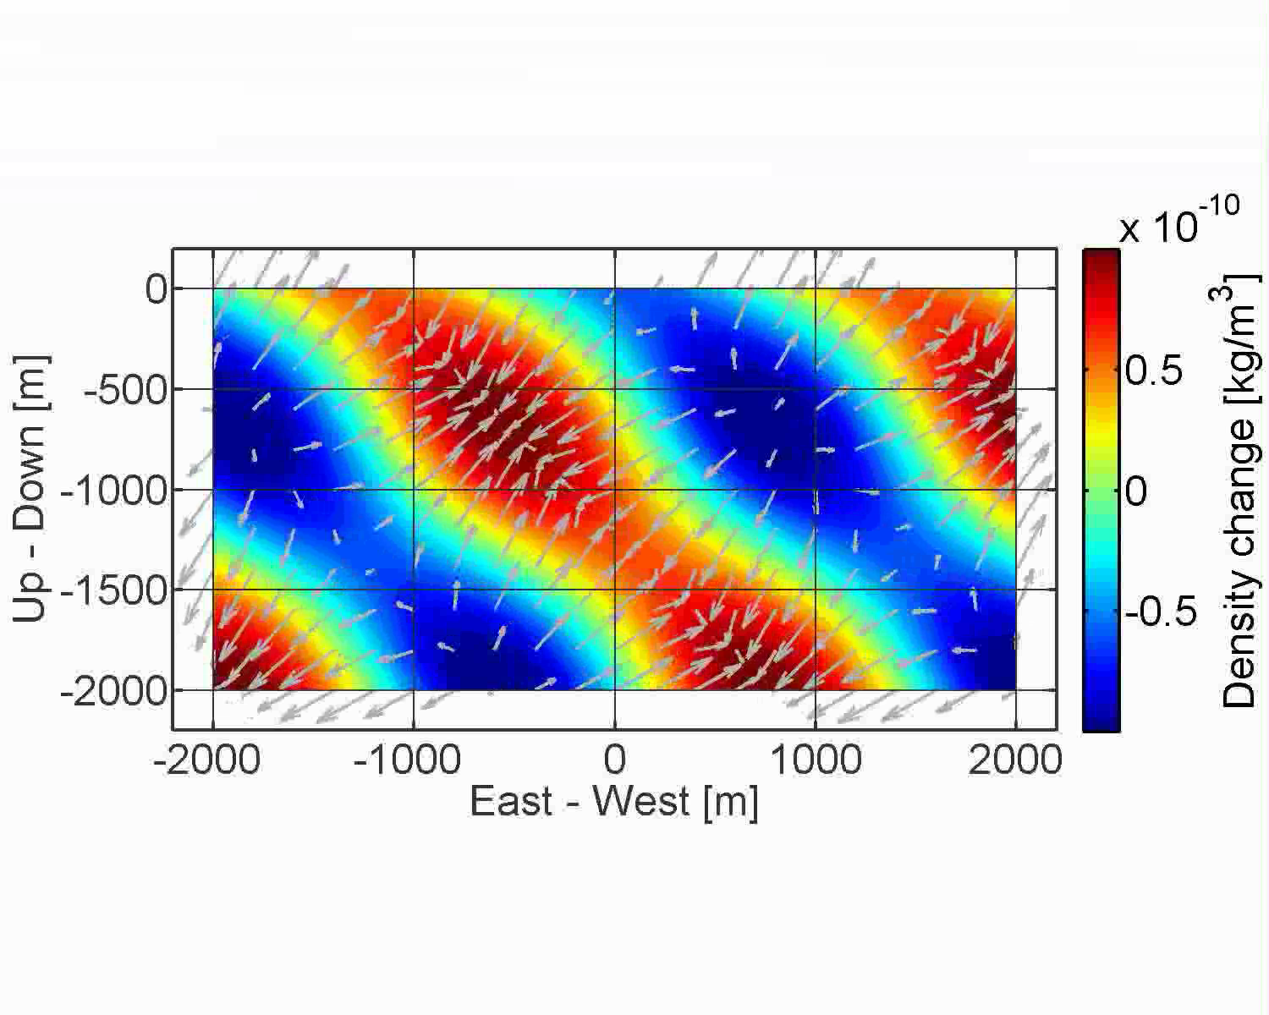
SeismicNoise::FreeSurface

Slide 6
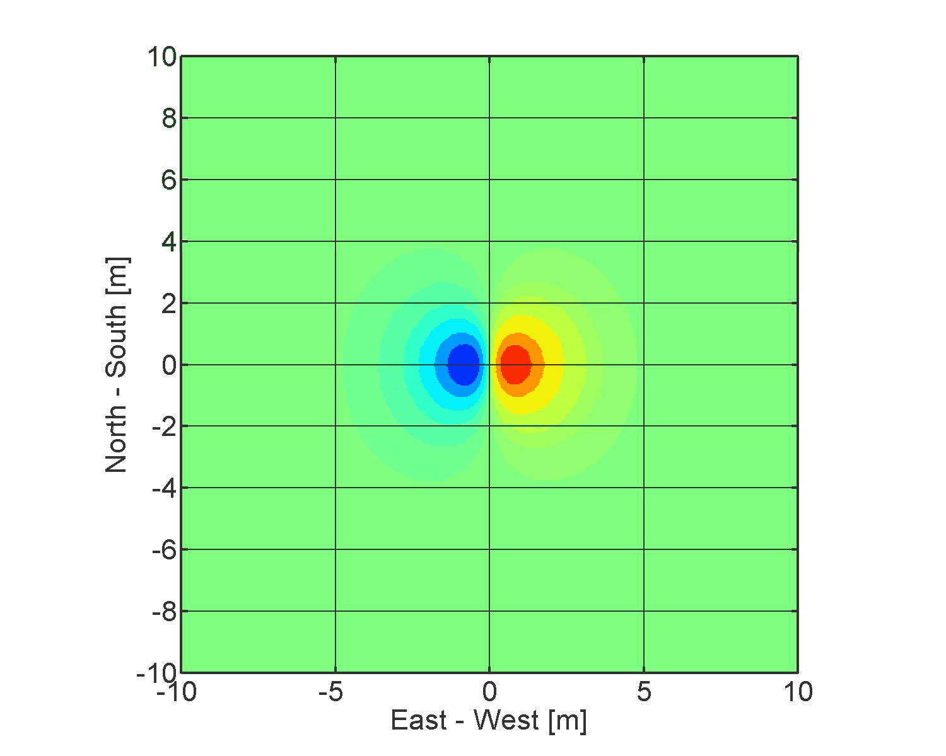
NewtonianNoise::RayleighWaves

Slide 7
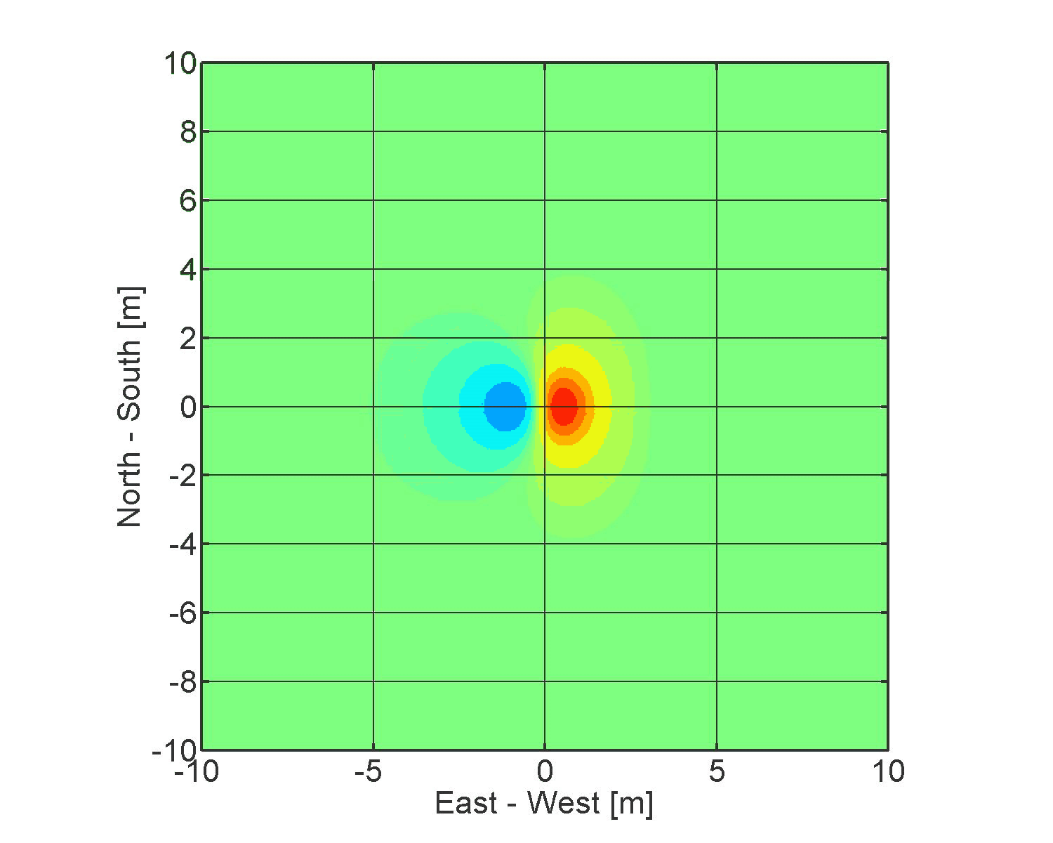
NewtonianNoise::FreeSurface

Slide 8
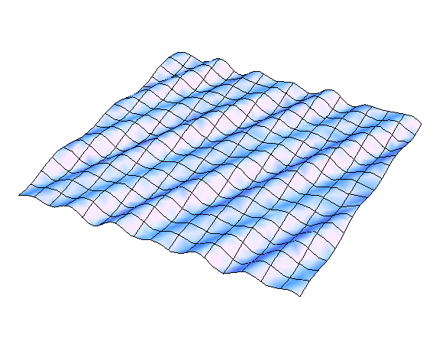
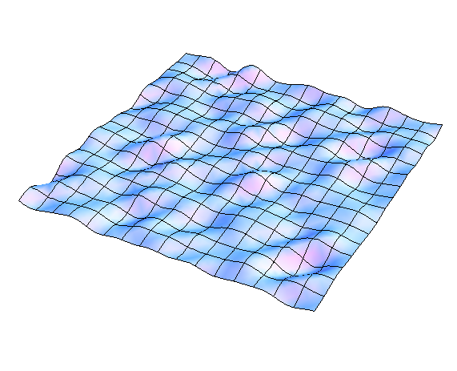
NoiseSubtraction::Strategies
The primitive version (feed forward).
The sophisticated version
Add up contributions from all points monitored by seismometers
Integrate NN from plane waves (or spherical). Only a few seismometers required.

Slide 9
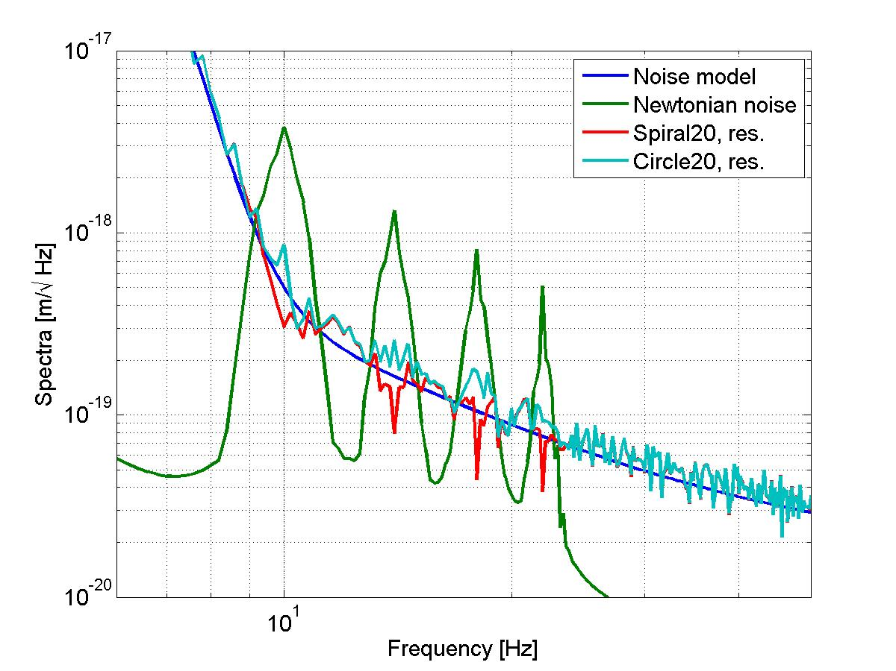
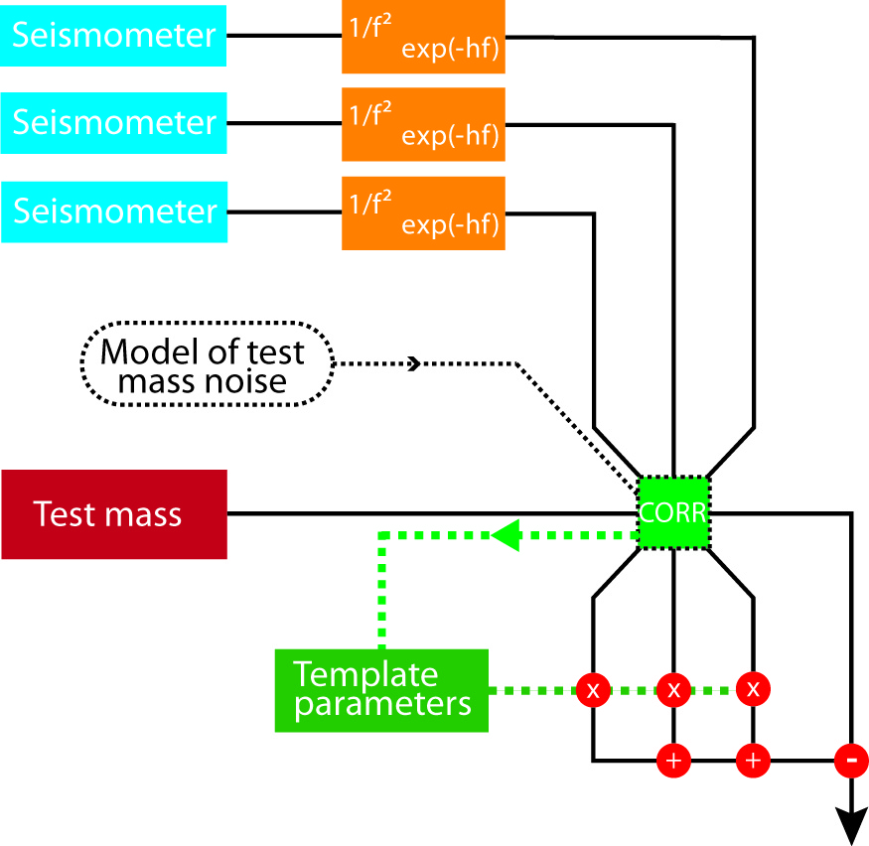
NoiseSubtraction::Simulation
Noise templates instead of feed-forward cancellation.

Slide 10
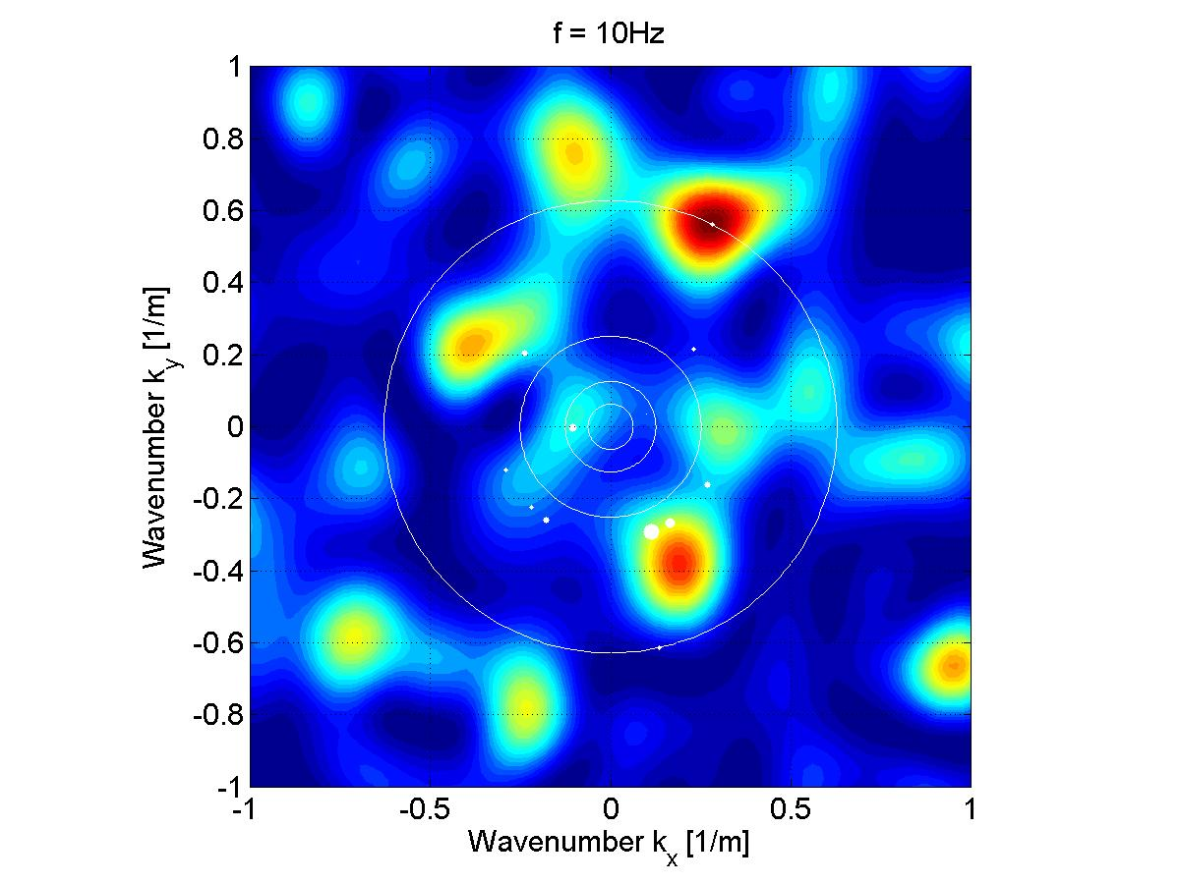
NoiseSubtraction::f-k-maps
Estimates of k-f maps can be poor, but subtraction performance is still optimal (at least in simulation).
Radius of white dots indicate amplitude of injected wave.

Slide 11
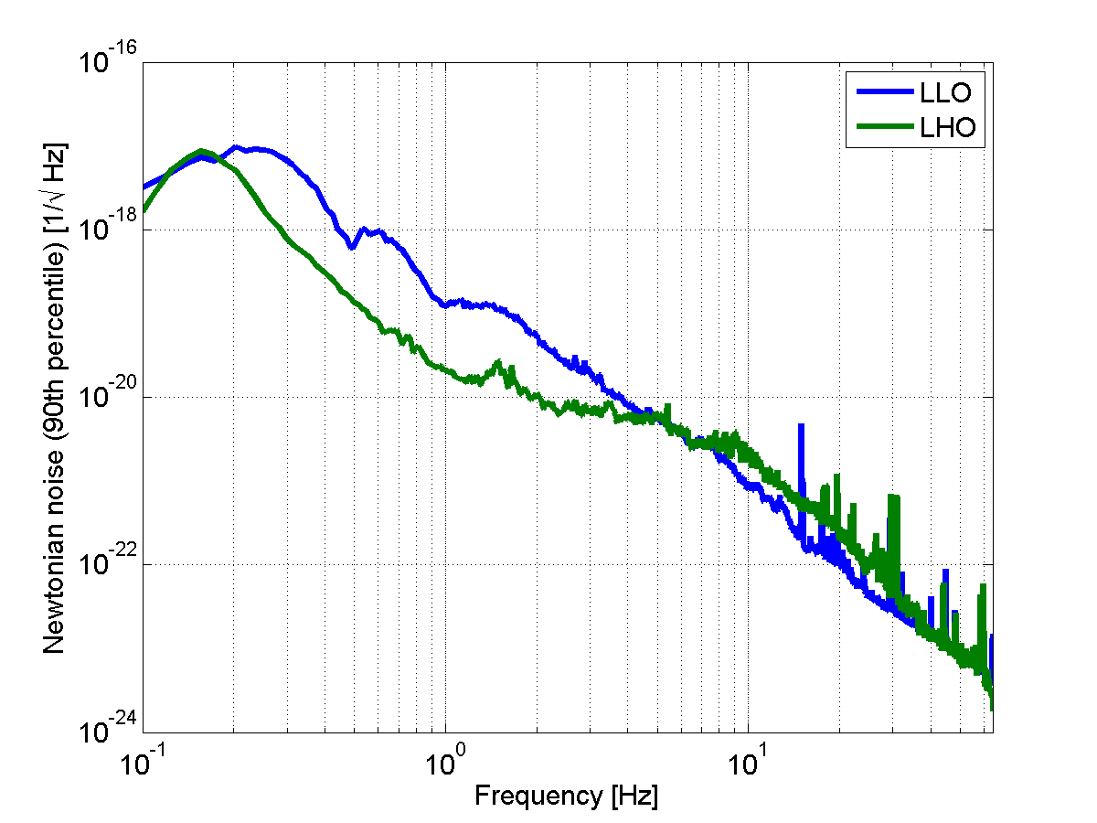
NoiseSubtraction::Challenge
NN modeled from seismic spectral histograms at LIGO sites
Mitigation by:
Site selection
NN subtraction
Distance to source of seismic density perturbation contributing
strain noise

Slide 12
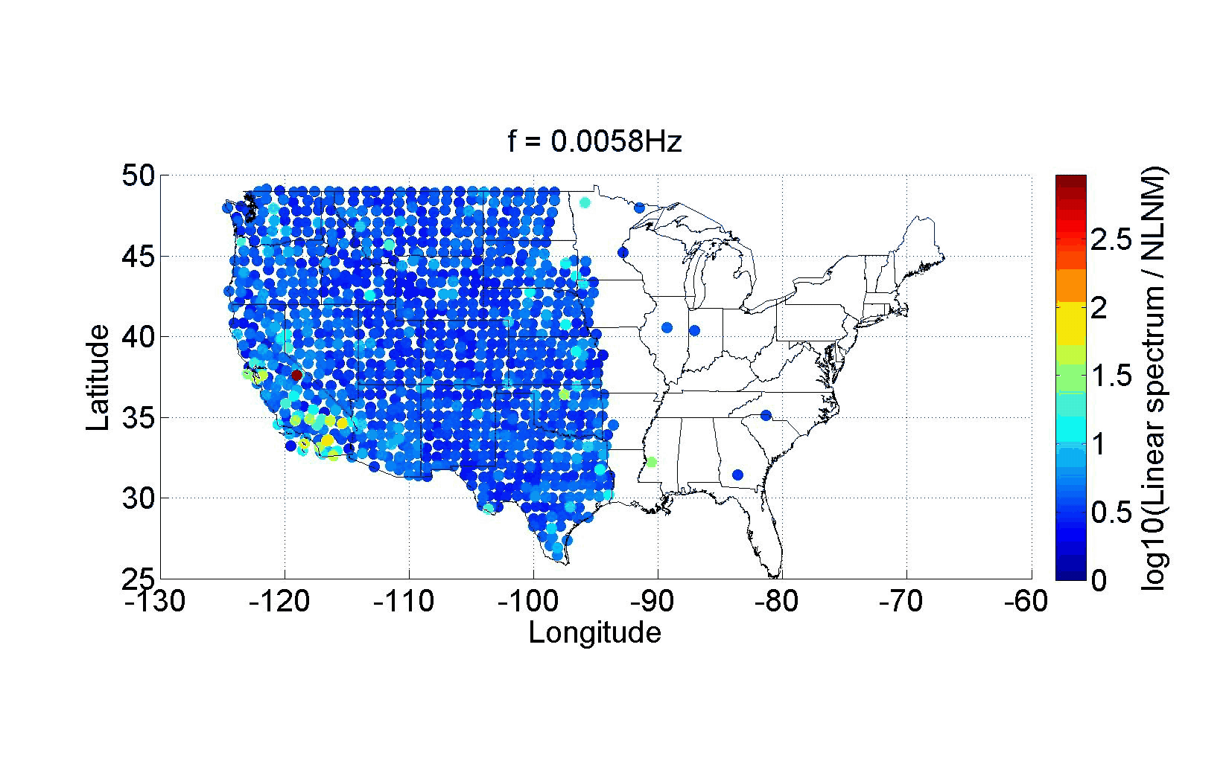
Seismicity::US.Average

Slide 13
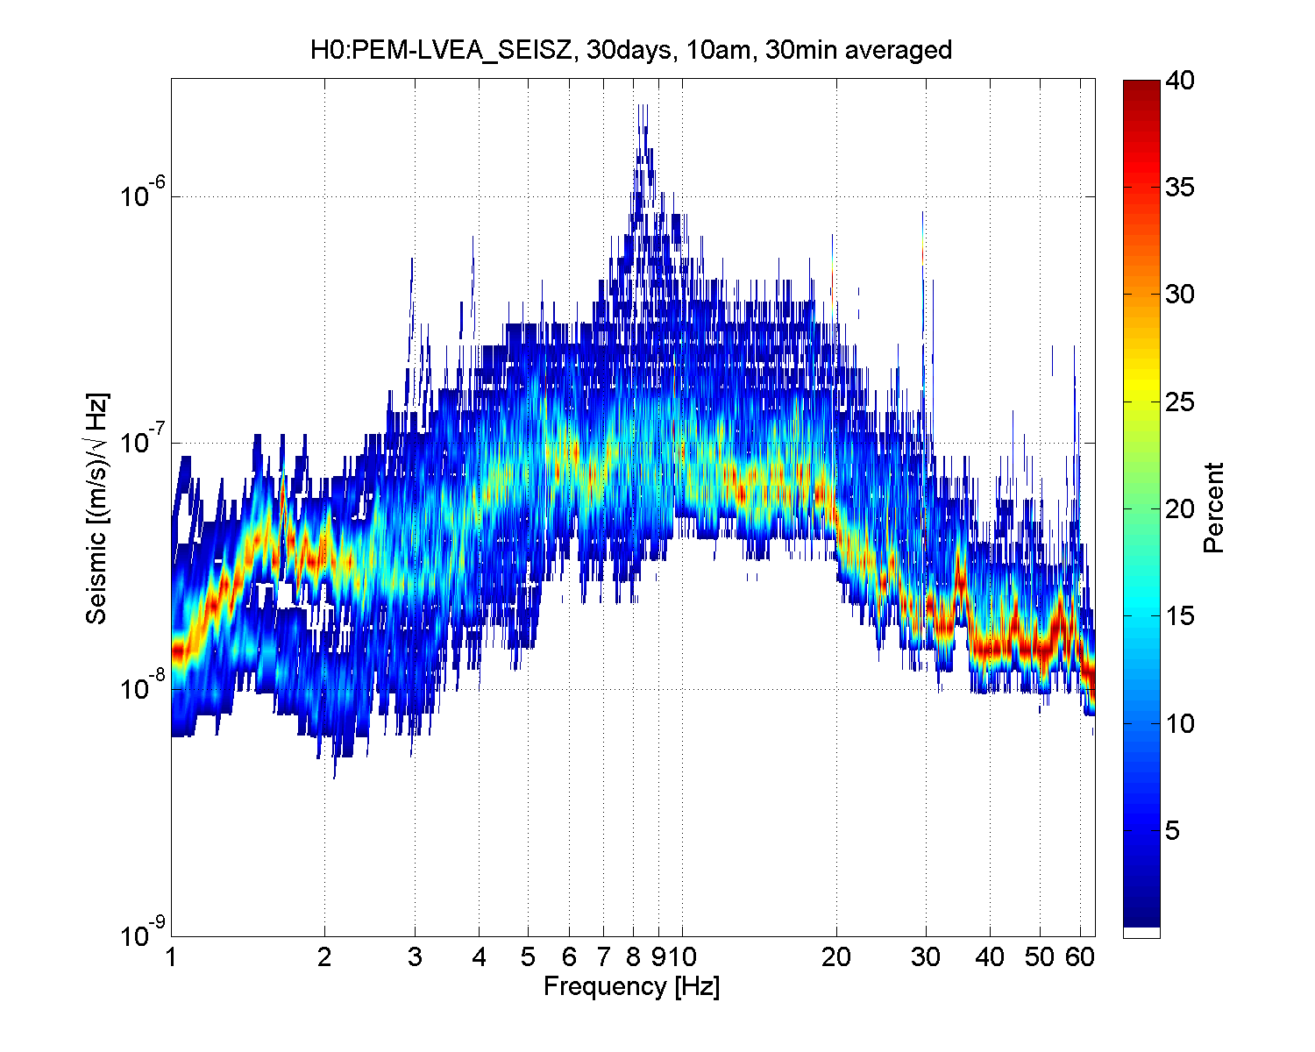
SurfacevUG::SeismicNoise
4100ft below surface
Texas, Sierra Blanca
LIGO Hanford
https://virgo.physics.carleton.edu/Seismic/USArray/usarray_summary_page.html

Slide 14
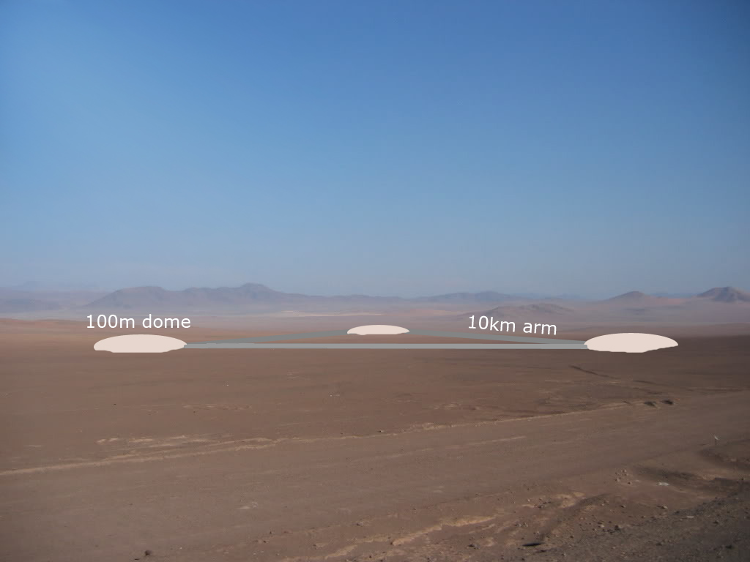
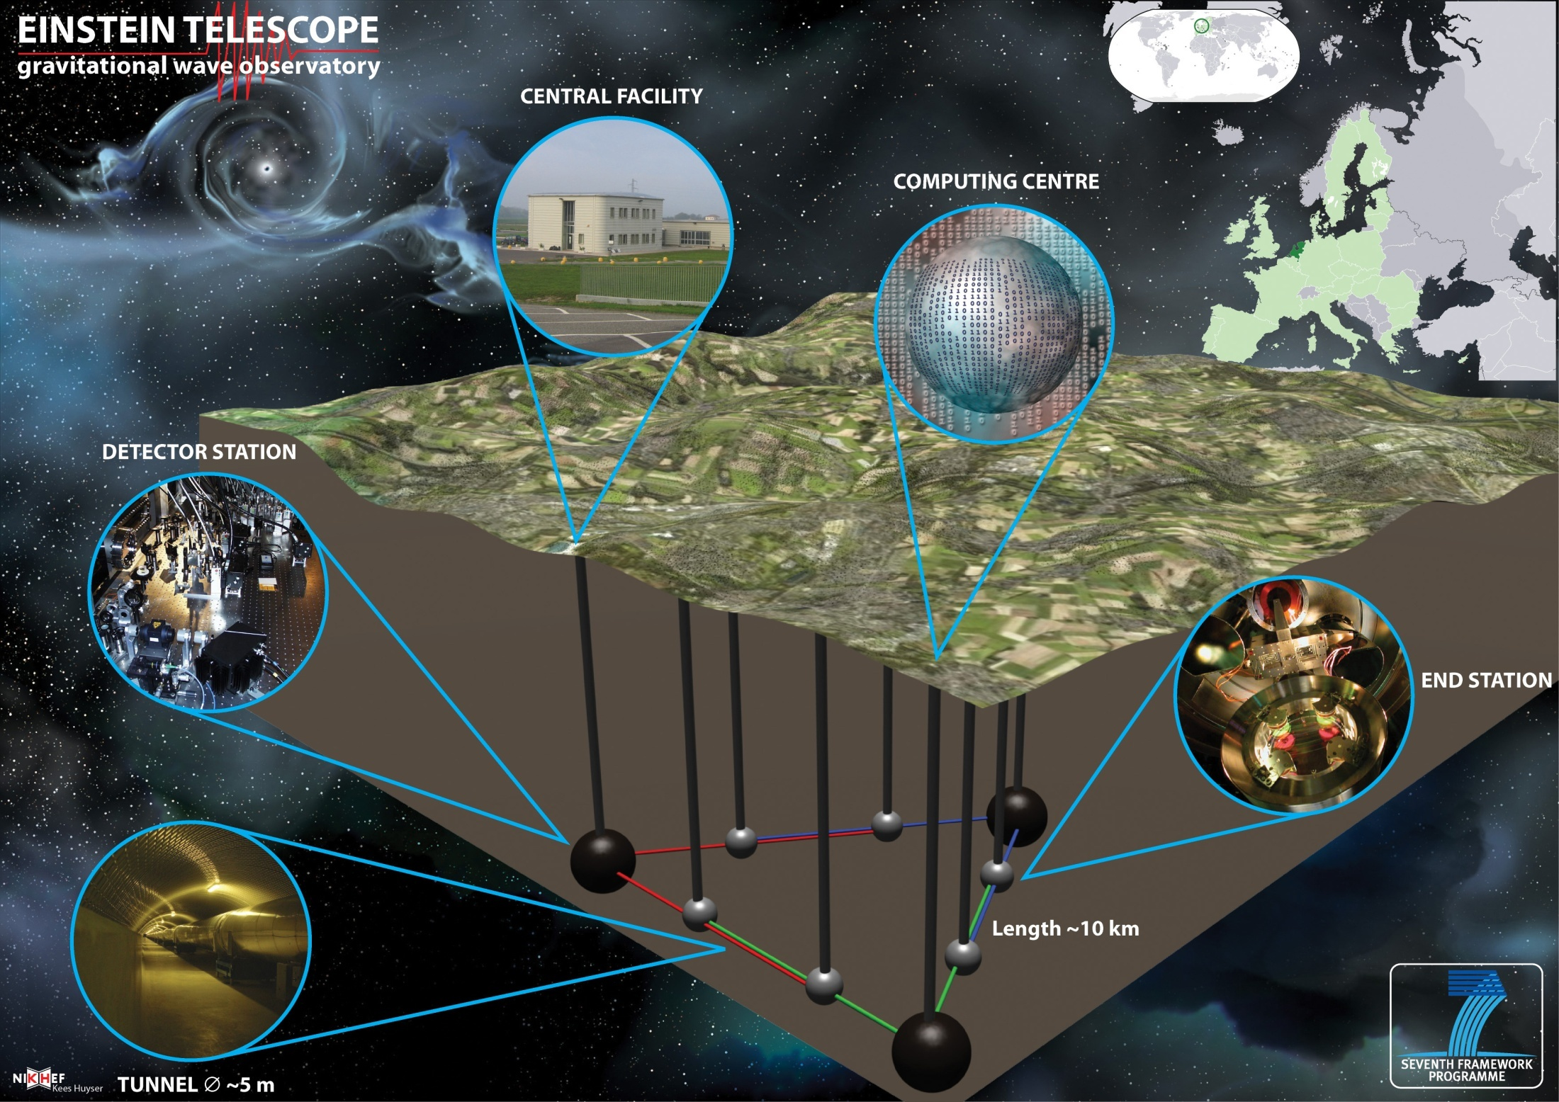
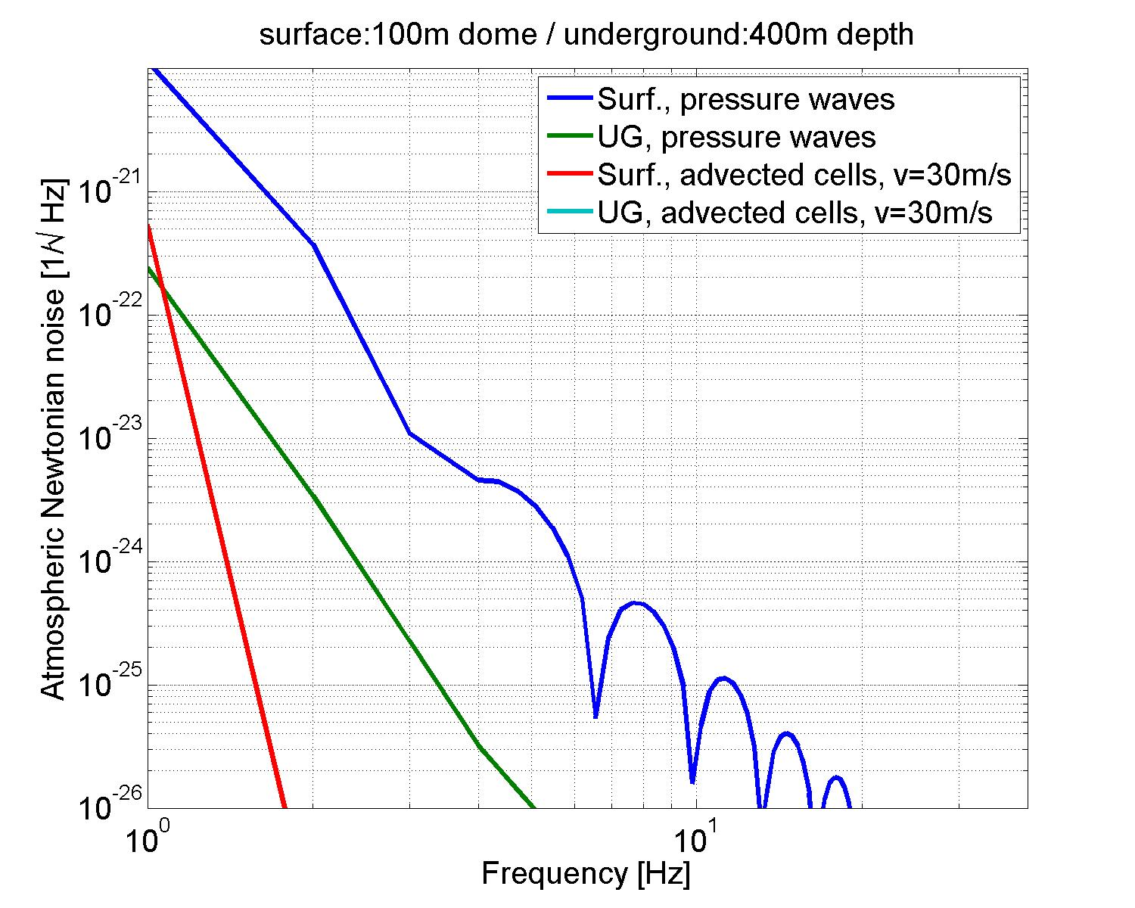
NewtonianNoise::Atmosphere
NN suppression by dome with diameter :
NN suppression at depth :
Underground NN from sound waves is weaker than shown here if sound propagation direction is rather horizontal than vertical.
Notes:
Constancy of kh is important difference between Rayleigh waves and sound waves in atmosphere.

Slide 15
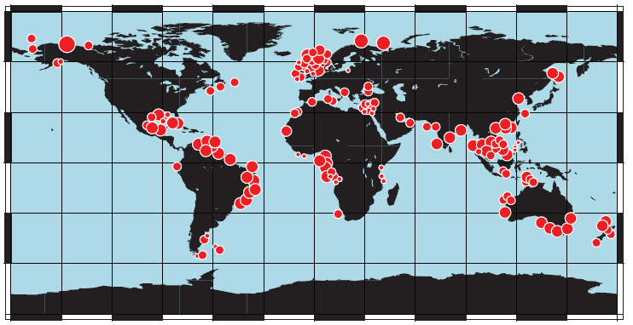
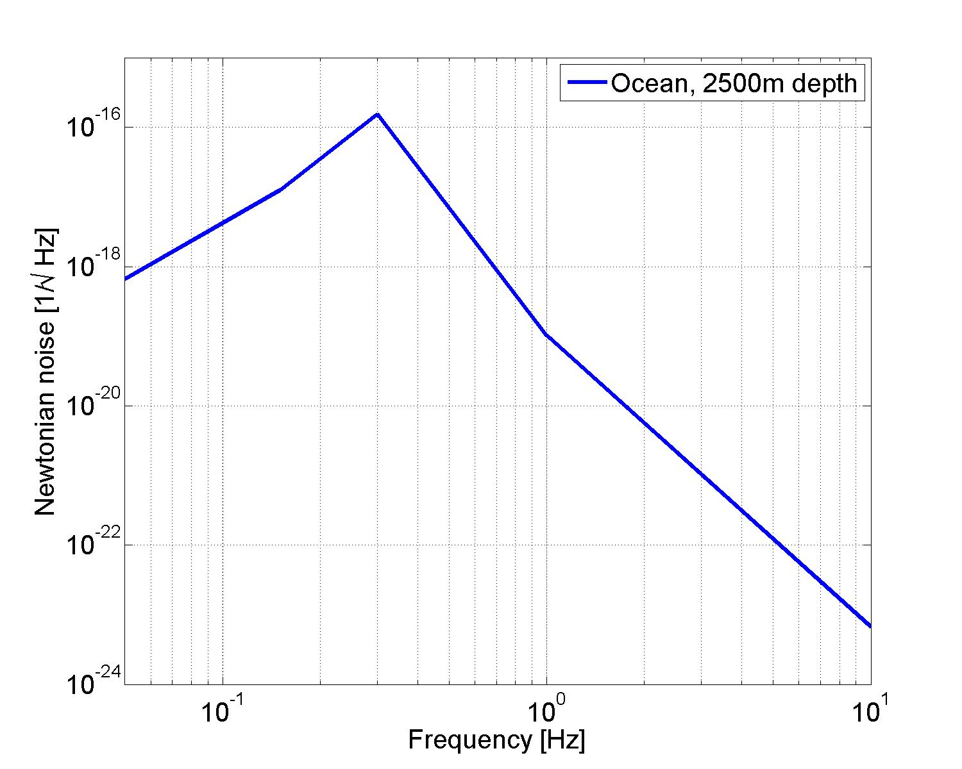
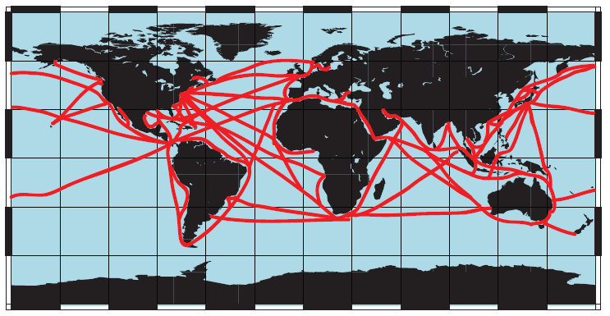
NewtonianNoise::Ocean
Seismic air-gun arrays (noise down to 5Hz)
Sound measured close to Virginia (ECONOMEX data).
Major commercial shipping lanes (noise down to 5Hz)
15
Notes:
Directional dependence of sound waves could mean less NN. Before humans started to create noise, whales were probably able to communicate with each other as far apart as Antarctica and the Aleutian Islands (Roger Payne).
15

Slide 16
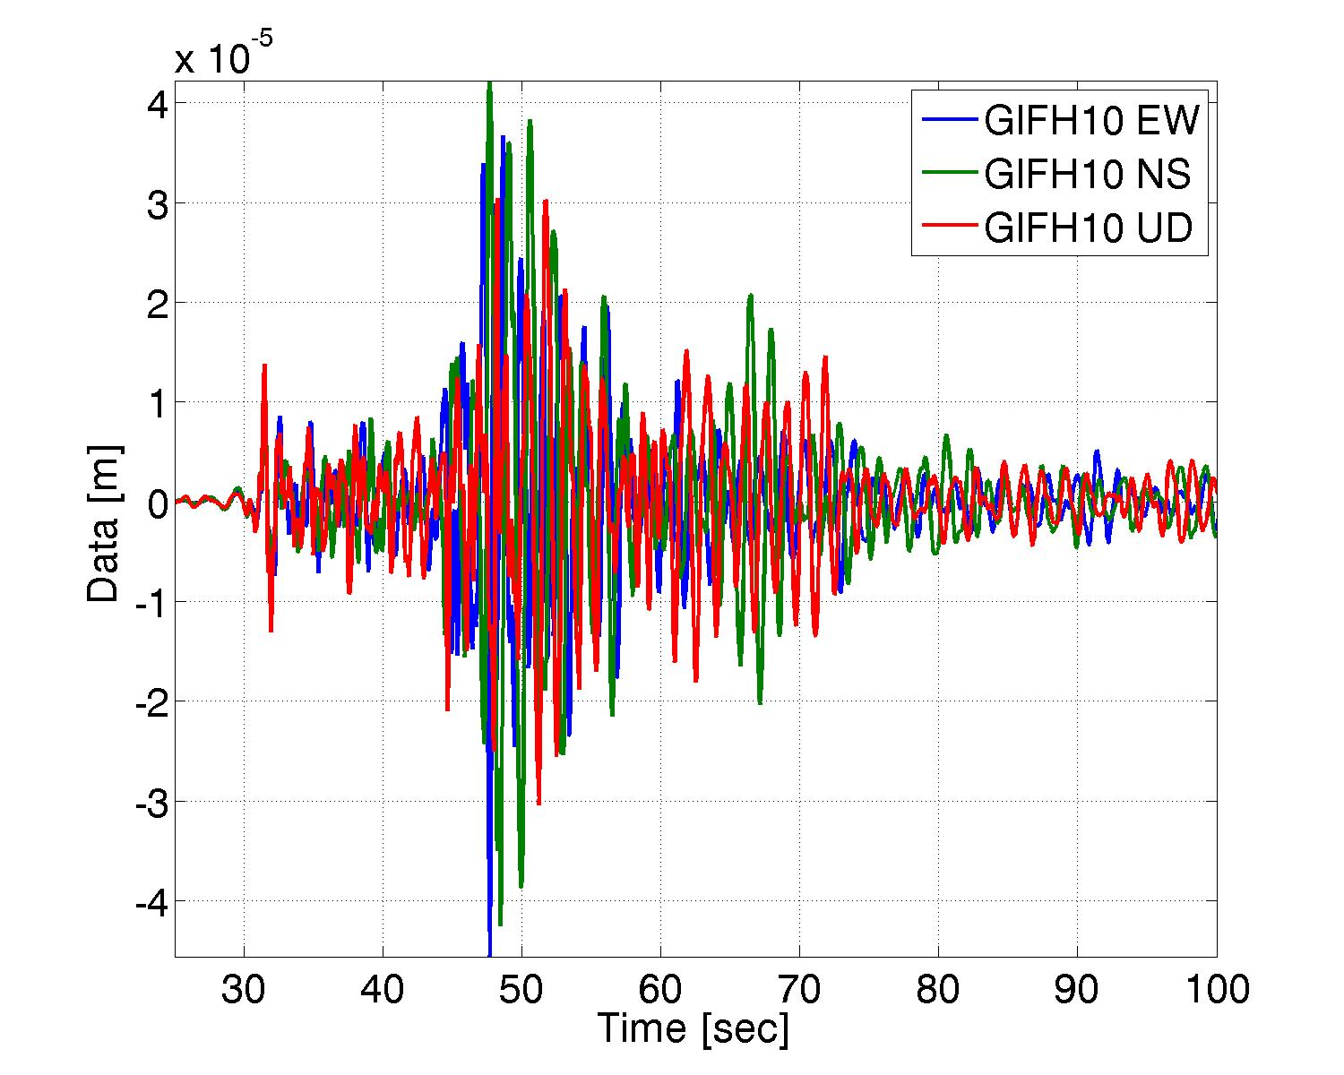
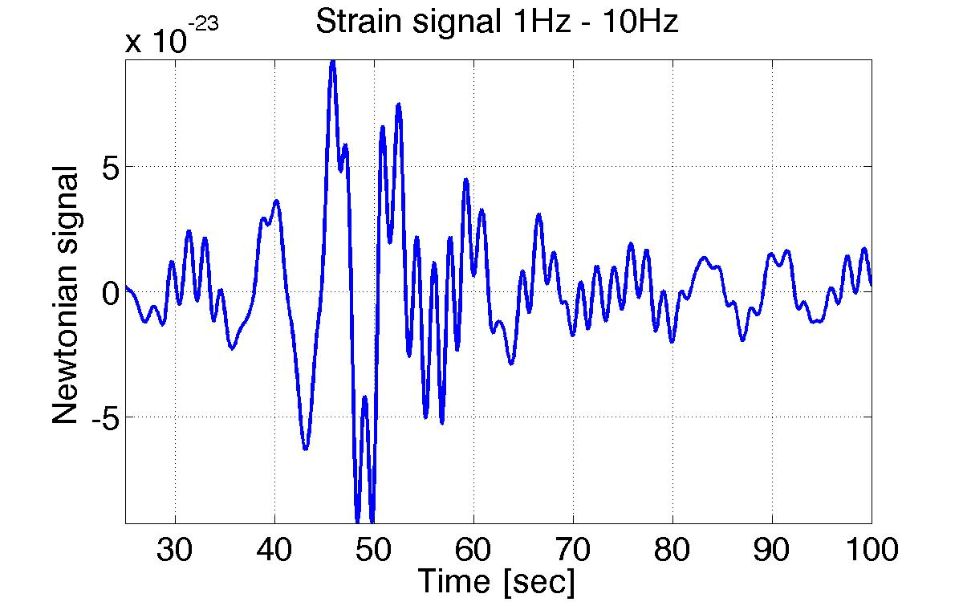
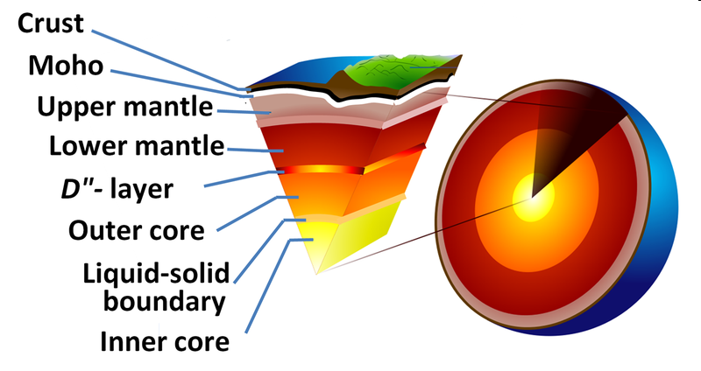
NewtonianNoise::HiddenNoise
Interface displacement
Strain: 0.5Hz – 10Hz
(interface at 100km depth)
Can we monitor all sources of Newtonian noise?

