Slide 1
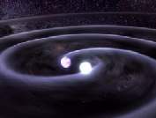

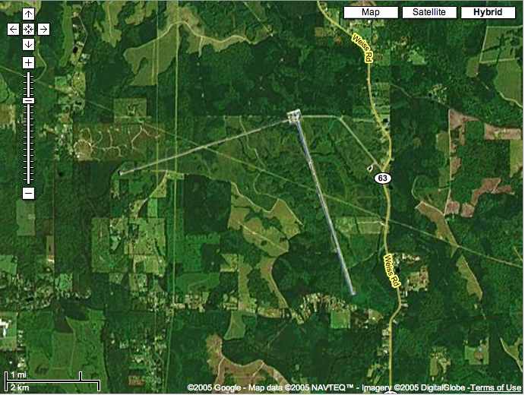
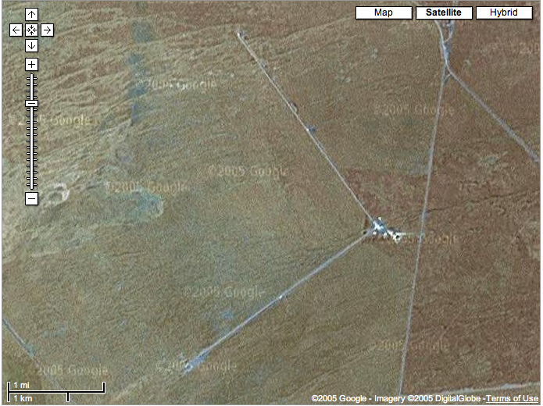
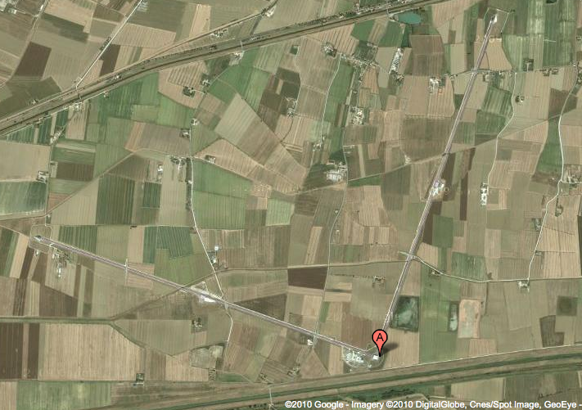
LIGO detectors: past, present and future
Gabriela González,
Louisiana State University
For the LIGO Scientific Collaboration
and the Virgo Collaboration
LIGO Livingston Observatory
LIGO Hanford Observatory
Virgo Interferometer

Slide 2
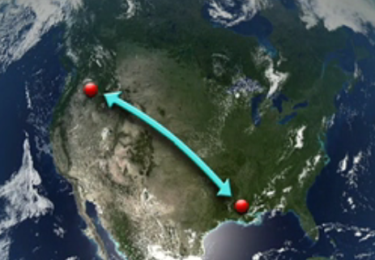
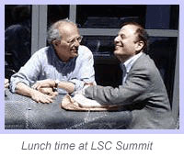
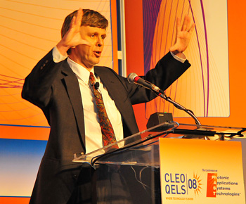
The LIGO project
Hanford, WA
4km, 2km
H1, H2 ifos
Livingston, LA
4 km ifo L1
800+ people in US, Europe, Asia and Australia working on the experiment and looking at the data:
LIGO Scientific Collaboration
www.ligo.org

Slide 3


Slide 4
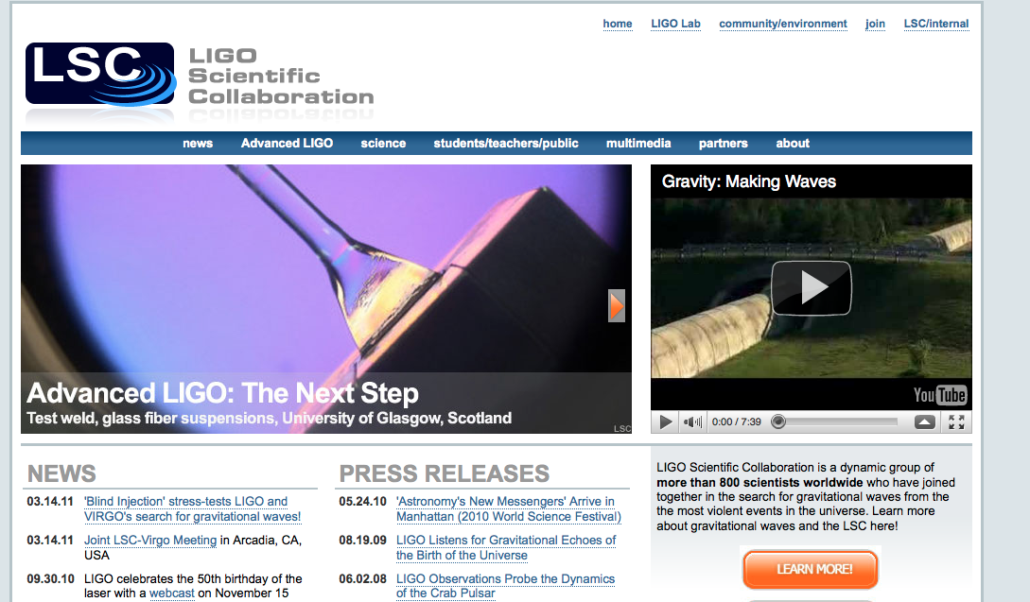
www.ligo.org

Slide 5
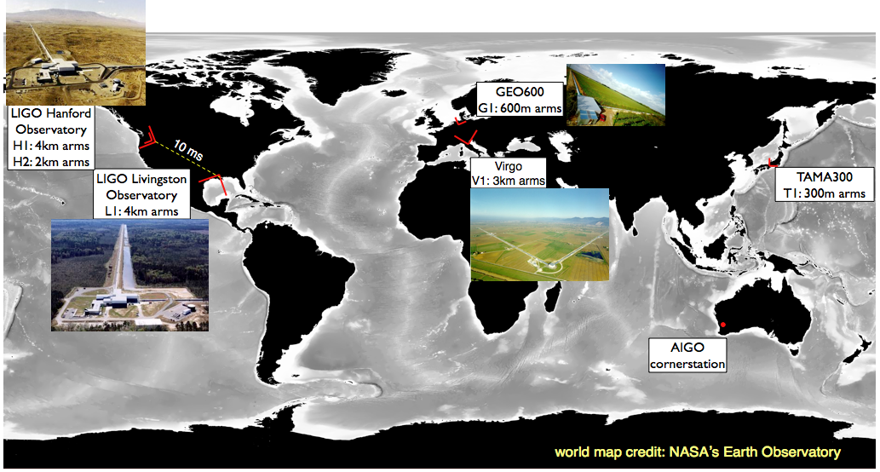
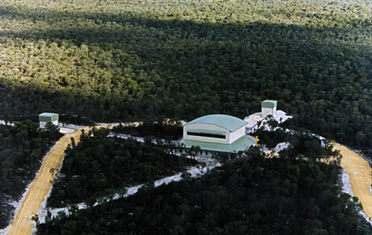
Past/present GW network

Slide 6
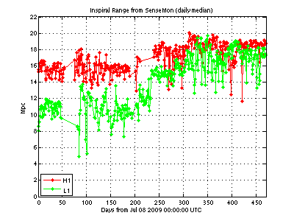
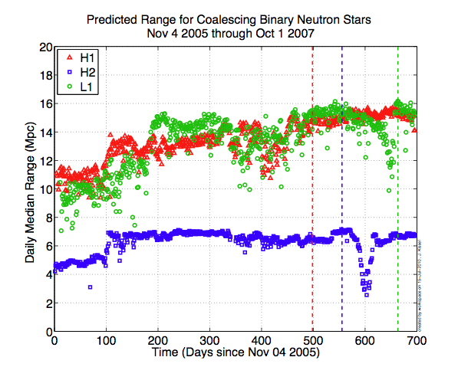
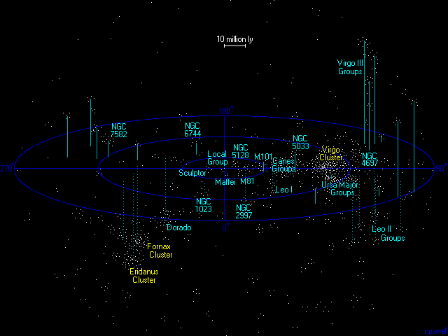
Recent past: binary neutron star reach
Sensitivity to coalescences in Virgo cluster: thousands of galaxies!
http://www.atlasoftheuniverse.com/virgo.html

Slide 7
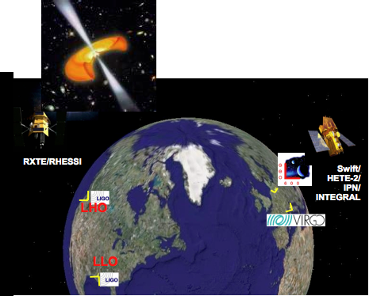
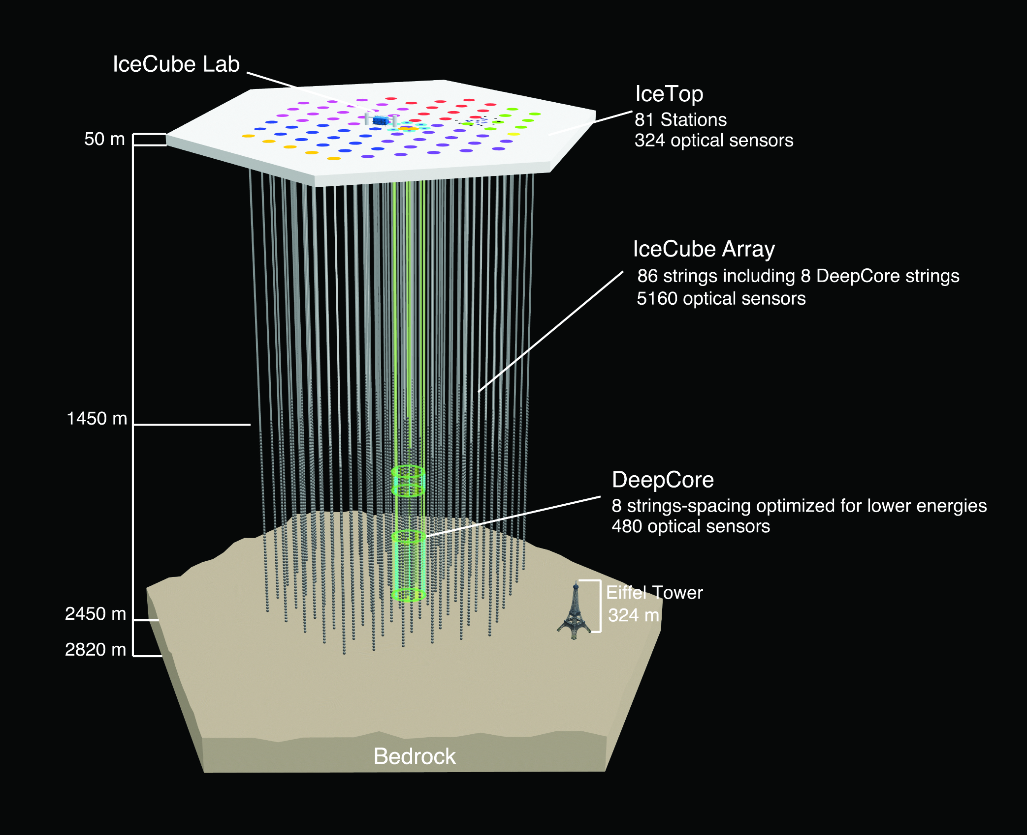
Recent past effort:
Multi messenger astronomy
LSC/Virgo current agreements with:
γ-rays: SWIFT, Fermi GBM, LAT
X-rays: RXTE
Neutrinos: Antares, IceCube
Wide-field Optical: QUEST, ROTSE, TAROT, Pi of theSky, SkyMapper, PTF
Radio: LOFAR

Slide 8
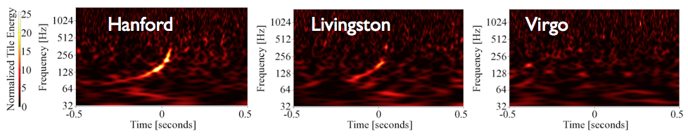
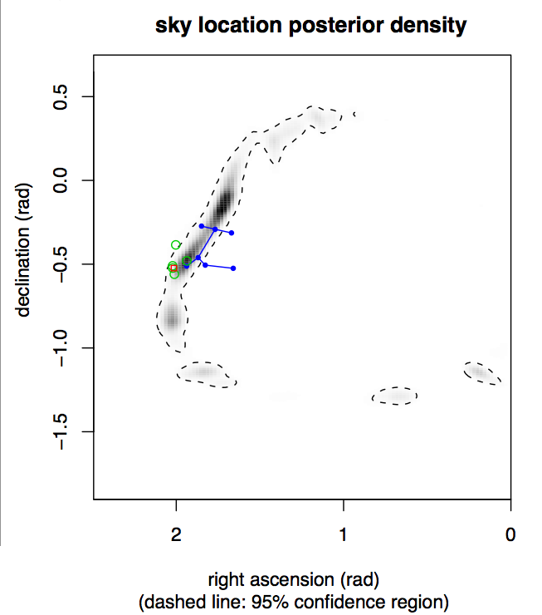
Recent past results:
An experiment on detection
Sept 16, 2010: A candidate signal detected in HLV network!
Most likely position: Canis Major; consistent with d=20-60 Mpc
Signal sent at T+42min to ROTSE, TAROT, Skymapper, Zadko) and the Swift X-ray space telescope
March, 2011: NOT a signal – a blind injection

Slide 9
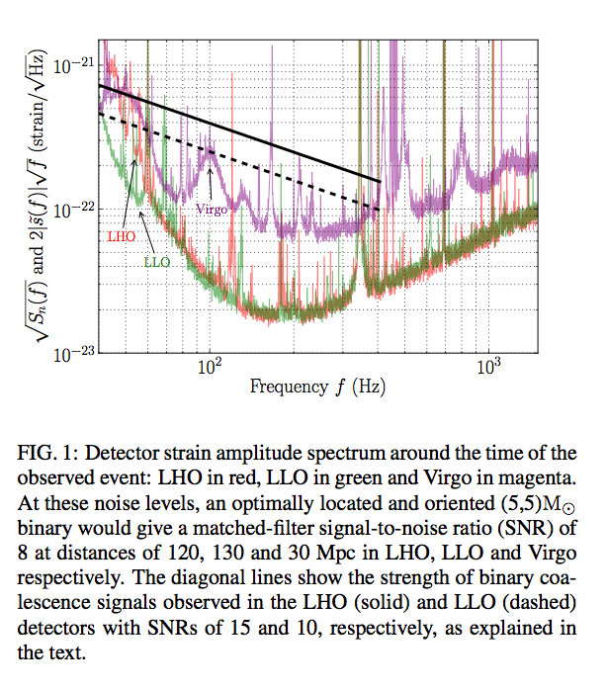
A network in action!

Slide 10

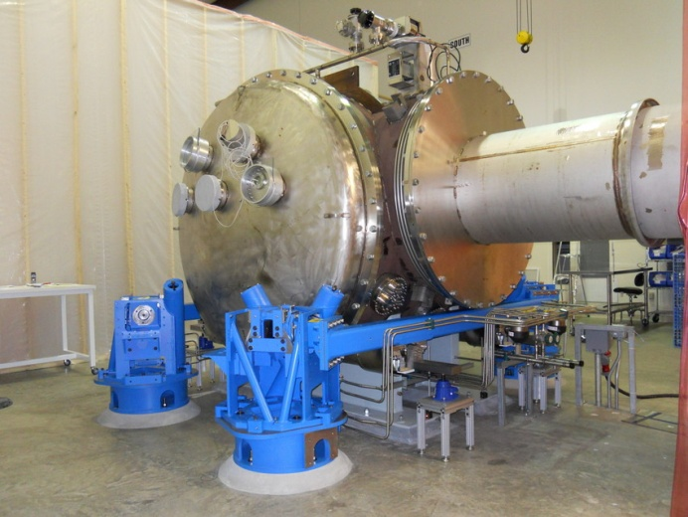
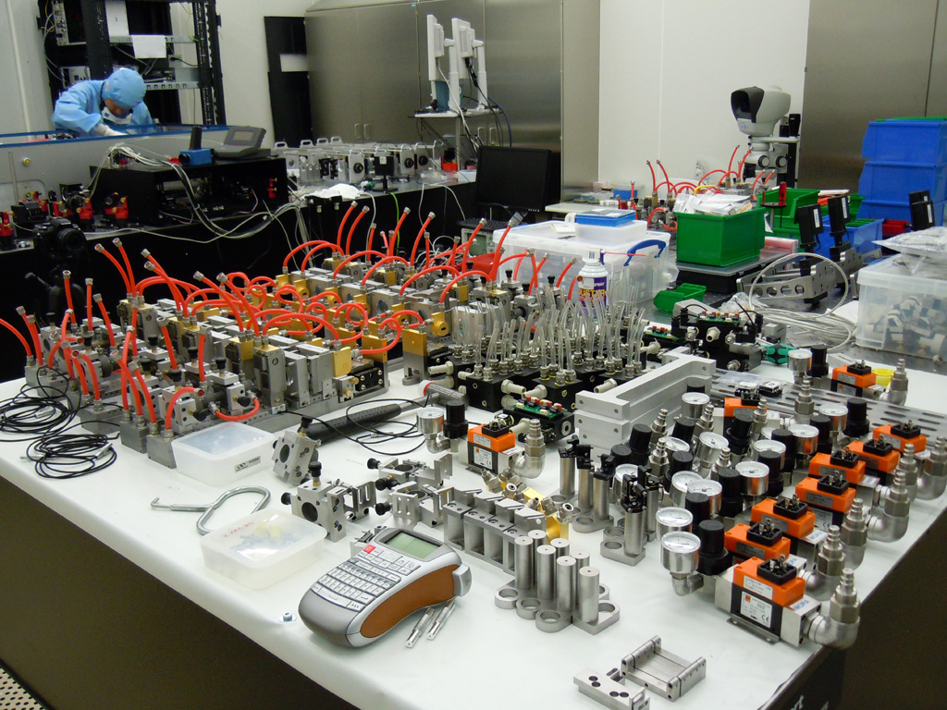
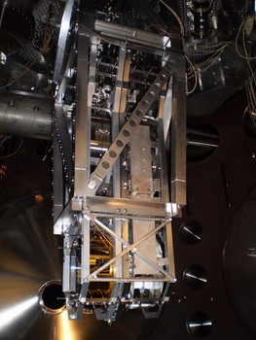
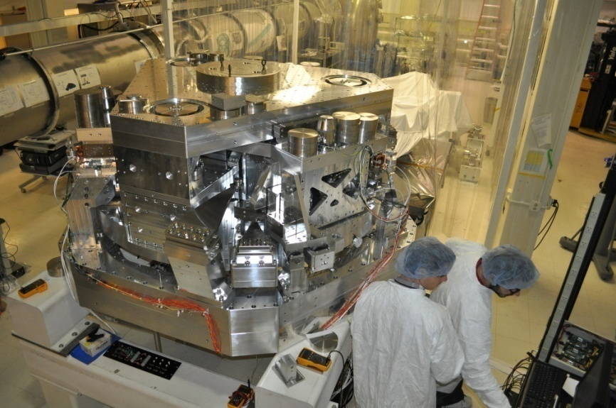
Present: Advanced LIGO detectors
Funding in place, installation already in progress, end of construction in 2015.
NOW
Notes:
P0900125-v8

Slide 11
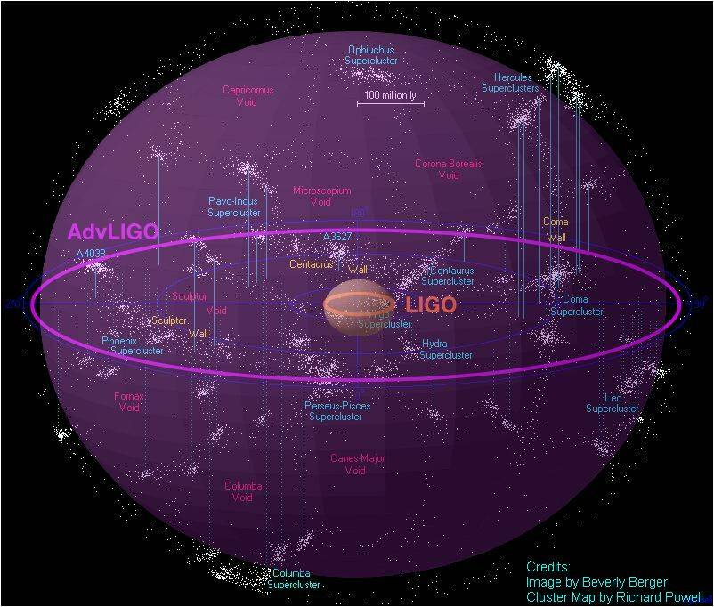
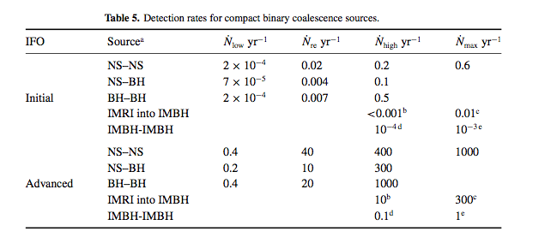
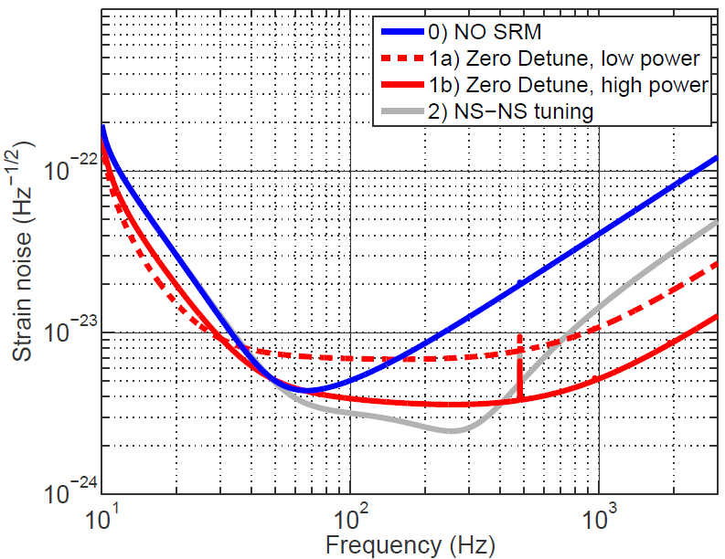
Future: Science with
Advanced LIGO detectors
Neutron Star Binaries:
  Initial LIGO: ~15 Mpc → rate ~1/50yrs
  Advanced LIGO: ~ 200 Mpc
  Realistic rate ~ 40/year !
Class. Quant. Grav. 27, 173001 (2010)
Detections are in our near future!
Notes:
P0900125-v8

Slide 12
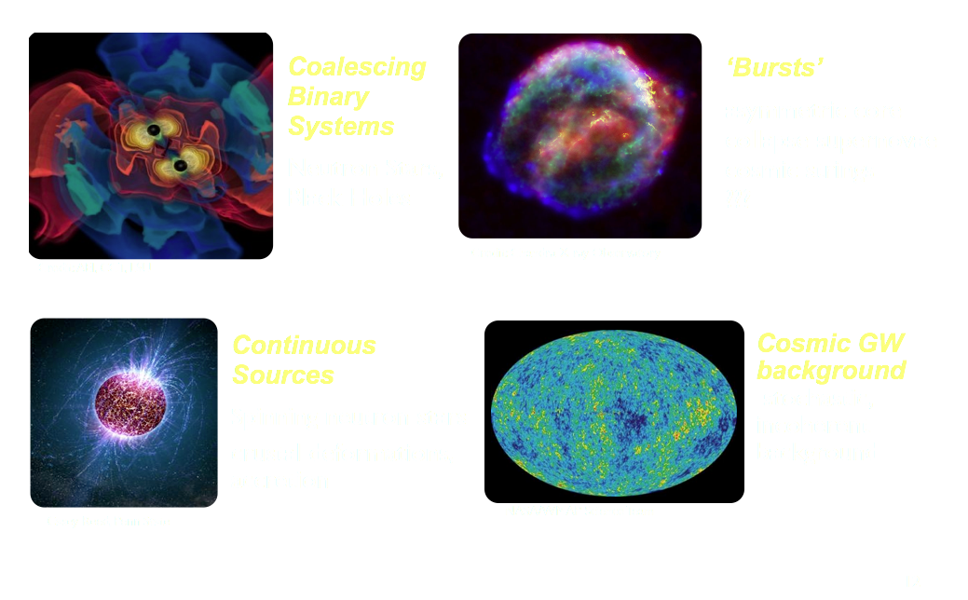
GW sources: not just binary systems!
Core collapse SN,
cosmic strings, ???
Neutron Stars,
Black Holes
Spinning neutron stars,
crustal deformations,
accretion
Cosmological background
Incoherent background
With increasing sensitivity, increasing kinds of sources!

Slide 13
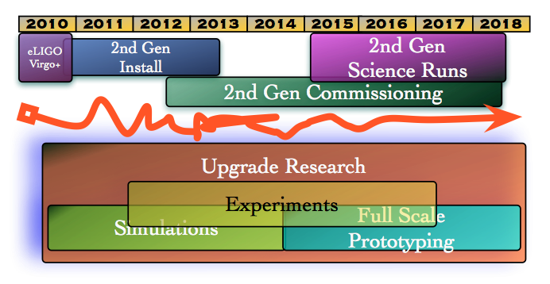
LSC working groups: past, present and future
Data analysis groups:
  Burst sources
  Compact Binary systems
  Stochastic Background
  Continuous waves
Instrumental working groups:
  Detector characterization
  Light sources
  Quantum Noise
  Suspensions,
  Seismic Isolation
  Optics
  Advanced
  Interferometer
  configuration :

Slide 14
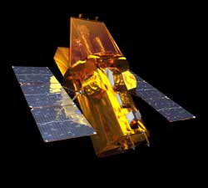
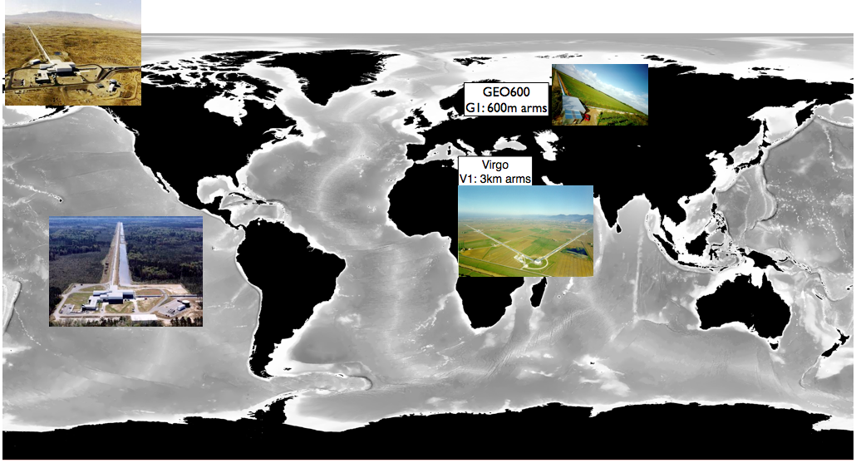
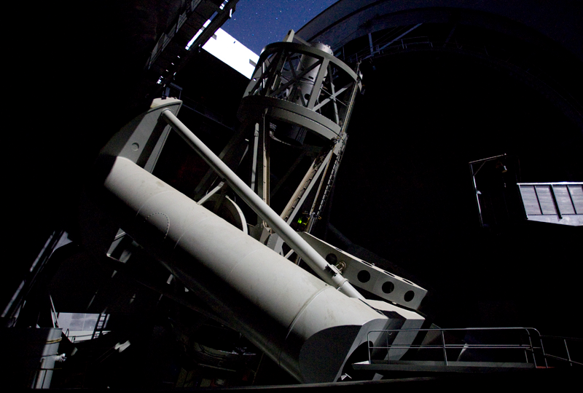
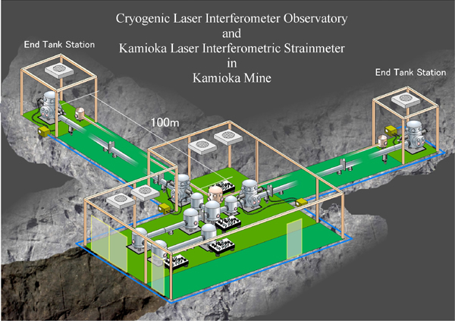
Future: Science with international, MM network
LIGO Hanford
Observatory
H1, H2: 4km arms
LCGT
3km arms
ET !
LIGO Livingston
Observatory
L1: 4km arms
LIGO Australia?
A1: 4km arms

