Slide 1
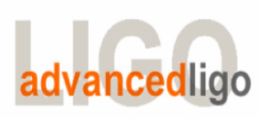
Seismic Isolation Group (SEI)
aLIGO HAM-ISI, LLO Unit 3,
Testing Validation
LIGO-G1100507-v2
April 19th, 2011
Céline Ramet, Michael Vargas, Adrien Le Roux, Vincent Lhuillier

Slide 2
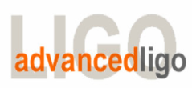
G1100507, aLIGO HAM-ISI, LLO Unit 3, Testing Validation
References
- E1000309 - aLIGO HAM-ISI, Pre-Integration Testing Procedure, Phase I (post assembly, before storage)- Please note that v5 was used but we’re now using v6
- E1000300 - HAM-ISI LLO test stand: software and electronic check
E1000327 aLIGO SEI Testing Report, HAM-ISI, LLO - Unit 3
Goals:
- Present tests performed on HAM-ISI LLO Unit 3
- Validate HAM-ISI LLO Unit 3

Slide 3
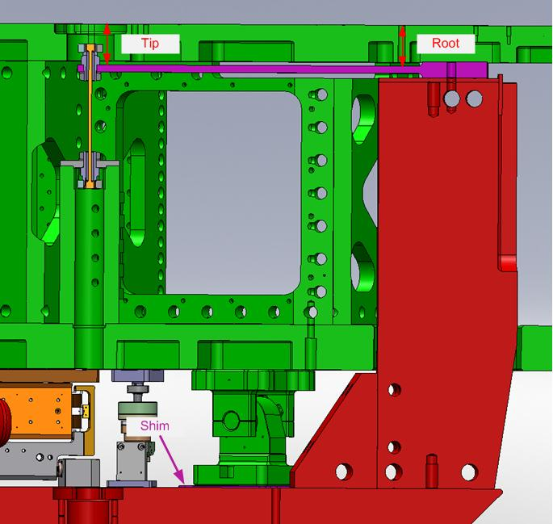
II. Tests performed during assembly
Step 1 - Check torques on all bolts
Step 2 - Check gaps under Support Posts
Step 3 - Pitchfork/Boxwork flatness before Optical Table install
Step 4 - Blade spring profile
Acceptance Criteria : Blades must be flat within 0.020" inches
Note that all locker shims are identical at 125 mils.
Passed
Passed
Passed
Passed
Blade # | Base (") | Tip(") | Flatness (mils)
1 | .495 | .491 | +4
2 | .501 | .489 | +12
3 | .498 | .490 | +8

Slide 4
II. Tests performed during assembly
Step 5 - Gap checks on actuators
Acceptance Criteria : Gaps must be within 0.010” of design. Can be adjusted before install
Step 6 - Check level of Stage 1
Acceptance Criteria: Maximum tilt of the optical table: 100 μrad
Max angle=(.5/64)/85.59= 91 urad
Failed
Passed
Actuator | Front Gap (1/1000") | Back Gap (1/1000")
V1 | 80 | 90
V2 | 90 | 75
V3 | 95/85 | 65/80
H1 | 85
H2 | 80
H3 | 80

Slide 5
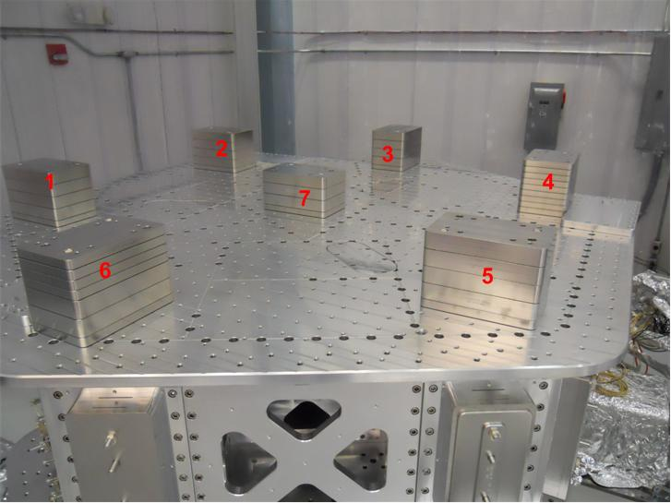
II. Tests performed during assembly
Step 7 - Mass budget and lockers shim thickness
Acceptance Criteria : 596.7Kg +/-25Kg (4%)
Step 8 - Lockers adjustment
Acceptance Criteria : Vertical and horizontal displacement near the
lockers must be lower than 2 mils
Optical Mass (Kg) | Wall Mass (Kg) | Keel Mass (Kg) | Total Mass (Kg)
305.00 | 178.58 | 90.08 | 573.66
Lockers shim thickness
Passed
Passed
Lockers | Shim thickness (mil)
A | 125
B | 125
C | 125
D | 125
D.I at Lockers | Dial indicators V | Dial indicators H
A | 0.5 | -1
B | 2 | 0
C | 0.25 | 0
D | -1.5 | -1.5
Notes:
5

Slide 6
III. Tests performed after assembly
Step 1 to 3 – Actuators, Sensors and Electronics Inventory
Step 4 - Set up sensors gap
Acceptance criteria:
- All mean values must be lower than 400 cts (a bit less than .0005”).
- All standard deviations below 5 counts.
Comments: The two satellite boxes are now synchronized
Passed
 | 10 Kg masses at each corners |  | No mass
Table locked | ADE boxes on |  | ADE boxes on
Sensors | Offset (Mean) | Std deviation | Offset (Mean) | Std deviation
H1 | -36.967 | 1.2 | -109.44 | 1.5
H2 | 254.8 | 1.1 | 243.71 | 0.8
H3 | -23.343 | 0.7 | -91.761 | 1.1
V1 | -264.62 | 0.6 | -52.461 | 1.6
V2 | -148.73 | 1.8 | 24.719 | 1.5
V3 | 196.35 | 1.4 | 296.66 | 1.2
Notes:
6

Slide 7
III. Tests performed after assembly
Step 5 - Measure the Sensor gap
Comments:
- Difficult to measure without scratching the target
No information of gaps measured on the Jig
Acceptance criteria:
- Measured gap must be 0.080”+/-0.002”
Sensors | Gap measured on the Jig | Gap measured on the table
H1 | NR | 0.080"
H2 | NR | 0.085"
H3 | NR | 0.085"
V1 | NR | 0.085"
V2 | NR | 0.085"
V3 | NR | 0.085"
Failed
Notes:
7

Slide 8
III. Tests performed after assembly
Step 6 - Check Sensor gaps after the platform release
Acceptance criteria:
- Absolute values of the difference between the unlocked and the locked table must be below 1600 cts (~0.002”)
- Considering the acceptance criteria of step 4, all mean values must be lower than
  2000 cts (~0.0025”)
 | Table locked |  | Table unlocked
Sensors | Offset (Mean) | Std deviation | Offset (Mean) | Diff
H1 | -274.44 | 0.83234 | 664.2 | 938.64
H2 | -43.197 | 0.75333 | -327.25 | -284.053
H3 | 159.76 | 0.74358 | -561.14 | -720.9
V1 | -296.64 | 1.0669 | 583.93 | 880.57
V2 | 245.48 | 1.4453 | 495.1 | 249.62
V3 | -362.15 | 1.627 | -1144.2 | -782.05
Passed
Notes:
8

Slide 9
III. Tests performed after assembly
Step 7 - Check range of motion (hand pushing)
  Step 7.1 – Test Nº1
Acceptance criteria:
- The vertical sensor readout be positive when the optic table is pushed in the +Z direction
- The horizontal sensor readout be negative when the optic table is pushed in the +RZ direction
- Absolutes value of all estimated motions must be higher than 16000counts (~0.020”)
 | CPS read out |  | Calculated after calibration
Sensors | UP (Counts) | Down (Counts) | UP (mil) | Down (mil)
V1 | 20269 | -20331 | 24.0 | -24.1
V2 | 20234 | -20363 | 23.9 | -24.1
V3 | 19885 | -19746 | 23.5 | -23.4
 | CPS read out |  | Calculated after calibration
Sensors | CW(-RZ) | CCW (+RZ) | CW (mil) | CCW (mil)
H1 | 18281 | -22331 | 21.6 | -26.4
H2 | 24413 | -19937 | 28.9 | -23.6
H3 | 18099 | -22126 | 21.4 | -26.2
Passed
Notes:
9

Slide 10
III. Tests performed after assembly
Step 7 - Check range of motion (hand pushing)
  Step 7.2 – Test Nº2
Acceptance criteria:
No contact point on sensors
Absolute value of sensor read out must be higher than 16000counts (~0.020”)
No contact point on actuators
Note that we’re not railing on V2-different from all other platforms tested so far
 | Push in positive direction | Push in negative direction | Railing | Actuator Gap Check
H1 | 20691 | -26431 |  | X
H2 | 24701 | -24100 |  | X
H3 | 25028 | -22929 |  | X
V1 | 19785 | -20422 |  | X
V2 | 31629 | -32519 |  | X
V3 | 19762 | -21787 |  | X
Passed
Notes:
10

Slide 11
III. Tests performed after assembly
Step 8 - Capacitive position sensor Power Spectrum
Acceptance criteria:
Magnitudes must lower than
Passed
 | Locked |  | Unlocked
 | at 0.1Hz | at 1Hz | at 0.1Hz | at 1Hz
Horizontal CPS | 1.E-07 | 2.E-08 | 5.E-07 | 8.E-08
Vertical CPS | 4.E-07 | 5.E-08 | 8.E-07 | 4.E-07
Notes:
11

Slide 12
III. Tests performed after assembly
Step 9 - GS13 Power Spectrum (Locked and Unlocked configuration)
Acceptance criteria:
Magnitudes must be lower than
Passed
 | Table locked
 | at 0.1Hz | at 1Hz | at 10Hz
H & V Geophones | 8.E-05 | 3.E-08 | 2.E-10
 | Taeble unlocked
 | at 0.1Hz | at 1Hz | at 10Hz
Horizontal Geophones | 3.E-04 | 1.E-07 | 1.E-11
Vertical Geophones | 5.E-05 | 1.E-07 | 1.E-11
Notes:
12

Slide 13
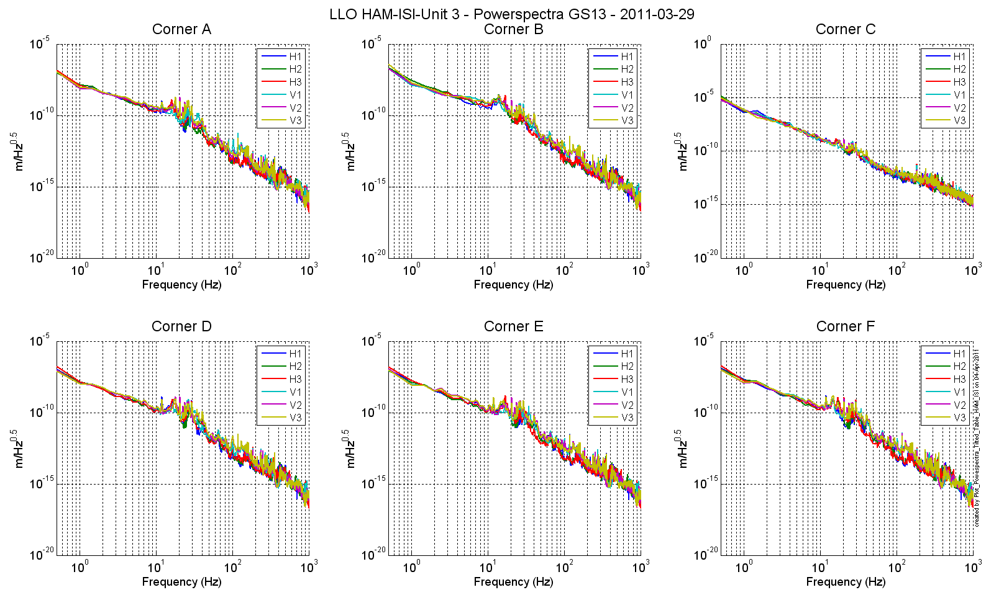
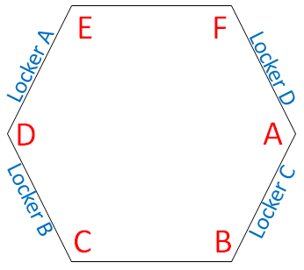
III. Tests performed after assembly
Step 9 - GS13 Power Spectrum (Table unlocked with a mass of 20 Kg at each corner of the optic table (1 mass at the time))
Acceptance Criteria:
- To be redefined
 | Unlocked (tilted with masses)
 | at 0.1Hz | at 1Hz | at 10Hz
H & V Geophones | 8.E-05 | 3.E-08 | 2.E-10
Notes:
13

Slide 14
III. Tests performed after assembly
Step 10 - Coil Driver, cabling and resistance check
Step 11 - Actuators Sign and range of motion (Local drive)
  Step 11.1 - Actuators sign
Acceptance criteria: A positive offset drive on one actuator
must give positive sensor readout on the collocated sensor
  Step 11.2 - Range of motion - Local drive
Acceptance criteria: Main couplings readout must be at least +/-16000counts (~0.002”)
Passed
Passed
Passed
 | Negative drive | Positive drive
H1 readout (count) | -24840 | 23704
H2 readout (count) | -23504 | 24473
H3 readout (count) | -25079 | 24232
V1 readout (count) | -19988 | 19535
V2 readout (count) | -25296 | 27191
V3 readout (count) | -22424 | 21599
Notes:
14

Slide 15
III. Tests performed after assembly
Step 12 - Vertical Capacitive Position Sensors Calibration (using dial indicators)
Vertical sensitivity: 845.3 count/mil 0.63% from nominal value)
Acceptance criteria: Deviation from nominal value < 2%. (Nominal is 840 count/mil)
Step 13 – Vertical Spring Constant
Vertical spring constant : 2.50e5N/m (+3.1% from nominal value)
Acceptance criteria:
Spring constant is within +/- 10/-1% of 2.428e5 N/m (HPD FEA Results).
Step 14 - Static Testing (Tests in the local basis)
Acceptance criteria: For a +1000 count offset drive
On Vertical actuators :
  Collocated sensors must be 1400 counts +/- 10%
On Horizontal actuators :
  Collocated sensors must be 2000 counts +/- 10%
  Non-collocated horizontal sensors must be 1250 counts +/-10%
Passed
Passed
 |  | Sensors (counts)
 |  | H1 | H2 | H3 | V1 | V2 | V3
Actuators (1000 counts) | H1 | 1967.669 | 1210.834 | 1224.792 | -3.392 | 12.744 | -33.92
 | H2 | 1207.929 | 2017.293 | 1256.419 | 11.939 | 21.785 | -21.05
 | H3 | 1224.299 | 1259.544 | 2015.90 | 37.030 | 16.072 | -30.849
 | V1 | 201.7530 | 172.320 | -313.735 | 1415.569 | -43.636 | -546.33
 | V2 | -276.287 | 261.940 | 230.952 | -554.369 | 1437.609 | -44.960
 | V3 | 159.632 | -385.887 | 142.389 | 44.354 | -612.036 | 1403.71
Notes:
15

Slide 16
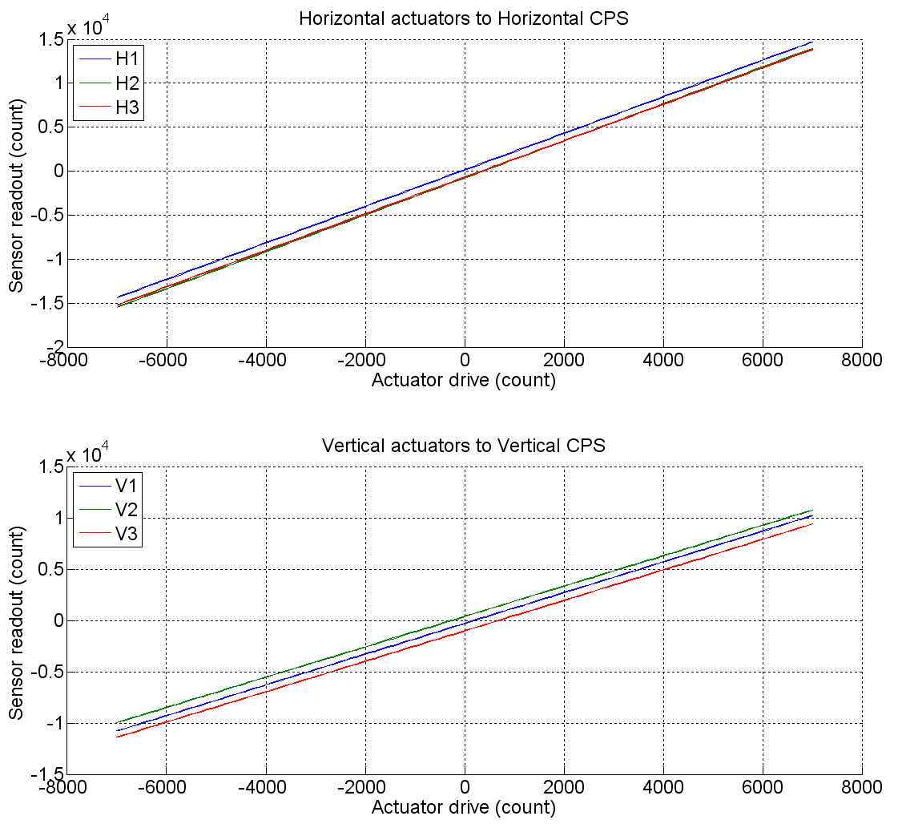
III. Tests performed after assembly
Passed
Step 15 – Linearity test
Acceptance criteria: Average slope +/- 3%
 | Slope | Offset | Average slope | Variation from average (%)
H1 | 2.077 | 127.6 | 2.0845 | -0.37
H2 | 2.102 | -763 |  | 0.83
H3 | 2.075 | -711 |  | -0.46
V1 | 1.498 | -282 | 1.4872 | 0.74
V2 | 1.479 | 368.3 |  | -0.53
V3 | 1.484 | -1024 |  | -0.20
Notes:
16

Slide 17
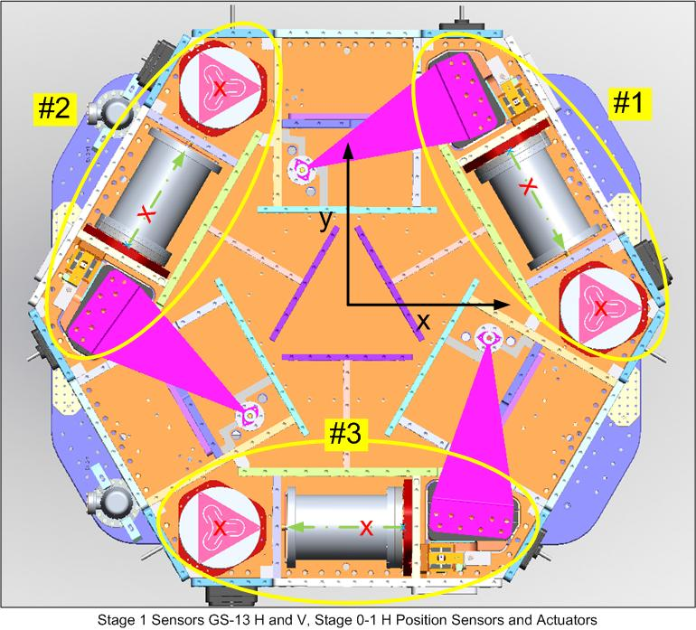
III. Tests performed after assembly
Step 16 - Static tests in the general coordinate basis
Notes:
17

Slide 18
III. Tests performed after assembly
Passed
Step 16 - Static tests in the general coordinate basis
Tests (for a +1000 counts actuation in each Cartesian direction)
Cartesian to local (CONT2ACT matrix)
Cartesian to Cartesian (DISP2CEN matrix)
Acceptance criteria : For a positive drive in the Cartesian basis:
- Local sensor readout must have the same sign that the reference table (CONT2ACT check)
Cartesian sensors read out must be positive (DISP2CEN check) in the drive direction
 |  | X Drive | Y Drive | Z Drive | Rx Drive | Ry Drive | Rz Drive
Sensors readout (count) | H1 | 263.528 | -390.4432 | 39.232 | -351.599 | -234.314 | -1870.593
 | H2 | 232.73 | 510.05 | 51.46 | 511.84 | -214.09 | -1926.44
 | H3 | -492.32 | 23.53 | 10.56 | 70.06 | 532.44 | -1901.82
 | V1 | -5.871 | 6.292 | 248.899 | -510.236 | -1619.426 | 11.019
 | V2 | -21.28 | -33.566 | 239.421 | 1633.514 | 398.43 | -57.855
 | V3 | 2.8 | -18.2 | 270.36 | -1169.8 | 1208.911 | 29.8
 | Direction read out | 492.38 | 524.71 | 256.965 | 2516.66 | 2506.73 | 2404.763
Notes:
18

Slide 19
III. Tests performed after assembly
Step 18 – Frequency response – Comparison with HAM6
  Step 18.1 – Local to local measurements
Horizontal sensors
Acceptance criteria:
  No major difference with the reference transfer functions (LLO-HAM6)
  Phase – less than 10º - In Phase – Out of Phase
  Damping (fit by eye with HAM6 transfer functions)
  DC gain
  Eigen frequencies shift less than 5%
Passed
19
Notes:
19

Slide 20
III. Tests performed after assembly
Step 18 – Frequency response – Comparison with HAM6
  Step 18.1 – Local to local measurements
Vertical sensors
Acceptance criteria:
  No difference with the reference transfer functions (HAM6 - SVN)
  Phase – less than 10º - In Phase – Out of Phase
  Damping (fit by eye with HAM6 transfer functions)
  DC gain
  Eigen frequencies shift less than 5%
Passed
20
Notes:
20

Slide 21
III. Tests performed after assembly
Step 18 – Frequency response – Comparison with HAM6
  Step 18.2 – Cartesian to Cartesian measurements
X, Y, RZ direction
Acceptance criteria:
  No difference with the reference transfer functions (HAM6 - SVN)
  Phase – less than 10º - In Phase – Out of Phase
  Damping (fit by eye with HAM6 transfer functions)
  DC gain
  Eigen frequencies shift less than 5%
Passed
21
Notes:
21

Slide 22
III. Tests performed after assembly
Step 18 – Frequency response – Comparison with HAM6
  Step 18.2 – Cartesian to Cartesian measurements
Z, RX, RY direction
Acceptance criteria:
  No difference with the reference transfer functions (HAM6 - SVN)
  Phase – less than 10º - In Phase – Out of Phase
  Damping (fit by eye with HAM6 transfer functions)
  DC gain
  Eigen frequencies shift less than 5%
Passed
22
Notes:
22

Slide 23
III. Tests performed after assembly
Step 19 - Lower Zero Moment Plan (TF between 10 mHz and 100 mHz
X Offset: 0.399 mm
Y Offset: 0.738 mm
Acceptance criteria
- Both offsets should be inferior to 1 mm
Passed
23
Notes:
23

Slide 24
III. Tests performed after assembly
Step 20 – Damping loops
  Step 20.1 – Transfer functions – Simulations
Vertical damping loops – (HAM6 filters + new electronics compensation)
Acceptance criteria:
Ham 6 damping loop must implemented and stable with
Phase margin must be at least 45º
Gain margin must be at least 20dB
Passed
V1 : solid line
V2 : dash line
V3 : dash-dot line
24
Notes:
24

Slide 25
III. Tests performed after assembly
Step 20 – Damping loops
  Step 20.1 – Transfer functions – Simulations
Horizontal damping loops (HAM6 filters + new electronics compensation)
Acceptance criteria:
Ham 6 damping loop must implemented and stable with
Phase margin must be at least 45º
Gain margin must be at least 20dB
Passed
H1 : solid line
H2 : dash line
H3 : dash-dot line
25
Notes:
25

Slide 26
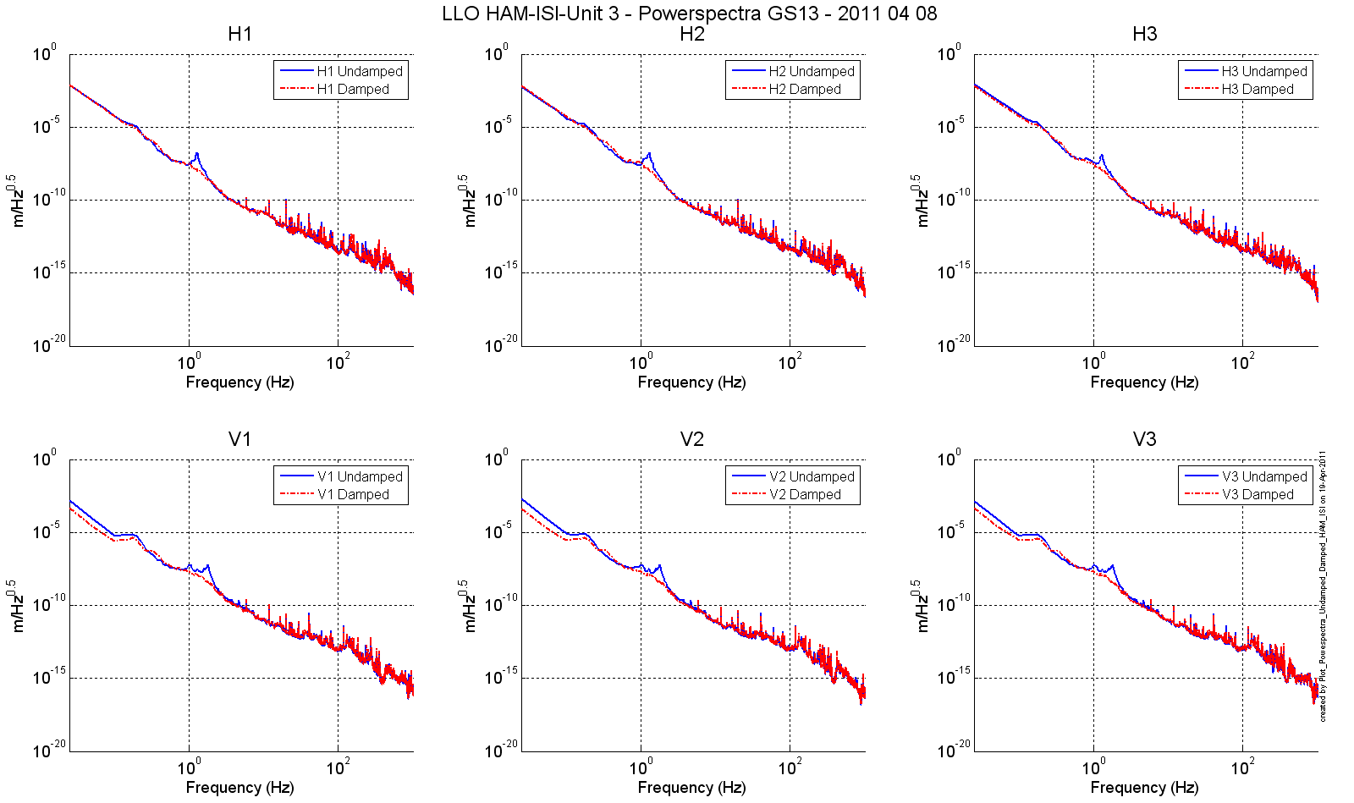
III. Tests performed after assembly
Step 20 – Damping loops
  Step 20.2 – Powerspectrum – Experimental
All damping filters engaged
Acceptance criteria:
Ham 6 damping loop must implemented and stable
Passed
26
Notes:
26

Slide 27
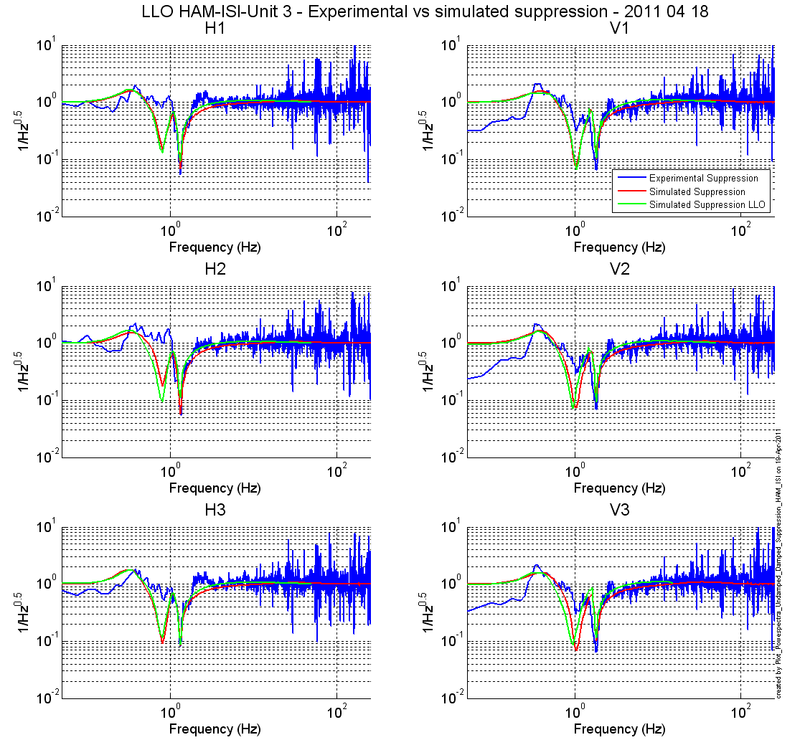
III. Tests performed after assembly
Step 20 – Damping loops
  Step 20.2 – Suppression – Experimental vs simulation vs HAM6 simulation
All damping filters engaged
Acceptance criteria:
Ham 6 damping loop must implemented and stable
Blue : Measurement
Red : Simulation
Green : HAM6
27
Notes:
27

Slide 28
IV. Summary
Missing information
  Some assembly measurements were done but not recorded at the time
    Actuator gaps
Tests results
  Passed without major difficulties
Failed tests
  Actuator gaps (1 measurement slightly over)
  Sensor gaps
28
Notes:
28

Slide 29
Questions?

Slide 30
Back Up Slides

Slide 31
III. Tests performed after assembly
Step 17 – Frequency response
  Step 17.1 – Local to local measurements
Horizontal sensors
Acceptance criteria:
  - On CPS, the phase must be 0º at DC
  - On Geophones, the phase must be -90º at DC
Passed
Notes:
31

Slide 32
III. Tests performed after assembly
Step 17 – Frequency response
  Step 17.1 – Local to local measurements
Vertical sensors
Acceptance criteria:
  - On CPS, the phase must be 0º at DC
  - On Geophones, the phase must be -90º at DC
Passed
Notes:
32

Slide 33
III. Tests performed after assembly
Step 17 – Frequency response
  Step 17.2 – Cartesian to Cartesian measurements
X, Y, RZ direction
Acceptance criteria:
  - On CPS, the phase must be 0º at DC
  - On Geophones, the phase must be -90º at DC
Passed
Notes:
33

Slide 34
III. Tests performed after assembly
Step 17 – Frequency response
  Step 17.2 – Cartesian to Cartesian measurements
Z, RX, RY direction
Acceptance criteria:
  - On CPS, the phase must be 0º at DC
  - On Geophones, the phase must be -90º at DC
Passed
Notes:
34

