Slide 1
Stray Light Control & Viewports
Michael Smith aLIGO NSF Review
LIGO Livingston Observatory
25-27 April 2011

Slide 2
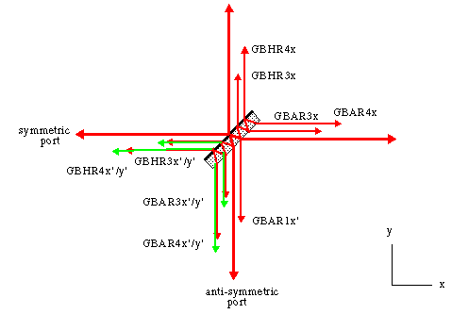
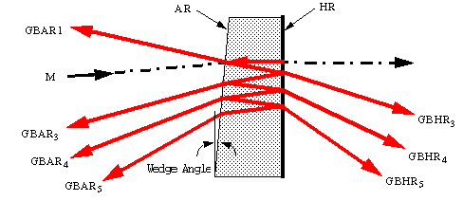
Stray Light Control Functions
Control stray light scatter in the interferometer using baffles, beam dumps, and attenuators
Reduce scattered light apparent displacement noise
Ghost beams

Slide 3
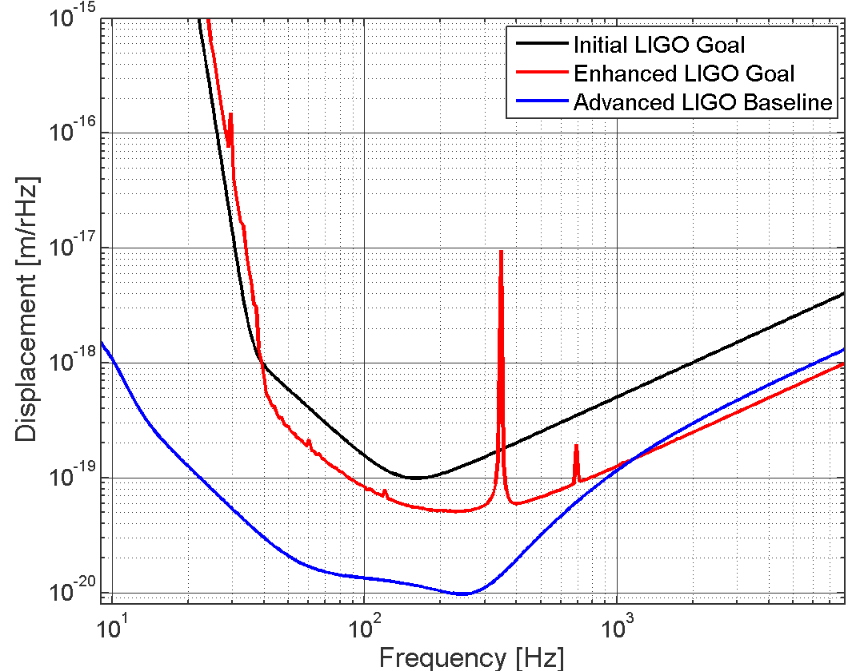
Stray Light Control Requirements
Total apparent stray light displacement noise <1/10 thermal noise limit
Thermal Noise Limit

Slide 4
Stray Light Control Design Concept
Porcelainized enamel coatings to reduce scattered light power
Small, Core Optic wedge angles simplify/consolidate many baffles and beam dumps in the recycling cavities
  Cavity Mirror Wedge angles
    ITM, 0.07 deg vertical wedge angle causes ghost beams to separate from the main beam in the vicinity of PR2 and SR2 for interception with beam dumps
    BS, 0.07 deg horizontal wedge angle provides the ITM pickoff beam in vicinity of SR2
Variety of suspended baffle surfaces reduce apparent scattered light displacement noise
  Arm Cavity Baffle (ACB), ITM Elliptical Baffle, Manifold/Cryopump Baffle
  Output Faraday Isolator
New ACB catches narrow and wide-angle scatter from ITM and ETM
New ACB photodetectors aid initial alignment; measure scattered light
New Mode Cleaner Tube Baffle mitigates recycling cavity scatter and errant beams

Slide 5
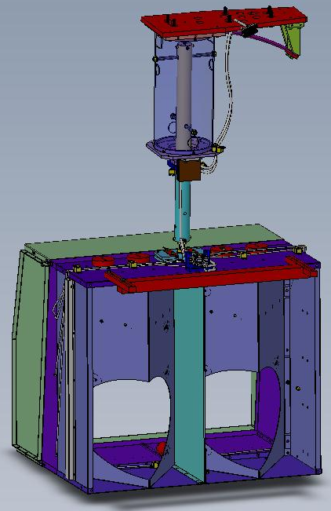
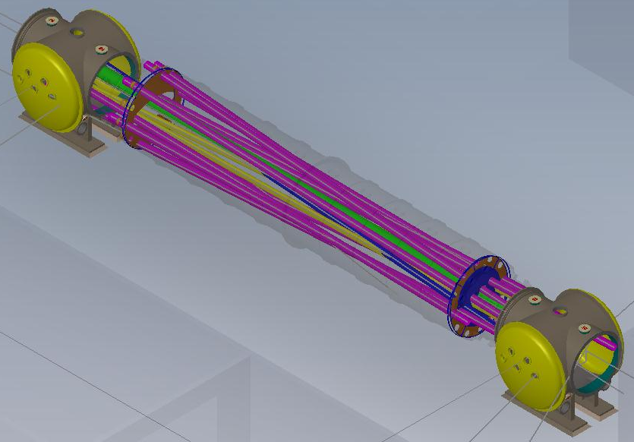
Scattered Light Control
Development Accomplishments - I
Scattered light displacement noise models with real suspensions meet SLC requirement
Developed porcelainized coating for baffles and beam dumps
Tested Output Faraday Isolator (OFI) and Arm Cavity Baffle (ACB) suspension designs with eddy current-damping at Caltech and LASTI
  Suspension model matches experimental data
Shipped OFI 1st Article to LHO for squeezer test
Completed vibration test --Manifold/Cryopump Baffle 1st Article
  Ready for one-arm integration at LHO
Developed new ACB design to mitigate wide-angle scatter from Test Mass
Created new Mode Cleaner Tube baffles for recycling cavity, based on eLIGO experience

Slide 6
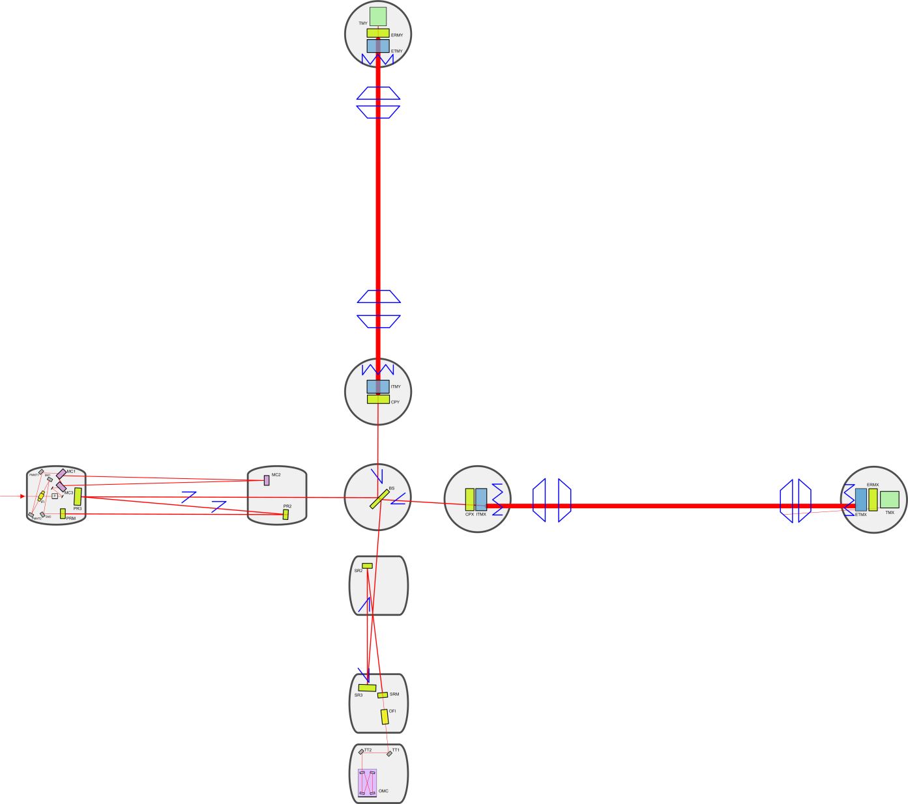
Stray Light Control (SLC)
PRx = power recycling cavity mirror
SRx = signal recycling cavity mirror
Arm cavity &
Wide Angle Baffle
Manifold/Cryopump Baffle
PR2 Scraper Baffle
Elliptical Baffle
Modecleaner Tube
Baffles
SR2 Flat Baffle
Hartmann VP Baffles
SR2 Scraper Baffle
SRM Flat Baffle
SR3 Flat Baffles
Output Faraday Isolator

Slide 7
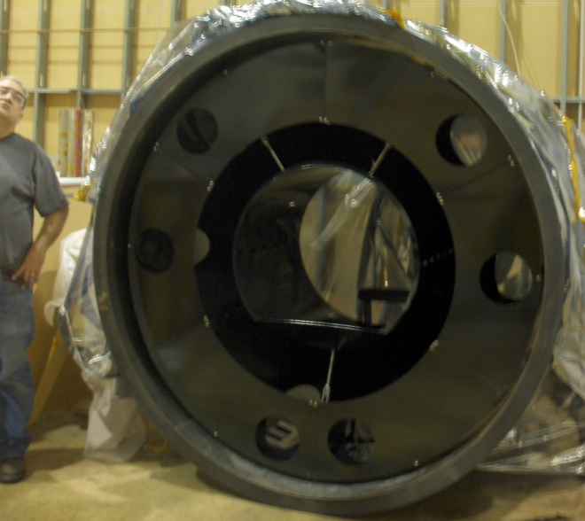
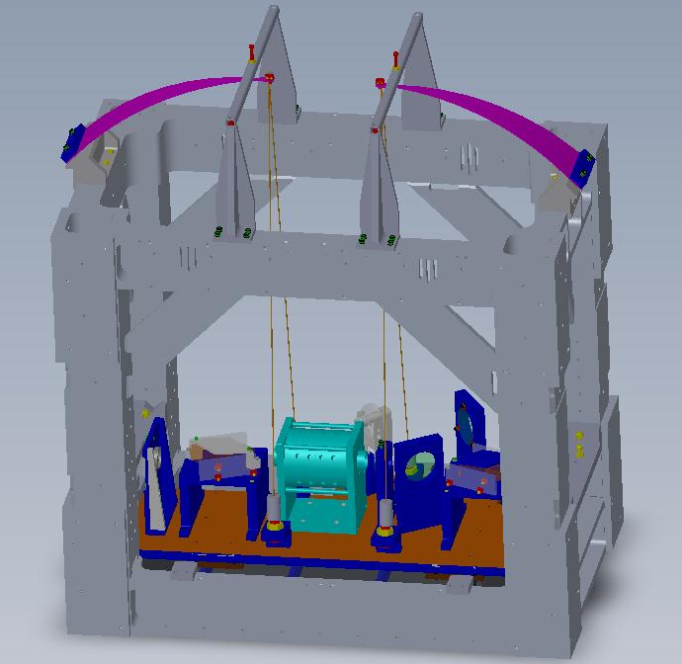
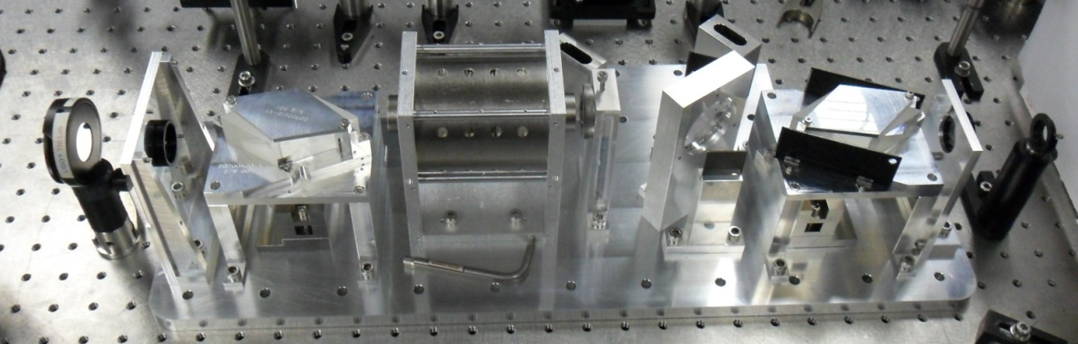
Scattered Light Control
Development Accomplishments – II
1st Articles Complete
  Manifold/Cryopump Baffle
  Output Faraday Isolator
Suspensions Tested
  Arm Cavity Baffle
  Manifold/Cryopump Baffle
  Output Faraday Isolator
Manifold/Cryopump Baffle 1st Article suspended inside manifold tube mock-up
Optical test of OFI at Caltech

Slide 8
Stray Light Control Development Status
Completed Output Faraday Isolator Final Design Review – Oct 2010
Completed Arm Cavity Baffle Final Design Review – April 2011
Most designs and drawings are complete
All other SLC baffles and beam dumps Final Design Review – June 2011

Slide 9
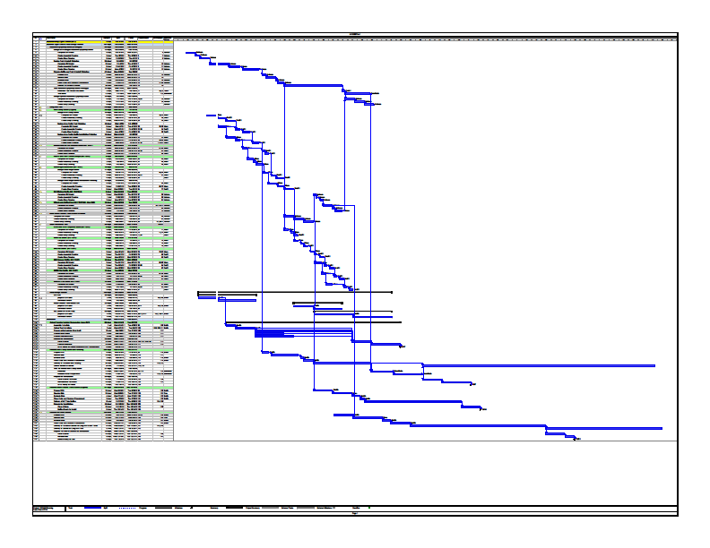
Stray Light Control
Project Plans and Reorganization
Project Plans
  Output Faraday Isolator 1st Article at LHO– April 2011
  Baffles and Beam Dumps for One-arm Integration ready – July 2011
  Baffles and Beam Dumps for Michelson Integration ready – August 2011
  All other baffles and beam Dumps for aLIGO Installation – Nov. 2011
Project Organization - Caltech
  Team Leader/Optical Engineer – Michael Smith
  Coordinator – Lisa Austin
  Suspensions Testing - Virginio Sannibale
  Mechanical Designer - Heidy Kelman
  Mechanical Designer - Niem Nguyen
  Mechanical Designer – Manuel Ruiz
  Draftspersons - Pool

Slide 10
Scattered Light Control
Challenges, Risks, and Mitigations
Delivering SLC in time for the One-arm & Michelson Integration?
  On track to meet Installation Schedule
Adequate seismic attenuation achieved?
  All suspended baffles and attenuators tested at CIT and LASTI, and meet SLC requirements
  Porcelainization of baffles is now a standard process
On-time delivery of procurements?
  Continuous monitoring of manufacturing progress
No remaining risks!!

Slide 11
Stray Light Control
Near Term Activities
Shipped 1st Article OFI to LHO for Squeezer Test
Shipped 1st Article Manifold/Cryopump Baffle to LHO for One-arm Integration
Completing procurement of Arm Cavity Baffle 1st Article
Completing Final Design Review
  Manifold/Cryopump Baffle and Mode Cleaner Tube Baffle – May, 2011
  All Other SLC baffles and beam dumps – June, 2011
Procuring all remaining baffles and beam dumps
Developing installation procedures and tooling

Slide 12
Viewport Functions
Provide optical viewports for the passage of optical beams in and out of the vacuum region(s) of the Interferometer.
  optical lever beams
  chamber illumination beams
  video camera beams
  optical beams for interferometer sensing and control
  Hartmann Sensor beams
  Photon Calibrator beams
Provide safety covers for all installed viewports
12

Slide 13
Viewport Requirements
Video camera Viewport (VP)—transmit visible light spectrum
Chamber illumination VP—uncoated viewports
OpLev VP—similar to iLIGO
Septum Plate (to isolate input and output HAM chambers) VP— similar to eLIGO
ISC and Hartmann VP—super-polished, low scattering, < 1/10 wave , special AR coatings
  Hartmann AR coating: 800nm – 1080nm
  ISC AR coating: 532nm and 1064nm
Safety covers to protect viewports during installation and commissioning
13

Slide 14
Viewport Design Concept
Reuse iLIGO VP wherever possible
New O-ring-sealed 6.0 inch VP for Interferometer Sensing and Control, and Hartmann beams
Septum VP similar to eLIGO design
Additional iLIGO style VPs needed for new Mode Cleaner Tube VPs
14

Slide 15
Viewport
Development Accomplishments
Analyzed VP scattered light
Determined viewport locations using ZEMAX beam layout
Established proper names for all viewports according to LIGO naming convention
Created a catalog of VP requirements and part numbers for all subsystems
Completed VP Final Design Review
Developed new specification for 6.0 inch ISC/Hartmann VP
15

Slide 16
Viewport Development Status
Drawings for 6.0 inch VP and Septum VPs are in progress
Final Design Review Complete April 2011
16

Slide 17
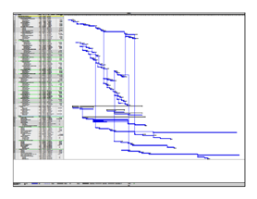
Viewport Project Plans and Reorganization
Project Plans
  On schedule for installation One-arm Integration– June 2011
  On schedule for deployment for Michelson Integration– July 2011
  On schedule for deployment of three aLIGO IFOs – August 2011
Project Organization
  Cognizant Engineer and Leader – Michael Smith – Caltech
  Coordinator – Lisa Austin – Caltech
  Installation Leads –
    Gerardo Moreno – Hanford
    Chris Guido– Livingston
LIGO-G1100451-v2
17

Slide 18
Viewport
Challenges, Risks, and Mitigations
On-time procurement of 6.0 inch VP and Septum VP?
  Monitoring of procurement and manufacturing progress
Other VPs mostly catalog items
  No known technical or schedule risks
18

