Slide 1
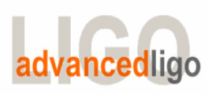
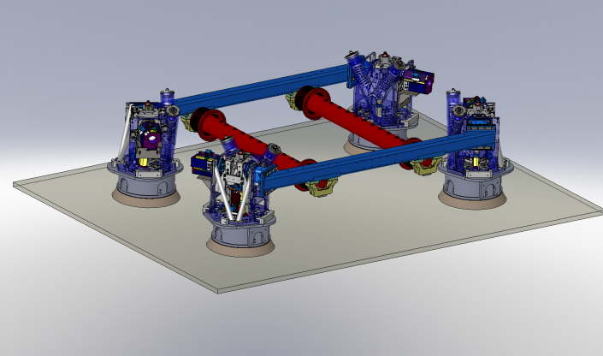
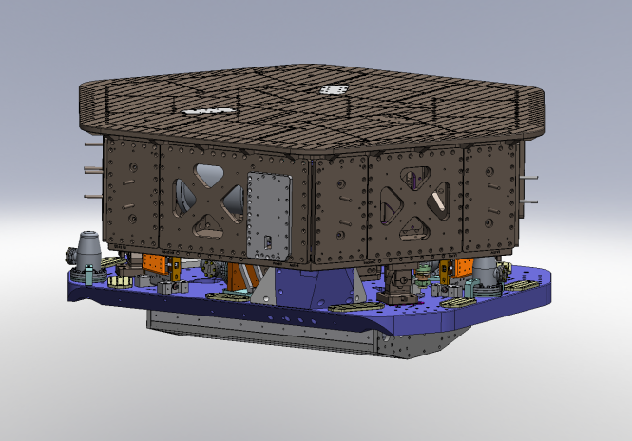
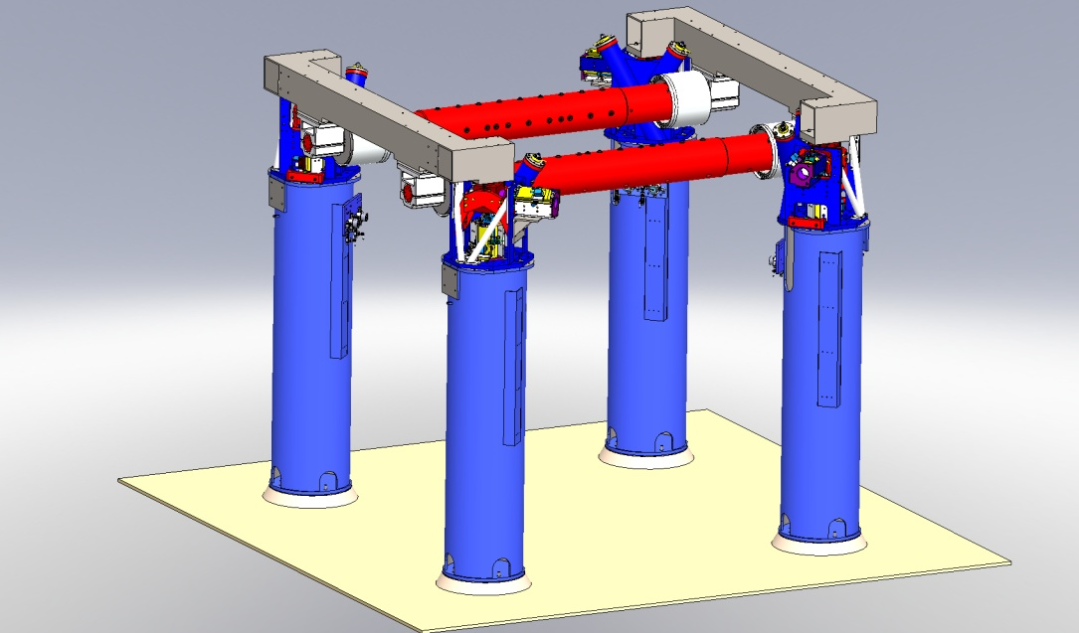
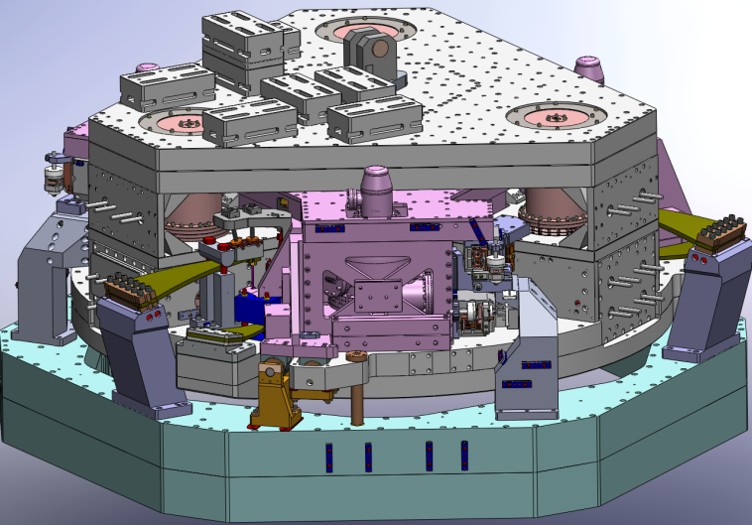
Seismic Isolation Group (SEI)
SEI Technical Status – NSF Review 2011
G1100447-v3
April 26, 2011
Fabrice Matichard for the SEI Team
  HAM-HEPI
  HAM-ISI
  BSC-HEPI
  BSC-ISI
1

Slide 2
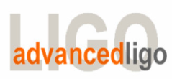
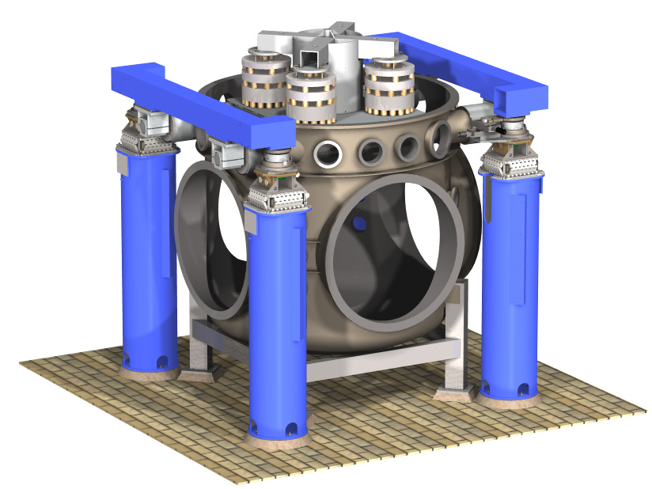
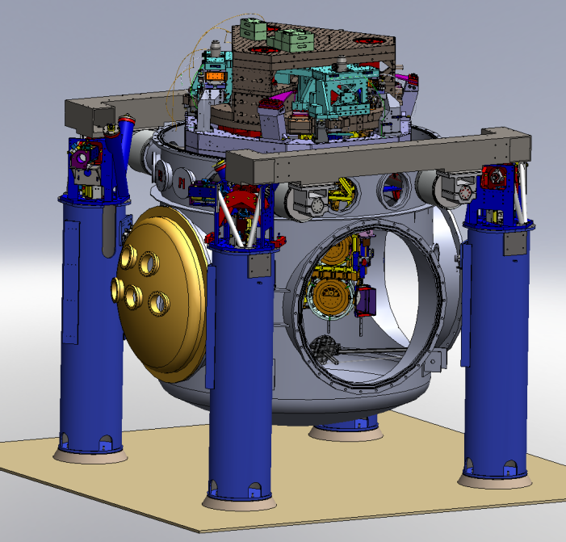
1. Advanced LIGO Seismic Isolation Overview
Provide quiet, well controlled platform for the optics in 6 DOF.
Provide low-frequency, large-throw positioning of the optics.
From Initial LIGO/Enhanced LIGO to Advanced LIGO
$38.3 M
  Initial LIGO – BSC Chambers Equipment
  Advanced LIGO – BSC Chambers Equipment
2

Slide 3
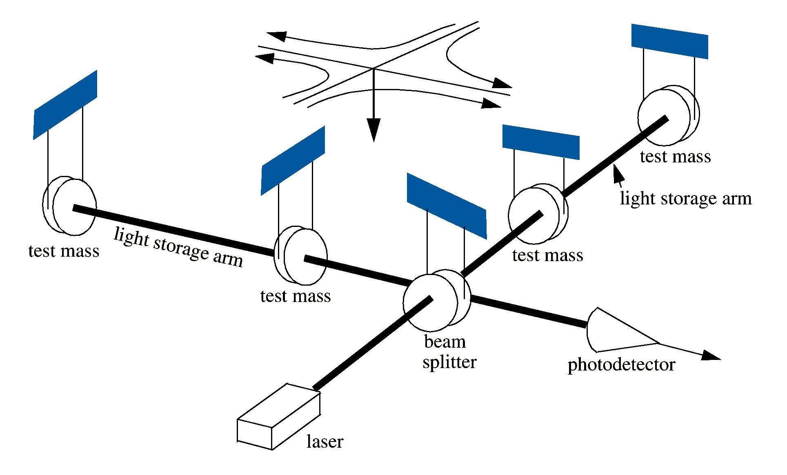


1. Advanced LIGO Seismic Isolation Overview
Small Test Mass Motions: needs for high performance seismic isolation
Noise Isolation:
Seismic
Thermal
Shot
h ~10⁻²¹
3

Slide 4
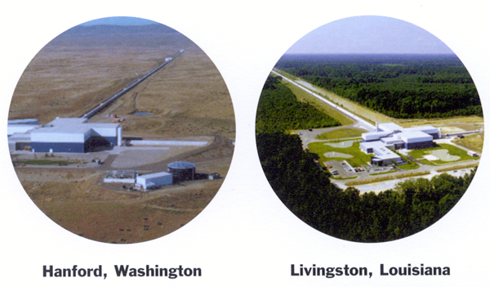
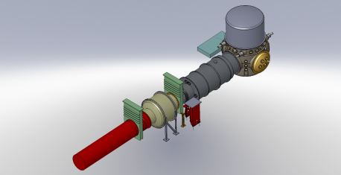
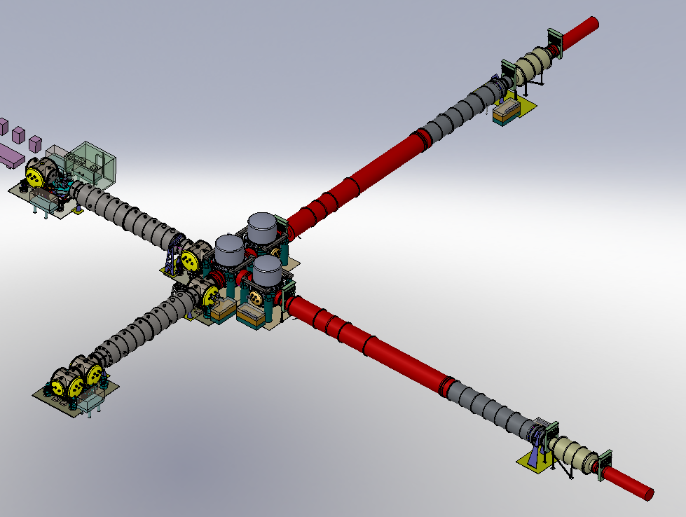
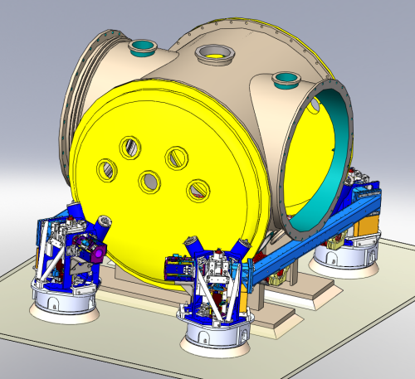
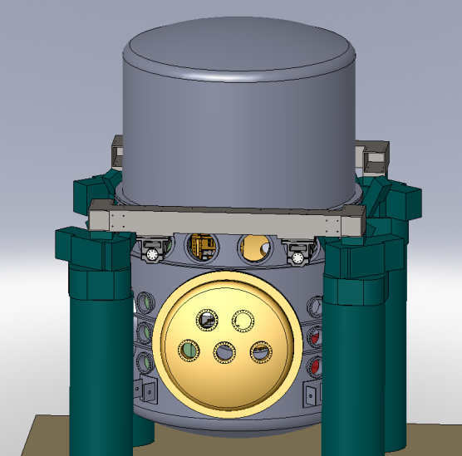
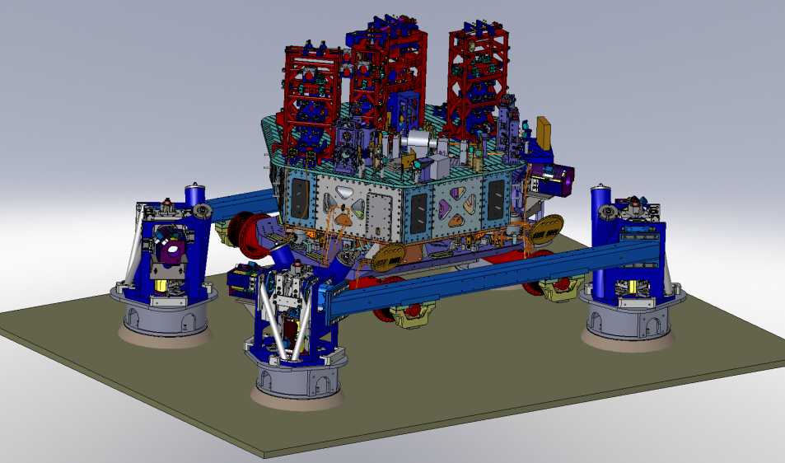
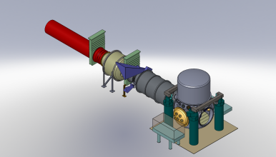
1. Advanced LIGO Seismic Isolation Overview
Y End Station
LIGO Livingston
System Layout
4 Km Y Arm
Auxiliary
Optics
(5 + 1
Chambers)
Core Optics
(5 Chambers)
Corner Station
4 Km X Arm
X End
Station
4

Slide 5
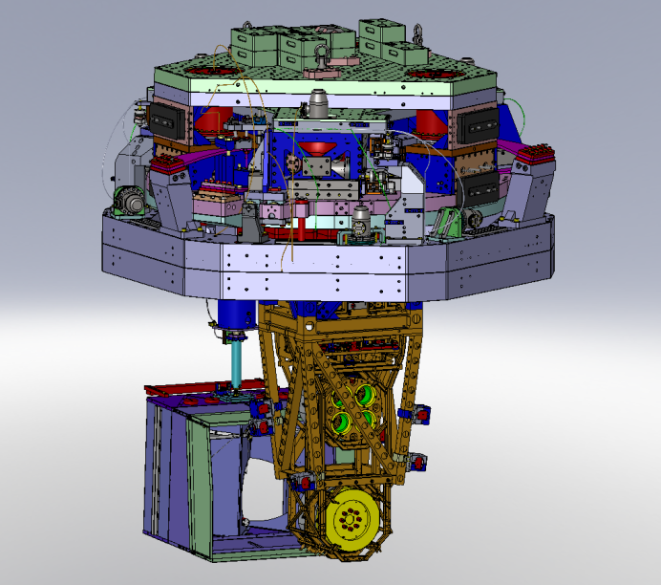
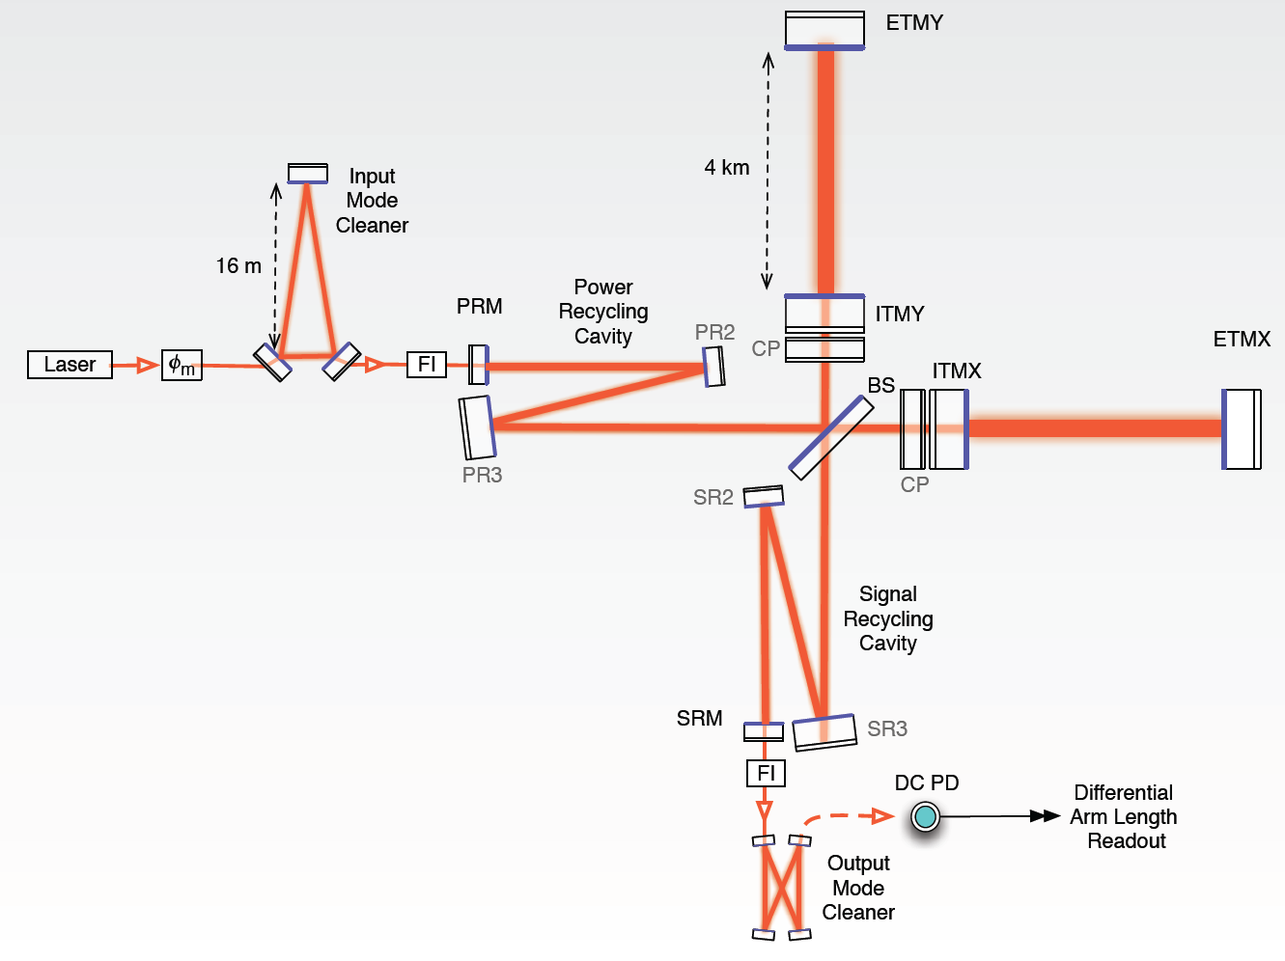
1. Advanced LIGO Seismic Isolation Overview
Optical Layout
5

Slide 6
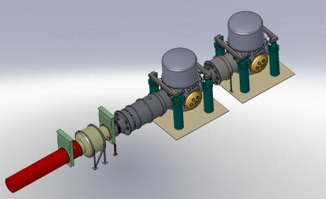
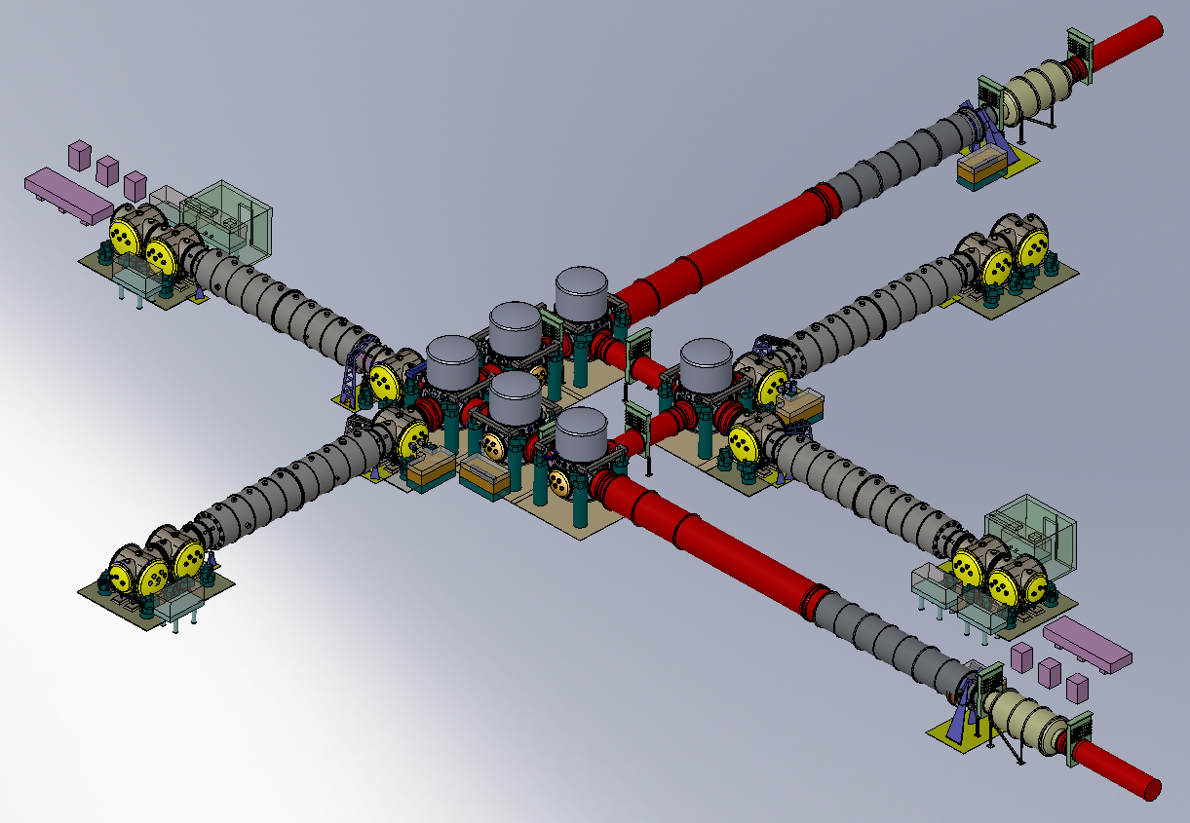
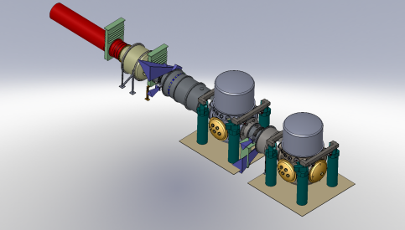
Conclusion
LIGO Hanford System Layout (H1 and H2)
Y End Station
4 Km Y Arm
Support
Auxiliary
Optics
(10+2 Chambers)
Support
Core Optics
(10 Chambers)
6 HAM Chambers for H1
5 BSC Chambers for H1
6 HAM Chambers for H2
5 BSC Chambers for H2
X End Station
6

Slide 7
1. Advanced LIGO Seismic Isolation Overview
Up to 7 Stages of Isolation in Series
HEPI (1) - SEI subsystem
Pre-Isolator
Low frequency positioning
Isolation from 0.1 to ~5 Hz
BSC-ISI (2) - SEI subsystem
Internal Seismic Isolation
Isolates above ~0.2 Hz
Quiet, well controlled table
Quad pendulum (up to 4) – SUS
Req: 10⁻¹⁹ m/√ Hz at 10 Hz
Up to 5 Stages of Isolation in Series
HEPI (1) - SEI subsystem
Pre-Isolator
Low frequency positioning
Isolation from 0.1 to ~5 Hz
BSC-ISI (1) - SEI subsystem
Internal Seismic Isolation
Isolates above ~0.2 Hz
Quiet, well controlled table
Triple pendulum (up to 3) – SUS
Req: 10⁻¹⁷ m/√Hz at 10 Hz
7

Slide 8
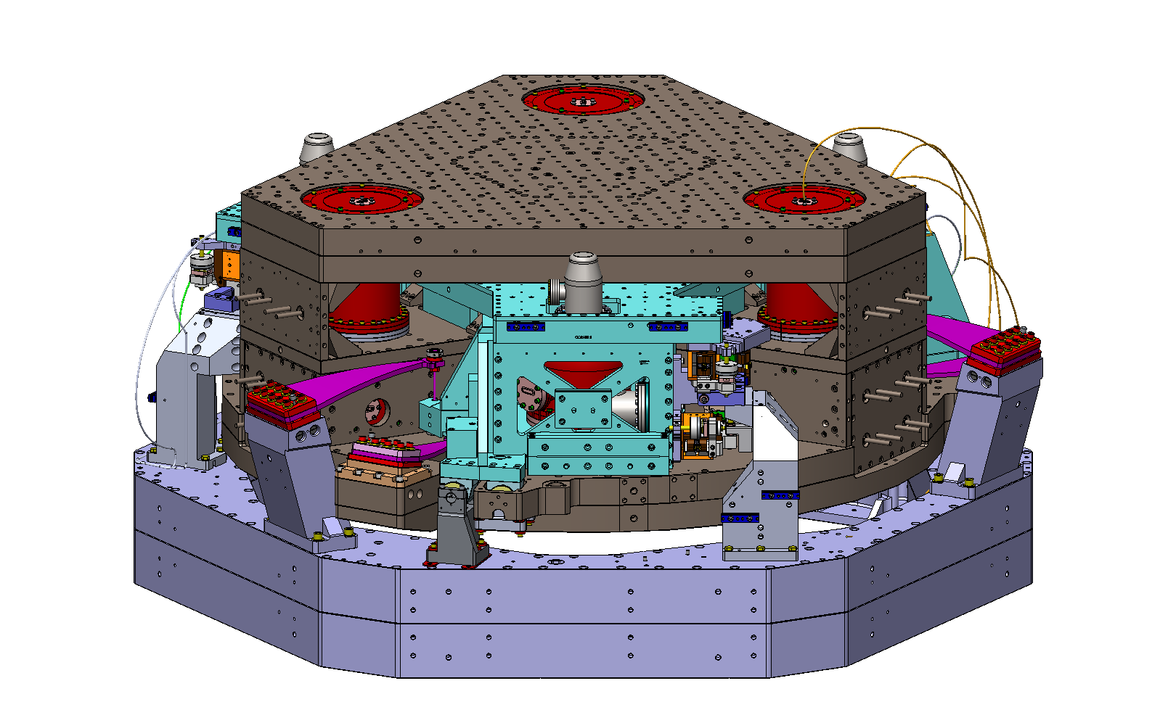
1. Advanced LIGO Seismic Isolation Overview
  Seismic Isolation Group responsibility:
  HAM-HEPI:
  Hydraulic External Pre Isolator
  HAM-ISI:
  Single Stage
  Internal Seismic Isolator
  HAM Chambers Equipment
  BSC-HEPI:
  Hydraulic External Pre Isolator
  BSC-ISI:
  Two-Stage Internal Seismic Isolator
  BSC Chambers Equipment
8

Slide 9
2. HEPI: Hydraulic Pre-Isolator
HAM-HEPI
2.1 Overview
2.2 Pre-Assembly Testing
2.3 Assembly
2.4 Performance
BSC-HEPI
  HEPI OVERVIEW:
  Pre-Isolator, Out of Vacuum
  Minimize heat dissipation in-vacuum
  6 Degrees of freedom
  Positioning and alignment, length and angle
  Low Frequency active isolation (0.1 Hz to ~5 Hz)
  Micro Seismic, Tidal Correction
  Was used for iLIGO and eLIGO at LLO
  Will be used on all chambers (18 HAM and 15 BSC).
  HAM Cross beams re-designed
  LLO HAM will become LHO BSC
April 2010 – April 2011
HEPI Progress Highlights
9

Slide 10
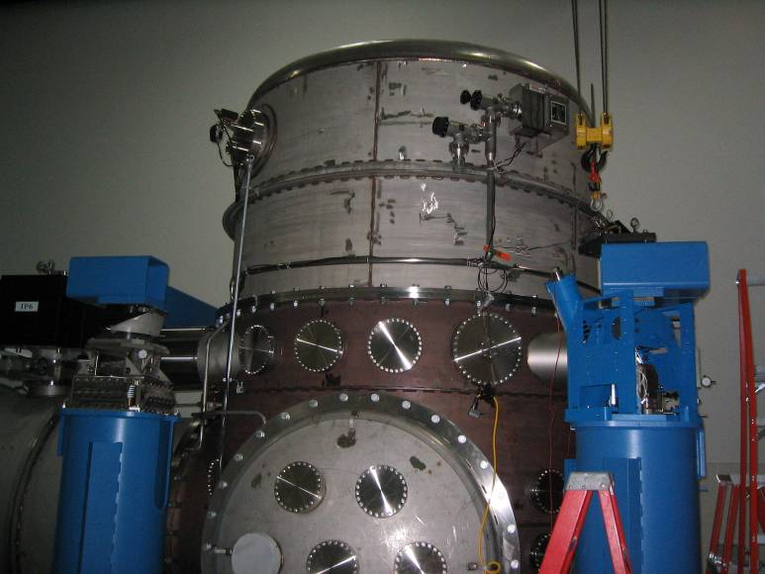
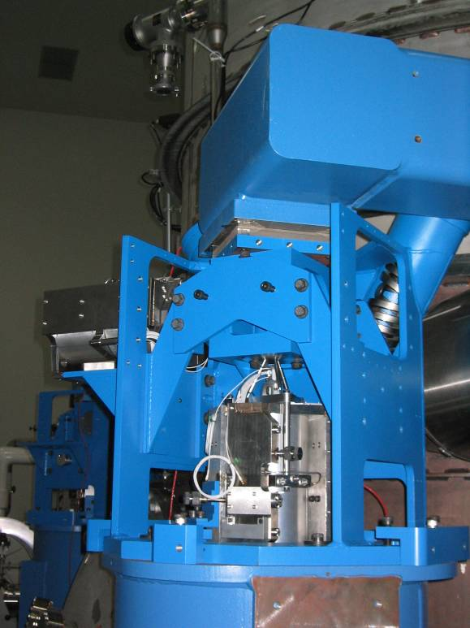
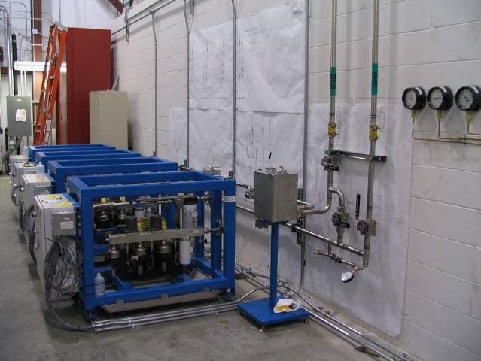
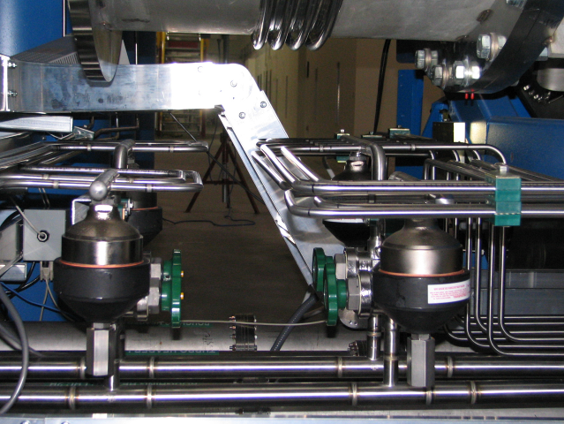
2. HEPI Overview
Installed at LLO for Initial LIGO.
Running for many years. Intended for Advanced LIGO, but installed to remediate large ground motion at first 2 stack modes.
LLO gets new electronics and new HAM units. LHO gets full installation.
All HAM crossbeams will be upgraded.
Recent performance improvements from optimal feedforward filtering based on interferometer signals.
A few of the new actuators may need to be rebuilt, tests underway on those at Stanford.
Many components of LHO system now assembled as modules, actuators being tested, installation and plumbing begins in early 2011.
HEPI
10

Slide 11
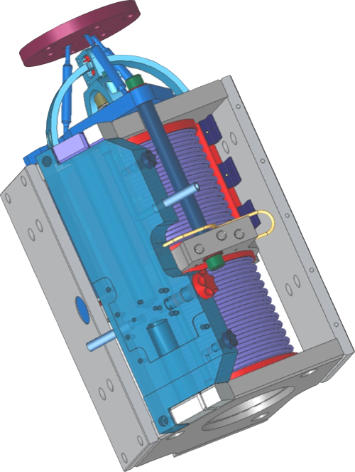
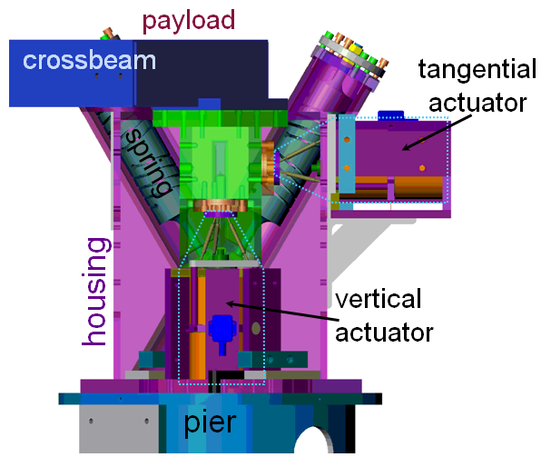
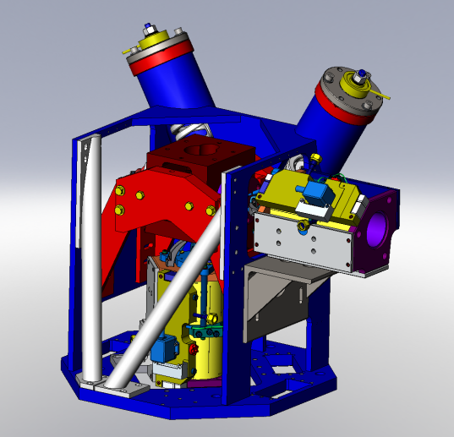
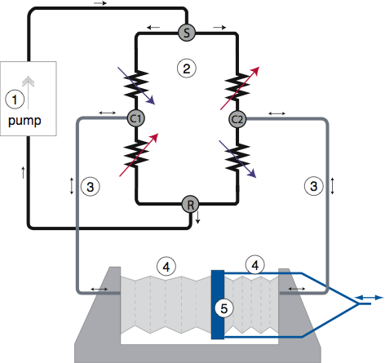
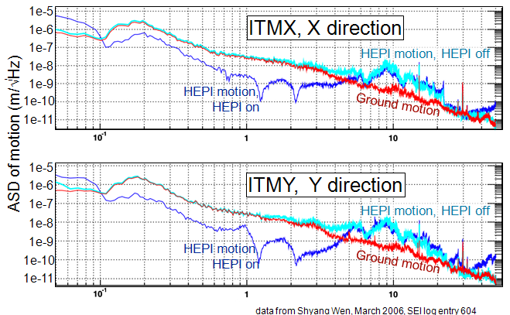
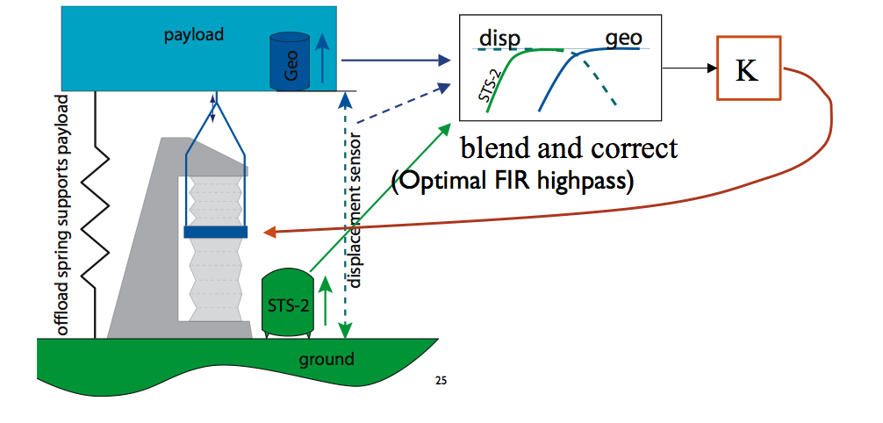
2. HEPI (Hydraulic Pre-Isolator)
More range than PZTs (+/- 1 mm)
More force than voice coils
(~400 lbs, static offset)
Quiet (<1 nm/√Hz at 1 Hz)
HEPI housing on pier top holds:
Actuators and sensors for vertical and tangential directions
Offload springs & payload adjustment
Caging, stops, alignment features...
Low frequency control topology
HEPI performance at LLO
11

Slide 12
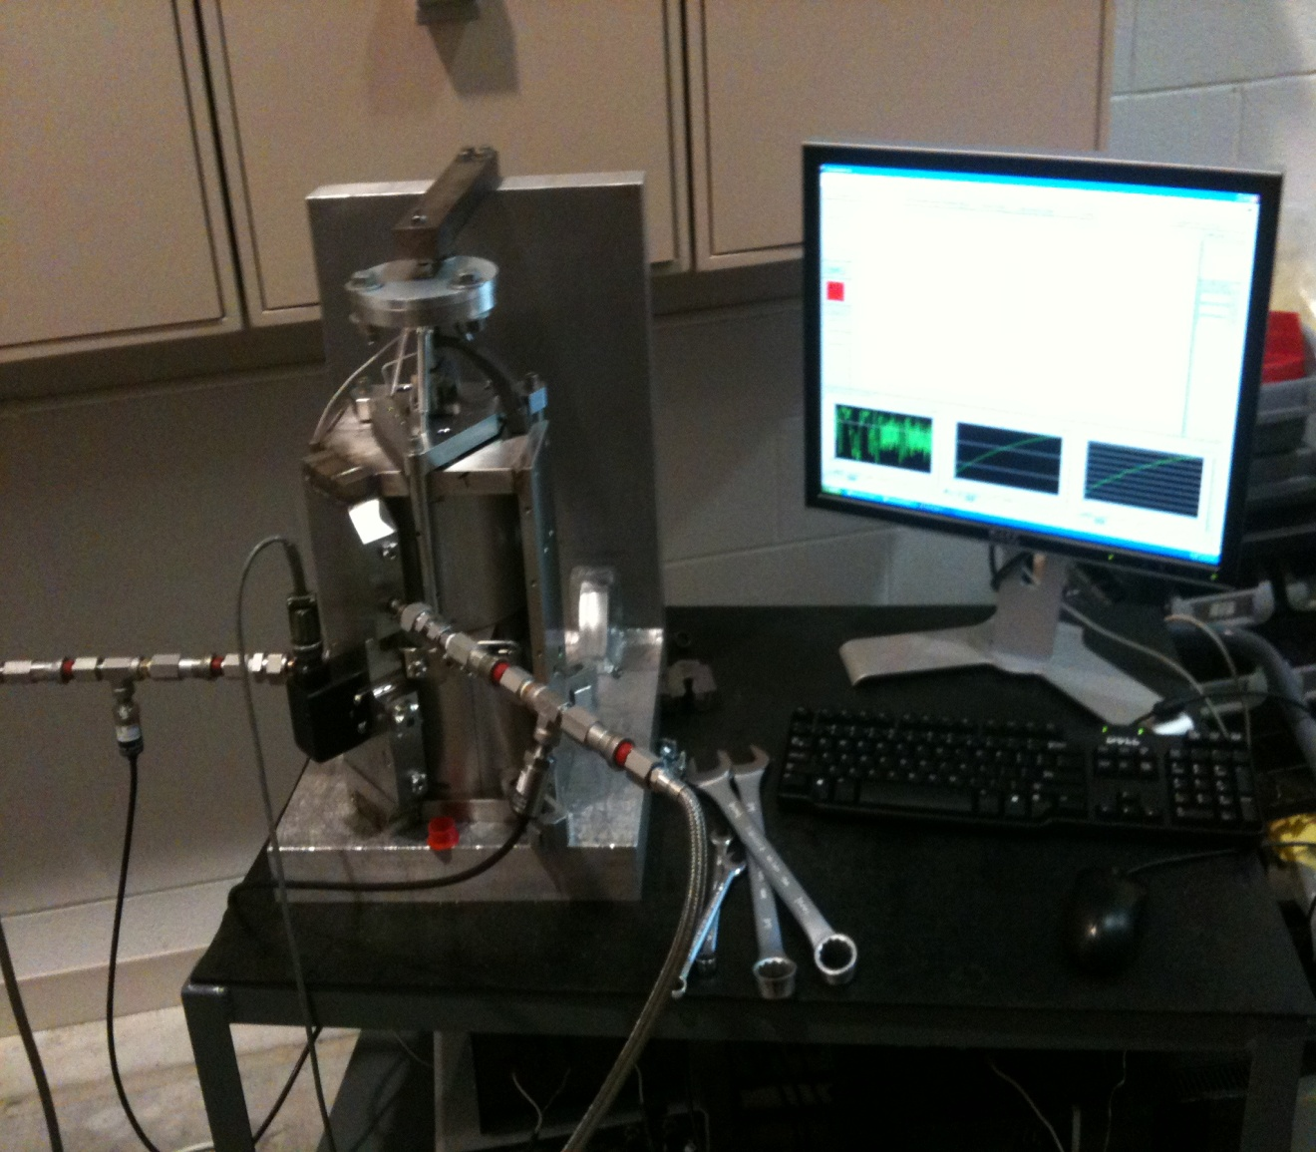
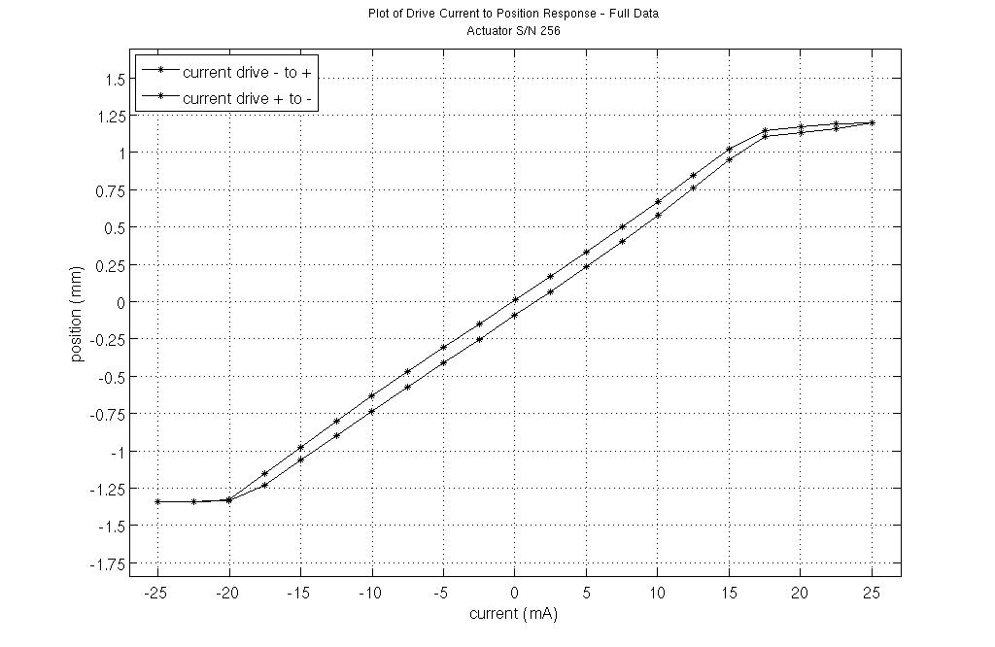
2. 2 HEPI Testing
Sensors: done (presented last year)
Actuators:
Test Stand Set-Up
Test Results
  Actuator attached to a calibrated force load cell.
  Capacitive displacement sensors mounted to monitor displacement. Typical maximum response range is from +/- 1.3mm.
  Actuators driven through a range of currents to the Parker valves that control the pressure differential of the HEPI fluid.
  The linear relationship of this drive current to displacement response is desired for at least 2 mm of displacement.
Linearity is confirmed for an actuation range of +/- 1mm.
Specification calls for +/- 1mm of linear actuation and response.
Maximum displacement is typically +/- 1.3mm, with none less than +/-1.1m
So far, 125 of the 144 HEPI actuators needed at LHO show a good linear response for at least 2mm of displacement.
Only 2 thus far display a slight non-linearity through a limited actuation range.
12

Slide 13
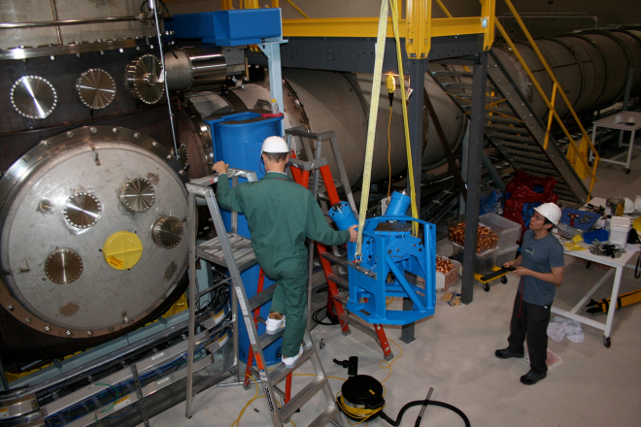
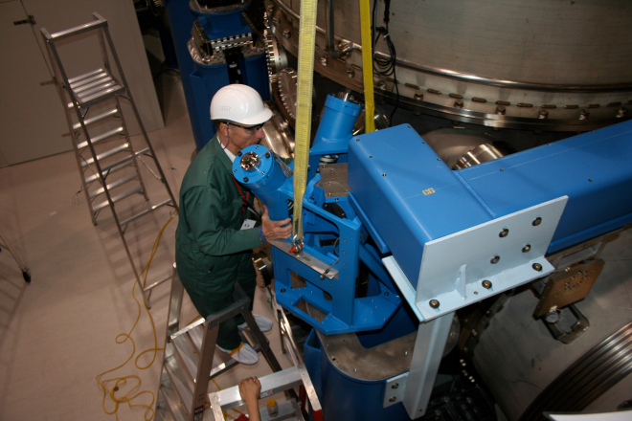
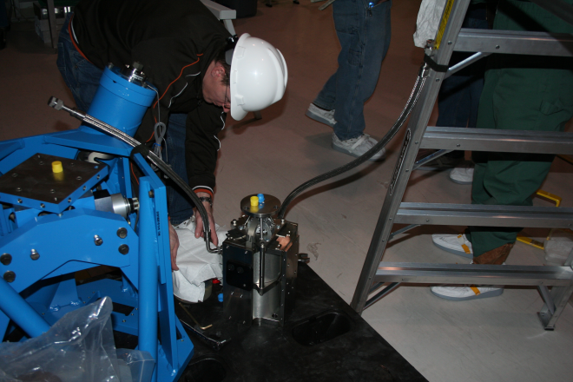
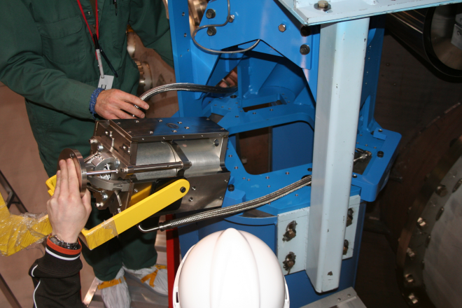
2. 3 HEPI Assembly
LHO - BSC HEPI Assembly Support:
  HEPI Support Structure
  HEPI Support Insertion
  HEPI Actuators
  Actuators Installation
13

Slide 14
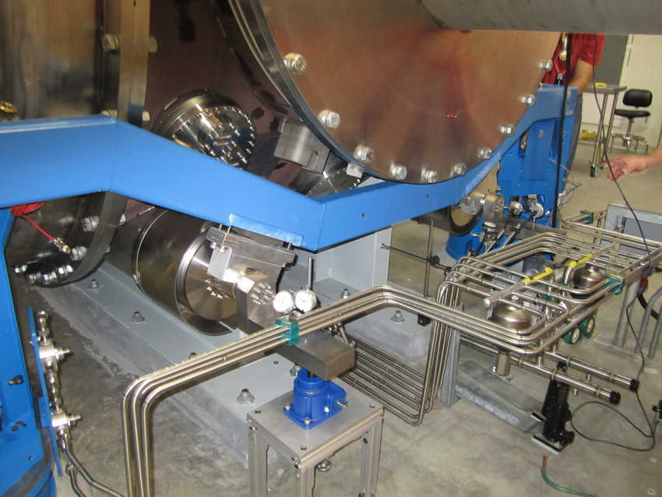
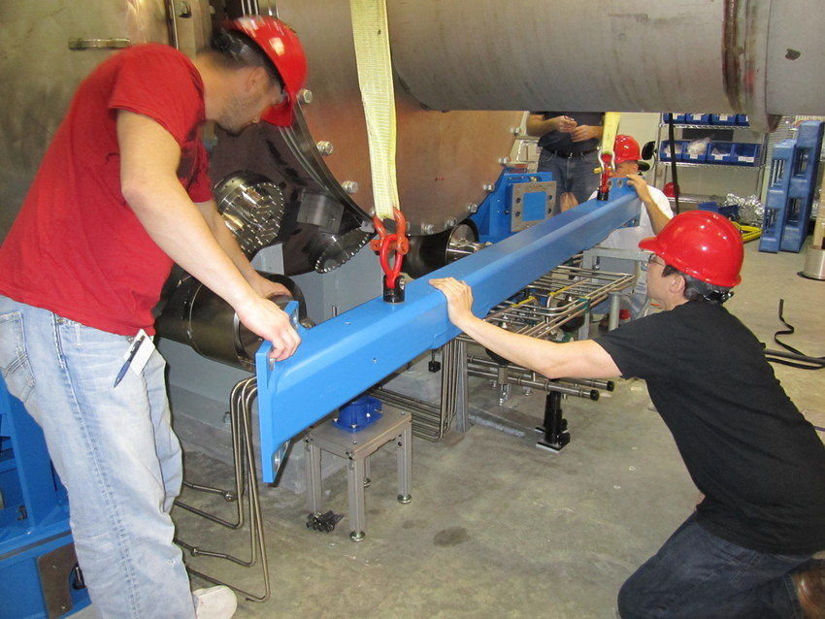
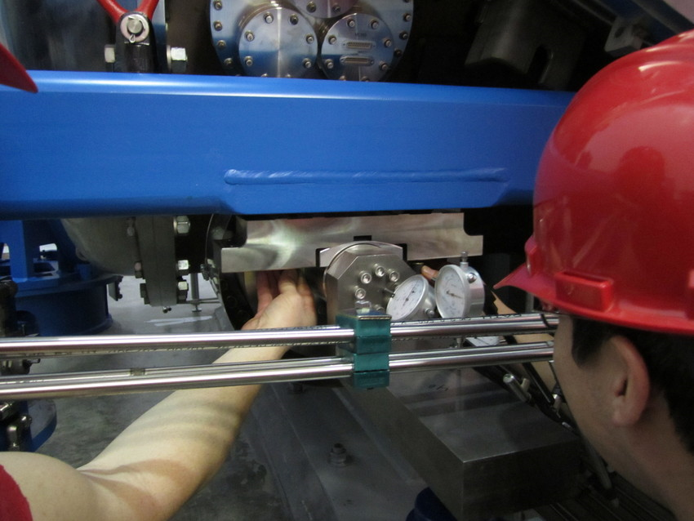
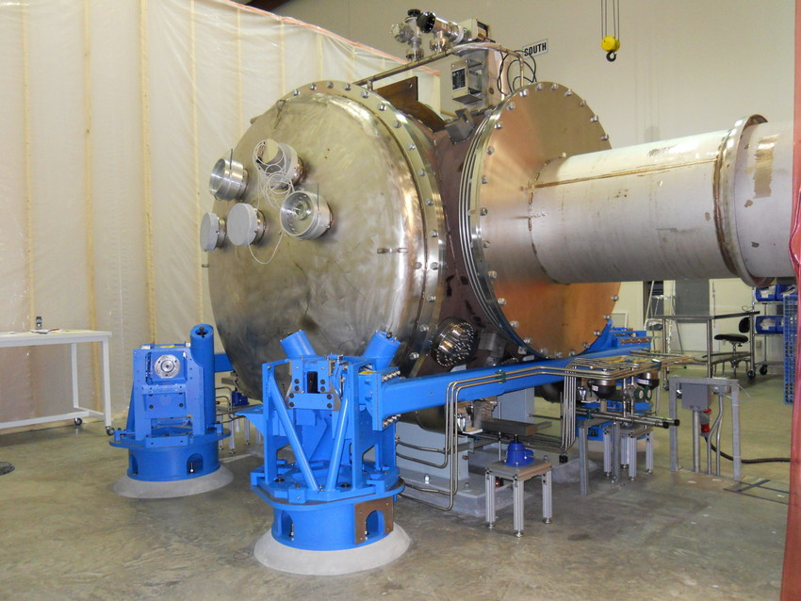
2. 3 HEPI Assembly
LLO - HAM 2 HEPI Assembly Support:
  Old Cross Beams
  New Cross Beams
  Clamps Adjustments
  Advanced LIGO HAM 2
14

Slide 15
2. 4 HEPI Performance
Example of control enhancements using HEPI

Slide 16
3. HAM-ISI: Single Stage Internal Seismic Isolator
  HAM-ISI Overview:
  Single-Stage Isolator
  Internal (In Vacuum)
  6 Degrees of freedom
  Positioning and alignment
  Active isolation (0.1 Hz to ~25 Hz)
  Passive Isolation (1/f ^2 from a few Hz to ~100Hz)
  Used in HAM6 at LLO and LHO to supports the OMC
  Will be used in all of the 15 HAM chambers
  6 Already assembled and tested
  Defects un walls
  Back on pace
  HAM-ISI on HEPI and Supporting Triple Suspensions (HAM 2)
  HAM-ISI Stage 0 (blue) supporting Stage 1 (brown)
16

Slide 17
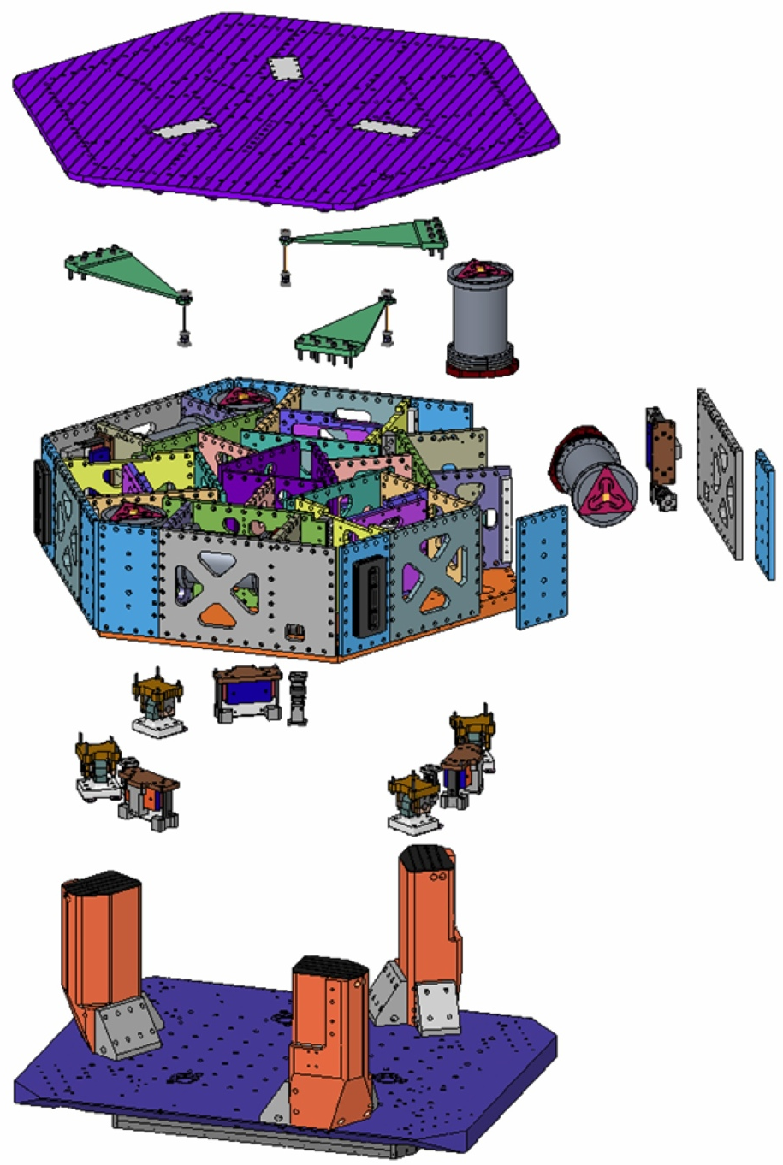
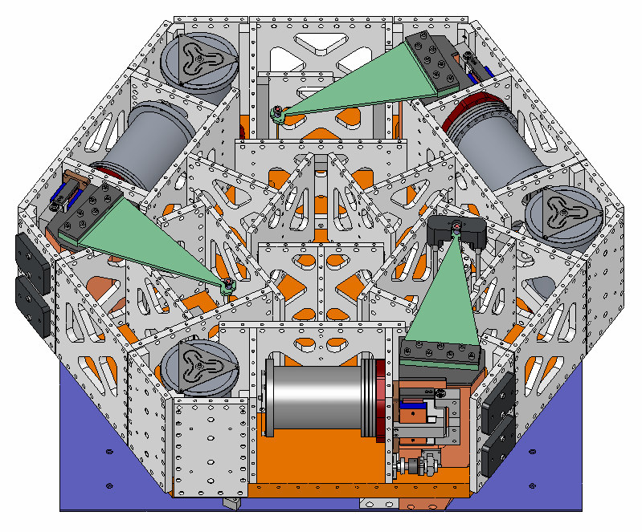
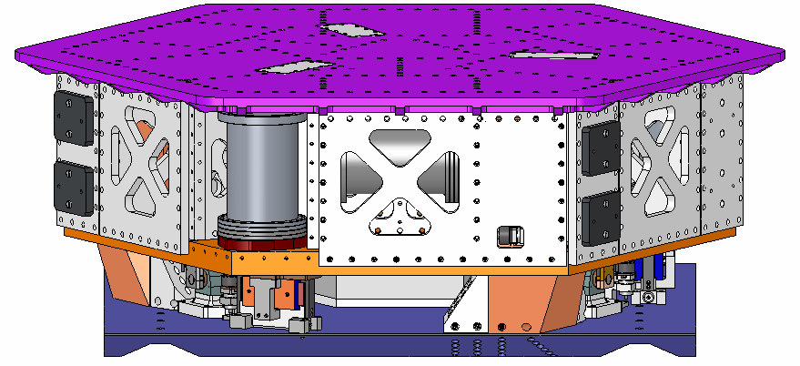
3. HAM-ISI Overview
  HAM-ISI Architecture:
  Springs and sensors under the optical table:
Optical table
Springs & Flexures
Vertical GS13 in pod (1 of 3)
Horizontal GS13 in pod (1 of 3)
Locker/
Limiter (1 of 4)
  Access to a vertical sensor:
Vertical
Actuator (1 of 3)
Springs
Posts
Stage 0
17

Slide 18
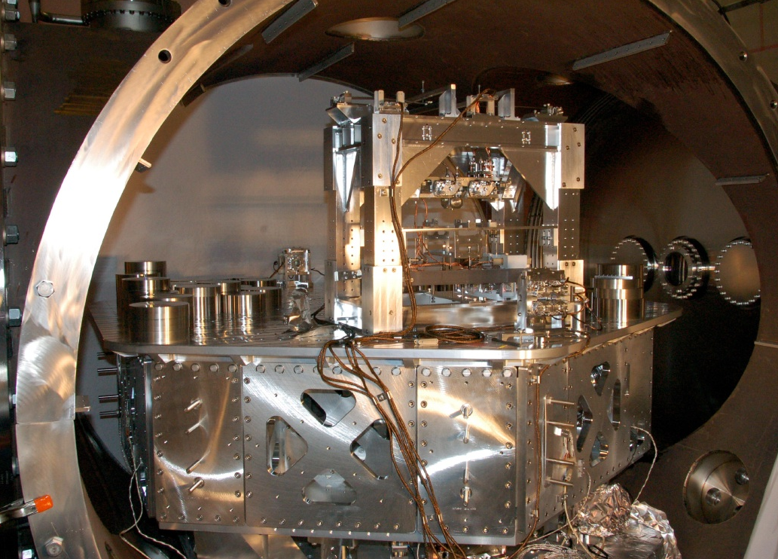
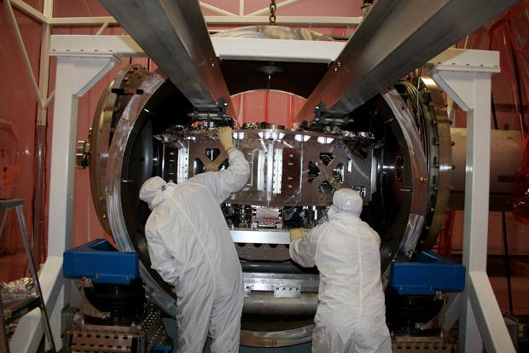
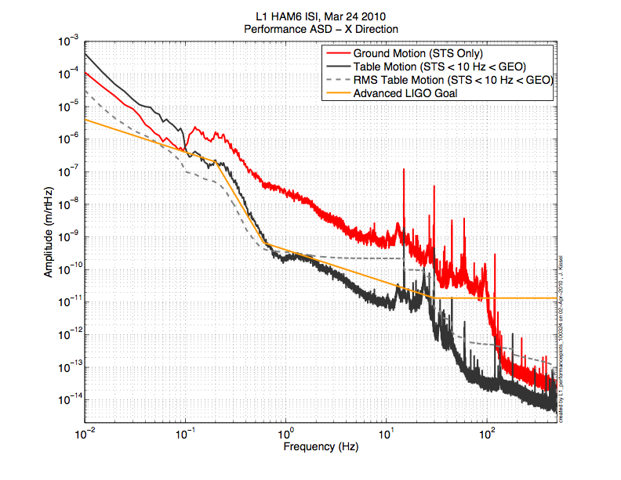
3. HAM-ISI: Single Stage Internal Seismic Isolator
Enhanced LIGO HAM6 Installation
        OMC on HAM-ISI in HAM 6
HAM ISI Performance, X
18

Slide 19
3. HAM-ISI: Single Stage Internal Seismic Isolator
April 2010 – April 2011
HAM-ISI Progress Highlights
3.1 Procurement, Clean & Bake
3.2 Assembly
3.2 Testing
19

Slide 20
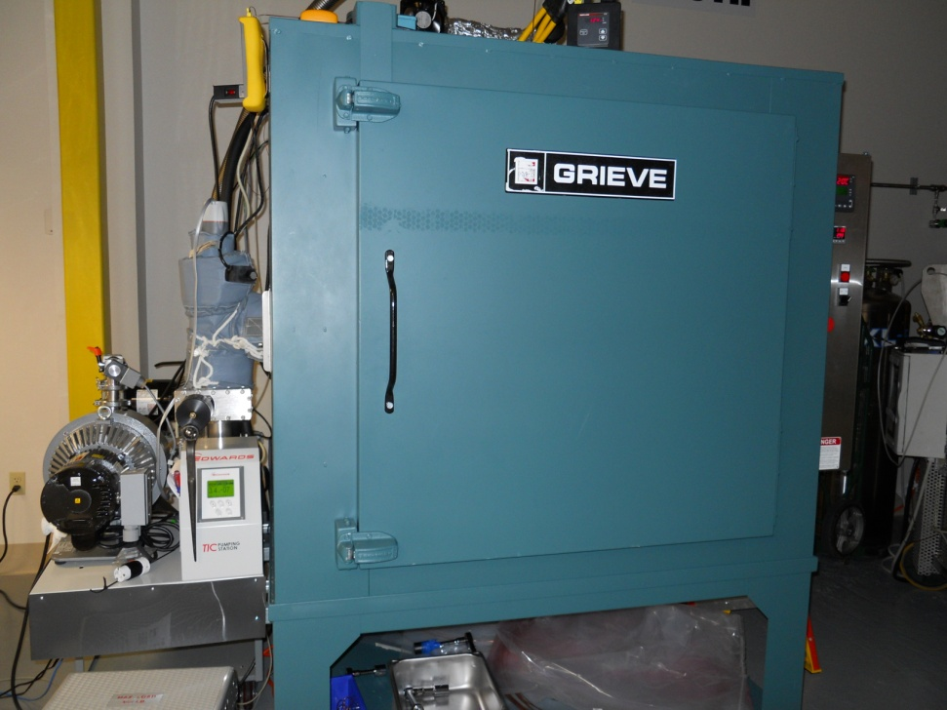
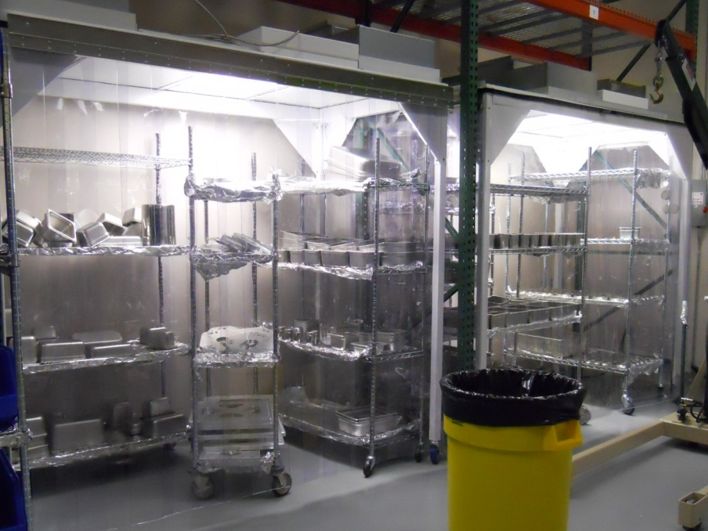

3.1 Procurement, Clean & Bake
Facility Modifications and Preparation (FMP)
LLO:
3 Vacuum Bake Ovens
1 large Air Bake Oven
LHO:
3 Vacuum Bake Ovens
1 large Air Bake Oven
  Vacuum Bake Oven
  Vacuum Prep Warehouse Drying Station
  Clean Parts ready for
  HAM-ISI assembly
20

Slide 21






3.3 HAM-ISI Assembly
Helicoils Inserts
Pitch Forks Assembly
Blades Posts on Stage 0:
Top view of the Blades Assembly:
Seismometers and Actuators:
Capacitive Position Sensors:
21

Slide 22




3.3 HAM-ISI Assembly
Storage Containers Prep
HAM-ISI Lift
Storage Containers Closing
Transport
22

Slide 23




3.3 HAM-ISI Assembly
Parts repairs:
Welded plugs
Risk of out gassing
No accurate list or records
Intensive investigation
X-Rays Inspection
Vacuum review board: no risk may be taken
Procurement of new plates
Back to assembly
Statement of work, drawings updated
More details in G1100463 QAME presentation
  LLO HAM-ISI Unit #3 re-assembled on 03/10/11
23

Slide 24




3.4 HAM-ISI Testing
Seismometer Pods Leak Testing
  Helium Leak Test
  At NorCal
  Before cleaning
  Max Leak Rate: 1 x 10-9 Torr L.s-1
Neon Leak Test
  At LLO
  After cleaning & assembly
  Max Leak Rate: 1 x 10-9 Torr L.s-1
  Helium Leak Test System
  Neon Leak Test CAD
  VPW Drying Station
  Leak Test Plot
24

Slide 25


3.4 HAM-ISI Testing
Seismometer Huddle Testing
  Seismometers to be tested
  GS13 Transfer Functions
  Huddle Bench
25

Slide 26


3.4 HAM-ISI Testing
Testing Overview
Several Levels of Testing
    Device Level testing
    Sub-assembly testing
    Major assembly testing
    Major assembly testing
    Phase I: Post-assembly
    Phase II: After SUS integration
    Phase III: Commissioning in the chamber
  Procedures
    Detailed description of the tests to perform
    Acceptance criteria
    Where the data must be saved in the SVN
  Test reports
    Spreadsheets, Results, SVN Location, etc…
    Comparison with reference results
26
26

Slide 27

3.4 HAM-ISI Testing
Testing Automation and Status
Automation of the testing process:
  Measure transfer functions, Power spectra with calibration
  Digitize filters
  To engage/disengage filters, ramp up/down control gain
  Perform Tests automatically
    Static tests
    Hysteresis-linearity test
    Range of motion
    Calibrated power spectra
    “Auto-generate” table report, “Auto-save” data
    and figures at the right location and the right name
Status:
  LHO
    3 units tested
    Tests restart next week
  LLO
    3 units tested
    Tests restart this week
27
27

Slide 28


4. BSC-ISI : Two Stage Internal Seismic Isolator
A support structure (Stage 0) and Two suspended active stages (Stage 1 & 2).
Will be installed for Advanced LIGO into the BSC chambers.
A BSC-ISI system in each of the 15 BSC chambers.
Optic table supports the core optics.
CAD Model of the aLIGO BSC-ISI supporting a Quadruple Pendulum
Prototype BSC-ISI on its assembly stand at LASTI.

Slide 29
4. Two Stage Internal Seismic Isolator
  BSC-ISI Overview:
  Two-Stage Isolator
  Internal (In Vacuum)
  12 Degrees of Freedom
  Positioning and alignment
  Active isolation
  (0.1 Hz to ~25 Hz)
  Passive Isolation
  (1/f ^4 from a few Hz to ~100Hz)
  Prototype at LASTI since 2006
  Advanced LIGO First Unit Built at LASTI in 2010.
  Will be used on all of the 15 BSC chambers
29

Slide 30


4. Two Stage Internal Seismic Isolator - Overview
Both suspended stages and have 6 degrees of freedom:
Blades provide the vertical flexibility
Rods provide the horizontal one
Suspension frequencies in the 1Hz-7Hz range
Passive isolation from few Hz to ~ 100Hz
Active isolation in the 0.1Hz-20Hz range.
Active control positioning
Stage 0 in violet
Stage 1 in cyan
Stage 2 in grey
Blades and flexure in yellow
Sensors in Red
Actuators in Pink
BSC-ISI as built for the prototype installed at LASTI

Slide 31






4. Two Stage Internal Seismic Isolator - Overview
Dirty assembly at LASTI (2006)
Clean assembly (2007)
Commissioning (2008)

Slide 32
4. Two Stage Internal Seismic Isolator - Overview
Global isolation (Active & Passive)
The ground motion is shown in Black. It is measured with a STS.
The HEPI motion is shown in Blue. It is measured with HEPI L4Cs.
The motion of stage 2 when the control is off is presented in Red
The motion of stage 2 when the control is on is presented in Purple
The relative requirements are presented in Grey

Slide 33

4. Two Stage Internal Seismic Isolator - Overview
Predictive noise budget for Advanced LIGO, the document G0810021-v1
At 17Hz the seismic noise was below the other sources of noise.
Estimation based on the BSC-ISI performances as of November 2008.
Performance improved since
Factor of 50 Improvement at 10 Hz.
Low Frequency noise
G0810021-v1

Slide 34





4. Two Stage Internal Seismic Isolator - Overview
BSC-ISI Re-design (2009-2010)
  Stage 0 Before Re-Design
  Stage 0 After Re-Design
  Pods Stiffener
  Stiffness Optimization
  Initial Design
  Final Design

Slide 35
4. Two Stage Internal Seismic Isolator
April 2010 – April 2011
BSC-ISI Progress Highlights
4.1 Design
4.2 Procurement
4.3 Assembly
4.4 Performance
4.5 Testing
35

Slide 36


4.1 Design
Design Completed (+200 drawings)
Design adjustments upon discussions with shops
Assembly Drawings
Bill of materials
List of Parts
Assembly Procedure. Main assembly and sub-assemblies: Sensors, Actuators, Flexures Assembly, Lockers…
36

Slide 37




4.1 Design
SEI Integration at the system Level
Layout, Mass budgets and Balancing:
Cabling and Flanges Layout:
37

Slide 38








4.2 Procurement and Quality Control
Procurement Process
Statements of work
Bidding Process
PO issuing
Communication with shops
Quality Control
Shipment
Cleanliness
Parts Cleaning
Inspection
Process improvements (Machining, Cleaning…)
38

Slide 39





4.2 Procurement
Inventory , Cleaning
Actuators Posts and Parts
Parts ready for cleaning
And more parts
Cleaned and labeled
by sub-assembly
More Parts ready for cleaning
39

Slide 40









4.3 Assembly
First Assembly at LASTI
Stage 0
Stage 1
Optical Table
Closing Stage 1
Sub-structures Connection
Stage 0, 1 and 2
Closing Stage 2
Actuators
GS13
40

Slide 41





4.3 Assembly
First Assembly at LASTI
A few seismometers
Trilliums in pods
Small Blades Loading
Large Blades Loading
Blades Loaded
41

Slide 42






4.3 Assembly
Assembly Complete
Problems fixed, Training
Assembly Sequence
Machining
Actuators and Sensors Cabling
Re-Design
Coating
Inspection
Compliance
First Transfer Functions
42

Slide 43


4.4 Performance
Modal Testing results of the new Stage 1
Testing Set Up
Testing Results
Damping Tests
43

Slide 44



4.4 Performance
Low Frequency and high frequency investigation :
Mu Metal Cans:
Electromagnetic Couplings
Structural Resonances:
Global Modes
Pods
Quad Structure

Slide 45



4.4 Performance
Structural Modes Damping
Counter-balance masses used as Vibration absorbers
Vibration absorbers
Vibration absorbers on the Quad Structure at LASTI
Transfer Functions Improvement
45

Slide 46









4.4 Performance
About 150 Vibration absorbers for all types of suspensions:
Vibration absorbers for Stage 2 and Stage 1:
46

Slide 47
4.5 Testing
Progress on Testing preparation list from April 2010
Preparation of the commissioning of 15 articles:
Procedure and instruction for testing, commissioning
Definition of standards for data acquisition and control design
Preparation of templates for expected results
Data storage subsystem by subsystem
Coordination of subsystems parallel commissioning
Handoffs preparation
Definition of acceptance tests
Manpower
Training

Slide 48



Systematic Approach to Control Infrastructure
4.5 Testing
Control architecture:
  The same across all modules and isolation stage
  Cognizant of other sub-systems
  In calibrated, physical units
  Informed by mechanical design
  Consistent in naming of channels/filter banks
Control Diagrams:
  Uses the latest-and-greatest CDS software
  Ready ahead of time
User interface (MEDM screens) that
  Reflects the underlying real-time structure
  Uses Clear left-to-right signal flow
  At-a-glance status lights for entire module
  Automated scripts for “the details”

Slide 49


4.5 Testing
Testing and Commissioning Preparation
Preparation
DCC Structure similar to the HAM-ISI
Testing procedure – Phase I in progress
Control commissioning scripts ready
Needs for automation
Strongly coupled system (Stage by Stage and H=>V)
Controlling one degree of freedom affects all the dynamic
Low frequency measurements (from 10mHz) => Long measurements
Implementation of the control in 15 Steps (~100 filters)
Experimental MIMO response (~400 transfer functions)
Needs to Reduce the number of measurements
Local to Local measurements
Control (Level II) with one set a measurements (13h)
49

Slide 50

4.5 Testing
Commissioning Scripts
“Symetrization”, calibration, dynamic, electronic compensation
Basis change (Local to Cartesian)
Damping filters
Blend filters
Isolation filters
Filters digitization
Engaging/disengaging the filters
Ramping up/down the gain
Levels of Control performances
Level 0: Damping Loops
Level 1 - UUG=7.5Hz - (Design ~ 3 min)
Level 2 - UUG=15Hz - (Design ~ 3 h)
Level 3 - UUG=30Hz - (Design ~ 3 days)
Status
Testers trained and ready for the BSC
Procedure, scripts ready
Working on the hardware
  Example with Stage 2 isolation
50

Slide 51
Advanced LIGO SEI Risks and Mitigation
If Hydraulic actuator assembly problems occur, then redesign and/or rework will be required.
All actuators assembled and successfully tested. Risk is retired.
If Parker servo valves become unavailable or fail during bench testing, then alternative design may be required.
No failure happened during bench testing. 20% spares have been procured. Risk is retired.
If hydraulic plumbing leak occurs, then repairs will be required.
Design includes plenty of valves and purge plugs to isolate any potential leak. Thoroughly leak check manifolds and tubing before adding fluid. Initial LIGO plumbing went very smoothly. No major leaks in 6 years of operations at LLO. Risk is low.
Contamination of hydraulic system will cause valve failures.
Additional flushing steps are being done for advanced LIGO plumbing. All valves, actuators, and filters are being flushed. We have spare valves to minimize down time. Accumulators are being changed. Risk is lower thanks to actions taken during the past year.
If Sercel L-4C Geophones failure rate increases, new design may be required.
Failures most likely to occur during shipment, initial assembly, and installation. Spares have been procured. Recent experience indicates all is in handling. They are handled very carefully. Risk is low.
If Steckheisen STS-2 seismometers are discontinued, then replacements may be required (STS-3); that may cause interface problems.
Switched to Nanometrics T-240. All T-240s have been delivered. We have procured spares. Risk is retired.
If Pod assemblies leak and require replacement, costs will be increased.
All pods components are Helium leak checked at supplier. Pod assemblies are filled with Neon and RGA scanned.
Production run to date, including installation, demonstrates success to date. Have internal pressure sensors to help ID catastrophic leaks if they occur. Maintain adequate supply of preassembled neon gas filled pods available. Risk is reduced.
51

Slide 52
Advanced LIGO SEI Risks and Mitigation
If BSC isolation does not meet requirements, additional R&D or lowered performance may result.
BSC at LASTI has demonstrated performance which does not limit the GW band. Keep R&D going on suppressing chamber modes, feedforward, tilt sensors. Focus on horizontal-tilt coupling. Very promising feed forward results. Also very promising testing on the first unit assembled. Risk is low.
If HAM isolation does not meet requirements, then additional R&D or lowered performance may result.
HAM6-ISI has demonstrated excellent performance. New cross beams will help. Feedforward isolation can improve the performance around 10 Hz. About to be tested at LASTI. Risk is low.
Wandering plant resonances in combined SEI-SUS system limit performance in SEI
One source of wandering resonance was the tall stacks of trim mass, which have been redesigned (and fixed). The other is from the quad frame, which will bedamped by the new vibration absorbers. Risk is much lower thanks to the damping development done this year.
If GS-13 instrument vender is lost, then delays to schedule occur for long lead procurement items and costs are increased.
All GS-13s have been delivered, including spares. Risk is retired.
Seismometer locks are weak point in reliability.
Trillium substituted for STS-2: eliminates one locker. More robust flexures adopted for GS-13, eliminates other locker. Risk is retired.
BSC-ISI take longer to build and clean than expected.
The first Advanced LIGO assembly at LASTI is promising. The re-design considerably speeds up the assembly process. One remaining issue regarding the balancing is currently investigated. Risk still exist. Must define a plan to fix the balancing issues in a timely manner.
SEI systems take longer to commission than expected.
Procedure has been designed and tested at LASTI. Control performance implementation will be incremental. We’ll start with very robust and easy to implement servo control. Team has been completed and trained. We keep improving the procedure, automating the process, and work on training.
52

Slide 53
Summary
HEPI:
Strong experience from Initial LIGO
All HEPI hardware has already arrived.
Assembly in progress. One BSC already installed at LHO. One HAM already installed at LLO.
Performance enhancements are investigated
HAM:
Two built and used in Enhanced LIGO. Very positive program.
6 new assemblies were completed and tested for Advanced LIGO.
Partial disassembly, re-assembly and re-testing due to part defects
First aLIGO installation scheduled for this summer
BSC:
Procurement is in very good shape.
First unit built at LASTI for testing
Assembly went very well
Balancing issue must be fixed
Preliminary Testing very encouraging
Assembly has started at LHO
Ready for testing and commissioning
Upcoming work:
Build Two BSC at LHO
One arm test commissioning at LHO
Build the remaining HAM-ISI needed for the LLO IFO
Start the BSC-ISI assembly at LLO
53

