Slide 1
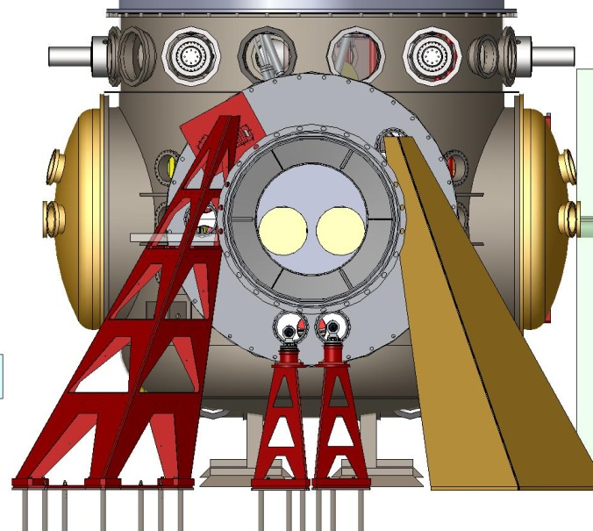
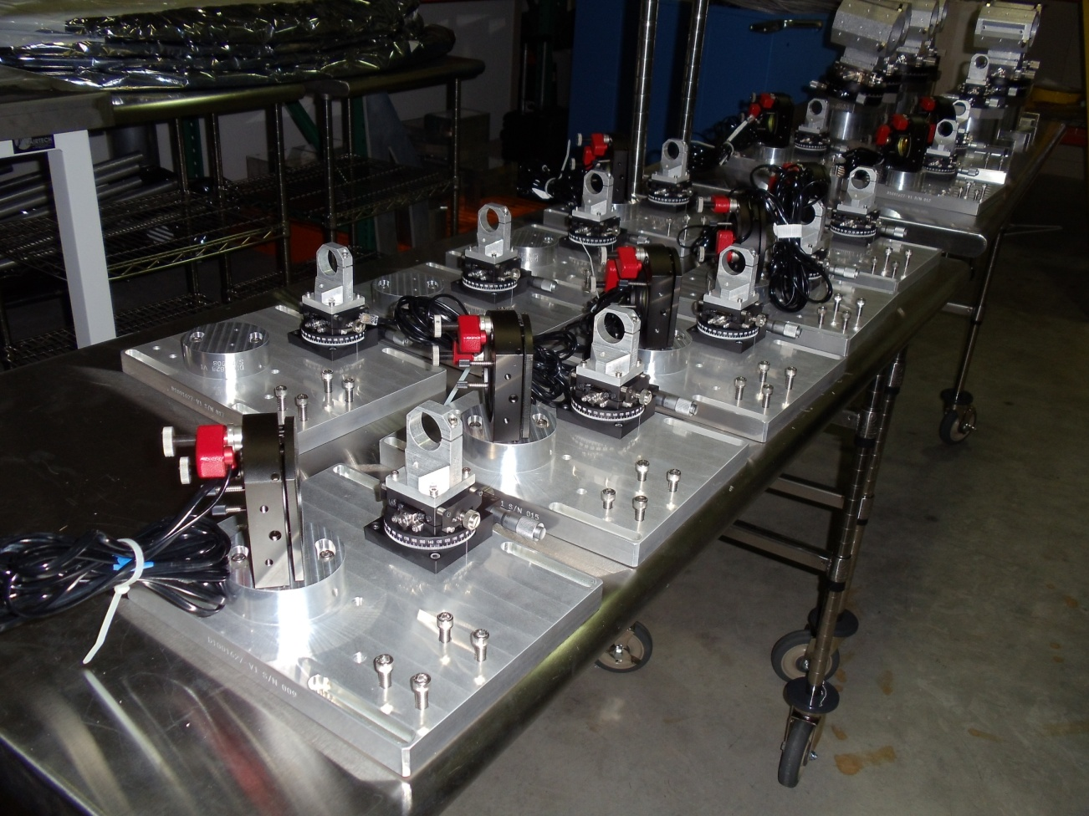
Optical Lever System (OpLev) Eric James

Slide 2
OpLev Functions
To assist in restoring alignment after invasive work
To restore coarse alignment after loss of lock
To tune the test mass actuators to minimize position-to-angle coupling
Monitor the angular alignment of the HAM optical tables
Local pitch and yaw mode damping during interferometer commissioning (not in science mode)

Slide 3
OpLev Requirements
All optical levers will provide less that 1 μrad drift over one hour
position-to-angle coupling of less than 100 nrad/μm

Slide 4
OpLev Design Concept
Baseline design based on iLIGO design with incremental improvements through lessons learned.
Beam launcher
Fiber to telescope launcher with goniometer pointing.
Pyramidal, folded-sheet, welded stainless steel pylons with damping material coating.
Receiver
Quadrant detector on XY translation stage.
Pyramidal pylons (same as above).

Slide 5
OpLev Project Status
Design phase completed
Completed Final Design Review for Beam Splitter/Fold Mirror OpLevs – April 2011
Completed testing first article receiver pylons – April 2011
Procurement phase 75% complete.
Transmitter pylons delivered to sites – April 2011
RX pylons in production.
Complete fabrication of pylons – May 2011
Purchased items: 75% Ordered, 55% delivered.
Procurement of some BS/FM fabricated items pending FDR.
Assembly / Installation begun.
Began assembly of OpLevs – April 2011
On target for scheduled installation in coordination with installation team.

Slide 6
OpLev Project Status
ITEMS STILL ONGOING
Complete fabrication of receiver pylons – May 2011.
Complete fabrication of enclosures – September 2011.
Procure remaining BS/FM fabricated OpLev items - in process.
Complete assembly of all Oplevs.
Installation in coordination with installation team.

Slide 7
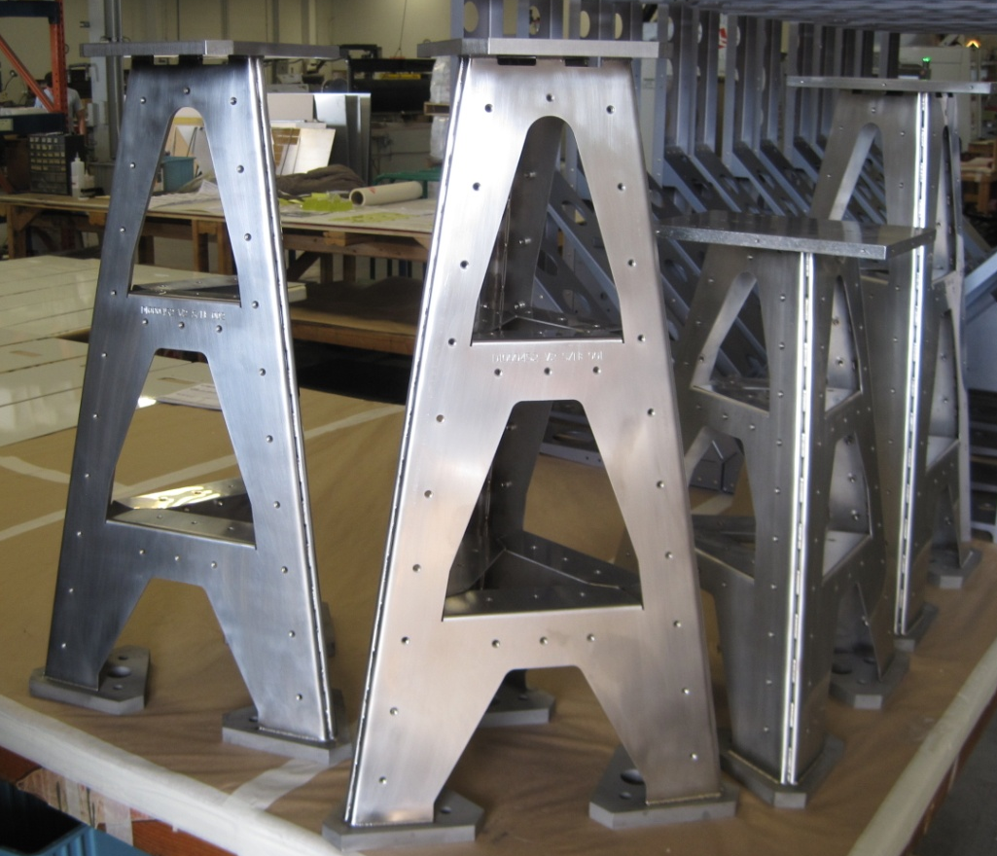
OpLev Procurement Accomplishments
Pylon contract ongoing – all TX pylons delivered.
All machined parts for ITM/ETM and PR3/SR3 delivered.
Opto-mechanical stages delivered
Most purchased hardware ordered.
Mapped out locations for all levers
iLIGO lasers to be rebuilt with angle cut fibers – contract in place.

Slide 8
OpLev Project Plans and Organization
Project Plans
On schedule for deployment for H2 Single Arm Test – Aug.2011
On schedule of deployment for Short Michelson Test – Jan. 2012
On schedule for deployment of three aLIGO IFOs – Apr. 2012
Project Organization
Cognizant Engineer and Leader – Eric James
Cognizant Scientist – Eric Black
Mechanical Engineer – Ignacio Romero
Project Engineer – Lisa Austin
Electrical Engineer - Mohana Mageswaran
Hanford Installation Lead – Gerardo Moreno
Livingston Installation Lead – Chris Guido
Optical Design and testing – Vladimir Dergachev
Drafting – Jesse Terrazas – Norris Kilpatrick – Eduardo Sanchez

Slide 9
OpLev Challenges, Risks, and Mitigations
Low challenge level
No known technical risks
Additional vibration controls may be necessary for large receiver pylons.
Damping materials proved adequate for prototype pylons.
Careful coordination with installation team will be necessary.

Slide 10
Summary
Contracts and Purchases coming in below estimates
Materials arriving at sites well ahead of time required.
No difficult assembly or installation issues.

