Slide 1
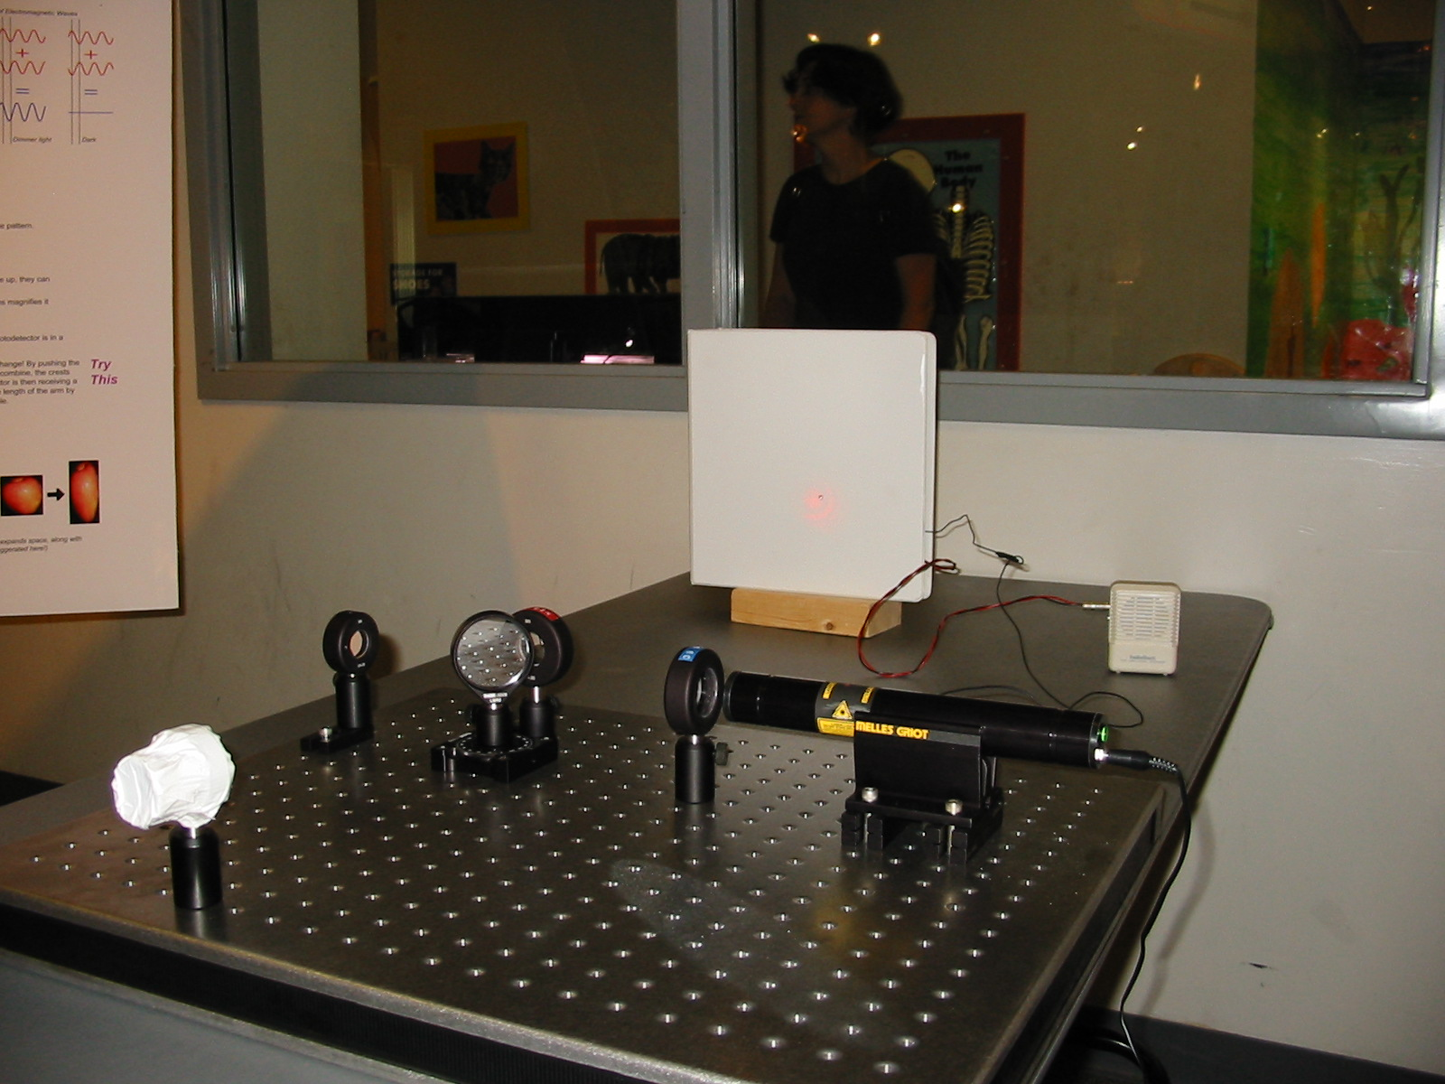
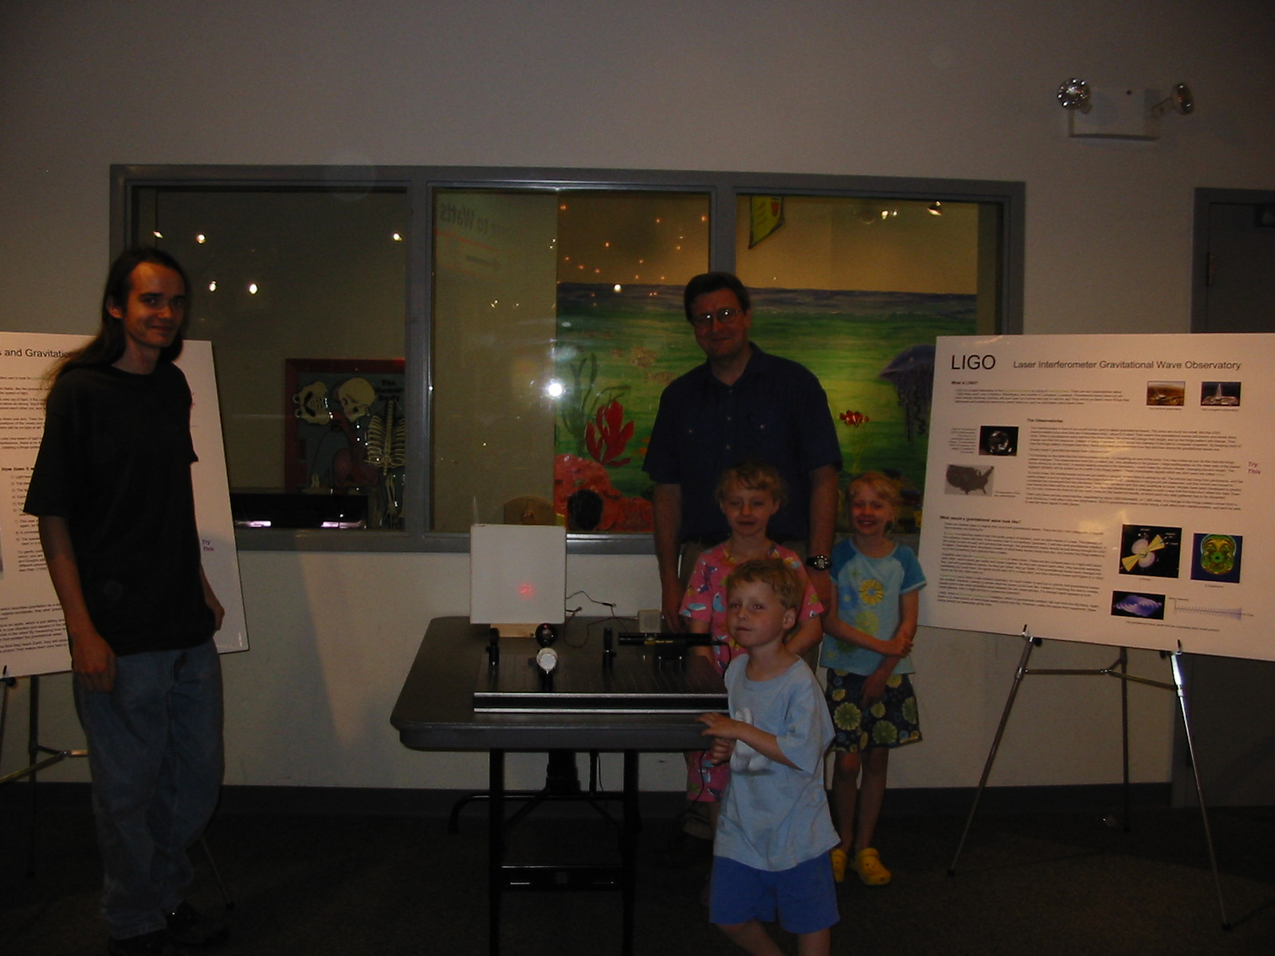
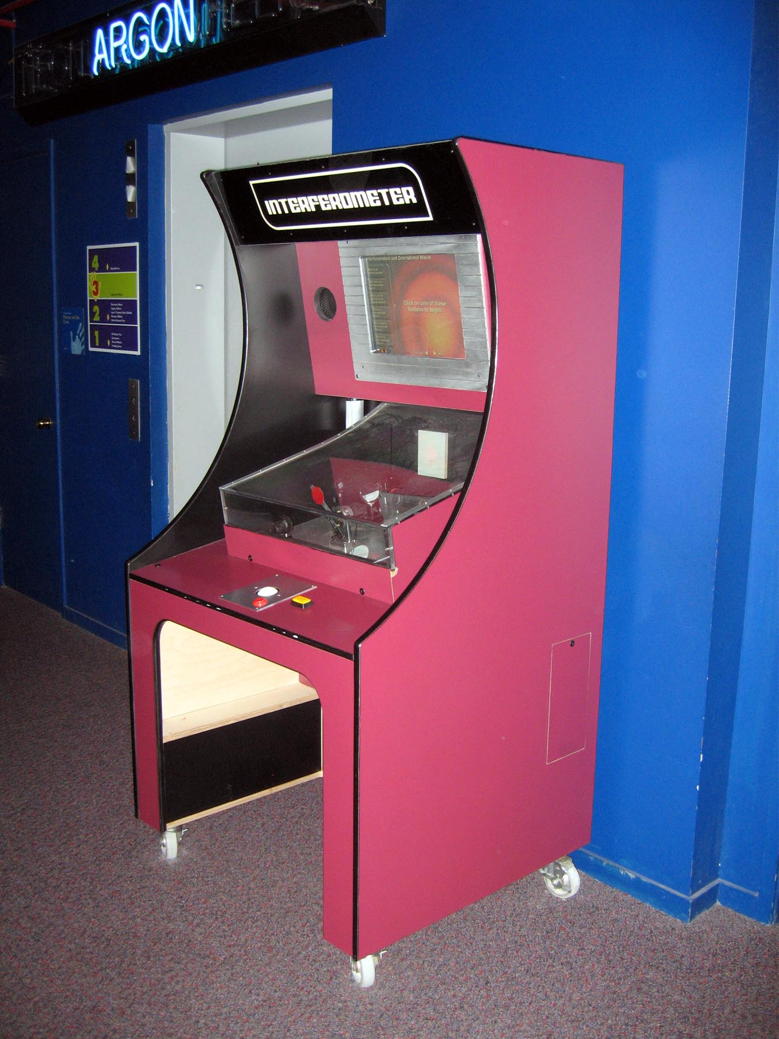
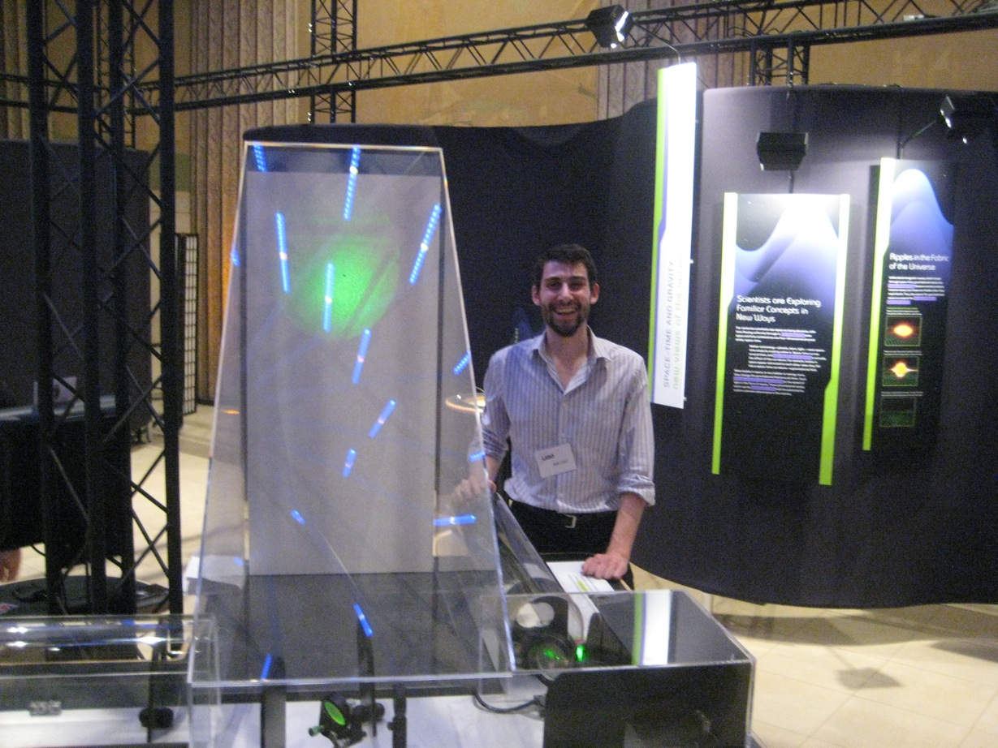
Building Interferometer Exhibits
Keith Riles
University of Michigan
LSC-Virgo Meeting, Arcadia March 14-17, 2011
DCC: G1100384-V1

Slide 2
History of Michigan group’s exhibit building
[more details at http://gallatin.physics.lsa.umich.edu/~keithr/outreach ]
Built 1st prototype Michelson interferometer in spring 2006
1 mW red HeNe
Off-the shelf lenses, beamsplitter
Optical breadboard
Retroreflectors for end mirrors (robust against misalignment)
Photodiode, homemade pre-amplifier and Radio Shack post-amplifier
Built by undergraduate Ramon Armen with electronics assistance from graduate student Evan Goetz

Slide 3
Showed prototype several times over the next year at Ann Arbor Hands On Museum – put together two posters on interferometers and gravitational waves
Ramon and/or I attended exhibit to answer questions and ensure safety
Lessons learned:
Posters not effective for children
Need plexiglass enclosure for laser and optics
A child will do whatever is necessary to destroy alignment

Slide 4
Museum director (Mel Drumm) and staff very enthusiastic about building an exhibit around the prototype
Settled upon a “kiosk” cabinet housing with addition of an interactive “electronic label” using a small computer running a flash program
All optics & laser fully enclosed, but external operated level allows beam blocking to make fringes come & go
Exhibits staff (John Bowditch, Charlie Stout, Dave Stapp) built the cabinet in about ~1 year (in parallel with other exhibits and work)
Cabinet costs footed by the Museum
Installed in museum’s Light & Optics Gallery in December 2008

Slide 5
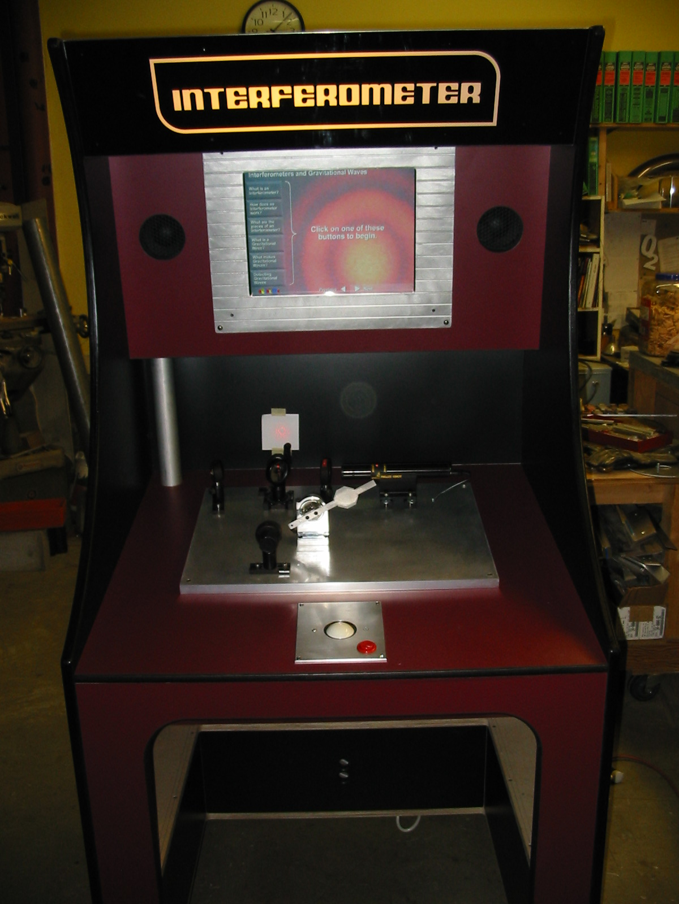
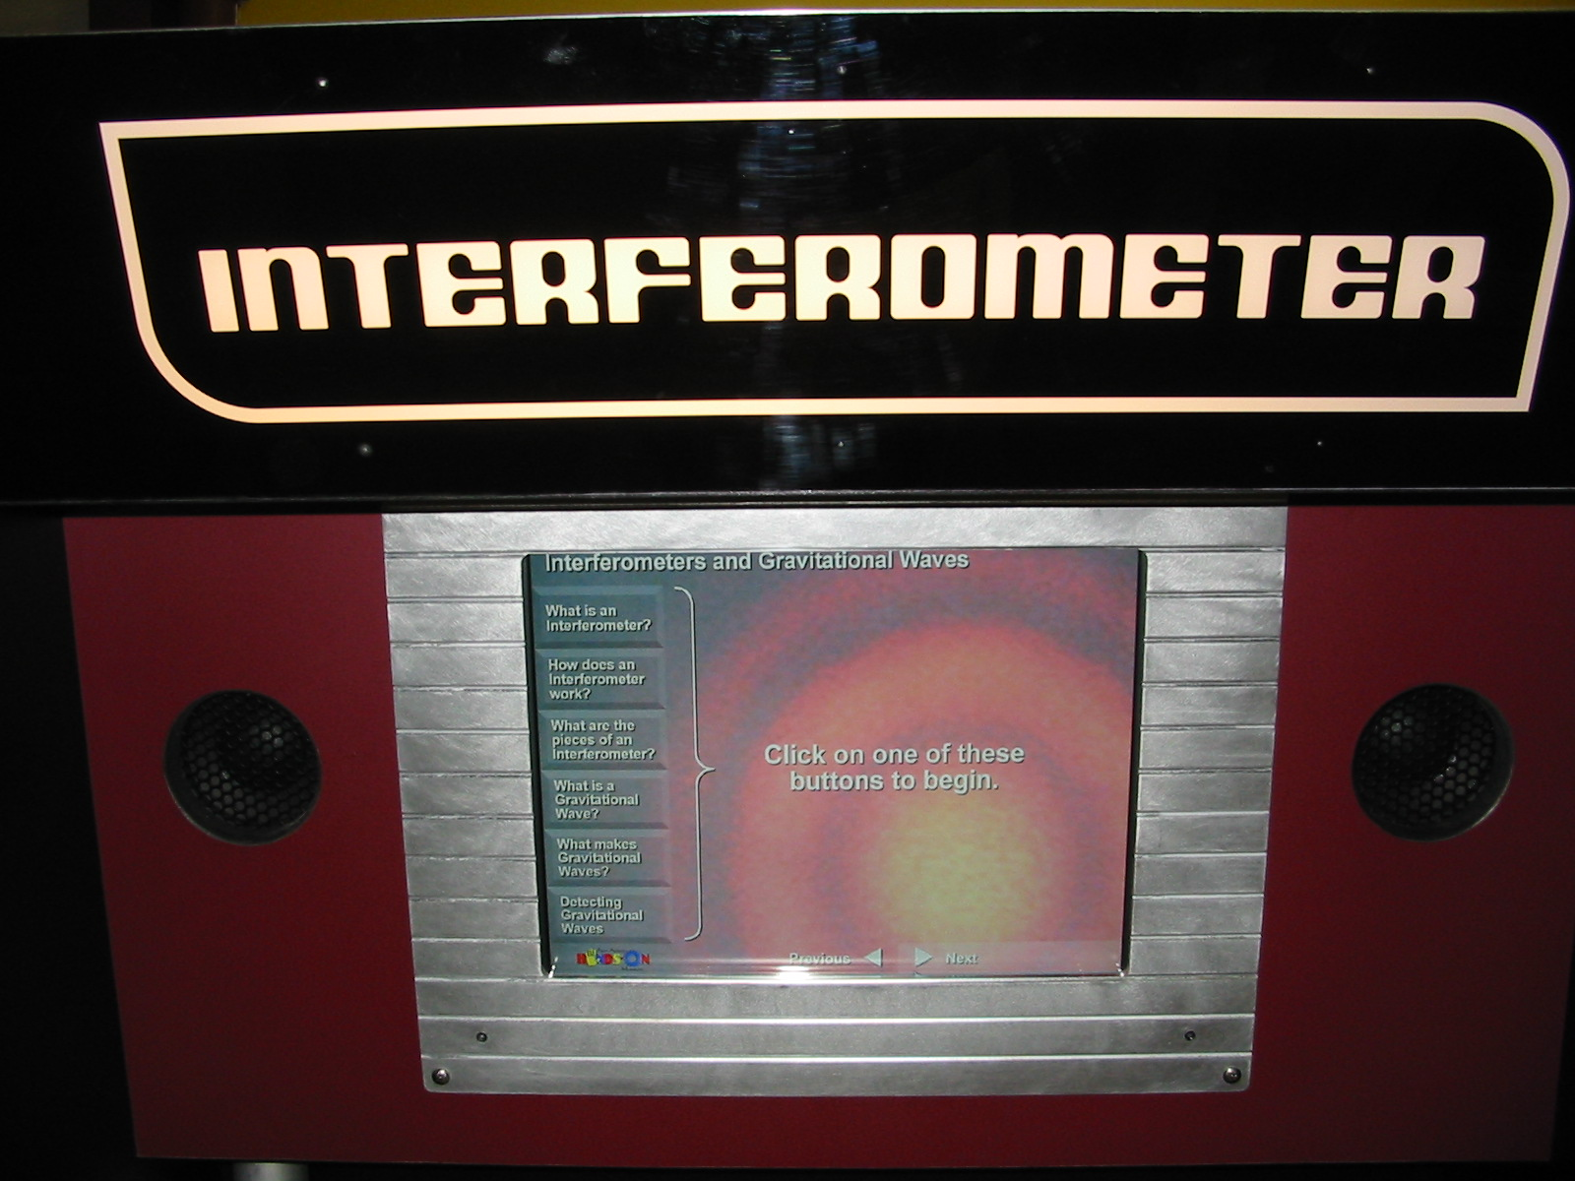
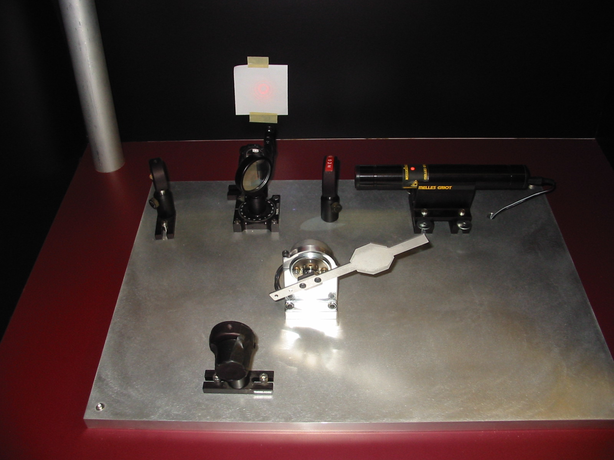
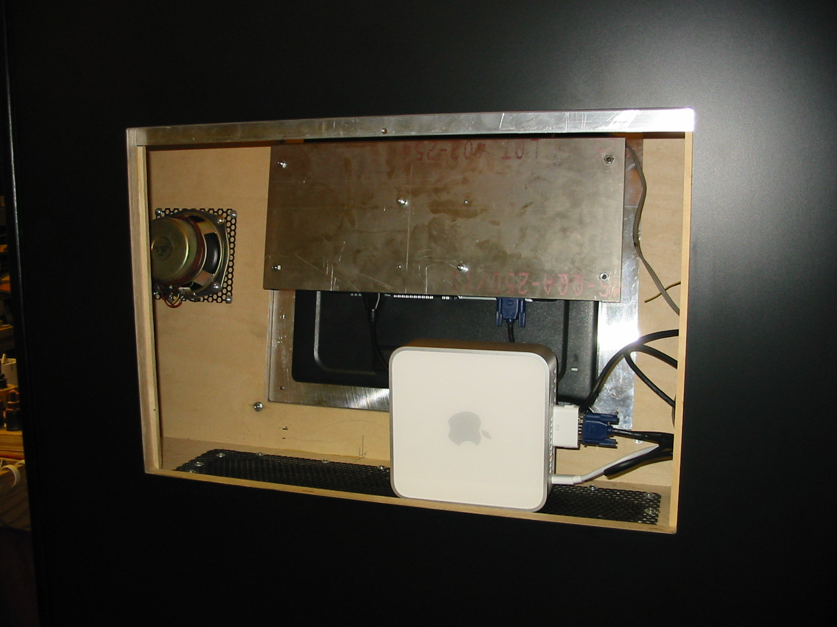
Near end of construction…
Back access panel

Slide 6
Joined LSC Education and Public Outreach Committee in 2008
Hi Dave,
I am interested in participating (to a limited degree) in
this working group. I have some experience in working
with a science museum here in Ann Arbor and have some
ideas to share, but I'm afraid I would not be able to
spend a lot of time on the effort.
cheers,
Keith
Hi Dave,
I am interested in participating (to a limited degree) in
this working group. I have some experience in working
with a science museum here in Ann Arbor and have some
ideas to share, but I'm afraid I would not be able to
spend a lot of time on the effort.
cheers,
Keith
One thing led to another…

Slide 7
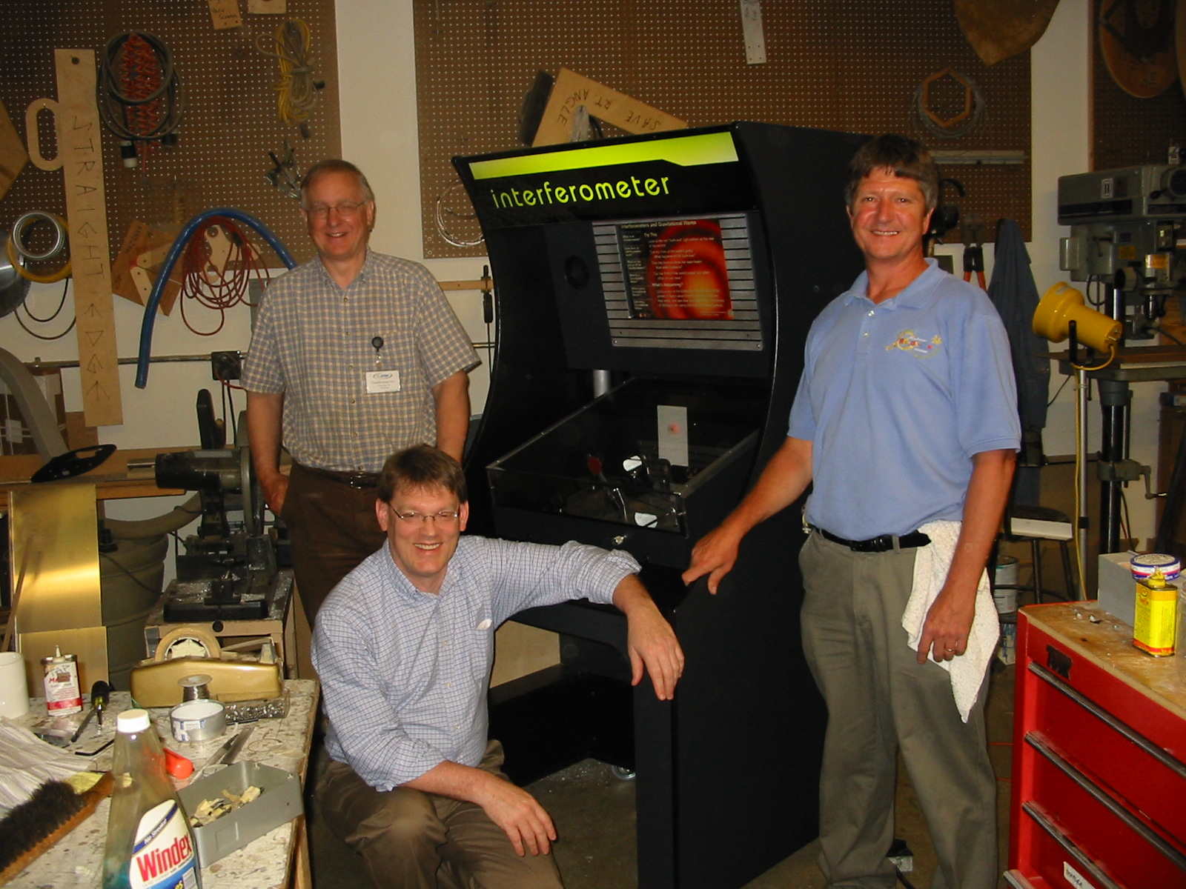
World Science Festival – June 2009
Subcontract to Museum to build a copy of the kiosk exhibit for the traveling LIGO exhibit
Michigan provided laser, optics, photodiode, preamplifier
Museum staff added small refinements to 1st copy:
New motif to match rest of LIGO exhibit
Improved housing for photodiode
John, Charlie and Dave with final exhibit in museum’s fabrication shop

Slide 8
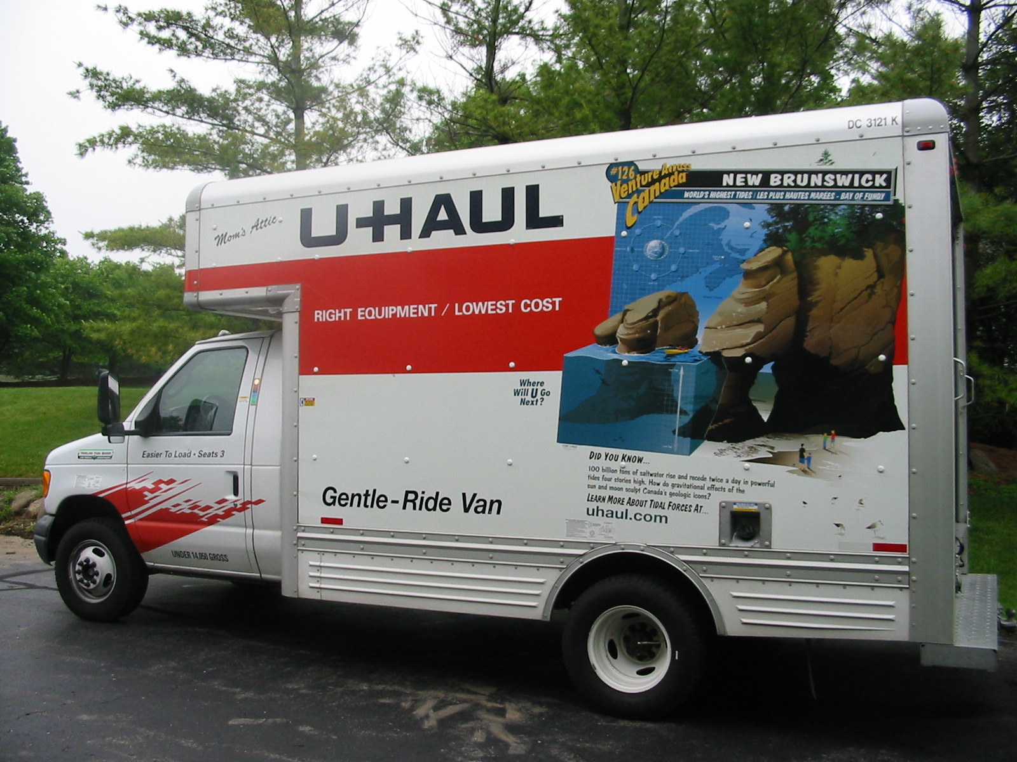
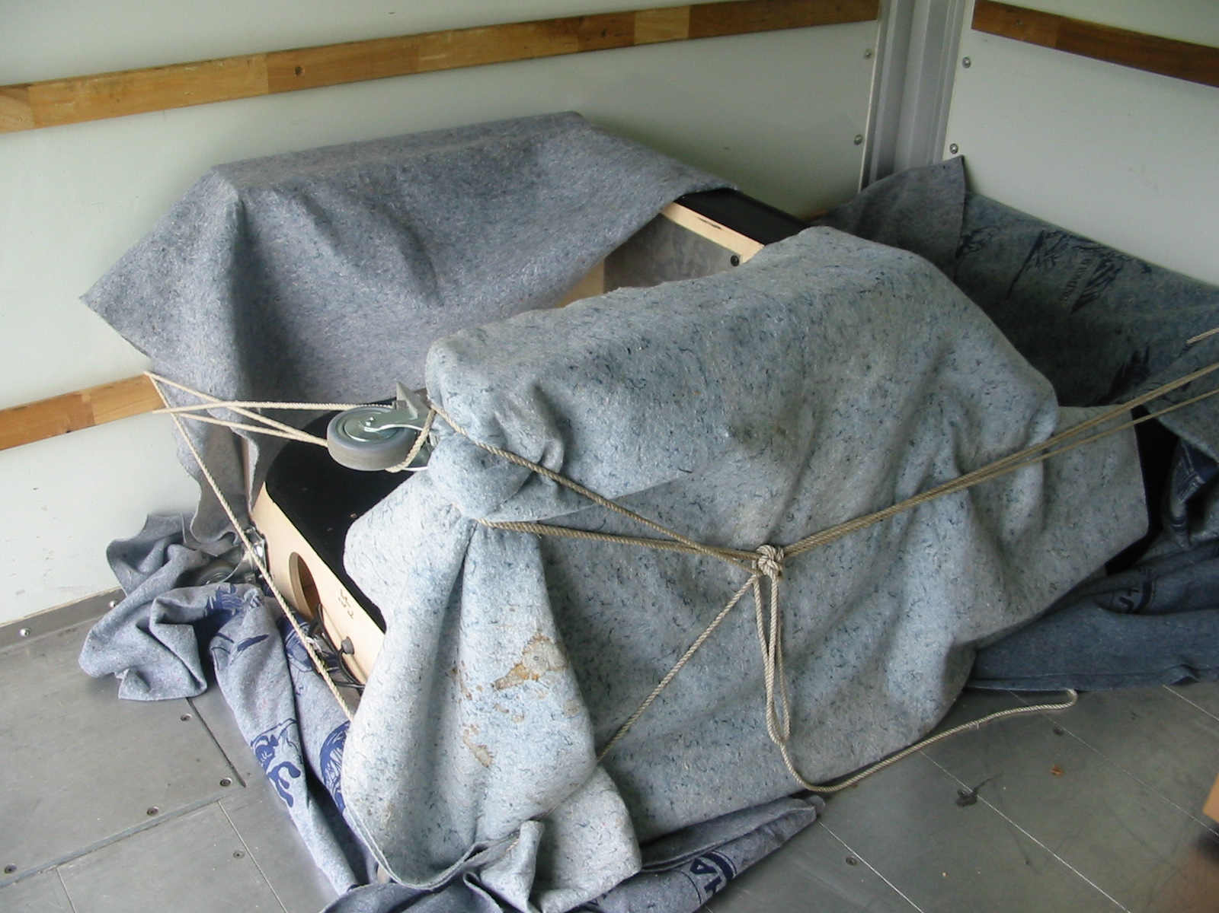
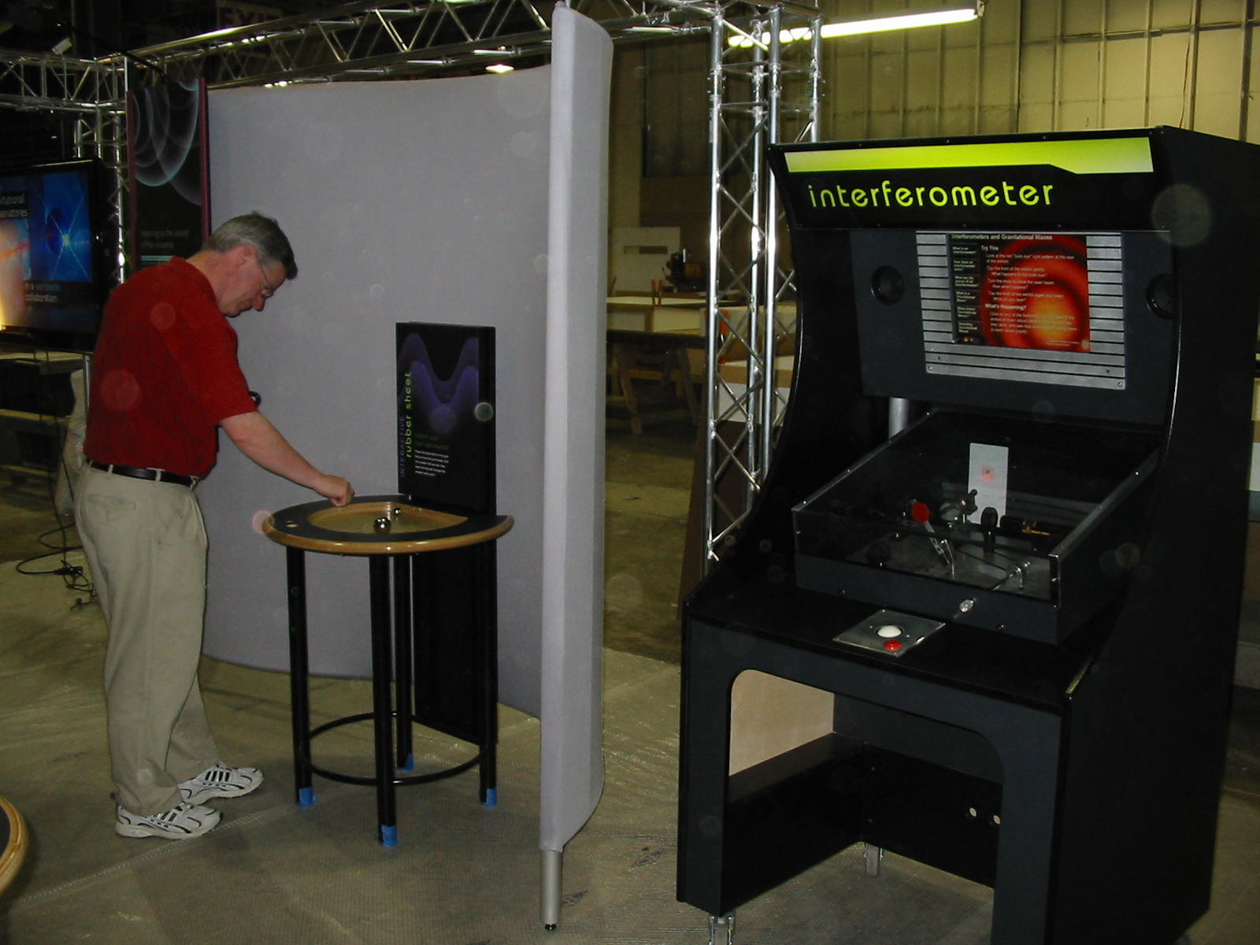
Off to New York!
At fabrication facility in New Jersey

Slide 9
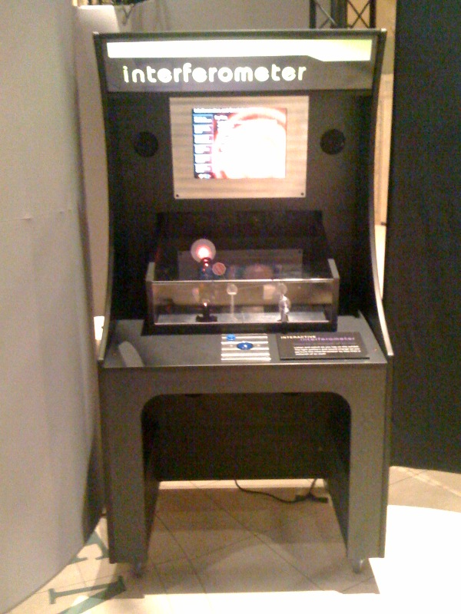
World Science Festival – June 2010
Subcontract to Museum to build another copy of the kiosk exhibit for the traveling LIGO exhibit
Again, Michigan provided laser, optics, photodiode, preamplifier
Museum staff added more refinements to 2nd copy:
Improved plexiglass enclosure
Improved beam stopper control
Improved window for photodiode (adjustable translucent filters)

Slide 10
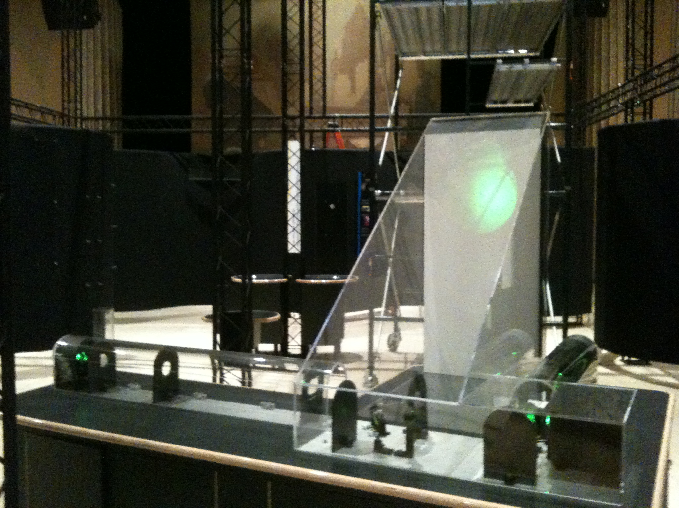
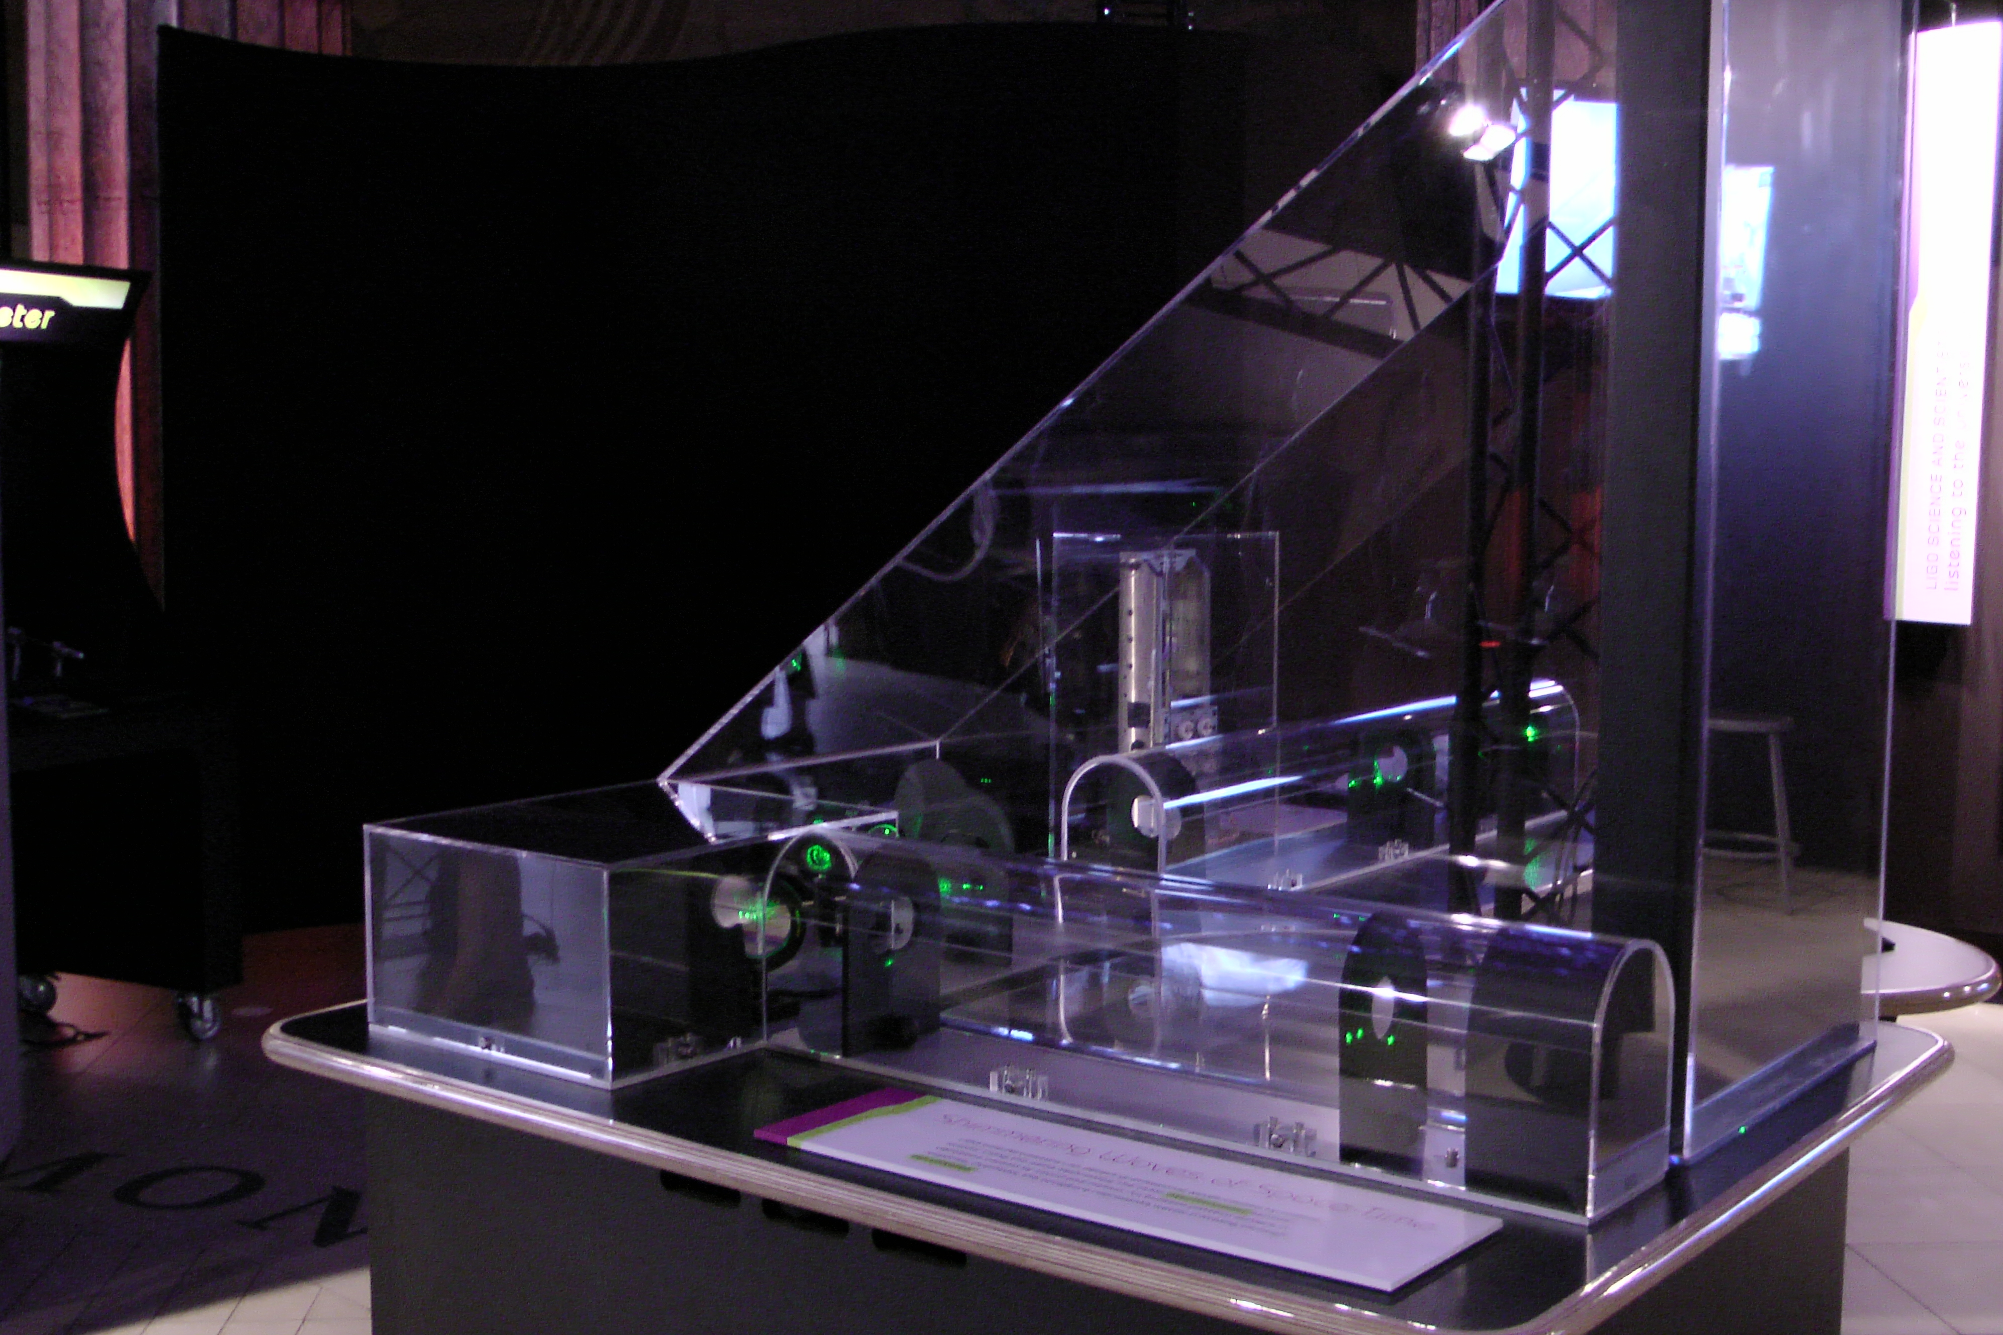
World Science Festival – June 2010
Volunteered to build a tabletop interferometer for large WSF 2010 Exhibit
60 mW green Nd-Yag (Laser Lab Components) – 50-m coherence length
Asymmetric arms to give bullseye fringe pattern
Customized plexiglass enclosure
Baffles to block stray light
Photodiode with audio amplification
Designed and built by graduate student Grant Meadors
Supporting table built by contractor
More details at
http://gallatin.physics.lsa.umich.edu/~keithr/outreach/index_ifo4.html

Slide 11
World Science Festival – June 2010
Some issues:
Laser more powerful than needed → Attenuated output for safety
Practical issues in fringe formation:
Retroreflectors do provide robustness against misalignment, but centering beam leads to unaesthetic artifacts in fringe pattern:
Displacing beam to side of retroreflector moves artifact away from bright center of fringes, but increases horizontal width of baffle apertures
Harder to suppress stray beams
Eyecatching fringes need to be large and at eye level
Projection at a distance (via a short-focal-length lens)
Large plexiglass enclosure
Beam clipping was a nuisance – required iterative alignment
→ “Next time” – use larger optics

Slide 12
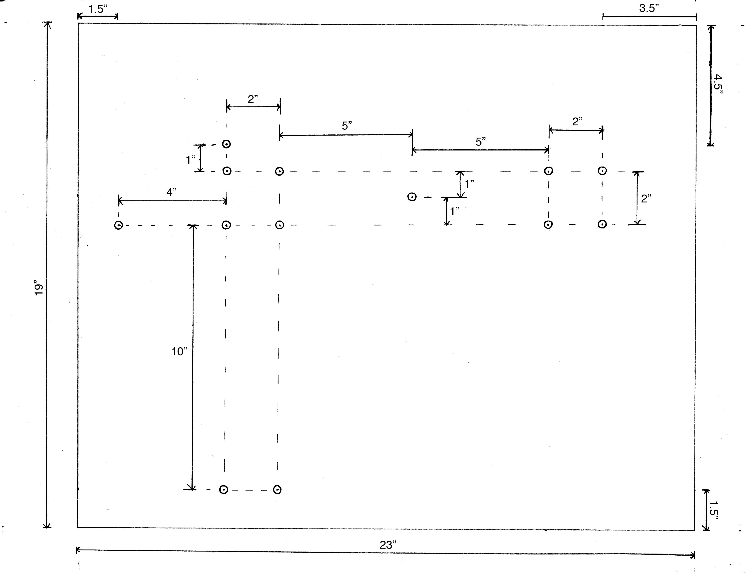
World Science Festival – June 2010
Some issues:
Working with plexiglass fabricator (local Michigan firm) required many iterations → Final result was satisfactory
But enclosure was heavy!
With delicate glue joints where arms join the corner station
Required ≥ 3 persons to move
Real pain during prep work in Michigan lab
Enclosure
Aluminum support plate

Slide 13
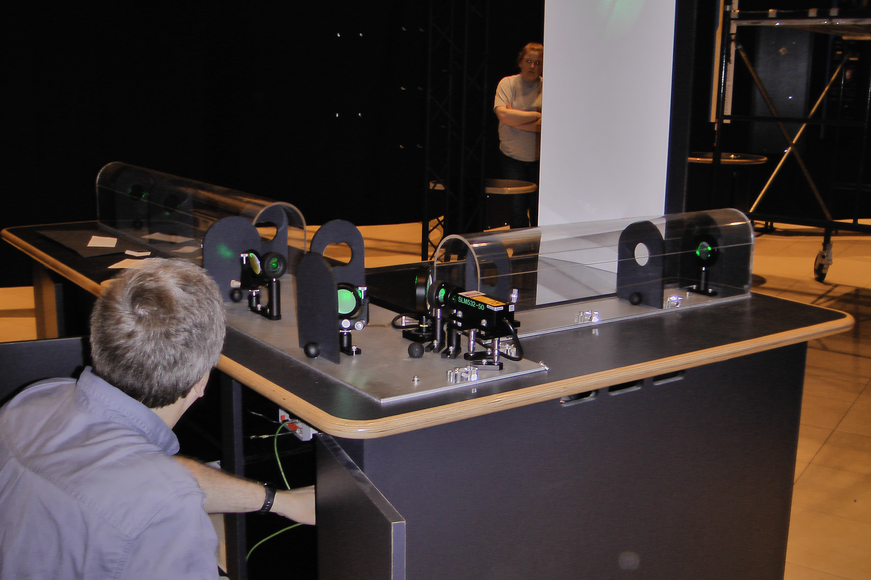
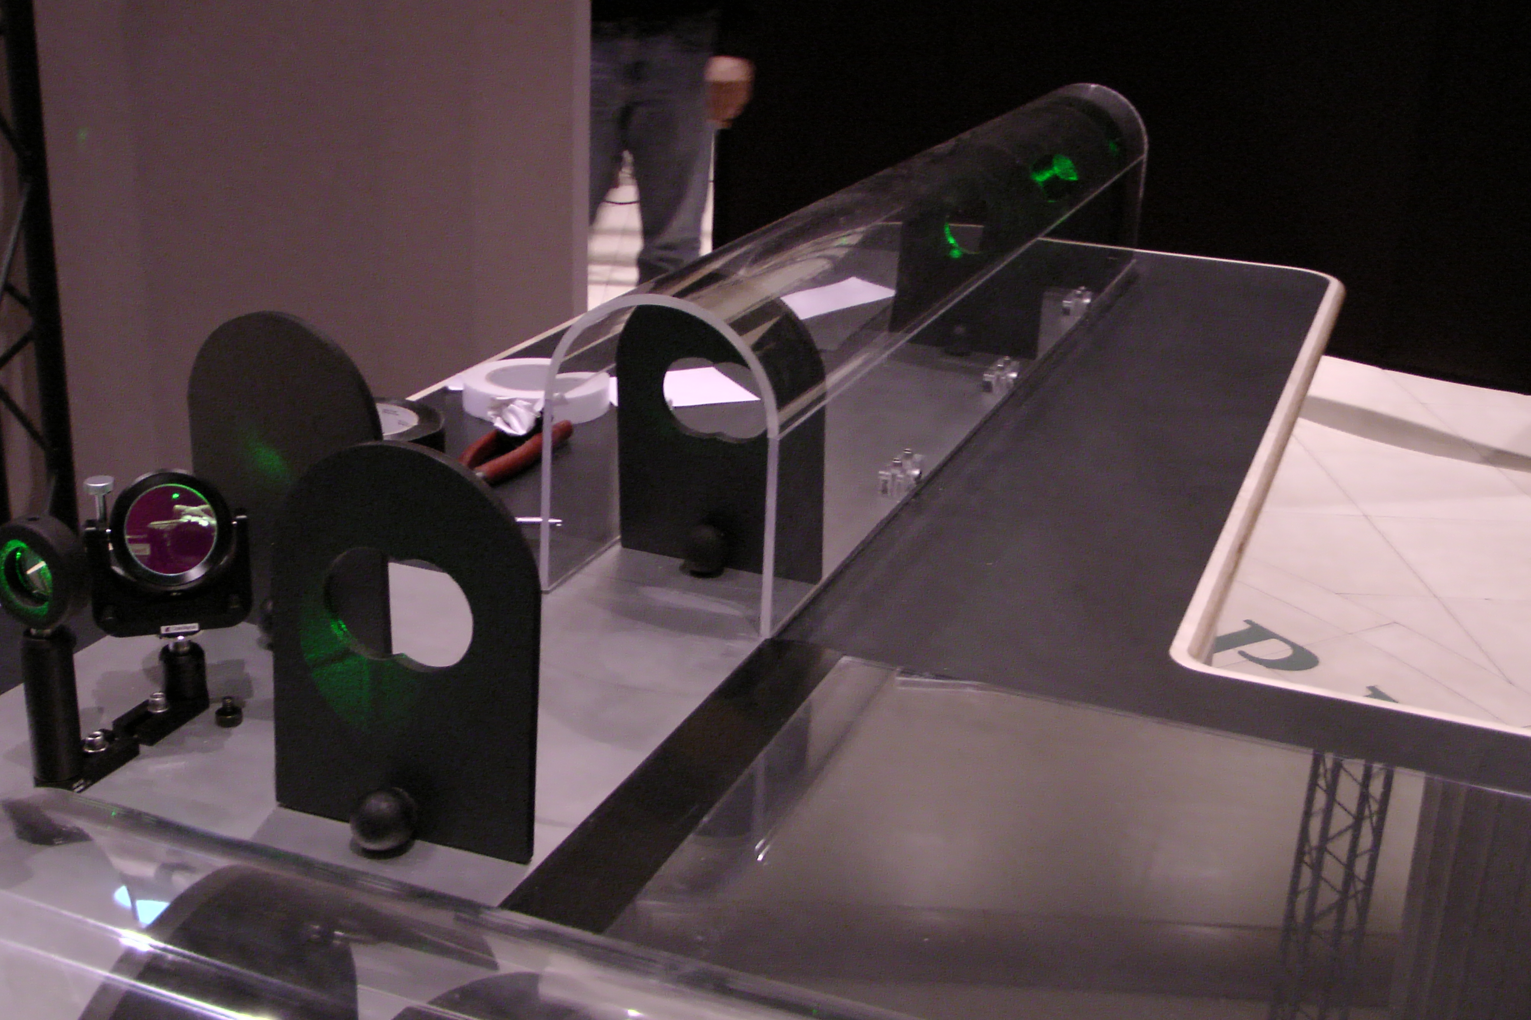
World Science Festival – June 2010
Fortunately, during transport into the U-Haul truck, the joints broke, making final prep work in New Jersey and Manhattan much easier!
Turned out we didn’t need them glued in the first place
Prepping in Manhattan

Slide 14
World Science Festival – June 2010
Some issues:
Working with local contractor on screen / photodiode box and baffles was frustrating
Screenbox quotes kept changing, despite Grant’s having provided a full-scale mockup at the outset
Delivered screenbox had a backing we didn’t want
We sawed a slot in it to get an easily detachable cable to photodiode

Slide 15
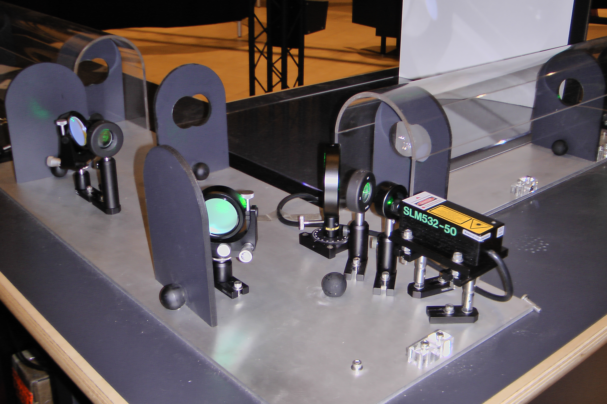
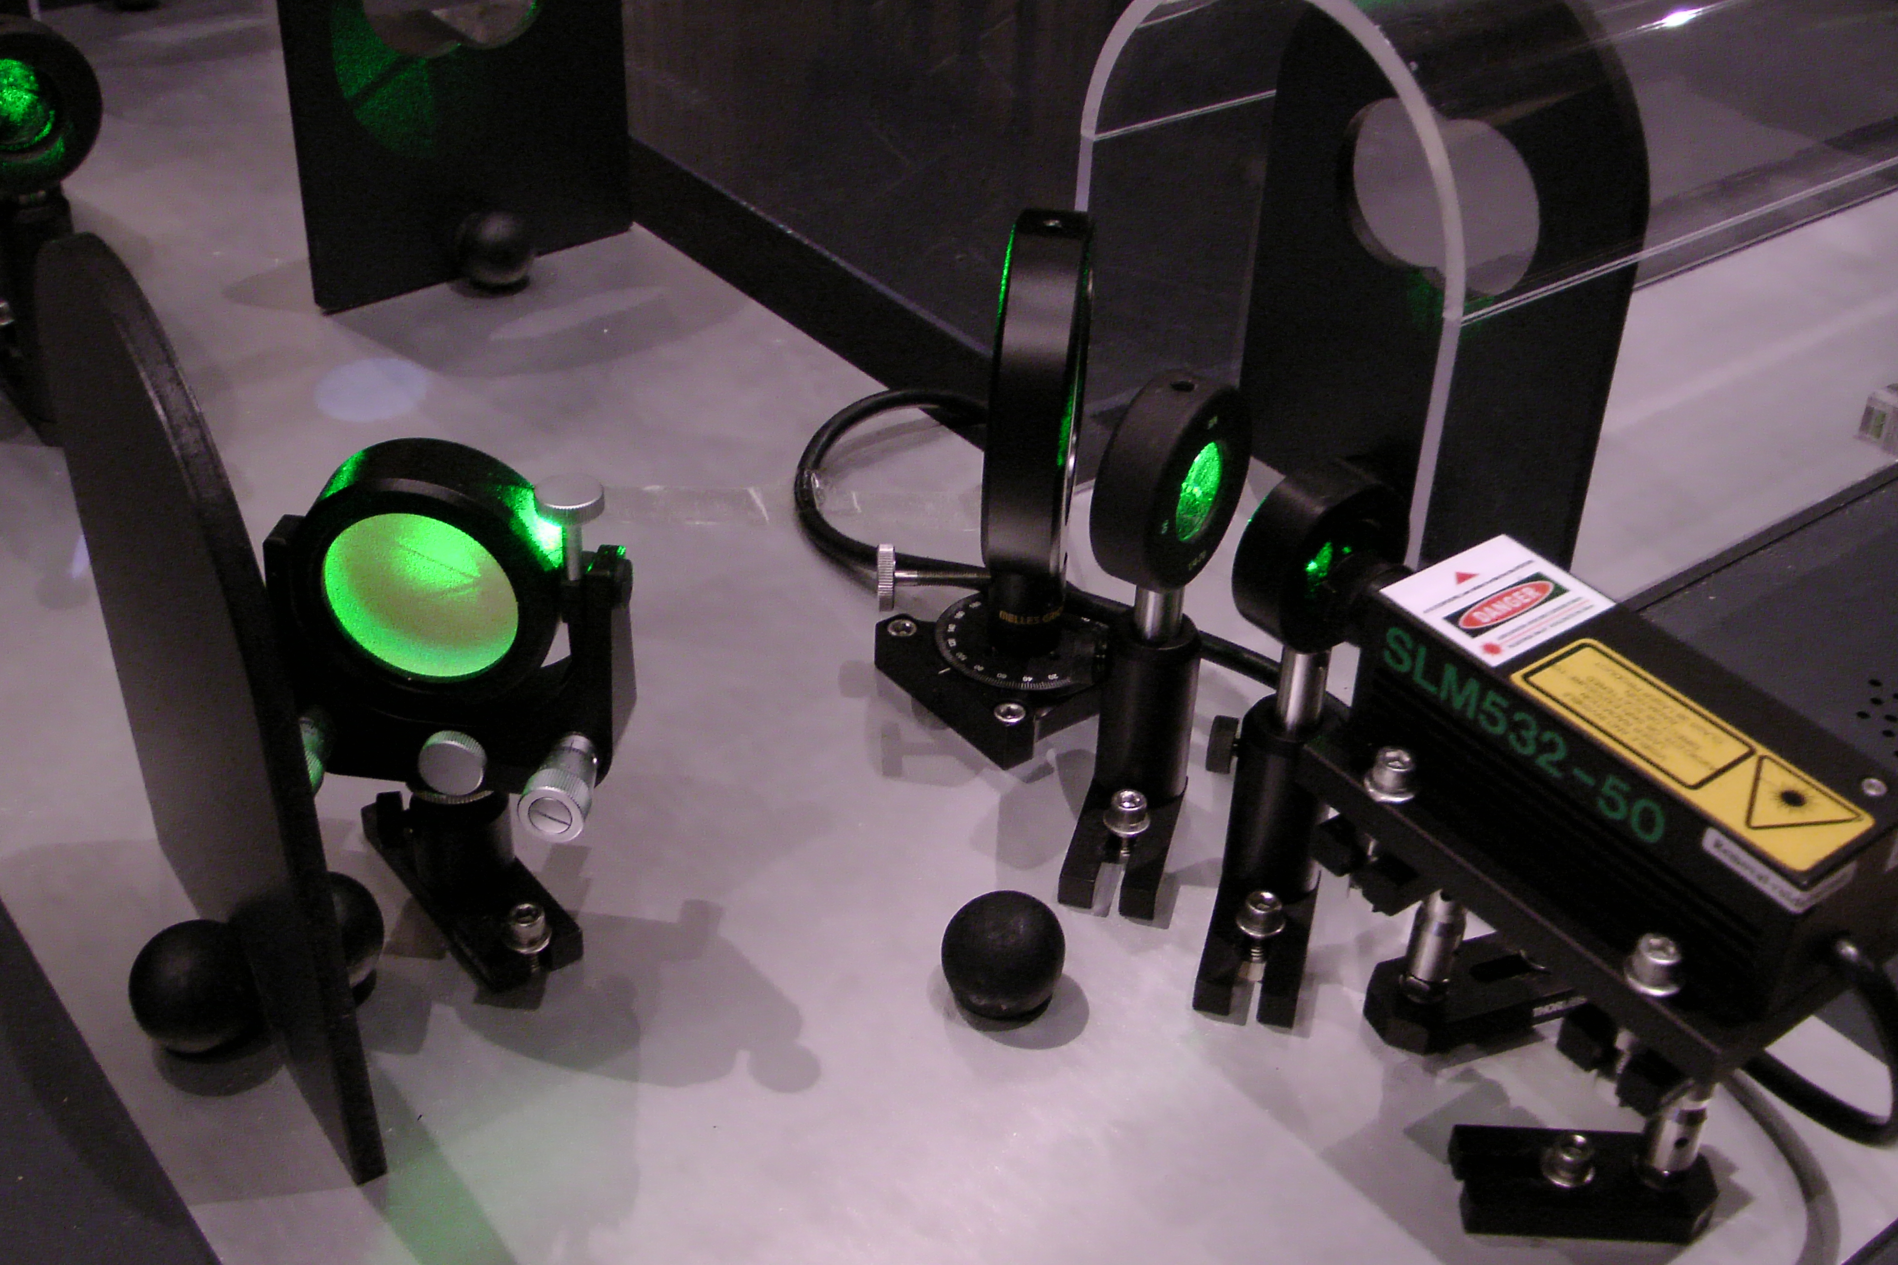
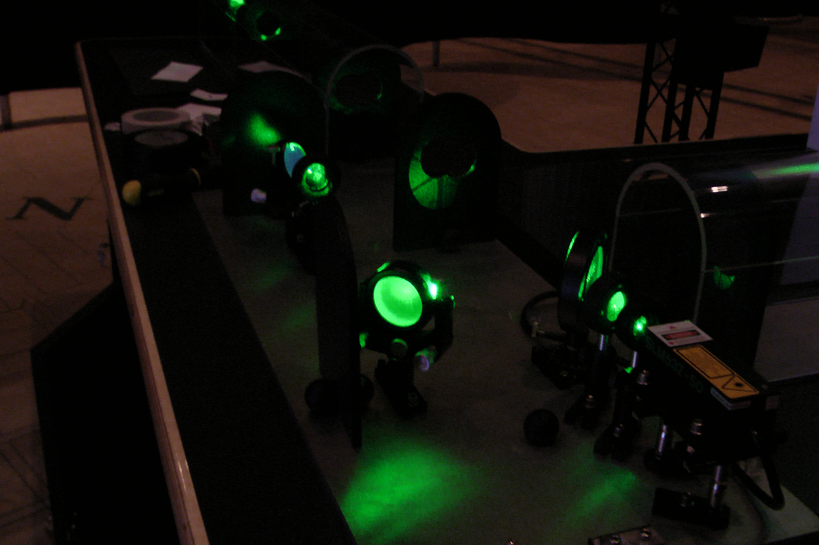
World Science Festival – June 2010
More close-up images

Slide 16
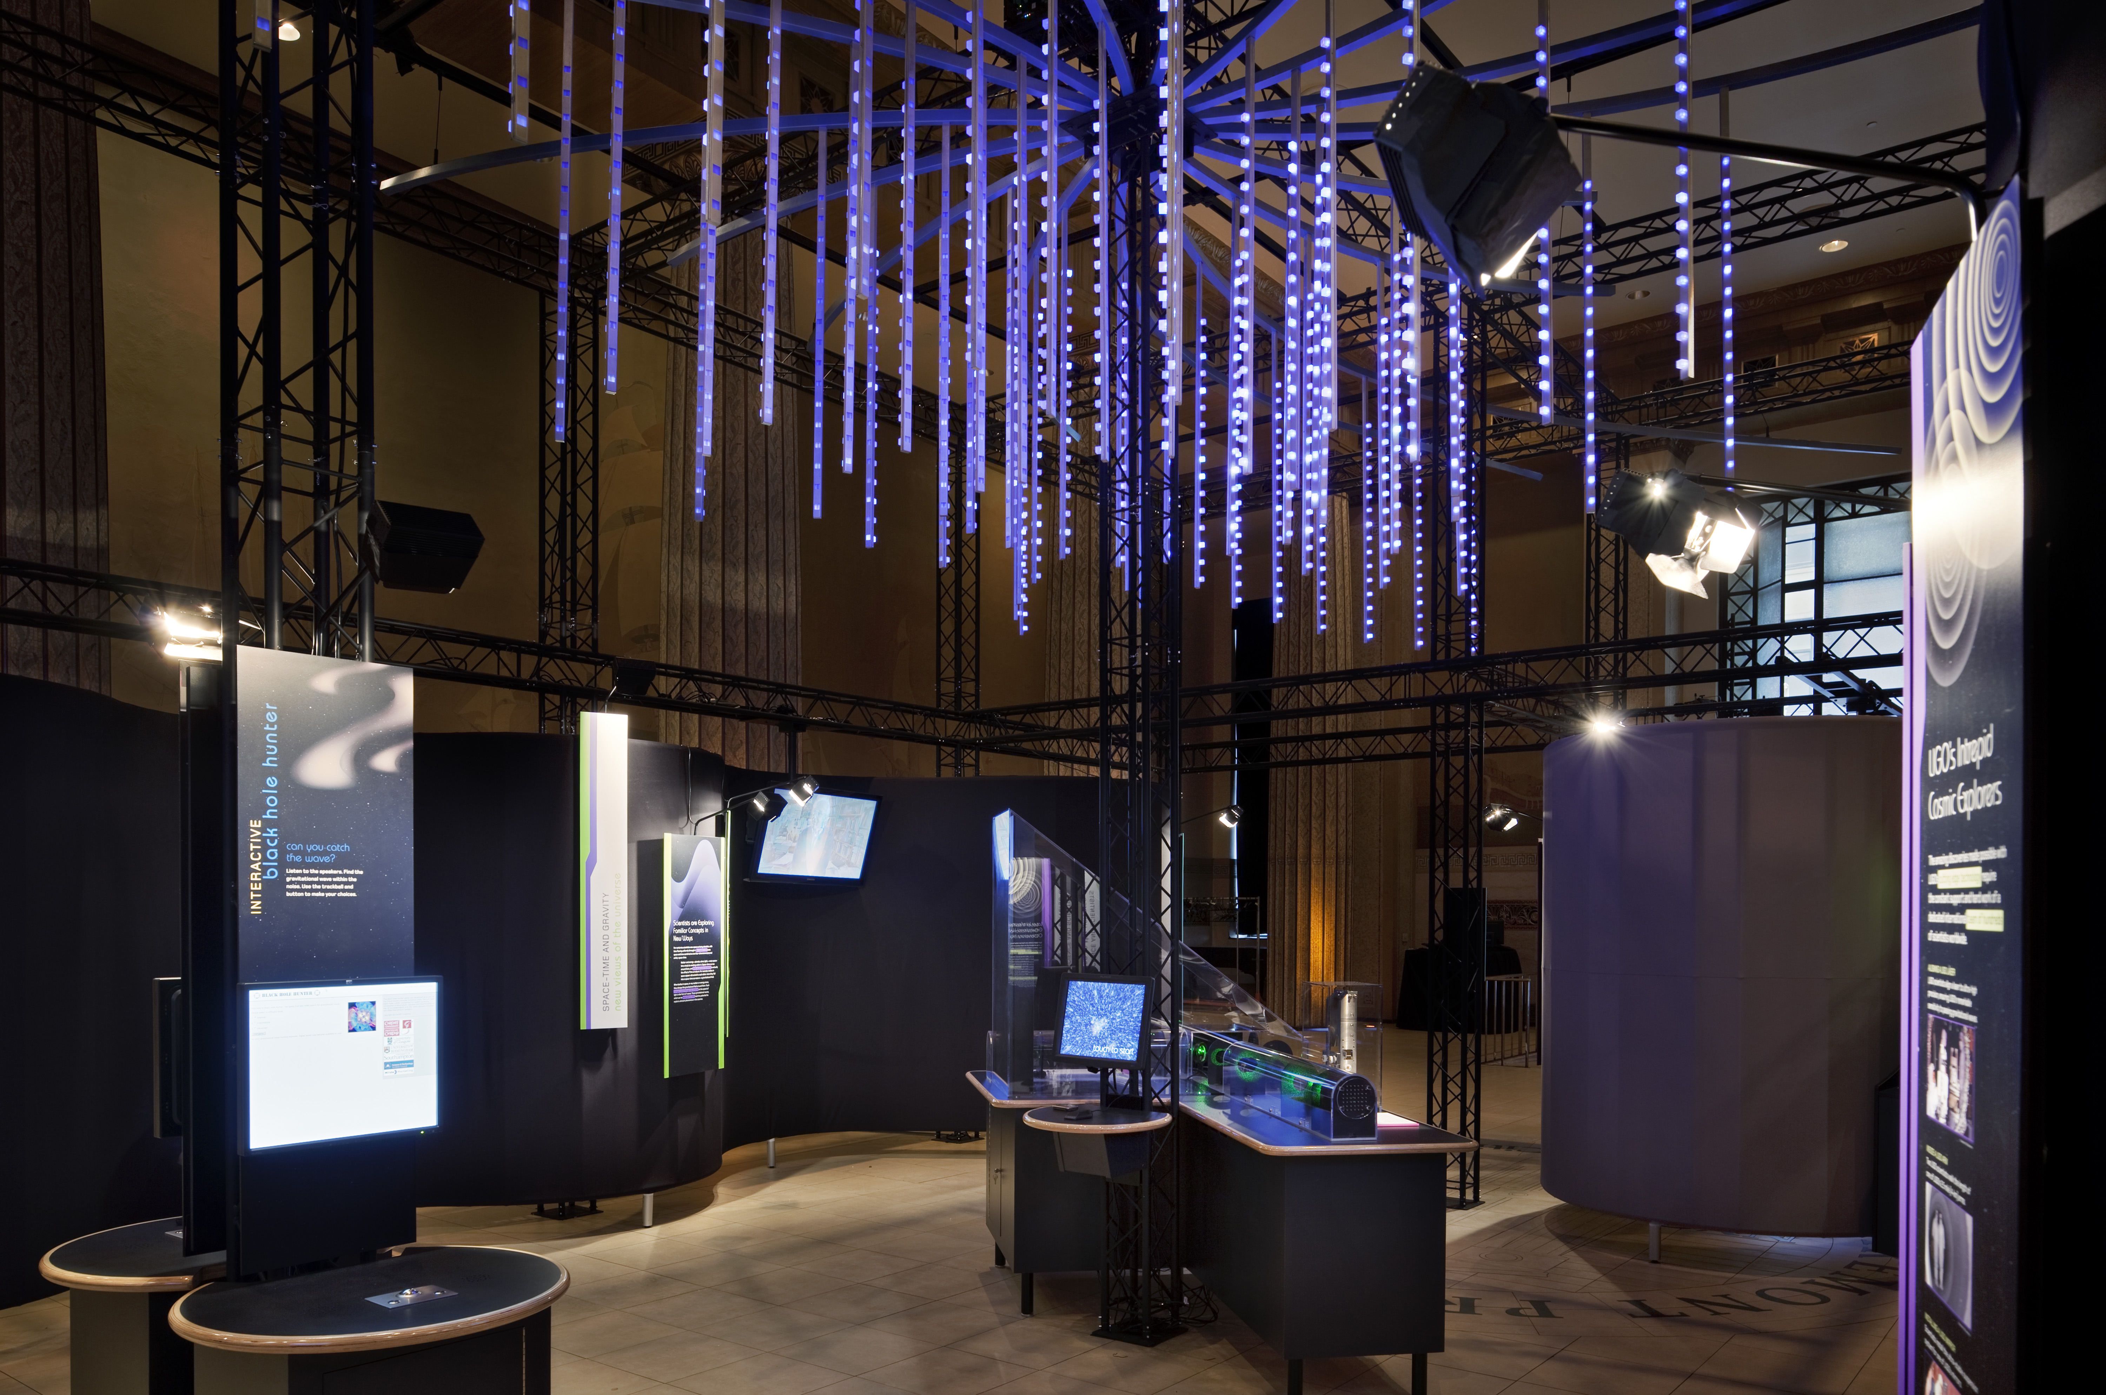
The Big Picture

Slide 17
Building robust interferometer exhibits is a lot of work, but fun too!

