Slide 1
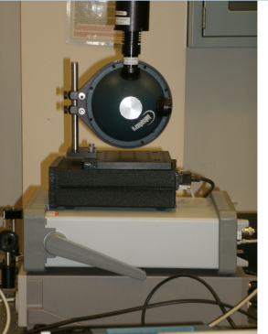
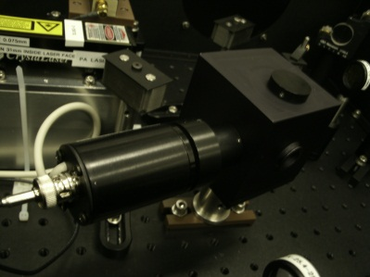
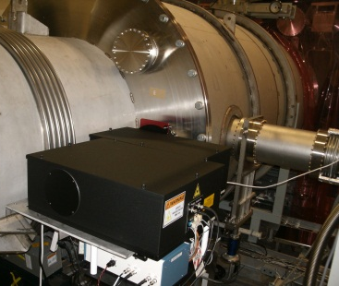
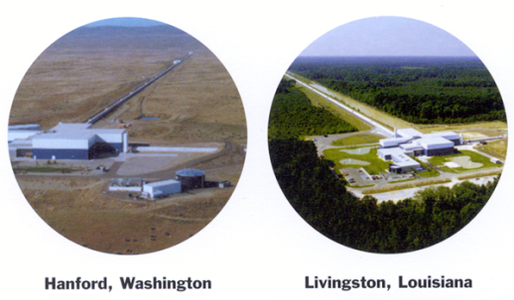
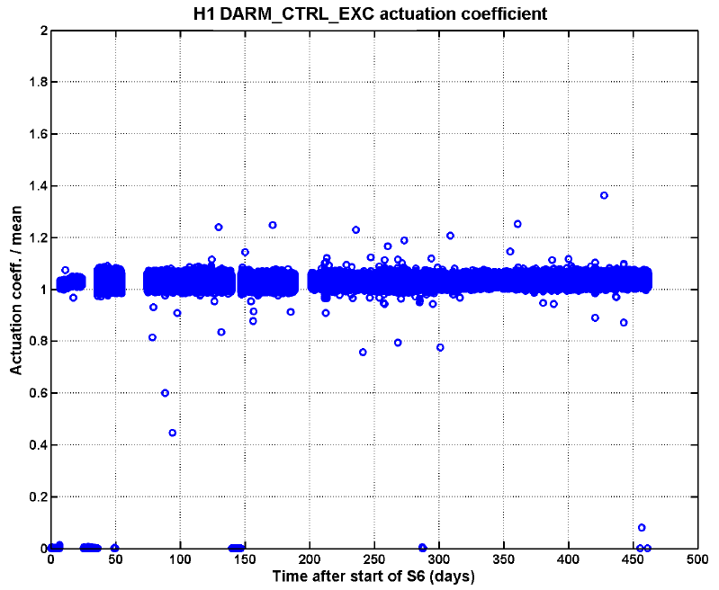
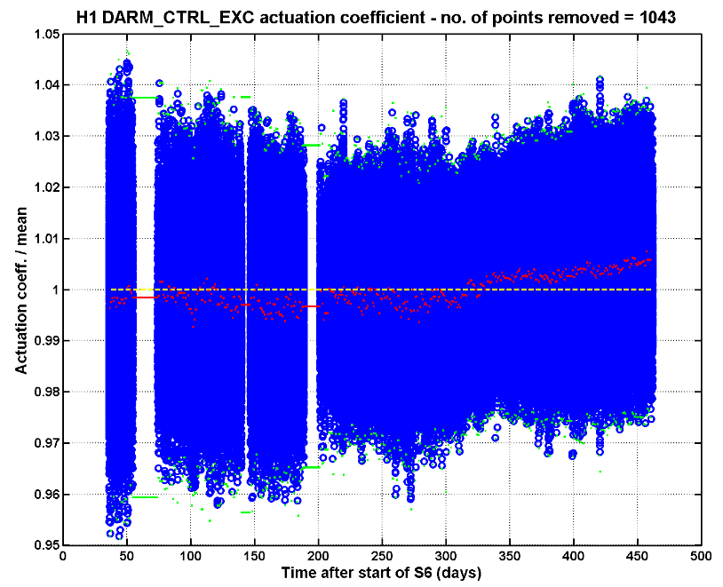
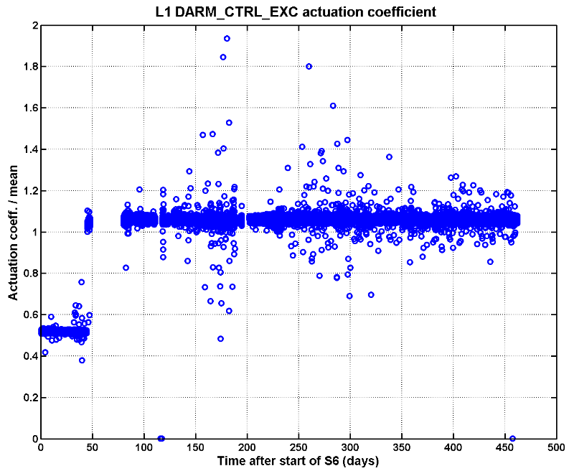
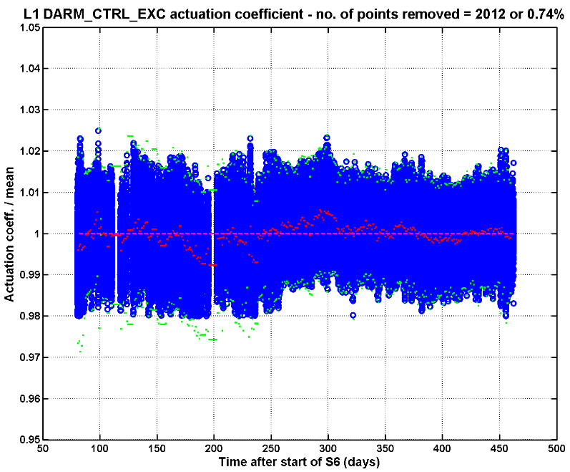
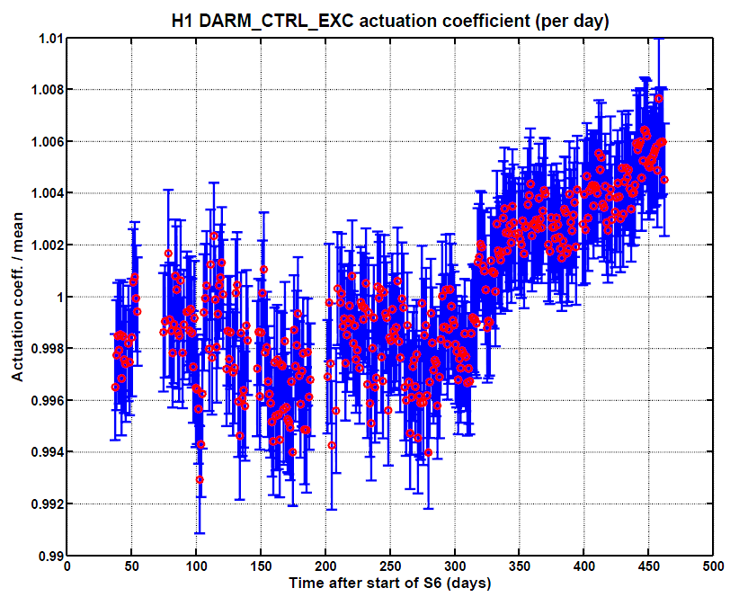
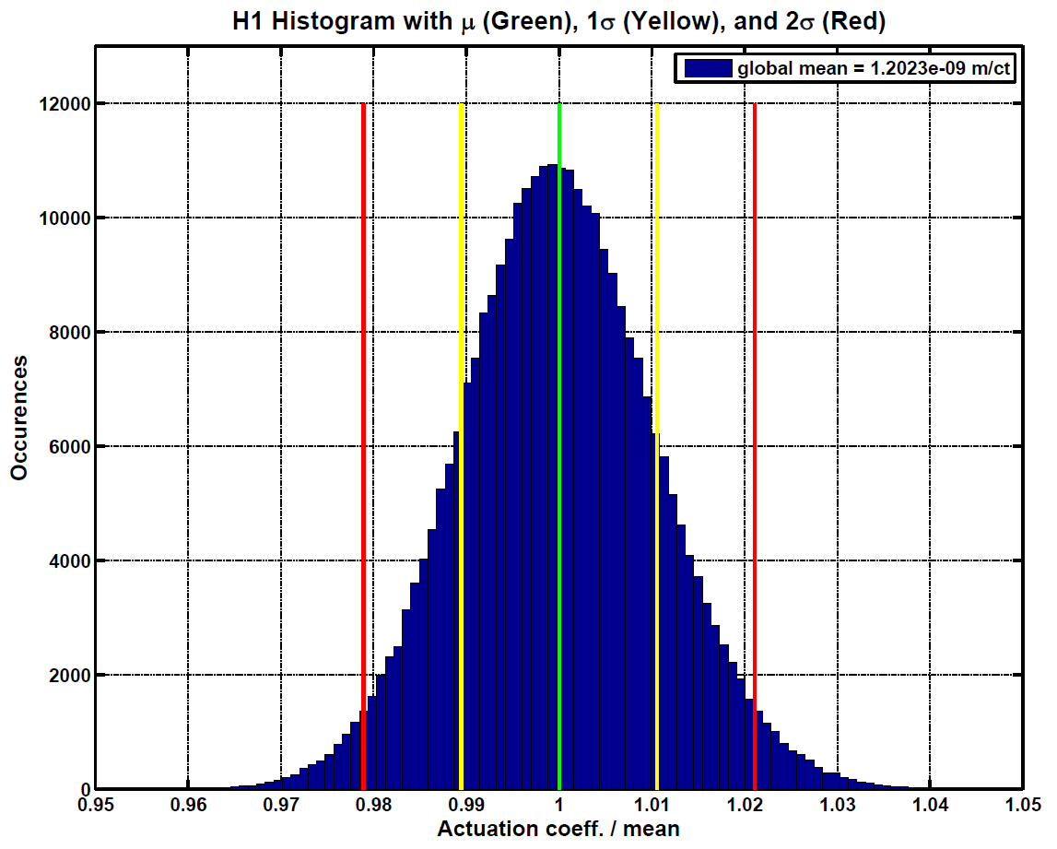
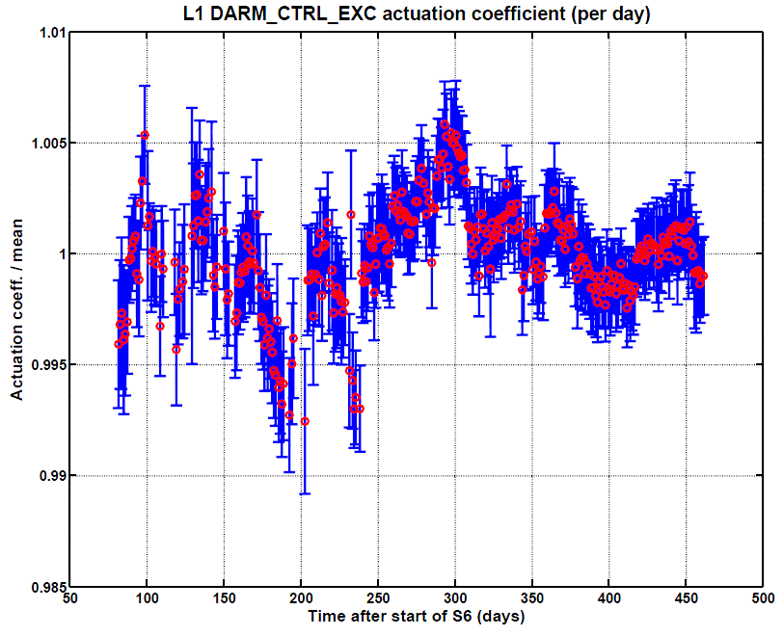
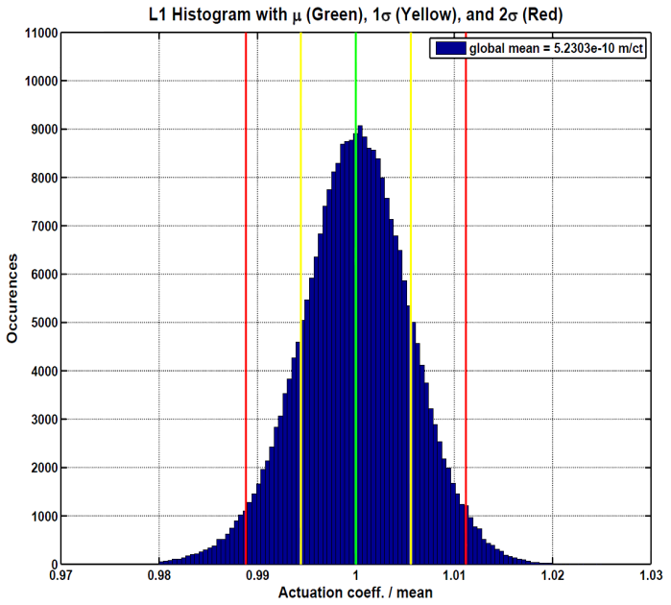
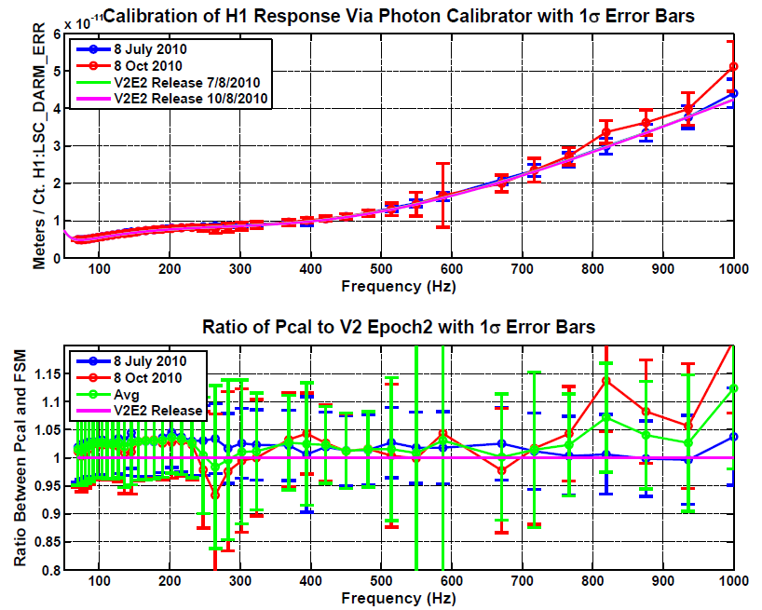
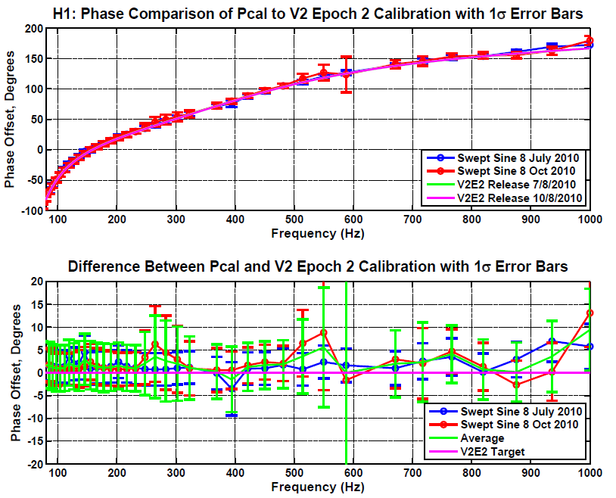
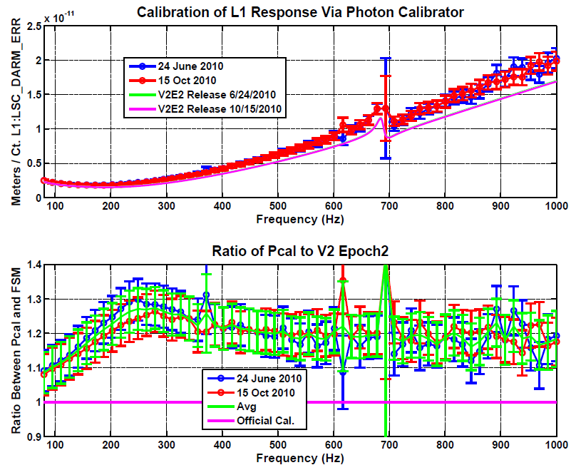
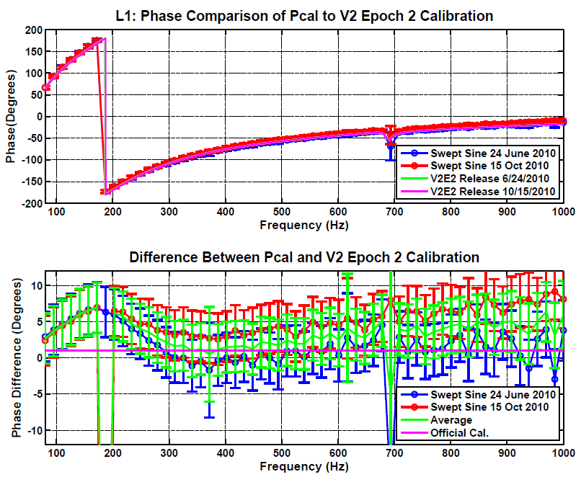
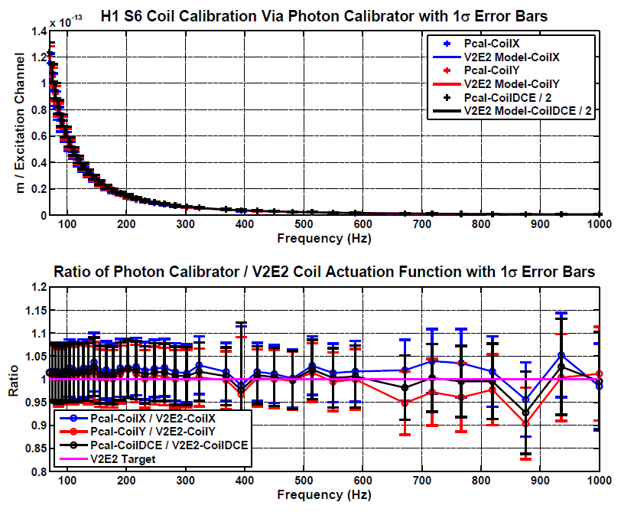
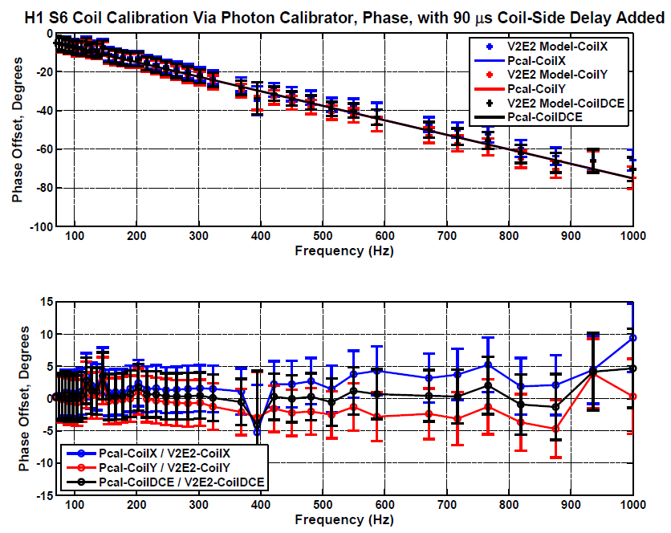
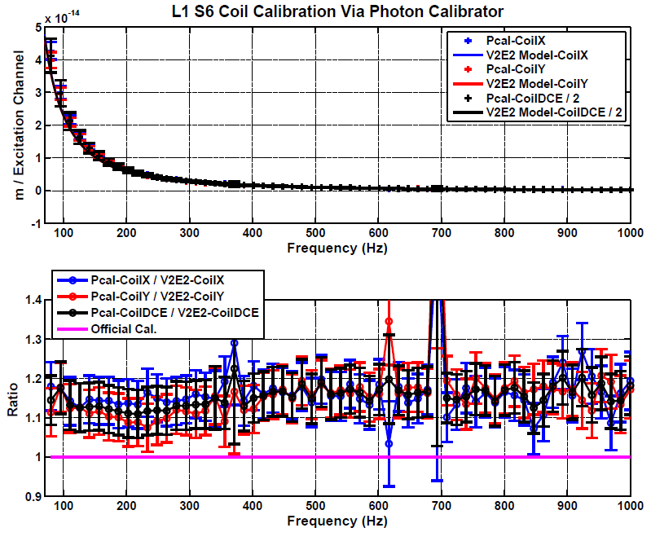
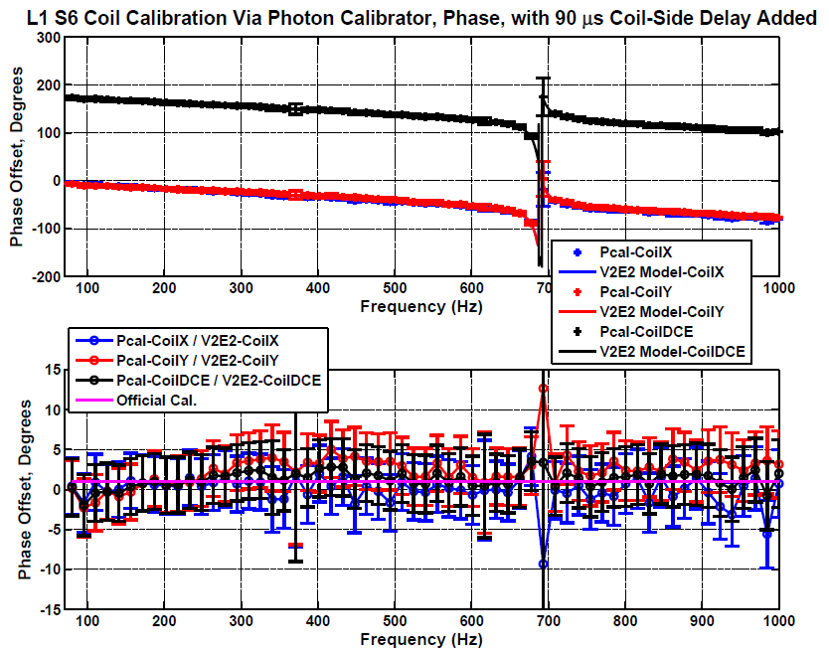
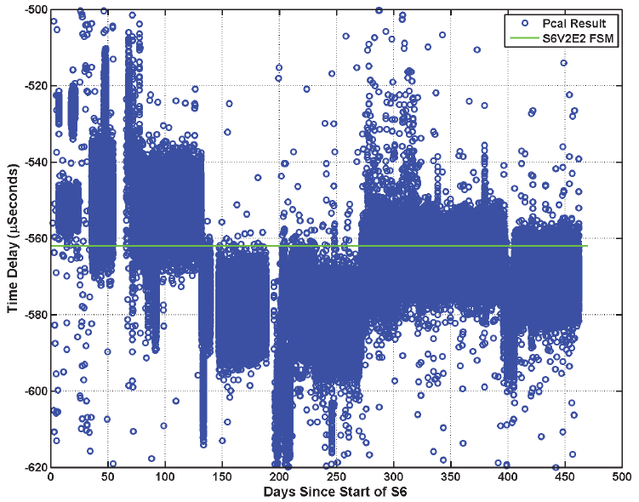
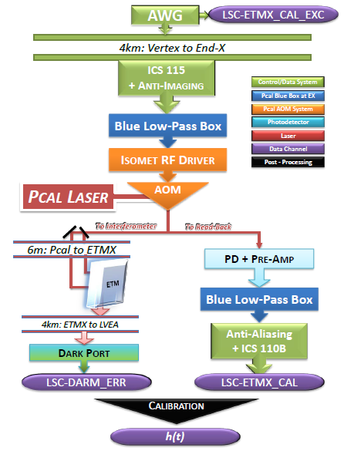
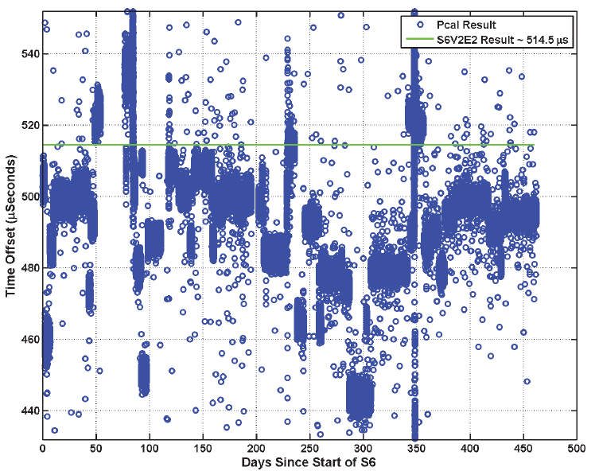
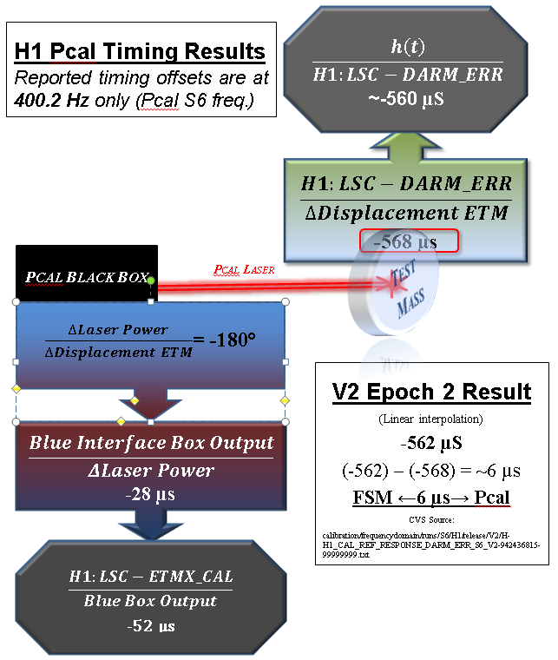
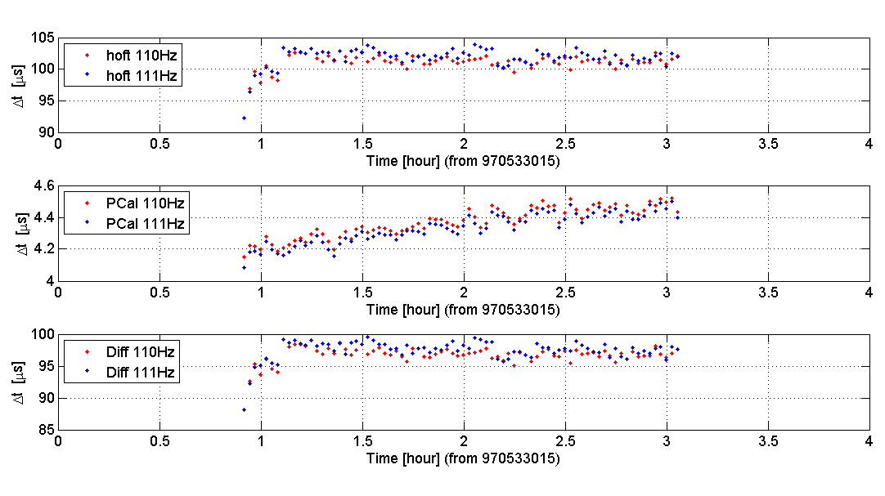
Photon Calibrator Investigations During S6
J. Berliner¹, R. Savage¹,
R. Grosso² , A. Sottile³, G. Mendell¹, K. Kawabe¹, I. Bartos⁴, H. Daveloza⁵, R. DeRosa⁶, G. Menichetti³, M. West⁷
¹LIGO Hanford Observatory, ²Universität Erlangen-Nürnberg, ³Università di Pisa, ⁴Columbia University, ⁵University of Texas at Brownsville, ⁶Louisiana State University , ⁷Syracuse University
Principle of Photon Calibrator Operation
Radiation Force of a Power-Modulated Beam On a Mirror :
$$F_{0}e_{}^{−iωt}=\frac{2p_{0}e_{}^{−iωt}}{c}$$
$F$= radiation force
$p$ = reflected light power on Test Mass
c = speed of light
$ω$= frequency of laser power modulation
Radiation-Induced Displacement of End Test Mass:
$$x_{0}=\frac{F_{0}}{Mω^{2}}$$
$x$= displacement of the ETM
M = mass of Test Mass
Displacement of ETM with Other Factors
$$x_{0}=x_{0}∙\left(\cos{θ}\right)$$
$z$ = unit vector that is normal to the HR surface of the Test Mass
$θ$ = incident angle of beam on Test Mass
Photon Calibrator Formula
$$x_{0}=\frac{2p_{0}}{c}∙\frac{1}{Mω^{2}}∙\left(\cos{θ}\right)$$
Gold Standard
(NIST↔LHO)
Working Standard
(LHO↔LLO)
↓
End Station
Box Photo
Detector
(Inside Pcal Box)
Interferometer
Pcal Laser
(Inside Pcal Box)
→→→Calibration Chain→→→
(1) | Long-Term Stability of Voice-Coil Actuators
H1 | Procedure Actuation Calibration Formula: $$\frac{meters of coil actuation}{counts LSC−DARM_CTRL_EXC}=\frac{counts LSC−ETMX_CAL}{counts LSC−DARM_CTRL_EXC} ×\frac{meters of Pcal actuation}{counts LSC−ETMX_CAL}$$ Box Calibration: $$\frac{{ETM Motion}_{meters}}{LSC−ETMX_CAL}=\frac{{ETM Motion}_{meters}}{{\left(NIST\right)Pcal}_{Watts}}×\frac{{NIST Pcal}_{Watts}}{{Gold Standard}_{Volts}}×\frac{{Gold Standard }_{Volts}}{{Working Standard}_{Volts}}×\frac{{Working Standard }_{Volts}}{LSC−ETMX_CAL}$$ Line Studies: During S6, coil and Pcal modulations were maintained at ~400 Hz in H1 and L1. We analyzed the heights of these lines in 60-second DFT’s using PcalMon (R. Grosso) and LineAmpFinder (G. Mendell and J. Berliner) on LDAS: $$Amplitude\left(x\right)=\sum_{n=1}^{60×sampling rate}{\sqrt{{\left(x_{n}\cos{\frac{2πx_{n}}{60×sampling rate}}\right)}^{2}+{\left(x_{n}\sin{\frac{2πx_{n}}{60×sampling rate}}\right)}^{2}}}$$ Alberto Sottile, Greg Mendell, and Guido Menichetti analyzed the line heights and accounted for outliers in the data. You can see their results in LIGO-P1100013. See Greg Mendell’s Talk (LIGO-G1100197)! NOTE: These studies ignore the uncertainty in the Box Calibration. The Swept-Sine studies consider these errors. | L1
This is every minute of science mode in S6. Some visible outliers clearly stand out here. Overall, the actuators seem stable to within ~10% as visible on this plot.
Out of 305,610 minutes of science mode, we deleted 1,043 outliers, or ~0.34% of the data, for this investigation.
L1’s Pcal photodetector developed a short-circuit at the beginning of the run. Otherwise, this plot shows overall stability to ±~15%.
Out of 268,997 minutes of science mode (with a working Pcal photodetector), we pruned off just ~0.74% of the times for this investigation.
$$\frac{meters of coil actuation@1Hz}{counts H1:LSC−DARM_CTRL_EXC}=\frac{counts H1:LSC−ETMX_CAL}{counts:H1:LSC−DARM_CTRL_EXC} ×\frac{meters of Pcal actuation}{counts H1:LSC−ETMX_CAL}$$
LSC-ETMX_CAL ≡ Pcal Read-Back; LSC-DARM_CTRL_EXC ≡ Coil Excitation
Actuation Coefficient
Line Studies
Box Calibration
When considering the daily averages of the actuation coefficient, we learned that the actuators were stable to ±1%, but slowly losing sensitivity with time, since day ~250.
When considering more than 99% of science time and detrending the slight trend in the points, µ ± 2σ is only ± ~2%.
When considering daily averages, the L1 actuators are shown to be very stable to ±~0.75%.
When considering more than 99% of science time, µ ± 2σ is only ± ~1%.
(2) | Photon Calibrator Swept-Sine Calibrations
H1 | Procedure Response Function Formula: $\frac{meters}{LSC−DARM\text{_}ERR}\left(f\right)=\frac{meters}{LSC−ETMX\text{_}CAL}(f)×\frac{1}{f^{2}}×\frac{LSC−ETMX\text{_}CAL}{LSC−DARM\text{_}ERR}(f)$ After locking the interferometer, we ran swept-sine measurements on the interferometer using the Photon Calibrator’s EPICS system. Actuation Function Formula: $$\frac{meters}{LSC−∗∗∗_EXC}\left(f\right)=\frac{meters}{LSC−ETMX\text{_}CAL}(f)×\frac{1}{f^{2}}×\frac{LSC−ETMX\text{_}CAL}{LSC−DARM\text{_}ERR}(f)×\frac{LSC−DARM_ERR}{LSC−∗∗∗_EXC}(f)$$ After finding the response function, we swept sines across the interferometer using the End Test Mass voice-coil actuators, and compared the response in DARM_ERR. The entire response and actuation calibration takes only ~1 hour! | L1
Overall, H1’s calibration shows <~5%, 5° systematic discrepancy in magnitude and phase for response and actuation.
In L1, a ~10-30% systematic discrepancy is evident in the magnitude of both response and actuation.
In phase, a large discrepancy is evident below 300 Hz in response. Bartos’s timing verification study (T1000638) confirms this.
Response Function
Pcal Box Calibration
Free Mass Transfer Function
Swept-Sines via EPICS
*** ≡ DARM, ETMX, ETMY
Response Function (see above)
Swept-Sines via EPICS
(3) | Accuracy of Interferometer Timing
H1 | Pcal: An Ideal Timing Calibrator | L1
Measuring the interferometer timing over the course of the entire science run. The green line is the official timing, and the blue points are the measured timing.
The actuation of the Photon Calibrator has two important features that make it a crucial player in assessing the timing of the interferometer response:
It is simple and well-understood: as soon as its effects are sensed, we can be sure that it alone was the stimulus for the response.
It’s effect is virtually instantaneous: once we compensate for the transfer functions of its components, the Photon Calibrator’s radiation force is only nanoseconds away from the Test Mass.
Imre Bartos and the Columbia timing group have studied this topic extensively (LIGO-T1000638). Also, Greg Mendell’s talk (LIGO-G1100197) addresses timing.
Measuring the interferometer timing over the course of the entire science run. The green line is the official timing, and the blue points are the measured timing. L1’s timing jumps erratically over the course of the run.
Characterizing the timing of the system electronics to account for systematic errors.
Characterizing the timing of the system electronics to account for systematic errors.
In July 2010, Imre Bartos used Pcal to verify the timing of H1’s h(t) generation. He noticed an anomalous downward drift in h(t)’s phase generation, as evident in the left plot. The other two plots are the time-dependent calibration factor for this period, which correlate with this drift.
Imre Bartos used Pcal to verify the timing of h(t)generation at 110 Hz. In L1, he found a ~100 µs (4°) systematic discrepancy in July 2010, as evident in the top and bottom plots.
LIGO-G1100189-v13

