Slide 1
Advanced LIGO ISC optics for in vacuum use
L. Barsotti
Mar 1, 2011

Slide 2
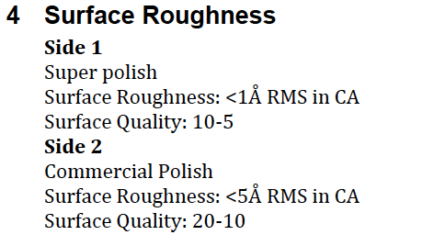
ISC optics (1” and 2”)
For use in HAM1, HAM3, HAM6, TRANSMON (needed in April)
About 110 (+ spares) optics for each IFO
All super-polished optics, except Precision Photonics ones
IBS coating

Slide 3
Optics from Different Vendors (sometime different vendors for each optic)
ATFilms
G&H (former General Optics)
Precision Photonics
Laseroptik / Photon Laseroptik (Germany)

Slide 4
Procedures?
Cleaning and baking procedures for these optics?
Need to have about 30 optics (+ spares) ready
in April for assembling the first TRANSMON for the H2 One Arm Test

Slide 5
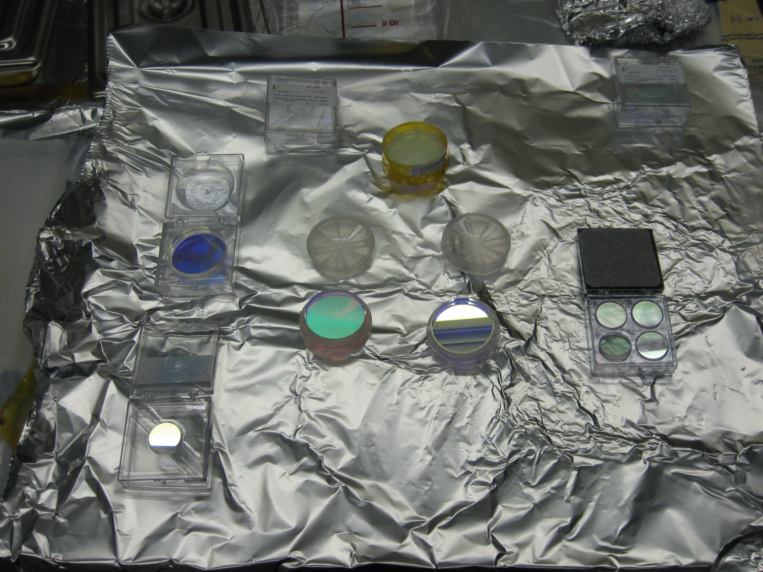
Some optics already received
G&H
ATF
Precision Photonics

Slide 6
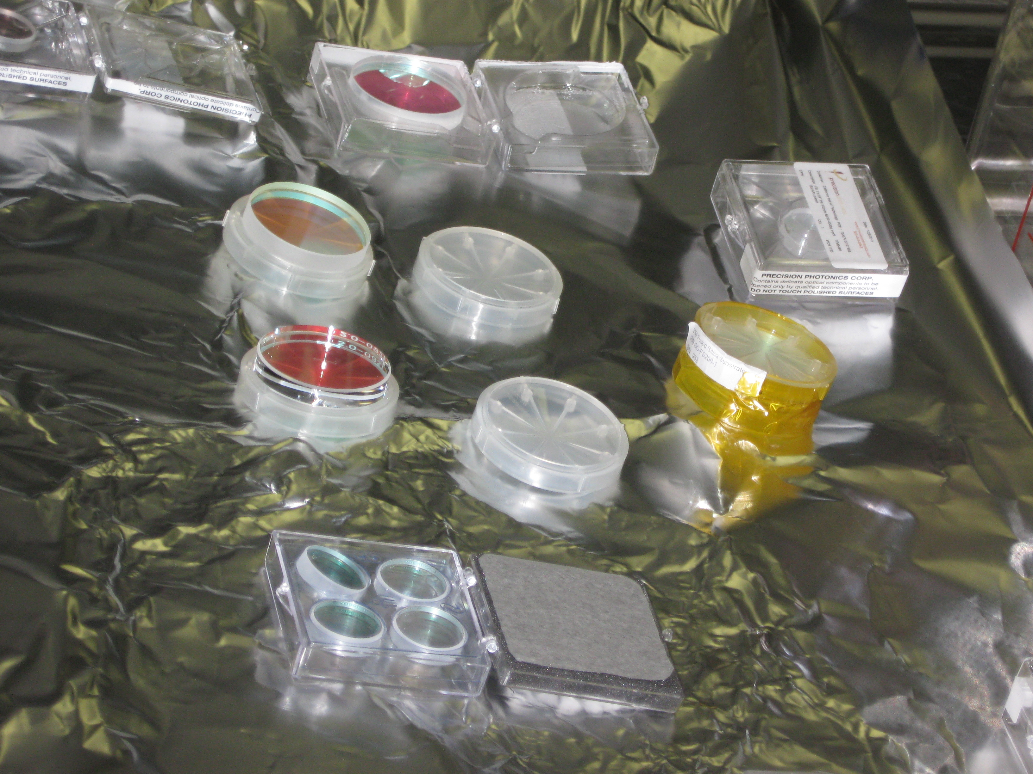
First Inspection
Dust particles clearly visible on all of them
Problems with holders
Specifications for the
optic barrel not included in
the spec document
➔ some are polished
some are not
Precision Photonics
G&H
ATF

