Slide 1
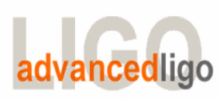
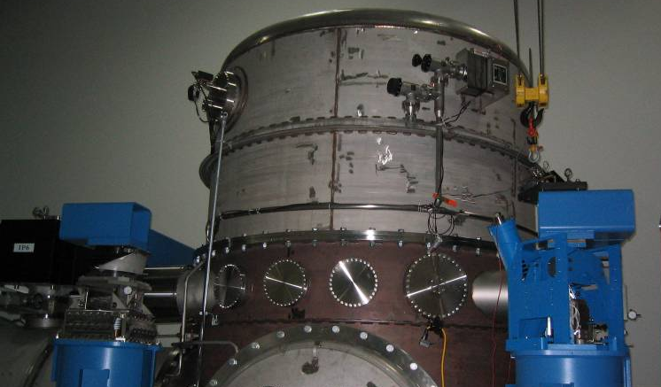
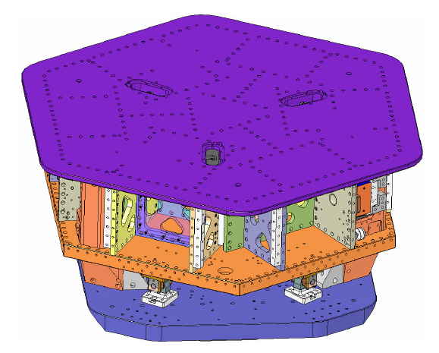
G1100169 - Seismic Testing and Commissioning Overview
Seismic Modules
15 HAM-ISI
15 BSC-ISI
15 HAM- HEPI &
15 BSC-HEPI
Seismic Testing and Commissioning Team
@ LHO
Corey Gray
Eric Allwine
Jeff Garcia
Hugh Radkins
Vincent Lhuillier
@ LLO
Adrien LeRoux
Céline Ramet
Mike Vargas
@ Stanford
Brian Lantz
@ MIT
Jeff Kissel
Fabrice Matichard
Richard Mittleman
Sébastien Biscans

Slide 2
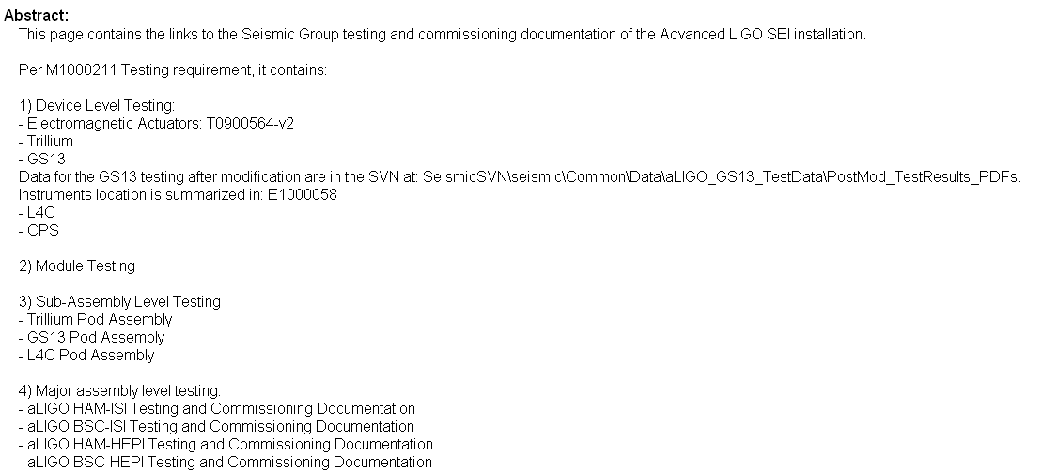
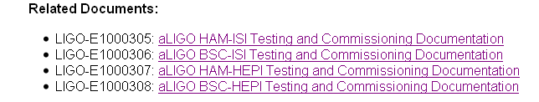
1) DCC Documentation
E1000304
aLIGO SEI Testing and Commissioning Documentation

Slide 3
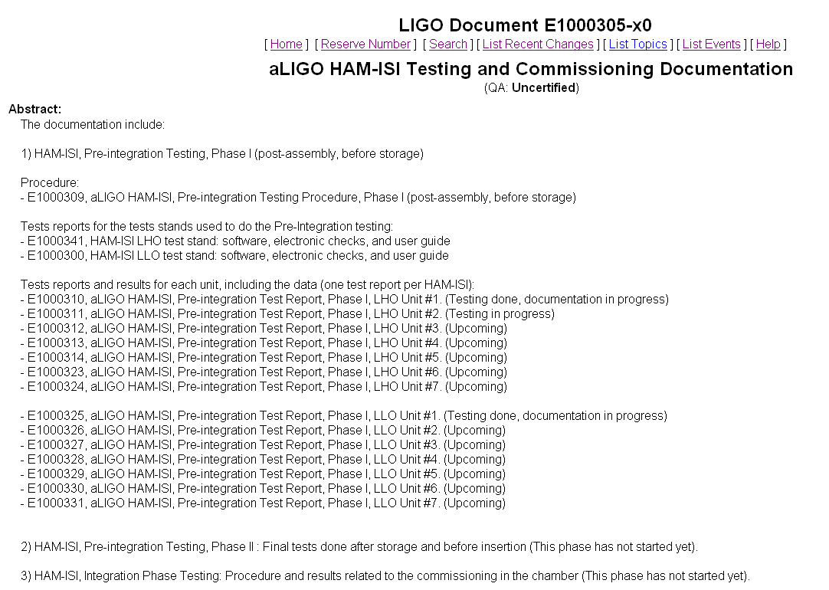

Slide 4
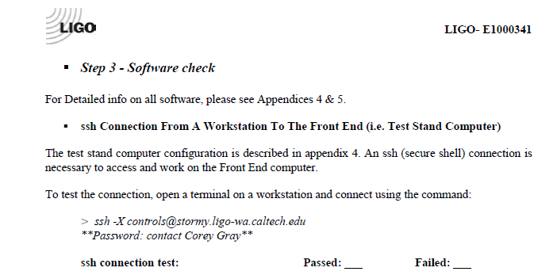
E1000341
HAM-ISI LHO test stand: software, electronic checks, and user guide
(Obsolete Test)
Check List:
SSH Connection
SVN
MEDM
Dataviewer
Awgstream
DTT
Foton
Matlab
mDV and ligodv
ini file
Data acquisition package

Slide 5
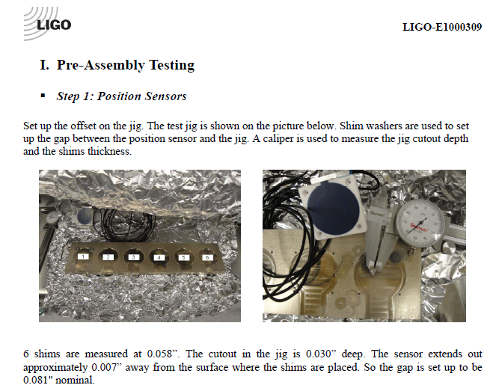
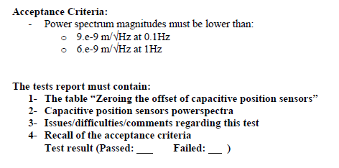
E1000309
aLIGO HAM-ISI, Pre-integration Testing Procedure, Phase I (post-assembly, before storage)

Slide 6
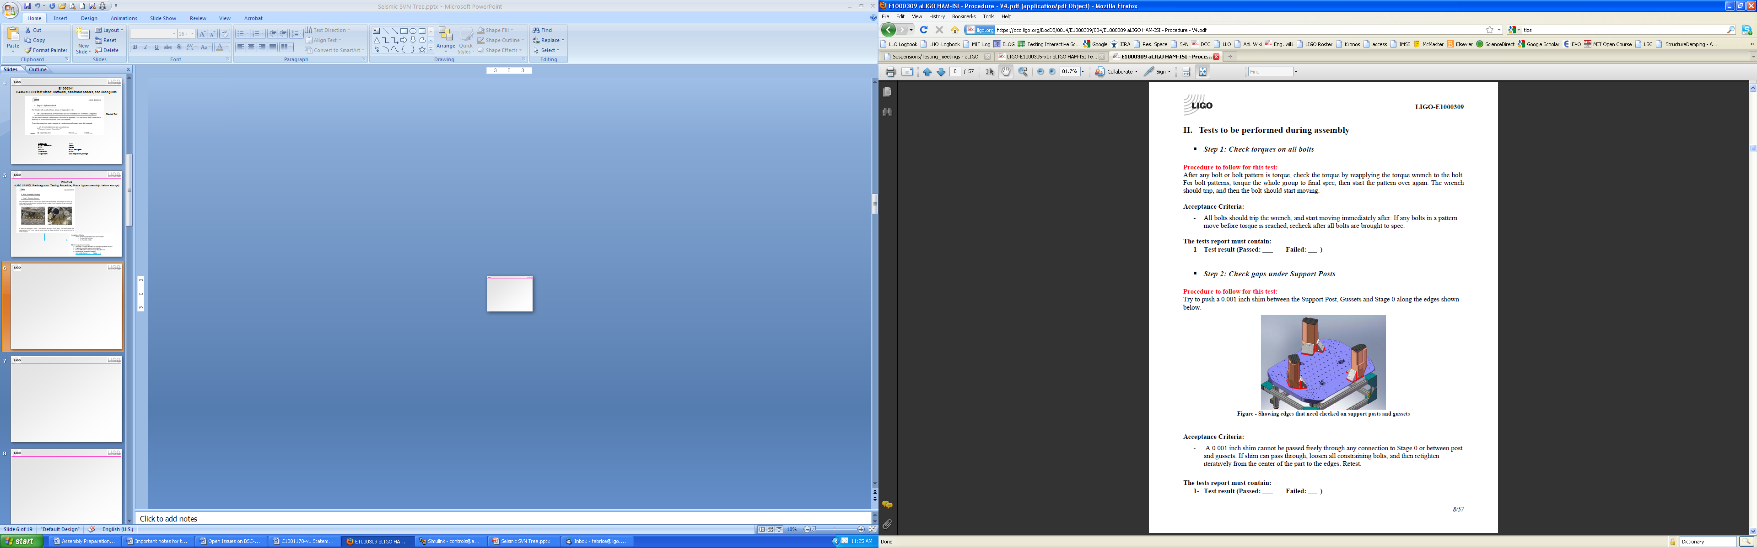

Slide 7
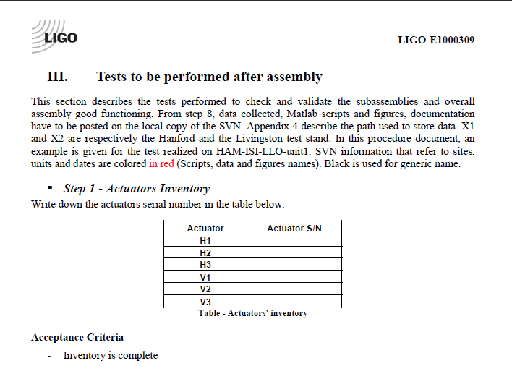

Slide 8
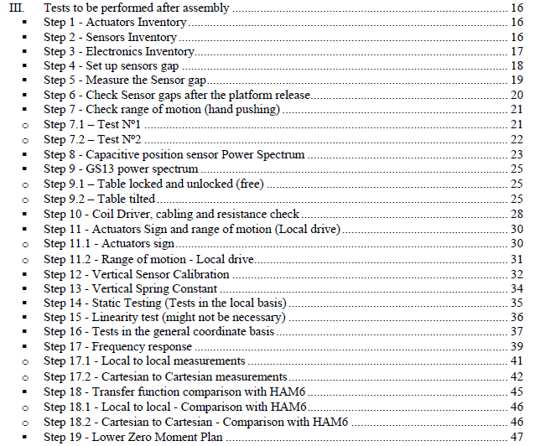

Slide 9
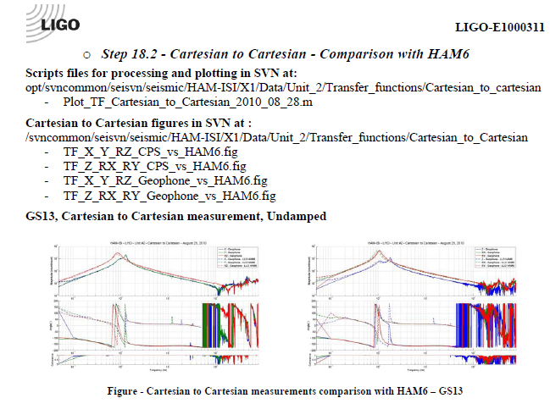
E1000311
aLIGO HAM-ISI, Pre-integration Test Report, Phase I, LHO Unit #2

Slide 10
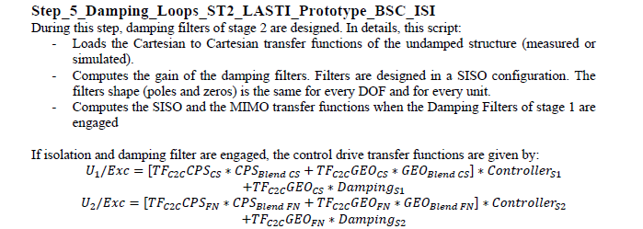
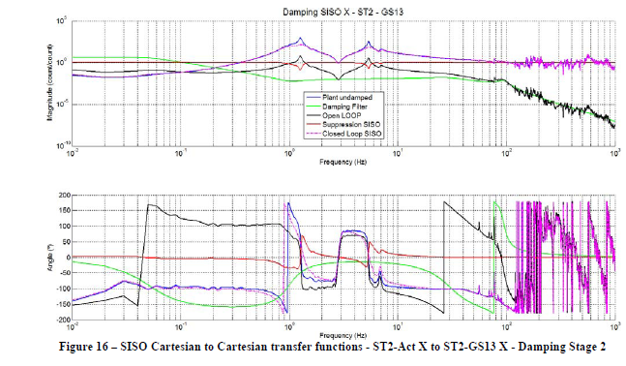
E1000488
aLIGO BSC-ISI Testing Procedure, Phase III
(After insertion, commissioning in the chamber)

Slide 11
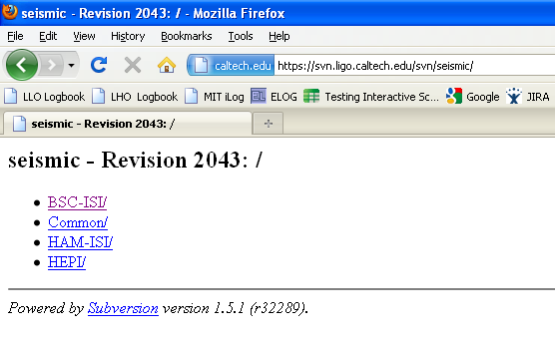
2) Seismic SVN Tree Description
https://svn.ligo.caltech.edu/svn/seismic/

Slide 12
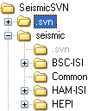
Seismic SVN Tree Description
Level 1: Module/

Slide 13
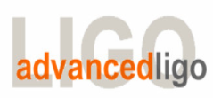
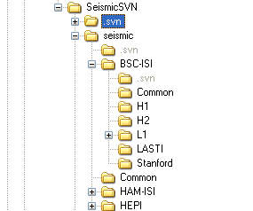
Level 2: Module/Site/
13

Slide 14
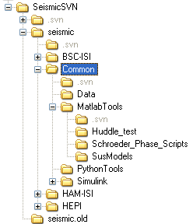
Level 2: Module/Common/
14

Slide 15
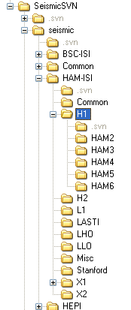
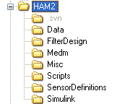
Level 2: Module/Site/Units
15

Slide 16
SEI Svn Reference document or wiki
Instructions
Recommendations
- Always use svn commands: svn mkdir, svn add, svn move…
Case sensitivity
FAQ
i.e. What happen if I check out instead of updating?
16

Slide 17
3) Testing Interactive Schedule
Which module is being used
For how long. Measurement Done.
What type of tests
Contact information
Goal is to help with testing organization.
Still very important to communicate.
Must be simple to use
Interactive, Online

Slide 18
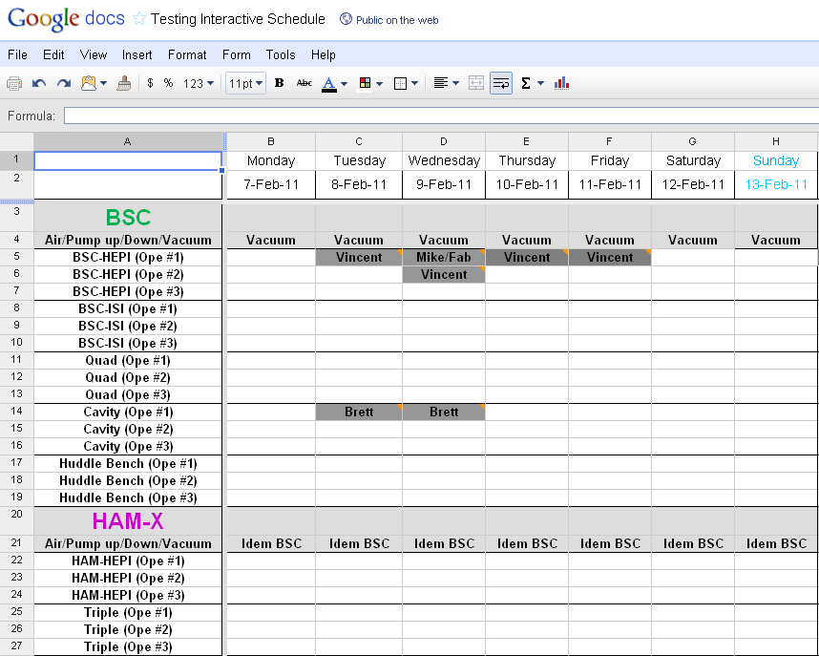
Online Interactive datasheet
https://spreadsheets.google.com/ccc?key=0AnuzOkrYewP3dHVjVnNSZ0Vtc2VVeUNIZDVZNkcyb2c&hl=en#gid=9

Slide 19
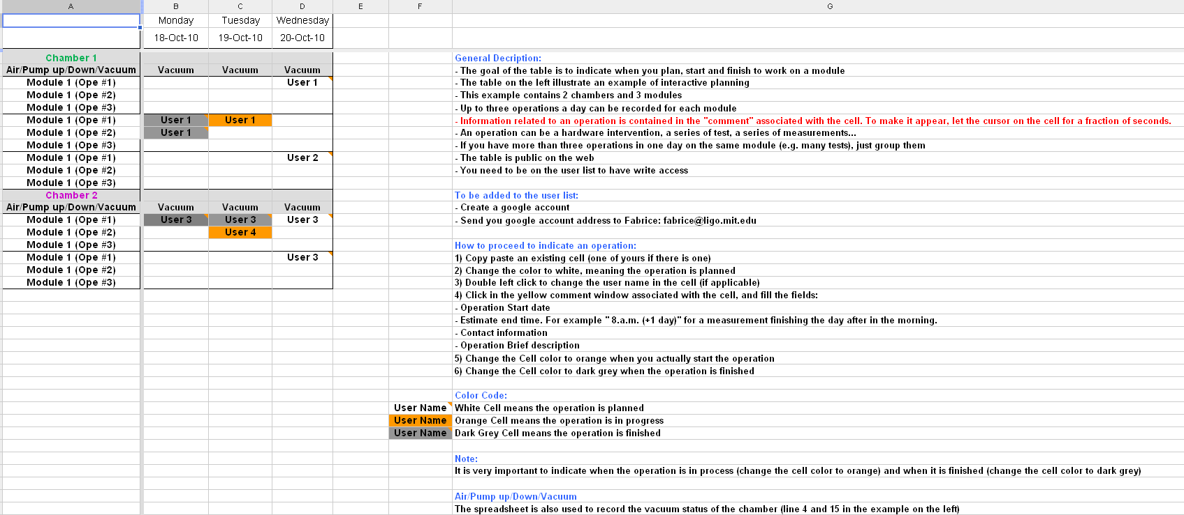
User Guide

