Slide 1
Adaptive Control Loops for Advanced LIGO
Brett Shapiro
25 February 2011

Slide 2





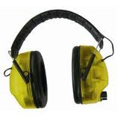

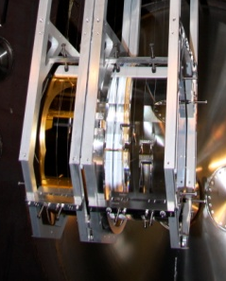


Control Loops Keep LIGO Running
weather
Evolving seismic noise from:
people
… adaptive control also makes a very good thesis topic…

Slide 3

How are Adaptive Loops Useful?
Simple example: Push on the pendulum to maintain a constant L.
Applied Force
Applied Force
L
Control Law

Slide 4
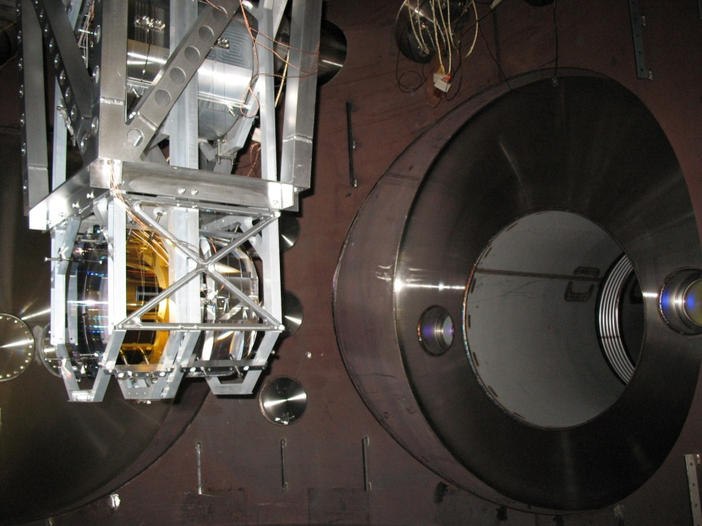
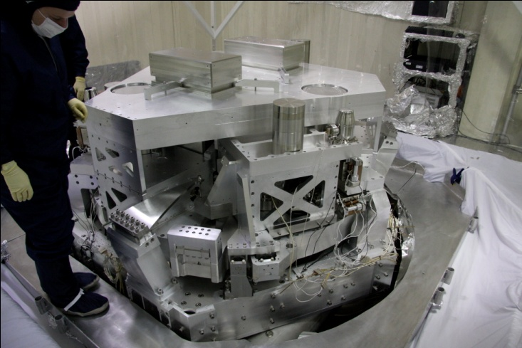
Adaptive Control for Isolation Systems
Suspensions:
Angular mirror control
Damping (modal or classical)
Length control?
Seismic Control
Isolation loops
sensor blending?
Can be used to optimize in real time:
aLIGO noise budget amplification (from sensor noise, barkhausen noise, etc)
actuator forces
RMS error signals
just about anything else

Slide 5
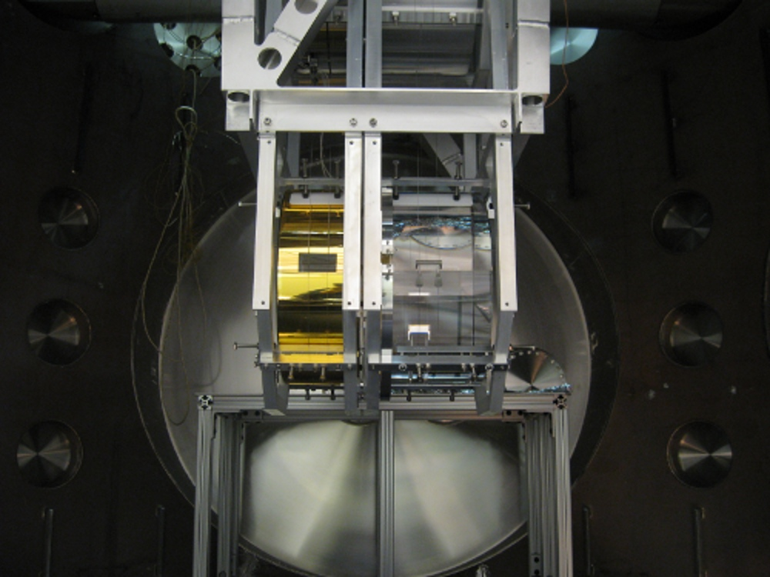
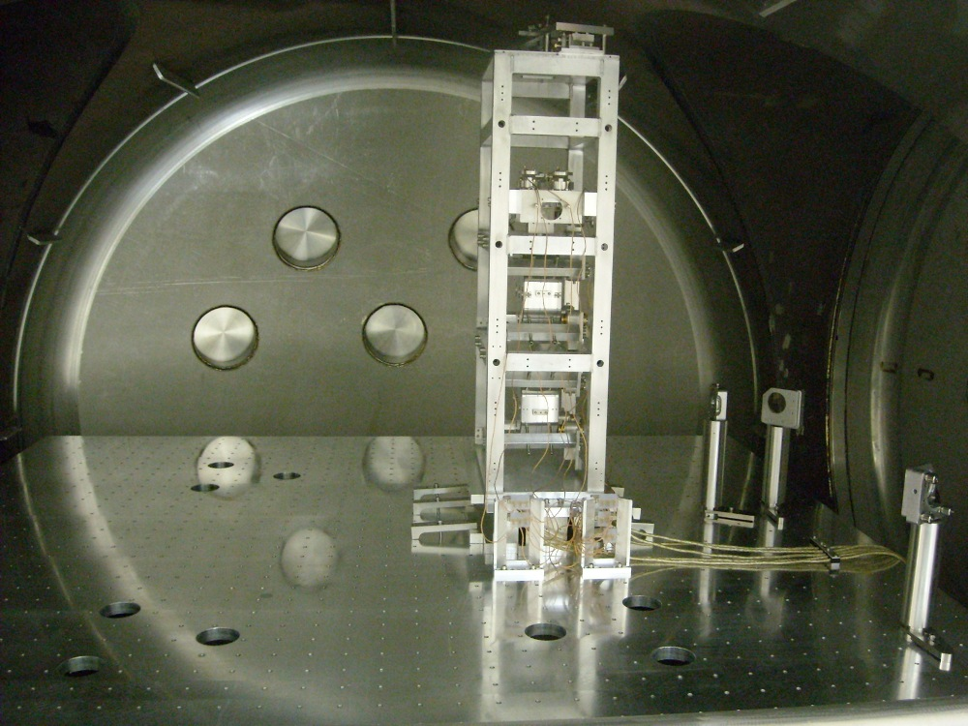
LASTI Quad-Triple Cavity
Quad Pendulum
Triple Pendulum
16 meters

Slide 6
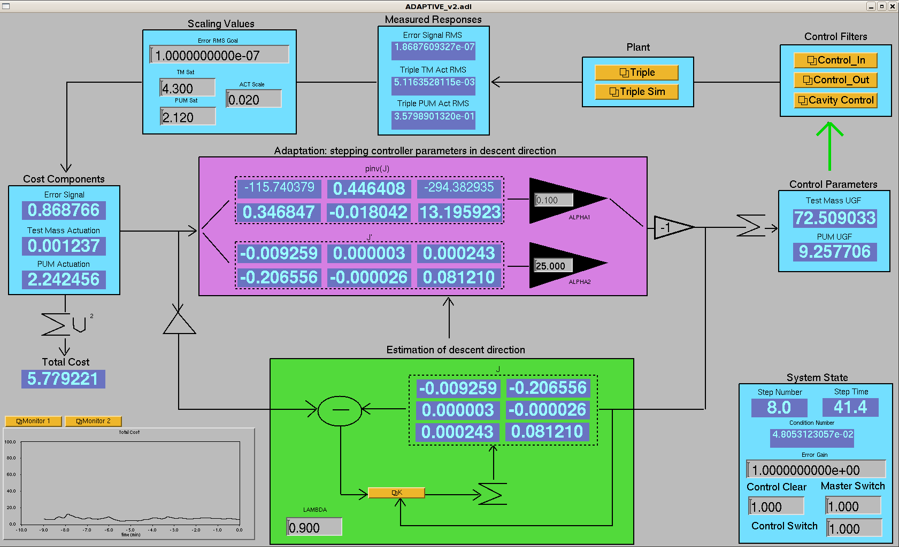
Adaptive Control MEDM Screen

Slide 7
Questions to Answer
What is being controlled in this experiment?
What is the adaptation optimizing?
What parameters are being adapted?
How are they being adapted?

Slide 8
LASTI Experimental Adaptive Setup
Optimization Goals:
Cavity Length RMS
Avoid saturating the actuators
  Penultimate mass
  Test mass
Solution: Least squares adaptation
Quad
Triple
Top mass (Top)
Penultimate mass (PUM)
Test mass (TM)
Length measurement:
AKA ‘Error signal’
Control Law

Slide 9
Control Block Diagram Diagram
Control
Triple
Cavity Noise
+
-
Error signal
3 primary components to adaptive control:
1. Control

Slide 10

Adaptive Control Architecture
Control
Triple
Cavity Noise
Adapt
+
-
Error signal
3 primary components to adaptive control:
1. Control – parameterized in terms of adapting parameters
2. Adaptation algorithm – updates control parameters

Slide 11

Adaptive Control Architecture
Control
Triple
Cavity Noise
Cost
Adapt
+
-
Error signal
3 primary components to adaptive control:
1. Control – parameterized in terms of adapting parameters
2. Adaptation algorithm – updates control parameters
3. Costs – variables that are optimized with adaptation

Slide 12
Adaptive Control Architecture
Control
Triple
Cavity Noise
Cost
Adapt
+
-
Error signal
3 primary components to adaptive control:
1. Control – parameterized in terms of adapting parameters
2. Adaptation algorithm – updates control parameters
- uses a least squares optimization routine
3. Costs – variables that are optimized with adaptation

Slide 13
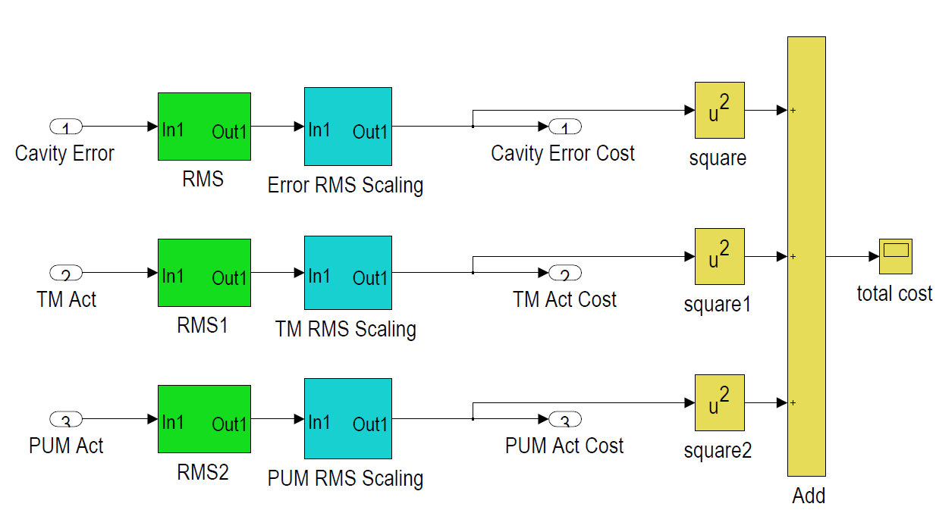
Cost Box: Summation of Costs
Control
Triple
Cavity Noise
Cost
Adapt
+
-
Error signal
The cost box measures the performance values we care about and scales them to get the costs:
1. Error RMS
2. PUM force RMS
3. Test mass force RMS

Slide 14
Control Box
Control
Triple
Cavity Noise
Cost
Adapt
+
-
Error signal
Control filters are parameterized in terms of:
PUM crossover frequencies
Test mass crossover frequency

Slide 15
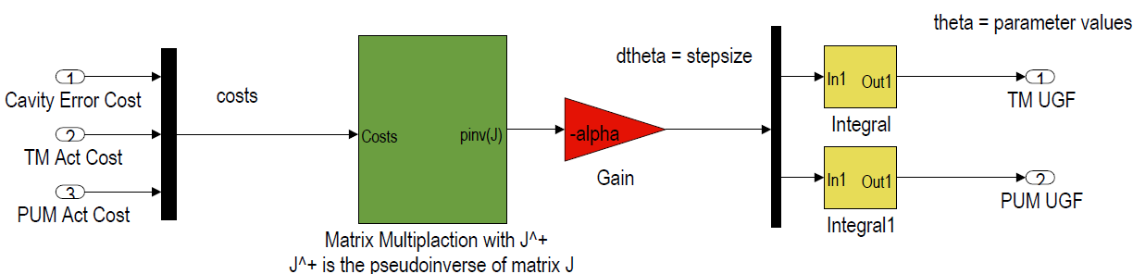
Adaptation Block
Control
Triple
Cavity Noise
Cost
Adapt
+
-
Error signal

Slide 16
Adaptation Algorithm: Least Squares Minimization Approach
Definitions for optimization
Optimization routine
Total system cost
J^{T} yields gradient descent (1st order).
J⁻¹ yields Gauss-Newton (2nd order).
Cost gradient
Variable list
v = total cost
c = list of costs we want to optimize
θ = list of adjustable control parameters
J = System Jacobian matrix
System Jacobian matrix

Slide 17
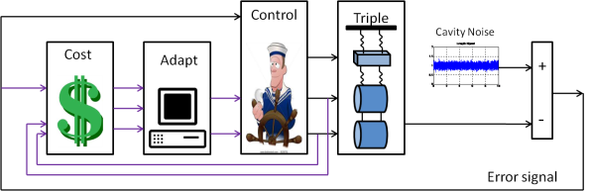
Adaptation Algorithm: quadratic minimization approach
Adaptation Problem
Question: What is J?
Answer: We do not know. It depends on θ and c, and other unknown or unmodeled parameters.
Good news: we can estimate it in real-time. A recursive least squares algorithm (RLS) is used.
Variable list
v = total cost
c = list of costs we want to optimize
θ = list of adjustable control parameters
J = system Jacobian matrix
α = user defined scalar step size

Slide 18
Results

Slide 19
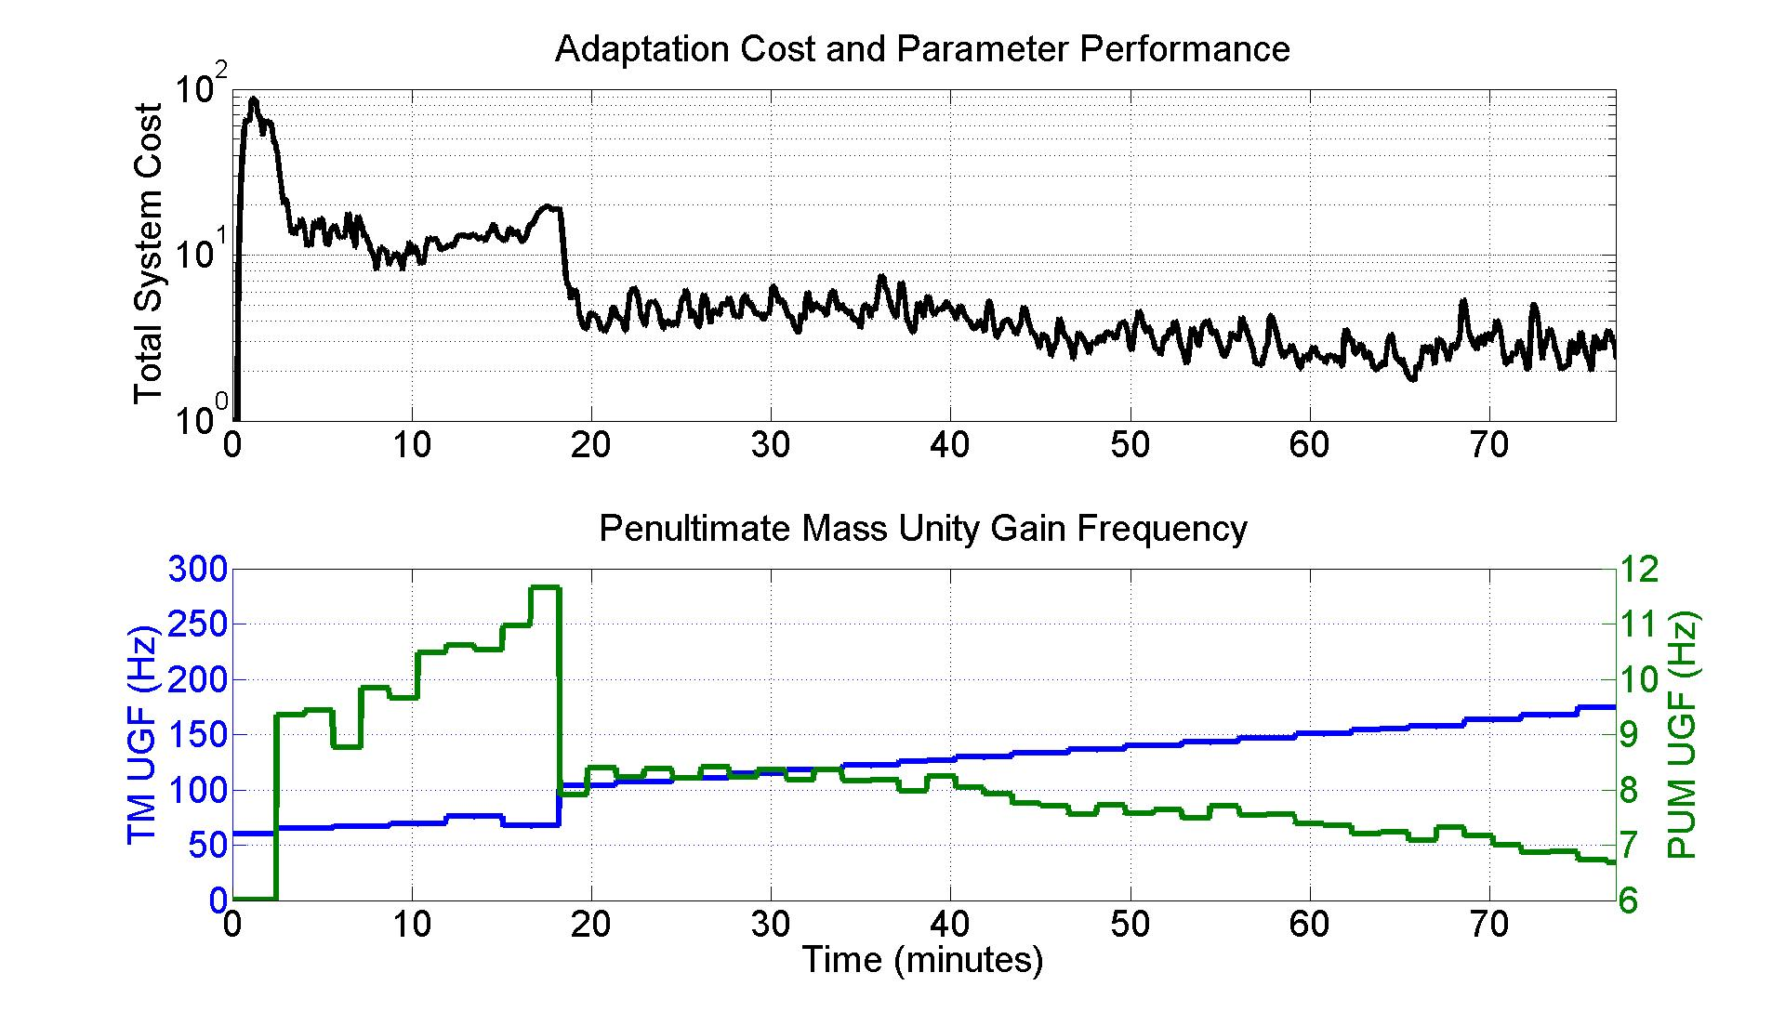
Simulated Results

Slide 20
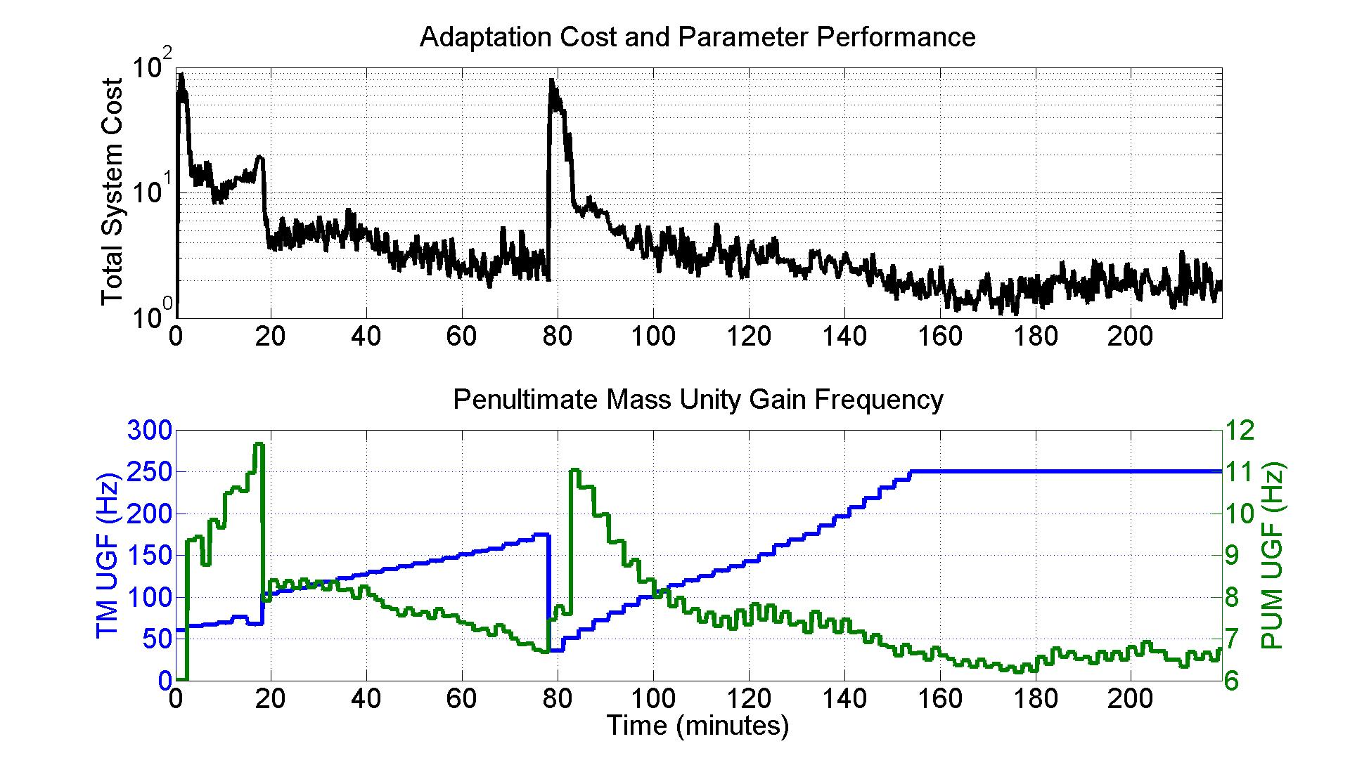
Results

Slide 21
Results

Slide 22
Conclusions
Adaptive control is a powerful real-time self-tuning method for many aLIGO loops.
  Can target arbitrary performance requirements:
    Avoiding actuator saturations
    Minimizing noise amplification
Real-time RLS estimation of system response compensates for unknowns adequately.
Adaptation speed is limited by RMS averaging
Complexities beyond this talk exist
  Achieving good estimates with the Jacobian
  Setting good stopping and starting conditions

Slide 23
Backups

Slide 24
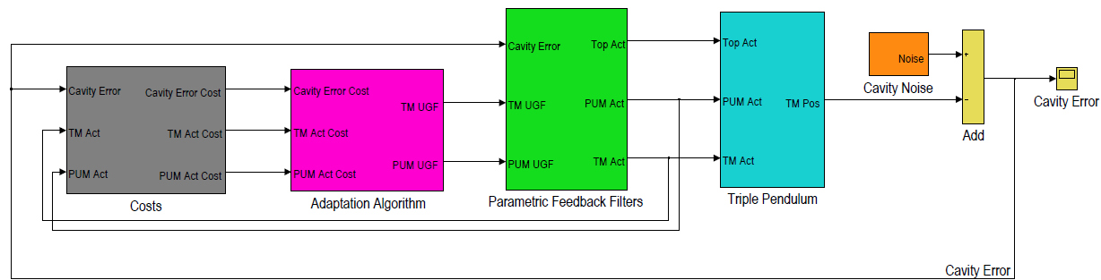
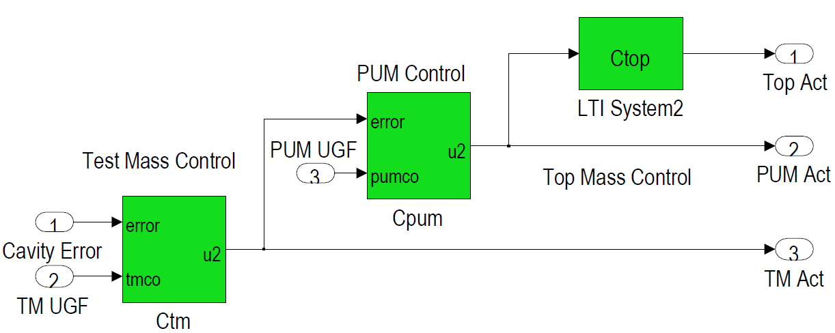
Feedback Filter Box

Slide 25

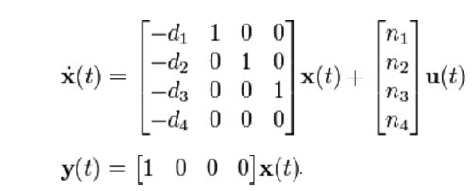
Transfer Function Canonical forms
Laplace Transfer function
State space transfer function in observer canonical form

Slide 26
Parametric Transfer Functions
Test mass feedback filter: Laplace form
Test mass feedback filter: State space form
ω_{ugf} = unity gain freq.
p -> gives phase margin around ugf
f -> f*ω_{ugf} is the freq. of a low pass pole
K is a constant scaling factor which compensates for the plant gain

Slide 27
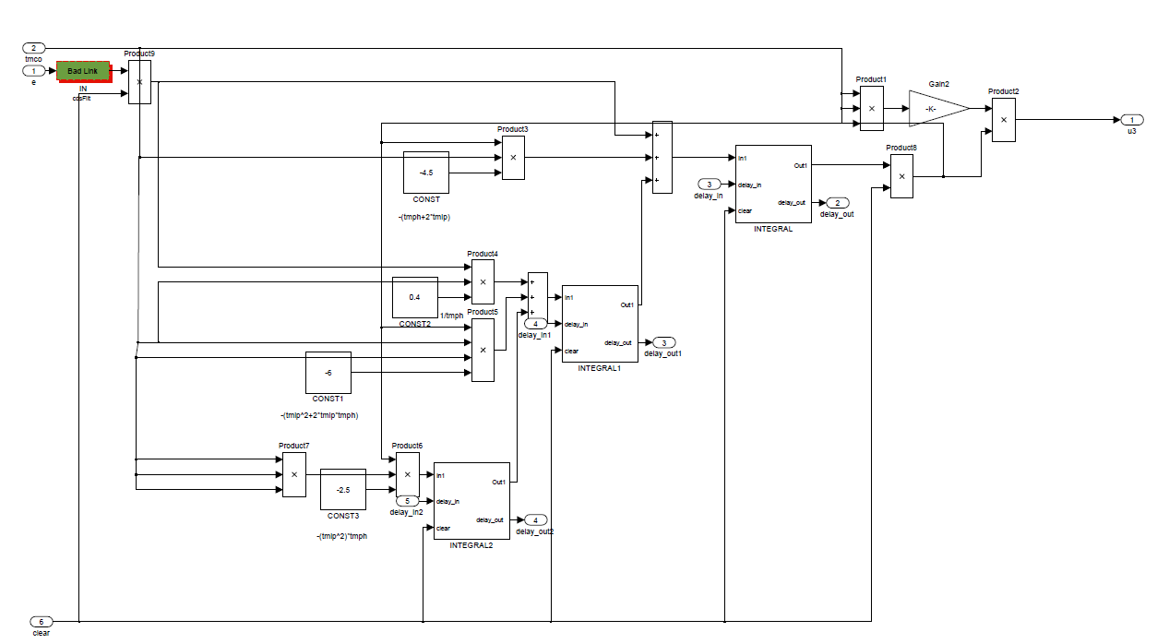
Parametric Filter in LIGO’s RCG Simulink Environment

Slide 28
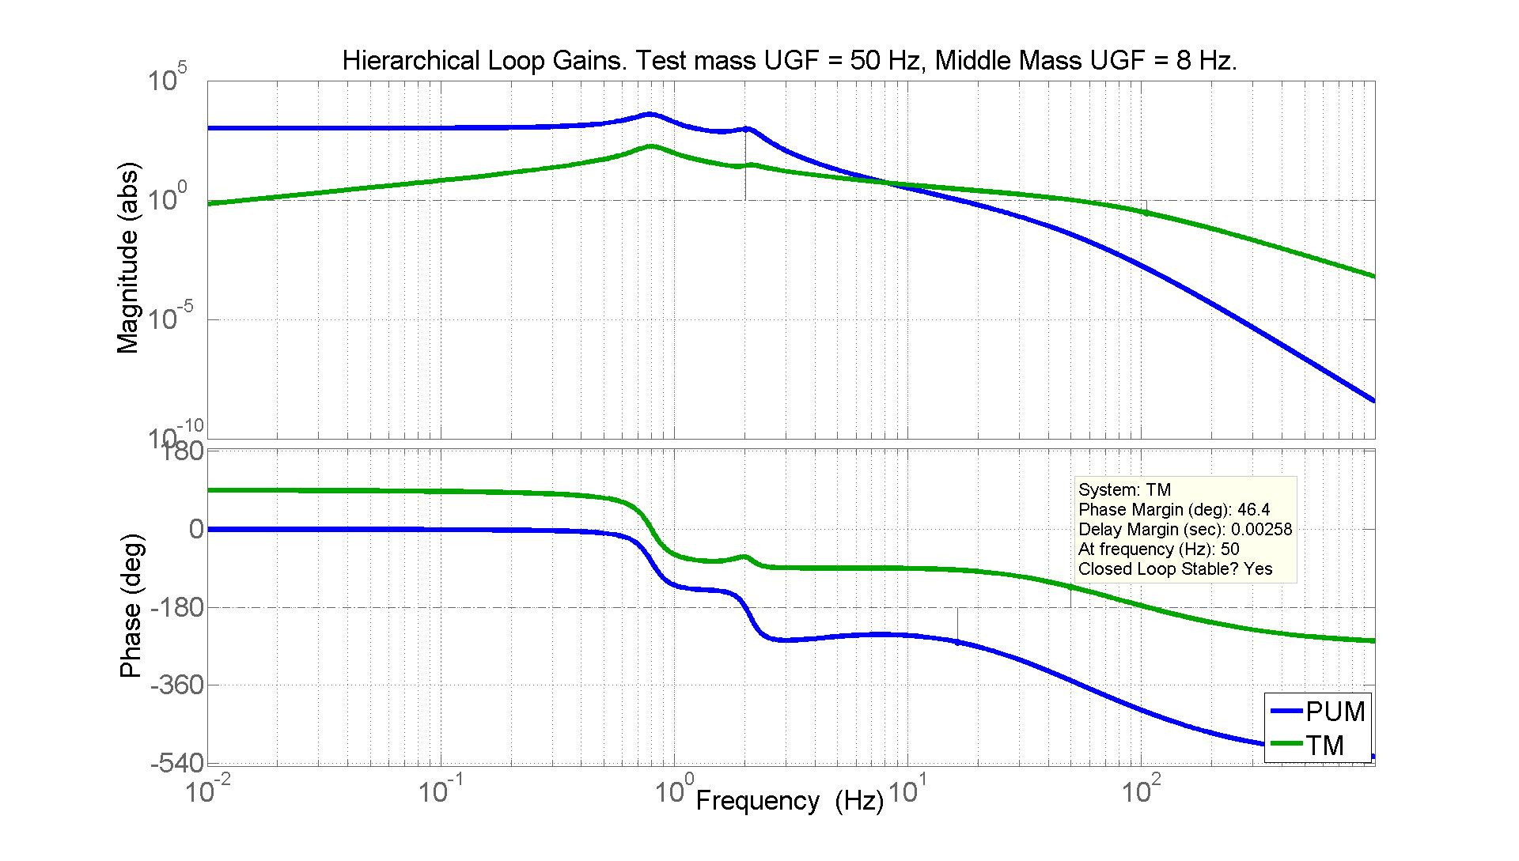
Parametric Controller TFs

Slide 29
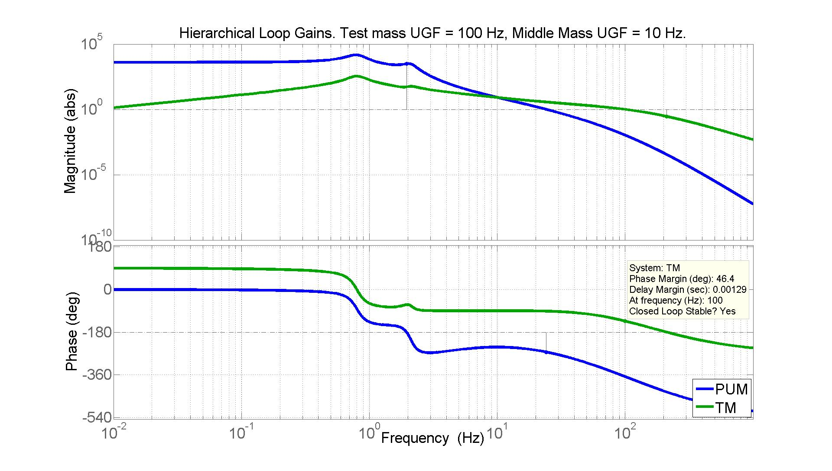
Parametric Controller TFs

Slide 30
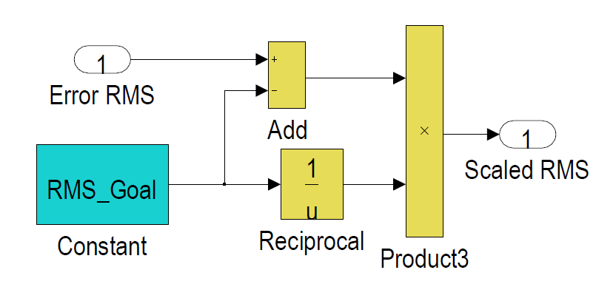
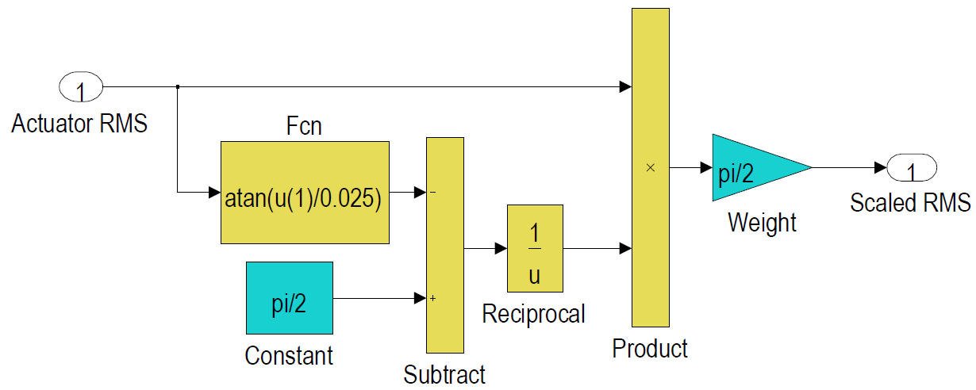
Cost Box Details
Error RMS scaling
Actuator RMS scaling
The error RMS is scaled relative to a target value (such as the design value).
The actuator RMS is scaled relative to its saturation limit. In this case, the scaled value is set to ‘explode’ when the RMS reaches the saturation limit.

Slide 31
Adaptation Algorithm: quadratic minimization approach
Cost Reduction Choices
1st order algorithm: gradient descent method
Variable list
2nd order algorithm: Gauss-Newton method
v = total cost
c = list of costs we want to optimize
θ = list of adjustable control parameters
J = system Jacobian matrix
α = user defined scalar step size
t = current time step
For invertible J
For noninvertible J
(+ -> pseudoinverse)

Slide 32
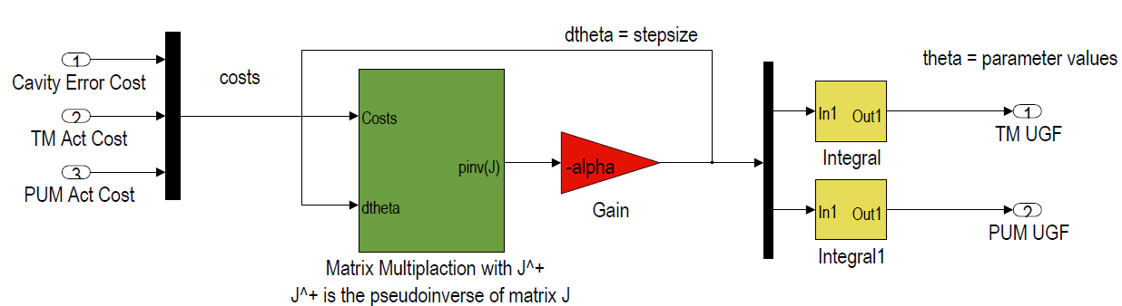
Adaptation Algorithm: quadratic minimization approach
Adaptation Problem
Jacobian definition
Approximate error
Variable list
v = total cost
c = list of costs we want to optimize
θ = list of adjustable control parameters
J = system Jacobian matrix
α = user defined scalar step size
t = current time step
RLS updating
K = Jacobian update gain

Slide 33
RLS for Jacobian Estimation
Cost function optimized by RLS
Iterative RLS algorithm
0. Initialize J and P
1.
Definitions:
i = row index of the Jacobian matrix
λ = exponential forgetting factor.
0 < λ ≤ 1
2.
3.
4. Go back to 1.

Slide 34
Convergence of Jacobian
A necessary condition for the convergence of RLS algorithm to the true J is that this matrix is nonsingular.
A real-time estimate of the invertiblility of this matrix is to calculate this matrix over a finite number of time steps and then calculate its condition number. The condition number is the smallest eigenvalue divided by the largest.
Condition number R = (max eigenvalue of Θ)/(min eigenvalue Θ)

Slide 35
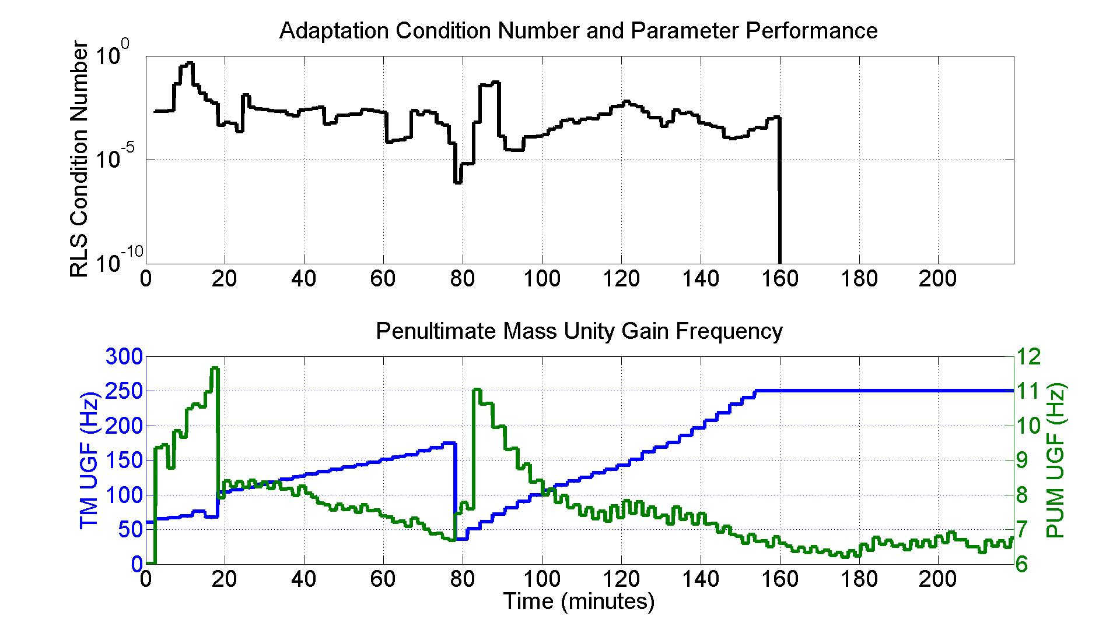
Results

Slide 36
Results

Slide 37
Thesis Contributions
The literature has very little on generating real-time estimates for how controller parameters influence the statistics of linear system performance.
Similarly there is little in the literature on using real-time function minimization techniques to optimize linear system performance.
Optimization of Jacobian estimation accuracy.
Optimizing adaptation rate using the measured statistics of the stochastic system performance.
Use of singular value decomposition to quantify behavior of control adaption and system Jacobian.

