Slide 1
EtherCAT (Beckhoff) for advanced LIGO
January 25, 2011
CDS Meeting, LHO
ISC Implementation

Slide 2
Why?
Need to replace VME based EPICS system
Used in the aLIGO PSL
Don’t want to maintain more systems than necessary
Used in the squeezer for slow controls
Good enough
100base Ethernet (no expensive backbone)
Low latency: Datagrams processed on the fly
Fast: 1-10 ms readout standard; 100us possible
Software: Windows based with EPICS interface
Modern
Cost effective for large number of slow channels
Stackable, DIN-rail mounted units with 1-4 channels typical
16 bit analog channel: ~$50-$100
Binary channel: ~$10-$20

Slide 3
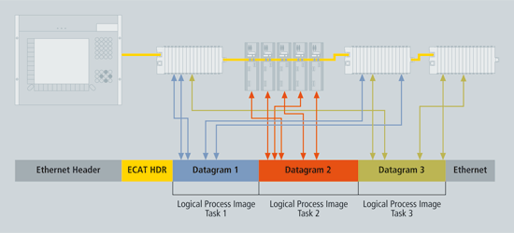
What is EtherCAT?

Slide 4
What is EtherCAT?
Protocol: (Raw) Ethernet frames
Memory mapped access (4GB)
UDP/IP encapsulation possible
Performance
Real-time kernel on PC
1000 distributed I/Os in only 30 µs
Topology
Line, star or tree; hot connect of branches possible
up to 65,535 devices
E-bus (LVDS) for DIN mounted modules
Stand-alone modules (IP67)
Distributed Clock
Special Safety Terminal
Useful information video

Slide 5
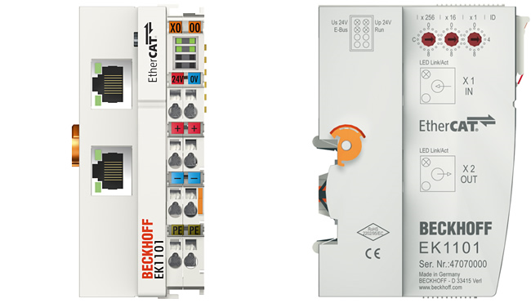
EtherCAT Coupler
E-Bus
IN
Ethernet
NEXT
DIN rail
Power
E-Bus:
– Ethernet OUT (LVDS)
– Ethernet IN (LVDS)
– 5V Power
Power:
– Positive (24V/5V)
– Ground
– Shield
Coupler requires +24V
to power E-Bus
Separate power for terminals

Slide 6
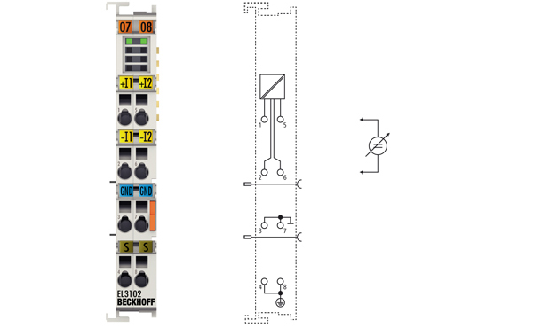
EtherCAT Terminal
4-channel binary TTL output
2-channel 16-bit analog input

Slide 7
3U Chassis Design

Slide 8
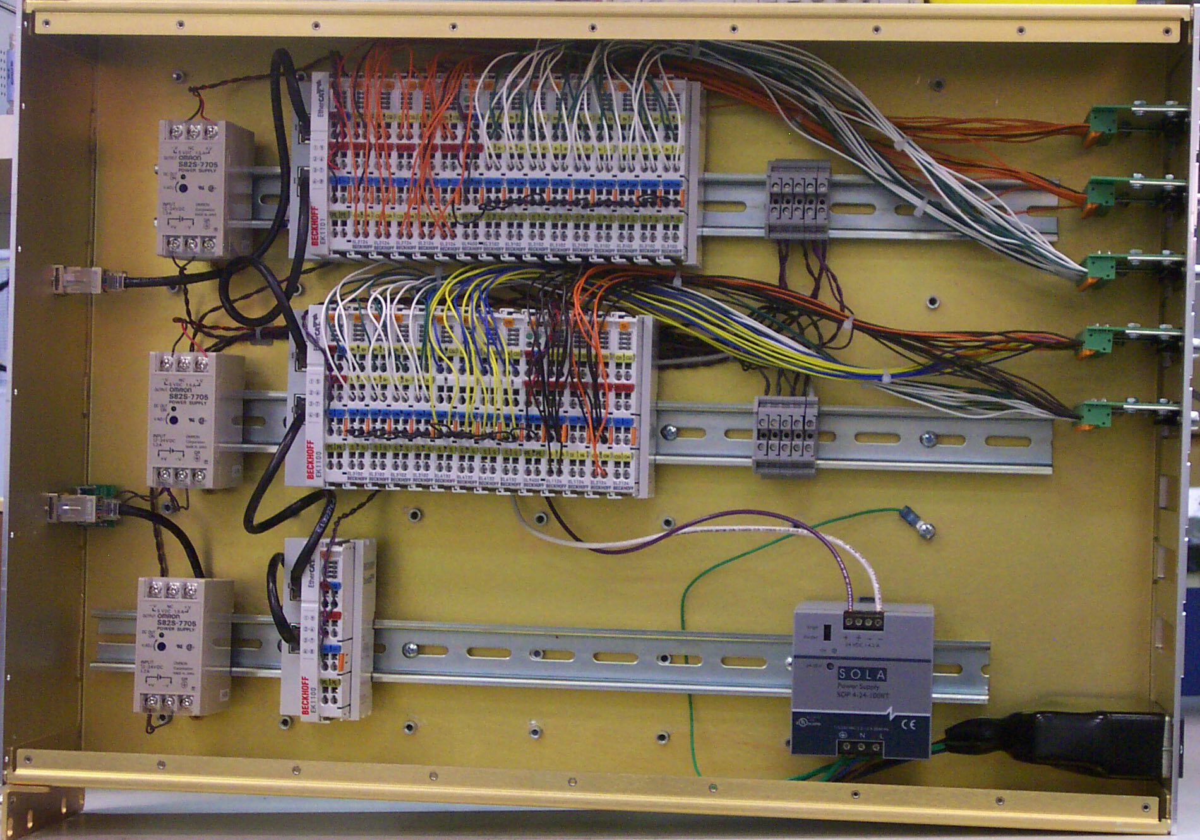
3U Chassis Design

Slide 9
3U Chassis Features
EtherCAT connections
2 front panel 100baseFX (fiber) input/output connections
2 auxiliary rear panel 100baseT connections (optional)
Power
24 VDC/5 A max (digital); 3-pin power D-sub
On-Off Switch/thermal breaker
Internal DC-DC converters for 5 VDC
9 rear adapter slots
1x 37pin/25pin D-sub
2x 15pin/9pin D-sub
Others…
3 internal DIN rails (20”)

Slide 10
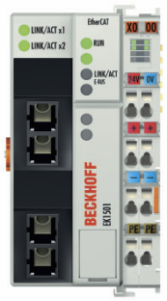
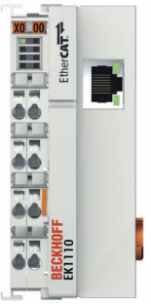
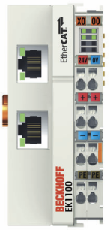
Ethernet Configuration
Fiber IN
Aux 1
Aux 2
Fiber OUT
Unconnected ports are automatically closed

Slide 11
Power and Grounding (1)
Analog terminals 1
Differential 16 bit analog inputs: EL3101 (1 chn), EL3102 (2 chn)
Differential 16 bit analog outputs: EL4132 (2 chn)
No connection to power bus
Common needs to be connected to
Signal ground of controlled chassis (preferred), or
Local power ground
Analog terminals 2
4 channel terminals: EL3104 and EL4134
Common connected to power bus ground
Connect power bus ground to signal or local power ground
May require feed terminal EL9190 to break power bus

Slide 12
Power and Grounding (2)
Binary terminals
TTL input : EL1124 (4 chn)
TTL output: EL2124 (4 chn)
TTL ground connected to power bus ground
Connect power bus ground to digital ground of controlled chassis
Powered from power bus: 5 VDC
Requires isolated DC-DC converter 24V in/5V out
Typically requires feed terminal EL9190 to break power bus and supply 5 VDC
Other terminals
EL9400: Power supply for E-Bus
EK1110/EL9011: Extension end terminal/End cap
EL6002/EL6022: Dual RS232/RS422 interface

Slide 13
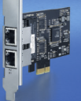
Programmable Logic Controller (PLC)
Computer room:
FC9022 (dual chn NIC)
Supermicro 2U(?)
Software:
TwinCAT PLC
Controller Toolbox
Serial Communications
OPC Server
EPICS Interface
Fiber to
Electronics room
EtherCAT chassis (optional)
– Fiber converter
– Weather stations, etc.
– Time Synchronization
Spare
1 Computer per station and interferometer

Slide 14
Software
Local user screen
Process variables
Shared Memory
Real-time task
EtherCAT
OPC Server
Periodic
User task
Periodic
User task
EPICS Interface
EPICS

Slide 15
Outlook
Easy to expand; easy to add a few more channels
Simple logic controllers and slow servos can be directly implemented in the Beckhoff PLC
TwinCAT 3 will support 64bit OS and C++/Matlab
We can support RS232/RS422/RS485 devices
Infrastructure to support legacy and “odd-ball” devices (picomotors, dust monitors, rotating waveplates, weather stations, etc.)
Future of the vacuum controls?

