Slide 1
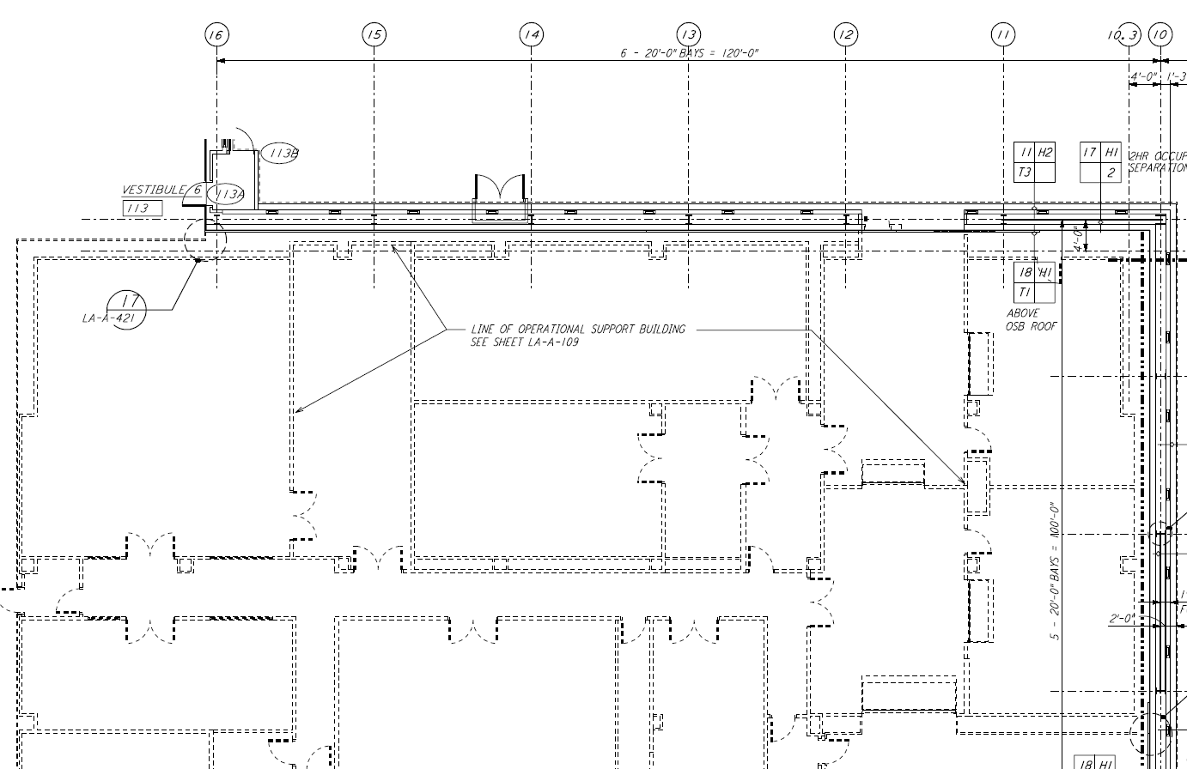
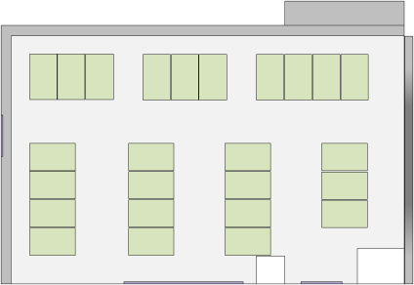
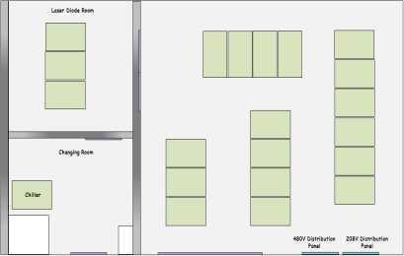
LLO CDS Components
Y-End Racks (Y-End)
Field Satellite
Racks
Racks and Rooms (RAR)
LVEA Racks
(LVEA)
Timing Master
Timing
Distribution
Cables
Timing Fanout
Front
End
Racks
18VDC
Subsystem
Electronics
Racks
DC
Extension
Cords
Field
I/O
Cables
Chassis
Chassis
Field
Front End Computer
24VDC
Chassis
Front End Computer
Chassis
Chassis
Chassis
Chassis
Chassis
Chassis
Fiber
Optic
Cables
Chassis
X-End Racks
(X-End)
Chassis
Chassis
I/O Extension
CDS
Electronics
Room (CER)
Operator
Control
Room (OCR)
Mass
Storage
Room (MSR)
AC Voltage
DC
Power
Racks
Laser
Diode
Room (LDR)
DC
Extension
Cables
CDS
Power
Room (CPR)
DC Power
Computer Users Room (CUR)
DC Power
DC Power
DC Power
DC Power
Electronics Test Racks (ETR)
DC Power

Slide 2
CDS Electronics Room (CER) Rack Layout
2feet
CDS Electronics Room (CER)
Each Rack is 39” Deep and 24” Wide
L1-PSL-C1
L1-OAF-C1
L1-UNK-C5
L1-TCS-C1
L1-SEI-C1
L1-SEI-C2
L1-SEI-C3
L1-SEI-C4
L1-SEI-C5
L1-SEI-C6
Front
Front
Front
PSL Rack 1
DAQ Rack 1
TCS Rack 1
SEI HAM1 and HAM6
SEI HAM2 and HAM3
SEI HAM4 and HAM5
SEI BSC1
SEI BSC2
SEI BSC3
SUS HAM2 Rack 2
SUS ITMX, ITMY, FMX, FMY, and BS Rack 1
ISC LVEA Rack 4
ISC LVEA Rack 1
L1-SUS-C4
L1-SUS-C5
L1-ISC-C4
L1-ISC-C1
SUS HAM2 Rack 1
SUS ITMX, ITMY, FMX, FMY, and BS Rack 2
ISC LVEA Rack 2
L1-SUS-C3
L1-SUS-C6
L1-UNK-C3
Front
L1-ISC-C2
SUS HAM3 and HAM4 Rack 2
Front
Front
Front
L1-SUS-C2
SUS HAM5 and HAM6 Rack 1
L1-SUS-C7
L1-UNK-C2
ISC LVEA Rack 3
L1-ISC-C3
SUS HAM3 and HAM4 Rack 1
L1-SUS-C1
SUS HAM5 and HAM6 Rack 2
L1-UNK-C1
L1-SUS-C8
2 feet

Slide 3
Laser Diode Room (LDR) Rack Layout
2feet
CDS Power Room (CPR)
Transformer
Laser Diode Room (LDR)
2feet
L1-LDR-C1
L1-VDC-C1
L1-VDC-C2
L1-VDC-C3
L1-VDC-C4
L1-VDC-C5
L1-LDR-C2
Front
L1-VDC-C6
Each Rack is 39” Deep and 24” Wide
Front
Changing Room
L1-VDC-C7
DC Supplies
208V Distribution
Panel – CDS1
LDR Chiller
208V Distribution
Panel – CDS2
2 feet
480V Distribution
Panel
208V Distribution
Panel

Slide 4
CDS Power Room (CPR) Rack Layout
2feet
CDS Power Room (CPR)
Transformer
Laser Diode Room (LDR)
2feet
L1-LDR-C1
L1-VDC-C1
L1-VDC-C2
L1-VDC-C3
L1-VDC-C4
L1-VDC-C5
L1-LDR-C2
Front
L1-VDC-C6
Each Rack is 39” Deep and 24” Wide
Front
Changing Room
L1-VDC-C7
DC Supplies
208V Distribution
Panel – CDS1
LDR Chiller
208V Distribution
Panel – CDS2
2 feet
480V Distribution
Panel
208V Distribution
Panel

Slide 5
CDS Electronics Room X-End (CERX) Rack Layout
(L1-SEI-XC1)
(L1-VDC-XC1)
(L1-SUS-XC1)
(L1-SUS-XC2)
(L1-TCS-XC1)
(L1-VDC-XC2)
(L1-DAQ-XC1)
CERX
(L1-FAC-XC1)

Slide 6
CDS Electronics Room Y-End (CERY) Rack Layout
(L1-FAC-YC1)
(L1-SUS-YC2)
(L1-DAQ-YC1)
(L1-TCS-YC1)
(L1-SUS-YC1)
(L1-SEI-YC1)
(L1-VDC-YC2)
(L1-VDC-YC1)
CERY

