Slide 1
aLIGO RFPD
RFPD Noise mitigation
R. Abbott
3 September, 2010

Slide 2
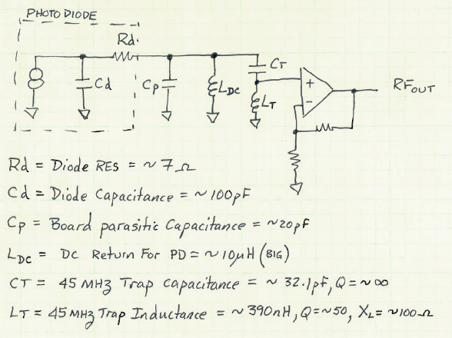
Test Setup
The output noise of this circuit is influenced by the opamp current noise being converted to voltage noise by the impedance “seen” when looking back from the positive input of the opamp. The top of Ct finds a path to ground through the other capacitances, thus creating a parasitic parallel capacitance just above the series resonance of Ct and Lt.

Slide 3
Means To A Solution
If it were possible to prevent the top of Ct from finding a low impedance ground path, it ought to be possible to remove the parasitic effect of the parallel resonance.

Slide 4
Solution
Use L_{DC} to “resonate” against the parasitic terms (diode and board capacitance) at the operating frequency (45 MHz)

Slide 5
Results
The first attempt to implement this yielded the following shot noise limited photocurrents:
9MHz = 22mA
45MHz = 2.4mA
Fixed the 45 MHz, but shot myself in the foot on 9MHz
Iterated the value of the resonating inductor to split the noise budget between 45 and 9 MHz, and switched to a different operational amplifier (was MAX4107, is now LMH6624MA)
9MHz = 2.3 mA
45MHz = 2.2 mA
Close agreement with SPICE model (~5% error in noise)

