Slide 1
aLIGO HAM-ISI, BSC-ISI, HAM-HEPI and BSC-HEPI matrices
The purpose of the change of basis matrices is to combine local instruments to sense (or drive ) the platforms rigid body motions along the axis of the interferometer (in other work they align the sensing basis of each platform with the axis of the interferometer)
The local sensors of a given set of instruments are typically noted H1, H2, H3, V1, V2 ,V3, standing for Horizontal 1 to 3 and Vertical 1 to 3*
The translation and rotations along the axis of the interferometer are noted X,Y,Z, RX,RY,RZ.
The objectives of this document are:
To describe the instruments location and orientation
To define which scripts have been used to calculate the change of basis matrices (must define clear location in the svn)
List the matrices values (for each of the two possible platform orientations)
Specify where the matrices are stored in the svn and the Structures names
Specify which scripts to use to load the matrices (populate...)
* HEPI sets of 8 instruments noted H1, H2, H3, H4, V1, V2 ,V3, V4 and BSC-ISI Stage 1 T240 set is made of 9 signals noted X1, Y1, Z1, X2, Y2, Z2, X3, Y3, Z3.

Slide 2
Table of contents
Instruments location and orientation – Page 3
Change of basis calculation and scripts – Page 9
Matrices Values – Page 21
HAM-ISI – Page 26
BSC-HEPI – Page 31
HAM-HEPI – Page 35
BSC-ISI – Page 41
Appendix 1: Translation between new and former naming convention – page 56
Appendix 2: Transfer Functions to highlights the instruments signs – Page 57

Slide 3
1) Instruments location and orientation

Slide 4
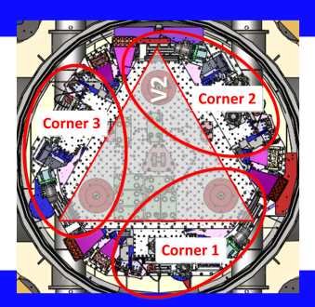
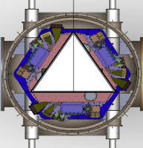
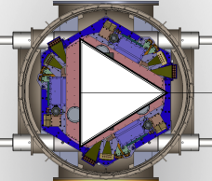
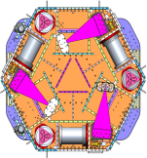
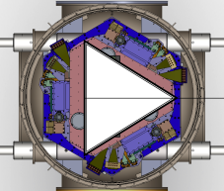
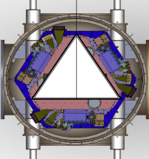
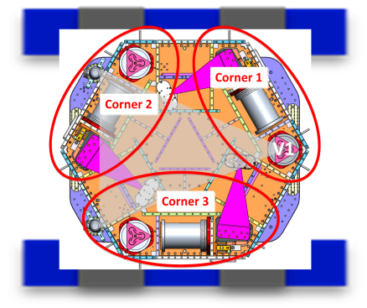
1.0) Modules Orientation
BSC-ISI Orientation.
(See G1000125 for mode details)
BS_ITMY_ETMX
ITMX_ETMY
2
1
2
1
2
1
Y
ETMY
3
4
3
3
4
4
2
1
X
ITMY
HAM1
HAM2
HAM3
3
4
1
1
1
2
1
2
1
2
1
HEPI Orientation.
2
2
2
1
HEPI Pier #
HEPI Actuator Orientation
3
4
3
4
3
4
3
4
3
4
3
4
BS
2
1
ITMX
ETMX
HAM4
HAM-ISI Orientation.
3
4
HAM_4_5_6
HAM_2_3
2
1
2
1
HAM5
2
1
3
4
2
1
See Appendix 1 for translation with former naming convention.
HAM6
3
3
4
3
4
4

Slide 5
Summary of Position Sensors signal “sign”:
HAM-HEPI: Positive RZ motion of HEPI Stage makes +H1, -H2, +H3 and -H4 IPS signals* for HAM 4,5,6
HAM-HEPI: Positive RZ motion of HEPI Stage makes -H1, +H2, -H3 and +H4 IPS signals* for HAM 1,2,3
HAM-ISI: Positive RZ motion of Stage 1 makes negative CPS signals* for all chambers
BSC-HEPI: Positive RZ motion of HEPI Stage makes +H1, -H2, +H3 and -H4 IPS signals* for ITMX, ETMY BSC
BSC-HEPI: Positive RZ motion of HEPI Stage makes -H1, +H2, -H3 and +H4 IPS signals* for BS, ITMY, ETMX
BSC-ISI: Positive RZ motion of Stage 1 makes negative CPS signals* for all chambers
BSC-ISI : Positive RZ motion of Stage 2 makes positive CPS signals* for all chambers
- HAM-HEPI, BSC-HEPI, HAM-ISI, BSC-ISI:
Positive Z motion makes positive PS signal in all local vertical sensors* (for all stages & all chambers)
These signs are checked during the assembly and testing process by pushing on the moving stages and watching the local sensors readouts. The position sensors are then used during the commissioning process to verify and correct if necessary the sign of all other instruments (actuators, geophones and seismometers)
*as read on the IN1 channel of the input filters

Slide 6
Details about horizontal HAM-ISI Instruments coordinates
The coordinate system’s origin is aligned with the horizontal actuators plane.
Positive RZ motion of Stage 1 makes negative local CPS signals. (Sensor is on Stage 0, target is on Stage 1, +RZ motion of stage 1 closes the gap.) The CPS sensors direction vectors are therefore negatively-oriented tangents as shown by the green arrows in the figure in the left. (-60 degrees angle in Corner 1)
For the calculation of the actuators matrices, it is assumed that each actuator is in the same orientation as its local CPS. If a local to local transfer function* shows otherwise, the actuator sign would be corrected in the “symetrization” filter located in the actuator’s output filter bank.
For the calculation of the GS13 matrices, it is assumed that each GS13 instrument is in the same orientation as its local CPS and actuator (+270 degrees phase at low frequency). If the local to local transfer function* shows otherwise, the GS13 instrument sign would be corrected in the “symetrization” filter located in the GS13 input filter bank.
For the calculation of the L4C matrices, it is assumed that the L4Cs are in the same orientation as the CPS, actuators, and GS13’s (tangent oriented negatively as shown by the green arrows). If the local to local transfer function* shows otherwise, the L4C instrument sign would be corrected in the “symetrization” filter located in the L4C input filter bank.
* Local to local transfer function: from local actuator “Exc channel” to “IN1 channel” in the local sensor input filter’s. Only the “Comp filter” must be engaged in the actuator bank (to partially revert the coil driver and actuator frequency response). See example in appendix 2.

Slide 7
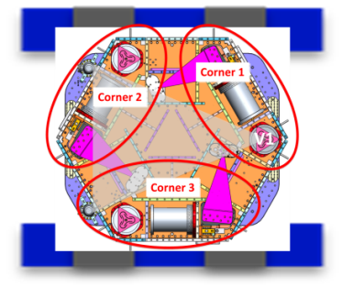
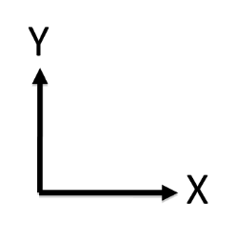
aLIGO HAM-ISI Sensors & Actuators Location
HAM_4_5_6 instruments location and direction:
Sensor | X [m] | Y [m] | Z [m] | Direction
Actuator H1 | 0.52342 | 0.64154 | 0.00000 | -60 deg to X
Position sensor H1 | 0.53071 | 0.66058 | -0.20358 | -60 deg to X
GS-13 H1 | 0.58849 | 0.33960 | -0.03334 | -60 deg to X
L4-C H1 | 0.48582 | 0.14852 | -0.40043 | -72.5 deg to X
Actuator V1 | 0.71120 | 0.00000 | -0.38119 | 0 deg to Z
Position sensor V1 | 0.64703 | -0.18553 | -0.39402 | 0 deg to Z
GS13 V1 | 0.78740 | 0.00000 | -0.04272 | 0 deg to Z
L4C V1 | 0.83502 | 0.00000 | -0.41821 | 0 deg to Z
L4C V2 | 0.71120 | 0.60325 | -0.41821 | 0 deg to Z
L4C V3 | -0.71120 | -0.60325 | -0.41821 | 0 deg to Z
Note that L4C V1, V2 and V3 are not 120 degrees apart and not on the same radius.
Notes: HAM 4,5,6 table orientation used for reference. All measurements originated at the center point of the Optics Table on the optics mounting side. The measurement termination locations are as follows: x,y,z center point (origin) of the Actuator field assembly; center point of the face of the Displacement Sensor Target closest to the Sensor; values for seismometers are taken at the approximate center of mass of the proof mass based on SW models (red center points or X)

Slide 8
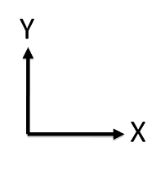
1.2) aLIGO BSC-ISI Sensors & Actuators
The coordinate system’s origin of Stage 1 is aligned with the Stage 1 horizontal actuators plane located (8.995” above the optical table).
The coordinate system’s origin of Stage 2 is aligned with the Stage 2 horizontal actuators plane (7.188” above the optical table).
Positive RZ motion of Stage 1 makes negative local CPS signals*. The CPS sensors direction vectors are therefore negatively-oriented tangents as shown by the green arrows in the figure in the left.
Positive RZ motion of Stage 2 makes positive local CPS signals**. The CPS sensors direction vectors are therefore positively-oriented tangents as shown by the green arrows in the figure in the left.
For the calculation of the actuators matrices, it is assumed that each actuator is in the same orientation as its local CPS. If a local to local transfer function* shows otherwise, the actuator sign would be corrected in the “symetrization” filter located in the actuator’s output filter bank.
For the calculation of the GS13 and L4C matrices, it is assumed that each instrument is in the same orientation as it local CPS and actuator. If the local to local transfer function* shows otherwise, the instrument sign would be corrected in the “symetrization” filter located in the input filter bank.
For the calculation of the T240 matrices, it is assumed that the X1 is in the same orientation as the CPS, and that Y1 points radially outward. If the local to local transfer function* shows otherwise, the Linstrument sign would be corrected in the “symetrization” filter located in the input filter bank.
L4C
X1
St1 CPS
Y1
St2 CPS
* Positive Stage 1 RZ motion makes negative CPS signal in all three corners. (Sensor on Stage 0, target on Stage 1, +RZ closes the gap and reduces the signal). This is true for both orientations.
** Positive Stage 2 RZ motion makes positive CPS signal in all three corners. (Sensor on Stage 1, target on Stage 2, +RZ opens the gap and increases the signal). This is true for both orientations.
GS13
[in]
IFO Axis
[in]

Slide 9
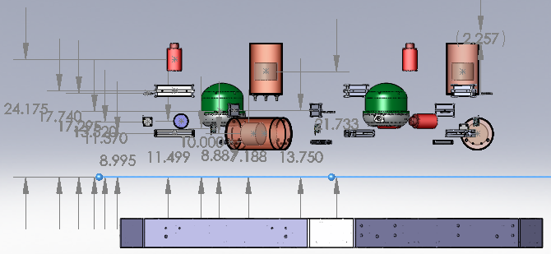
1.2) aLIGO BSC-ISI Sensors & Actuators
BS, ITMY, ETMX instruments location and direction:
 | X [m] | Y [m] | Z [m] | Direction | Notes
Stage 0-1 Act H1 | -0.8217 | -0.3051 | 0.0000 | 90 deg to X | Center Bobbin
Stage 0-1 CPS H1 | -0.9614 | -0.3164 | 0.0603 | 90 deg to X | Center Face of sensor
T240 (X1,Y1,Z1) | -0.5714 | 0.0000 | 0.1160 | -90 deg to X | Center XY, Z-TBD
L4C H1 | -0.7874 | -0.1083 | 0.0600 | 90 deg to X | Center
Stage 0-1 Act V1 | -0.8217 | -0.3237 | 0.2221 | 0 deg to Z | Center Bobbin
Stage 0-1 CPS V1 | -0.9614 | -0.3841 | 0.2108 | 0 deg to Z | Center Face of sensor
L4C V1 | -0.8217 | 0.0000 | 0.3855 | 0 deg to Z | Center
Stage 1-2 Act H1 | -0.5300 | -0.3678 | 0.0000 | -30 deg to X | Center Bobbin
Stage 1-2 CPS H1 | -0.6153 | -0.4432 | 0.0714 | -30 deg to X | Center Face of sensor
GS13 H1 | -0.4089 | -0.6438 | 0.0432 | -30 deg to X | CG
Stage 1-2 Act V1 | -0.5108 | -0.3895 | 0.1667 | 0 deg to Z | Center Bobbin
Stage 1-2 CPS V1 | -0.5817 | -0.3492 | 0.1608 | 0 deg to Z | Center Face of sensor
GS13 V1 | -0.3429 | -0.5939 | 0.3694 | 0 deg to Z | CG
L4C
X1
St1 CPS
Y1
St2 CPS
GS13
[in]
IFO Axis
[in]
[in]
T240 center is about 13.551” above the optical table, that is 4.556” above the Stage 1 Actuator Plane, that is 0.116 m above the Stage 1 Actuator Plane.

Slide 10
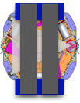
1.3) aLIGO HAM-HEPI Sensors & Actuators
HAM4,5,6 instruments location and direction:
Sensor | X [m] | Y [m] | Z [m] | Angle
Actuator H1 | 1.628 | .730 | 0 | 119 deg to X
Position sensor H1 | 1.641 | .707 | 0 | 119 deg to X
L4-C H1 | 1.554 | .864 | 0 | 119 deg to X
Actuator V1 | 1.554 | .864 | -0.083 | 0 deg to Z
Position sensor V1 | 1.554 | .864 | -0.122 | 0 deg to Z
L4C V1 | 1.554 | .864 | 0.149 | 0 deg to Z
H1
Coordinate system’s origin is aligned with horizontal actuators plane
For the Ham 4,5,6 chambers, Positive RZ motion makes +H1, -H2, +H3 and -H4 IPS signals.
For the calculation of the actuators matrices, it is assumed that each actuator is in the same orientation as its local IPS. If a local to local transfer function shows otherwise, the actuator sign would be corrected in the “symetrization” filter located in the actuator’s output filter bank.
For the calculation of the L4C matrices, it is assumed that the L4Cs are in the same orientation as the CPS. If the local to local transfer function shows otherwise, the L4C instrument sign would be corrected in the “symetrization” filter located in the L4C input filter bank.
HAM4,5,6
Corner 2 direction:
61 degrees
Corner 1 direction:
119 degrees
2
1
Corner 3 direction:
-61 degrees
3
4
Corner 4 direction:
-119 degrees
HAM4,5,6

Slide 11
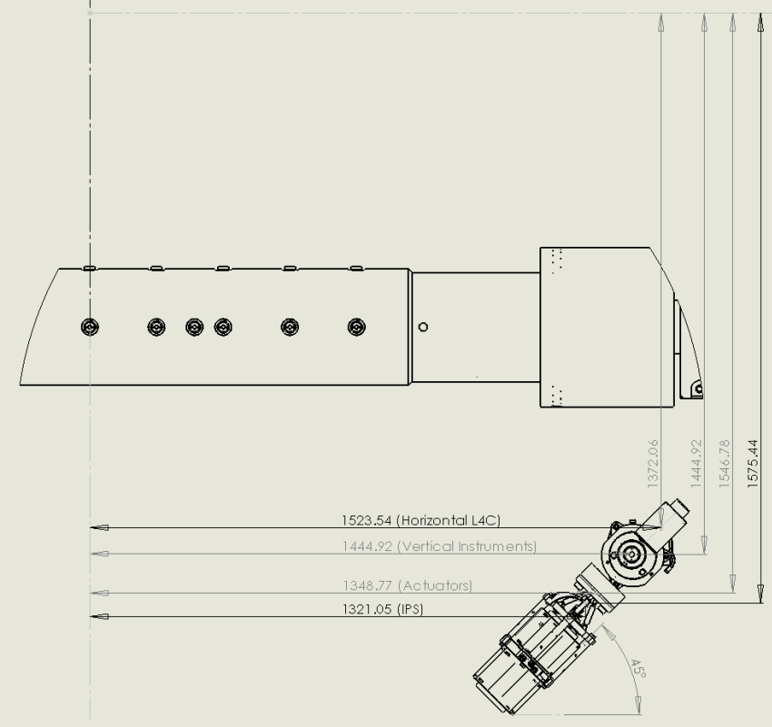
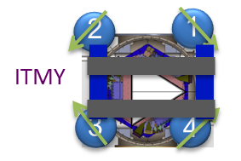
1.4) aLIGO BSC-HEPI Sensors & Actuators
BS, ITMY, ETMX instruments location and direction:
Sensor | X [m] | Y [m] | Z [m] | Angle
Actuator H1 | 1.348 | 1.547 | 0 | -45 deg to X
Position sensor H1 | 1.321 | 1.575 | 0 | -45 deg to X
L4-C H1 | 1.523 | 1.372 | 0 | -45 deg to X
Actuator V1 | 1.445 | 1.445 | -0.092 | 0 deg to Z
Position sensor V1 | 1.445 | 1.445 | -0.123 | 0 deg to Z
L4C V1 | 1.445 | 1.445 | 0.02 | 0 deg to Z
Drawing of
Corner # 4 of ITMY
Coordinate system’s origin is aligned with horizontal actuators plane
For the BS, ITMY, ETMX , Positive RZ motion makes -H1, +H2, -H3 and +H4 IPS signals.
For the calculation of the actuators matrices, it is assumed that each actuator is in the same orientation as its local IPS. If a local to local transfer function shows otherwise, the actuator sign would be corrected in the “symetrization” filter located in the actuator’s output filter bank.
For the calculation of the L4C matrices, it is assumed that the L4Cs are in the same orientation as the CPS. If the local to local transfer function shows otherwise, the L4C instrument sign would be corrected in the “symetrization” filter located in the L4C input filter bank.
Corner 2 Direction:
- 135 degrees
Corner 1 Direction:
- 45 degrees
Corner 3
135 degrees
Corner 4
45 degrees

Slide 12
2) Change of basis calculation
And scripts

Slide 13
2.1) Calculations
Sensors (1/3)
$$C={\left\{x y z_{ }{R_{x}}_{ }{{{ R}_{y}}_{ }}_{ }{R_{z}}_{ }\right\}}^{′}$$
Platform’s rigid body motion in the Cartesian basis:
The origin is on the vertical axis of symmetry, and in the horizontal actuators plan
Units are $[m]$ for the translation, $\left[rad\right]$ for the rotation (or any time derivatives of these respective units)
The order${\left\{x y z_{ }{R_{x}}_{ }{{{ R}_{y}}_{ }}_{ }{R_{z}}_{ }\right\}}^{′}$ will be swapped to ${\left\{x y {R_{z} z}_{ }{R_{x}}_{ }{{{ R}_{y}}_{ }}_{ }\right\}}^{′}$ at the end of the calculations
Measurements in the local basis:
$$L={\left\{l_{h1} l_{h2} l_{h3 }l_{v1} l_{v2} l_{v3}\right\}}^{′}$$
Units are $[m]$ for all measurements (or any time derivatives of these units)

Slide 14
Sensors (2/3)
The sensor location in the Cartesian basis is noted:
$$A_{i}={\left\{a_{i} b_{i} c_{i}\right\}}^{′}$$
For $i=h_{1},{ h}_{2},…,{ v}_{3}$
Units are $\left[m\right]$
The sensor direction in the Cartesian basis is noted:
$$J_{i}={\left\{ j_{i} k_{i} l_{i}\right\}}^{′}$$
For $i=h_{1},{ h}_{2},…,{ v}_{3}$
Direction vector amplitude is unity $\left|J_{i}\right|$
The motion of the sensor located in $A_{i}$ is:
$\left\{\begin{matrix}x \\ y \\ z\end{matrix}\right\}+\left\{\begin{matrix}Rx \\ Ry \\ Rz\end{matrix}\right\}×A_{i}$ = $\left\{\begin{matrix}x \\ y \\ z\end{matrix}\right\}−A_{i}×\left\{\begin{matrix}Rx \\ Ry \\ Rz\end{matrix}\right\}$=${ P}_{i} C$
$Cross{(A}_{i})=\left[\begin{matrix}0 & {−c}_{i} & b_{i} \\ c_{i} & 0 & {−a}_{i} \\ {−b}_{i} & +a_{i} & 0\end{matrix}\right]$
With:
$$P_{i}=\left[ I\left(3\right) | −Cross(A_{i})\right]$$
Where:
$$P_{i}=\left[\begin{matrix}1 & 0 & 0 \\ 0 & 1 & 0 \\ 0 & 0 & 1\end{matrix} \begin{matrix}0 & c_{i} & {−b}_{i} \\ {−c}_{i} & 0 & a_{i} \\ b_{i} & −a_{i} & 0\end{matrix}\right]$$

Slide 15
Sensors (3/3)
The measurement of the sensor located in $A_{i}$ is the motion projected on the direction of the sensor:
$$l_{i}= J_{i}^{′} P_{i} C$$
The sensor matrix $S$ (such as $L=S C$) is made of lines of $J_{i}^{′} P_{i}:$
$$S=\left[\begin{aligned}{ J}_{h1}^{′} P_{h1 } \\ { J}_{h2}^{′} P_{h2 } \\ … \\ { J}_{v3}^{′} P_{h3 }\end{aligned}\right]$$
The Local to Cartesian matrix is $S^{−1}:$
$$C=S^{−1} L$$
Units are dimensionless $[m/m]$ for the components of the first three lines of $S^{−1}$
Units are $[rad/m]$ for the components of the last three lines of $S^{−1}$
(or any time derivatives of these units)

Slide 16
Actuators (1/3)
$$F_{C}={\left\{{F_{x}{ F}_{y }F_{z} {τ_{x }τ_{y}}_{ }τ_{z}}_{ }\right\}}^{′}$$
Platform’s forces in the Cartesian basis:
The origin is on the vertical axis of symmetry, and in the horizontal actuators plan
Units are $[N]$ for the forces, $\left[N.m\right]$ for the torques
The order${\left\{F_{x}{ F}_{y }F_{z} {τ_{x }τ_{y}}_{ }τ_{z}\right\}}^{′}$ will be swapped to ${\left\{F_{x}{ F}_{y }{τ_{z} F}_{z} {τ_{x }τ_{y}}_{ }\right\}}^{′}$ at the end of the calculations
Forces in the local basis:
$$F_{L}={\left\{F_{h1} F_{h2} F_{h3 }{ F}_{v1} F_{v2} F_{v3}\right\}}^{′}$$
Units are $[N]$ for all forces
The actuators location in the Cartesian basis is noted:
$$A_{i}={\left\{a_{i} b_{i} c_{i}\right\}}^{′}$$
For $i=h_{1},{ h}_{2}…$
Units are $\left[m\right]$
The actuators direction in the Cartesian basis is noted:
$$J_{i}={\left\{ j_{i} k_{i} l_{i}\right\}}^{′}$$
For $i=h_{1},{ h}_{2}…$
The amplitude of the direction vector is unity: $\left|{ J}_{i }\right|$

Slide 17
Actuators (2/3)
The forces at the center of the Cartesian basis can be written using the direction vectors $J_{i}$:
$\left\{\begin{matrix}F_{x} \\ F_{y} \\ F_{z}\end{matrix}\right\}=\left[ \begin{matrix}J_{h1} & … & J_{v3}\end{matrix}\right]\left\{\begin{matrix}F_{h1} \\ … \\ F_{v3}\end{matrix}\right\}$
The moments at the center of the Cartesian basis can be written using the direction vectors $J_{i}$:
$$\left\{\begin{matrix}τ_{x } \\ τ_{y} \\ τ_{z}\end{matrix}\right\}=\left[{ A}_{h1}×\begin{matrix}J_{h1} & … & { A}_{v3}×J_{v3}\end{matrix}\right]\left\{\begin{matrix}F_{h1} \\ … \\ F_{v3}\end{matrix}\right\}$$
The drive matrix $D$ (such as $F_{C}=D{ F}_{L}$) made of columns of${ Q}_{i}{ J}_{i}:$
$$D=\left[\begin{matrix}Q_{h1}{ J}_{h1} & … & Q_{v3}{ J}_{v3}\end{matrix}\right]$$
$Cross{(A}_{i})=\left[\begin{matrix}0 & {−c}_{i} & b_{i} \\ c_{i} & 0 & {−a}_{i} \\ {−b}_{i} & +a_{i} & 0\end{matrix}\right]$
$$Q_{i}=\left[\begin{matrix}I(3,3) \\ Cross{(A}_{i})\end{matrix}\right]$$
With:
where:

Slide 18
Actuators (3/3)
The Cartesian to Local matrix is $D^{−1}:$
${ F}_{L}$ $=D^{−1} F_{C}$
Units are dimensionless $[N/N]$ for the components of the first three lines of $D^{−1}$
Units are $[m]$ for the components of the last three lines of $D^{−1}$

Slide 19
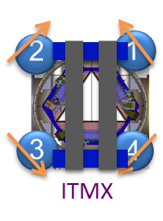
HEPI Horizontal Pringle Sensor Definition
- A unity horizontal “pringle” deformation is defined as a deformation that generates a unity displacement in each corner (H1 to H4).
- In other words, a local displacement sensor reads a “positive 1 meter signal” for a “unity positive HP deformation”
H2=1
H1=1
HP = +1
H3=1
H4=1
H2=1
H1=1
HP = +1
H3=1
H4=1

Slide 20
HEPI Horizontal Pringle Sensor Definition
H2=1
H1=1
2
1
HP = +1
3
4
HAM 2,3
H3=1
H4=1
H2=1
H1=1
2
1
HP = +1
3
4
HAM4,5,6
H3=1
H4=1
Note: A Positive HP always compress the blue beams and extend the support tubes.

Slide 21
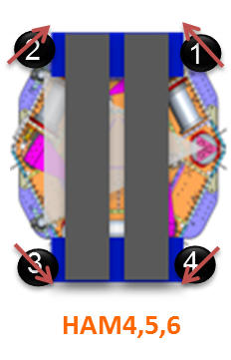
Vertical Pringle Sensor Definition
A unity Vertical “pringle” deformation is defined as a deformation that generates a displacement of 1 Meter in each sensor (V1=1 to V4).
A positive VP deformation generates a positive V1 and V3 (negative V2 and V4)
V2= -1
V1=1
VP = +1
V3=1
V4= -1
2
1
3
4
HAM 2,3

Slide 22
2.2) Scripts

Slide 23
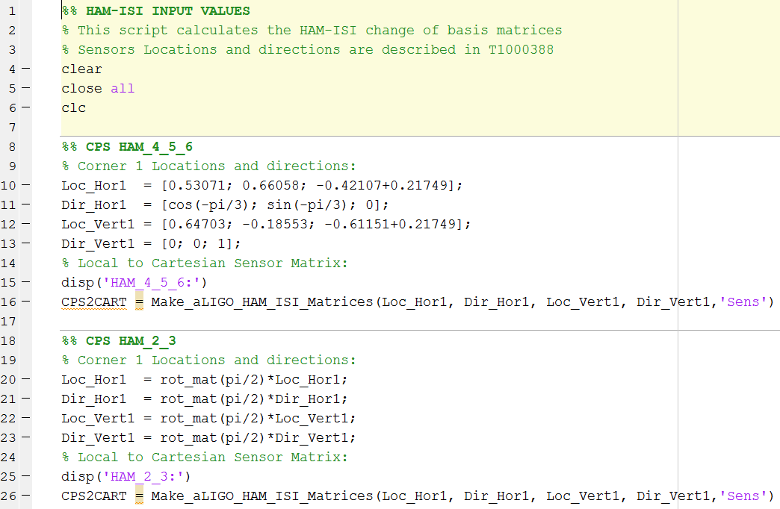
aLIGO_HAM_ISI_Matrices_Input_Values.m

Slide 24
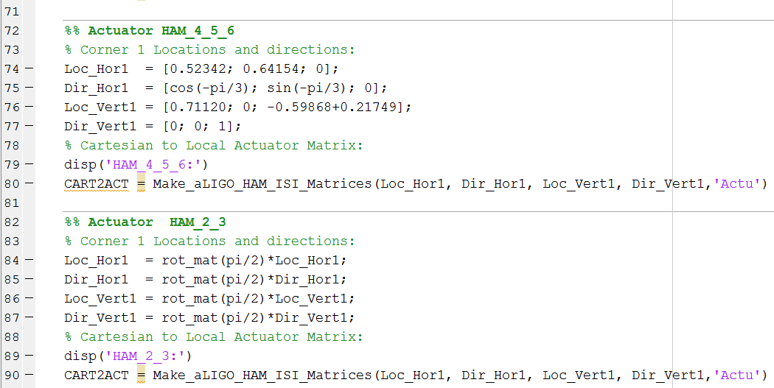

Slide 25
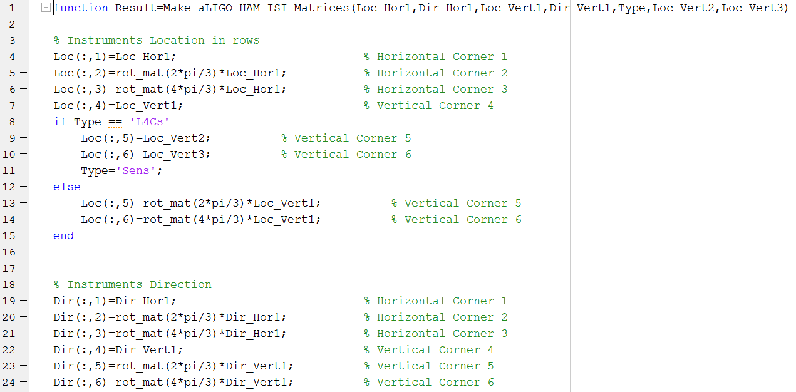
Make_aLIGO_HAM_ISI_Matrices

Slide 26
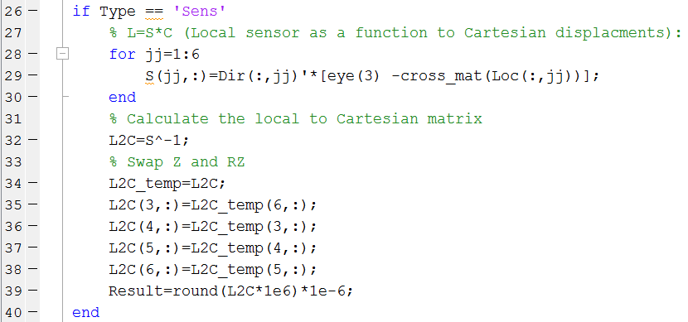
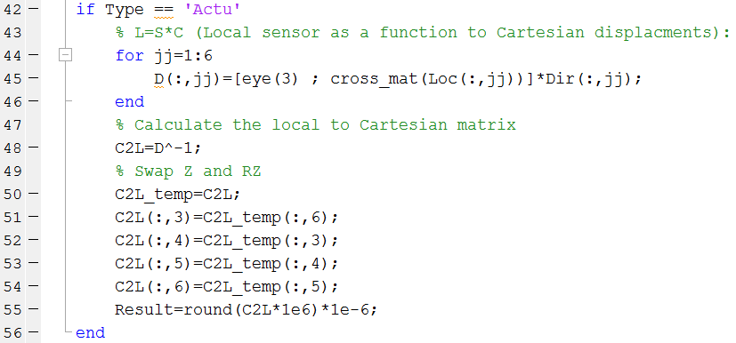
Projections from Cartesian to Local Motions
Inverting.
Re-ordering
Rounding

Slide 27
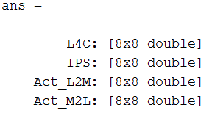
2.3) Output Names
Current Outputs
make_ham_hepi_modal_matrixs(2)
The standard version will use the MEDM channel names
Add DCC #, date, and name of mfile used to create the matrices

Slide 28
3) Matrices values

Slide 29
3.1) HAM-ISI Matrices
Old programs and matrices
Matrix calculation program
Output Data
Output Data
Input Values/Top level script
>> load aLIGO_HAM_ISI_4_5_6.mat
Note: Old matrices have been saved in /seismic/HAM-ISI/Common/Basis_Change_Matrices/Archives

Slide 30
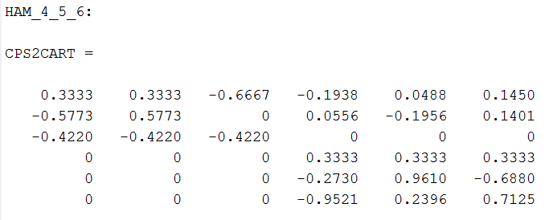
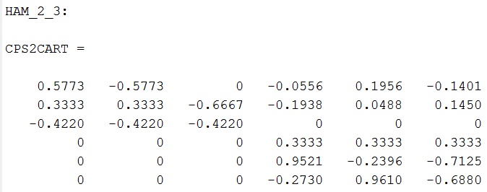
HAM-ISI CPS
HAM 4,5,6
HAM 2,3

Slide 31
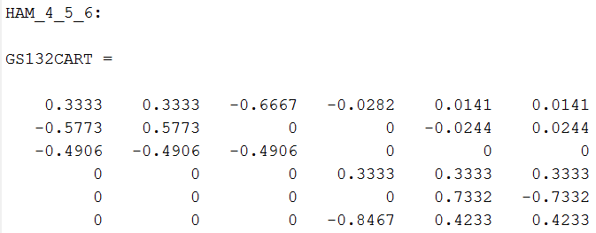
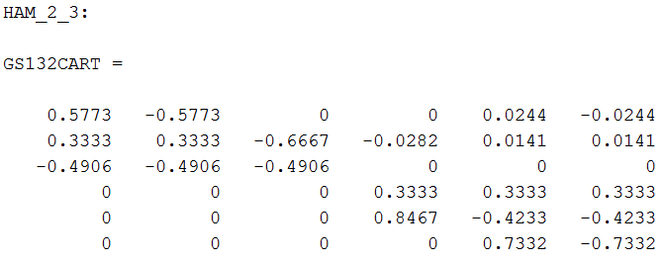
HAM-ISI GS13
HAM 4,5,6
HAM 2,3

Slide 32
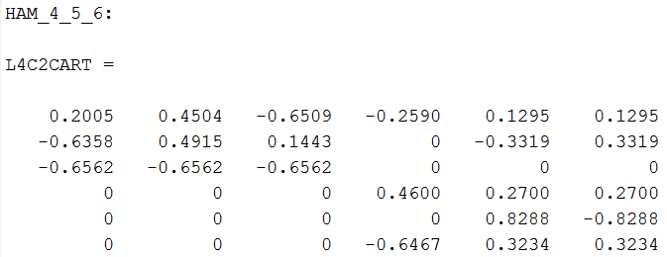
HAM-ISI L4Cs
HAM 4,5,6
Need to Check L4C Signs
No Stage 0 L4Cs on HAM 2&3

Slide 33
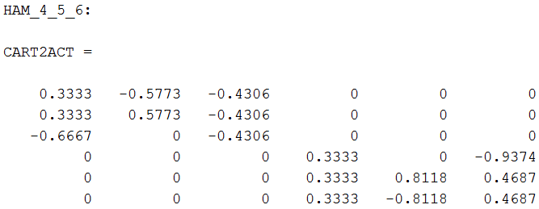
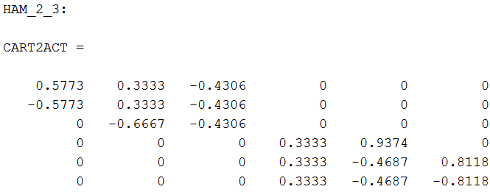
HAM-ISI Actuators
HAM 4,5,6
HAM 2,3

Slide 34
3.2) BSC-HEPI Matrices
Matrix calculation program
Output Data
Output Data
Input Values/Top level script

Slide 35
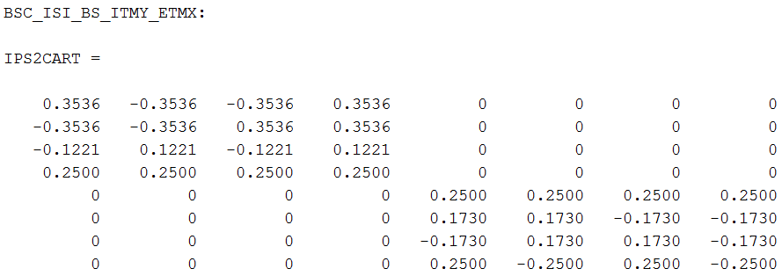
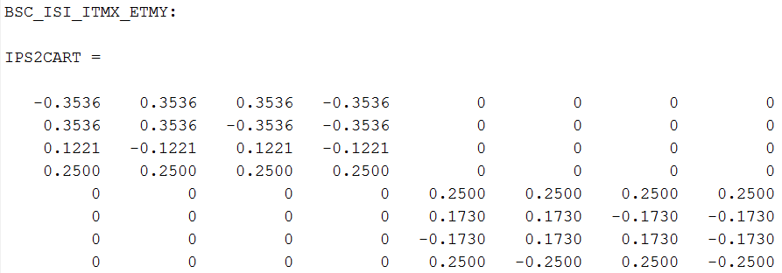
BSC-HEPI IPS
HEPI not ISI

Slide 36
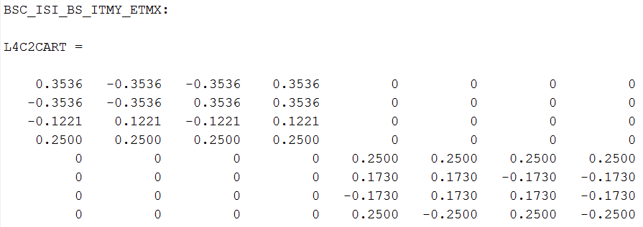
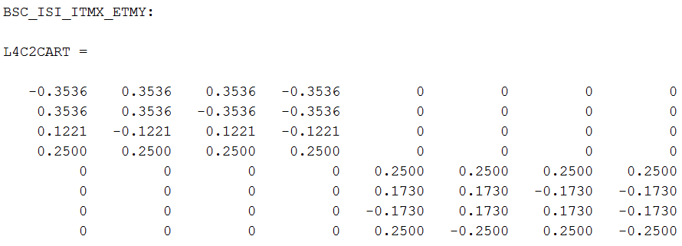
BSC-HEPI L4C

Slide 37
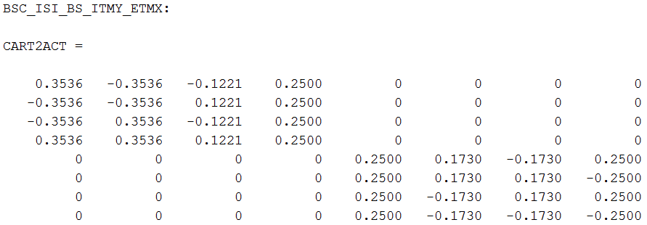
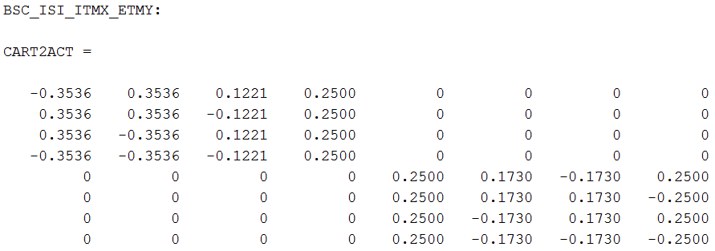
BSC-HEPI Actuators

Slide 38
3.3) HAM-HEPI Matrices
Matrix calculation program
Output Data
Output Data
Input Values/Top level script

Slide 39
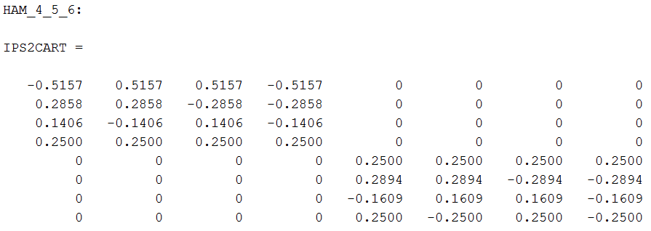
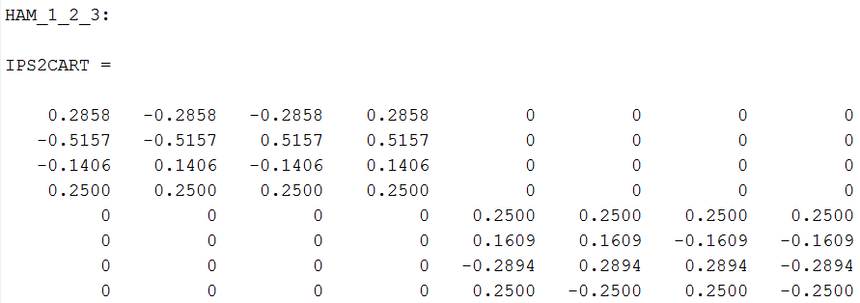
BSC-HEPI IPS
2
1
3
4
HAM4,5,6
2
1
3
4
HAM 2,3

Slide 40
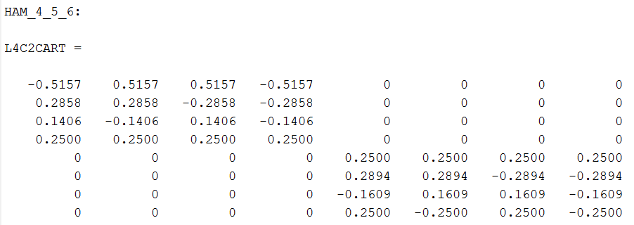
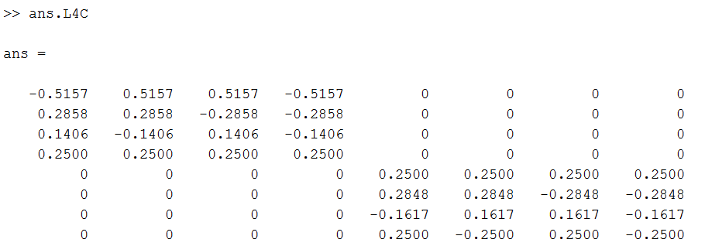
HAM-HEPI
L4C
HAM 4,5,6
aLIGO_HAM_HEPI_4_5_6.mat
make_ham_hepi_modal_matrixs(2)
2
1
3
4
HAM4,5,6

Slide 41
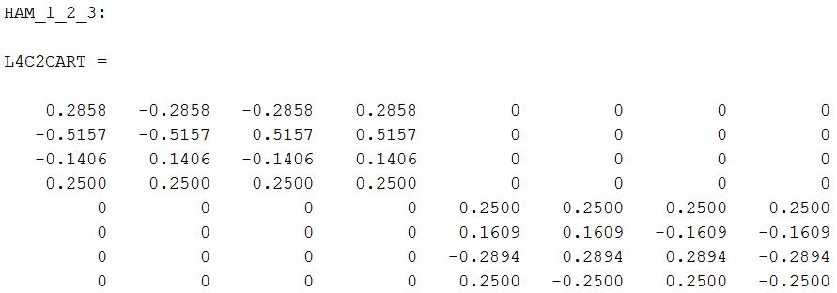
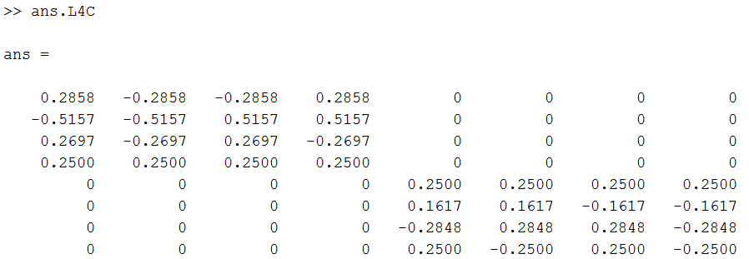
HAM-HEPI
L4C
HAM 2,3
aLIGO_HAM_HEPI_1_2_3.mat
make_ham_hepi_modal_matrixs(1)
2
1
3
4
HAM 2,3

Slide 42
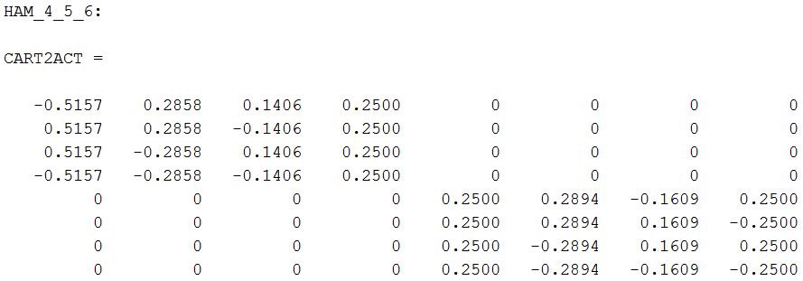
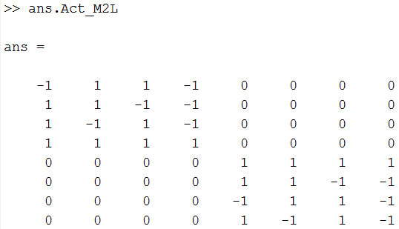
HAM-HEPI
ACT
HAM4,5,6
aLIGO_HAM_HEPI_4_5_6.mat
make_ham_hepi_modal_matrixs(2)
2
1
3
4
HAM4,5,6

Slide 43
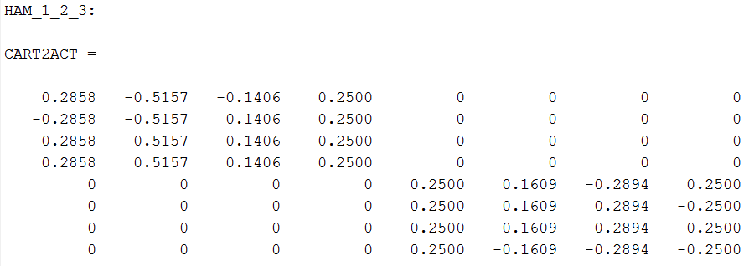
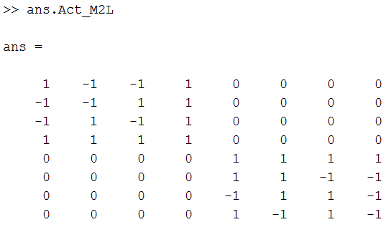
HAM-HEPI
ACT
HAM 2,3
aLIGO_HAM_HEPI_1_2_3.mat
make_ham_hepi_modal_matrixs(1)
2
1
3
4
HAM 2,3

Slide 44
3.4) BSC-ISI Matrices
/seismic/BSC-ISI/Common/Basis_Change_BSC_ISI/aLIGO/Matrices/
- aLIGO_BSC_ISI_Matrices_Direction_X.mat
- aLIGO_BSC_ISI_Matrices_Direction_Y.mat
- aLIGO_BSC_ISI_Matrices_Y_Direction.mat
- aLIGO_BSC_ISI_Matrices_Y_Direction_2011_10_01.mat
BS_ITMY_ETMX
ITMX_ETMY
2
1
2
1
3
4
3
4
Stage 1
Stage 1
Stage 2
Stage 2

Slide 45
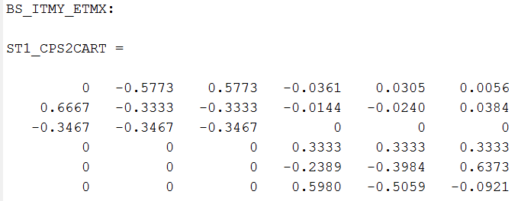
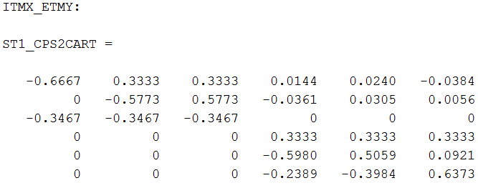
BSC-ISI
Stage 1 CPS
BS_ITMY_ETMX
2
1
3
4
Stage 1
ITMX_ETMY
2
1
3
4
Stage 1

Slide 46
BSC-ISI
Stage 1 T240
2
X3
1
BS_ITMY_ETMX
Y3
Cartesian to Local Test to check the sign Y1, Y2,Y3?
Y1
Y2
IFO Axis
X1
X2
3
4
X1 Y1 Z1 X2 Y2 Z2 X3 Y3 Z3
X
Y
RZ
Z
RX
RY

Slide 47
BSC-ISI
Stage 1 T240
ITMX_ETMY
2
X2
1
Y3
IFO Axis
X3
Y2
Y1
X1
3
4
X1 Y1 Z1 X2 Y2 Z2 X3 Y3 Z3
X
Y
RZ
Z
RX
RY

Slide 48
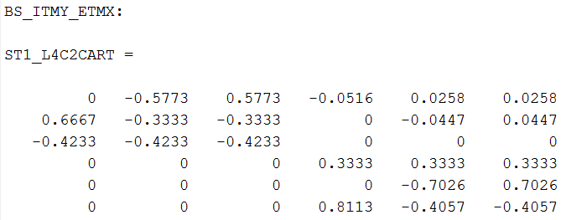
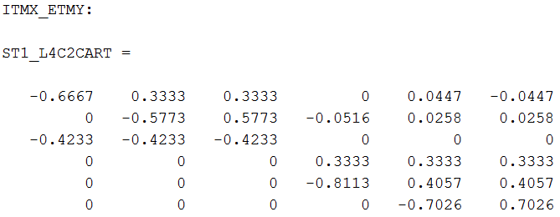
BSC-ISI
Stage 1 L4C
BS_ITMY_ETMX
2
1
3
4
ITMX_ETMY
2
1
3
4

Slide 49
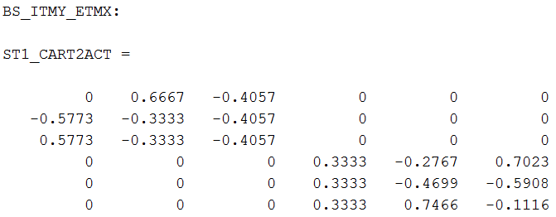
BSC-ISI
Stage 1 Actuator
BS_ITMY_ETMX
2
1
3
4
ITMX_ETMY
2
1
3
4

Slide 50
BSC-ISI
Stage 2 CPS
BS_ITMY_ETMX
2
1
3
4
ITMX_ETMY
2
1
3
4

Slide 51
BSC-ISI
Stage 2 GS13
BS_ITMY_ETMX
2
1
3
4
ITMX_ETMY
2
1
3
4

Slide 52
BSC-ISI
Stage 2 Actuator
BS_ITMY_ETMX
2
1
3
4
ITMX_ETMY
2
1
3
4

Slide 53
Appendix 1: Translation between new and former naming convention
The old convention (“X direction”, “Y direction” naming) is now obsolete and should not ne used anywhere anymore
HAM-ISI in HAM 4, 5 and 6 used to be labeled “X direction” (because V1 GS13 points toward the X axis). The mat files containing their matrices are now labeled “HAM_ISI_4_5_6 “ for clarity.
HAM-ISI in HAM 2 and 3 used to be labeled “Y direction” (because V1 GS13 points toward the X axis). The mat files containing their matrices are now labeled “HAM_ISI_2_3 “ for clarity.
HAM-HEPI in HAM 4, 5 and 6 used to be labeled “Y direction” (because these chambers are aligned with the Y axis). The mat files containing their matrices are now labeled “HAM_HEPI_4_5_6 “ for clarity.
HAM-HEPI in HAM 2 and 3 used to be labeled “X direction” (because these chambers are aligned with the X axis). The mat files containing their matrices are now labeled “HAM_ISI_2_3 “ for clarity.
BSC-ISI in BS, ITMY and ETMX used to be labeled “X direction” (because V2 GS13 points toward the X axis). The mat files containing their matrices are now labeled “BSC_ISI_BS_ITMY_ETMX “ for clarity.
BSC-ISI in ITMX and ETMY used to be labeled “Y direction” (because V1 GS13 points toward the X axis). The mat files containing their matrices are now labeled “BSC_ISI_ITMX_ETMY“ for clarity.
BSC-HEPI in BS, ITMY and ETMX used to be labeled “Y direction” (because these chambers are aligned with the Y axis). The mat files containing their matrices are now labeled “BSC_HEPI_BS_ITMY_ETMX “ for clarity.
BSC-HEPI in ITMX and ETMY used to be labeled “X direction” (because these chambers are aligned with the X axis). The mat files containing their matrices are now labeled “BSC_HEPI_ITMX_ETMY “ for clarity.

Slide 54
Appendix 2:
Example of Transfer Functions to establish instrument signs to be applied in symetrization filters.

Slide 55
HAM-HEPI IPS transfer functions*: - Actuators and IPS are in phase in this example.
No sign correction necessary in the output symmetrization filters
* Local to local transfer function: from local actuator “Exc channel” to “IN1 channel” in the local sensor input filter’s. Only the “Comp filter” must be engaged in the actuator bank (to partially revert the coil driver and actuator frequency response).

Slide 56
HAM-HEPI L4Cs transfer functions*:
- Actuators and horizontal L4Cs are in phase in this example. No sign correction needed in the input symmetrization filters of the Horizontal L4Cs
- Actuators and vertical L4Cs are out of phase in this example. A sign correction is necessary in the input symmetrization filters of the vertical L4Cs
* Local to local transfer function: from local actuator “Exc channel” to “IN1 channel” in the local sensor input filter’s. Only the “Comp filter” must be engaged in the actuator bank (to partially revert the coil driver and actuator frequency response).

Slide 57
BSC HEPI: Actuators and IPS are in phase.

Slide 58
BSC-HEPI:
Actuators and L4Cs are out of phase. This is corrected in the symetrization filters.

Slide 59
HAM-ISI: Actuators and CPS are in phase.

Slide 60
HAM-ISI: Actuators and GS13 are in phase.

Slide 61
BSC-ISI: Stage1 Actuators and CPS are in phase.

Slide 62
BSC-ISI: Stage 1 T240
Actuators and Horizontal T240s are out of phase.
Actuators and Vertical T240s are in phase.
No symmetrization Filters
Sign in the blend?
Cross couplings in matrices ok?
Analog gain mode?

Slide 63
BSC-ISI:
Stage 1 Actuators and L4Cs are out of phase. This is corrected in the symetrization filters.
Analog gain mode?

Slide 64
BSC-ISI: Stage 2 Actuators and CPS are in phase.

Slide 65
BSC-ISI: Stage 2 Actuators and GS13s are in phase.

