Slide 1
LSC RFPD Analysis
observed instabilities in Rf opamps
R. Abbott, 30 July 2010

Slide 2
Test Setup
Network Analyzer input on P2 with path shorted to U2. P3 terminated in 50 ohms. Measurement taken of input impedance (S11) vs. frequency

Slide 3
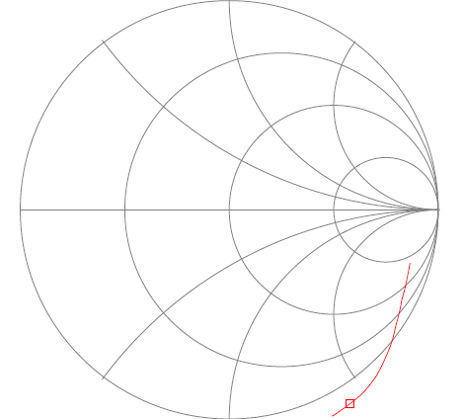
Observations of Input Impedance
Frequencies above 100 MHz are potentially unstable (negative resistance)
40 MHz 113Ω, 13pF
100 MHz 0Ω, 11pF
150 MHz -8.7Ω, 13pF

Slide 4
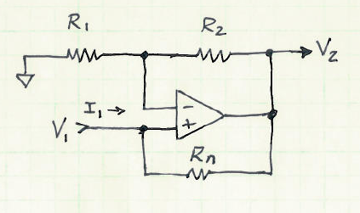
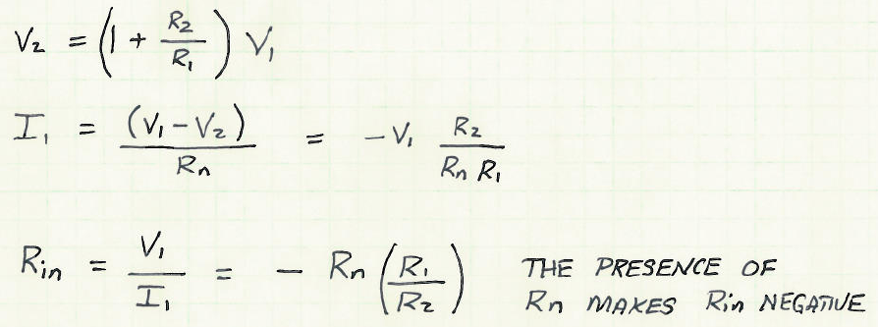
Making A Negative Resistance
Opamp Circuit
Input Impedance
A negative resistance implies gain. Gain in conjunction with a frequency selective network can, and does, create an oscillator.

Slide 5
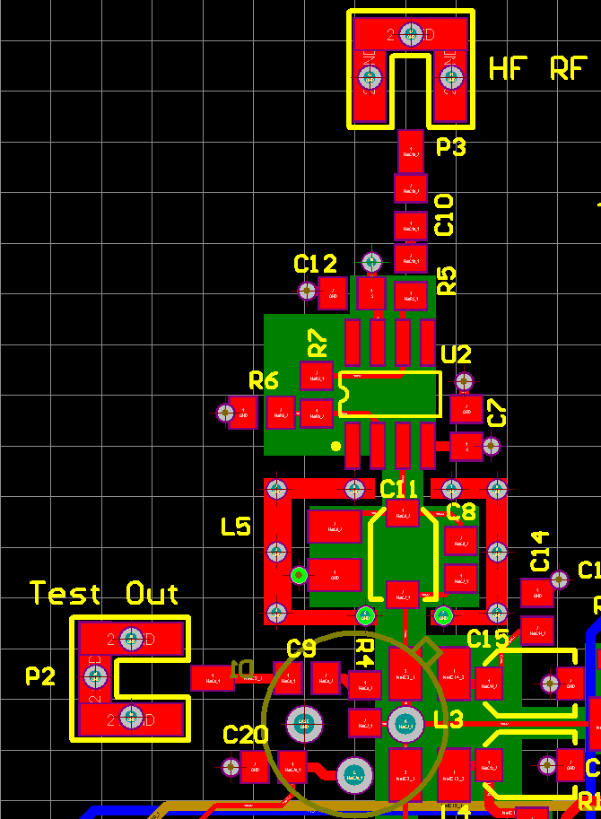
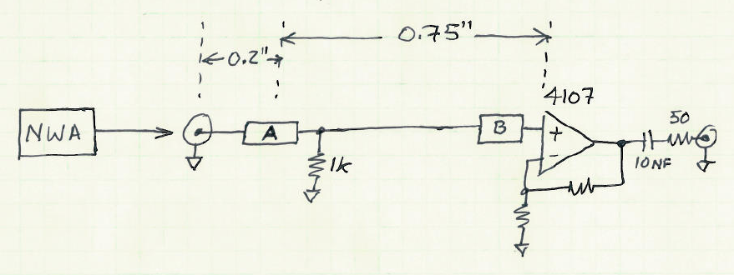
Who Is To Blame?
Positive feedback could be internal to the RF opamp, bleeding back out the + pin.
Positive feedback could be related to circuit layout.

Slide 6
Measured Data
Real and imaginary data in ohms
A substantial change in input impedance is only seen when 50 Ω is added to the RF input, not the input of the opamp.
Conclusion is that the phenomenon is related to layout.
Frequency | S11 Bare Board | S11 50Ω on RF input | S11 50Ω touching 4107
50 MHz | 69.7Ω, -258Ω | 103Ω, -257Ω | 71Ω, -257Ω
100 MHz | 0.4Ω, -141Ω | 34Ω, -132Ω | 1Ω, -137Ω
150 MHz | -8.2Ω, -79Ω | 27Ω, -80Ω | -3Ω, -73Ω

