Slide 1
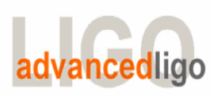
Seismic Isolation Group (SEI)
aLIGO HAM-ISI, LHO Unit #1,
Testing Validation
LIGO-G1000721-v1
July 23, 2010
SEI Team

Slide 2
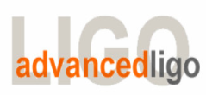
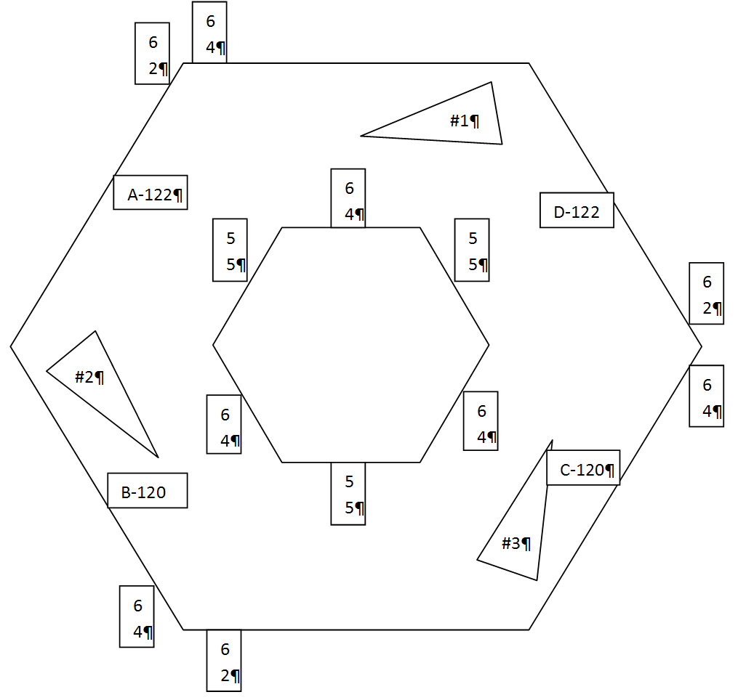
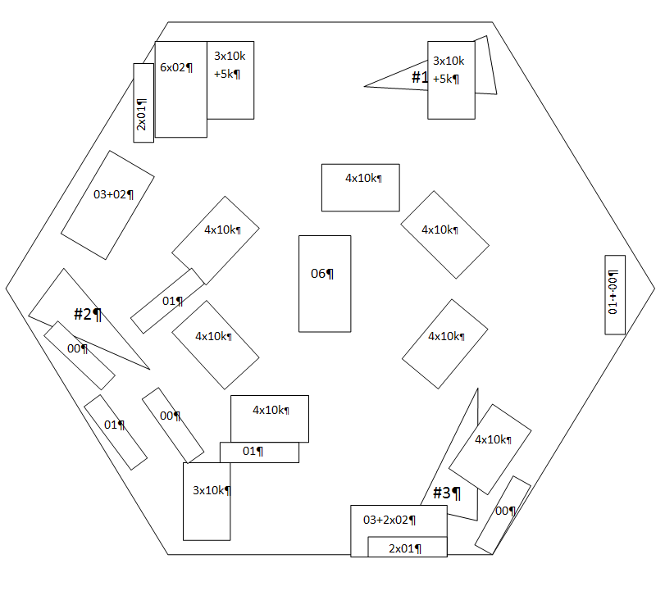
G1000721, aLIGO HAM-ISI, LHO Unit #1, Testing Validation
Goals:
Review the progress done since the testing presentation (G1000692)
Validate the first assembly
GS13 and actuators pre testing:
Data related to GS-13 post podding.
Actuator data sheet: T0900564-v2.
Detailed Mass Budget: has been included in T1000329.

Slide 3
G1000721, aLIGO HAM-ISI, LHO Unit #1, Testing Validation
24 Hz Resonance:

Slide 4
G1000721, aLIGO HAM-ISI, LHO Unit #1, Testing Validation
Position sensors
Step 4 - Set up sensors gap
Step 5 - Measure the Sensor gap
Step 6 - Check Sensor gaps after the platform release
Table locked | Both ADE boxes on |  | One ADE boxe ON at the same time
Sensors | Offset (Mean) | Std deviation | Offset (Mean) | Std deviation
V1 | -54 | 8.0 | -52 | 2.1
H1 | 35 | 1.0 | 12 | 0.7
V2 | -88 | 2.7 | -84 | 2.4
H2 | -12 | 2.0 | -27 | 1.2
V3 | 21 | 0.9 | 25 | 0.7
H3 | -281 | 9.4 | -258 | 1.0
Sensors | Gap measured on the Jig | Gap measured on the Table | % of change
V1 | xx | 80 | N/A
H1 | xx | 80 | N/A
V2 | xx | 80 | N/A
H2 | xx | 80 | N/A
V3 | xx | 80 | N/A
H3 | xx | 80 | N/A
 | Locked | Unlocked | Diff unlocked - locked
Sensors | Offset (Mean) | Offset (Mean)
V1 | -54 | -980 | -926
V2 | -88 | 237 | 325
V3 | 21 | -356 | -377
H1 | 35 | 571 | 536
H2 | -12 | 787 | 799
H3 | 281 | 11 | -270
4

Slide 5
G1000721, aLIGO HAM-ISI, LHO Unit #1, Testing Validation
Position sensors
Step 7 - Check the position sensors sign and range of motion
Y-Axis Up/Down Measurement
Y-Axis Up/Down Measurement
 | UP | DOWN
V1 (counts) | 19402 | -18954
V2 | 18571 | -20667
V3 | 20450 | -19306
A (mils) | 24 | -24.5
B | 25 | -23
C | 25 | -21.5
D | 24 | -22.5
 | UP | DOWN
V1 (counts) | 19893 | -20444
V2 | 21078 | -18716
V3 | 17559 | -20010
A (mils) | 24 | -22
B | 22 | -23
C | 25 | -23
D | 27.5 | -22
5

Slide 6
G1000721, aLIGO HAM-ISI, LHO Unit #1, Testing Validation
Position sensors
Step 12 - Vertical Sensor Calibration
Corner | Dial indicator readout for the negative drive | Dial indicator readout for the 0 drive | Dial indicator readout for the positive drive | Difference
A | -19 | 0.000 | 18.75 | 37.75
B | -19 | 0.000 | 18.75 | 37.75
C | -19 | 0.000 | 19 | 38
D | -19 | 0.000 | 19 | 38
Average | -19 | 0.000 | 18.875 | 37.9
Sensors | Counts | Counts | Counts | Difference (Counts)
V1 | -16961 | -1332 | 14373 | 31334
V2 | -15970 | -244 | 15431 | 31401
V3 | -16449 | -863 | 14687 | 31136
 |  |  | Average | 31290
6

Slide 7
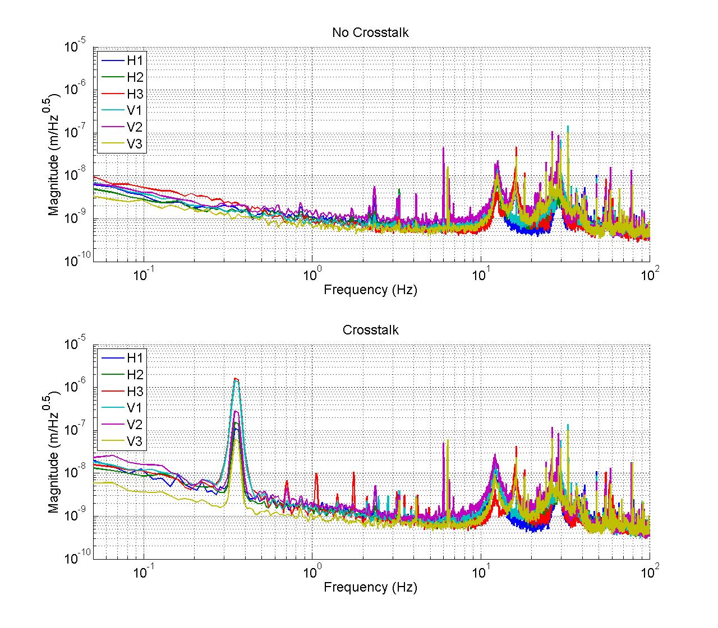
G1000721, aLIGO HAM-ISI, LHO Unit #1, Testing Validation
Calibrated power spectrums
7

Slide 8
G1000721, aLIGO HAM-ISI, LHO Unit #1, Testing Validation
Step 8: Range of motion
- In MEDM, make sure no actuator is driven
- Disable watchdogs by setting 'GEO limit’ to 40,000 counts and the ‘ACT limit’ to 30,000 counts
- Confirm that the limits are counting back towards the 'safe limit' (30K or 40K)
- Pull up the CPS signals (V1, V2, V3) in a data viewer window (DISPPF_V1_IN1_DAQ)
- Pull up the coordinate displacement sensors (X, Y, Z)
- Monitor outputs (X, Y, Z) and (V1, V2, V3, H1, H2, H3)
- Prepare the test (MEDM – ISI_HAM_CONT_Z)
  Set the gain ramp time to 20s set in the direction you want to test
  Set up the gain to 0
  Output ON
  Add a bias values of 10,000counts (upper limit)
- Run the test by setting the gain to 4.4 (X direction); 5.1 (Y direction); 8.9 (Z direction)
- Write down CPS Values
- Set gain to 0
- Run the test by setting the gain to -4.4 (X direction); -5.1 (Y direction); -8.9 (Z direction)
- Write down CPS Values
- Proceed to another direction
Note: for Z displacement, the table should it the stops after 80,000 counts on Z drive X, Y Z tests are probably sufficient to determine the range of motion of the optic table.
8

Slide 9
G1000721, aLIGO HAM-ISI, LHO Unit #1, Testing Validation
LZMP
First measurement, (RY in green).
X offset = 0.24 mm
Y offset = 0.30 mm
Second measurement (RY in magenta)
X offset = 0.14 mm
Y offset = 0.16 mm
9

Slide 10
G1000721, aLIGO HAM-ISI, LHO Unit #1, Testing Validation
Damping loops
Controller made of:
- a compensation filter to account for the difference in the electronics
- the original damping loops from eLIGO.
H1: Solid line, H2: Dash line, H3: Dash-Dot line
10

Slide 11
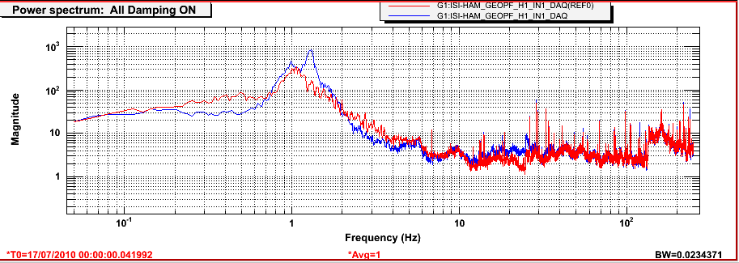
G1000721, aLIGO HAM-ISI, LHO Unit #1, Testing Validation
Damping loops
Conclusion:
One issue:
- 24 Hz resonance: more investigation?
One info:
- Control loops on unit 2
Recent Progress
- Complementary test for range of motion: in progress.
- Mass budget updated
- Calibrated spectrums
- CPS problem solved
- LZMP estimated
- Damping loops installed
Time to move to unit 2?
11

