Slide 1
Technologies of Gravitational Wave Detection
LIGO-G1000642-V1
Koji Arai – LIGO Laboratory / Caltech

Slide 2
Background / Overview
Introduce common technologies / terminologies
Brief review of GW / GW detection
Interferometer GW detectors
Interferometry
Sensing & Control

Slide 3
Interferometer GW detection

Slide 4
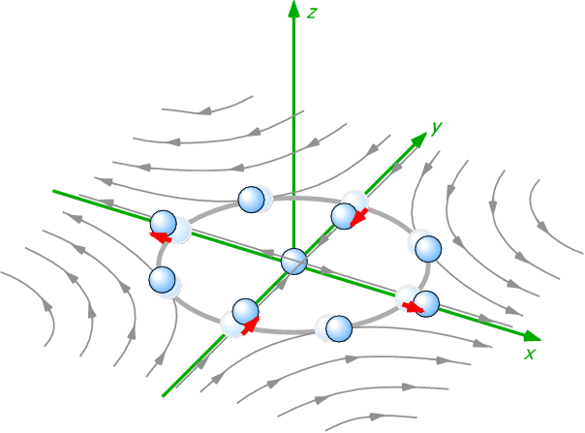
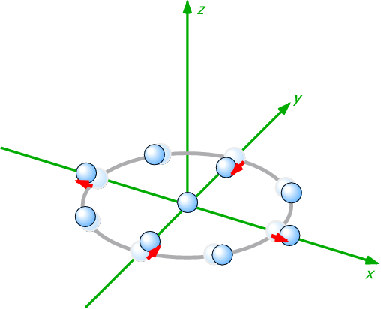
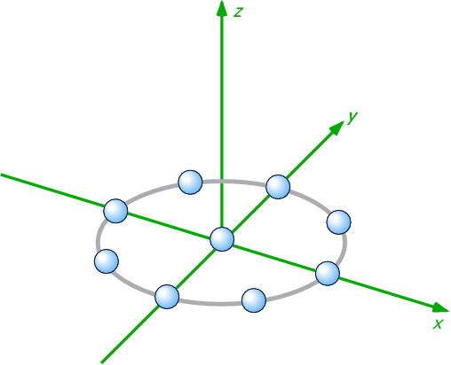
Gravitational wave
General Relativity
Gravity = Spacetime curvature
Gravitational Wave = Wave of spacetime curvature
GW
Generated by motion of massive objects
Propagates with speed of light
Cause quadrupole deformation of the spacetime
GW
Free mass

Slide 5
Interferometer GW detection
Michelson-type interferometers are used
Differential change of the arm path lengths
=>change interference
condition
Mirror
Mirror
Beamsplitter
Interference
Fringe
Laser

Slide 6
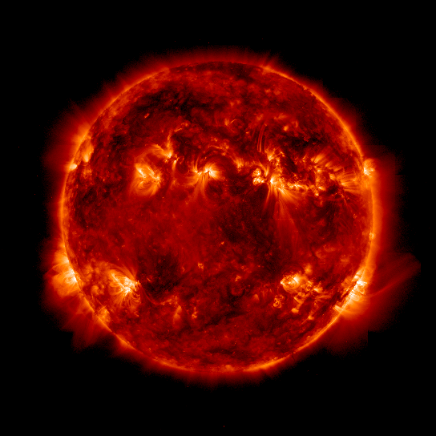
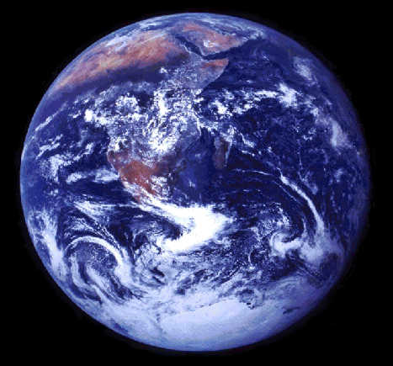
Amplitude of GWs
The effect of GW is very small
h ~ 10⁻²¹ => distance of 1m changes 10⁻²¹m
Corresponds to:
change by ~1 angstrom for distance between the sun and the earth
1.5 x 10¹¹ m
changes
by a size of a H atom!

Slide 7
Size of interferometer GW detectors
Mirror
GW Detection = Length measurement
The longer arms, the bigger the effect
GW works as strain => dx = h_{GW} x L_{arm}
Until cancellation of the signal happens
in the arms
Optimum arm length
Mirror
Mirror
Laser
Photodetector
Mirror
Laser
Photodetector

Slide 8
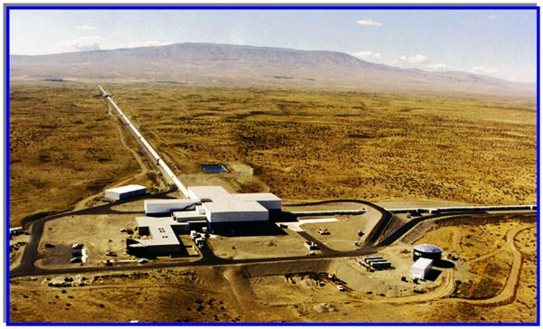
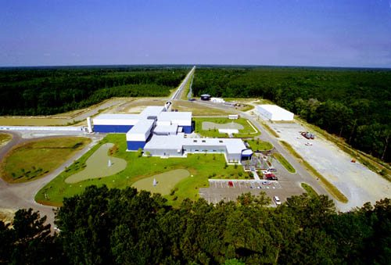
Size of interferometer GW detectors
LIGO Observatories
Hanford (4km&2km) Livingston (4km)
\
c.f. Virgo (FRA/ITA) 3km, GEO (GER/GBR) 600m, TAMA (JPN) 300m
Still shorter than the optimum length
=> Use optical cavity to increase life time of the photons in the arm

Slide 9
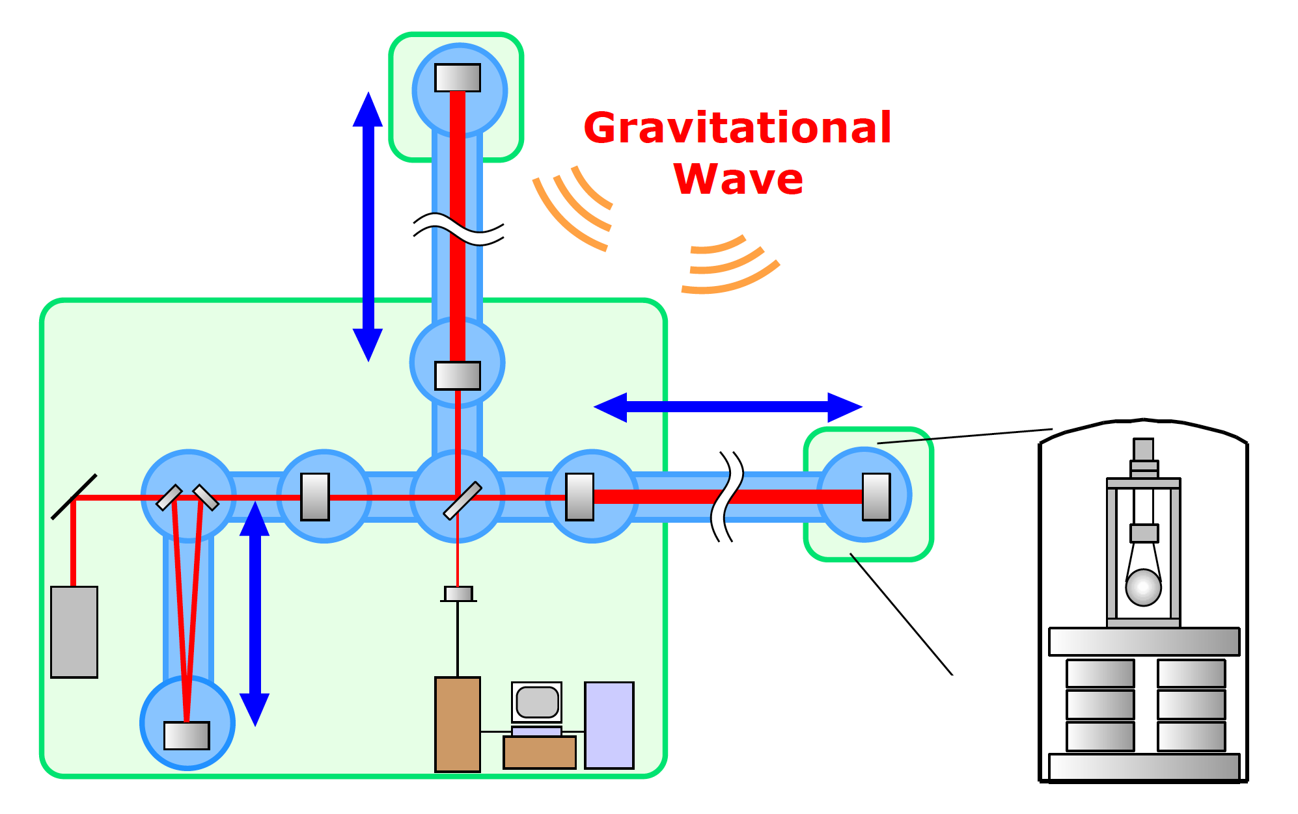
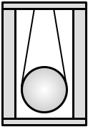
Components of the interferometer
“Still simplified” LIGO Interferometer
4km
Fabry-Perot
Cavity
Vacuum Chamber /
Beam tube
4km Fabry-Perot Cavity
Mirror Suspension
Beamsplitter
Recycling
Mirror
Photodetector
Mirror
Digital Control System
Vibration
Isolation
System
Mode
Cleaner
L~12m
Laser
Data Acquisition
/Analysis System

Slide 10
Components of the interferometer
3 fundamentals of the GW detector
Optics
Mechanics
Electronics

Slide 11
What can we do for the detection?
An IFO produces a continuous signal in the GW channel
The detector is fixed on the ground => can not be directed to a specific angle
GWs and noises are, in principle, indistinguishable
=> Anything we detect is GW
Reduce noises!
Obs. distance is inv-proportional to noise level
x10 better => x10 farther => x1000 more galaxies

Slide 12
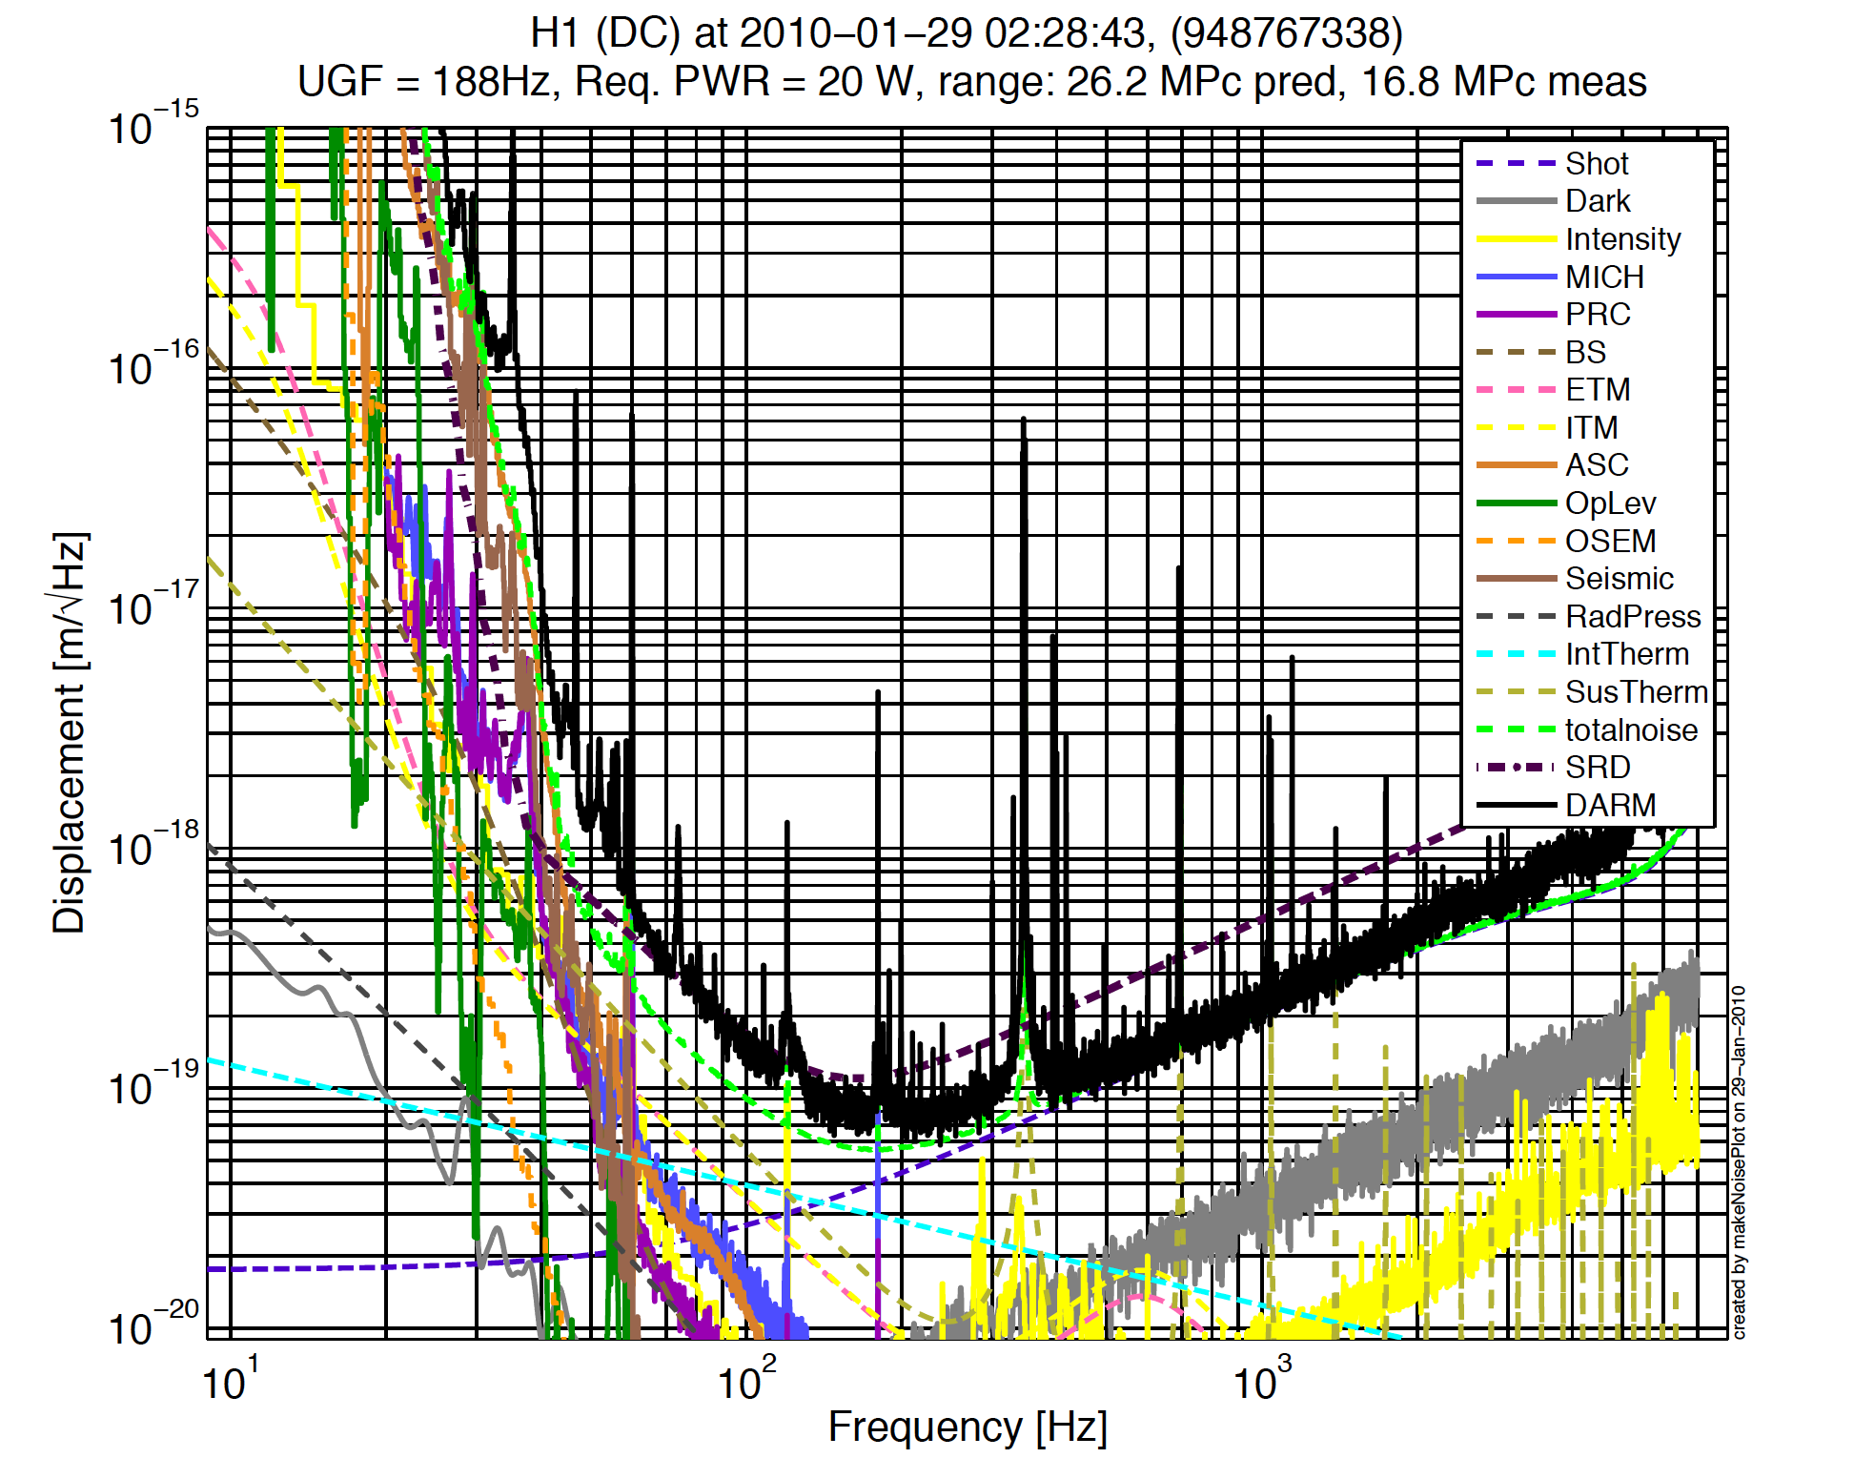
Recent sensitivity of LIGO
Sensitivity (=noise level) of Enhanced LIGO
Laser shot noise
Laser radiation
pressure noise
thermal noise
seismic noise
Laser intensity
/frequency noise
electronics noise
digitization noise
angular control noise
......
h= 2x10⁻²³ /rtHz

Slide 13
Summary
GWs ~ ripples of the spacetime
Not yet directly detected ~ the effect is so small (h<10⁻²¹)
Michelson-type interferometers are used
GW detection is a precise length (=displacement) measurement!
GW effect is very small

Slide 14
Summary
Essentially, the larger, the better. LIGO has two largest interferometers
in the world
IFO consists of many components
Optics / Mechanics / Electronics
and their combinations (e.g. Opto-Electronics)
noise and signal are, in principle, indistinguishable. Noise reduction is the matter.

Slide 15
Interferometry

Slide 16
Laser interferometry
GW detection
= High sensitive detection of displacement
Laser interferometry is an indispensable technology (lambda ~ 1um)
We use optical cavities in many places
What is an optical cavity?

Slide 17
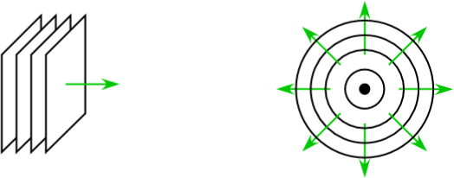
Gaussian beam
Propagation of EM waves
Plane wave Spherical
wave
Gaussian beam:
A solution to paraxial approximated wave equation
Amplitude distribution of the beam is Gaussian
Equiphase
Planes
Any laser beam does diverge
Rayleigh range
Coherent
Light source
Spherical-
wave like
waist
divergence
angle
Plane-wave like

Slide 18
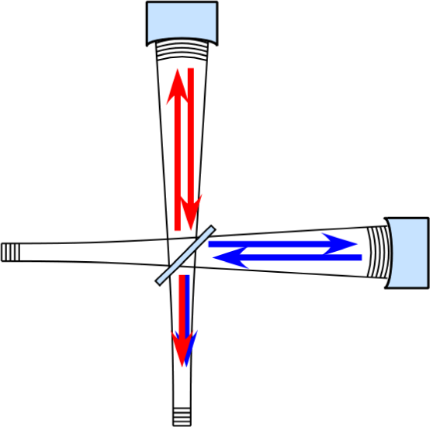
Fringes
Two beams overlap at the BS
Differential change of the arm length
=> fringe condition changed
Power
Bright Fringe
Power
Dark Fringe
dx

Slide 19
Phase measurement
Why an interferometer is sensitive?
the wavelength is used as a scale
We can not directly read
phases of the E-field
=> What we can use is
the detected power
Power depends on the optical phase
by using interference
Power

Slide 20
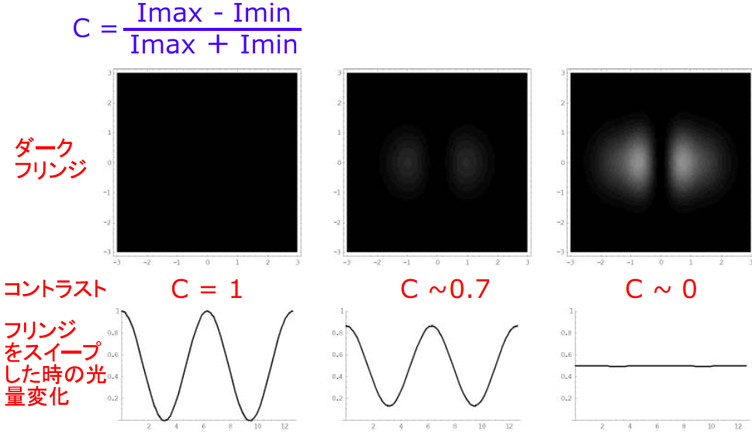
Fringes
Contrast
Contrast Defect with mirror tilting
If you really see fringe stripes,
that’s BAD!
Dark Fringe
Contrast
Light intensity at PD with
the mirror swept

Slide 21
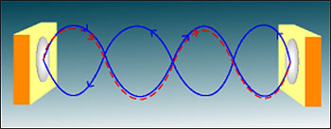
Fabry-Perot Optical Resonator Cavities
Two facing high reflective mirror
When the optical phase of the incident beam matches the phase in the cavity => resonance
2 mirror cavity = Fabry-Perot (FP)
more mirrors = ring cavity
not much difference
R=99%
R~100%
Laser
~400W
1W

Slide 22
Fabry-Perot Optical Resonator Cavities
Conservation of energy:
R_{i}+T_{i}+L_{i} = 1
When 2kL = n(2π), (ie, L=nλ/2),
E_{cir} , E_{tran} maximized ⇒ resonance!

Slide 23
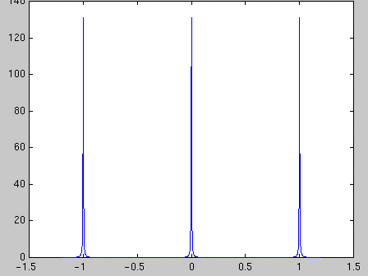
FP circulating field
Power Gain
ΔL = λ /2
Cavity:
a larger phase change is obtained
Δ f = f_{fsr} = c/2L
δ f
Free Spectral Range: f_{FSR} = c/2L
Finesse = δ f /f_{fsr}
dL or f
Δν = Δ(2kL)/2π = Δf/f_{fsr} = ΔL/(λ /2)
Phase enhancement factor N_{FP}=2F/Pi

Slide 24
Optical cavity
How useful are the optical cavities?
FP arms:
Enhance the phase change in the MI arm
= larger response to GWs

Slide 25
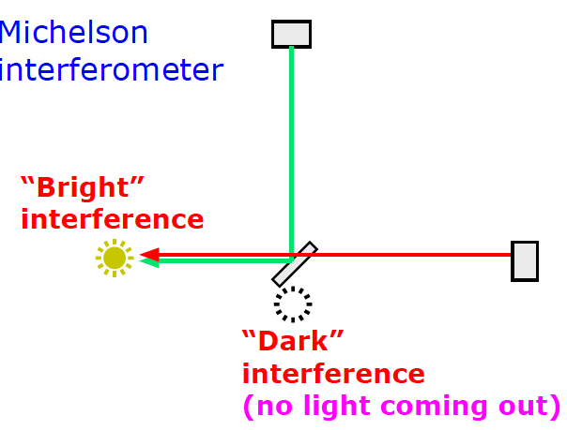
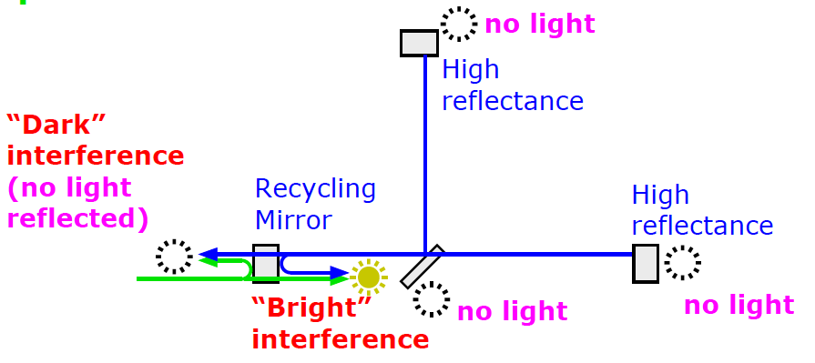
Optical cavity
Power recycling
Increase the light
power towards the BS
compound
mirror

Slide 26
Optical cavity
Freq Stabilization (Mode Cleaner/Ref Cav)
Cavity length (L) and Laser freq (f) are equivalent
=>Use L as a reference of f
e.g.
dL~1pm, L~0.1m
=> freq stability of 10⁻¹¹ (df=3kHz for f~300THz)
Spacial mode filtering
Signal Recycling

Slide 27
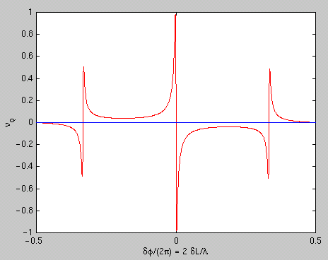
Pound-Drever-Hall technique (PDH)
Signal extraction scheme for the cavities
Phase modulation -> RF optical sidebands
Reflected beam -> detected / demodulated
V
Laser
Electro-Optic
Modulator
Faraday
Isolator
or
Pick-off mirror
dL or f

Slide 28
Summary
Interferometer is a sensitive device
Because we are reading the phase of the light
Optical cavity is more sensitive
Because the phase change is enhanced
by the cavity
Optical cavities are useful!
The PDH technique

Slide 29
Sensing & Control

Slide 30
Sensing and Control
Feedback controls are a common technique in the instruments and measurements
For high sensitivity, we use interferometry.
The response of the interferometers are nonlinear
Michelson: moderately
Fabry-Perot: highly nonlinear
Presence of seismic disturbance
We need to control the mirror positions

Slide 31
Sensor
A sensor is an instrument to convert a physical quantity to a signal --- mostly a voltage signal
linear sensor nonlinear sensor (almost) useless
(IFO)
No control control
needed needed
V
V
V
dx
dx
dx

Slide 32
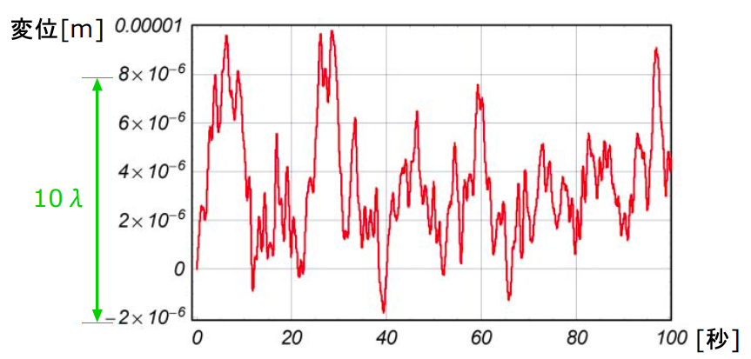
Mirror motion
The mirrors of the interferometer is suspended
At low frequency (f<1Hz), the vibration isolation
is not effective
Mirror swings an order of lambda (~um)
[sec]

Slide 33
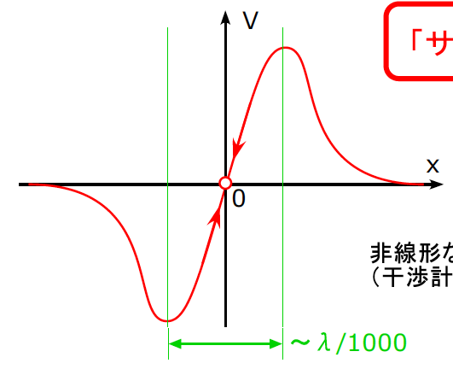
Asymptotically Linear Sensor
Nonlinear sensor can also be used as a linear sensor
by utilizing feedback control
e.g. PDH signal
“error signal”
Servo Lock!
The IFO is locked at its most sensitive state

Slide 34
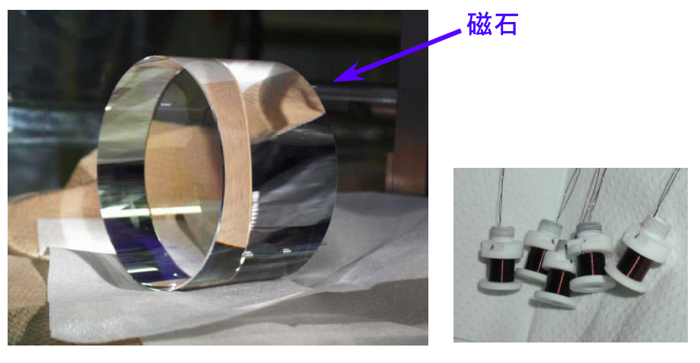
Actuators
In particular for the current GW IFO case,
coil-magnet pairs are used to actuate the position and angles of the mirrors
magnet

Slide 35
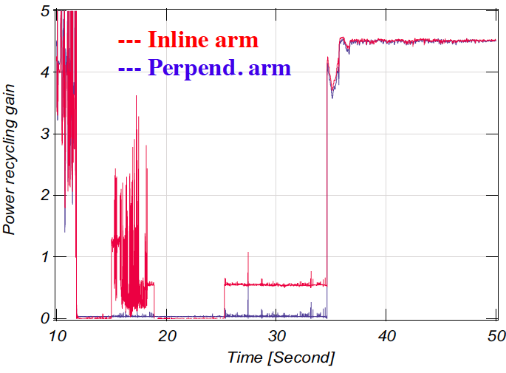
Lock Acqusition
The moment of lock acquisition
Intracavity power
One arm
Locked!
Another arm Locked!

Slide 36
Block diagram
If the sensor is linear we don’t need feedback
disturbance
sensor
error signal
Verr = H dx
i.e. dx = Verr / H

Slide 37
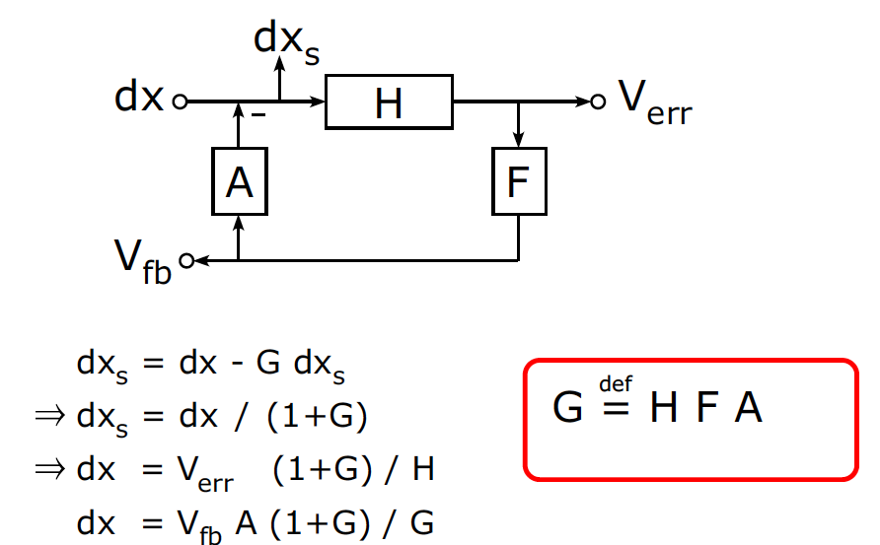
Block diagram
When the feedback is applied:
disturbance
stabilized disturbance
error signal
actuator
sensor
servo filter
feedback
signal
Open loop transfer function

Slide 38
Effect of a feedback to the signals
Linear sensor
Response with feedback (error signal)
Response with feedback (feedback signal)
the size of the signal depends
on the fb gain (G)
G<<1 the error signal is good
G>>1 the fb signal is good
disturbance
sensor
error signal
sensor (incl. the feedback loop)
disturbance
error signal
sensor (incl. the feedback loop)
disturbance
feedback signal

Slide 39
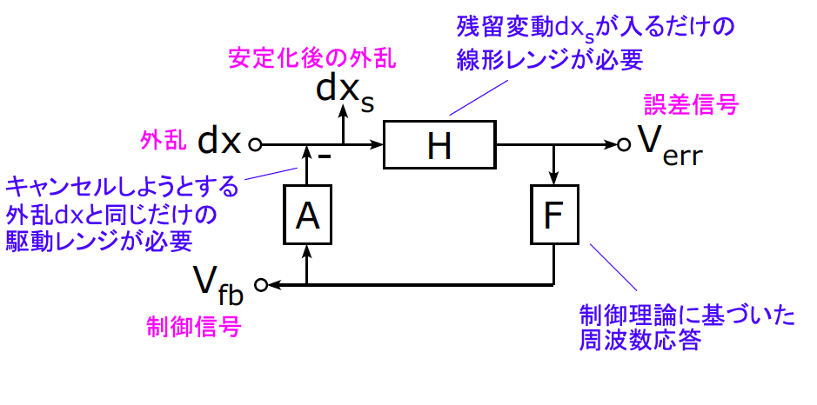
For stable feedback control
linear range
to accomodate
residual dx_{s}
stabilized disturbance
Modeling of a control loop
helps you
error signal
disturbance
actuator range
to cancel the disturbance
servo filter
shape based on
a control theory
feedback
signal

Slide 40
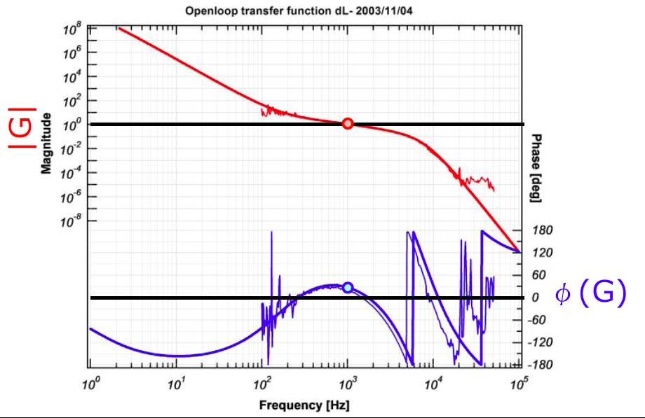
Example of an open loop TF
Unity Gain Frequency
bigger gain at LF
bigger phase margin at UGF
smaller gain at HF
Phase margin

Slide 41
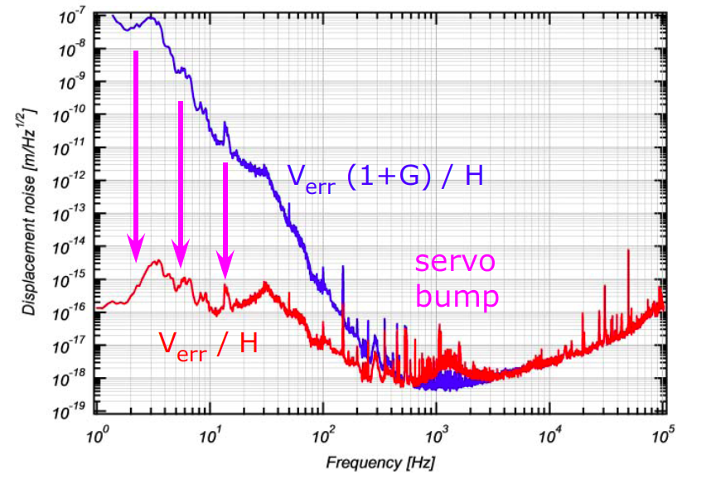
Supression of the error signal
By knowing H, A, F, we can reproduce the
original disturbance level

Slide 42
Summary
With feedback control, we can treat a nonlinear
system as a linear system
Feedback control is the key for GW interferometers to keep their performance
An openloop transfer function is to be designed
in each case.
Feedback control changes the signals from the system. Modeling always helps to understand
how the original signals are.

