Slide 1
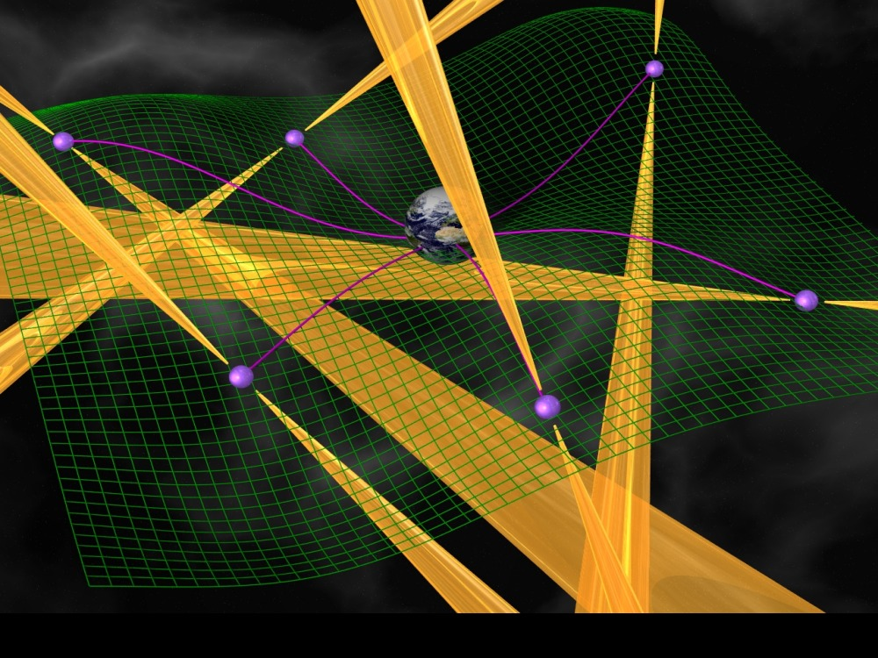
NANOGrav: A Galactic Scale Gravitational Wave Observatory
Andrea N. Lommen
Chair, NANOGrav
Associate Professor of Physics and Astronomy
Head of Astronomy Program
Director of Grundy Observatory
Franklin and Marshall College
Lancaster, PA
Image Courtesy of Michael Kramer

Slide 2
Talk represents work with:
NANOGrav
European Pulsar Timing Array
Parkes Pulsar Timing Array
Thrilled with the work of:
A. Sesana, A. Vecchio, M. Volunteri, C. N. Colacino
Melissa Anholm, Xavier Siemens, Larry Price, U. Milwaukee
Joe Romano, Graham Woan
r3wkee
Rutger van Haasteren, Yuri Levin, U. Leiden

Slide 3
The International Pulsar Timing Array

Slide 4
Concept of Using Pulsars to Detect Gravitational Radiation
Imprint on Pulsar timing residuals
Sazhin 1978
Explicit connection between Doppler data from spacecraft and pulsar timing data
Detweiler 1979
Concept of a Pulsar Timing Array
Foster and Backer 1990
First limit on stochastic GW background
Stinebring, Ryba, Taylor, & Romani 1990
Notes:
\citet{detweiler:1979:ptm} made explicit the connection between the doppler data from spacecraft and pulsar timing residuals, and showed how timing residuals could be used to bound the contribution to the nanoHertz-band contribution to the stochastic gravitational wave background

Slide 5
Stability of the clocks

Slide 6
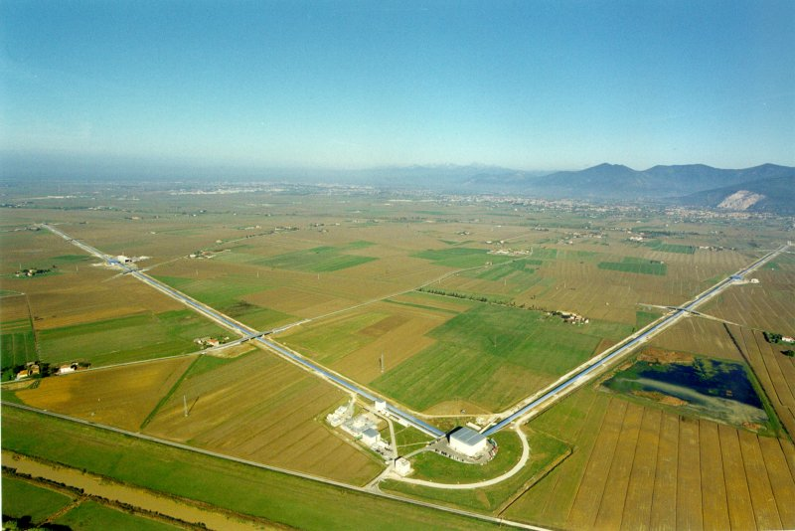
Photo Courtesy of Virgo
Pulsar1
Pulsar2
Earth
Adapted from NASA figure
Notes:
Need to make the point both here and on the burst slide, that we have 30 different detector arms in which to measure coincidence.

Slide 7
Most obvious GW source: SuperMassive Black Hole Binaries

Slide 8
Orbital Motion in the Radio Galaxy 3C 66B: Evidence for a Supermassive Black Hole Binary Sudou, Iguchi, Murata, Taniguchi (2003) Science 300: 1263-1265.
Constraining the Properties of Supermassive Black Hole Systems Using Pulsar Timing: Application to 3C 66b, Jenet, Lommen, Larson and Wen (2004) ApJ 606:799-803.
10
10
0
0
Residual(μs)
Residual(μs)
-10
-10
Simulated residuals due to 3c66b
Data from Kaspi, Taylor, Ryba 1994

Slide 9
MBH-MBH (indiv)
Gal NS/BH
PSRs
BH-BH (indiv)
Figure by Paul Demorest (see arXiv:0902.2968)
Notes:
Log(5e-15) = -14.3
Log(1/20yrs) = -8.8
The green/current line is the limit we get from our current actual data, using the methods I described in my thesis. Of course this is subject to the usual debate over how exactly to determine/define these limits, etc.. but that should only change things by a order unity factor (one would hope). So this line represents 17 pulsars (12 GBT, 7 Arecibo, 2 overlap) timed monthly for ~5 years, with varying RMS's between ~100 ns and ~1 us.The other lines (except the 1855 line) all come from scaling the green line in various ways. The blue "2015" line assumes we keep timing the same 17 pulsars for another ~5 years in exactly the same way we are now, and that we keep getting about the same RMS for each source. I think this one is a fairly realistic projection.The lovely hot pink "2020" line comes from extending the current experiment out to 2020, then dividing the resulting limit by a (pretty arbitrary) factor of 4. You can make up whatever story you like to justify the "4" .. ie, some appropriate combination of more psrs, telescope time, collecting area, etc.-Paul
The slope on the right side is basically h=rms/P
The turnover is at 1/ the length of the dataset. The slope is due to the fact that you are detecting fractions of periods. H goes as the period. Same slope other direction.

Slide 10
Sesana, Vecchio and Volunteri 2009

Slide 11
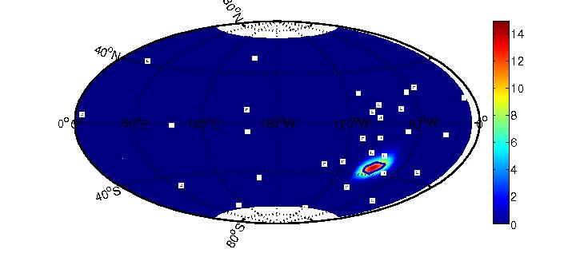
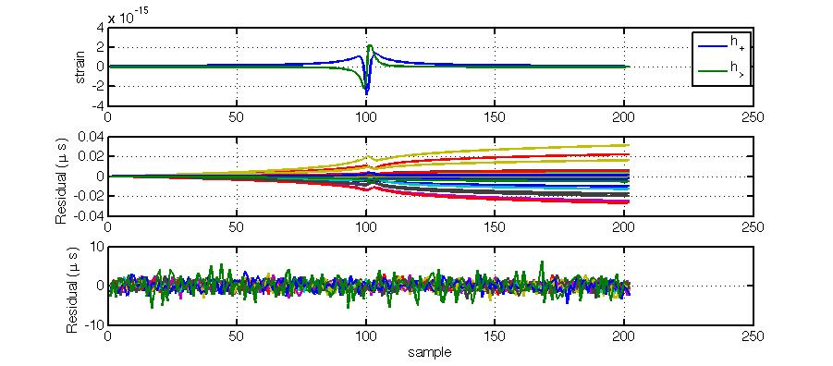
2 10⁹ solar mass black holes flying by each other with a separation of 40 Schwarzschild Radii.
Distance: 100 Mpc
30 IPTA pulsars
Using Maximum Entropy analysis (Summerscales et al 2008)

Slide 12
The Advantage of New Wide-band Backend System at Green Bank “GUPPI”

Slide 14
Summary
Pulsars make a galactic scale gravitational wave observatory which is poised to detect gravitational waves in 5-10 years.
Individual and collections of super massive black hole binaries with year-long periods (10s of nHz) are our most considered source.
In the burst work are pushing the sensitivity of the PTAs to higher GW frequencies (10⁻⁵ Hz). We’ve shown that we can recover the waveform and the direction of the GW radiation.

Slide 16
Detectability of a Waveform

Slide 17
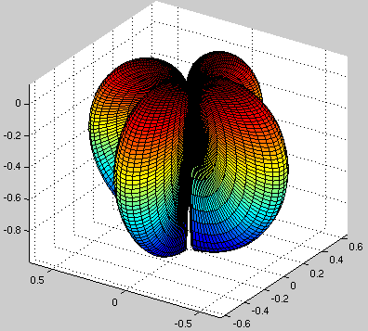
The shape of the GW response
Thanks Bill Coles
Notes:
Not fair to call it an interferometer - the rub is that in the case of an interferometer your resolution goes inversely with the separation of your receivers. With GWs you’re always sampling the same beam pattern. Beam doesn’t get smaller.

Slide 18
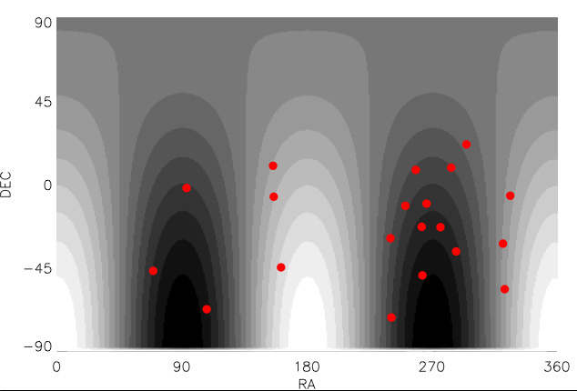

Slide 19
Graphic: Penn State University

Slide 20
Larger impact parameter is also more detectable

Slide 21
Maximum Entropy
Summerscales, Burrows, Finn and Ott 2008
Notes:
The principle of maximum entropy states that, subject to known constraints, the probability distribution which best represents the current state of knowledge is the one with largest entropy.
So if someone asks:
Well what does that mean?
Entropy is a logarithmic measure of the density of states:
entropy is a logarithmic measure of the density of states:
where the P_i is the probability of being in the ith state. That’s a general law.
How does that apply to our situation?
In our case this is an integral rather than a sum, and we get the probability distribution by writing down the likelihood function the d-Rh is equal to detector noise, so you have to characterise your detector noise
Least presumptive model for the noise is that it’s a multivariate Gaussian (so if all you know is the distribution’s mean and covariance you can write that down)
And that’s when you get to write down the formula for the probability distribution that d-Rh is equal to detector noise (it’s the exponent of –xN-1x over the sqrt of some 2pi’s times the determinant of N where the N is the covariance of the noise.

Slide 22
A 5 x 10⁹ solar-mass black hole binary coalescing 100 Mpc away. 30 IPTA pulsars, improved by 10, sampled once a day.
Thank you to Manuela Campanelli, Carlos O. Lousto, Hiroyuki Nakano, and Yosef Zlochower
for waveforms. Phys.Rev.D79:084010 (2009). http://ccrg.rit.edu/downloads/waveforms

Slide 23
Probability density

Slide 24
Log of probability density

Slide 25
Log(probability density) as a function of sky position

Slide 27
Rms and dataspan are the currency of the field
From Jenet, Hobbs, van Straten, Manchester, Bailes, Verbiest, Edwards, Hotan, Sarkissian & Ord (2006)
Notes:
Alpha
-1 for relic (so omega_g independent of frequency)
-2/3 for SMBHB
-7/6 for cosmic strings
Ah wait so what is it I’m looking for -
Strain goes as rms/data length
Omega goes as the derivative of that squared per frequency interval which gets you data/length^5
Okay so what’s this measure?

Slide 28
Detectability of a Waveform (continued)
So what matters is the integral of the waveform:
Notes:
I’ve assumed that t_c is much greater than 0 and much less than t so we’re integrating over the whole gaussian basically. If you want to consider the gaussian just beginning to influence the EM wave you get an error function here. The point here is how the width of the burst, or the period of the sine wave influences the residual response. So for the sake of maximum residual response, you don’t actually want a burst source that looks like those zoom-whirl waveforms.

Slide 29
Table from NANOGrav white paper (Demorest, Lazio & Lommen, 2009)

Slide 31
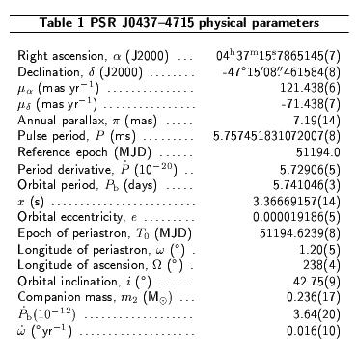
Precision Timing Example
Astrometric Params
RA, DEC, μ, π
Spin Params
P_{spin}, P_{spin}
Keplerian Orbital Params
P_{orb}, x, e, ω, T₀
Post-Keplerian Params
ω, γ, P_{orb}, r , s
~100 ns RMS
timing residuals!
Recent work (e.g. Verbiest et al 2009) shows
this is sustainable over 5+ yrs for several MSPs
van Straten et al., 2001
Nature, 412, 158

